Slide 1
Camera model and calibration
Samuel Cheng
Slide credit: James Tompkin, Naoh Snavely

Slide 2
What is a camera?

Slide 3
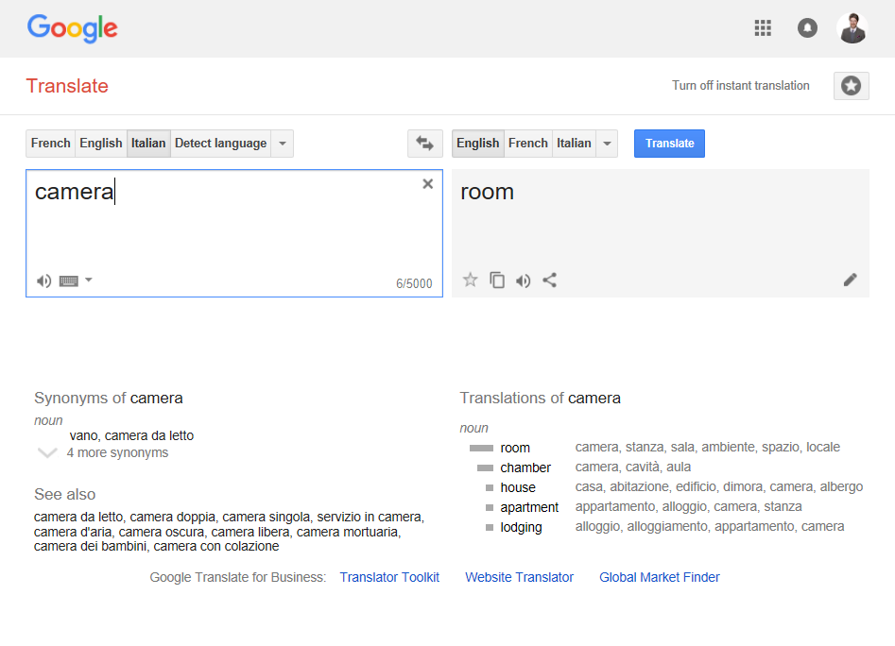

Slide 4
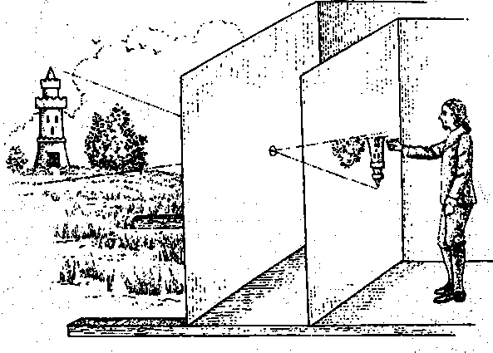
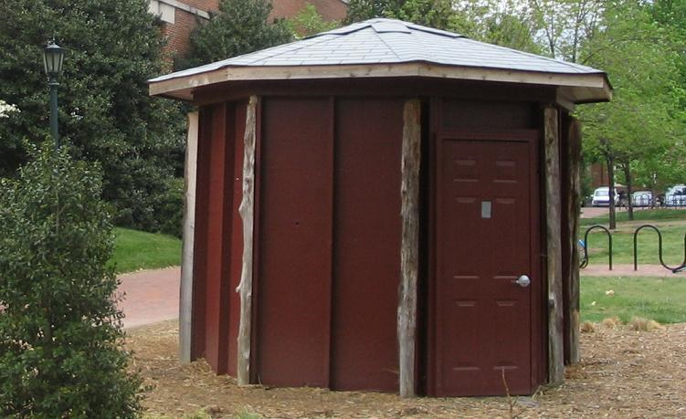
Camera obscura: dark room
Known during classical period in China and Greece (e.g., Mo-Ti, China, 470BC to 390BC)
Illustration of Camera Obscura
Freestanding camera obscura at UNC Chapel Hill
Photo by Seth Ilys
James Hays

Slide 5
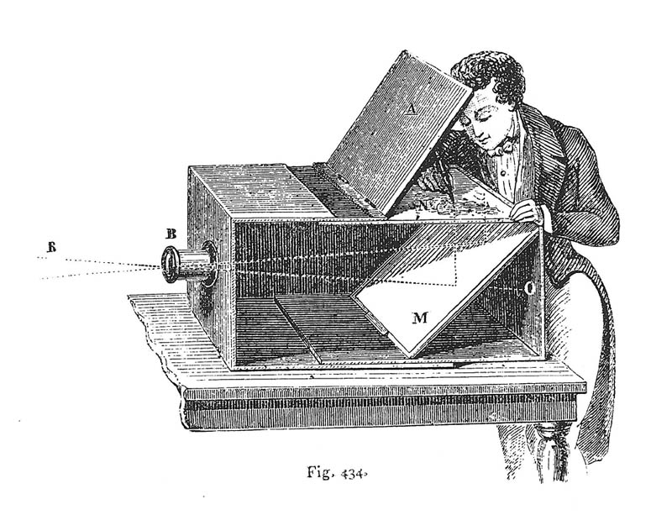
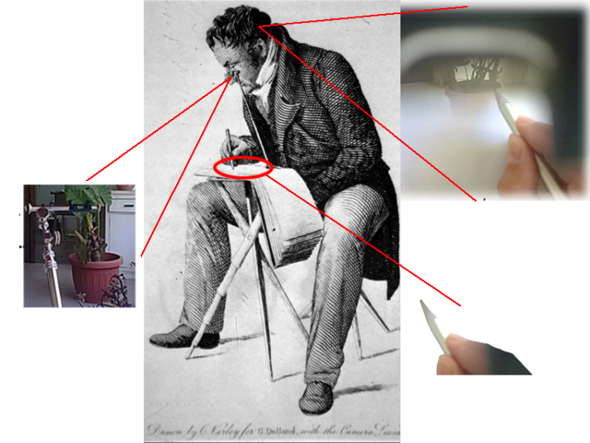
Camera obscura / lucida used for tracing
Lens Based Camera Obscura, 1568
Camera lucida
drawingchamber.wordpress.com
Notes:
https://drawingchamber.wordpress.com/about-me/about/camera-obscura-claude-glass-and-camera-lucida/
Obscura = dark
Lucida = light

Slide 6
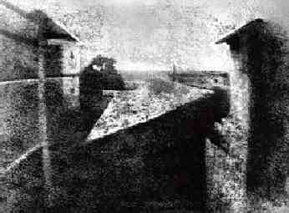
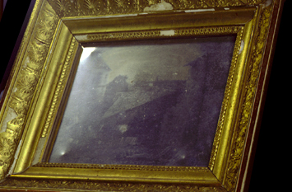
First Photograph
Oldest surviving photograph
  Took 8 hours on pewter plate
Photograph of the first photograph
Joseph Niepce, 1826
Stored at UT Austin
Niepce later teamed up with Daguerre, who eventually created Daguerrotypes

Slide 7
Dimensionality Reduction Machine (3D to 2D)
3D world
2D image
Figures © Stephen E. Palmer, 2002

Slide 8
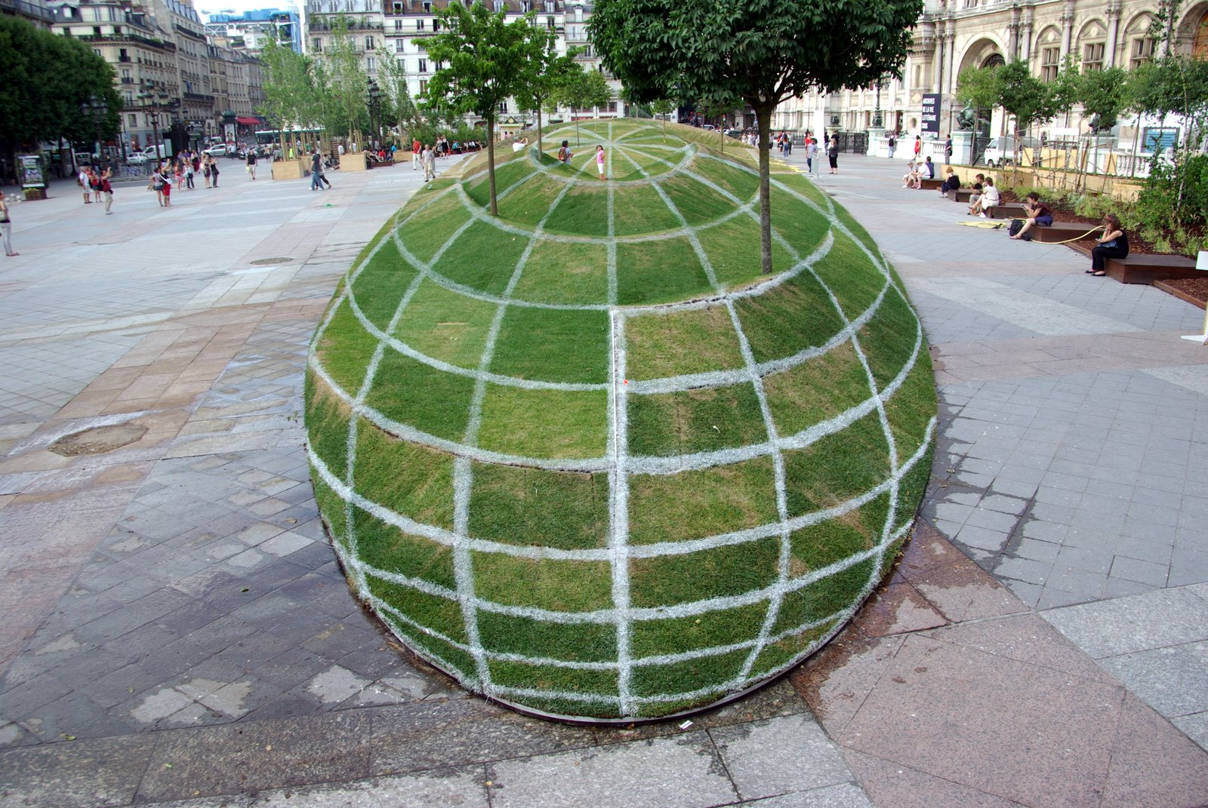
Notes:
Paris town hall
“Anamorphosis” - a distorted projection or perspective requiring the viewer to use special devices or occupy a specific vantage point (or both) to reconstitute the image.

Slide 9
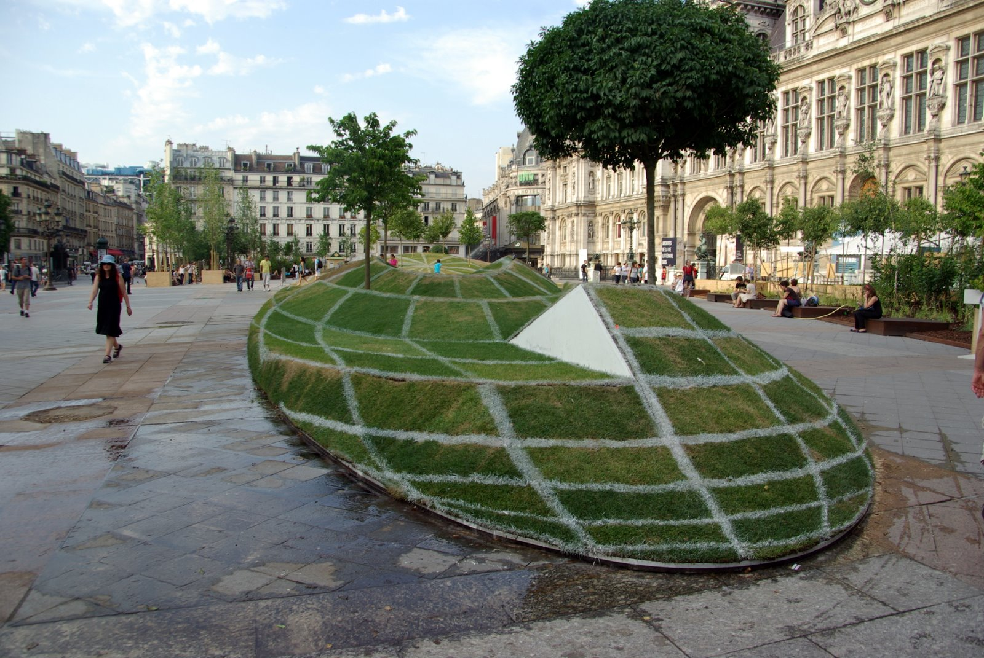

Slide 10
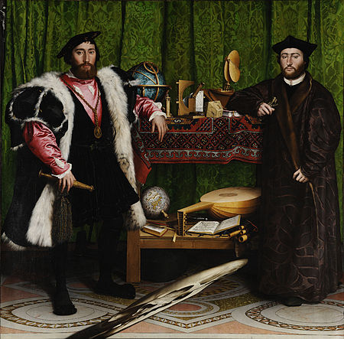
Holbein’s The Ambassadors - 1533

Slide 11
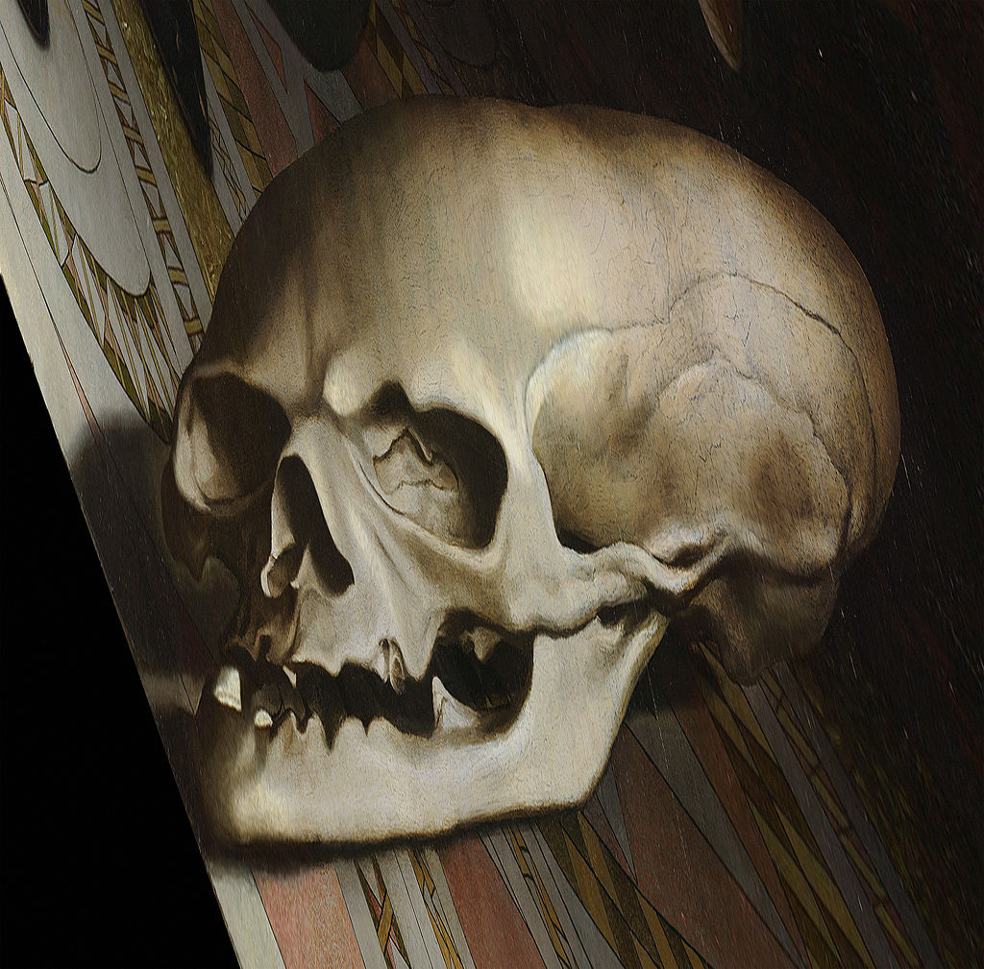
Holbein’s The Ambassadors – Memento Mori

Slide 12
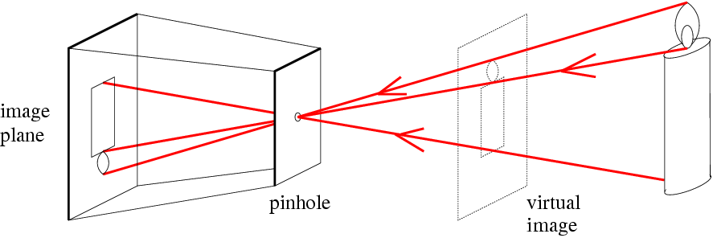
Pinhole camera model
d
c
Real object
d = Focal length (or f)
c = Optical center of the camera
Figure from Forsyth

Slide 13
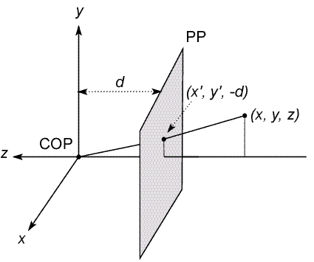
Modeling projection
PP: projection plane
COP: center of projection
Both (x’,y’,-d) and (x,y,z) project to the same point at PP
(x,y,z) -> (x’,y’) where x’ = d (x/z) and y’ = d (y/z)

Slide 14
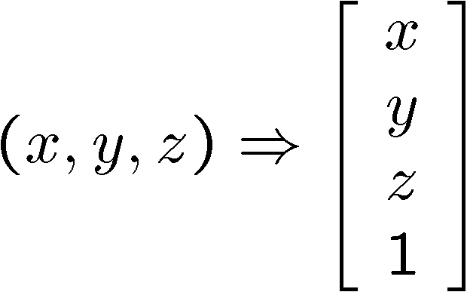
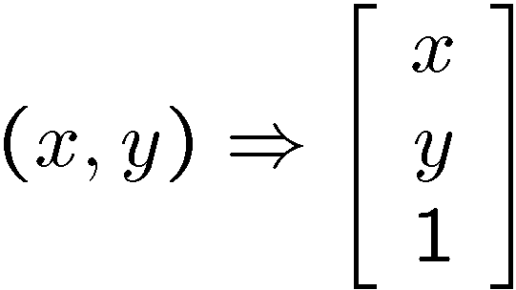
Modeling projection
Is the projection a linear transformation?
  no—division by z is nonlinear
Homogeneous coordinates to the rescue!
Recall that:
homogeneous image
coordinates
homogeneous scene
coordinates

Slide 15
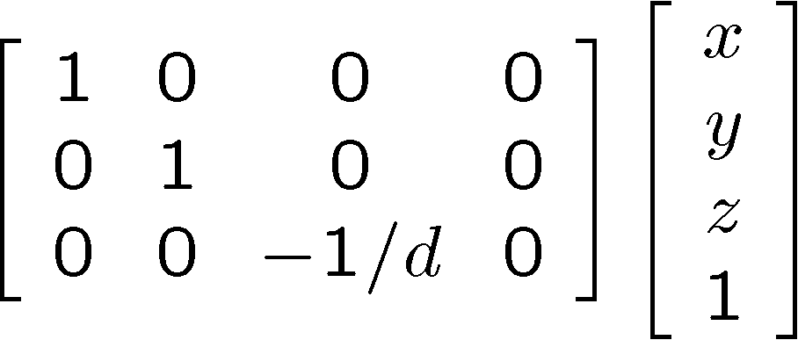
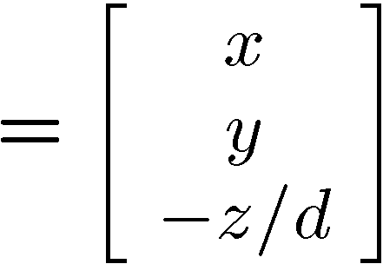
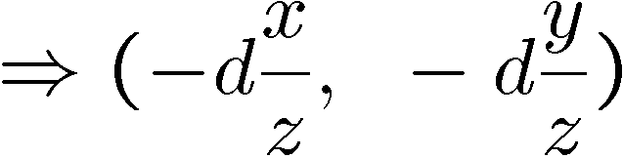
Perspective Projection
Projection is a matrix multiply using homogeneous coordinates:
divide by third coordinate
This is known as perspective projection
  The matrix is the projection matrix

Slide 16
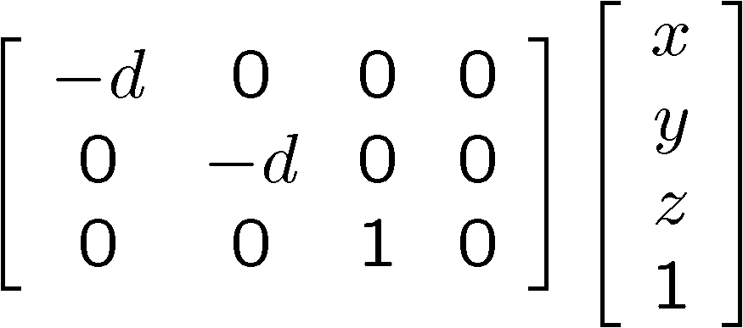
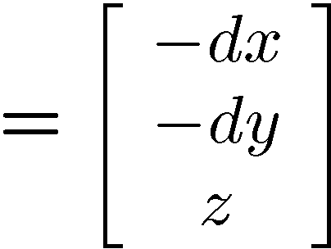
Perspective Projection
Note that scaling the projection matrix does not change the transform

Slide 17
Orthographic Projection
Special case of perspective projection
  Distance from the COP to the image plane is infinite
  Also called “parallel projection”
  What’s the projection matrix?
Image
World
Slide by Steve Seitz

Slide 18
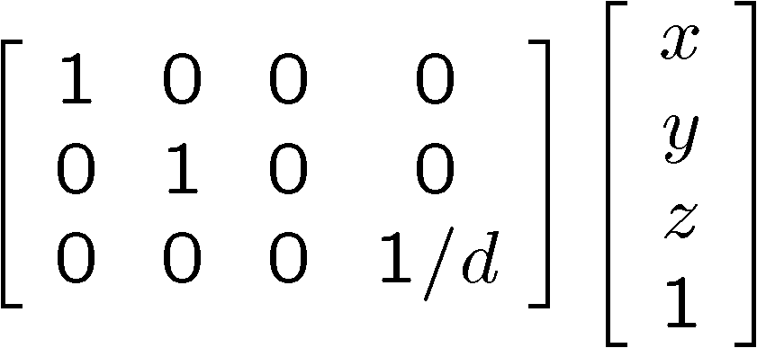
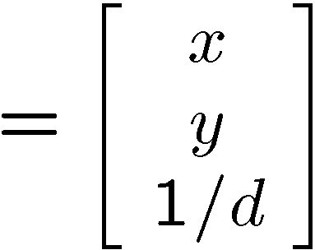

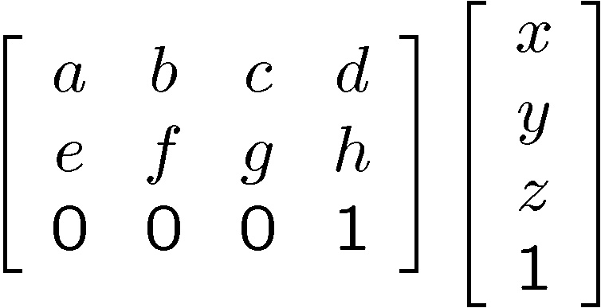
Variants of orthographic projection
Scaled orthographic
  Also called “weak perspective”
Affine projection
  Also called “paraperspective”

Slide 19
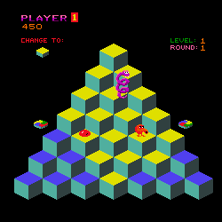
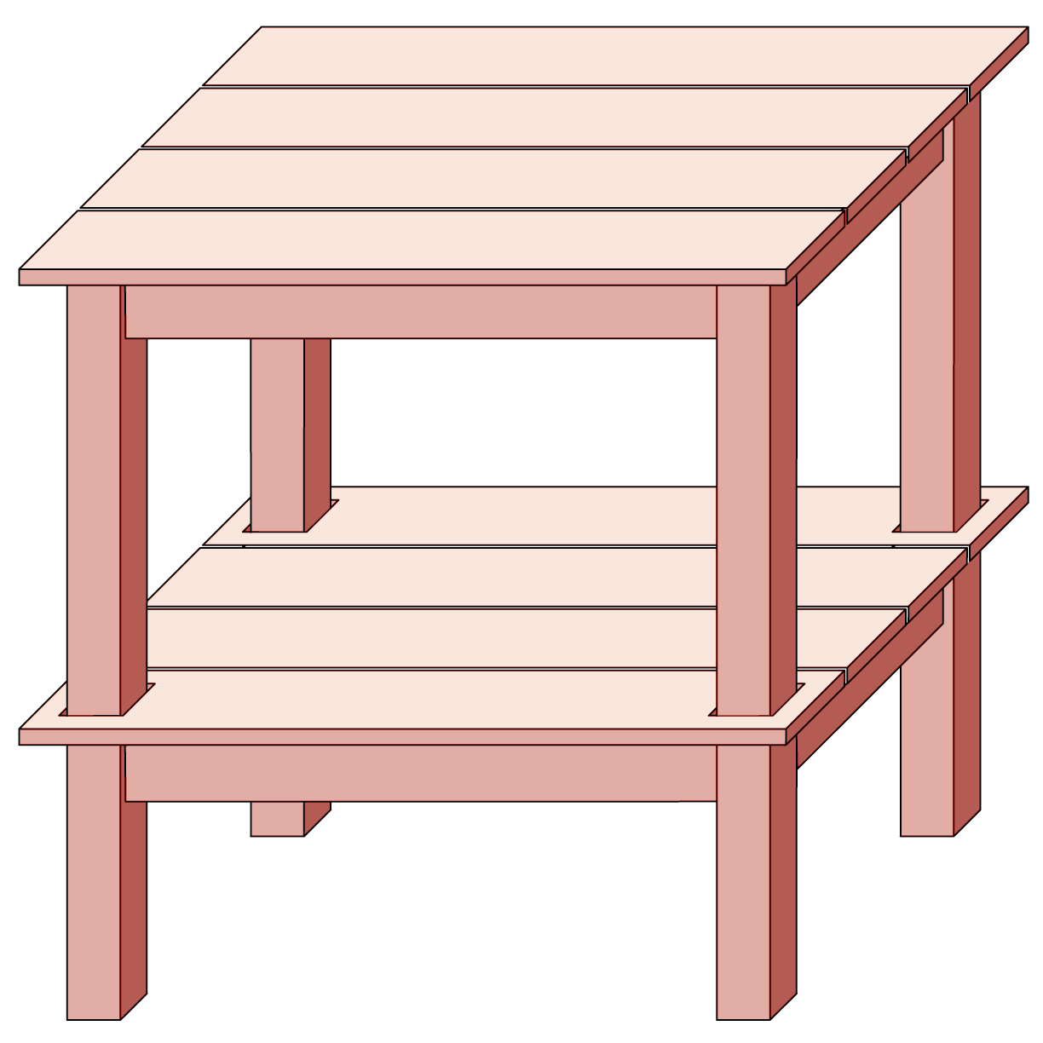
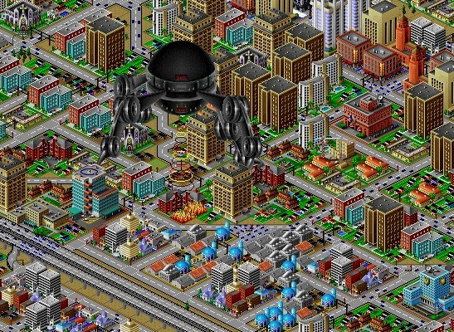
Orthographic projection

Slide 20
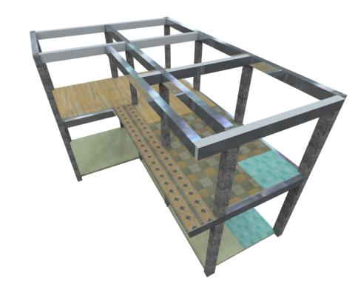
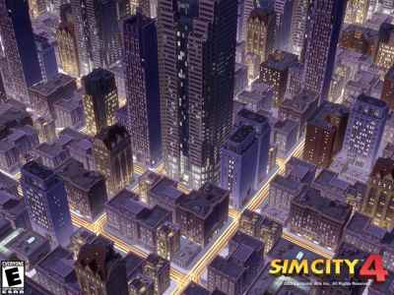
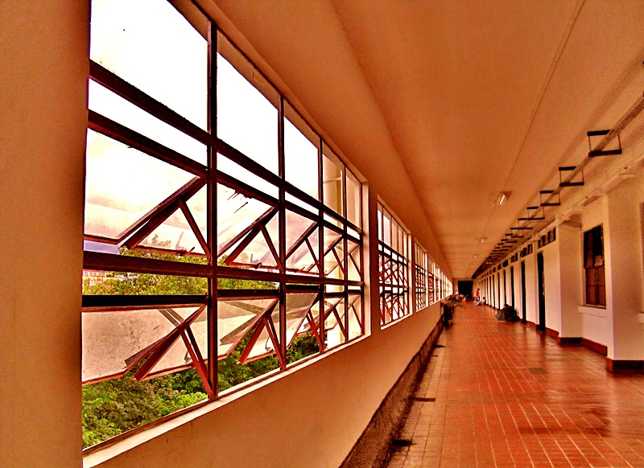
Perspective projection

Slide 21
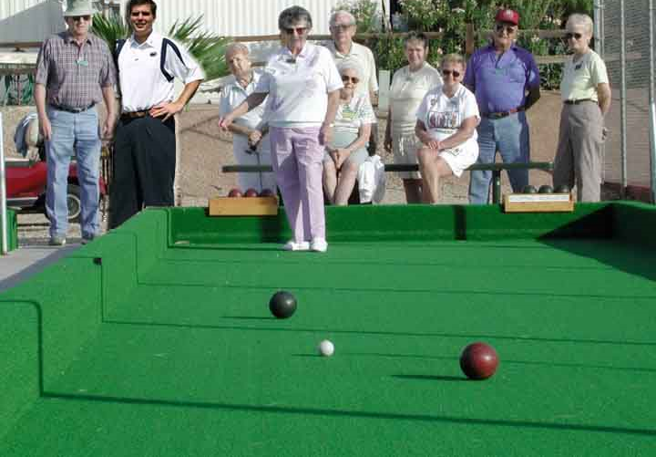
Perspective projection
What is preserved?
Straight lines are still straight.

Slide 22
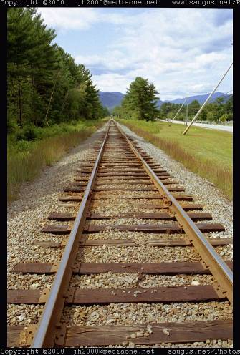
Vanishing points and lines
Parallel lines in the world
intersect in the projected image at a “vanishing point”.
Parallel lines on the same plane in the world converge to vanishing points on a “vanishing line”.
E.G., the horizon.
Vanishing Point
Vanishing Point
Vanishing Line
Notes:
Various properties of vanishing points/lines.
Parallel lines intersect at a point
The intersection of red lines and blue lines form a parallelogram
Sets of parallel lines on the same plane form a vanishing line
Sets of parallel planes form a vanishing line
Not all lines that intersect are parallel

Slide 23
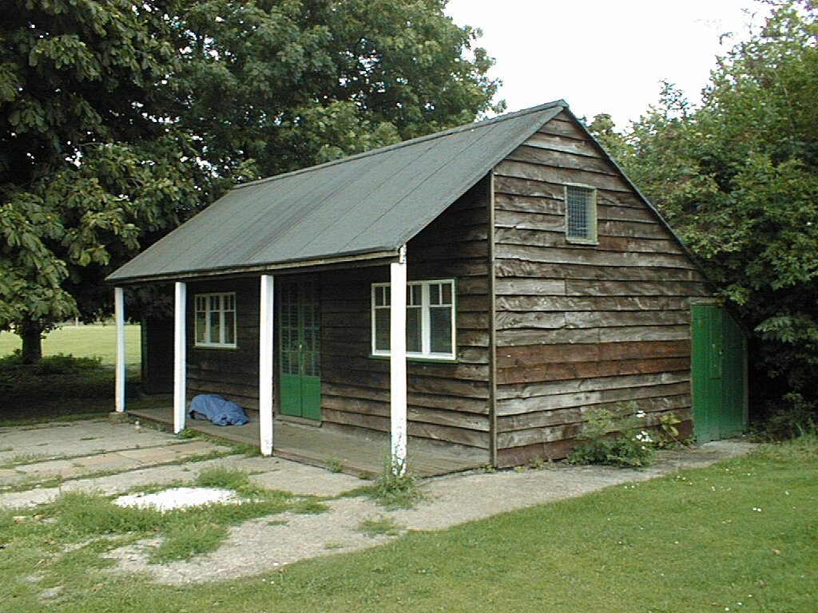
Vanishing points and lines
Vertical vanishing
point
(at infinity)
Vanishing
point
Vanishing
point
Slide from Efros, Photo from Criminisi

Slide 24
Projection properties
Many-to-one: any points along same ray map to same point in image
Points → points
Lines → lines
But line through focal point projects to a point
Planes → planes (or half-planes)
  But plane through focal point projects to line

Slide 25
Camera parameters
How many numbers do we need to describe a camera?
We need to describe its pose in the world
We need to describe its internal parameters

Slide 26
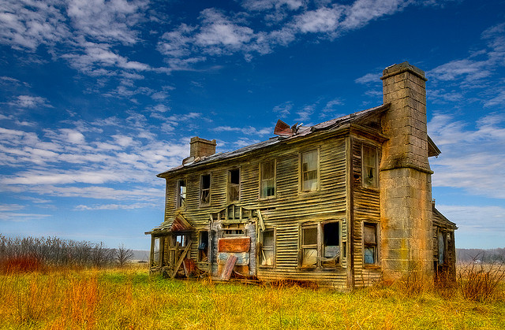
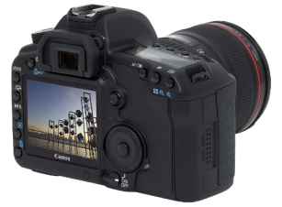
A Tale of Two Coordinate Systems
v
y
COP
u
Camera
w
o
x
Two important coordinate systems:
1. World coordinate system
2. Camera coordinate system
z
“The World”

Slide 27
Camera parameters
To project a point (x,y,z) in world coordinates into a camera
First transform (x,y,z) into camera coordinates
Need to know extrinsics
  Camera position (in world coordinates)
  Camera orientation (in world coordinates)
Then project into the image plane
  Need to know camera intrinsics
  Coming soon
These can all be described with matrices

Slide 28







Extrinsics
How do we get the camera to “canonical form”?
  (Center of projection at the origin, x-axis points right, y-axis points up, z-axis points backwards)
Step 1: Translate by -c
0

Slide 29
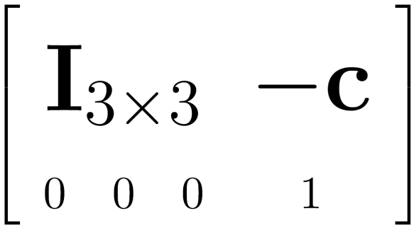

Extrinsics
How do we get the camera to “canonical form”?
  (Center of projection at the origin, x-axis points right, y-axis points up, z-axis points backwards)
Step 1: Translate by -c
How do we represent translation as a matrix multiplication?
0

Slide 30
Extrinsics
How do we get the camera to “canonical form”?
  (Center of projection at the origin, x-axis points right, y-axis points up, z-axis points backwards)
Step 1: Translate by -c
Step 2: Rotate by R
0
3x3 rotation matrix

Slide 31
Extrinsics
How do we get the camera to “canonical form”?
  (Center of projection at the origin, x-axis points right, y-axis points up, z-axis points backwards)
Step 1: Translate by -c
Step 2: Rotate by R
0

Slide 32





Camera parameters
A camera is described by several parameters
  Translation T of the optical center from the origin of world coords
  Rotation R of the image plane
  focal length f, principle point (x’_{c}, y’_{c}), pixel size (s_{x}, s_{y})
  blue parameters are called “extrinsics,” red are “intrinsics”
Projection equation
  The projection matrix models the cumulative effect of all parameters
  Useful to decompose into a series of operations
identity matrix
intrinsics
projection
rotation
translation
  The definitions of these parameters are not completely standardized
    especially intrinsics—varies from one book to another

Slide 33
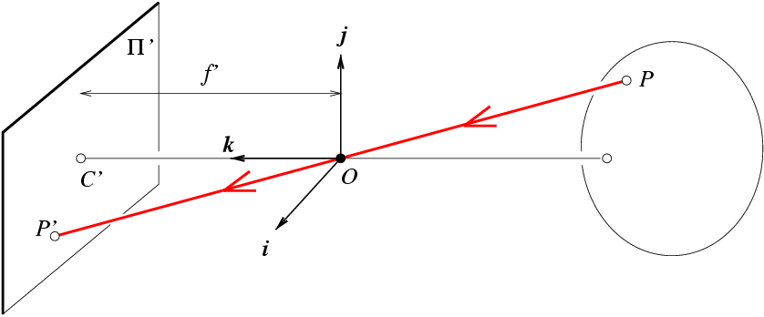
Camera (projection) matrix
Slide Credit: Savarese
R,t
j_{w}
X
k_{w}
O_{w}
x
i_{w}
x: Image Coordinates: (U,V,1)
K: Intrinsic Matrix (3x3)
R: Rotation (3x3)
t: Translation (3x1)
X: World Coordinates: (X,Y,Z,1)
Extrinsic Matrix
Notes:
We can use homogeneous coordinates to write ‘camera matrix’ in linear form.

Slide 34
Projection matrix (ignore extrinsics)
d_{i}
X
O’
(0,0,0)
x
Intrinsic Assumptions
Unit aspect ratio
Optical center at (0,0)
No skew
Extrinsic Assumptions
No rotation
Camera at (0,0,0)
K
Slide Credit: Savarese
Notes:
Work through equations for u and v on board

Slide 35
Remove assumption: aligned optical center
d_{i}
X
O’
O’
(0,0,0)
x
Intrinsic Assumptions
Unit aspect ratio
Optical center at -(U₀,V₀)
No skew
Extrinsic Assumptions
No rotation
Camera at (0,0,0)
K
Slide Credit: Savarese
Notes:
Work through equations for u and v on board

Slide 36
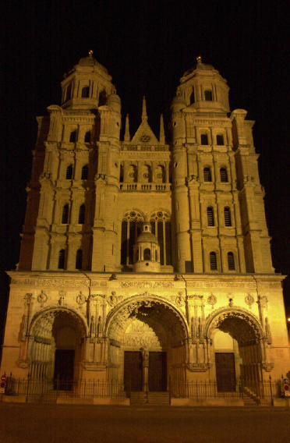
Perspective distortion
Problem for architectural photography: converging verticals
Source: F. Durand

Slide 37
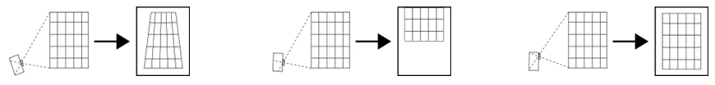
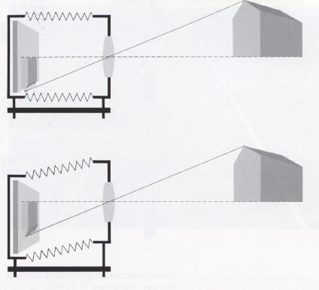
Perspective distortion
Problem for architectural photography: converging verticals
Solution: view camera (lens shifted w.r.t. film)
Tilting the camera upwards results in converging verticals
Keeping the camera level, with an ordinary lens, captures only the bottom portion of the building
Shifting the lens upwards results in a picture of the entire subject
http://en.wikipedia.org/wiki/Perspective_correction_lens
Source: F. Durand

Slide 38
Perspective distortion
Problem for architectural photography: converging verticals
Result:
Source: F. Durand

Slide 39
Remove assumption: aligned optical center
d_{i}
X
O’
O’
(0,0,0)
x
Intrinsic Assumptions
Unit aspect ratio
Optical center at -(U₀,V₀)
No skew
Extrinsic Assumptions
No rotation
Camera at (0,0,0)
K
Slide Credit: Savarese
Notes:
Work through equations for u and v on board

Slide 40
Remove assumption: unit aspect ratio
d_{i}
X
O’
O’
(0,0,0)
x
Intrinsic Assumptions
Optical center at -(U₀,V₀)
No skew
Extrinsic Assumptions
No rotation
Camera at (0,0,0)
K
Slide Credit: Savarese
Notes:
Work through equations for u and v on board

Slide 41
Remove assumption: non-skewed pixels
d_{i}
X
O’
O’
(0,0,0)
x
Intrinsic Assumptions
Optical center at -(U₀,V₀)
Extrinsic Assumptions
No rotation
Camera at (0,0,0)
K
Slide Credit: Savarese
Notes:
Work through equations for u and v on board

Slide 42
Summary
James Hays

Slide 43
Camera Matrix DEMO

Slide 44
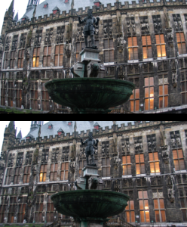
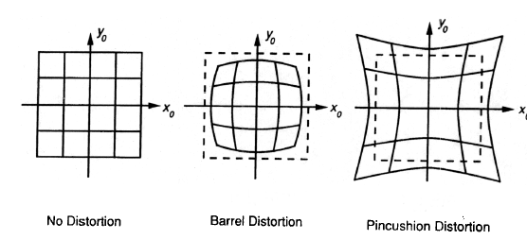
Beyond Pinholes: Radial Distortion
Radial distortion can be introduced due to the use of lens
.
.
.
Corrected Barrel Distortion
Image from Martin Habbecke

Slide 45
Radial distortion
Radial distortion can be reduced by the following correction
r is the radial distance from the center of the scene
The parameters can be estimated by shooting straight lines since a straight line is supposed to be preserved under perspective projection

Slide 46
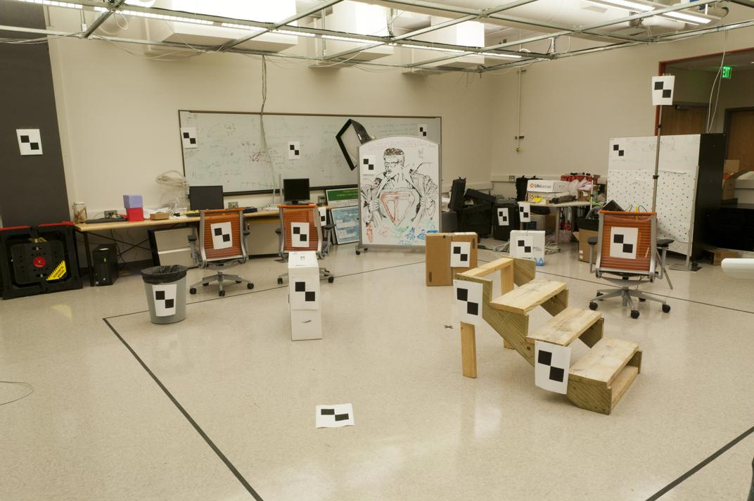
World vs Camera coordinates
James Hays

Slide 47
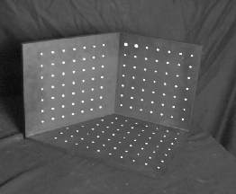
Calibrating the Camera
James Hays
Use an scene with known geometry
  Correspond image points to 3d points
  Get least squares solution (or non-linear solution)
Known 2d image coords
Known 3d
world locations
M
Unknown Camera Parameters

Slide 48
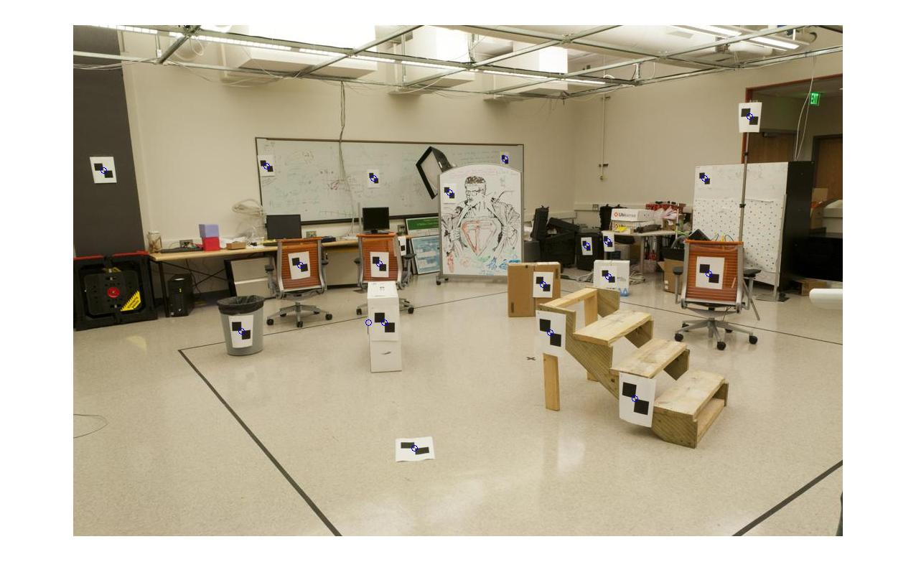
How do we calibrate a camera?
Known 2d image coords
Known 3d world locations
880 214
43 203
270 197
886 347
745 302
943 128
476 590
419 214
317 335
783 521
235 427
665 429
655 362
427 333
412 415
746 351
434 415
525 234
716 308
602 187
312.747 309.140 30.086
305.796 311.649 30.356
307.694 312.358 30.418
310.149 307.186 29.298
311.937 310.105 29.216
311.202 307.572 30.682
307.106 306.876 28.660
309.317 312.490 30.230
307.435 310.151 29.318
308.253 306.300 28.881
306.650 309.301 28.905
308.069 306.831 29.189
309.671 308.834 29.029
308.255 309.955 29.267
307.546 308.613 28.963
311.036 309.206 28.913
307.518 308.175 29.069
309.950 311.262 29.990
312.160 310.772 29.080
311.988 312.709 30.514
James Hays

Slide 49
Unknown Camera Parameters
Known 2d image coords
Known 3d locations
First, work out where X,Y,Z projects to under candidate M.
Two equations per 3D point correspondence
James Hays

Slide 50
Unknown Camera Parameters
Known 2d image coords
Known 3d locations
Next, rearrange into form where all M coefficients are individually stated in terms of X,Y,Z,u,v.
-> Allows us to form lsq matrix.

Slide 51
Unknown Camera Parameters
Known 2d image coords
Known 3d locations
Next, rearrange into form where all M coefficients are individually stated in terms of X,Y,Z,u,v.
-> Allows us to form lsq matrix.

Slide 52
Unknown Camera Parameters
Known 2d image coords
Known 3d locations
Finally, solve for m’s entries using linear least squares
Method 1 –
Ax=b form
M = A\Y;
M = [M;1];
M = reshape(M,[],3)';
James Hays
Notes:
Method 1 – nonhomogeneous linear system. Not related to homogeneous coordinates!! - https://en.m.wikipedia.org/wiki/System_of_linear_equations

Slide 53
Unknown Camera Parameters
Known 2d image coords
Known 3d locations
Or, solve for m’s entries using total linear least-squares.
Method 2 –
Ax=0 form
[U, S, V] = svd(A);
M = V(:,end);
M = reshape(M,[],3)';
James Hays
Notes:
Method 2 – homogeneous linear system. Not related to homogeneous coordinates!! - https://en.m.wikipedia.org/wiki/System_of_linear_equations

Slide 54
How do we calibrate a camera?
Known 2d image coords
Known 3d world locations
880 214
43 203
270 197
886 347
745 302
943 128
476 590
419 214
317 335
783 521
235 427
665 429
655 362
427 333
412 415
746 351
434 415
525 234
716 308
602 187
312.747 309.140 30.086
305.796 311.649 30.356
307.694 312.358 30.418
310.149 307.186 29.298
311.937 310.105 29.216
311.202 307.572 30.682
307.106 306.876 28.660
309.317 312.490 30.230
307.435 310.151 29.318
308.253 306.300 28.881
306.650 309.301 28.905
308.069 306.831 29.189
309.671 308.834 29.029
308.255 309.955 29.267
307.546 308.613 28.963
311.036 309.206 28.913
307.518 308.175 29.069
309.950 311.262 29.990
312.160 310.772 29.080
311.988 312.709 30.514
James Hays

Slide 55


Known 2d image coords
Known 3d world locations
1st point
880 214
43 203
270 197
886 347
745 302
943 128
476 590
419 214
335
…
$$(u1,v1)$$
312.747 309.140 30.086
305.796 311.649 30.356
307.694 312.358 30.418
310.149 307.186 29.298
311.937 310.105 29.216
311.202 307.572 30.682
307.106 306.876 28.660
309.317 312.490 30.230
307.435 310.151 29.318
…..
$$(X1,Y1,Z1)$$
Projection error defined by two equations – one for u and one for v

Slide 56


Known 2d image coords
Known 3d world locations
880 214
43 203
270 197
886 347
745 302
943 128
476 590
419 214
335
…
312.747 309.140 30.086
305.796 311.649 30.356
307.694 312.358 30.418
310.149 307.186 29.298
311.937 310.105 29.216
311.202 307.572 30.682
307.106 306.876 28.660
309.317 312.490 30.230
307.435 310.151 29.318
…..
2nd point
$$(u2,v2)$$
$$(X2,Y2,Z2)$$
Projection error defined by two equations – one for u and one for v

Slide 57
How many points do I need to fit the model?
Degrees of freedom?
5
6
Think 3:
Rotation around x
Rotation around y
Rotation around z
Notes:
How many known points are needed to estimate this?
Why 5?
Why 6? Don’t we have 12 parameters here?
But matrix is not full rank -> it’s a projection (we can tell because it isn’t square -> the column space is 4D, but the row space is 3D, so this matrix projects a 4D space to a 3D space)
One of the dimensions is lost – intuitive, dimensionality reduction machine.
Ambiguous scale in the camera projection matrix. This scale is in the null space of the matrix, i.e., there is a line of possible solutions (plane?)

Slide 58
How many points do I need to fit the model?
Degrees of freedom?
5
6
M is 3x4, so 12 unknowns, but projective scale ambiguity – 11 deg. freedom.
One equation per unknown -> 5 1/2 point correspondences determines a solution (e.g., either u or v).
More than 5 1/2 point correspondences -> overdetermined, many solutions to M.
Least squares is finding the solution that best satisfies the overdetermined system.
Why use more than 6? Robustness to error in feature points.
Notes:
How many known points are needed to estimate this?
Why 5?
Why 6? Don’t we have 12 parameters here?
8 equations in 2D -> 16 parameters
But matrix is not full rank -> it’s a projection (we can tell because it isn’t square -> the column space is 4D, but the row space is 3D, so this matrix projects a 4D space to a 3D space)
One of the dimensions is lost – intuitive, dimensionality reduction machine.
Ambiguous scale in the camera projection matrix. This scale is in the null space of the matrix, i.e., there is a line of possible solutions (plane?)
Actually only need 8 points to produce a valid (up to scale) projection matrix.

Slide 59
Solving - why two methods?
Any projection is inherently ambiguous
A space of possible solutions
Under projective model, this is our projective scale ambiguity.
x₁
x
v₁
v₂

Slide 60
Calibration with linear method
Advantages
  Easy to formulate and solve
  Provides initialization for non-linear methods
Disadvantages
  Doesn’t directly give you camera parameters
  Doesn’t model radial distortion
  Can’t impose constraints, such as known focal length
Non-linear methods are preferred
  Define error as difference between projected points and measured points
  Minimize error using Newton’s method or other non-linear optimization
James Hays

Slide 61
Can we factorize M back to K [R | T]?
Yes!
We can directly solve for the individual entries of K [R | T].
James Hays

Slide 62
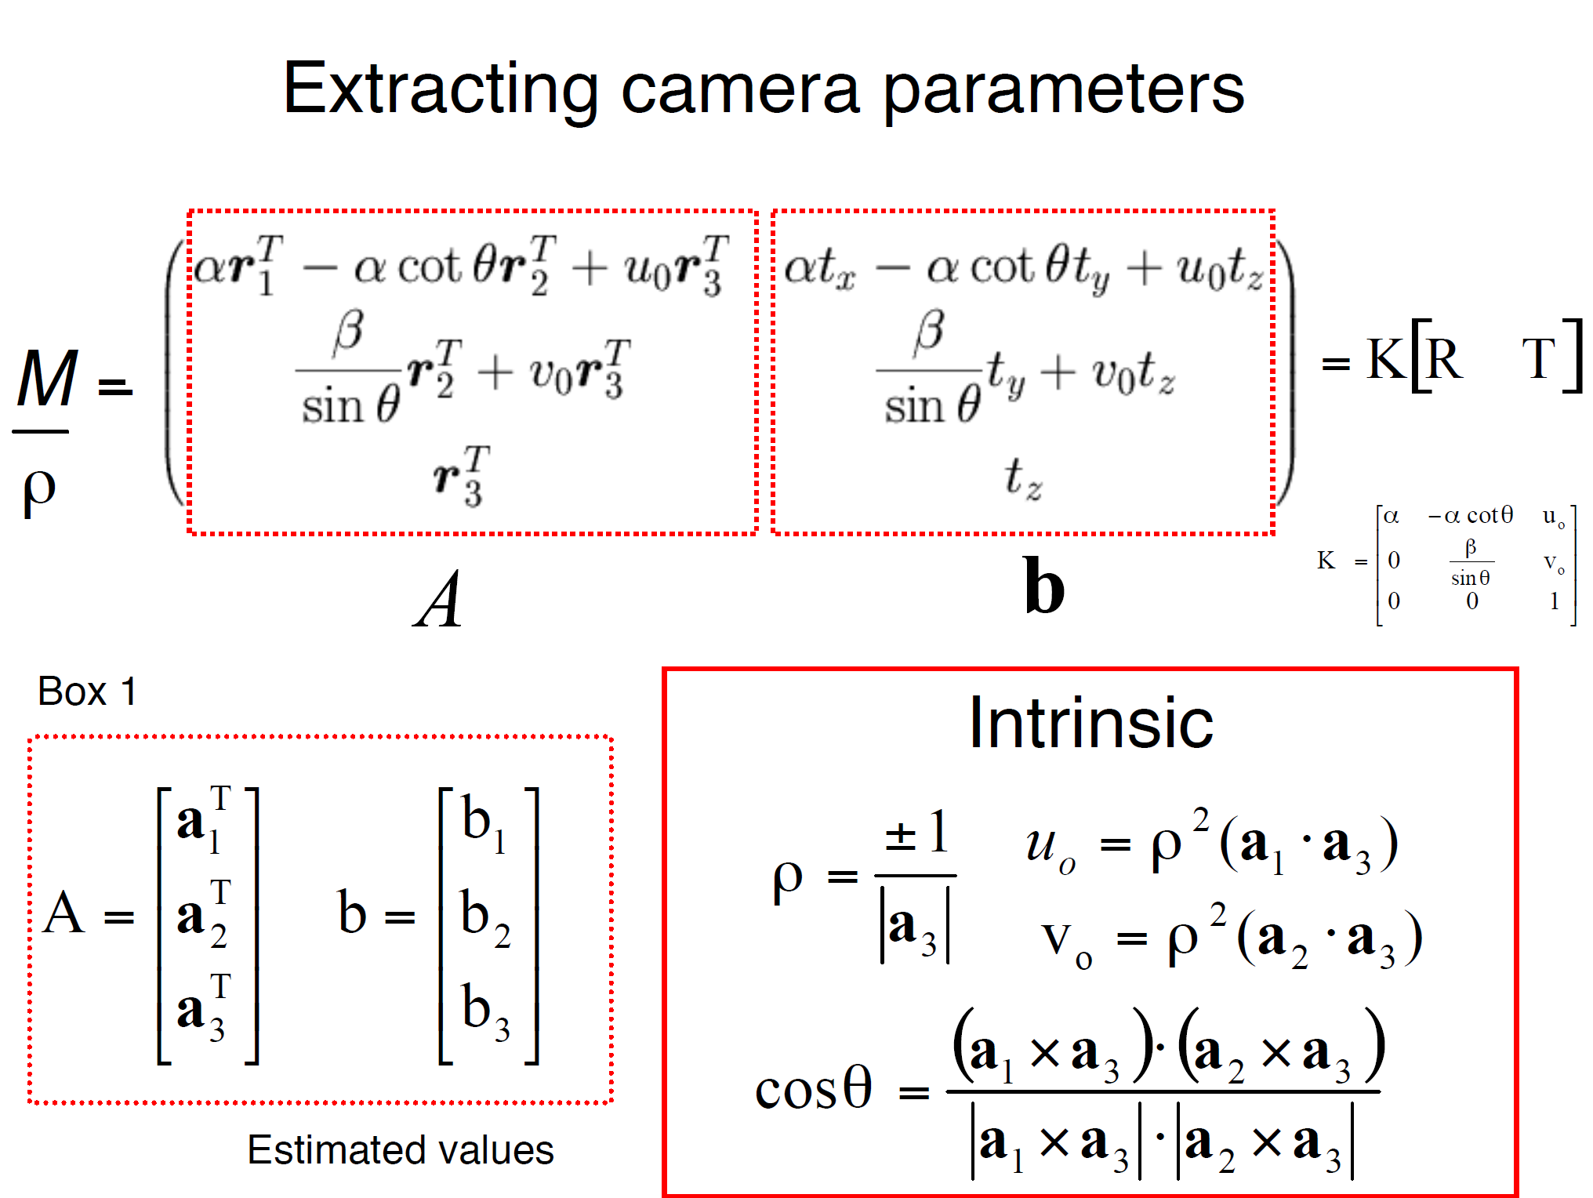
a_{n} = nth column of A
James Hays

Slide 63
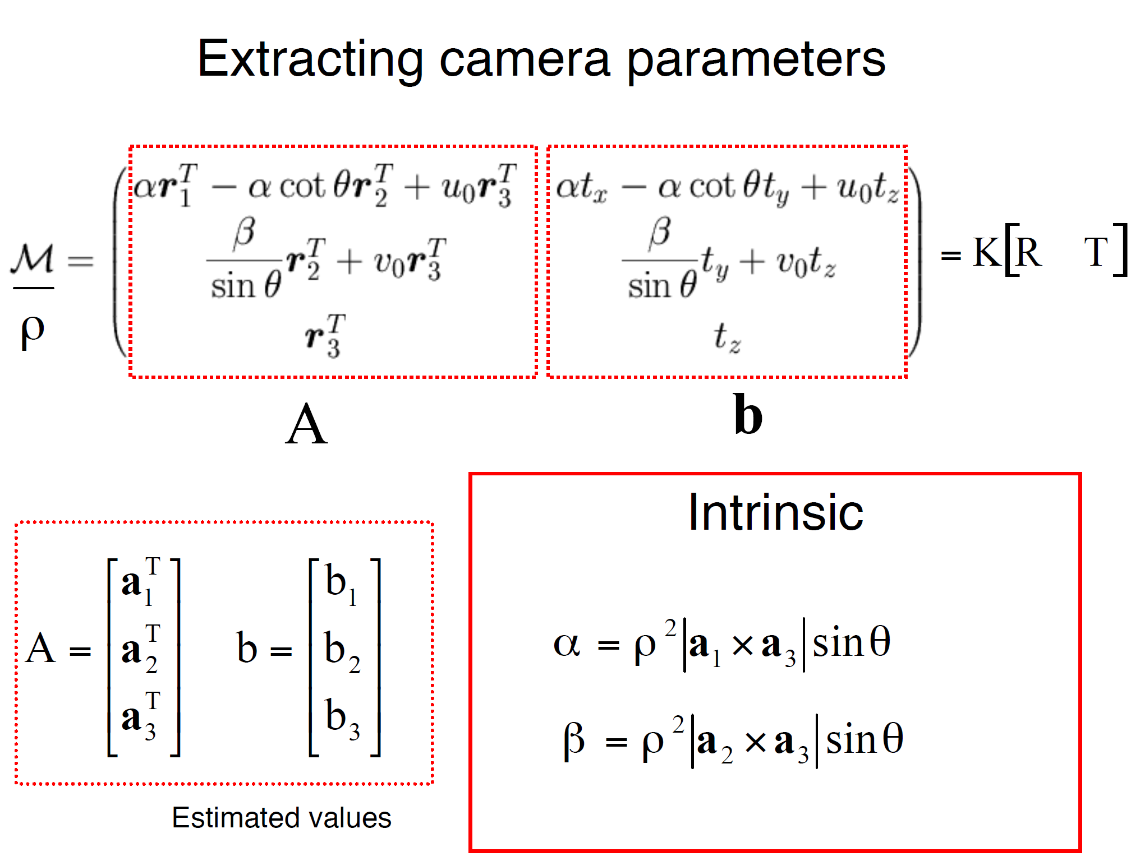
James Hays

Slide 64
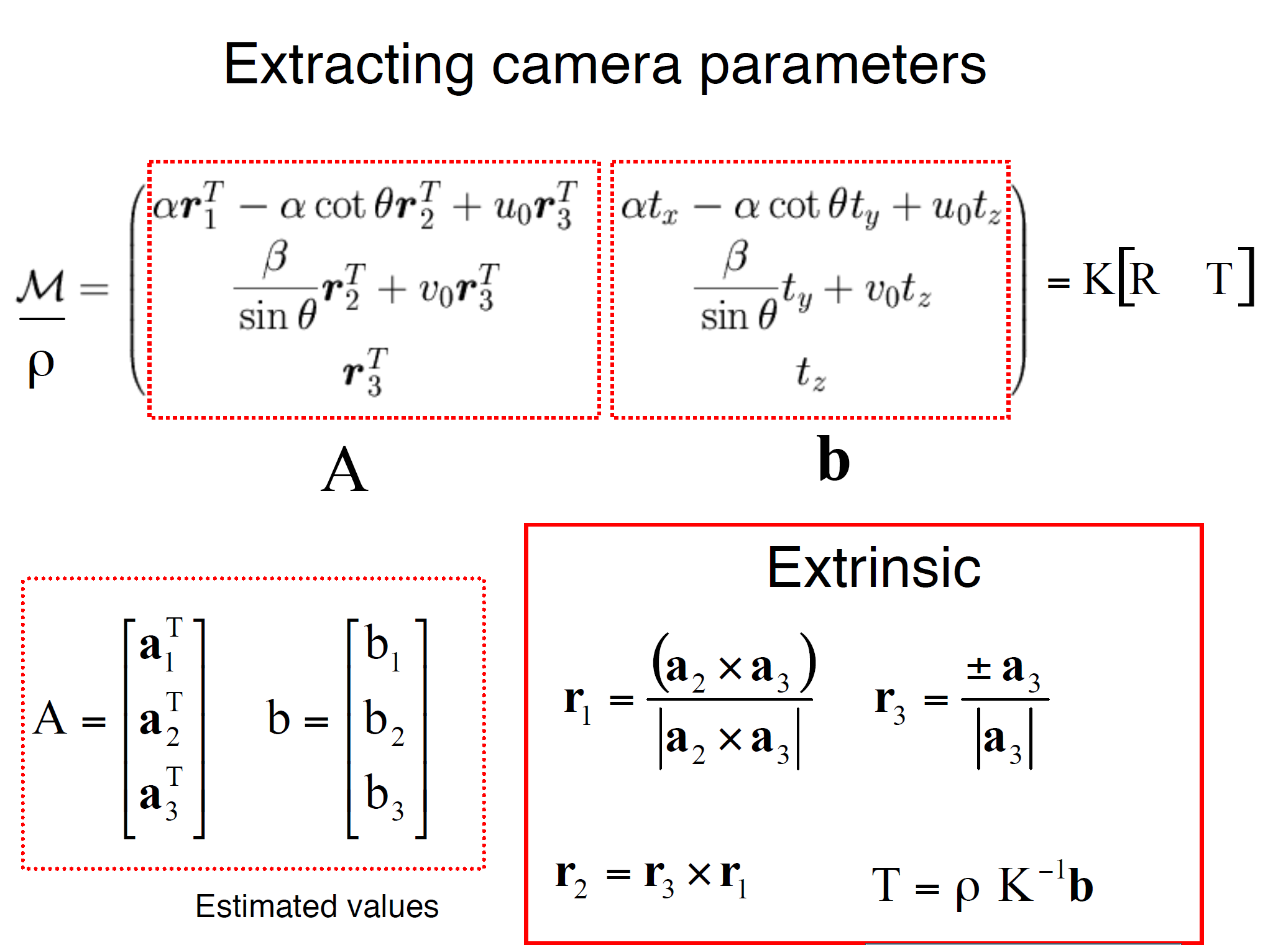
James Hays

Slide 65
Can we factorize M back to K [R | T]?
Yes!
We can also use RQ factorization (not QR)
  R in RQ is not rotation matrix R; crossed names!
R (right diagonal) is K
Q (orthogonal basis) is R.
T, the last column of [R | T], is inv(K) * last column of M.
  But you need to do a bit of post-processing to make sure that the matrices are valid. See http://ksimek.github.io/2012/08/14/decompose/
James Hays

Slide 66
Recovering the camera center
t
m₄
C=-R⁻¹ K⁻¹ m₄
Q
James Hays

Slide 67
Recovering the camera center
This is not the camera center C.
It is –RC, as the point is rotated before t_{x}, t_{y}, and t_{z} are added
t
So we need
-R⁻¹ K⁻¹ m₄ to get C.
m₄
This is t × K
So K⁻¹ m₄ is t
Q is K × R.
So we just need -Q⁻¹ m₄
Q
James Hays

Slide 68
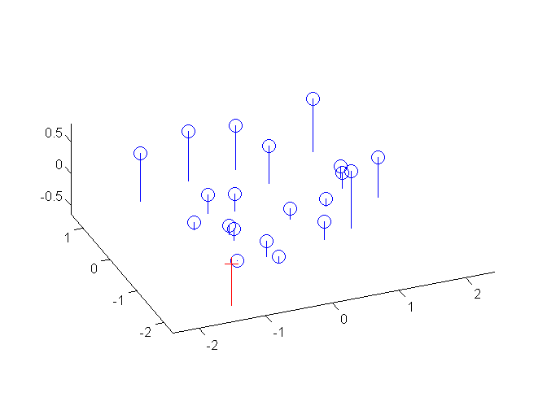
Estimate of camera center
1.0486 -0.3645
-1.6851 -0.4004
-0.9437 -0.4200
1.0682 0.0699
0.6077 -0.0771
1.2543 -0.6454
-0.2709 0.8635
-0.4571 -0.3645
-0.7902 0.0307
0.7318 0.6382
-1.0580 0.3312
0.3464 0.3377
0.3137 0.1189
-0.4310 0.0242
-0.4799 0.2920
0.6109 0.0830
-0.4081 0.2920
-0.1109 -0.2992
0.5129 -0.0575
0.1406 -0.4527
1.5706 -0.1490 0.2598
-1.5282 0.9695 0.3802
-0.6821 1.2856 0.4078
0.4124 -1.0201 -0.0915
1.2095 0.2812 -0.1280
0.8819 -0.8481 0.5255
-0.9442 -1.1583 -0.3759
0.0415 1.3445 0.3240
-0.7975 0.3017 -0.0826
-0.4329 -1.4151 -0.2774
-1.1475 -0.0772 -0.2667
-0.5149 -1.1784 -0.1401
0.1993 -0.2854 -0.2114
-0.4320 0.2143 -0.1053
-0.7481 -0.3840 -0.2408
0.8078 -0.1196 -0.2631
-0.7605 -0.5792 -0.1936
0.3237 0.7970 0.2170
1.3089 0.5786 -0.1887
1.2323 1.4421 0.4506

Slide 69
Calibration example

