Slide 1
Optical Flow
Samuel Cheng
Slide credit: Juan Carlos Niebles and Ranjay Krishna

Slide 2
What we will learn today?
Optical flow
Lucas-Kanade method
Horn-Schunk method
Pyramids for large motion
Common fate
Applications
Reading: [Szeliski] Chapters: 8.4, 8.5
[Fleet & Weiss, 2005]
http://www.cs.toronto.edu/pub/jepson/teaching/vision/2503/opticalFlow.pdf

Slide 3
What we will learn today?
Optical flow
Lucas-Kanade method
Horn-Schunk method
Pyramids for large motion
Common fate
Applications
Reading: [Szeliski] Chapters: 8.4, 8.5
[Fleet & Weiss, 2005]
http://www.cs.toronto.edu/pub/jepson/teaching/vision/2503/opticalFlow.pdf

Slide 4
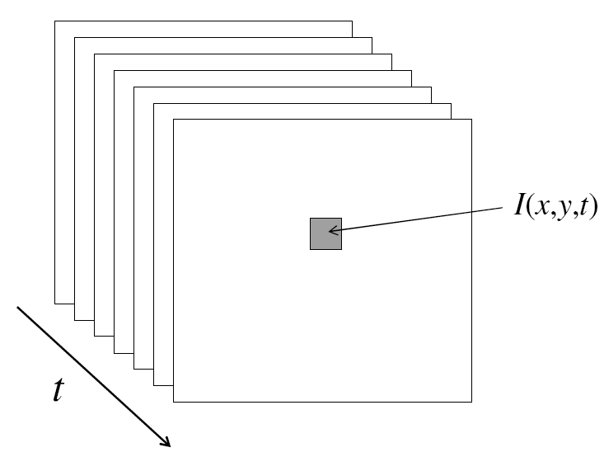
From images to videos
A video is a sequence of frames captured over time
Now our image data is a function of space (x, y) and time (t)

Slide 5
Why is motion useful?

Slide 6
Why is motion useful?

Slide 7
Optical flow
Definition: optical flow is the apparent motion of brightness patterns in the image
Note: apparent motion can be caused by lighting changes without any actual motion
  Think of a uniform rotating sphere under fixed lighting vs. a stationary sphere under moving illumination
  GOAL: Recover image motion at each pixel from optical flow
Source: Silvio Savarese

Slide 8
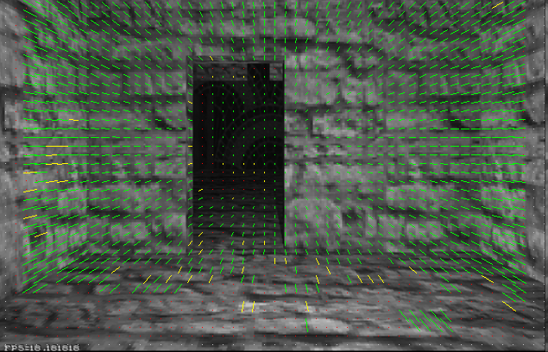
Optical flow
Vector field function of the spatio-temporal image brightness variations
Picture courtesy of Selim Temizer - Learning and Intelligent Systems (LIS) Group, MIT

Slide 9
Estimating optical flow
I(x,y,t–1)
I(x,y,t)
Given two subsequent frames, estimate the apparent motion field u(x,y), v(x,y) between them
Key assumptions
  Brightness constancy: projection of the same point looks the same in every frame
  Small motion: points do not move very far
  Spatial coherence: points move like their neighbors
Source: Silvio Savarese

Slide 10
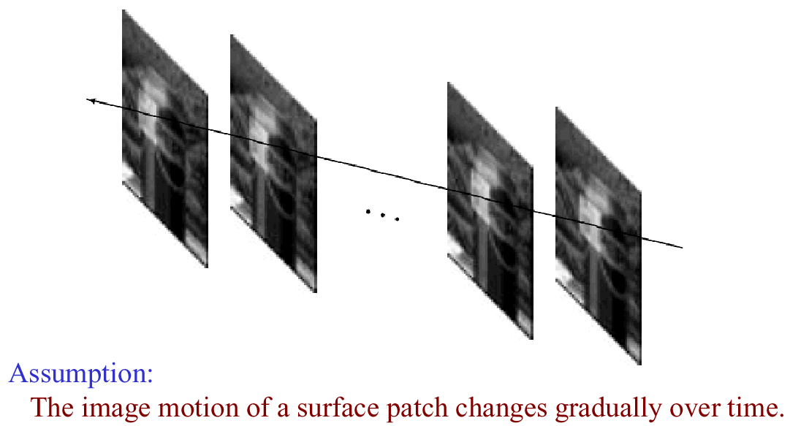
Key Assumptions: small motions
* Slide from Michael Black, CS143 2003

Slide 11
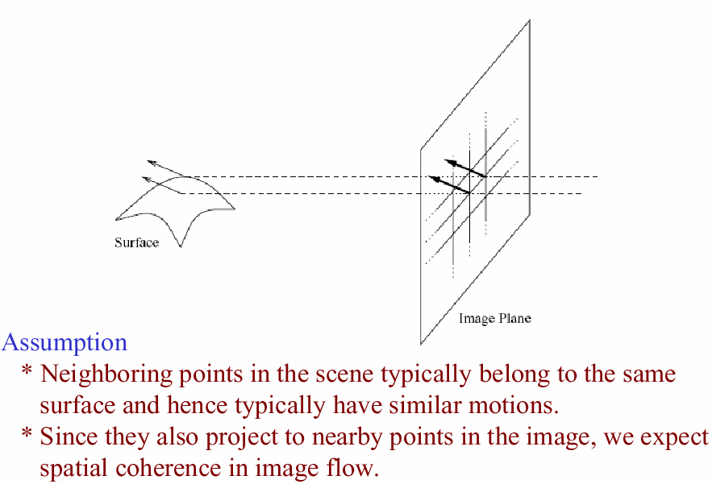
Key Assumptions: spatial coherence
* Slide from Michael Black, CS143 2003

Slide 12
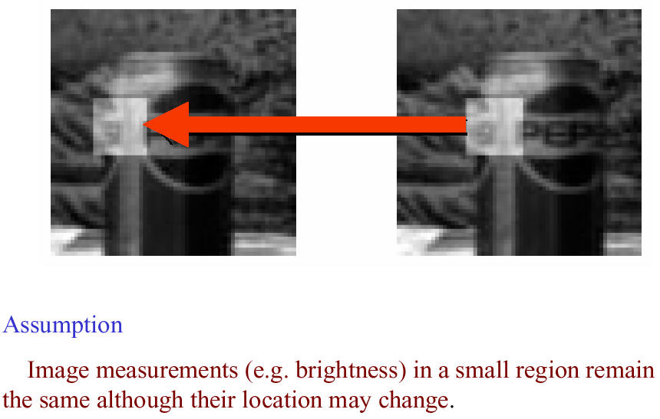
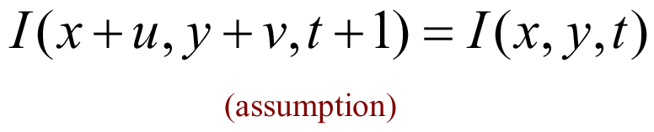
Key Assumptions: brightness Constancy
* Slide from Michael Black, CS143 2003

Slide 13


The brightness constancy constraint
I(x,y,t–1)
I(x,y,t)
Brightness Constancy Equation:
Linearizing the right side using Taylor expansion:
Image derivative along x
Source: Silvio Savarese
Hence,

Slide 14
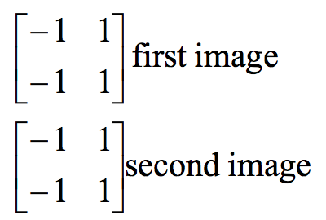
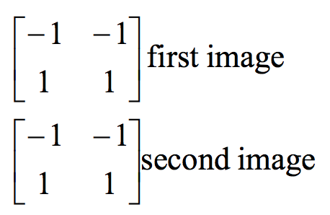
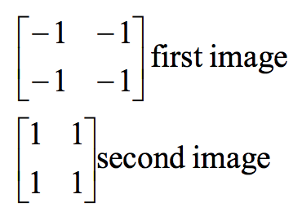



Filters used to find the derivatives
$$I_{x}$$
$$I_{y}$$
$$I_{t}$$

Slide 15
The brightness constancy constraint
Can we use this equation to recover image motion (u,v) at each pixel?
How many equations and unknowns per pixel?
  One equation (this is a scalar equation!), two unknowns (u,v)
The component of the flow perpendicular to the gradient (i.e., parallel to the edge) cannot be measured
gradient
(u,v)
  If (u, v ) satisfies the equation,
  so does (u+u’, v+v’ ) if
(u’,v’)
(u+u’,v+v’)
Source: Silvio Savarese
edge
Notes:
A: u and v are unknown, 1 equation

Slide 16
The aperture problem
Source: Silvio Savarese
Actual motion

Slide 17
The aperture problem
Source: Silvio Savarese
Perceived motion

Slide 18
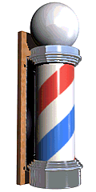
The barber pole illusion
Source: Silvio Savarese
http://en.wikipedia.org/wiki/Barberpole_illusion

Slide 19

The barber pole illusion
Source: Silvio Savarese
http://en.wikipedia.org/wiki/Barberpole_illusion

Slide 20

The barber pole illusion
Source: Silvio Savarese
http://en.wikipedia.org/wiki/Barberpole_illusion

Slide 21
What we will learn today?
Optical flow
Lucas-Kanade method
Horn-Schunk method
Pyramids for large motion
Common fate
Applications
Reading: [Szeliski] Chapters: 8.4, 8.5
[Fleet & Weiss, 2005]
http://www.cs.toronto.edu/pub/jepson/teaching/vision/2503/opticalFlow.pdf

Slide 22
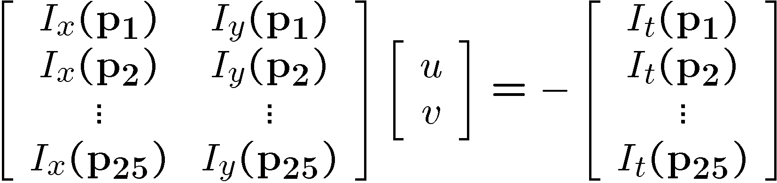
Solving the ambiguity…
B. Lucas and T. Kanade. An iterative image registration technique with an application to stereo vision. In Proceedings of the International Joint Conference on Artificial Intelligence, pp. 674–679, 1981.
How to get more equations for a pixel?
Spatial coherence constraint:
Assume the pixel’s neighbors have the same (u,v)
  If we use a 5x5 window, that gives us 25 equations per pixel
Source: Silvio Savarese

Slide 23




Lucas-Kanade flow
Overconstrained linear system:
Source: Silvio Savarese

Slide 24

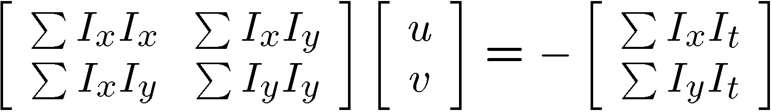


Lucas-Kanade flow
Overconstrained linear system
Least squares solution for d given by
Source: Silvio Savarese
  The summations are over all pixels in the K x K window

Slide 25
Conditions for solvability
  Optimal (u, v) satisfies Lucas-Kanade equation
When is This Solvable?
  A^{T}A should be invertible
  A^{T}A should not be too small due to noise
    eigenvalues λ₁ and λ ₂ of A^{T}A should not be too small
  A^{T}A should be well-conditioned
    λ ₁/ λ ₂ should not be too large (λ ₁ = larger eigenvalue)
Source: Silvio Savarese
Does this remind anything to you?

Slide 26
M = A^{T}A is the second moment matrix !
(Harris corner detector…)
Eigenvectors and eigenvalues of A^{T}A relate to edge direction and magnitude
  The eigenvector associated with the larger eigenvalue points in the direction of fastest intensity change
  The other eigenvector is orthogonal to it
Source: Silvio Savarese
Notes:
Suppose M = vv^T . What are the eigenvectors and eigenvalues? Start by considering Mv

Slide 27
Interpreting the eigenvalues
Classification of image points using eigenvalues of the second moment matrix:
λ₂
“Edge”
λ₂ >> λ₁
“Corner”
λ₁ and λ₂ are large,
λ₁ ~ λ₂
Source: Silvio Savarese
λ₁ and λ₂ are small
“Edge”
λ₁ >> λ₂
“Flat” region
λ₁

Slide 28
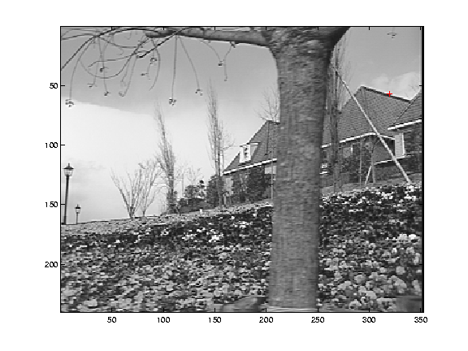
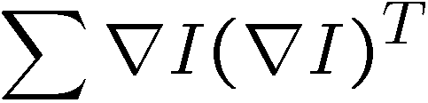
Edge
Source: Silvio Savarese
gradients very large or very small
large λ₁, small λ₂

Slide 29
Low-texture region
Source: Silvio Savarese
gradients have small magnitude
small λ₁, small λ₂

Slide 30
High-texture region
Source: Silvio Savarese
gradients are different, large magnitudes
large λ₁, large λ₂

Slide 31
Errors in Lucas-Kanade
What are the potential causes of errors in this procedure?
  Suppose A^{T}A is easily invertible
  Suppose there is not much noise in the image
When our assumptions are violated
  Brightness constancy is not satisfied
  The motion is not small
  A point does not move like its neighbors
    window size is too large
    what is the ideal window size?
* From Khurram Hassan-Shafique CAP5415 Computer Vision 2003

Slide 32
Improving accuracy
Recall our small motion assumption
I_{t-1}(x,y)
I_{t-1}(x,y)
This is not exact
  To do better, we need to add higher order terms back in:
I_{t-1}(x,y)
This is a polynomial root finding problem
  Can solve using Newton’s method (out of scope for this class)
  Lucas-Kanade method does one iteration of Newton’s method
    Better results are obtained via more iterations
* From Khurram Hassan-Shafique CAP5415 Computer Vision 2003

Slide 33
Iterative Refinement
Iterative Lucas-Kanade Algorithm
  Estimate velocity at each pixel by solving Lucas-Kanade equations
  Warp I(t-1) towards I(t) using the estimated flow field
    - use image warping techniques
  Repeat until convergence
* From Khurram Hassan-Shafique CAP5415 Computer Vision 2003

Slide 34
When do the optical flow assumptions fail?
In other words, in what situations does the displacement of pixel patches
not represent physical movement of points in space?
1. Well, TV is based on illusory motion
  – the set is stationary yet things seem to move
2. A uniform rotating sphere
  – nothing seems to move, yet it is rotating
3. Changing directions or intensities of lighting can make things seem to move
  – for example, if the specular highlight on a rotating sphere moves.
4. Muscle movement can make some spots on a cheetah move opposite direction of motion.
  – And infinitely more break downs of optical flow.

Slide 35
What we will learn today?
Optical flow
Lucas-Kanade method
Horn-Schunk method
Pyramids for large motion
Common fate
Applications
Reading: [Szeliski] Chapters: 8.4, 8.5
[Fleet & Weiss, 2005]
http://www.cs.toronto.edu/pub/jepson/teaching/vision/2503/opticalFlow.pdf

Slide 36
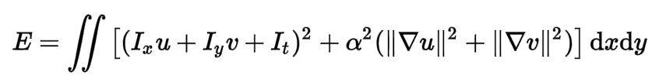
Horn-Schunk method for optical flow
The flow is formulated as a global energy function which is should be minimized:

Slide 37
Horn-Schunk method for optical flow
The flow is formulated as a global energy function which is should be minimized:
The first part of the function is the brightness consistency.

Slide 38
Horn-Schunk method for optical flow
The flow is formulated as a global energy function which is should be minimized:
The second part is the smoothness constraint. It’s trying to make sure that the changes between frames are small.

Slide 39
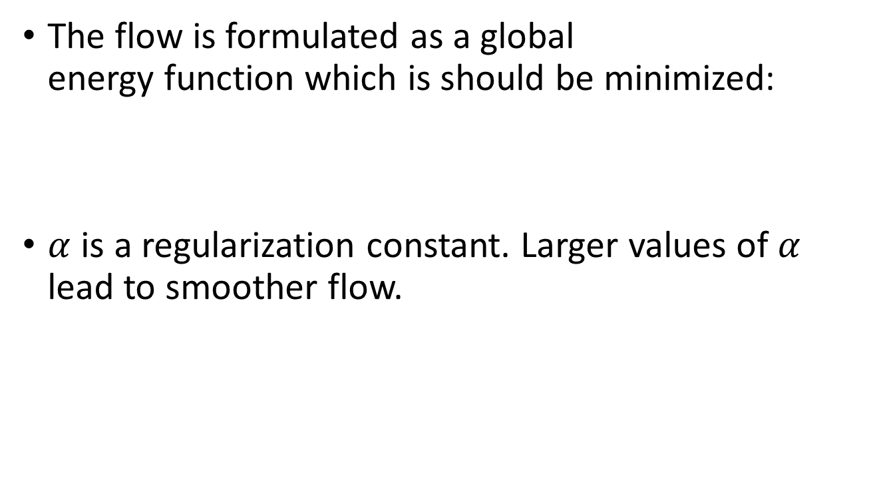
Horn-Schunk method for optical flow
The flow is formulated as a global energy function which is should be minimized:
$α$ is a regularization constant. Larger values of $α$ lead to smoother flow.

Slide 40

Horn-Schunk method for optical flow
The flow is formulated as a global energy function which is should be minimized:
We want to find $u$, $v$ to minimize E. Note that $u$, $v$ themselves are function. E is a “functional” of $u$, $v$. By calculus of variation, as ϵ→0

Slide 41
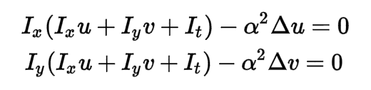
Horn-Schunk method for optical flow
Using integration by part,

Slide 42
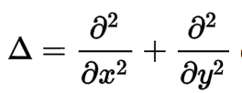


Horn-Schunk method for optical flow
Where is called the Laplace operator. In practice, it is often computed as
where is the weighted average of u measured at (x,y).

Slide 43
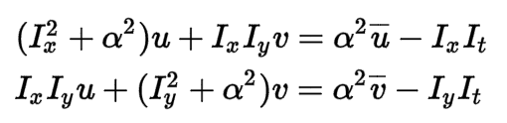
Horn-Schunk method for optical flow
Now we substitute
in:
We get:
Which is linear in u and v and can be solved for each pixel individually.

Slide 44
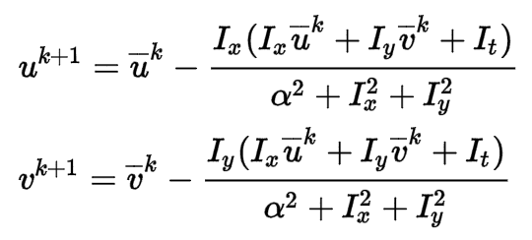
Iterative Horn-Schunk
But since the solution depends on the neighboring values of the flow field, it must be repeated once the neighbors have been updated.
So instead, we can iteratively solve for u and v using:

Slide 45

What does the smoothness regularization do anyway?
It’s a sum of squared terms (a Euclidian distance measure).
We’re putting it in the expression to be minimized.
=> In texture free regions, there is no optical flow
=> On edges, points will flow to nearest points, solving the aperture problem.
Regularized flow
Optical flow
Slide credit: Sebastian Thurn

Slide 46
Dense Optical Flow with Michael Black’s method
Michael Black took Horn-Schunk’s method one step further, starting from the regularization constant:
Which looks like a quadratic:
And replaced it with this:
Why does this regularization work better?

Slide 47
What we will learn today?
Optical flow
Lucas-Kanade method
Horn-Schunk method
Pyramids for large motion
Common fate
Applications

Slide 48
Recap
Key assumptions (Errors in Lucas-Kanade)
  Small motion: points do not move very far
  Brightness constancy: projection of the same point looks the same in every frame
  Spatial coherence: points move like their neighbors
Source: Silvio Savarese

Slide 49
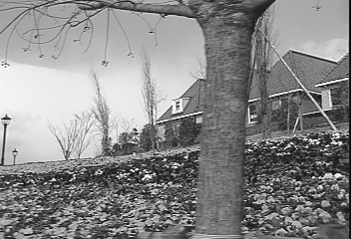
Revisiting the small motion assumption
* From Khurram Hassan-Shafique CAP5415 Computer Vision 2003
Is this motion small enough?
  Probably not—it’s much larger than one pixel (2nd order terms dominate)
  How might we solve this problem?

Slide 50
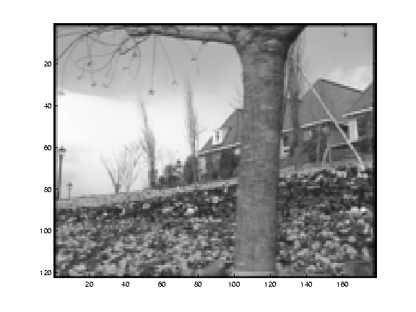
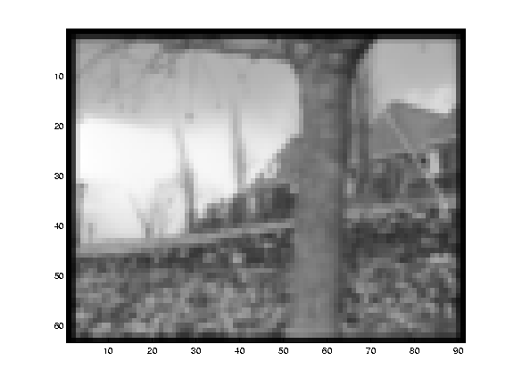
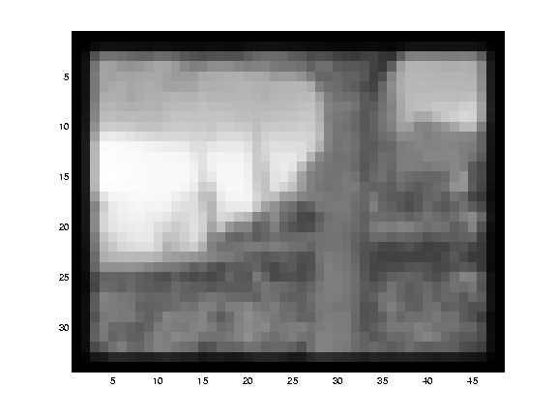
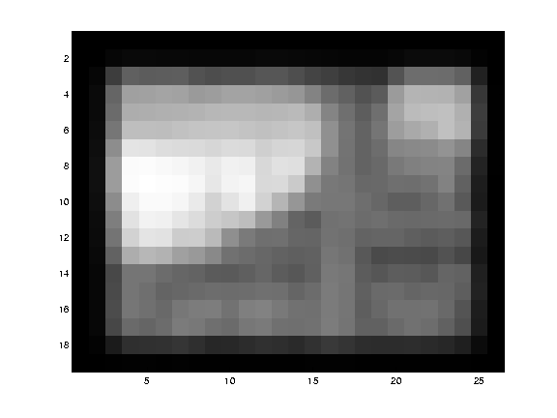
Reduce the resolution!
* From Khurram Hassan-Shafique CAP5415 Computer Vision 2003

Slide 51
Coarse-to-fine optical flow estimation
u=1.25 pixels
u=2.5 pixels
u=5 pixels
image H
u=10 pixels
image I
image 1
image 2
Source: Silvio Savarese
Gaussian pyramid of image 1
Gaussian pyramid of image 2

Slide 52
Coarse-to-fine optical flow estimation
run iterative L-K
warp & upsample
run iterative L-K
.
.
.
image J
image I
image 1
image 2
Source: Silvio Savarese
Gaussian pyramid of image 1 (t)
Gaussian pyramid of image 2 (t+1)

Slide 53
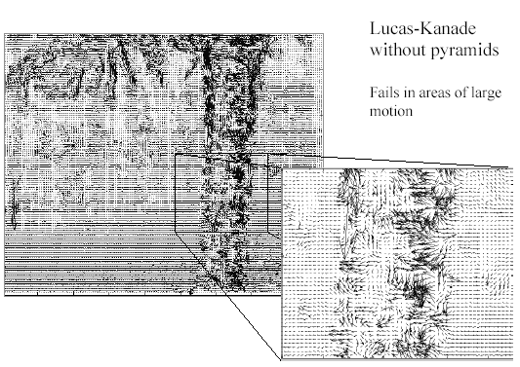
Optical Flow Results
* From Khurram Hassan-Shafique CAP5415 Computer Vision 2003

Slide 54
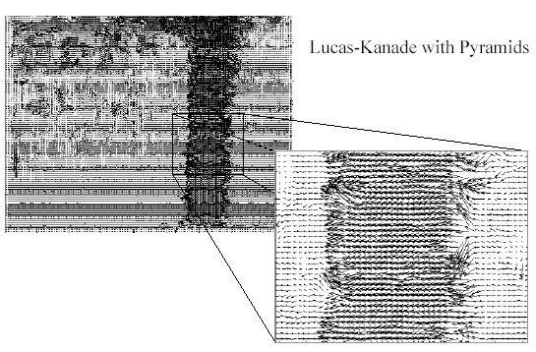
Optical Flow Results
* From Khurram Hassan-Shafique CAP5415 Computer Vision 2003
http://www.ces.clemson.edu/~stb/klt/
OpenCV

Slide 55
What we will learn today?
Optical flow
Lucas-Kanade method
Horn-Schunk method
Pyramids for large motion
Common fate
Applications

Slide 56
Recap
Key assumptions (Errors in Lucas-Kanade)
  Small motion: points do not move very far
  Brightness constancy: projection of the same point looks the same in every frame
  Spatial coherence: points move like their neighbors
Source: Silvio Savarese

Slide 57
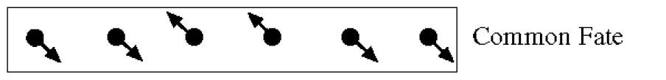
Reminder: Gestalt – common fate

Slide 58
Motion segmentation
How do we represent the motion in this scene?
Source: Silvio Savarese

Slide 59
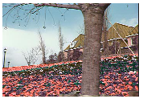
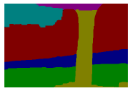
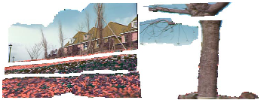
Motion segmentation
J. Wang and E. Adelson. Layered Representation for Motion Analysis. CVPR 1993.
Break image sequence into “layers” each of which has a coherent (affine) motion
Source: Silvio Savarese

Slide 60
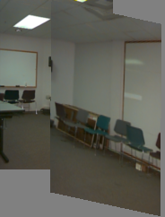
Affine motion
Substituting into the brightness constancy equation:
Source: Silvio Savarese

Slide 61
Affine motion
Substituting into the brightness constancy equation:
Each pixel provides 1 linear constraint in 6 unknowns
Least squares minimization:
Source: Silvio Savarese

Slide 62
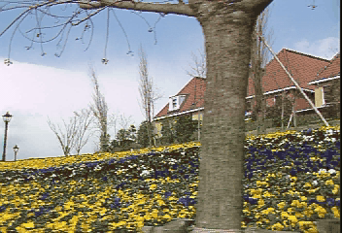
How do we estimate the layers?
1. Obtain a set of initial affine motion hypotheses
  Divide the image into blocks and estimate affine motion parameters in each block by least squares
    Eliminate hypotheses with high residual error
  Map into motion parameter space
  Perform k-means clustering on affine motion parameters
    Merge clusters that are close and retain the largest clusters to obtain a smaller set of hypotheses to describe all the motions in the scene
Source: Silvio Savarese

Slide 63
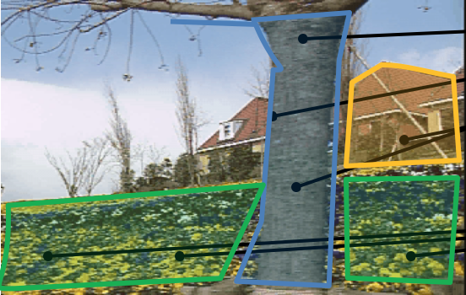
How do we estimate the layers?
1. Obtain a set of initial affine motion hypotheses
  Divide the image into blocks and estimate affine motion parameters in each block by least squares
    Eliminate hypotheses with high residual error
  Map into motion parameter space
  Perform k-means clustering on affine motion parameters
    Merge clusters that are close and retain the largest clusters to obtain a smaller set of hypotheses to describe all the motions in the scene
Source: Silvio Savarese

Slide 64
How do we estimate the layers?
1. Obtain a set of initial affine motion hypotheses
  Divide the image into blocks and estimate affine motion parameters in each block by least squares
    Eliminate hypotheses with high residual error
  Map into motion parameter space
  Perform k-means clustering on affine motion parameters
    Merge clusters that are close and retain the largest clusters to obtain a smaller set of hypotheses to describe all the motions in the scene
2. Iterate until convergence:
  Assign each pixel to best hypothesis
    Pixels with high residual error remain unassigned
  Perform region filtering to enforce spatial constraints
  Re-estimate affine motions in each region
Source: Silvio Savarese

Slide 65
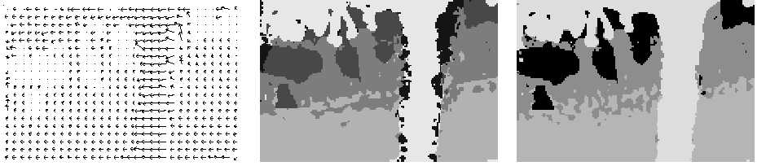
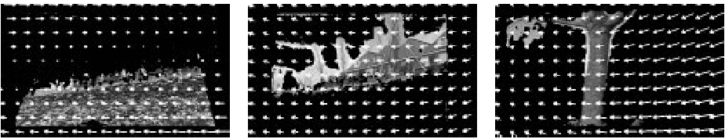
Example result
Source: Silvio Savarese
J. Wang and E. Adelson. Layered Representation for Motion Analysis. CVPR 1993.

Slide 66
What we will learn today?
Optical flow
Lucas-Kanade method
Horn-Schunk method
Pyramids for large motion
Common fate
Applications

Slide 67
Uses of motion
Tracking features
Segmenting objects based on motion cues
Learning dynamical models
Improving video quality
  Motion stabilization
  Super resolution
Tracking objects
Recognizing events and activities

Slide 68
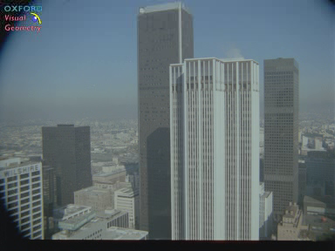
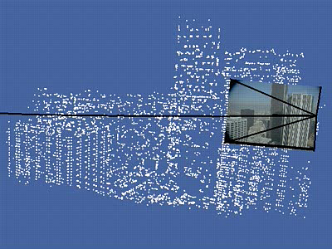
Estimating 3D structure
Source: Silvio Savarese

Slide 69
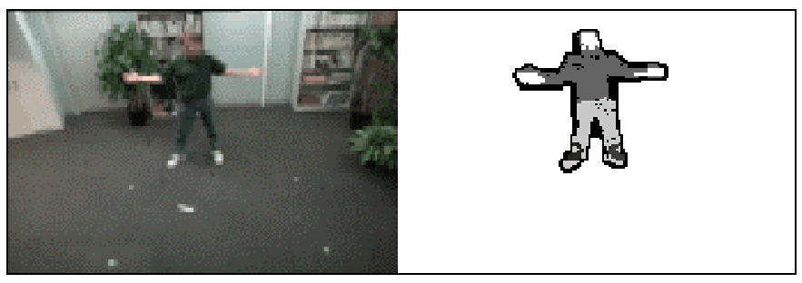
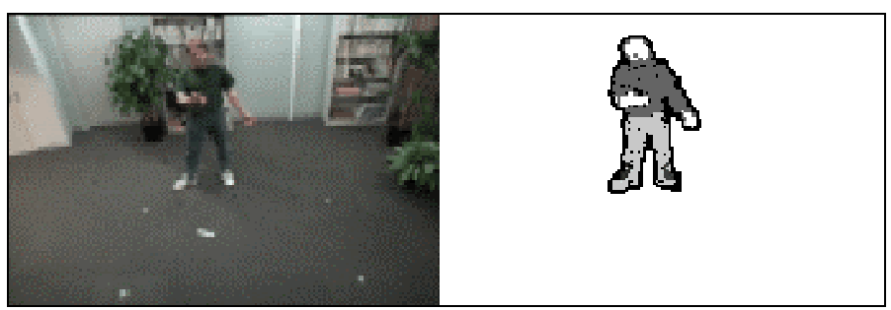
Segmenting objects based on motion cues
Background subtraction
  A static camera is observing a scene
  Goal: separate the static background from the moving foreground
Source: Silvio Savarese

Slide 70
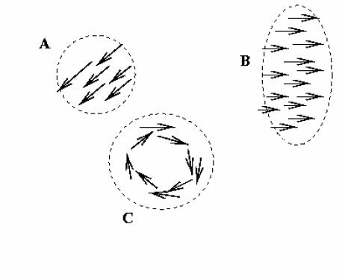
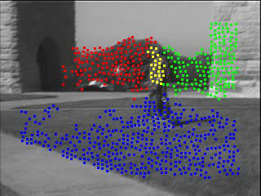
Segmenting objects based on motion cues
Motion segmentation
  Segment the video into multiple coherently moving objects
Source: Silvio Savarese
S. J. Pundlik and S. T. Birchfield, Motion Segmentation at Any Speed, Proceedings of the British Machine Vision Conference (BMVC) 2006

Slide 71
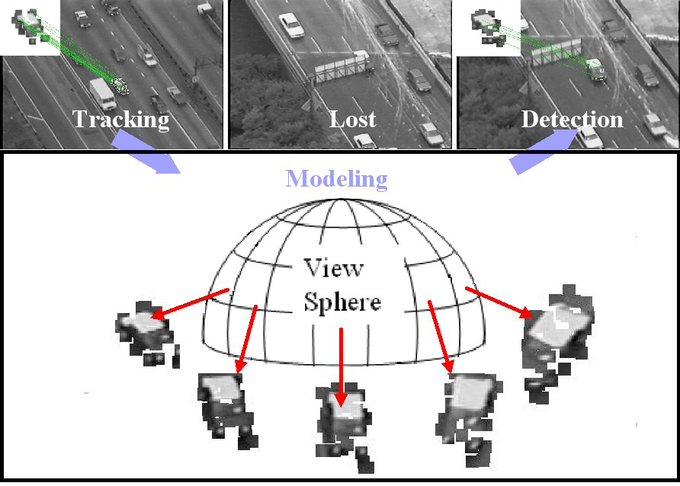
Tracking objects
Source: Silvio Savarese
Z.Yin and R.Collins, "On-the-fly Object Modeling while Tracking," IEEE Computer Vision and Pattern Recognition (CVPR '07), Minneapolis, MN, June 2007.

Slide 72
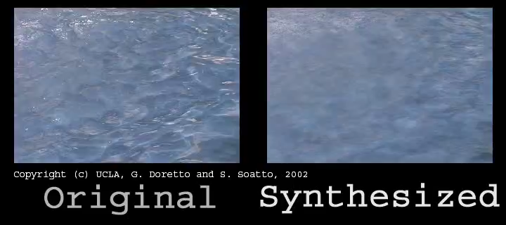
Synthesizing dynamic textures

Slide 73
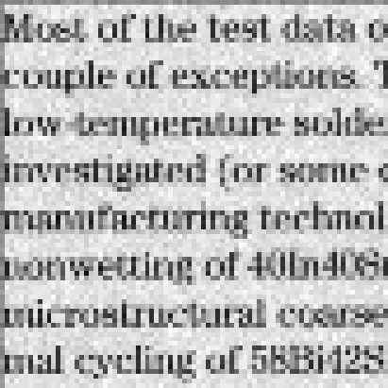
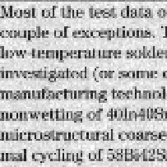
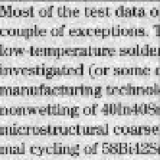
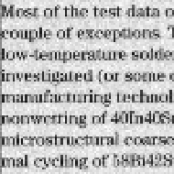
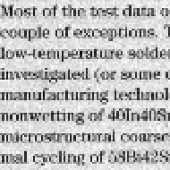




Super-resolution
Example: A set of low quality images
Source: Silvio Savarese

Slide 74

Super-resolution
Each of these images looks like this:
Source: Silvio Savarese

Slide 75

Super-resolution
The recovery result:
Source: Silvio Savarese

Slide 76

Recognizing events and activities
Tracker
Source: Silvio Savarese
D. Ramanan, D. Forsyth, and A. Zisserman. Tracking People by Learning their Appearance. PAMI 2007.

Slide 77

Recognizing events and activities
Juan Carlos Niebles, Hongcheng Wang and Li Fei-Fei, Unsupervised Learning of Human Action Categories Using Spatial-Temporal Words, (BMVC), Edinburgh, 2006.

Slide 78

Recognizing events and activities
Crossing – Talking – Queuing – Dancing – jogging
Source: Silvio Savarese
W. Choi & K. Shahid & S. Savarese WMC 2010
Notes:
15’ from last point

Slide 79

W. Choi, K. Shahid, S. Savarese, "What are they doing? : Collective Activity Classification Using Spatio-Temporal Relationship Among People", 9th International Workshop on Visual Surveillance (VSWS09) in conjuction with ICCV 09

Slide 80

Optical flow without motion!

Slide 81
What we have learned today?
Optical flow
Lucas-Kanade method
Horn-Schunk method
Pyramids for large motion
Common fate
Applications
Reading: [Szeliski] Chapters: 8.4, 8.5
[Fleet & Weiss, 2005]
http://www.cs.toronto.edu/pub/jepson/teaching/vision/2503/opticalFlow.pdf

