Slide 1
Viola-Jones detector and Eigenface
Samuel Cheng
(Slide credits: James Thompkins, Juan Carlos Niebles and Ranjay Krishna)

Slide 2
Face detection

Slide 3
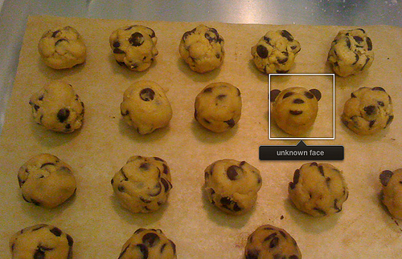
Consumer application: Apple iPhoto
Things iPhoto thinks are faces

Slide 4
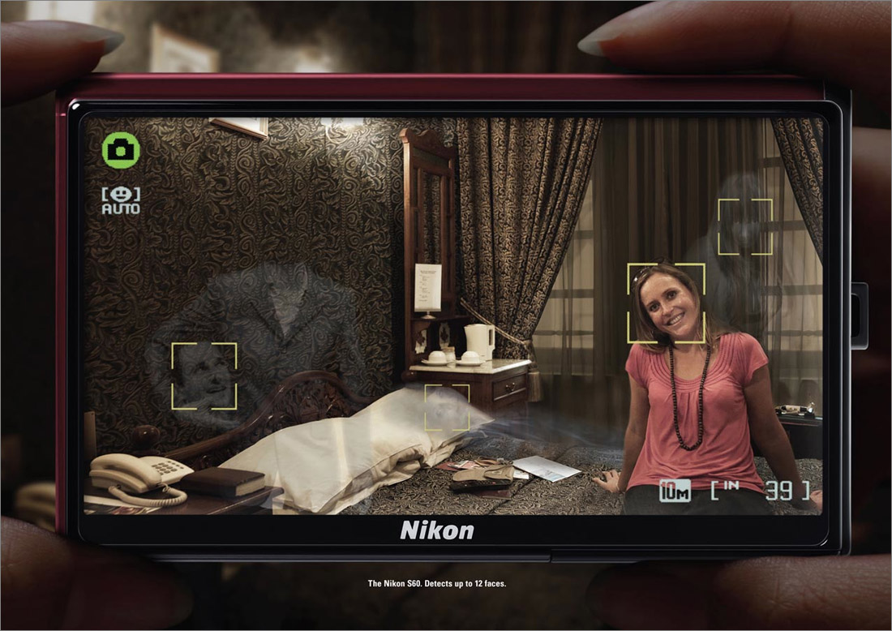
"The Nikon S60 detects up to 12 faces."

Slide 5
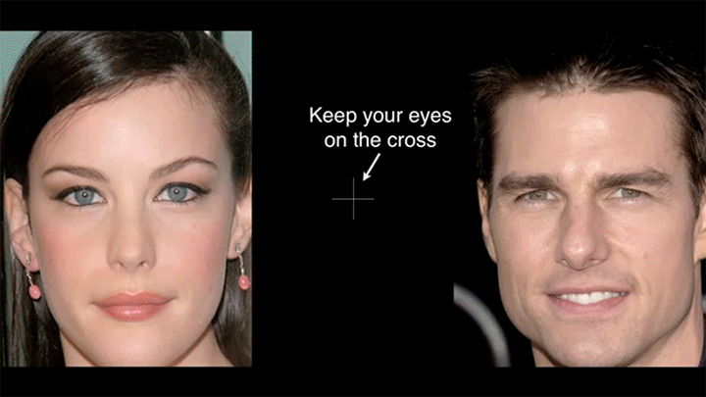
“Flashed Face Distortion”
2nd Place in the 8th Annual Best Illusion of the Year Contest , VSS 2012

Slide 6
Notes:
scary

Slide 7
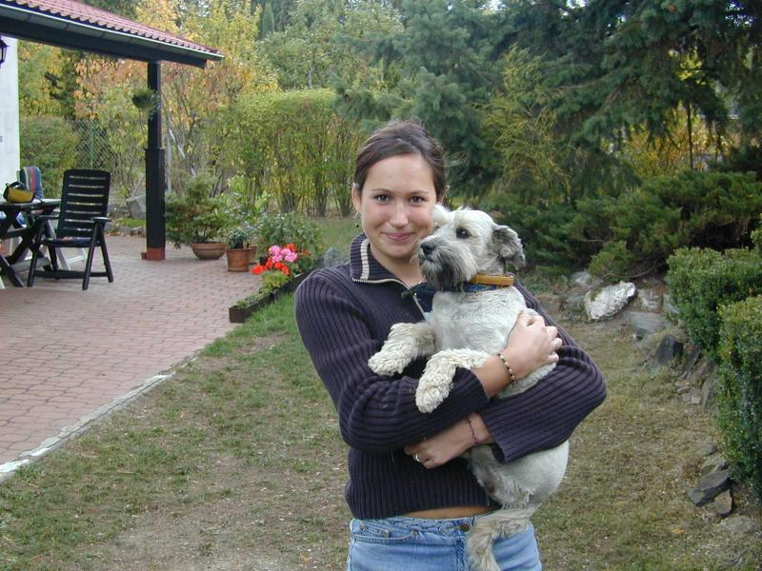
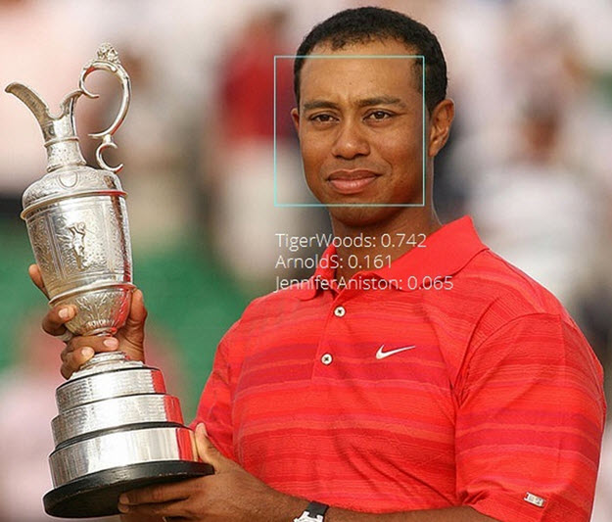

Face detection and recognition
Detection
Recognition
“Sally”

Slide 8
Challenges of face detection
Sliding window = tens of thousands of location/scale evaluations
  One megapixel image has ~10⁶ pixels, and a comparable number of candidate face locations
Faces are rare: 0–10 per image
  For computational efficiency, spend as little time as possible on the non-face windows.
  For 1 Mpix, to avoid having a false positive in every image, our false positive rate has to be less than 10⁻⁶
James Hays

Slide 9
Influential Works in Detection
Sung-Poggio (1994, 1998) : ~2000 citations
  Basic idea of statistical template detection, bootstrapping to get “face-like” negative examples, multiple whole-face prototypes (in 1994)
Rowley-Baluja-Kanade (1996-1998) : ~3600
  “Parts” at fixed position, non-maxima suppression, simple cascade, rotation, pretty good accuracy, fast
Schneiderman-Kanade (1998-2000,2004) : ~1700
  Careful feature engineering, excellent results, cascade
Viola-Jones (2001, 2004) : ~13,000
  Haar-like features, Adaboost as feature selection, hyper-cascade, very fast
Dalal-Triggs (2005) : ~16,000 citations
  Careful feature engineering, excellent results, HOG feature, online code
Felzenszwalb-McAllester-Ramanan (2008): ~4,600 citations
  Template/parts-based blend
Girshick et al. (2013): ~2000 citations
  R-CNN / Fast R-CNN / Faster R-CNN. Deep learned models on object proposals.
James Hays

Slide 10
What we will learn today
Viola-Jones Face Detection
The Eigenfaces Algorithm
Linear Discriminant Analysis (LDA)
P. Viola and M. Jones. Rapid object detection using a boosted cascade of simple features. CVPR 2001.
Turk and Pentland, Eigenfaces for Recognition, Journal of Cognitive Neuroscience 3 (1): 71–86.
P. Belhumeur, J. Hespanha, and D. Kriegman. "Eigenfaces vs. Fisherfaces: Recognition
Using Class Specific Linear Projection". IEEE Transactions on pattern analysis and machine
intelligence 19 (7): 711. 1997.

Slide 11
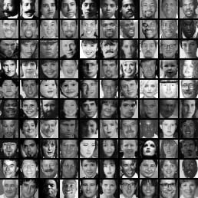
Sliding Window Face Detection with Viola-Jones
P. Viola and M. Jones. Rapid object detection using a boosted cascade of simple features. CVPR 2001.
P. Viola and M. Jones. Robust real-time face detection. IJCV 57(2), 2004.
Many Slides from Lana Lazebnik

Slide 12
The Viola/Jones Face Detector
A seminal approach to real-time object detection.
Training is slow, but detection is very fast
Key ideas:
1. Integral images for fast feature evaluation
2. Boosting for feature selection
3. Attentional cascade for fast non-face window rejection

Slide 13
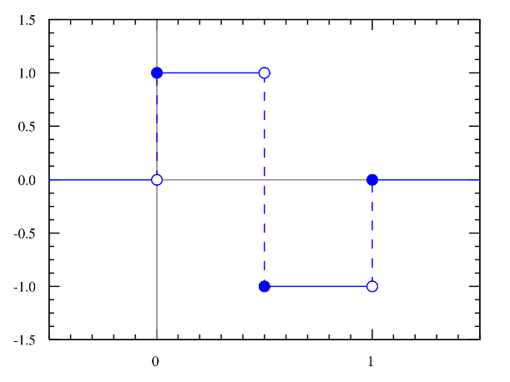
Features that are fast to compute
Haar wavelet
“Haar-like features”
  Differences of sums of intensity
  Computed at different positions and scales
  within sliding window
-1
+1
Two-rectangle features
Three-rectangle features
Etc.
CC BY-SA 3.0, https://commons.wikimedia.org/w/index.php?curid=801361

Slide 14

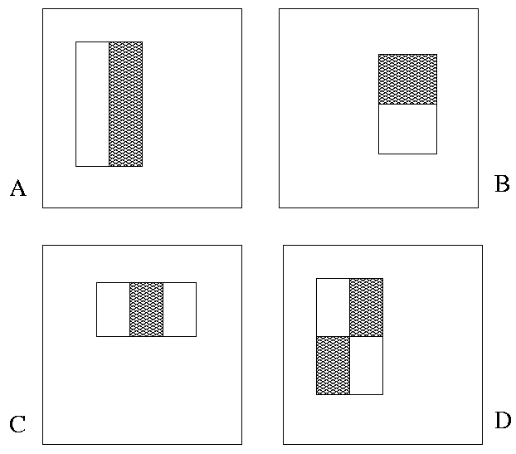
Image Features
“Rectangle filters”
Value = ∑(pixels in white area)
– ∑(pixels in black area)
Notes:
For real problems results are only as good as the features used...
This is the main piece of ad-hoc (or domain) knowledge
Rather than the pixels, we have selected a very large set of simple functions
Sensitive to edges and other critcal features of the image
** At multiple scales
Since the final classifier is a perceptron it is important that the features be non-linear… otherwise the final classifier will be a simple perceptron.
We introduce a threshold to yield binary features
Image: Sadiq Khan; major of London

Slide 15
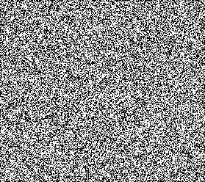



Example
Source
Result

Slide 16


Computing a rectangle feature
Integral Image

Slide 17
But these features are rubbish…!
Yes, individually they are ‘weak classifiers’
Jargon: ‘feature’ and ‘classifier’ are used interchangeably here.
Also with ‘learner’.
But, what if we combine thousands of them…
-1
+1
Two-rectangle features
Three-rectangle features
Etc.
CC BY-SA 3.0, https://commons.wikimedia.org/w/index.php?curid=801361

Slide 18
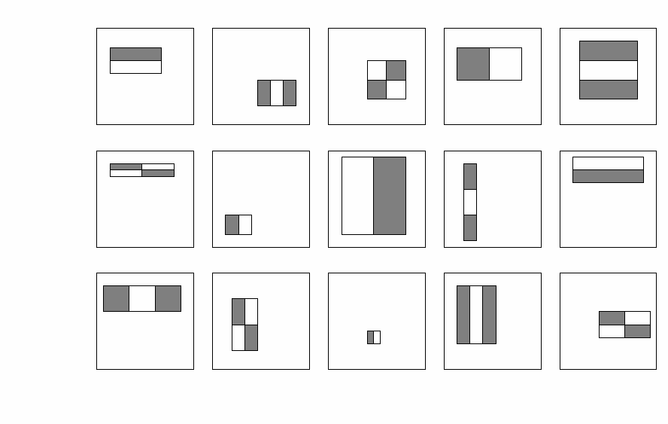
How many features are there?
For a 24x24 detection region, the number of possible rectangle features is ~160,000!
Notes:
So, how many can we get?

Slide 19
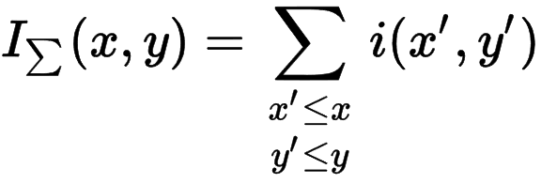
1. Integral images for fast feature evaluation
The integral image computes a value at each pixel (x,y) that is the sum of all pixel values above and to the left of (x,y), inclusive.
This can quickly be computed in one pass through the image.
‘Summed area table’
i(x,y)

Slide 20
Computing the integral image
Image
Region already computed
Current pixel

Slide 21
Computing the integral image
ii(x, y-1)
s(x-1, y)
i(x, y)
Cumulative row sum: s(x, y) = s(x–1, y) + i(x, y)
Integral image: ii(x, y) = ii(x, y−1) + s(x, y)
MATLAB: ii = cumsum(cumsum(double(i)), 2);

Slide 22
Computing sum within a rectangle
Let A,B,C,D be the values of the integral image at the corners of a rectangle
The sum of original image values within the rectangle can be computed as:
  sum = A – B – C + D
D
B
C
A
Only 3 additions are required for any size of rectangle!

Slide 23
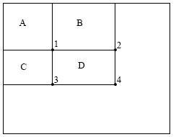
Integral Images
ii = cumsum(cumsum(im, 1), 2)
x, y
ii(x,y) = Sum of the values in the grey region
SUM within Rectangle D is
ii(4) - ii(2) - ii(3) + ii(1)

Slide 24
How many features are there?
For a 24x24 detection region, the number of possible rectangle features is ~160,000!
At test time, it is impractical to evaluate the entire feature set.
Can we learn a ‘strong classifier’ using just a small subset of all possible features?

Slide 25
2. Boosting for feature selection
Initially, weight each training example equally.
Weight = size of point
Slide credit: Paul Viola

Slide 26
2. Boosting for feature selection
In each boosting round:
Find the weak classifier
that achieves the lowest
weighted training error.
Raise the weights of
training examples
misclassified by
current weak classifier.
Round 1:
Weak
Classifier 1
Slide credit: Paul Viola

Slide 27
Boosting illustration
In each boosting round:
Find the weak classifier
that achieves the lowest
weighted training error.
Raise the weights of
training examples
misclassified by
current weak classifier.
Round 1:
Weights
Increased

Slide 28
Boosting illustration
In each boosting round:
Find the weak classifier
that achieves the lowest
weighted training error.
Raise the weights of
training examples
misclassified by
current weak classifier.
Round 2:
Weak
Classifier 2

Slide 29
Boosting illustration
In each boosting round:
Find the weak classifier
that achieves the lowest
weighted training error.
Raise the weights of
training examples
misclassified by
current weak classifier.
Round 2:
Weights
Increased

Slide 30
Boosting illustration
In each boosting round:
Find the weak classifier
that achieves the lowest
weighted training error.
Raise the weights of
training examples
misclassified by
current weak classifier.
Round 3:
Weak
Classifier 3

Slide 31
Boosting illustration
Round 3:
Compute final classifier as linear combination of all weak classifier.
Weight of each classifier is directly proportional to its accuracy.
Exact formulas for re-weighting and combining weak learners depend on the particular boosting scheme (e.g., AdaBoost).
Y. Freund and R. Schapire, A short introduction to boosting,
Journal of Japanese Society for Artificial Intelligence, 14(5):771-780, September, 1999.

Slide 32
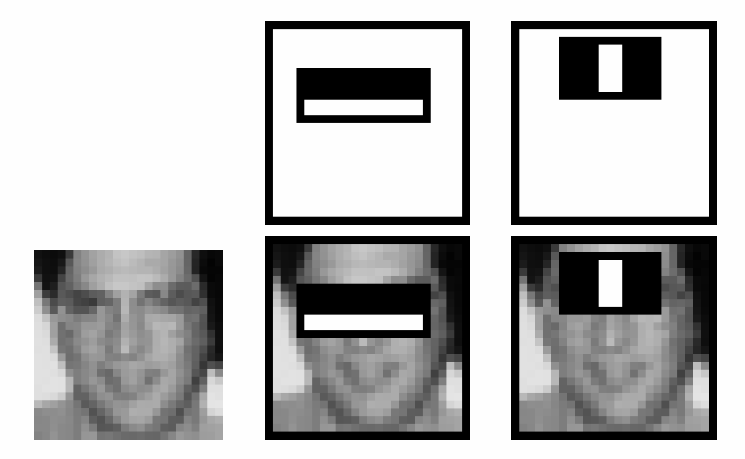
Boosting for face detection
First two features selected by boosting:
This feature combination can yield 100% recall and 50% precision

Slide 33
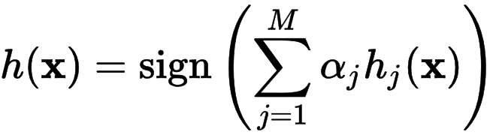
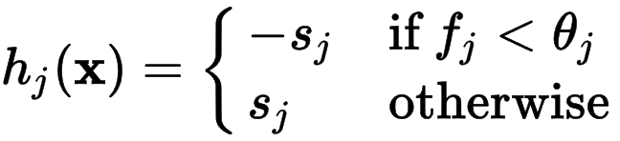

Feature selection with boosting
Create a large pool of features (180K)
Select discriminative features that work well together
  “Weak learner” = feature + threshold + ‘polarity’
  Choose weak learner that minimizes error on the weighted training set, then reweight
Weak learner
Final strong learner
window
Learner weight
value of rectangle feature
threshold
‘polarity’ = black or white region flip

Slide 34
2. Boosting for feature selection
Boosting is a learning scheme that combines weak learners into a more accurate ensemble classifier
Weak learners based on rectangle filters:
Ensemble classification function:
value of rectangle feature
parity
threshold
window
learned weights
Notes:
What is the point of the parity p if we have alpha weights anyway?

Slide 35
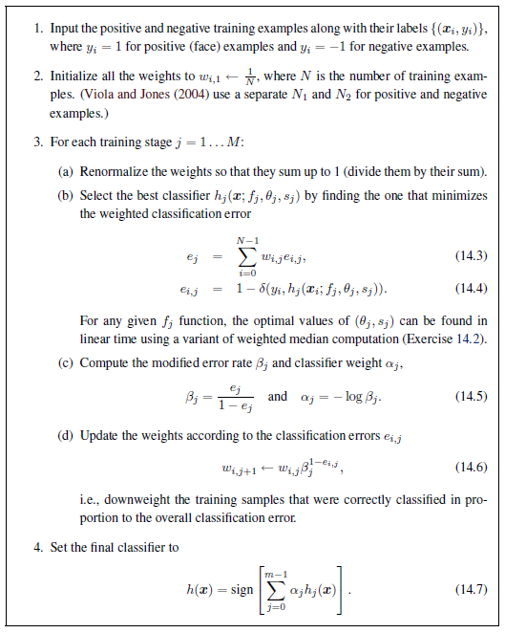
Adaboost pseudocode
Szeliski p665

Slide 36
Boosting vs. SVM
Advantages of boosting
  Integrates classifier training with feature selection
  Flexibility in the choice of weak learners, boosting scheme
  Testing is fast
Disadvantages
  Needs many training examples
  Training is slow
  Often doesn’t work as well as SVM (especially for many-class problems)
Notes:
Complexity of training for boosting is linear instead of quadratic in the number of training examples

Slide 37
Cascade for Fast Detection
Fast classifiers early in cascade which reject many negative examples but detect almost all positive examples.
Slow classifiers later, but most examples don’t get there.
Stage 1
h₁(x) > t₁?
Yes
Stage 2
h₂(x) > t₂?
Stage N
h_{n}(x) > t_{n}?
Yes
…
Pass
No
No
No
Examples
Reject
Reject
Reject

Slide 38
Attentional cascade
Chain classifiers that are progressively more complex and have lower false positive rates:
Receiver operating characteristic
% False Pos
0
50
vs
false
neg
determined by
0 100
% True positive
T
T
T
IMAGE
SUB-WINDOW
T
FACE
Classifier 1
Classifier 2
Classifier 3
F
F
F
NON-FACE
NON-FACE
NON-FACE
Notes:
In general simple classifiers, while they are more efficient, they are also weaker.
We could define a computational risk hierarchy (in analogy with structural risk minimization)…
A nested set of classifier classes
The training process is reminiscent of boosting…
- previous classifiers reweight the examples used to train subsequent classifiers
The goal of the training process is different
- instead of minimizing errors minimize false positives

Slide 39
Attentional cascade
The detection rate and the false positive rate of the cascade are found by multiplying the respective rates of the individual stages
A detection rate of 0.9 and a false positive rate on the order of 10⁻⁶ can be achieved by a
10-stage cascade if each stage has a detection rate of 0.99 (0.99¹⁰ ≈ 0.9) and a false positive rate of about 0.30 (0.3¹⁰ ≈ 6×10⁻⁶)
T
T
T
IMAGE
SUB-WINDOW
T
FACE
Classifier 1
Classifier 2
Classifier 3
F
F
F
NON-FACE
NON-FACE
NON-FACE

Slide 40
Training the cascade
Set target detection and false positive rates for each stage
Add new features to the current stage
  Test on a validation set
  Both detection and false positive rates should decrease
  May need to lower boosting threshold to increase detection rate
If the overall false positive rate is not low enough, then add another stage
Keep false positives from current stage to train the next stage

Slide 41

The implemented system
Training Data
  5000 faces
    All frontal, rescaled to
    24x24 pixels
  300 million non-faces
    9500 non-face images
  Faces are normalized
    Scale, translation
Many variations
  Across individuals
  Illumination
  Pose
Notes:
This situation with negative examples is actually quite common… where negative examples are free.

Slide 42
Viola-Jones details
38 stages with 1, 10, 25, 50 … features
  6061 total used out of 180K candidates
  10 features evaluated on average
Training Examples
  4916 positive examples
  10000 negative examples per stage
Scanning
  Scale detector rather than image
  Scale steps = 1.25 (factor between two consecutive scales)
  Translation step = 1*scale (# pixels between two consecutive windows)
Non-max suppression: average coordinates of overlapping boxes
Train 3 classifiers and take vote

Slide 43
System performance
Training time: “weeks” on 466 MHz Sun workstation
38 cascade layers, total of 6061 features
Average of 10 features evaluated per window on test set
“On a 700 Mhz Pentium III processor, the face detector can process a 384 by 288 pixel image in about .067 seconds”
  15 Hz
  15 times faster than previous detector
  of comparable accuracy (Rowley et al., 1998)

Slide 44
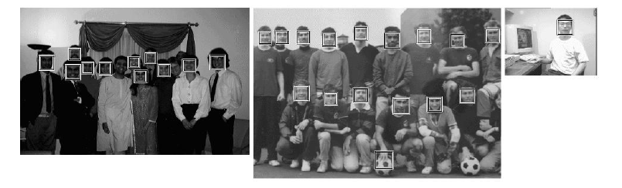
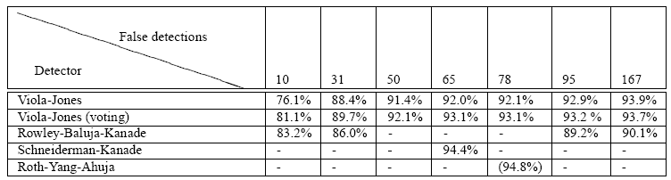
Viola Jones Results
Speed = 15 FPS (in 2001)
MIT + CMU face dataset

Slide 45
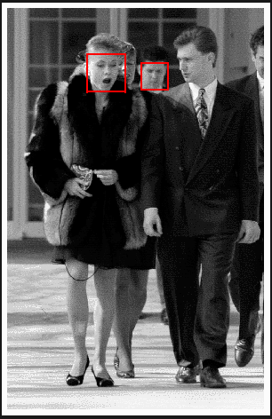
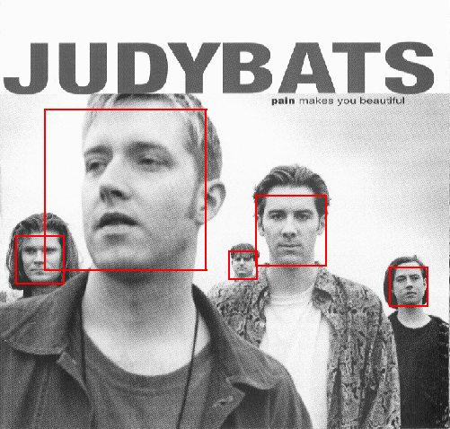
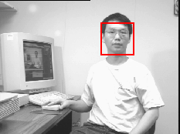
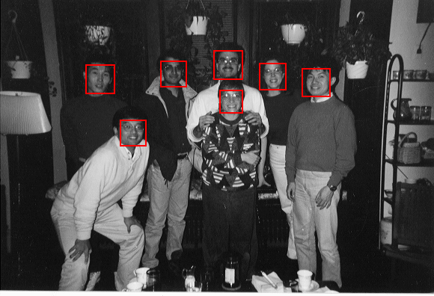
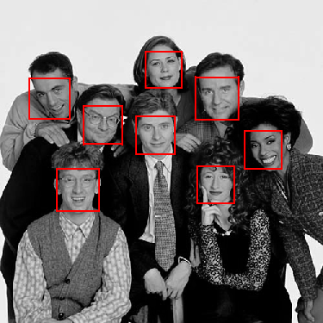
Output of Face Detector on Test Images
Notes:
Newsroom

Slide 46
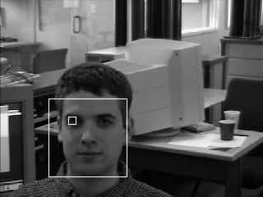
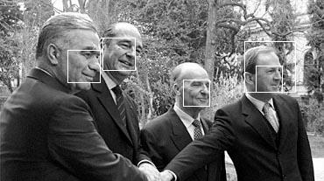
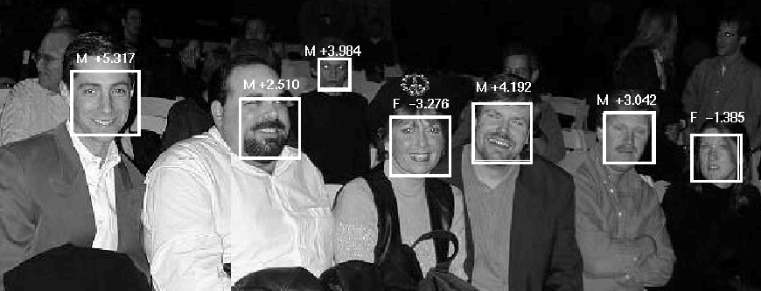
Other detection tasks
Facial Feature Localization
Profile Detection
Male vs.
female

Slide 47
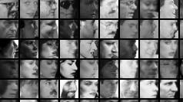
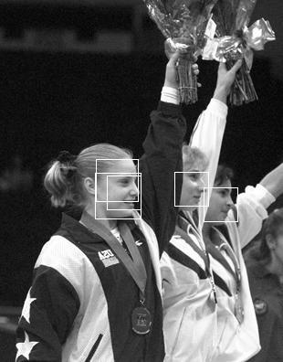
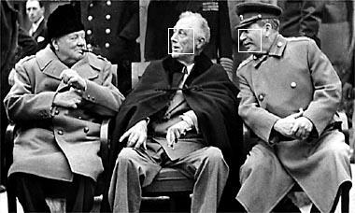
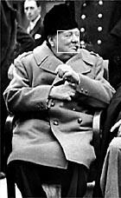
Profile (non-frontal) Detection

Slide 48
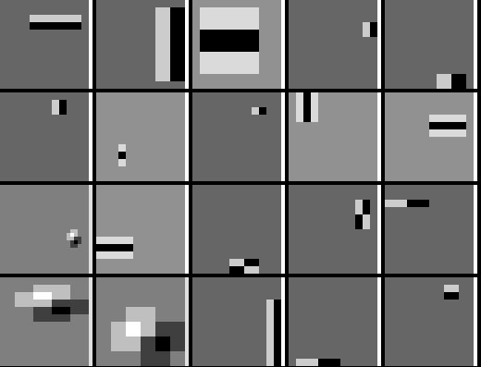
Profile Features

Slide 49
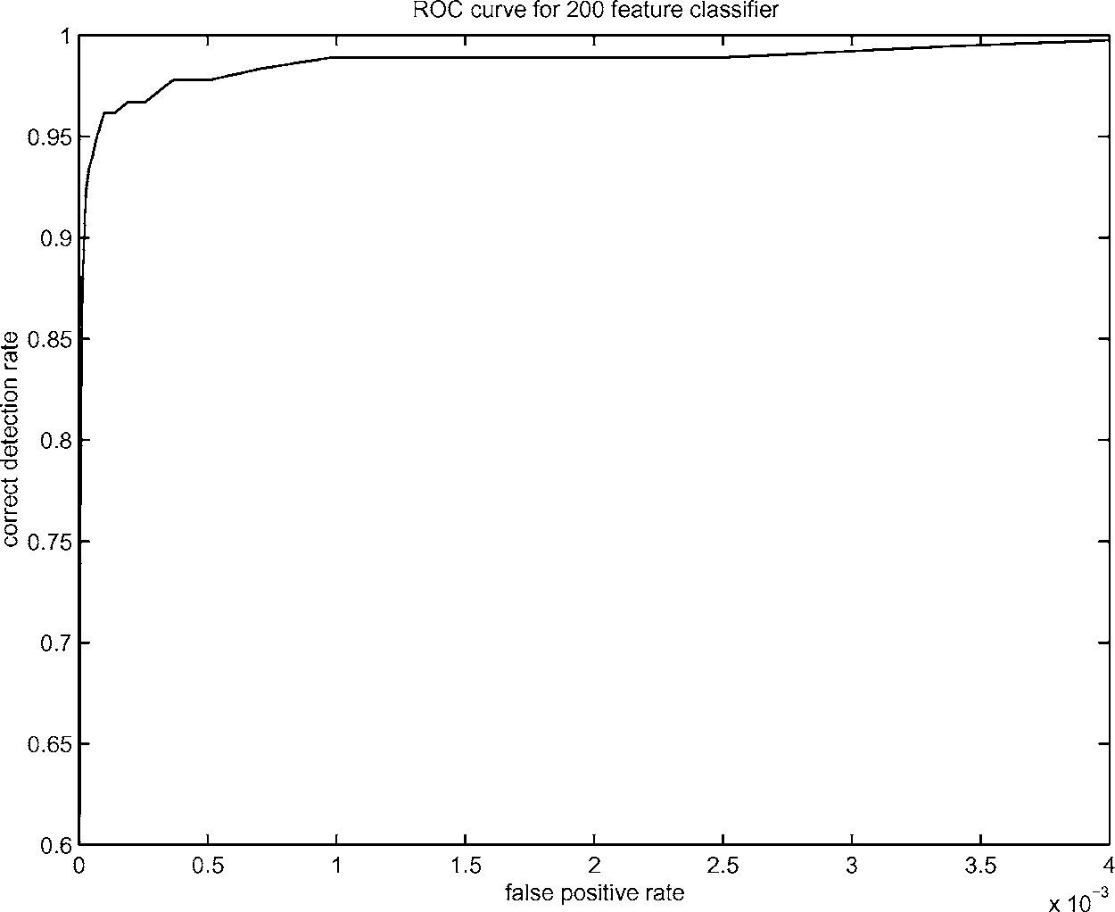
Boosting for face detection
A 200-feature classifier can yield 95% detection rate and a false positive rate of 1 in 14084
True positive rate
Not good enough!
Receiver operating characteristic (ROC) curve

Slide 50
Live demo

Slide 51
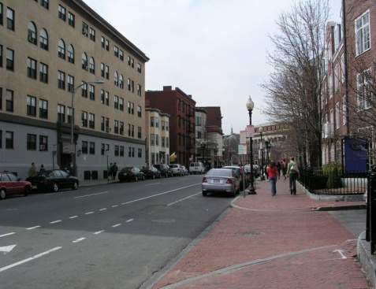
Summary: Viola Jones
Sliding window for search
Features based on differences of intensity (gradient, wavelet, etc.)
  Excellent results = careful feature design
Boosting for feature selection
Integral images, cascade for speed
Stage 1
H₁(x) > t₁?
Yes
Stage 2
H₂(x) > t₂?
…
Stage N
H_{N}(x) > t_{N}?
Yes
Pass
Examples
No
No
No
Reject
Reject
Reject

Slide 52
What we will learn today
Viola-Jones Face Detection
The Eigenfaces Algorithm
Linear Discriminant Analysis (LDA)
P. Viola and M. Jones. Rapid object detection using a boosted cascade of simple features. CVPR 2001.
Turk and Pentland, Eigenfaces for Recognition, Journal of Cognitive Neuroscience 3 (1): 71–86.
P. Belhumeur, J. Hespanha, and D. Kriegman. "Eigenfaces vs. Fisherfaces: Recognition
Using Class Specific Linear Projection". IEEE Transactions on pattern analysis and machine
intelligence 19 (7): 711. 1997.

Slide 53
Detection versus Recognition
Detection finds the faces in images
Recognition recognizes WHO the person is

Slide 54
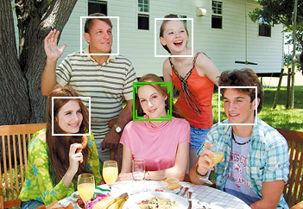
Face Recognition
Digital photography

Slide 55
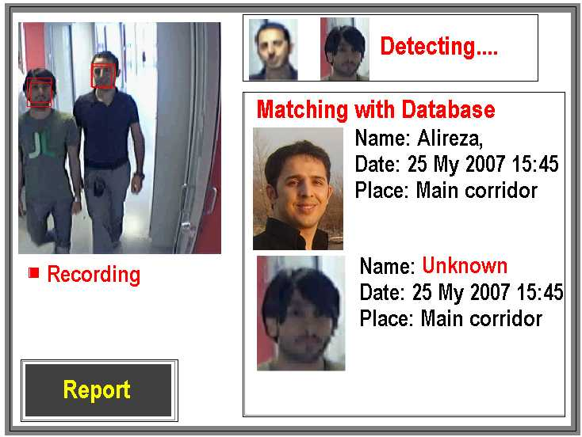
Face Recognition
Digital photography
Surveillance

Slide 56
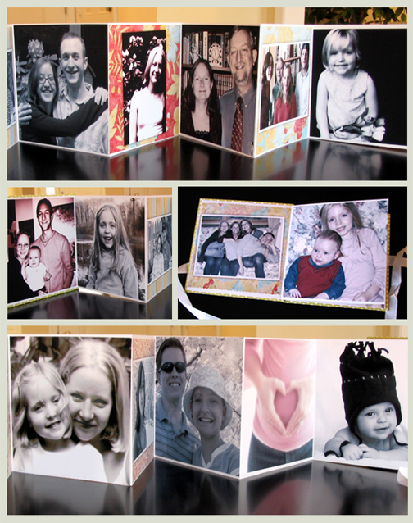
Face Recognition
Digital photography
Surveillance
Album organization

Slide 57
Face Recognition
Digital photography
Surveillance
Album organization
Person tracking/id.

Slide 58
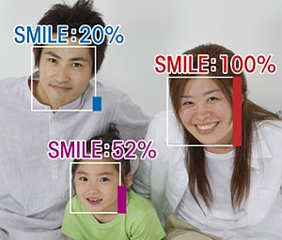
Face Recognition
Digital photography
Surveillance
Album organization
Person tracking/id.
Emotions and expressions

Slide 59
Face Recognition
Digital photography
Surveillance
Album organization
Person tracking/id.
Emotions and expressions
Security/warfare
Tele-conferencing
Etc.

Slide 60
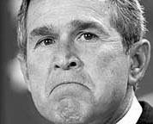

The Space of Faces
An image is a point in a high dimensional space
  If represented in grayscale intensity, an N x M image is a point in R^{NM}
  E.g. 100x100 image = 10,000 dim
Slide credit: Chuck Dyer, Steve Seitz, Nishino

Slide 61
100x100 images can contain many things other than faces!

Slide 62
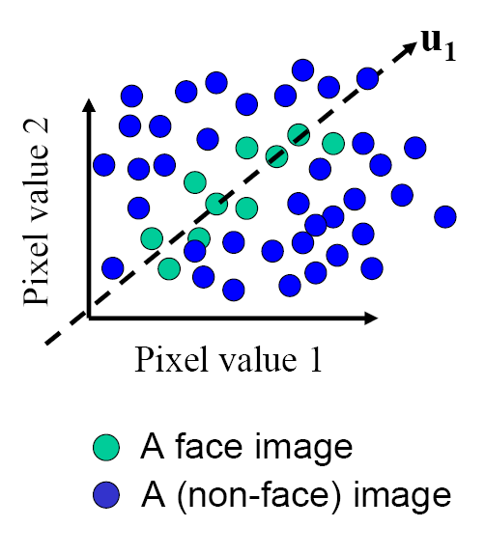
The Space of Faces
ɸ₁
An image is a point in a high dimensional space
  If represented in grayscale intensity, an N x M image is a point in R^{NM}
  E.g. 100x100 image = 10,000 dim
However, relatively few high dimensional vectors correspond to valid face images
We want to effectively model the subspace of face images
Slide credit: Chuck Dyer, Steve Seitz, Nishino

Slide 63
Where have we seen something like this before?
ɸ₁

Slide 64
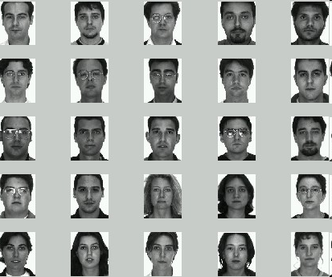
Image
space
Face space
  Compute n-dim subspace such that the projection of the data points onto the subspace has the largest variance among all n-dim subspaces.
Maximize the scatter of the training images in face space

Slide 65
Key Idea
So, compress them to a low-dimensional subspace that
captures key appearance characteristics of the visual DOFs.
USE PCA for estimating the sub-space
(dimensionality reduction)
Compare two faces by projecting the images into the subspace and measuring the EUCLIDEAN distance between them.

Slide 66
Eigenfaces: key idea
Assume that most face images lie on a low-dimensional subspace determined by the first k (k<<d) directions of maximum variance
Use PCA to determine the vectors or “eigenfaces” that span that subspace
Represent all face images in the dataset as linear combinations of eigenfaces
M. Turk and A. Pentland, Face Recognition using Eigenfaces, CVPR 1991

Slide 67
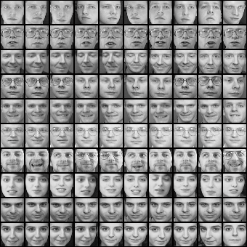
Training images: x₁,…,x_{N}

Slide 68
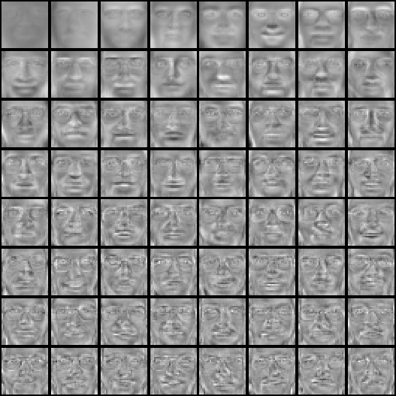

Top eigenvectors: ɸ₁,…,ɸ_{k}
Mean: μ

Slide 69
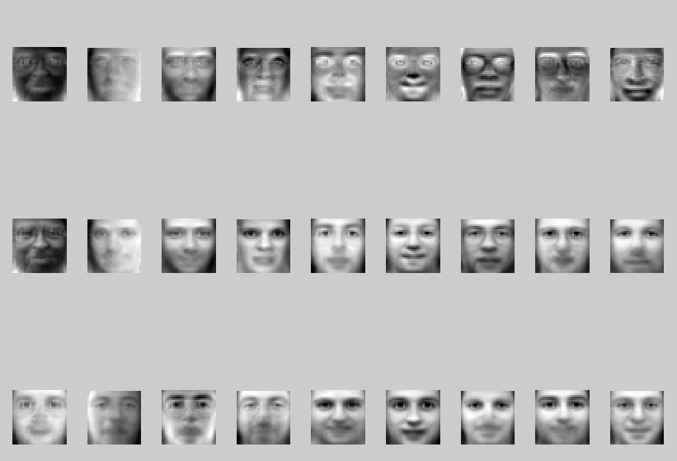
Visualization of eigenfaces
Principal component (eigenvector) ɸ_{k}
μ + 3σ_{k}ɸ_{k}
μ – 3σ_{k}ɸ_{k}

Slide 70
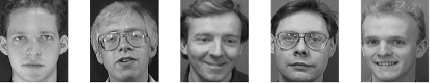
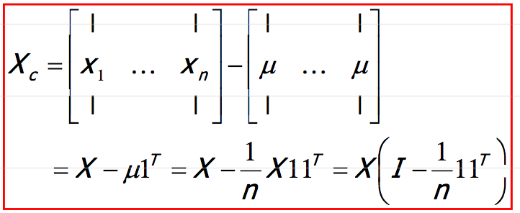
Eigenface algorithm
Training
  Align training images x₁, x₂, …, x_{N}
  Compute average face
  Compute the difference image (the centered data matrix)
Note that each image is formulated into a long vector!

Slide 71
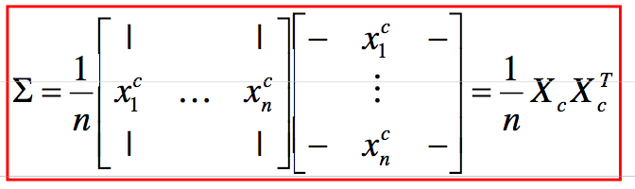
Eigenface algorithm
  Compute the covariance matrix
  Compute the eigenvectors of the covariance matrix Σ
  Compute each training image x_{i} ‘s projections as
  Visualize the estimated training face x_{i}

Slide 72
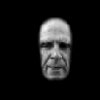
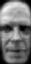











Eigenface algorithm
  Compute each training image x_{i} ‘s projections as
  Visualize the estimated training face x_{i}
$$x_{i}$$
Reconstructed training face

Slide 73
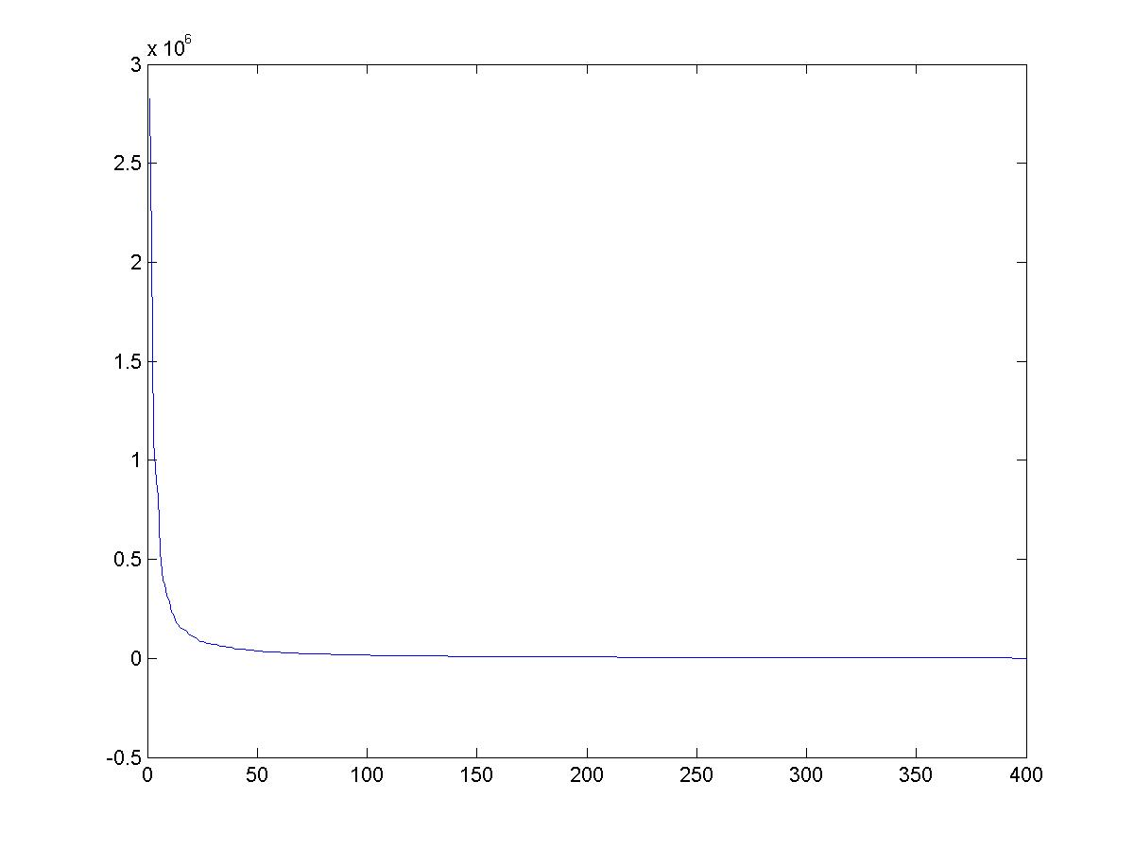
Eigenvalues (variance along eigenvectors)

Slide 74
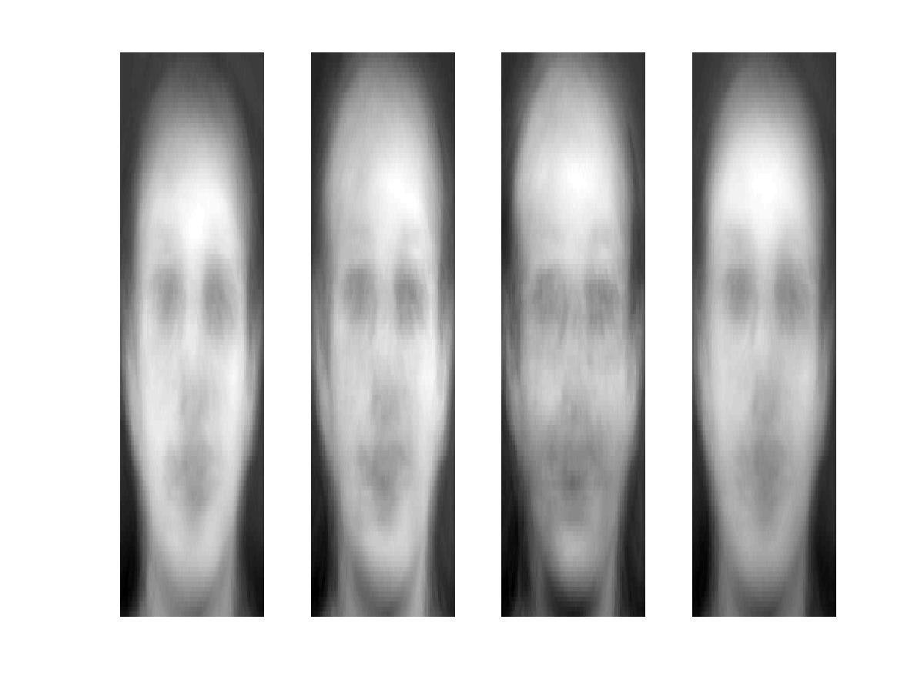


Reconstruction and Errors
K = 4
K = 200
K = 400
Only selecting the top K eigenfaces → reduces the dimensionality.
Fewer eigenfaces result in more information loss, and hence less discrimination between faces.

Slide 75
Eigenface algorithm
Testing
  Take query image t
  Project into eigenface space and compute projection
  Compare projection w with all N training projections
    Simple comparison metric: Euclidean (Mahalanlobis distance will help)
    Simple decision: K-Nearest Neighbor
    (note: this “K” refers to the k-NN algorithm, is different from the previous K’s referring to the # of principal components)

Slide 76

Visualization of eigenfaces
Eigenfaces look somewhat like generic faces.

Slide 77
Besides face recognitions, we can also do
Facial expression recognition

Slide 78

Happiness subspace (method A)

Slide 79

Disgust subspace (method A)

Slide 80



Facial Expression Recognition
Movies (method A)

Slide 81
Shortcomings
Requires carefully controlled data:
  All faces centered in frame
  Same size
  Some sensitivity to angle
Alternative:
  “Learn” one set of PCA vectors for each angle
  Use the one with lowest error
Method is completely knowledge free
  (sometimes this is good!)
  Doesn’t know that faces are wrapped around 3D objects (heads)
Notes:
Makes no effort to preserve class distinctions

Slide 82
Summary for Eigenface
Pros
Non-iterative, globally optimal solution
Limitations
PCA projection is optimal for reconstruction from a low dimensional basis, but may NOT be optimal for discrimination…

Slide 83
What we will learn today
Viola-Jones Face Detection
The Eigenfaces Algorithm
Linear Discriminant Analysis (LDA)
P. Viola and M. Jones. Rapid object detection using a boosted cascade of simple features. CVPR 2001.
Turk and Pentland, Eigenfaces for Recognition, Journal of Cognitive Neuroscience 3 (1): 71–86.
P. Belhumeur, J. Hespanha, and D. Kriegman. "Eigenfaces vs. Fisherfaces: Recognition
Using Class Specific Linear Projection". IEEE Transactions on pattern analysis and machine
intelligence 19 (7): 711. 1997.

Slide 84
Which direction will is the first principle component?

Slide 85

Fischer’s Linear Discriminant Analysis
Goal: find the best separation between two classes
Slide inspired by N. Vasconcelos
Notes:
We explicitly would like to use the label information when doing the project. This is something that PCA does not do. PCA is an unsupervised dimensionality reduction. We want to use the labels to also do the projections.

Slide 86
Difference between PCA and LDA
PCA preserves maximum variance
LDA preserves discrimination
  Find projection that maximizes scatter between classes and minimizes scatter within classes

Slide 87
Illustration of the Projection
Using two classes as example:
x2
x2
x1
x1
Poor Projection
Good

Slide 88
Basic intuition: PCA vs. LDA

Slide 89




LDA with 2 variables
We want to learn a projection W such that the projection converts all the points from x to a new space (For this example, assume m == 1):
Let the per class means be:
And the per class covariance matrices be:
We want a projection that maximizes:
$$z=w^{T}x$$

Slide 90
Fischer’s Linear Discriminant Analysis
Between class scatter
Within class scatter
Slide inspired by N. Vasconcelos
Notes:
We explicitly would like to use the label information when doing the project. This is something that PCA does not do. PCA is an unsupervised dimensionality reduction. We want to use the labels to also do the projections.

Slide 91
LDA with 2 variables
The following objective function:
Can be written as

Slide 92


LDA with 2 variables
We can write the between class scatter as:
Also, the within class scatter becomes:

Slide 93

LDA with 2 variables
We can plug in these scatter values to our objective function:
And our objective becomes:
Slide inspired by N. Vasconcelos

Slide 94
LDA with 2 variables
The scatter variables
Slide inspired by N. Vasconcelos

Slide 95
Visualization
x2
Within class scatter
x1
Between class scatter

Slide 96



Linear Discriminant Analysis (LDA)
Maximizing the ratio
Is equivalent to maximizing the numerator while keeping the denominator constant, i.e.
And can be accomplished using Lagrange multipliers, where we define the Lagrangian as
And maximize with respect to both w and λ
Slide inspired by N. Vasconcelos

Slide 97




Linear Discriminant Analysis (LDA)
Setting the gradient of
With respect to w to zeros we get
or
This is a generalized eigenvalue problem
The solution is easy when exists
Slide inspired by N. Vasconcelos

Slide 98




Linear Discriminant Analysis (LDA)
In this case
And using the definition of S_{B}
Noting that (μ₁-μ₀)^{T}w=α is a scalar this can be written as
and since we don’t care about the magnitude of w

Slide 99
LDA with N variables and C classes

Slide 100


Variables
N Sample images:
C classes:
Average of each class:
Average of all data:

Slide 101
Scatter Matrices
Scatter of class i:
Within class scatter:
Between class scatter:

Slide 102

Mathematical Formulation
Recall that we want to learn a projection W such that the projection converts all the points from x to a new space z:
After projection:
  Between class scatter
  Within class scatter
So, the objective becomes:
$$z=w^{T}x$$

Slide 103
Mathematical Formulation
Solve generalized eigenvector problem:

Slide 104
Mathematical Formulation
Solution: Generalized Eigenvectors
Rank of W_{opt} is bounded by
  Rank(S_{B}) <= C-1
  Rank(S_{W}) <= N-C

Slide 105
PCA vs. LDA
Eigenfaces exploit the max scatter of the training images in face space
Fisherfaces attempt to maximise the between class scatter, while minimising the within class scatter.

Slide 106
Basic intuition: PCA vs. LDA

Slide 107

Results: Eigenface vs. Fisherface
Input: 160 images of 16 people
Train: 159 images
Test: 1 image
Variation in Facial Expression, Eyewear, and Lighting
With glasses
Without glasses
3 Lighting conditions
5 expressions

Slide 108

Eigenface vs. Fisherface

Slide 109
What we have learned today
Introduction to face recognition
The Eigenfaces Algorithm
Linear Discriminant Analysis (LDA)
Turk and Pentland, Eigenfaces for Recognition, Journal of Cognitive Neuroscience 3 (1): 71–86.
P. Belhumeur, J. Hespanha, and D. Kriegman. "Eigenfaces vs. Fisherfaces: Recognition
Using Class Specific Linear Projection". IEEE Transactions on pattern analysis and machine
intelligence 19 (7): 711. 1997.

