Slide 1
Edge Detection
Samuel Cheng
Slide credits: James Hays, Lana Lazebnik, Steve Seitz, David Forsyth, David Lowe, Fei-Fei Li, and Derek Hoiem

Slide 2
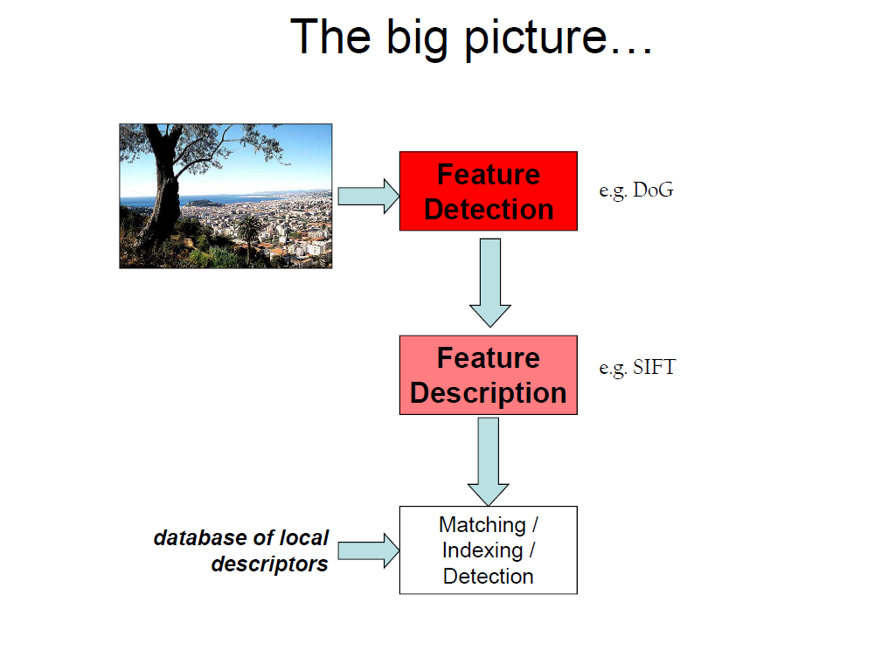
Fei Fei Li

Slide 3
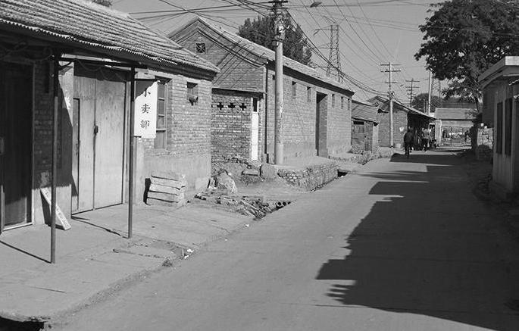

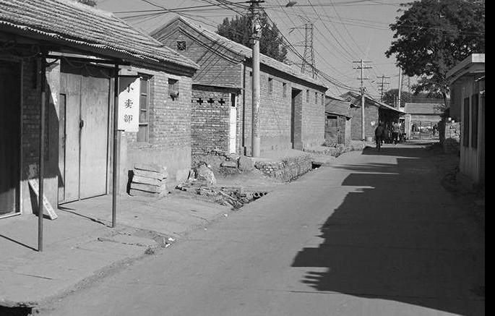
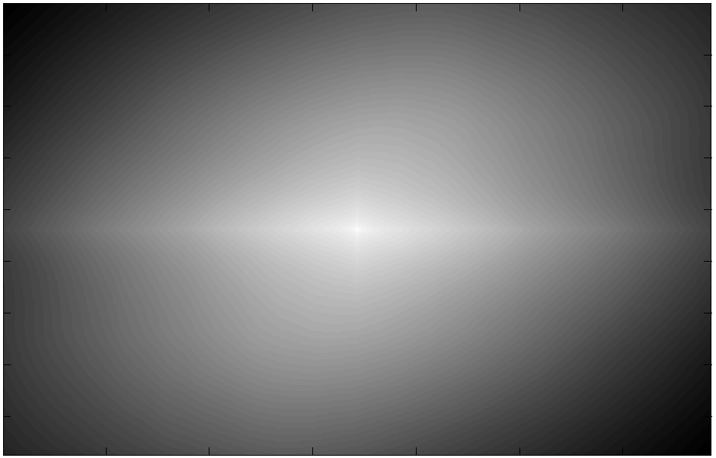
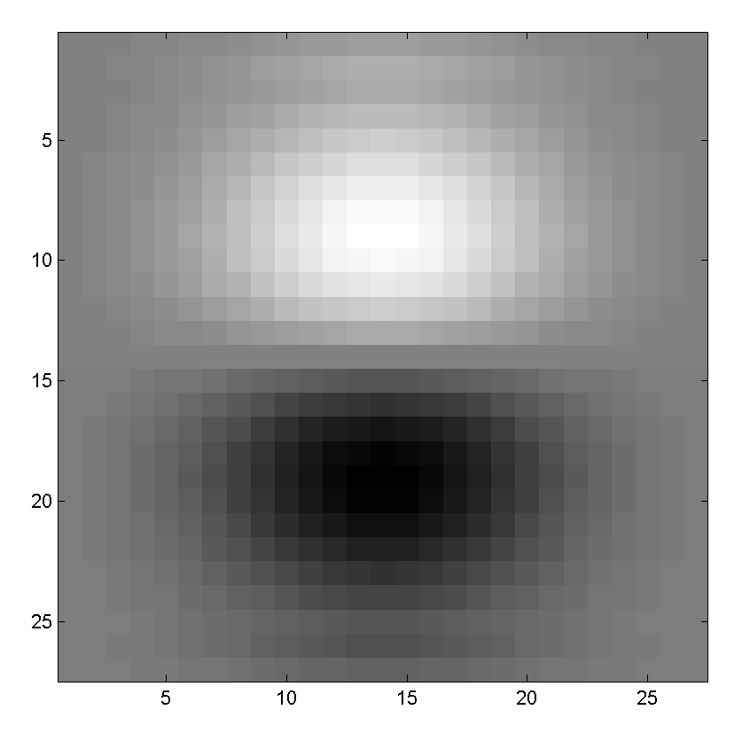
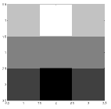
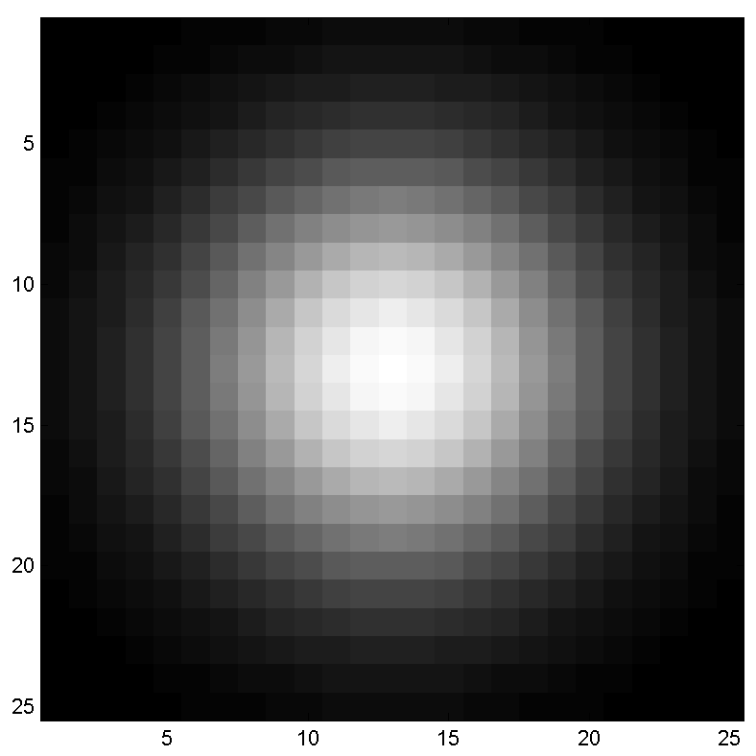
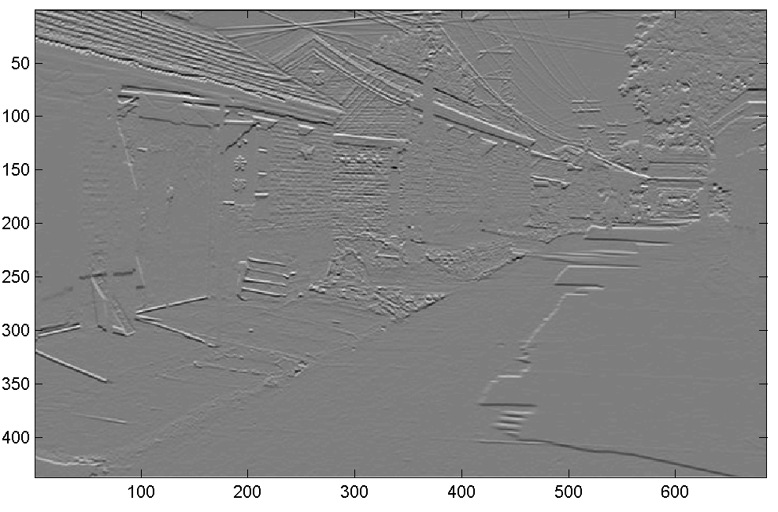
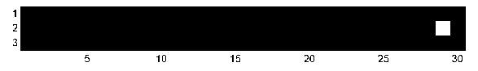
Think-Pair-Share
* = Convolution operator
a) _ = D * B
b) A = _ * _
c) F = D * _
d) _ = D * D
D
H
F
I
A
B
C
G
E
Hoiem
Notes:
a) G = D * B
b) A = B * C
c) F = D * E
d) I = D * D

Slide 4
What we will learn today
Edge detection
Image Gradients
Derivative of Gaussian
Sobel edge detector
Canny edge detector

Slide 5


Slide 6
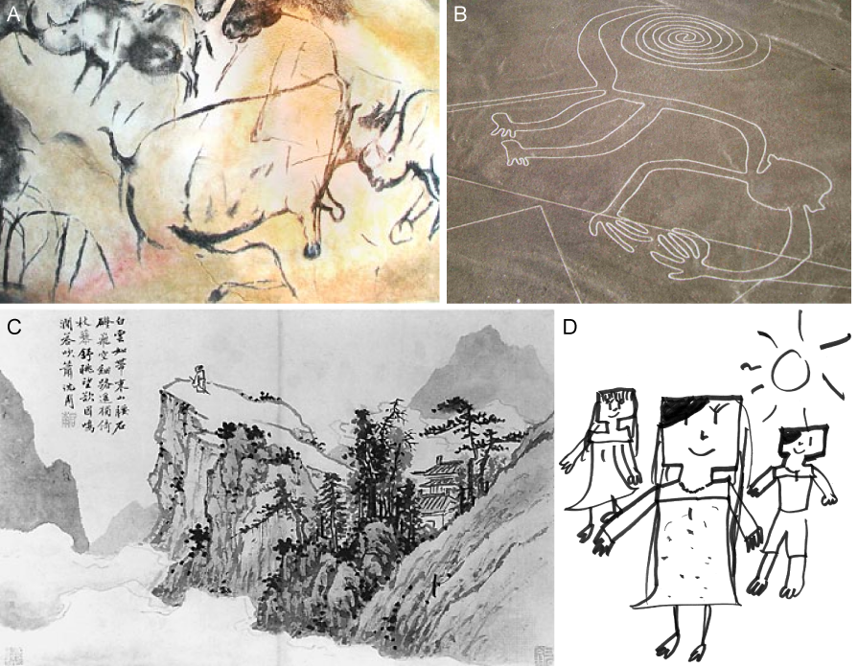
Cave painting at Chauvet, France, about 30,000 B.C.;
Aerial photograph of the picture of a monkey as part of the Nazca Lines geoglyphs, Peru, about 700 – 200 B.C.;
Shen Zhou (1427-1509 A.D.): Poet on a mountain top, ink on paper, China;
Line drawing by 7-year old I. Lleras (2010 A.D.).
Notes:
Edges are significant local changes in the image and are important features for analyzing images. Edges typically occur on the boundary between two different regions in an image.

Slide 7
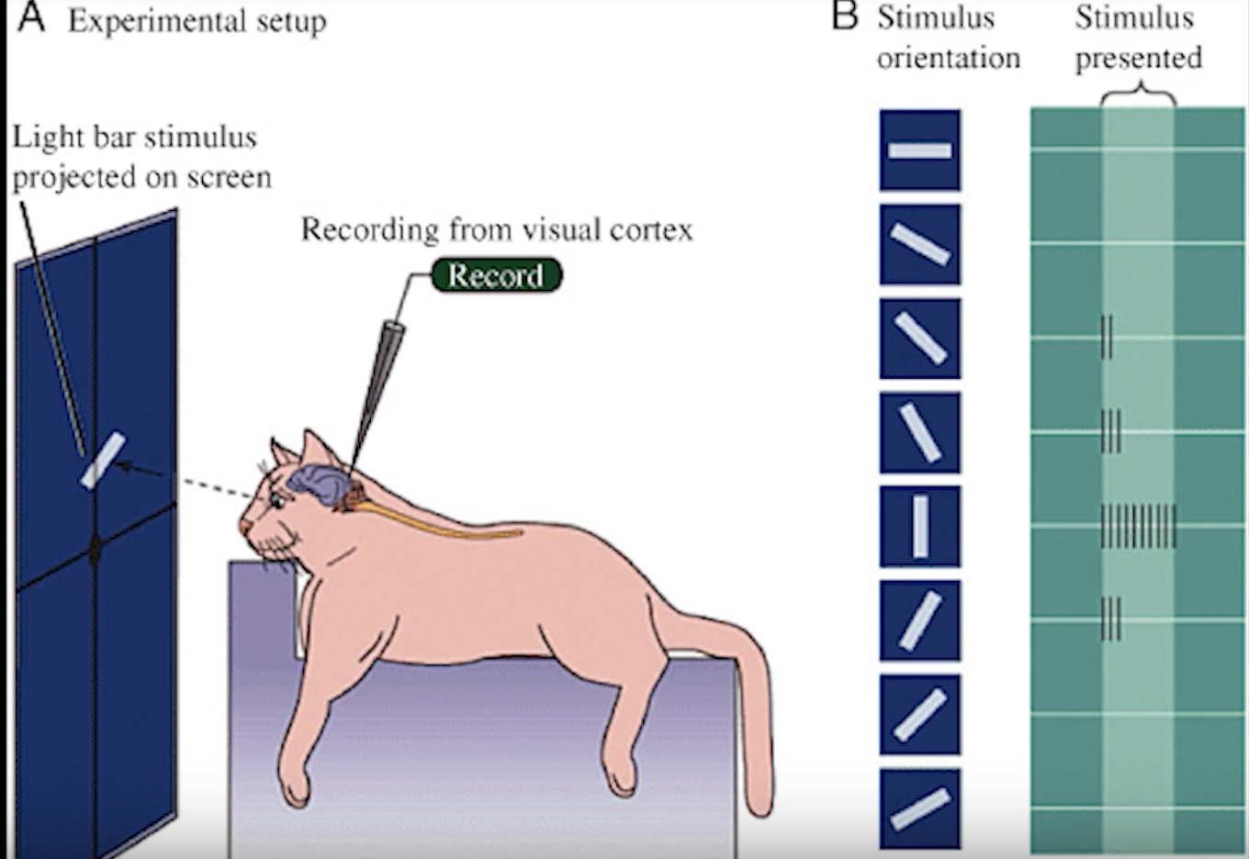
Hubel & Wiesel, 1960s

Slide 8
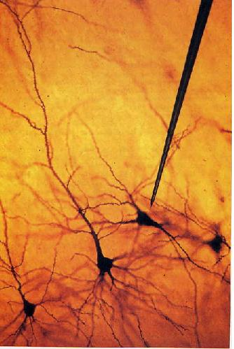
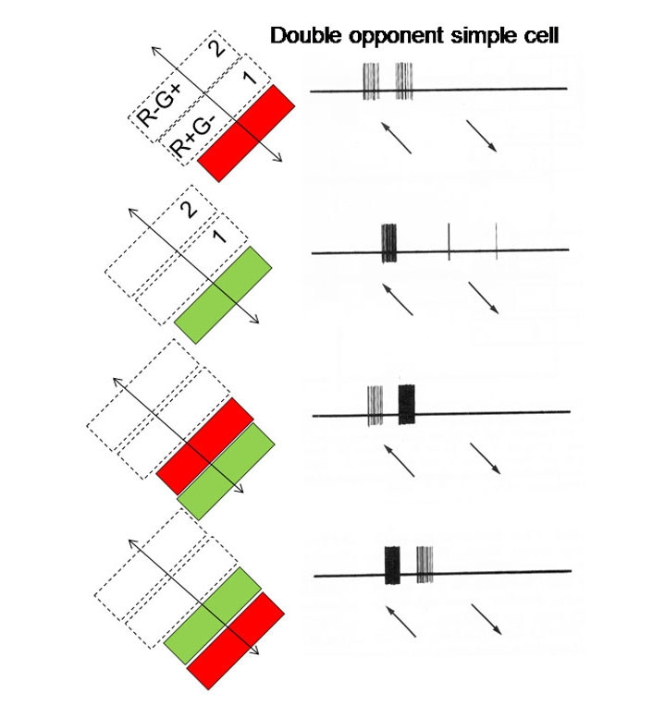
We know edges are special from human (mammalian) vision studies
Hubel & Wiesel, 1960s
Notes:
Hubel and Wiesel started out by trying to get neurons in the visual cortex to respond to traditional visual stimuli such as dots. They had little success. No matter the size or position of the circles, their neurons just couldn’t care less. Then one day while they were recording from yet another stubbornly silent neuron, it suddenly started firing like crazy as they changed the projection slide that they were using to present the stimuli. Turns out, the cell was responding to the edge of the slide. That’s when Hubel and Wiesel discovered that there are cells specialized for detecting lines—a basic feature of the visual world.

Slide 9
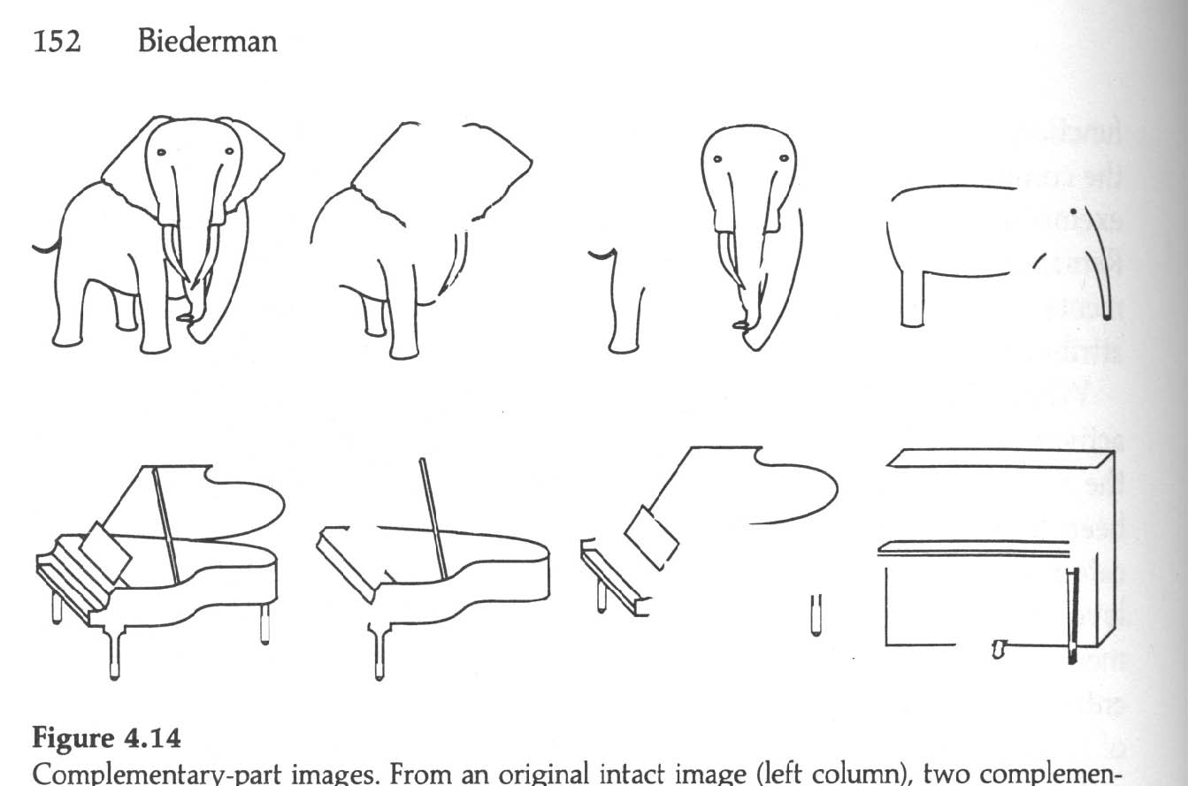
We know edges are special from human (mammalian) vision studies
Notes:
Part-deleted complementary images were created by deleting approximately half the components from each image. In this way each complementary images contained about 50% of the original contour. Put together the two complementary images would reproduce the intact line drawing. A same name, different exemplar image was also created (right column) to assess non-visual priming in a naming experiment (Biederman and Cooper, 1991).
Performance of human subjects on identical and complement images was strikingly different indicating that complementary part-deleted image pairs were not equivalent to each other for human observers. In fact, the complement image was perceived as if it were a different exemplar of the same category.

Slide 10
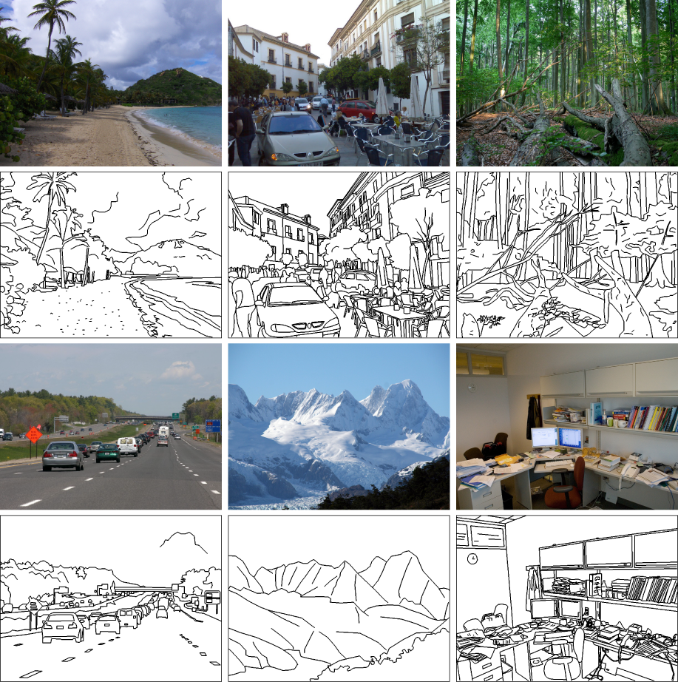
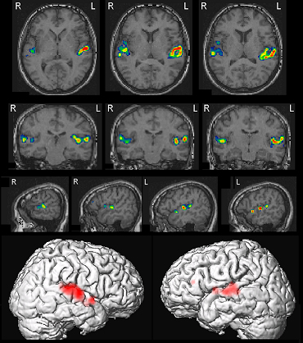
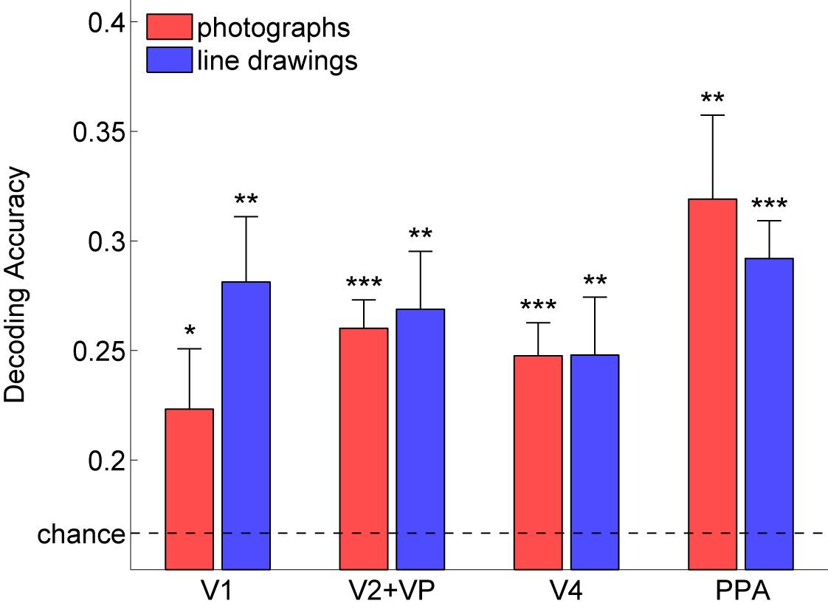
Walther, Chai, Caddigan, Beck & Fei-Fei, PNAS, 2011
Notes:
They collected fMRI data while participants viewed photographs and line drawings of beaches, city streets, forests, highways, mountains, and offices. Despite the marked difference in scene statistics, we were able to decode scene category from fMRI data for line drawings just as well as from activity for color photographs,
global scene structure, which is preserved in line drawings, plays an integral part in representing scene categories

Slide 11
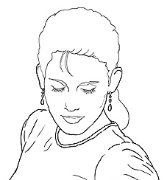
Edge detection
Goal: Identify sudden changes (discontinuities) in an image
  Intuitively, most semantic and shape information from the image can be encoded in the edges
  More compact than pixels
Ideal: artist’s line drawing (but artist is also using object-level knowledge)
Source: D. Lowe

Slide 12
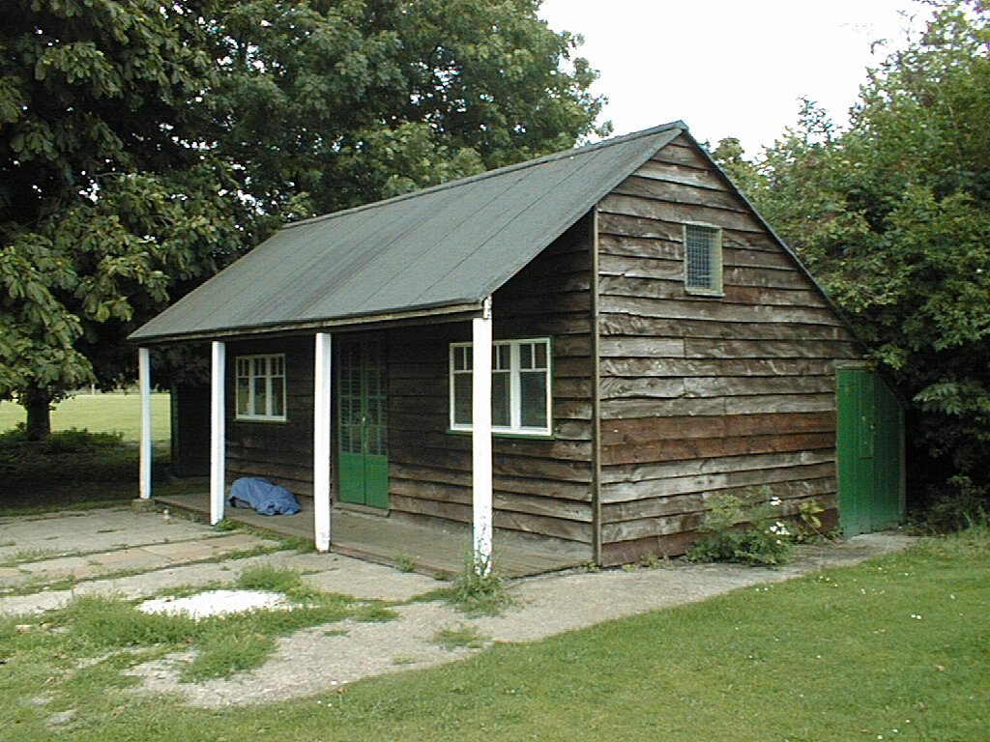
Why do we care about edges?
Extract information, recognize objects
Recover geometry and viewpoint
Vertical vanishing
point
(at infinity)
Vanishing
line
Vanishing
point
Vanishing
point
Source: J. Hayes

Slide 13
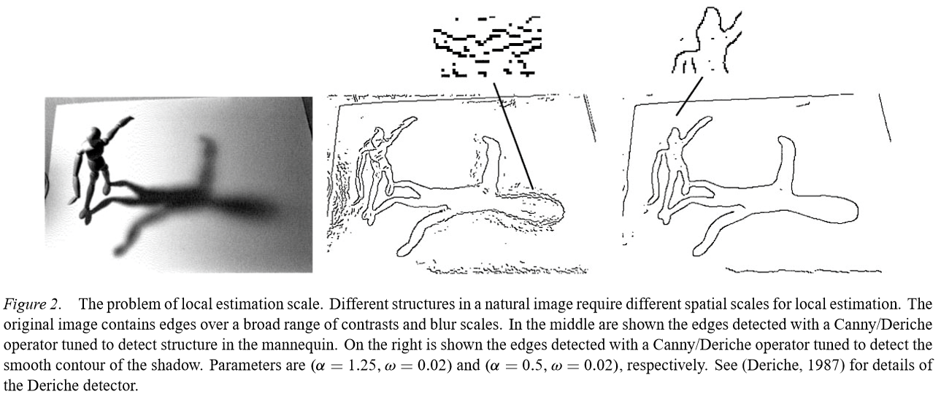
Elder – Are Edges Incomplete? 1999
What information would we need to ‘invert’ the edge detection process?

Slide 14
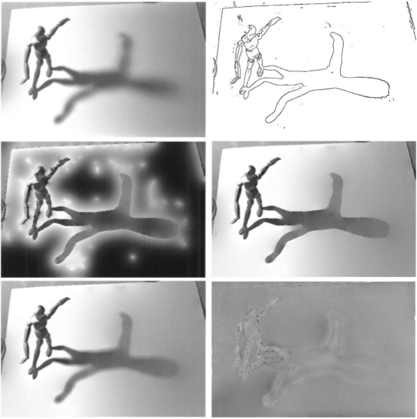
Elder – Are Edges Incomplete? 1999
Edge ‘code’:
position,
gradient magnitude,
gradient direction,
blur.
Notes:
http://link.springer.com/article/10.1023%2FA%3A1008183703117

Slide 15
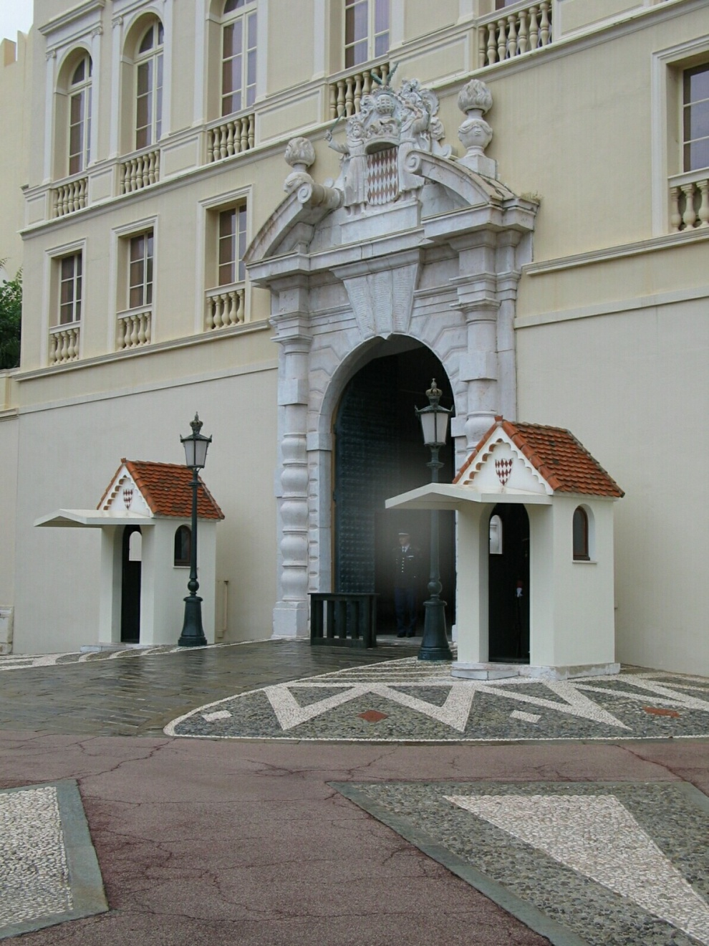
Origins of edges
surface normal discontinuity
depth discontinuity
surface color discontinuity
illumination discontinuity
Source: D. Hoiem

Slide 16
Closeup of edges
Surface normal discontinuity
Source: D. Hoiem

Slide 17
Closeup of edges
Depth discontinuity
Source: D. Hoiem

Slide 18
Closeup of edges
Surface color discontinuity
Source: D. Hoiem

Slide 19
What we will learn today
Edge detection
Image Gradients
Derivative of Gaussian
Sobel edge detector
Canny edge detector

Slide 20
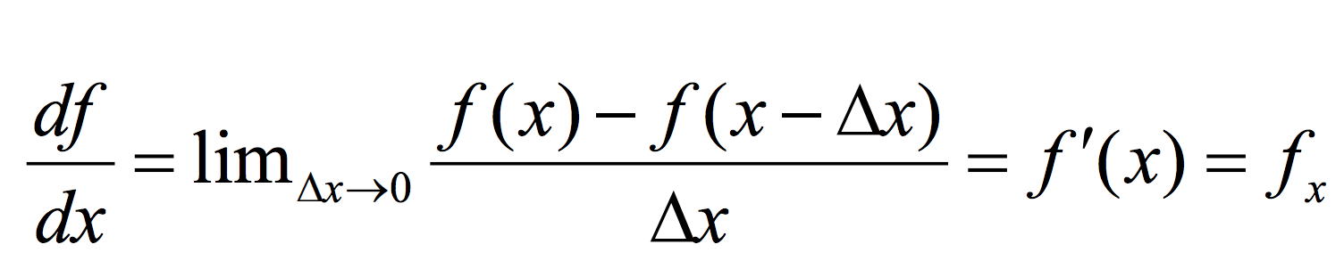
Derivatives in 1D

Slide 21
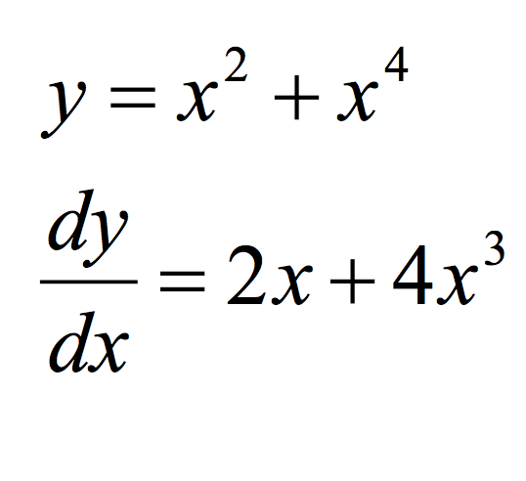
Derivatives in 1D - example

Slide 22
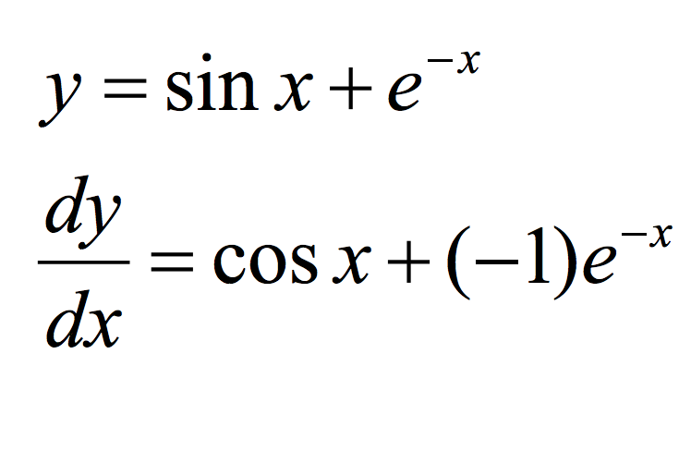
Derivatives in 1D - example
Slide credit: Dr Mubarak

Slide 23
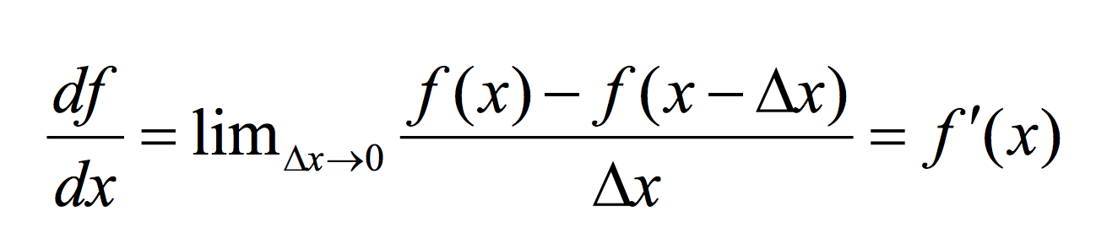
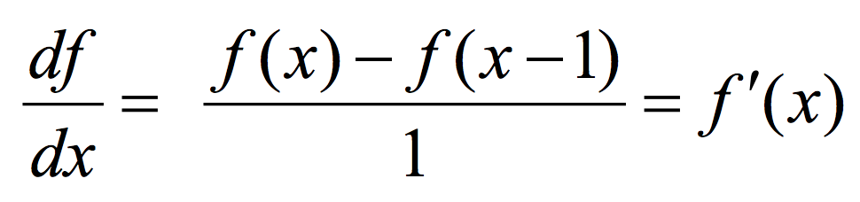
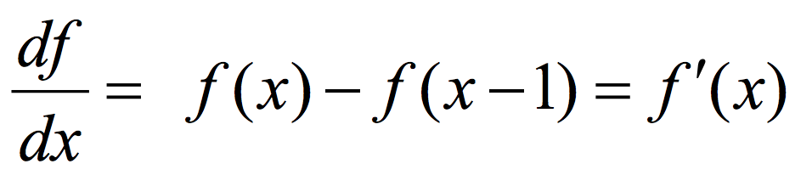
Discrete Derivative in 1D

Slide 24
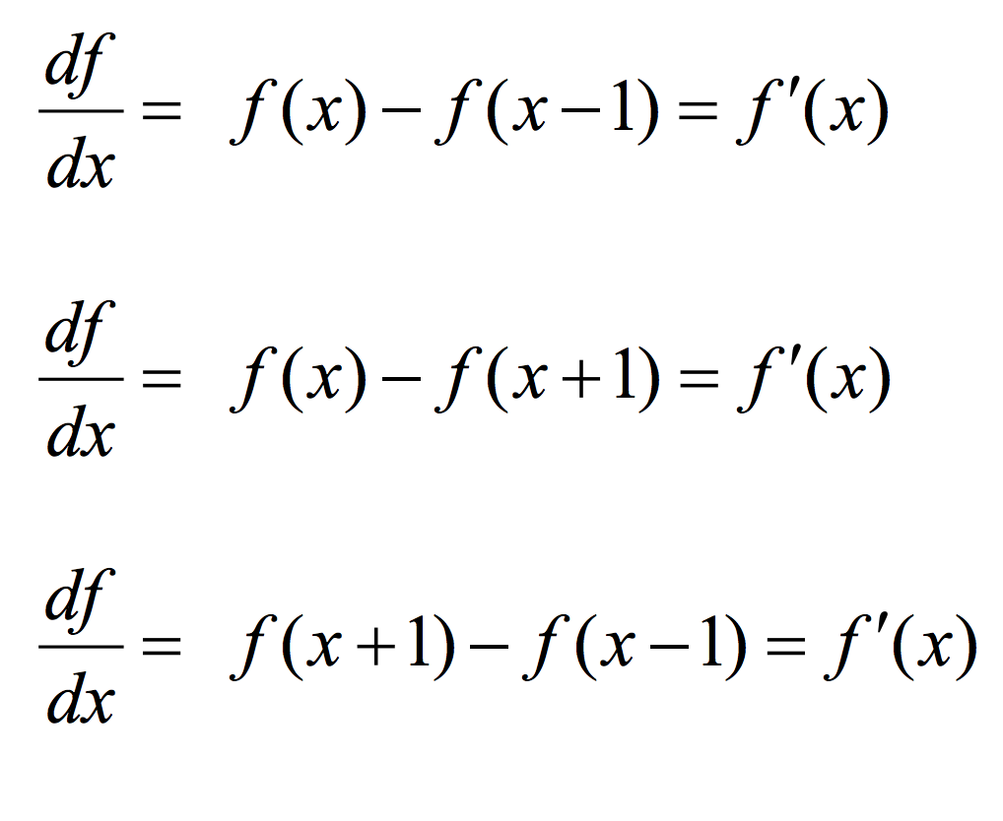
Types of Discrete derivative in 1D
Backward
Forward
Central

Slide 25
1D discrete derivate filters
Backward filter: [0 1 -1]
Forward: [-1 1 0]
Central: [ 1 0 -1]

Slide 26
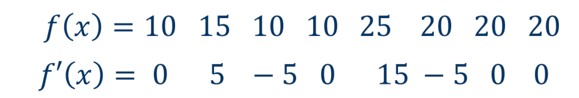
1D discrete derivate example

Slide 27
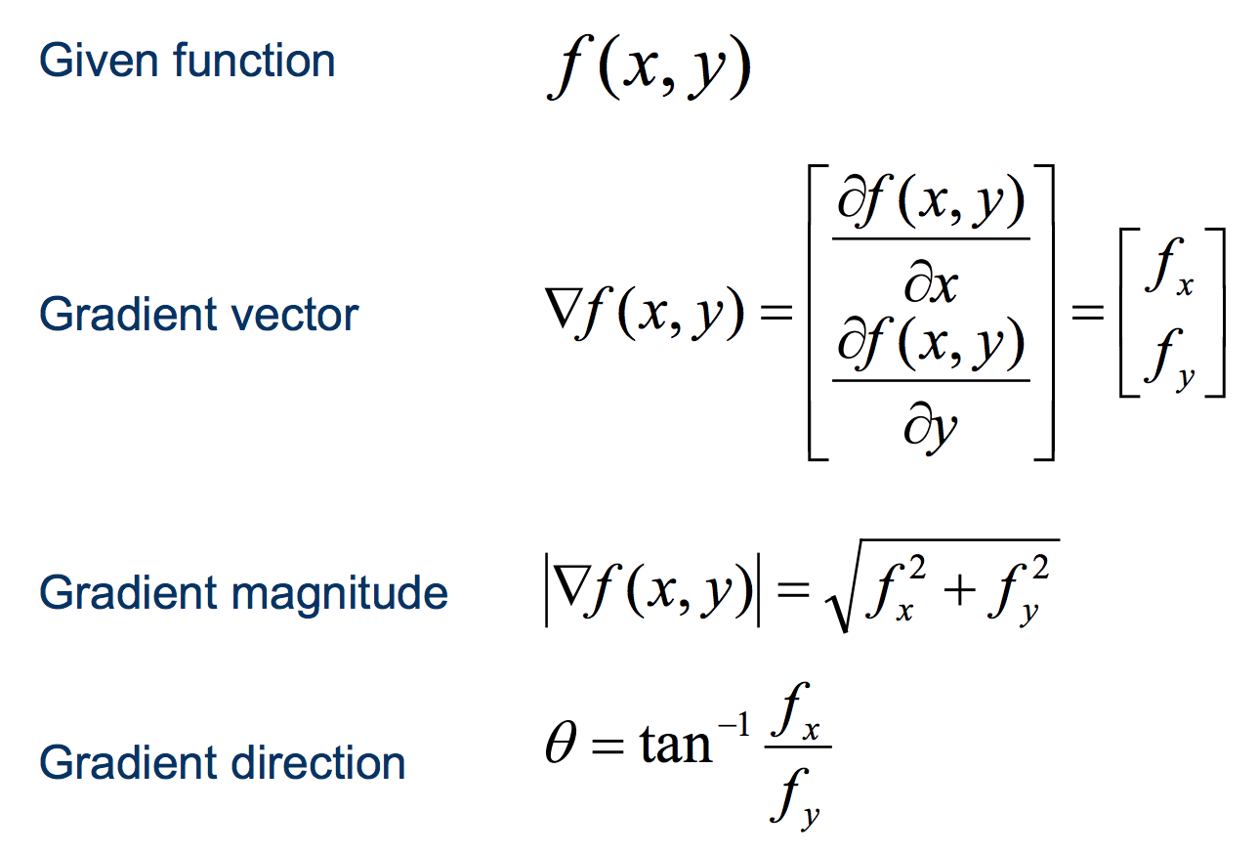
Discrete derivate in 2D

Slide 28
Discrete derivate in 2D

Slide 29
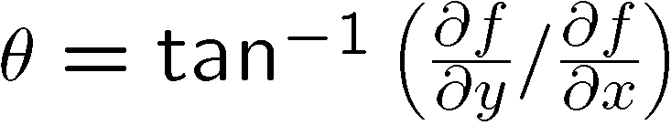
Discrete derivate in 2D

Slide 30
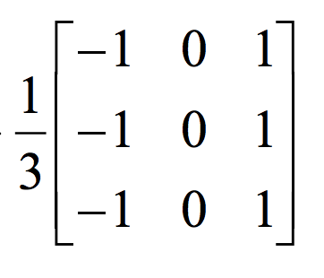
2D discrete derivative filters
What does this filter do?

Slide 31
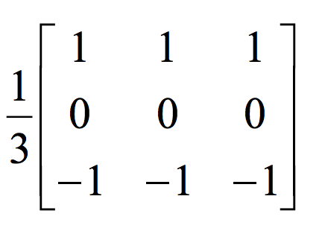
2D discrete derivative filters
What about this filter?

Slide 32
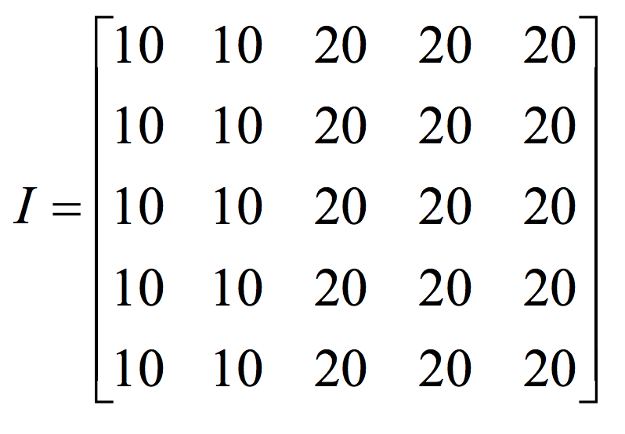
2D discrete derivative - example

Slide 33
2D discrete derivative - example
What happens when we apply this filter?

Slide 34
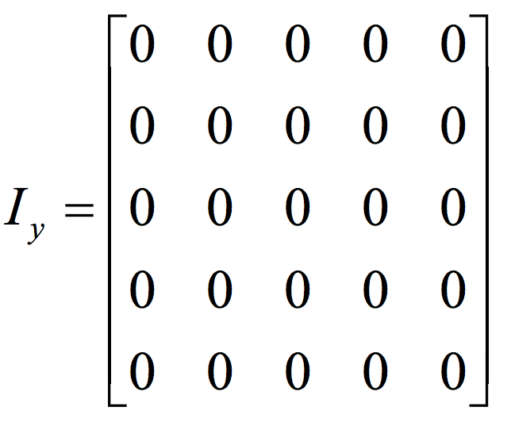
2D discrete derivative - example
What happens when we apply this filter?

Slide 35
2D discrete derivative - example
Now let’s try the other filter!

Slide 36
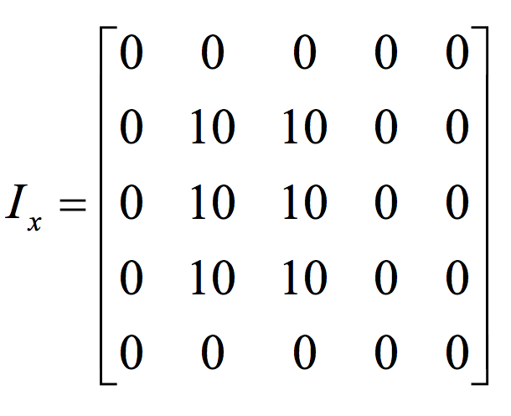
2D discrete derivative - example
What happens when we apply this filter?

Slide 37
What we will learn today
Edge detection
Image Gradients
Derivative of Gaussian
Sobel edge detector
Canny edge detector

Slide 38

Characterizing edges
An edge is a place of rapid change in the image intensity function
intensity function
(along horizontal scanline)
image
first derivative
edges correspond to
extrema of derivative

Slide 39
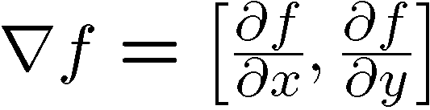
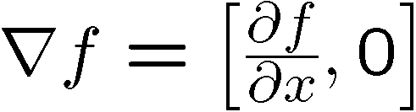

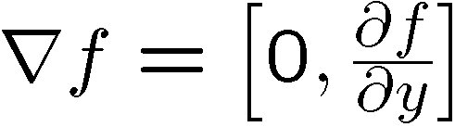
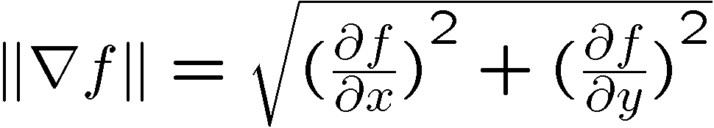
Image gradient
The gradient of an image:
The gradient vector points in the direction of most rapid increase in intensity
The gradient direction is given by
  how does this relate to the direction of the edge?
The edge strength is given by the gradient magnitude
Source: Steve Seitz
Notes:
give definition of partial derivative: lim h->0 [f(x+h,y) – f(x,y)]/h

Slide 40
Finite differences: example
Original
Image
Gradient magnitude
x-direction
y-direction
Which one is the gradient in the x-direction? How about y-direction?

Slide 41
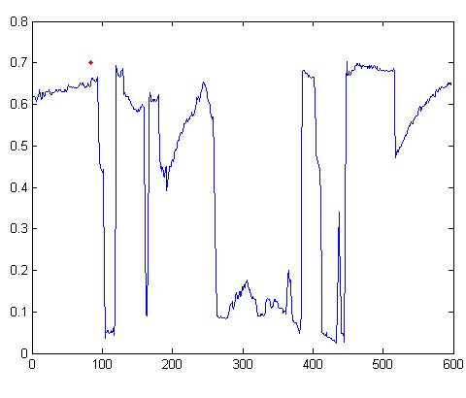

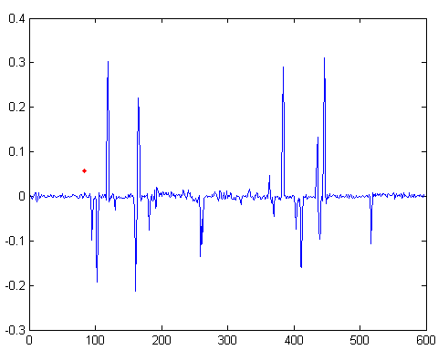
Intensity profile
Intensity
Gradient
Source: D. Hoiem

Slide 42

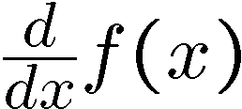
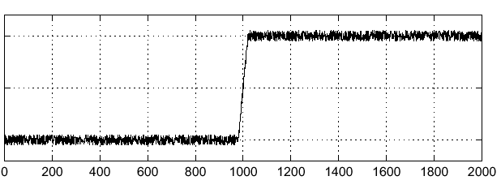
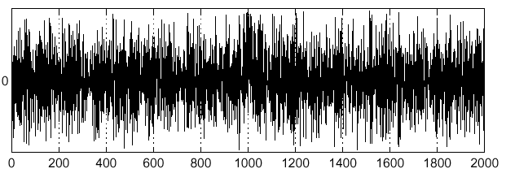
Effects of noise
Consider a single row or column of the image
  Plotting intensity as a function of position gives a signal
Where is the edge?
Source: S. Seitz
Notes:
How to fix?

Slide 43
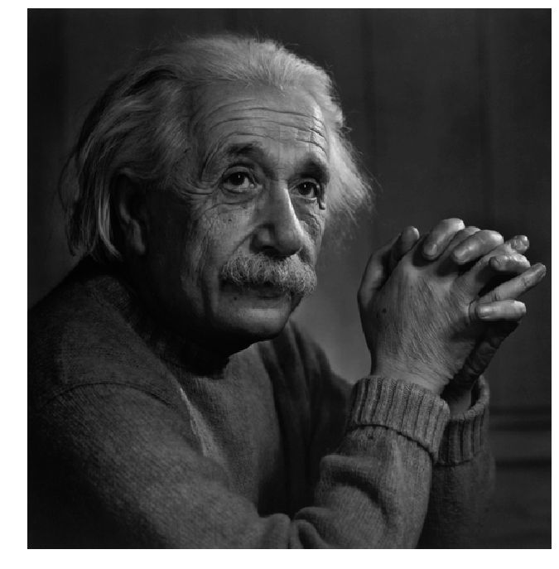
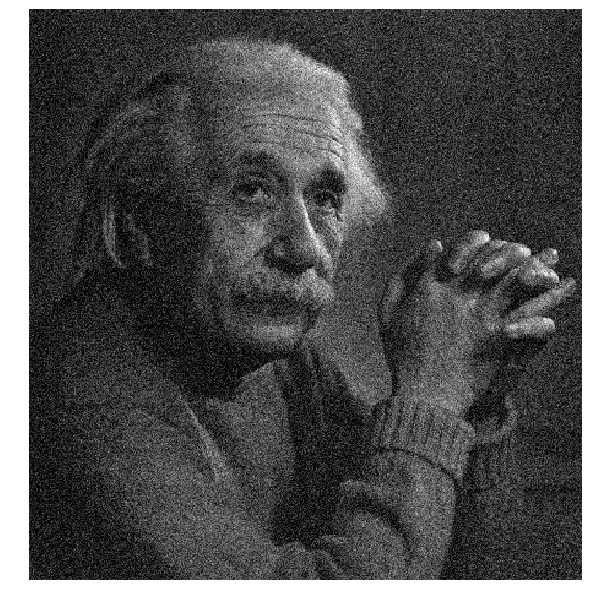
Effects of noise
Notes:
How to fix?

Slide 44
Effects of noise
Finite difference filters respond strongly to noise
  Image noise results in pixels that look very different from their neighbors
  Generally, the larger the noise the stronger the response
What is to be done?
  Smoothing the image should help, by forcing pixels different to their neighbors (=noise pixels?) to look more like neighbors
Source: D. Forsyth

Slide 45
Effects of noise
Finite difference filters respond strongly to noise
  Image noise results in pixels that look very different from their neighbors
  Generally, the larger the noise the stronger the response
What is to be done?
  Smoothing the image should help, by forcing pixels different to their neighbors (=noise pixels?) to look more like neighbors
Source: D. Forsyth

Slide 46
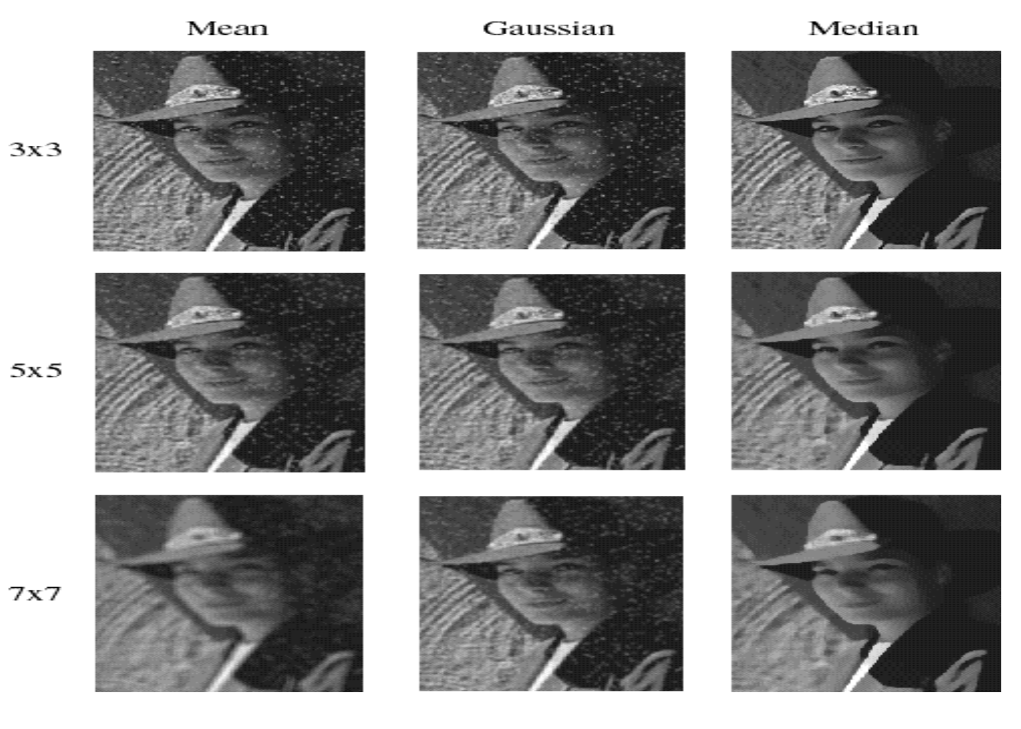
Smoothing with different filters
Slide credit: Steve Seitz

Slide 47
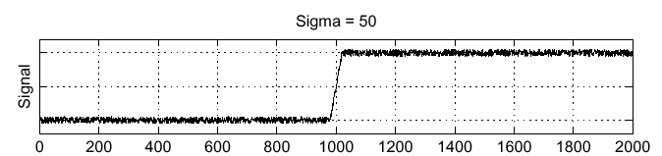



Solution: smooth first
f
g
f * g
To find edges, look for peaks in
Source: S. Seitz

Slide 48

Derivative theorem of convolution
This theorem gives us a very useful property:
This saves us one operation:
f
Source: S. Seitz

Slide 49


Derivative of Gaussian filter
* [1 0 -1] =
2D-gaussian
x - derivative

Slide 50


Derivative of Gaussian filter
x-direction
y-direction

Slide 51
Derivative of Gaussian filter

Slide 52
What we will learn today
Edge detection
Image Gradients
Derivative of Gaussian
Sobel edge detector
Canny edge detector

Slide 53




Smoothing with different filters
Mean smoothing
Gaussian (smoothing * derivative)
Slide credit: Steve Seitz

Slide 54


Discrete Approximation
Prewitt edge detector
Sobel edge detector
$$G_{x}=\left[\begin{matrix}+1 & 0 & −1 \\ +1 & 0 & −1 \\ +1 & 0 & −1\end{matrix}\right]=\left[\begin{matrix}1 \\ 1 \\ 1\end{matrix}\right]\left[\begin{matrix}+1 & 0 & −1\end{matrix}\right]$$
smoothing
differentiation
$$G_{x}=\left[\begin{matrix}+1 & 0 & −1 \\ +2 & 0 & −2 \\ +1 & 0 & −1\end{matrix}\right]=\left[\begin{matrix}1 \\ 2 \\ 1\end{matrix}\right]\left[\begin{matrix}+1 & 0 & −1\end{matrix}\right]$$

Slide 55


Sobel Operator
uses two 3×3 kernels which are convolved with the original image to calculate approximations of the derivatives
one for horizontal changes, and one for vertical

Slide 56


Sobel Operation
Magnitude:
Angle or direction of the gradient:
Notes:
Gradient is a vector!

Slide 57
Sobel Filter example
Notes:
We can threshold the gradient map, and choose edges to be the pixels above T.

Slide 58

Sobel Filter Problems
Poor Localization (Trigger response in multiple adjacent pixels)
Thresholding value favors certain directions over others
  Can miss oblique edges more than horizontal or vertical edges
  False negatives
Notes:
Thresholding is….

Slide 59



Tradeoff between smoothing at different scales
1 pixel
3 pixels
7 pixels
Smoothed derivative removes noise, but blurs edge. Also finds edges at different “scales”.
Source: D. Forsyth

Slide 60

Designing an edge detector
Criteria for an “optimal” edge detector:
  Good detection: the optimal detector must minimize the probability of false positives (detecting spurious edges caused by noise), as well as that of false negatives (missing real edges)

Slide 61
Designing an edge detector
Criteria for an “optimal” edge detector:
  Good detection: the optimal detector must minimize the probability of false positives (detecting spurious edges caused by noise), as well as that of false negatives (missing real edges)
  Good localization: the edges detected must be as close as possible to the true edges

Slide 62
Designing an edge detector
Criteria for an “optimal” edge detector:
  Good detection: the optimal detector must minimize the probability of false positives (detecting spurious edges caused by noise), as well as that of false negatives (missing real edges)
  Good localization: the edges detected must be as close as possible to the true edges
  Single response: the detector must return one point only for each true edge point; that is, minimize the number of local maxima around the true edge

Slide 63
What we will learn today
Edge detection
Image Gradients
A simple edge detector
Sobel edge detector
Canny edge detector

Slide 64
Canny edge detector
Probably the most widely used edge detector in computer vision.
Theoretical model: step-edges corrupted by additive Gaussian noise.
Canny showed that first derivative of Gaussian closely approximates the operator that optimizes the product of signal-to-noise ratio and localization.
J. Canny, A Computational Approach To Edge Detection, IEEE Trans. Pattern Analysis and Machine Intelligence, 8:679-714, 1986.
22,000 citations!
L. Fei-Fei

Slide 65


Demonstrator Image
rgb2gray(‘img.png’)
Notes:
“Asian Business Woman 2” by Bold Content is licensed under CC BY 2.0

Slide 66
Canny edge detector
Filter image with x, y derivatives of Gaussian
Source: D. Lowe, L. Fei-Fei

Slide 67
Derivative of Gaussian filter
x-direction
y-direction

Slide 68



Compute Gradients
X Derivative of Gaussian
Y Derivative of Gaussian
(x2 + 0.5 for visualization)

Slide 69
Canny edge detector
Filter image with x, y derivatives of Gaussian
Find magnitude and orientation of gradient
Source: D. Lowe, L. Fei-Fei

Slide 70

Compute Gradient Magnitude
sqrt( XDerivOfGaussian .^2 + YDerivOfGaussian .^2 ) = gradient magnitude
(x4 for visualization)

Slide 71


Compute Gradient Orientation
Threshold magnitude at minimum level
Get orientation via
theta = atan2(gy, gx)
Unthresholded:

Slide 72
Canny edge detector
Filter image with x, y derivatives of Gaussian
Find magnitude and orientation of gradient
Non-maximum suppression:
  Thin multi-pixel wide “ridges” to single pixel width
Source: D. Lowe, L. Fei-Fei

Slide 73


Non-maximum suppression for each orientation
At pixel q:
We have a maximum if the value is larger than those at both p and at r.
Interpolate along gradient direction to get these values.
Source: D. Forsyth

Slide 74

Before Non-max Suppression
Gradient magnitude (x4 for visualization)

Slide 75

After non-max suppression
Gradient magnitude (x4 for visualization)

Slide 76
Canny edge detector
Filter image with x, y derivatives of Gaussian
Find magnitude and orientation of gradient
Non-maximum suppression:
  Thin multi-pixel wide “ridges” to single pixel width
‘Hysteresis’ Thresholding
Source: D. Lowe, L. Fei-Fei
Notes:
Hysteresis is the dependence of the state of a system on its history -> bad word to use in this sense (comes from engineering)

Slide 77
Edge linking
Assume the marked point is an edge point. Then we construct the tangent to the edge curve (which is normal to the gradient at that point) and use this to predict the next points (here either r or s).
Source: D. Forsyth

Slide 78
‘Hysteresis’ (adaptive) thresholding
Two thresholds – high and low
Grad. mag. > high threshold? = strong edge
Grad. mag. < low threshold? noise
In between = weak edge
‘Follow’ edges starting from strong edge pixels
Continue them into weak edges
    Connected components (Szeliski 3.3.4)
Source: S. Seitz

Slide 79


Final Canny Edges
$$σ=\sqrt{2}, t_{low}=0.05,t_{high}=0.1$$

Slide 80




Effect of σ (Gaussian kernel spread/size)
Original
$$σ=\sqrt{2}$$
$$σ=4\sqrt{2}$$
The choice of σ depends on desired behavior
  large σ detects large scale edges
  small σ detects fine features
Source: S. Seitz

Slide 81
Canny edge detector
Filter image with x, y derivatives of Gaussian
Find magnitude and orientation of gradient
Non-maximum suppression:
  Thin multi-pixel wide “ridges” to single pixel width
‘Hysteresis’ Thresholding:
  Define two thresholds: low and high
  Use the high threshold to start edge curves and the low threshold to continue them
  ‘Follow’ edges starting from strong edge pixels
    Connected components (Szeliski 3.3.4)
MATLAB: edge(image, ‘canny’)
Source: D. Lowe, L. Fei-Fei

Slide 82

45 years of boundary detection
Source: Arbelaez, Maire, Fowlkes, and Malik. TPAMI 2011 (pdf)

