Slide 1
Globally Optimal Generalized Maximum Multi Clique Problem (GMMCP) using Python code for Pedestrian Object Tracking
By
Beni Mulyana

Slide 2
Tracking by Detection
Human Detection
Data Association
Tracks
Input can be avi or mp4 video, converted to jpg frames using videosequence library
Human detection use yolo darkflow. It gives 4 bboxes coordinates. So we have 4 parameters as input for data association
Data association use GMMCP algorithm

Slide 3
Data Association
Bipartite Matching
Frame 2
Frame 3
GMMCP Matching
Frame 2
Frame 1
Frame 3
Frame 1
The limited-locality-methods in bipartite matching do not carry the information out of their current locality (i.e. no edges to or from the frames other than 3 and 4). So, it makes difficulties to handle occlusion. Meanwhile, GMMCP matching gather all information in temporal global frames makes easier to handle occlusion by incorporating other detections in other frames.
Frame 5
Frame 4
Frame 5
Frame 4
Temporally Local!
Temporally Global!

Slide 4
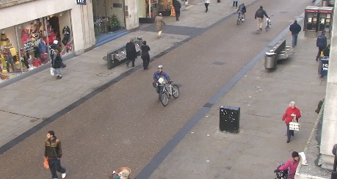
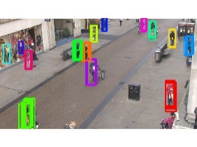
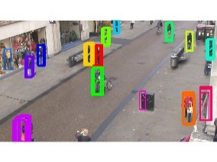
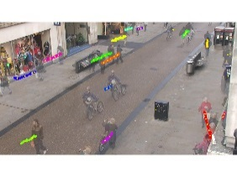
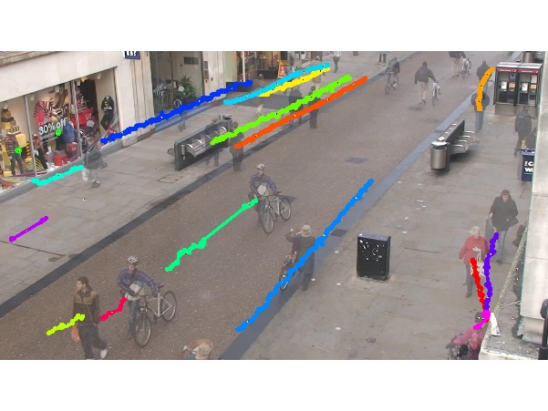
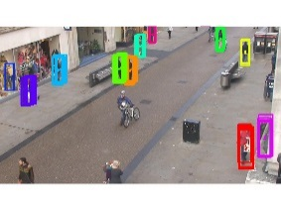
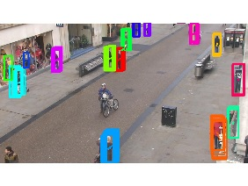
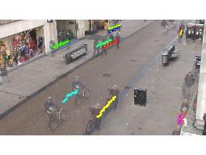
GMMCP Pipeline
Input Video
Detected Humans
Human
Detection
Low-level Tracklets
Mid-level Tracklets
GMMCP
Stitch Tracklets
Final Trajectories
Segment 01
Segment 05
Segment 06
Segment 10

Slide 5
Low-Level Tracklet Generation
Segment 1
Segment 2
Frames 1-10
Frames 11-20
From 4 boxes input, we got two attributes of person detection in a frame which are : coordinate tracklets and color histogram
The low-level tracklets are found using a simple overlap criteria where bounding boxes that overlap more than 60% in consecutive frames are connected in a segment. The appearance of tracklet is defined by computing median of all color histogram detections in a tracklet , where m is index of segment and n is index of node tracklet.

Slide 6
GMMCP Cost Computation
Segment m
Segment i
The weight cost is defined using linear combination of the histogram cost connections and motion cost connections :

Slide 7
GMMCP Cost Computation
Segment m
Segment i
By computing the histogram intersection between the two nodes in different segment, we got cost of color histogram in between tracklet in segment 1 and tracklet in segment 2

Slide 8
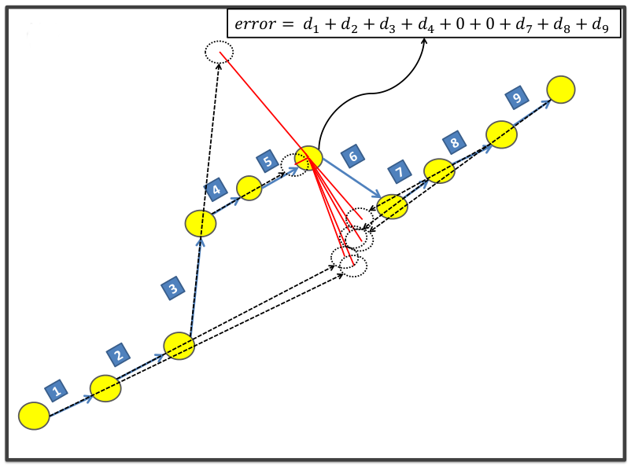
GMMCP Cost Computation
By computing the deviation error
We can get cost of motion
With the spatial velocity vector
for every node is defined as :
and sigma = 20

Slide 9
Number of Weight Cost
Segment 1
Segment 2
Segment 4
Segment 3
All cost connections will create a mesh networks. The amount of cost connections fulfill the combination of 2 tracklets from all created tracklets :

Slide 10
GMMCP with ADN
Segment 1
Segment 2
Segment 4
Segment 3
Purpose to handling occlusion by using single super dummy node (aggregated dummy node)
Edges of ADN are integer variable. Therefore, in optimization, we use Mixed binary-integer programming
Dummy edges are fixed weight. In here use 0.4.

Slide 11
Segment Clustering
Cluster
Segment 1
Segment 2
Cluster 1
Cluster 2
Segment 4
Cluster N-1
Segment 3
Cluster N
To reduce computation complexity in GMMCP calculation, it use clustering with 4 segments in each cluster
Every edge of cluster is chained to other edge of cluster to create long video sequence.

Slide 12
GMMCP optimization
The purpose of GMMCP optimization is to create cliques simultaneously and globally by maximizing vector multiplication of all weight cost and edges from all segment and tracklet with subject to constraint :
Rule 1 :
To ensures the solution would form a clique

Slide 13
GMMCP optimization
Rule 2 :
To enforce sum of outgoing edges of a tracklet and entering a segment <= 1.
Thus one clique that will create does not include more than one tracklet from each cluster.

Slide 14
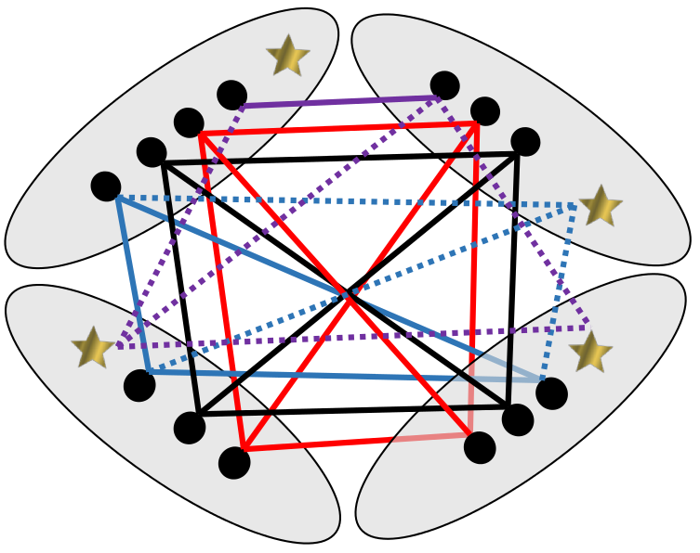
GMMCP optimization
Rule 3 :
These 3 rules are mixed binary-integer programming. We use dlpk python library to solve it. Finally, we got multiple cliques simultaneously!. That clique called as mid-level tracklet
Where K is maximum number tracklet in a cluster and h is number of segment in a cluster.
It guarantees that every tracklet from each segment is selected

Slide 15
Final Track Generation
With the chaining method, we can run and integrate a long video sequence by cutting that video into many separate chains and we can run or merging some of these chain sequences as we want.
Cluster 1
Cluster 2
Long track video
Cluster N-1
Cluster N

Slide 16
THANK YOU!.

