Slide 1
LIFT: Learned Invarient Feature Transform
Kwang Moo Yi∗,1 , Eduard Trulls∗,1 , Vincent Lepetit2 , Pascal Fua1 1Computer Vision Laboratory, Ecole Polytechnique F´ed´erale de Lausanne (EPFL) 2 Institute for Computer Graphics and Vision, Graz University of Technology {kwang.yi, eduard.trulls, pascal.fua}@epfl.ch, lepetit@icg.tugraz.at

Slide 2
Content
LIFT
Other Lessons

Slide 3
LIFT Abstract
Abstract. We introduce a novel Deep Network architecture that implements the full feature point handling pipeline, that is, detection, orientation estimation, and feature description. While previous works have successfully tackled each one of these problems individually, we show how to learn to do all three in a unified manner while preserving end-to-end differentiability. We then demonstrate that our Deep pipeline outperforms state-of-the-art methods on a number of benchmark datasets, without the need of retraining.

Slide 4
Feature Extraction
Algorithm is an update on the slides of February 8th
Combines the steps into one process, and uses deep learning

Slide 5
Key Points
Feature – an interesting part of an image:
Edge, corner, blob, or ridge
Important that it is repeatable

Slide 6
Pipeline

Slide 7
Detection
Take the score of sections of the image
Non-Maximum Suppression/Outlier Rejection
softargmax
Now have the key points, crop around them
See also FAST, SIFT, SURF, MSER, SFOP

Slide 8
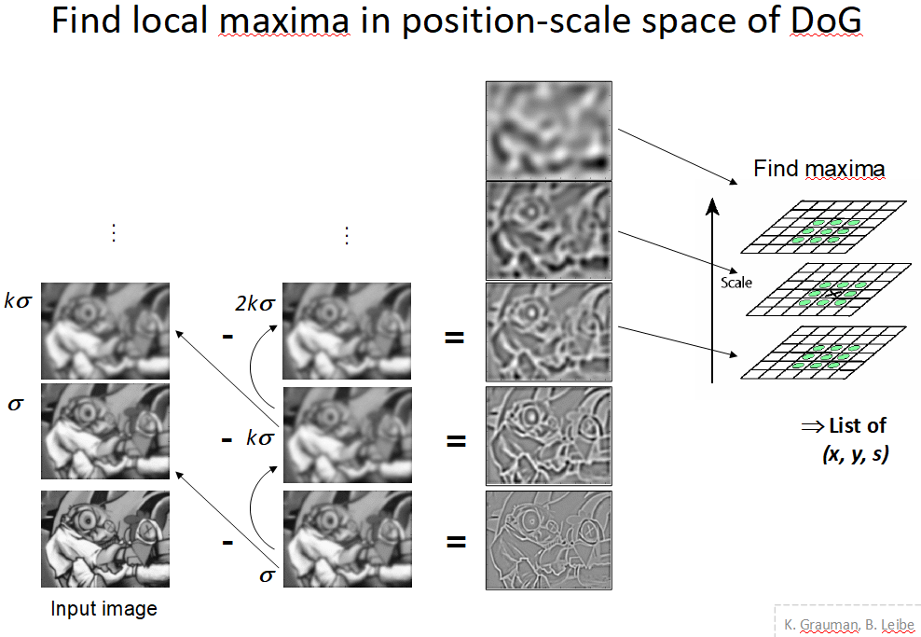
Score
From
feature extraction
slides

Slide 9
Orientation Estimation
Want to match the picture with others, but first need to have all the pictures be aligned
See also SIFT

Slide 10
Feature Descriptors
Break patch down into histograms
See also SIFT, SURF, DAISY

Slide 11
Deep Learning
Subset of Machine Learning
Machine learning – a self-adaptive algorithm that improves at analysis with added data
Deep Learning – uses artificial neural networks to do machine learning
Allows for non-linear analysis of data

Slide 12
Deep learning
Used deep learning to train the components
As opposed to “hand-crafting”
Components trained in reverse
Descriptor, then orientation estimator, then detector

Slide 13
Data set
Piccadilly circus and the Roman Forum
Piccadilly – 3,384 images and 59,000 unique points
Roman Forum – 1,658 images, 51,000 unique points

Slide 14
Training
Blue = same, green = different, red = no features

Slide 15
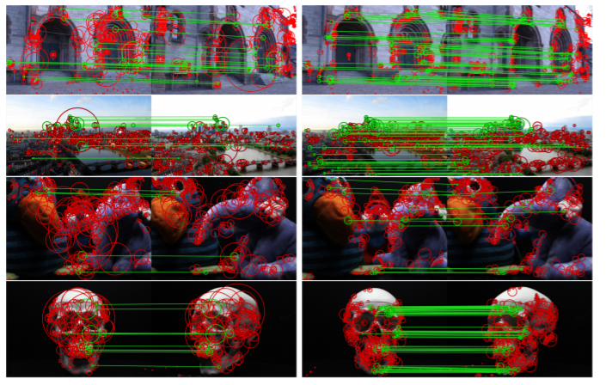
Results
Left = SIFT, Right = LIFT

Slide 16
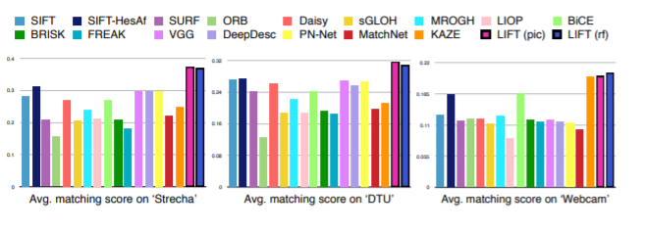
Results

Slide 17
Problems and Lessons
Choosing a topic
Running the code
Presentation

Slide 18
Choosing a topic
Reading a research paper
Lack of Source Code/Difficulty of implementing algorithms
Some papers are dead ends

Slide 19
Code Difficulties
Platforms
Dependencies Change

Slide 20
Platforms I tried or considered
Windows 10
Windows Subsystem for Linux (WSL) (Ubuntu)
Virtual Box Virtual Machine (Ubuntu)
Google Cloud Platform
Dual booting
School Computers
Borrowing my friend’s laptop

Slide 21
Windows Subsytem for Linux

Slide 22
Problematic Programs
LIFT
OpenCV
Flufl.lock
Anaconda
Theano
Python 2 vs 3
PIP vs PIP 3
PATH variables

Slide 23
Presentation
Not cutting losses and working on presentation

