Slide 1
Modeling the world with photos
Authors: Noah Snavely · Steven M. Seitz · Richard Szeliski

Slide 2
Introduction
Large database of photos off the internet
Navigation through photos

Slide 3
Concepts
Feature detection
Structure from Motion & Image Based Modeling
Image Based Rendering

Slide 4
Feature detection
SIFT (Scaled Invariant Feature Transform)
1. Constructing a scale space
2. LoG Approximation
3. Finding keypoints
4. Get rid of bad key points
5. Assigning an orientation to the keypoints
6. Generate SIFT features

Slide 5
Structure from motion
Bundle adjustment
Refine 3d coordinates and optical characteristics of the camera
Minimize reprojection error
Nonlinear least-squares algorithms
Last step

Slide 6
Image Based Rendering
Synthesizing new views
Sparse 3d model
Goal is to browse through the images

Slide 7
Annotation
Assign information
Transfer between all the images
2D annotation

Slide 8
Main challenge
Match and reconstruct from large database of images
uncontrolled

Slide 9
Other systems
Other systems needs to have parameters of the camera (GPS, Focal length, geometry of the area)
Snavely’s system mostly doesn’t need that. Instead uses computer vision.

Slide 10
Matching
SIFT Key descriptors
Approximate nearest neighbor (ANN), ratio threshold of 0.6
Organized by tracks
Notes:
Track is a connected set of points across multiple images

Slide 11
Image Connectivity graph
Notes:
Neato toolkit in Graphiz, neato mass spring system.

Slide 12
Mapping out the camera
Start off with a single pair of cameras
Triangulates, then bundle adjustment
Add another camera repeat
Notes:
Pair of cameras need large number of matches

Slide 13
Camera Locations

Slide 14
Image Connectivity graph

Slide 15
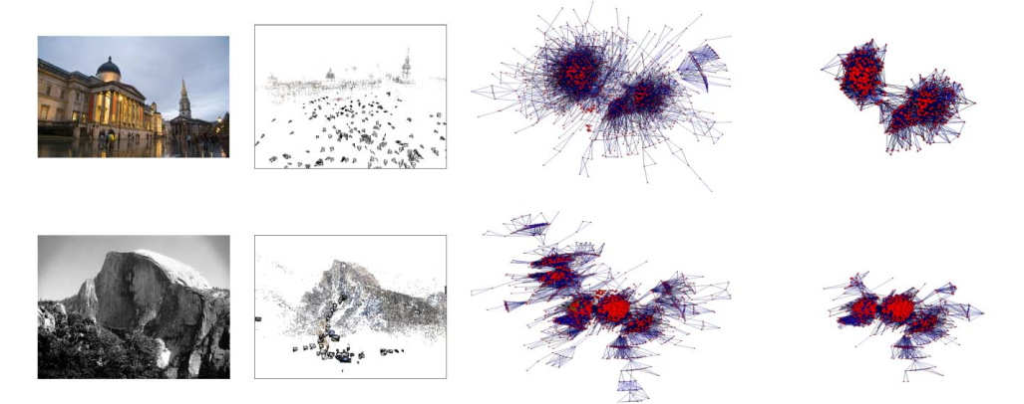
Image Connectivity graph

Slide 16
Geo-Registration
Determine absolute geocentric coordinates of the camera
Optional
Estimate ‘gravity’ vector, if correct simply align manually

Slide 17
Absolute coordinates

Slide 18
PHOTOEXPLORER
Interface for navigating through photos
Viewing through a virtual camera (can overlap images taken)
Non-photorealistic rendering

Slide 19
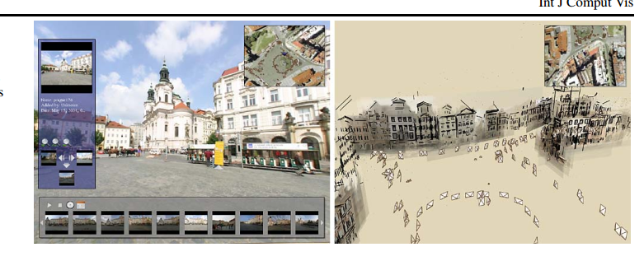
PhotoEXplorer

Slide 20
Object-based navigation
Feature matching
Find’s best photo based on score.
Visibility of points
Angle
Image resolution

Slide 21
Registering new images
Mode for overview scene
Drag and drop new image at approximate location
SIFT keypoints matched with 20 nearest camera.

Slide 22
Results
Notre Dame
Mount Rushmore
Trafalgar Square
Yosemite
Trevi Fountain
Sphinx
St. Basil’s
Colosseum
Prague
Annecy
Great Wall

Slide 23
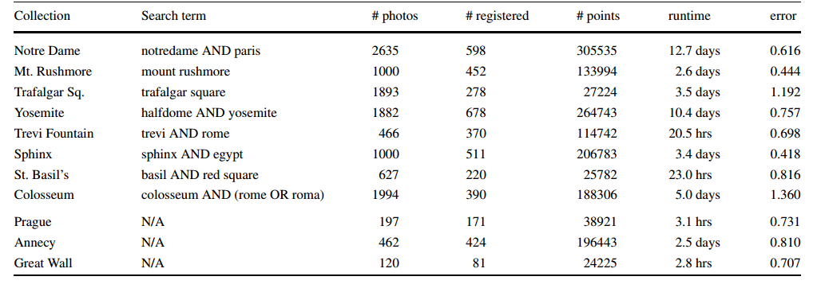
RUNTIME

Slide 24
Code
Bundler: Structure from Motion (SfM) for Unordered Image Collections
Written by Noah Snavely
Builds 3d space
Inputs are image set, image features, and image matches
Why no image matching included?

Slide 25
THINGS TO IMPROVE
Scale
Operate on millions of images
Variability
More capabilities, such as matching ground view to satellite
Online algorithm
Annotate real time using phone camera

Slide 26
Sources
http://phototour.cs.washington.edu/ by Noah Snavely

