Slide 1
Point Cloud Library
Computer Vision
Soubhi Hadri
Department of Electrical and Computer Engineering
University of Oklahoma
March, 2018

Slide 2
Outline:
Introduction
Point Cloud Overview
PCL (Point Cloud Library) Structure
PCL Walkthrough
MeshLab
PCL Installation
Example

Slide 3
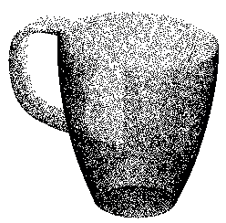
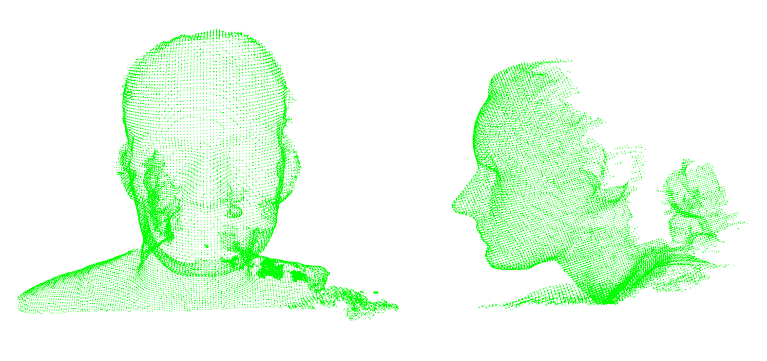
Introduction :
What is a point cloud?
A point cloud is a data structure used to represent a collection of multi-dimensional points (usually in 3D X,Y,Z).
Used to represent 3D information about the world
Each 3D point can contain more information like: RGB color, distance, intensity …
1/37

Slide 4
Introduction :
What is a point cloud?
2/37

Slide 5
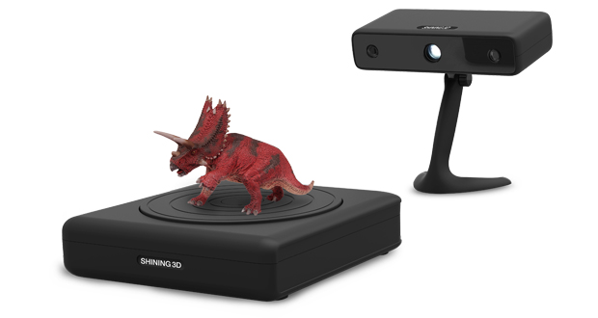
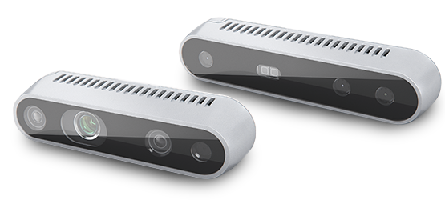
Introduction :
How is point cloud generated?
Point clouds can be acquired from hardware sensors:
Stereo Cameras
3D Scanners
Time-of-flight cameras
Generated from a computer program
…..
3/37

Slide 6
PCL Overview:
Point Cloud Library (or PCL):
Large scale, open project for 2D/3D image and point cloud processing.
Cross-platform
Contains numerous state-of-the art algorithms :
Filtering
Feature Estimation
Surface Reconstruction
Registration
segmentation
…
Under BSD license and is open source software. It is free for commercial and research use.
4/37

Slide 7
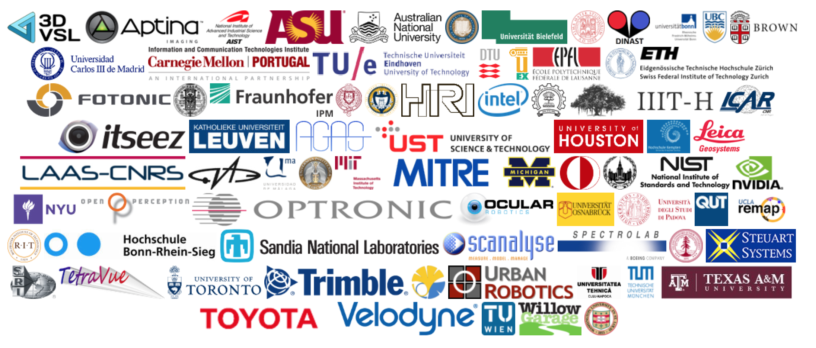
PCL Overview:
Who is developing PCL:
Many organizations all around the world including :
5/37

Slide 8
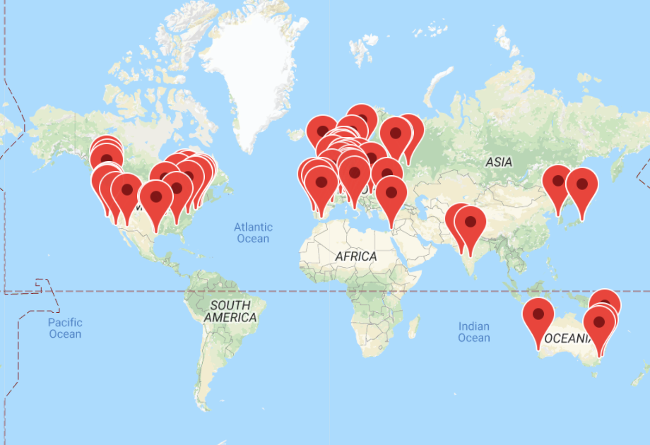
PCL Overview:
Who is developing PCL:
Many organizations all around the world including :
6/37

Slide 9
PCL Overview:
Who is financially supporting PCL:
Toyota , Google, Nvidia, Intel, ….
7/37

Slide 10
PCL Structure :
Point Cloud Library (or PCL):
PCL is split into a series of smaller code libraries:
It can be compiled separately.
Think about PCL is as a graph of code libraries.
8/37

Slide 11
PCL Structure:
Point Types in PCL:
PointXYZ - Members: float x, y, z; most used.
PointXYZI - Members: float x, y, z, intensity; Simple XYZ + intensity.
PointXYZRGBA - Members: float x, y, z; uint32_t rgba; RGBA information packed into a single integer.
PointXYZRGB - float x, y, z, rgb; RGBA information packed into a float.
PointNormal - float x, y, z; float normal[3], curvature; surface normals and curvatures.
……..
Not enough! Defining your own custom PointT type.
9/37

Slide 12
PCL Walkthrough:
PCL is split in a number of modular libraries. The most important :
Filters
Features
Keypoints
Registration
Kdtree
Octree
Visualization
I/O
Common
…
10/37

Slide 13
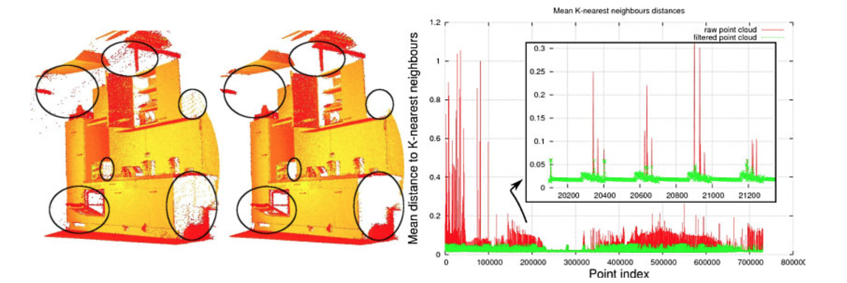
PCL Walkthrough: Filters
Example : noise removal
Some of these outliers can be filtered by performing a statistical analysis on each point’s neighborhood.
Trimming those that do not meet a certain criteria.
11/37

Slide 14
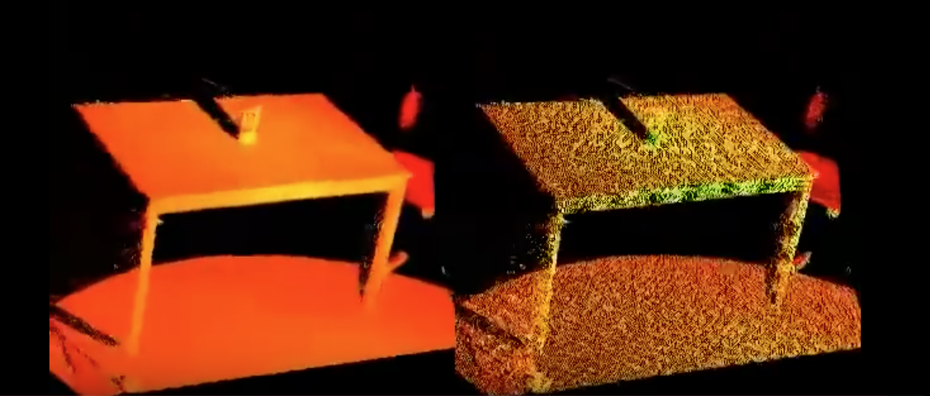
PCL Walkthrough: Filters
Downsampling a PointCloud using a VoxelGrid filter
Reduce the number of points – a point cloud dataset, using a voxelized grid approach.
12/37

Slide 15
PCL Walkthrough: Filters
Removing outliers using a StatisticalOutlierRemoval filter
Remove noisy measurements, e.g. outliers, from a point cloud dataset using statistical analysis techniques.
13/37

Slide 16
PCL Walkthrough: Segmentation
Algorithms for segmenting a point cloud into distinct clusters.
These algorithms are best suited for processing a point cloud that is composed of a number of spatially isolated regions.
Clustering is often used to break the cloud down into its constituent parts, which can then be processed independently.
plane model segmentation
cylinder model segmentation
14/37

Slide 17
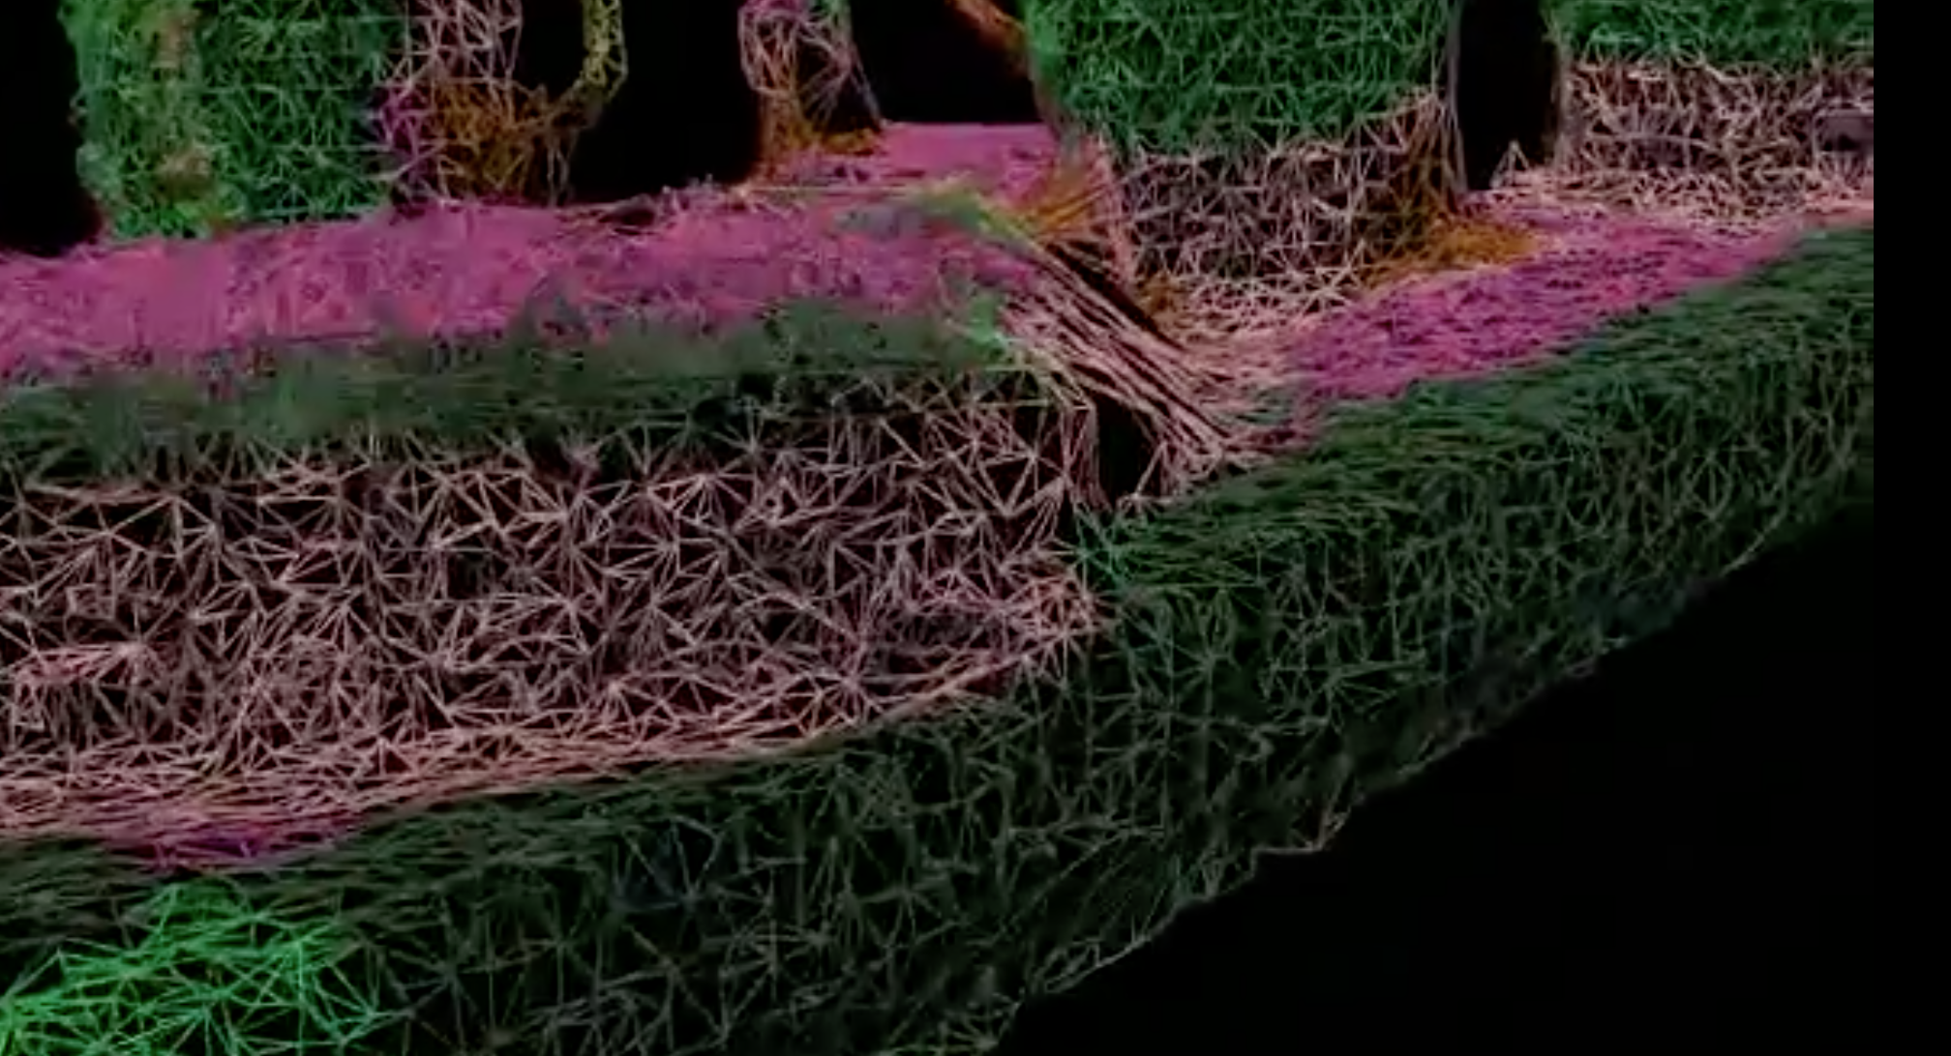
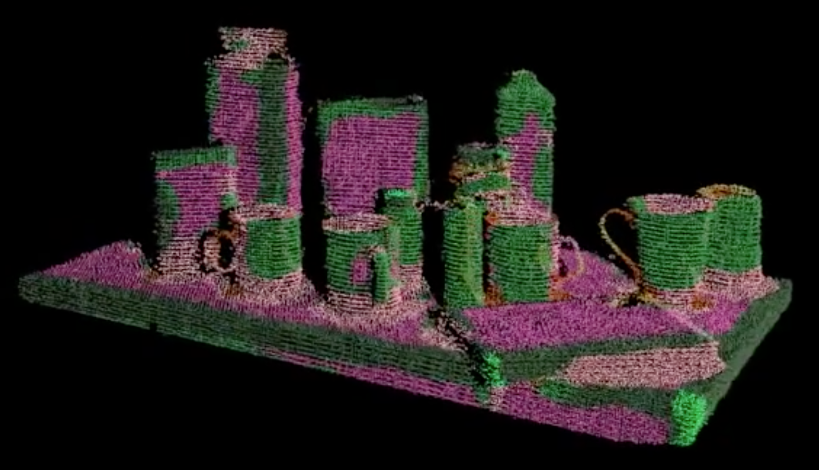
PCL Walkthrough: Surface
Deals with reconstructing the original surfaces from 3D scans.
Surface Triangulation obtain a triangle mesh based on projections of the local neighborhoods.
15/37

Slide 18
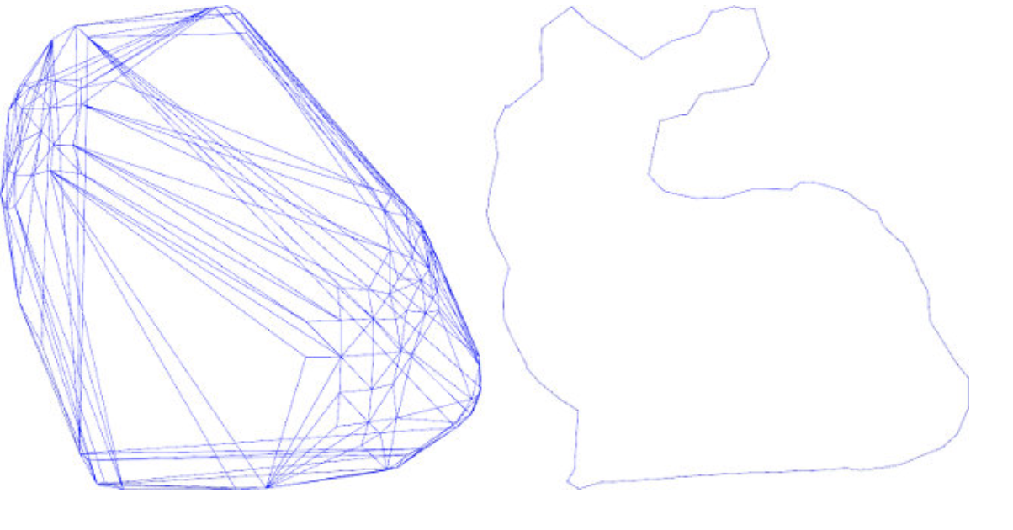
PCL Walkthrough: Surface
Calculate a simple 2D hull polygon (concave or convex) for a set of points supported by a plane.
Creating a convex or concave hull is helpful:
Simplifying the surface representation.
When boundaries need to be extracted.
16/37

Slide 19
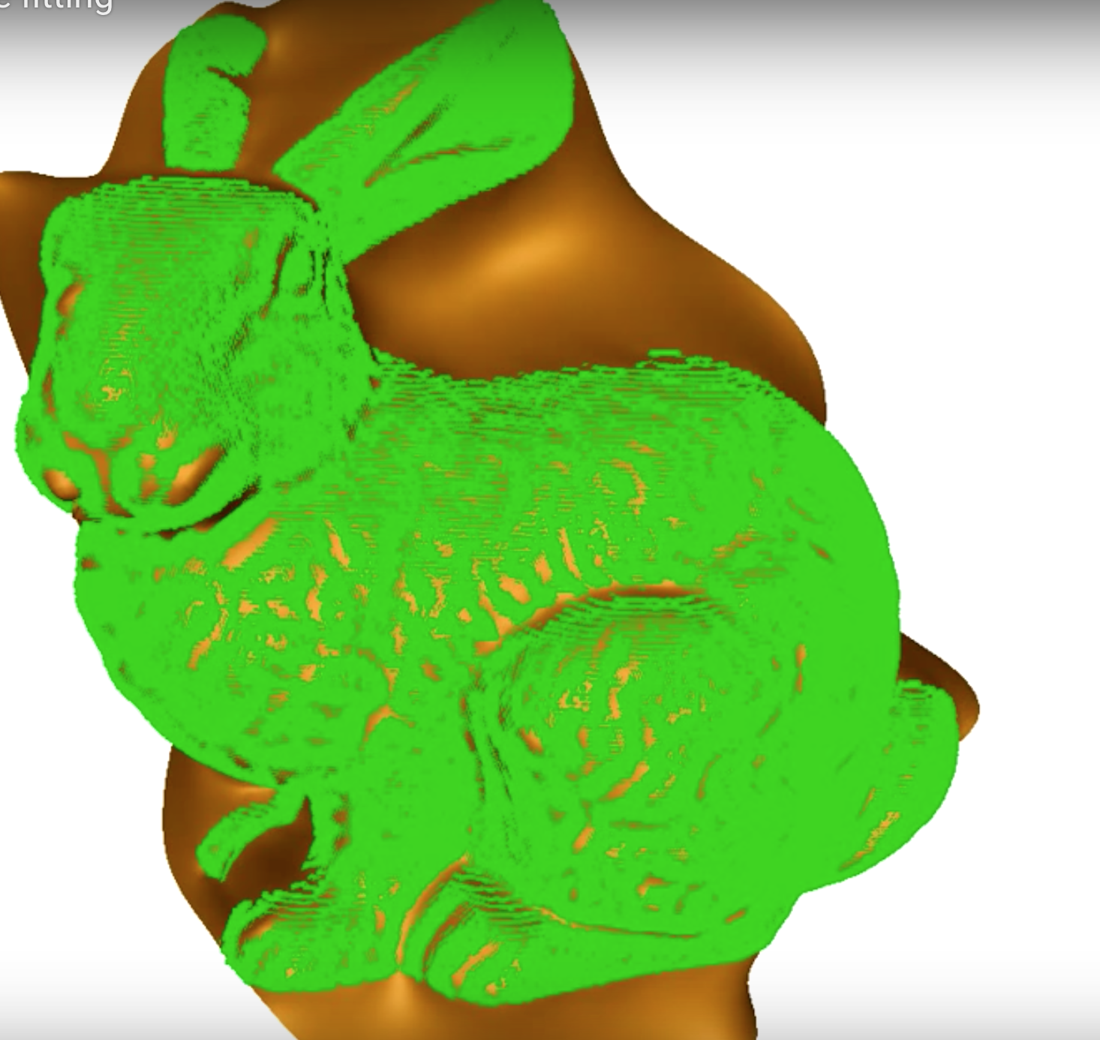
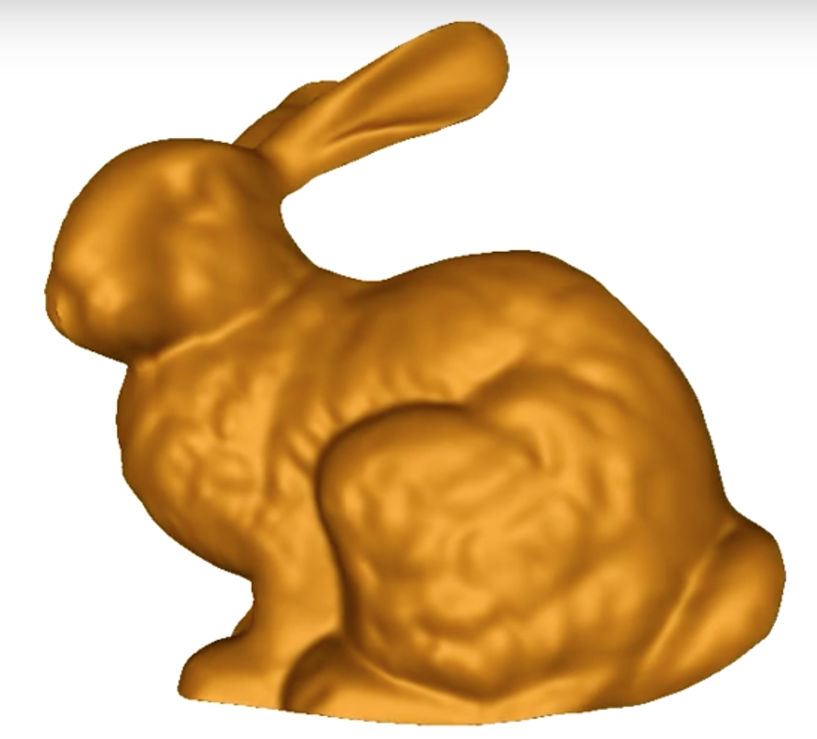
PCL Walkthrough: Surface
B-spline fitting algorithm to obtain a smooth, parametric surface representation.
17/37

Slide 20
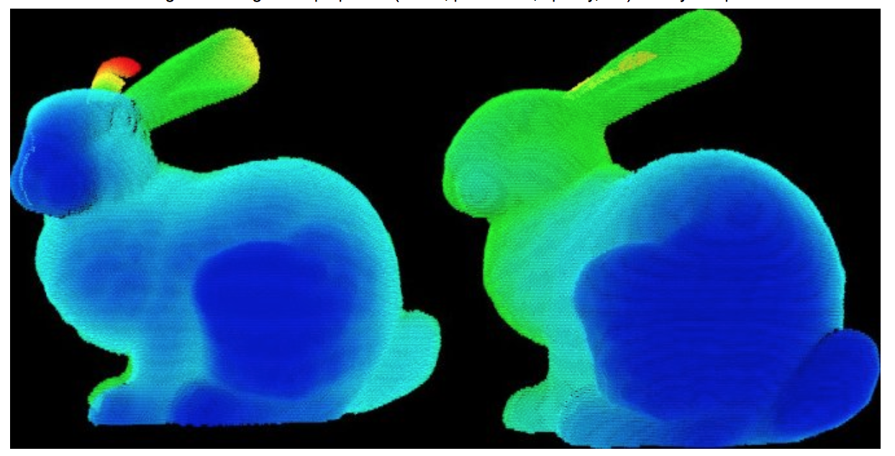
PCL Walkthrough: Visualization
Quickly prototype and visualize the results of algorithms operating on 3D point cloud data.
Similar to OpenCV’s highgui routines for displaying 2D images and for drawing basic 2D shapes on screen.
Rendering and setting visual properties (colors, point sizes, opacity, etc) for any n-D point cloud datasets
18/37

Slide 21
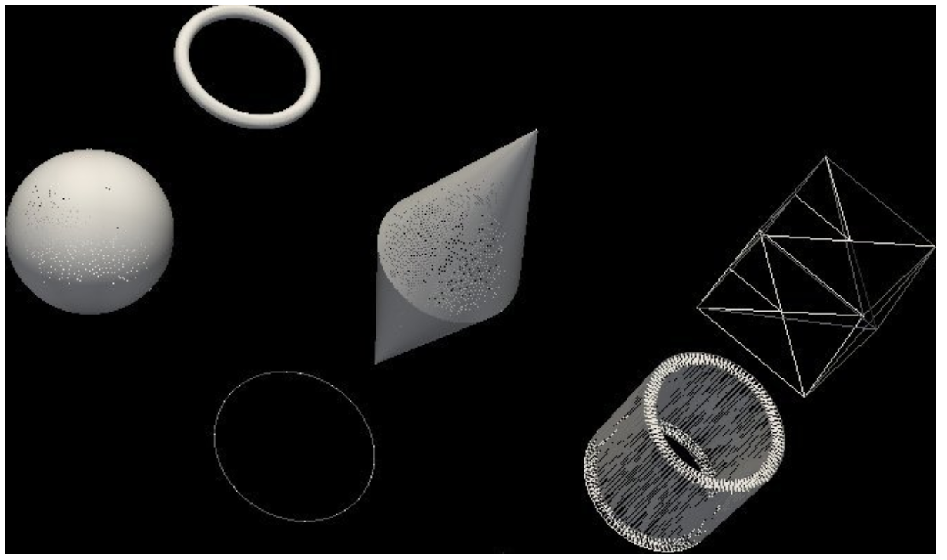
PCL Walkthrough: Visualization
Quickly prototype and visualize the results of algorithms operating on 3D point cloud data.
Similar to OpenCV’s highgui routines for displaying 2D images and for drawing basic 2D shapes on screen.
Drawing basic 3D shapes on screen (e.g., cylinders, spheres,lines, polygons, etc)
19/37

Slide 22
PCL Walkthrough: Visualization
Quickly prototype and visualize the results of algorithms operating on 3D point cloud data.
Similar to OpenCV’s highgui routines for displaying 2D images and for drawing basic 2D shapes on screen.
Histogram visualization module (PCLHistogramVisualizer) for 2D plots
20/37

Slide 23
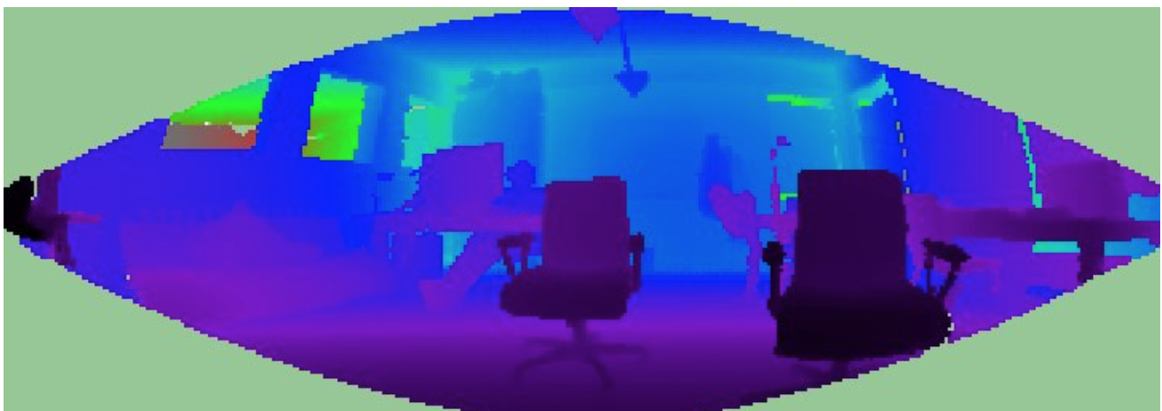
PCL Walkthrough: Visualization
Quickly prototype and visualize the results of algorithms operating on 3D point cloud data.
Similar to OpenCV’s highgui routines for displaying 2D images and for drawing basic 2D shapes on screen.
RangeImage visualization module
21/37

Slide 24
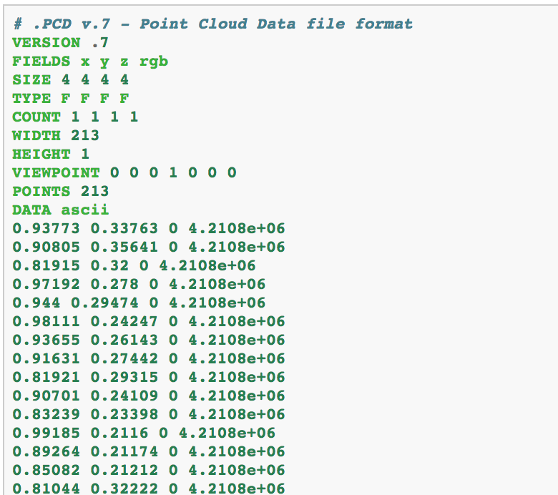
PCL Walkthrough: I/O
Contains classes and functions for reading and writing point cloud data (PCD/PLY/…) files.
Capturing point clouds from a variety of sensing devices.
PCD (Point Cloud Data)
point clouds can be stored to disk as files, into the PCD format.
PCD file consists of:
Header:
VERSION - specifies the PCD file version
FIELDS - specifies the name of each dimension/field that a point can have.
SIZE - specifies the size of each dimension in bytes
TYPE - specifies the type of each dimension as a char.
COUNT - specifies how many elements does each dimension have
WIDTH - specifies the width of the point cloud dataset in the number of points
HEIGHT - specifies the height of the point cloud dataset in the number of points.
22/37

Slide 25
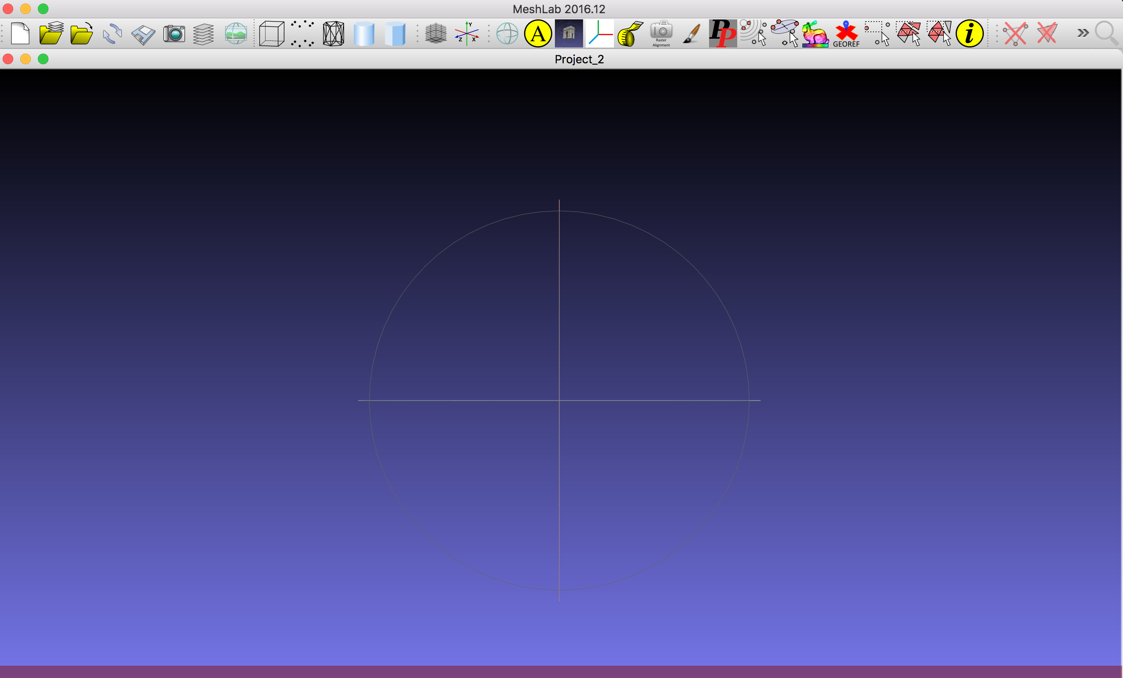
MeshLab:
Open source system for processing and editing 3D triangular meshes.
Available : Mac, Windows, Linux and Source.
You can use it to show point clouds.
23/37

Slide 26
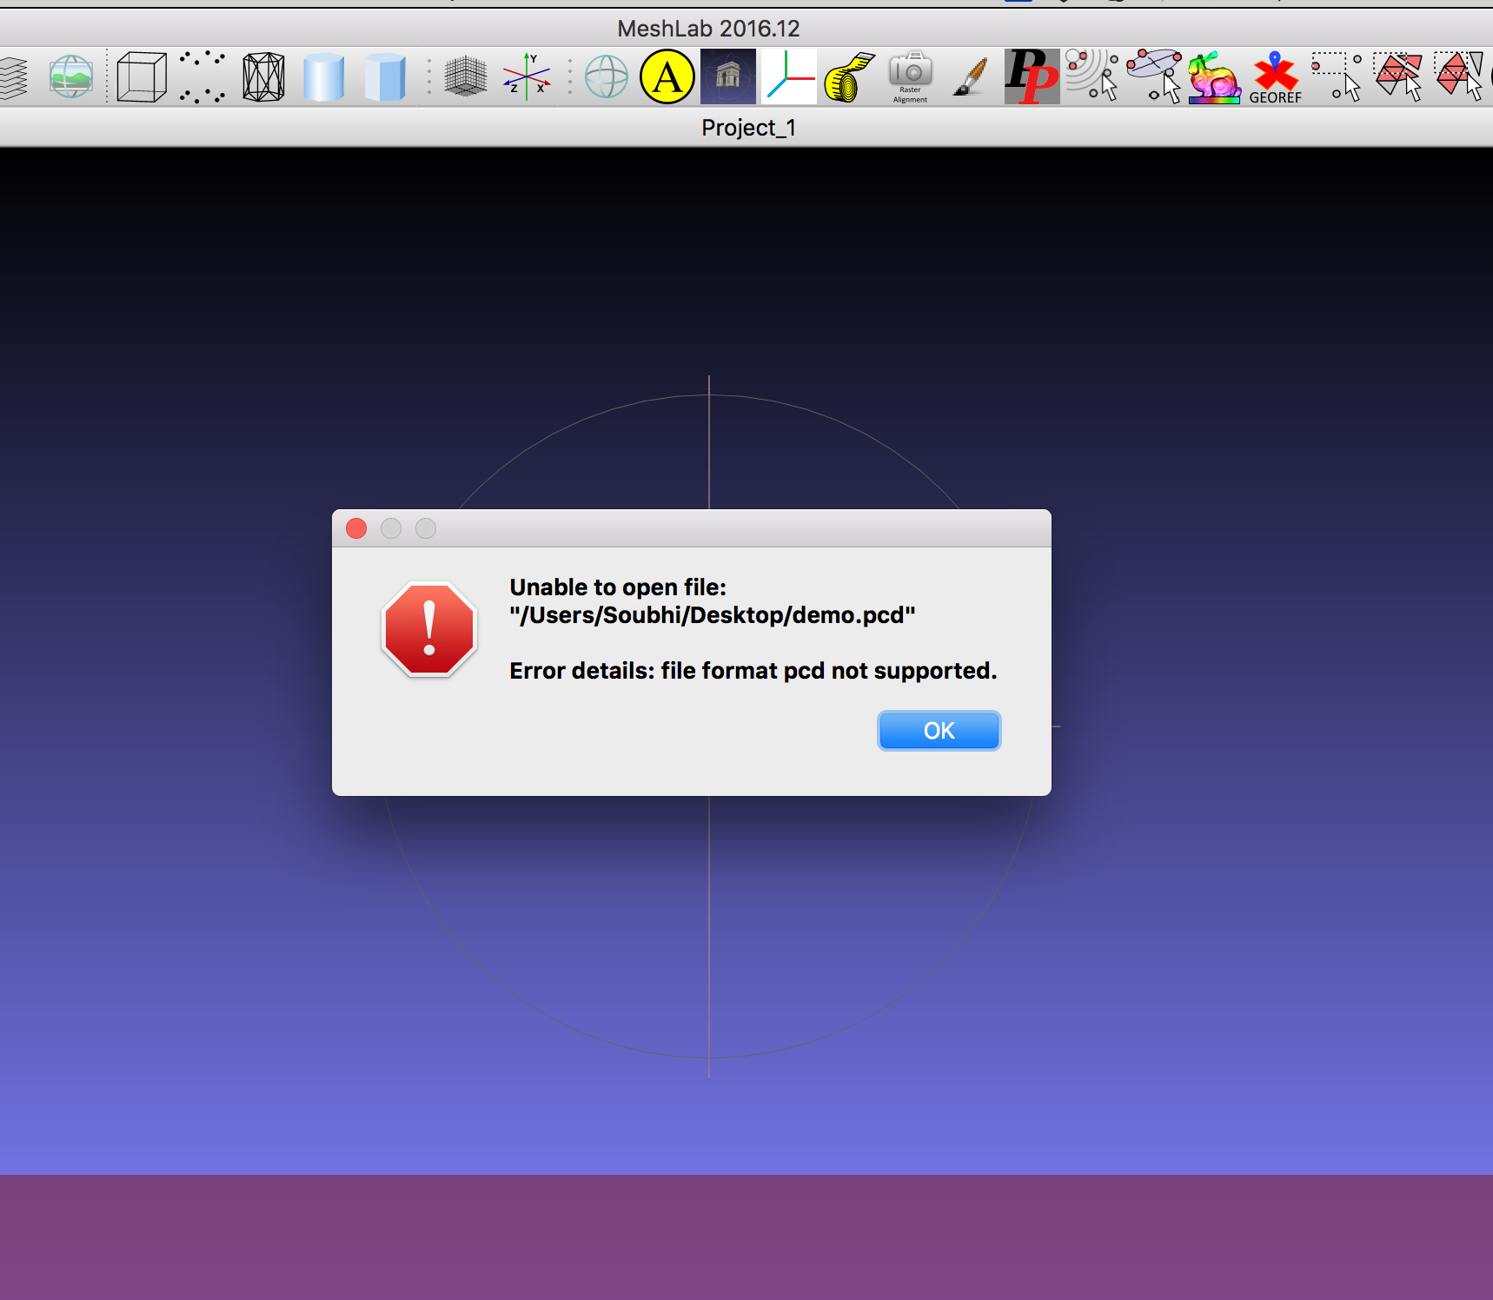
MeshLab:
Drag & Drop PCD file
24/37

Slide 27
PCL Installation:
Depends on 3rd party libraries:
Boost
Eigen
FLANN
VTK
Prebuilt binaries are available for Linux, Windows, and Mac OS X.
To build PCL out of sources:
Clone code from github.
PCL relies on CMake as a build tool.
25/37

Slide 28
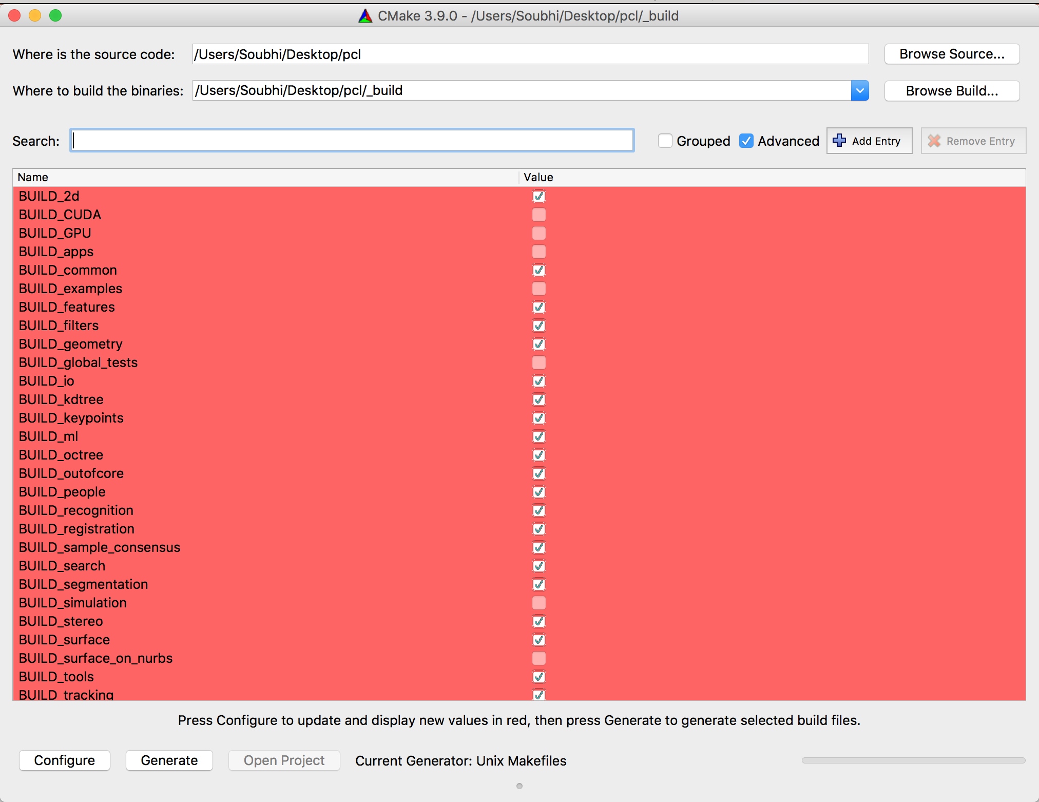
PCL Installation:
1
Set the configurations
2
4
5
3
26/37

Slide 29
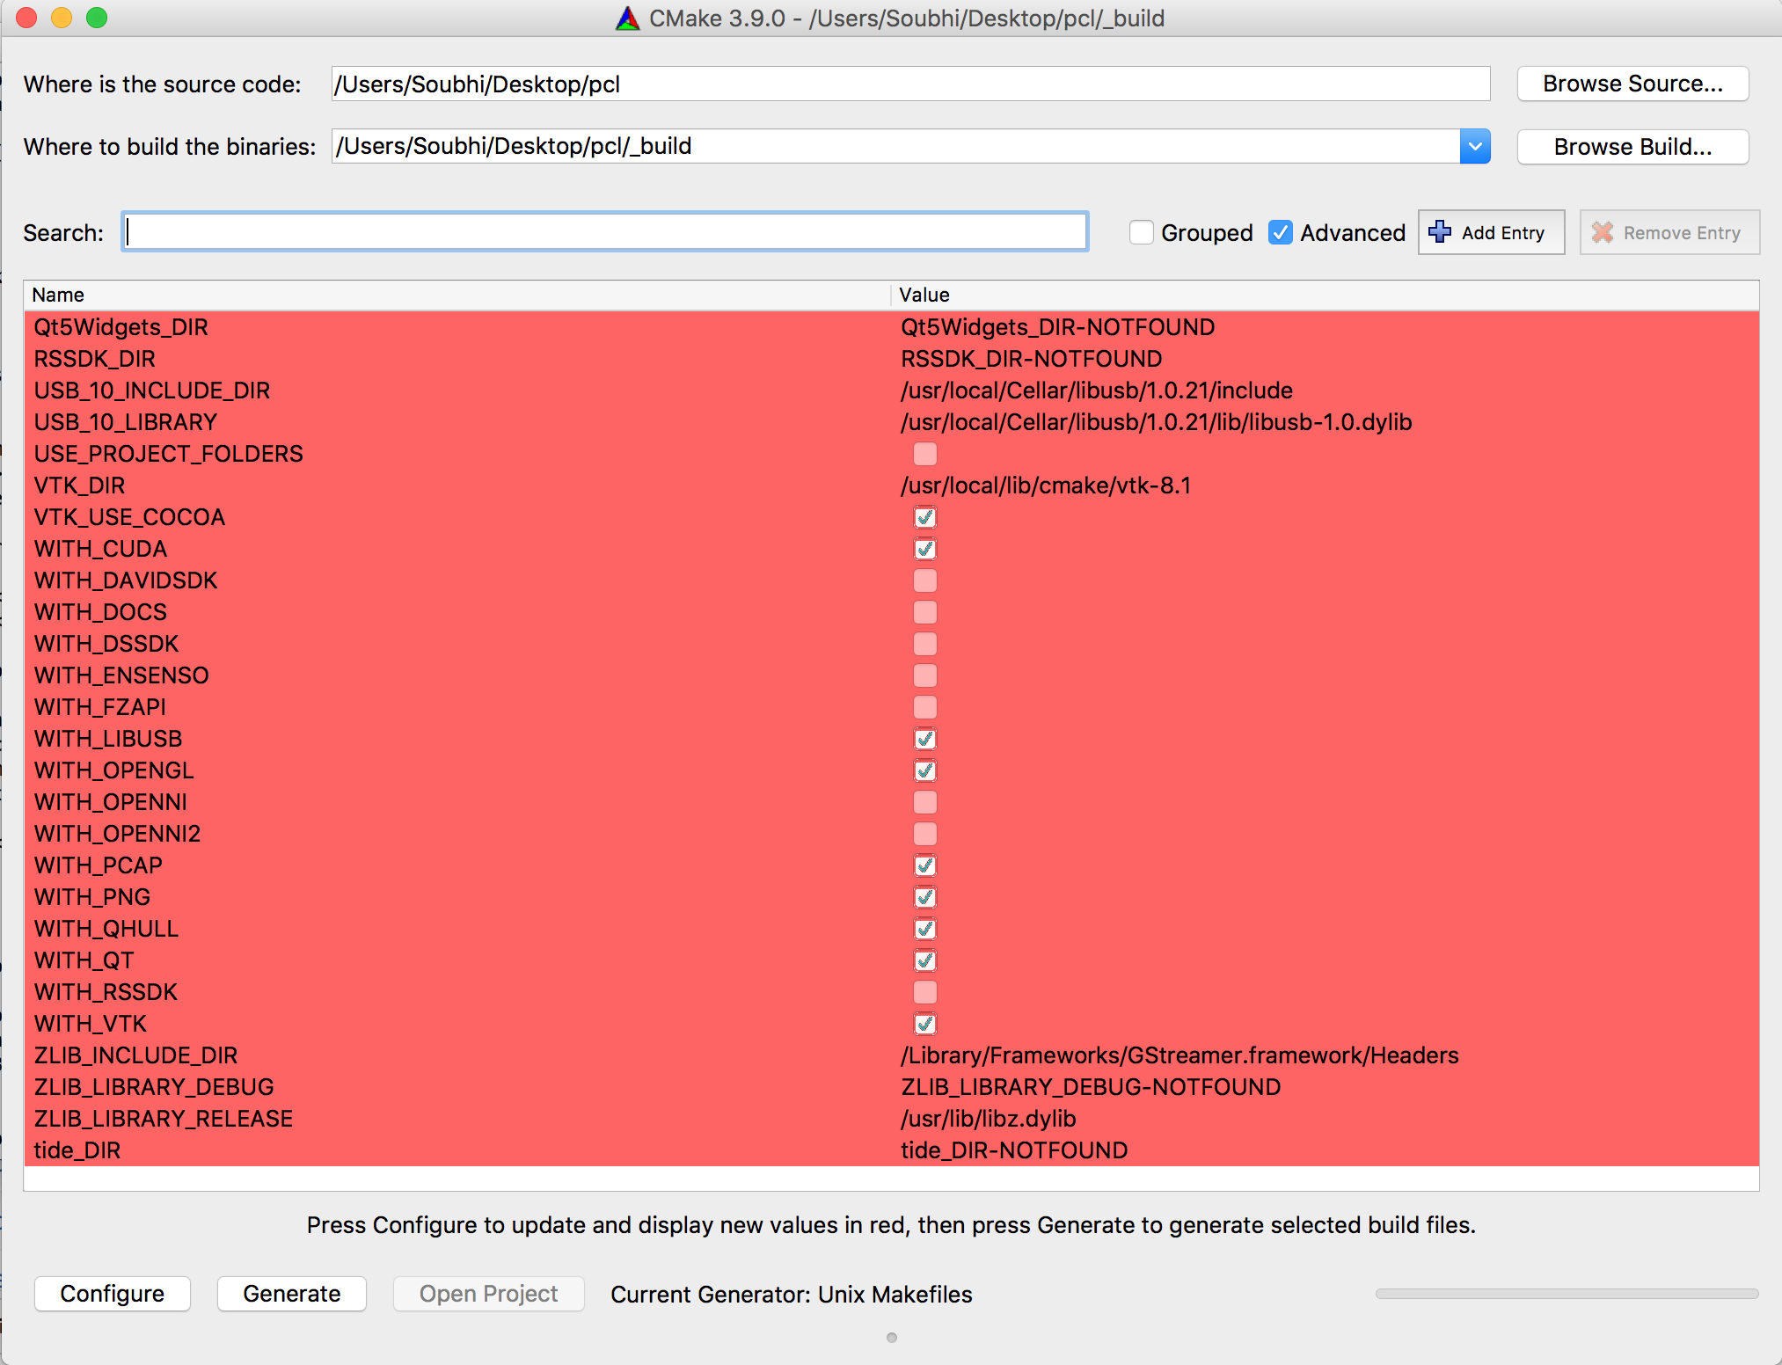
PCL Installation:
Configure.
Generate.
Go to _build and execute make
27/37

Slide 30
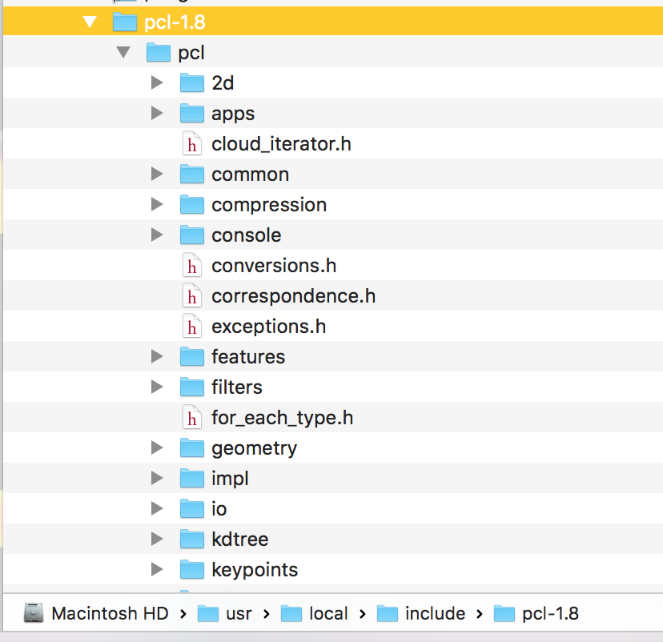
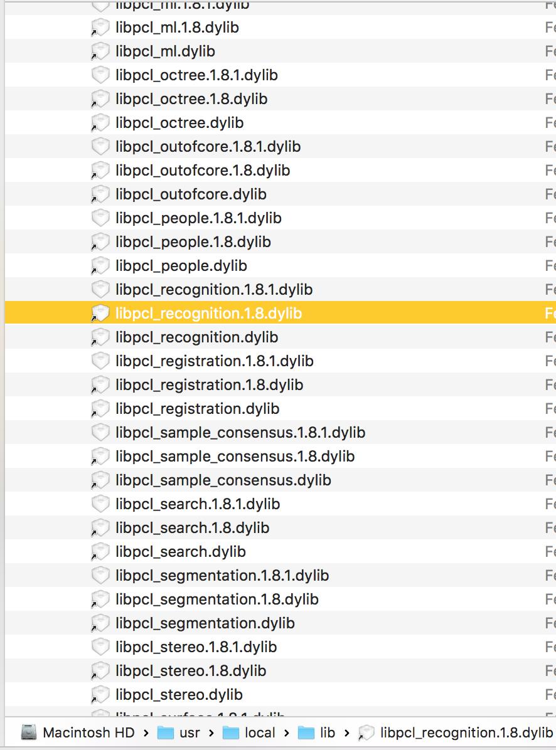
PCL Installation:
Execute make install in _build
28/37

Slide 31
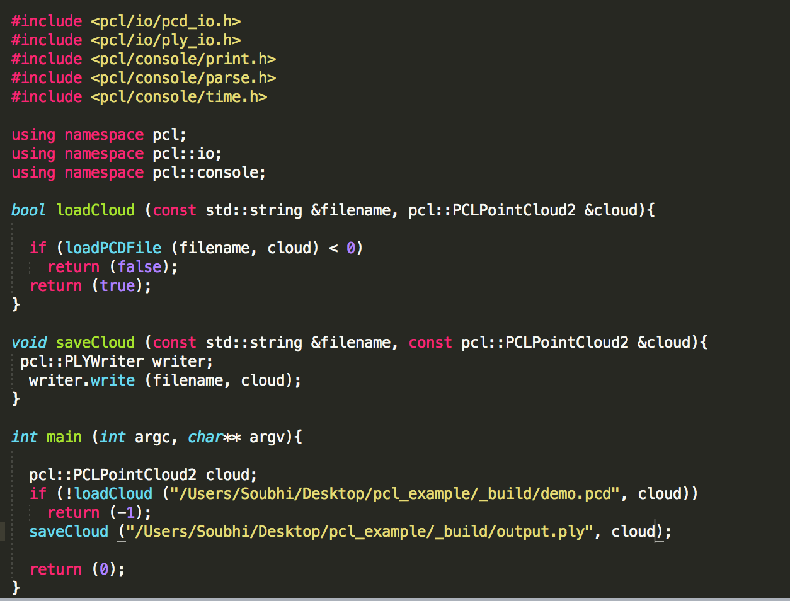
PCL Example:
To convert PCD to PLY:
C++ main code.
29/37

Slide 32
PCL Example:
To convert PCD to PLY:
C++ main code.
Cmakefile.
30/37

Slide 33
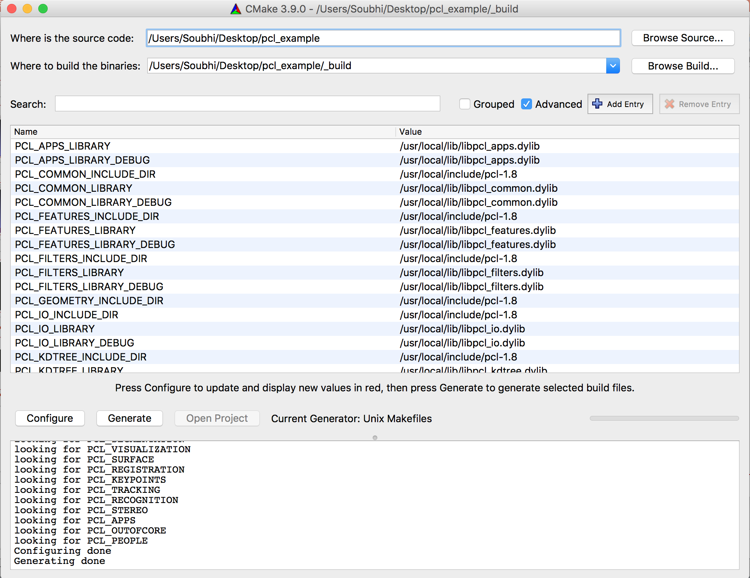
PCL Example:
To convert PCD to PLY:
C++ main code.
Cmakefile.
Cmake-GUI configure + generate.
31/37

Slide 34
PCL Example:
To convert PCD to PLY:
C++ main code.
Cmakefile.
Cmake-GUI configure + generate.
In _build folder execute make .
32/37

Slide 35
PCL Example:
To convert PCD to PLY:
C++ main code.
Cmakefile.
Cmake-GUI configure + generate.
In _build folder execute make .
Run pcl_example and check for ply output file
33/37

Slide 36
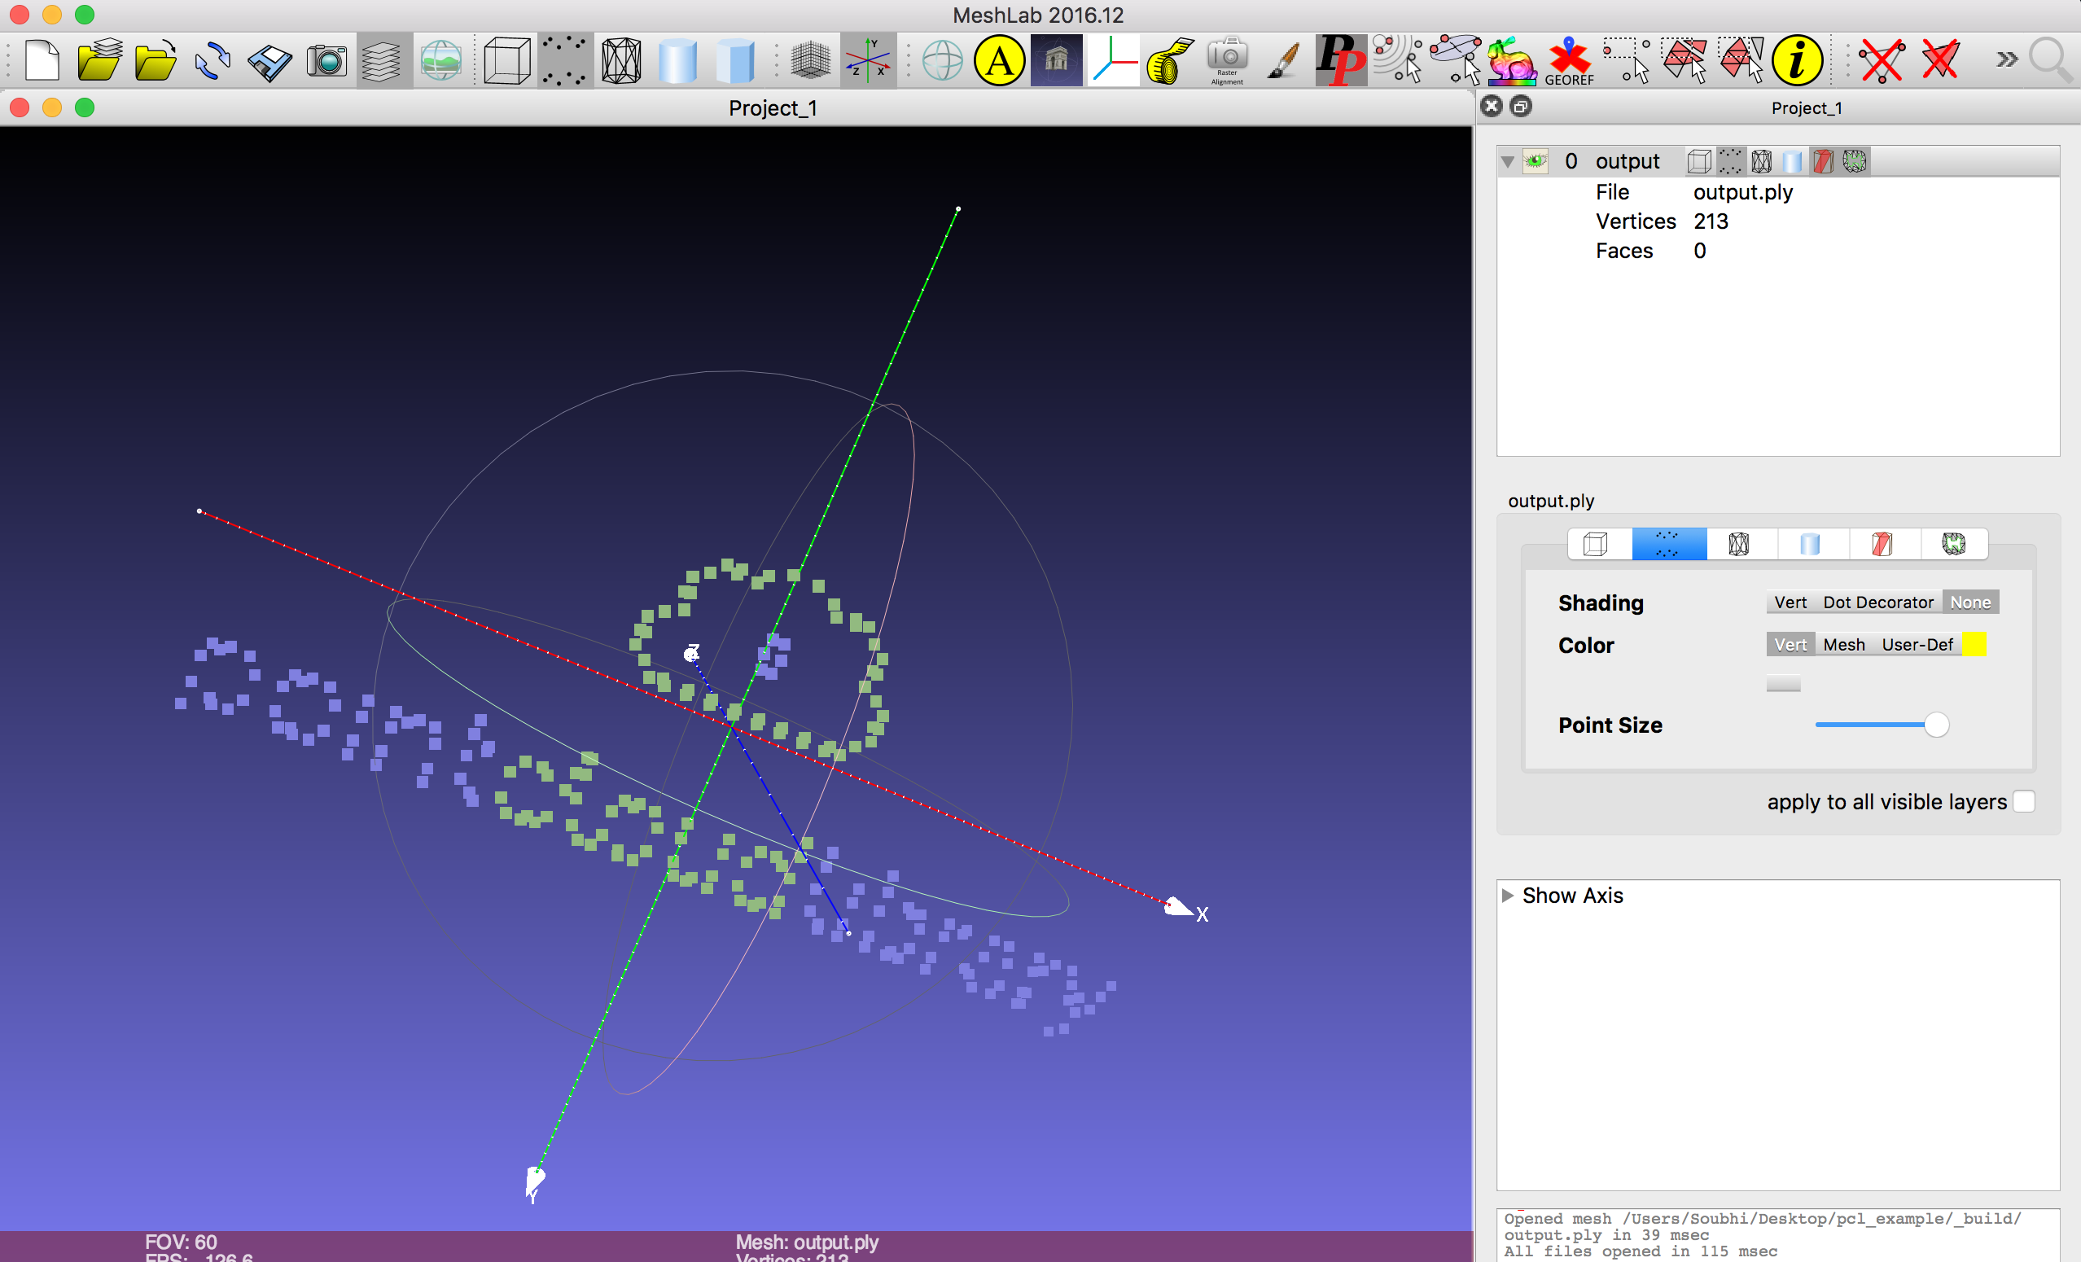
PCL Example:
34/37

Slide 37
Resources:
PCL official website : pointclouds.org.
MeshLab : meshlab.net.
35/37

Slide 38
Script on GitHub: PCD-2-PLY
36/37

Slide 39
Thank you
37/37

