Slide 1
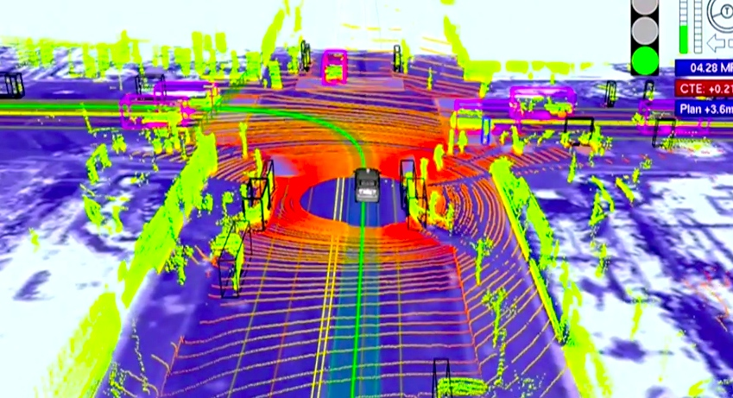
Computer Vision at the Dawn of Transportation Autonomy Eric Whiting

Slide 2
Abstract
After years of research and development, autonomous transportation is beginning to take off. What obstacles need to be overcome to allow for a future of autonomous transportation, and what role will computer vision play? As cost and stigma continue to hamstring self-driving vehicles computer vision will need to improve to make use of cheaper sensors while pushing for higher accuracy, quicker response time, and fewer errors. This presentation will examine the technology and methods currently being implemented in autonomous and semi-autonomous transportation, dive into emerging computer vision methods which may be able to push autonomy into the future, and hopefully catch a glimpse of what our future will be like with autonomous transportation with a focus on the role that computer vision has to play in that future.

Slide 3
Outline
Definition
Motivation
History
Current State
How current autonomous computer vision systems work
Technology in use
Issues with autonomy
Future State
Ideal State

Slide 4
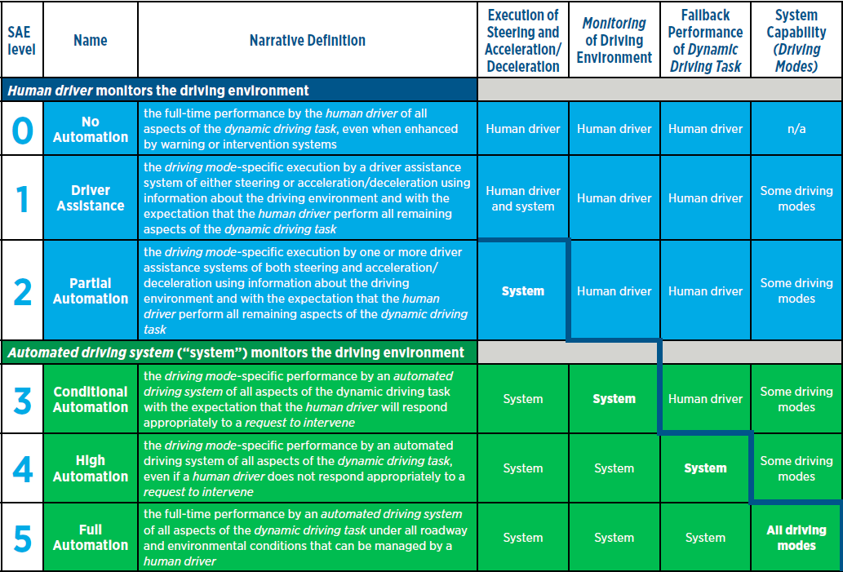

Slide 5
Motivation for Autonomy
Safety
37,601 Fatalities in 2016 (NHTSA) Up from 35,485 in 2015
2.4 million injuries in 2015
6.3 million police reported crashes in 2015
Time – Commute time used productively, Faster
Money
Multipurpose cars always transporting something
Reduce cost to society of traffic incidents (est. $836 Billion NHTSA 2016)
Traffic Reduction
Predictable behavior (no more road rage)
Communication between vehicles

Slide 6
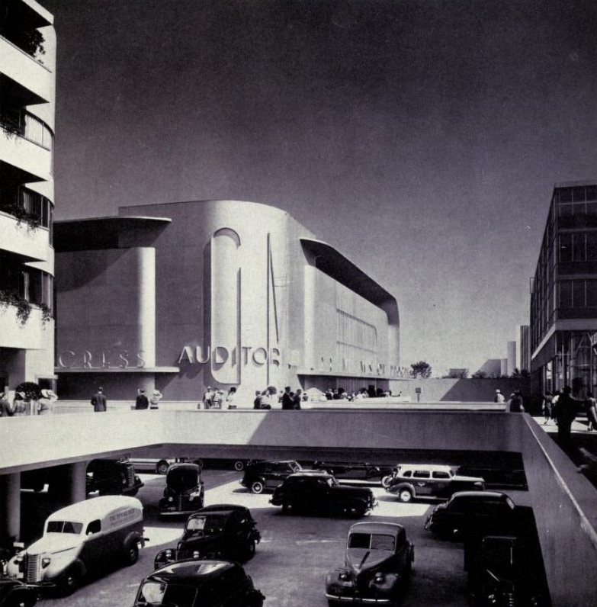
A Brief History of Autonomous Transportation

Slide 7
The Idea of Autonomy
1920s – Radio Controlled Cars
1930s – Concept of roadway-embedded circuits
1940s – Idea that humans should be removed from driving
1950s – Roadway-embedded guidance tested by RCA/GM
1960s - Roadway-embedded guidance R&D / Proposals in US and GB
1970s - Roadway-embedded guidance R&D as funding fizzles
Beginning of automation logic research

Slide 8
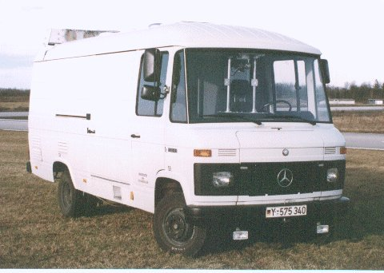
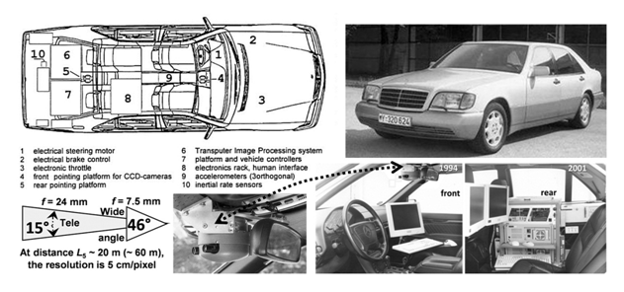
First Vision Guidance
The 80s saw the development of the first Robotic Cars
Ernst Dickmanns
VaMoRs (1986 Mercedes Van)
Lane Staying
Eureka Prometheus Project
Lane Changes
Saccadic Vision
Feature/Object detection
Kalmann Filtering for uncertain
sensor readings
Dickmanns, E. (2017). Developing the Sense of Vision for Autonomous Road Vehicles
at UniBwM. Computer, 50(12), 24-31.

Slide 11
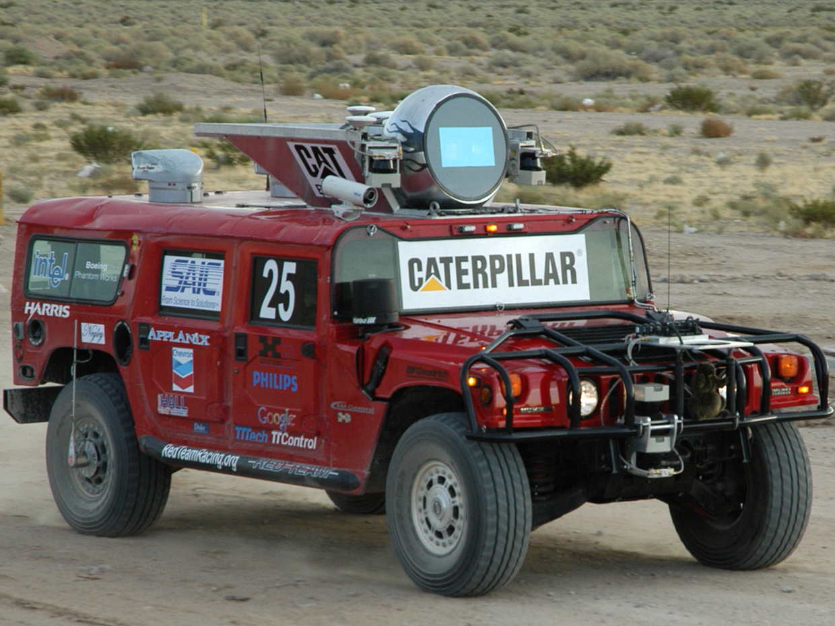
DARPA Grand Challenge 2005
LIDAR
GPS
Image
Inertial Sensors
Obstacle Detection
211 km off-road course
First held in 2004 but nobody completed the course… Not even close
Later held additional off-road competitions as well as urban competitions

Slide 12
Modern Autonomy 2010 on
Rapid technological advancement
Many parties working on the problem

Slide 13
Self Driving Car System
Computer Vision
Sensor Fusion
Localization
Path Planning
Control
Camera
LiDAR
Radar
Ultrasound
Accelerometers
Encoders
Computing
Software
Actuators
Control

Slide 14
CV Applications in self driving cars - NVIDIA

Slide 15
Computer Vision
Object Detection
Visual Interpretation
Line Detection
Optical Flow
Lights
Signs
Cars
People
Animals
Trees
Lanes
Curbs
Plates
Gestures
Motorcycles
Scooters
Cycles
Places
Robots
Behavior

Slide 16
Regional Convolutional Neural Networks (R-CNN) Object Detection Overview
Input an Image
Object Boundary Detection
Feature Detection
Object Identification
Refine Boundaries
Output Image with boxes and labels

Slide 17
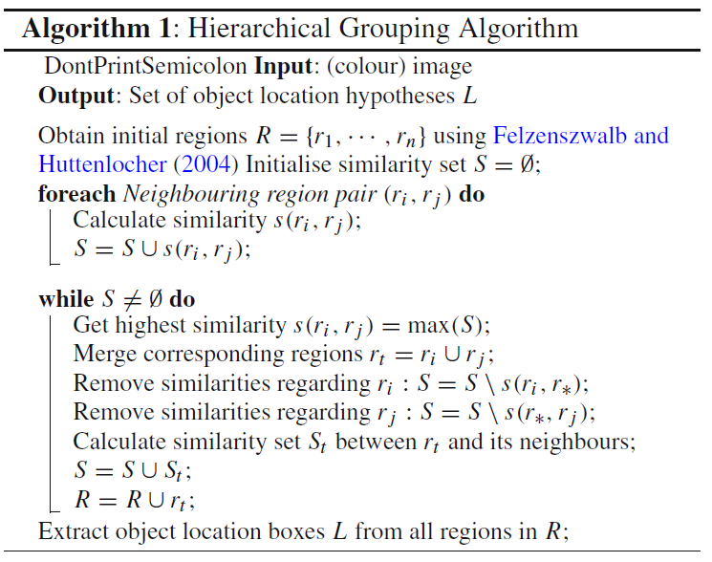
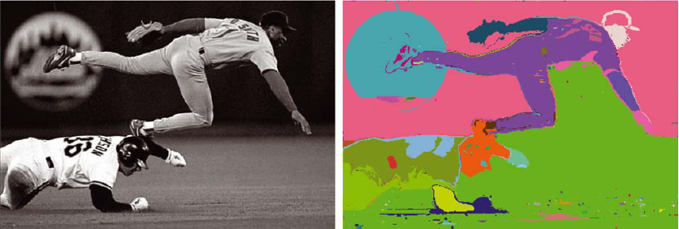
Regional Convolutional Neural Networks (R-CNN) Object Boundary Detection
Selective Search >
Initial Regions
Efficient Graph-Based Image Segmentation
Calculate Similarities
Merge Regions
Remove overlap
Output box locations

Slide 18
Regional Convolutional Neural Networks (R-CNN) Segmentation

Slide 19
Regional Convolutional Neural Networks (R-CNN) Selective Search

Slide 20
Regional Convolutional Neural Networks (R-CNN) CNN feature extraction
ImageNet
Warp image region to small, predefined size (eg 224x224x3)
5 Convolutional layers
2 Fully Connected Layers
4096-dimentional feature vector

Slide 21
Regional Convolutional Neural Networks (R-CNN) ImageNet

Slide 22
Regional Convolutional Neural Networks (R-CNN) ImageNet

Slide 23
Regional Convolutional Neural Networks (R-CNN) Object Identification
ImageNet
15 million high-res, labeled images
22 thousand categories
Compares image features to learned features
Computes a comparison histogram

Slide 24
Regional Convolutional Neural Networks (R-CNN) Object Identification

Slide 25
Regional Convolutional Neural Networks (R-CNN) Refine Boundaries
Linear Regression

Slide 26
R-CNN Improvements / Iterations
HoG-based (before CNN)
R-CNN
Fast R-CNN – RoI Pooling
Faster R-CNN – CNN-Based region proposal
Mask R-CNN (facebook) – Pixel-level regions

Slide 28
Sensor Fusion
Multiple Camera 3D mapping with LIDAR
Associating radar data with image data
Path Prediction
Tracking
Biometrics
Free Space
Result – 3D representation of the vehicles surroundings
Cameras
LIDAR
Radar
Ultrasound
Accelerometer
GPS
Odometer
IR

Slide 29
LIDAR / CV comparison
LiDAR hardware is much more expensive
CV has a longer range than LiDAR which maxes at about 100m
CV excels at object detection
CV is lighting dependent
CV has higher resolution and can see color
LiDAR excels at distance and speed calculation
Both can generate 3D models though LiDAR might be more practical in self driving cars
The combination of the 2 yields a better result that each do independently

Slide 30
Localization
GPS Accurate to 1-2 meters > Not sufficient alone
Pre-imaged LiDAR ground map
LiDAR distances to known landmarks
CV Image based localization
CV/LIDAR/Sonar calibrates location to GPS maps

Slide 31
Localization

Slide 32
Path Planning
Long-term path planning
Short term path planning
Open Driving Space Projection
Obstacle paths
Real Time tracking of all available tracks ahead
Traffic
Road Work
Accidents
Obstacles
Moving object paths
Emergency Vehicles
Predictive Path Modeling

Slide 33
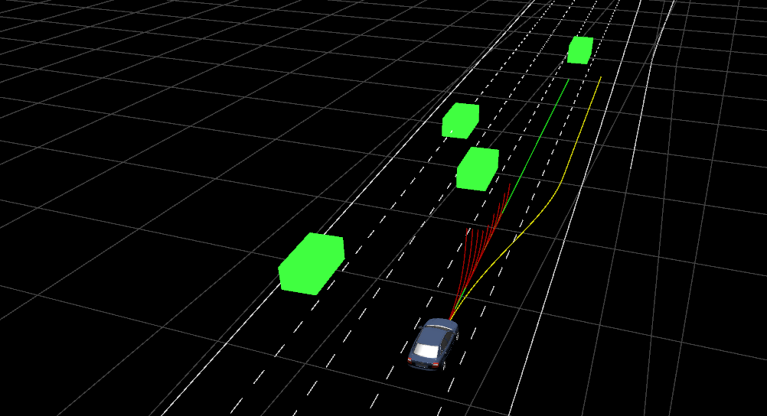

Slide 34
Control
Defines what the car needs to do given certain conditions
Steering, gas, brakes, etc
If object detected in front of car apply brakes
Emergency swerving maneuvers
Loss of traction situations
Unavoidable accidents

Slide 35
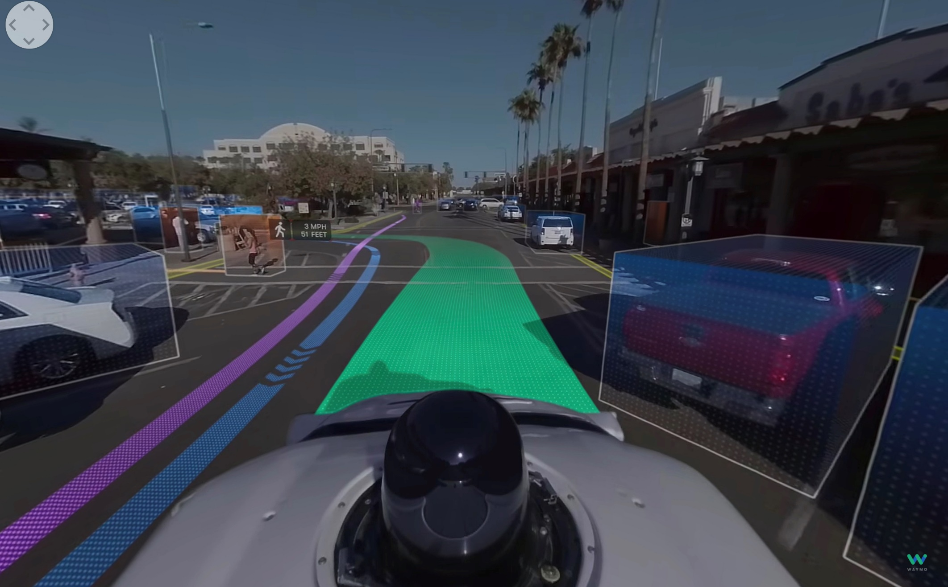

Slide 37
Cost Considerations / Outlook
Current system cost $70,000 - $150,000
LIDAR expensive but should become cheaper
Some estimate a 90% reduction in cost to ~$5,000 by 2025

Slide 38
Issues
In a no win situation, how does a computer know what to do?
CV computational cost vs LiDAR

Slide 39
Future
Connected Cars
Less or more CV dependent?
Human model vs machine model
Fully Driverless
Racing
Flight
Other Ideas?

Slide 40
Lessons Learned
CV is just a (critical) piece of the puzzle
Driverless Car CV is hot right now
February has 28 days
Black Hole of Papers
Barrier to Entry

Slide 41
Available Source Code and Info
http://cs.brown.edu/~pff/index.html (Segmentation) C++
https://www.learnopencv.com/selective-search-for-object-detection-cpp-python/ (Selective Search openCV tutorial)
http://caffe.berkeleyvision.org/
http://www.rossgirshick.info (R-CNN code, info, versions) Python
Udacity Self Driving Car Nanodegree

Slide 42
Sources
Dickmanns, E. (2017). Developing the Sense of Vision for Autonomous Road Vehicles at UniBwM. Computer, 50(12), 24-31.
Uijlings, J., Sande, R., Gevers, K., & Smeulders, E. (2013). Selective Search for Object Recognition. International Journal of Computer Vision, 104(2), 154-171.
Felzenszwalb, P., & Huttenlocher, F. (2004). Efficient Graph-Based Image Segmentation. International Journal of Computer Vision, 59(2), 167-181.
Krizhevsky, A., Sutskever, I., & Hinton, G. (2017). ImageNet classification with deep convolutional neural networks. Communications of the ACM, 60(6), 84-90.
Girshick, R., Donahue, J., Darrell, T., & Malik, J. (2013). Rich feature hierarchies for accurate object detection and semantic segmentation.
http://www.cs.cmu.edu/~zkolter/pubs/levinson-iv2011.pdf
http://www.cis.upenn.edu/~jshi/GraphTutorial/Tutorial-ImageSegmentationGraph-cut1-Shi.pdf
https://blog.athelas.com/a-brief-history-of-cnns-in-image-segmentation-from-r-cnn-to-mask-r-cnn-34ea83205de4
https://medium.com/udacity/how-self-driving-cars-work-f77c49dca47e
https://spectrum.ieee.org/cars-that-think/transportation/self-driving/cmu-solves-12-year-old-darpa-grand-challenge-mystery
https://web.archive.org/web/20170903105244/https://www.sae.org/misc/pdfs/automated_driving.pdf
http://www.templetons.com/brad/robocars/cameras-lasers.html
http://robohub.org/how-do-self-driving-cars-work/
https://www.reuters.com/article/us-autos-delphi/self-driving-costs-could-drop-90-percent-by-2025-delphi-ceo-says-idUSKBN1DY2AC
https://towardsdatascience.com/helping-a-self-driving-car-localize-itself-88705f419e4a
https://www.youtube.com/watch?time_continue=1&v=D1jds-KxXJA
https://www.youtube.com/watch?v=dLwdY0S_8DY
https://www.youtube.com/watch?time_continue=3&v=_bRwX9n3z4k
https://www.youtube.com/watch?v=B8R148hFxPw
https://www.youtube.com/watch?v=aircAruvnKk&t=1s
https://www.youtube.com/watch?v=IHZwWFHWa-w&t=1004s
https://www.youtube.com/watch?v=Ilg3gGewQ5U&t=3s

Slide 43
Thank You!

