Slide 1
Resampling
Samuel Cheng
Slide credits: Noah Snavely

Slide 2
Tentative presentation schedule
Date | Location | # presentations
Feb 27 | Norman | 1
March 1 | Norman | 2
March 6 | Norman | 2
March 13 | Tulsa | 2
March 15 | Tulsa | 1
Title and abstract due: Feb 15
Speaker schedule TBD: next Tuesday

Slide 3
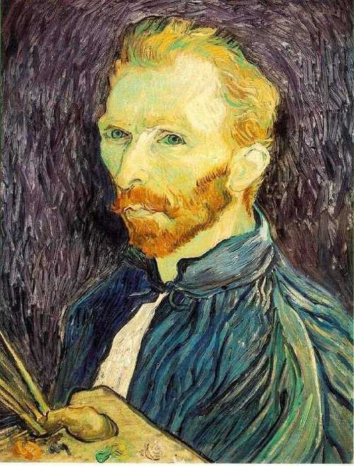
Image Scaling
This image is too big to fit on the screen. How can we generate a half-sized version?
Source: S. Seitz

Slide 4

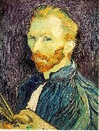

Image sub-sampling
1/8
1/4
Throw away every other row and column to create a 1/2 size image
  - called image sub-sampling
Source: S. Seitz

Slide 5
Image sub-sampling
1/2
1/4 (2x zoom)
1/8 (4x zoom)
Why does this look so crufty?
Source: S. Seitz

Slide 6
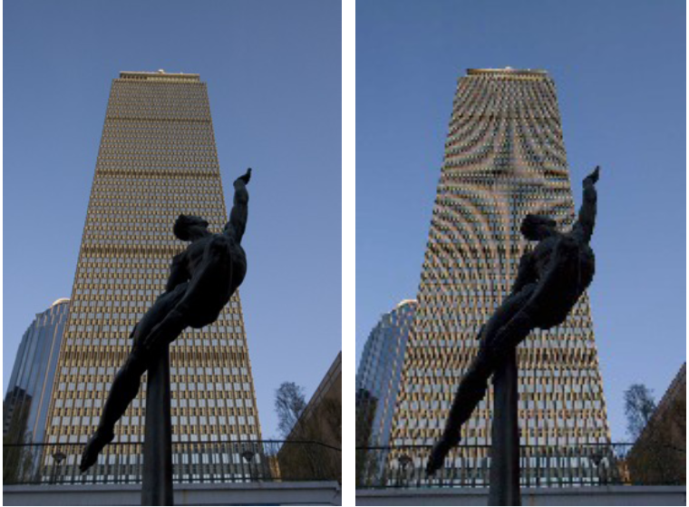
Image sub-sampling
Source: F. Durand

Slide 7
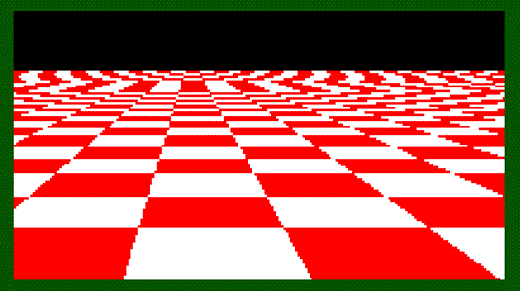
Even worse for synthetic images
Source: L. Zhang

Slide 8
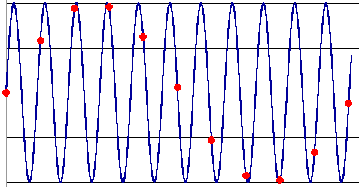
Aliasing
Occurs when your sampling rate is not high enough to capture the amount of detail in your image
Can give you the wrong signal/image—an alias
To do sampling right, need to understand the structure of your signal/image
Enter Monsieur Fourier…
To avoid aliasing:
  sampling rate ≥ 2 * max frequency in the image
    said another way: ≥ two samples per cycle
  This minimum sampling rate is called the Nyquist rate
Source: L. Zhang

Slide 9
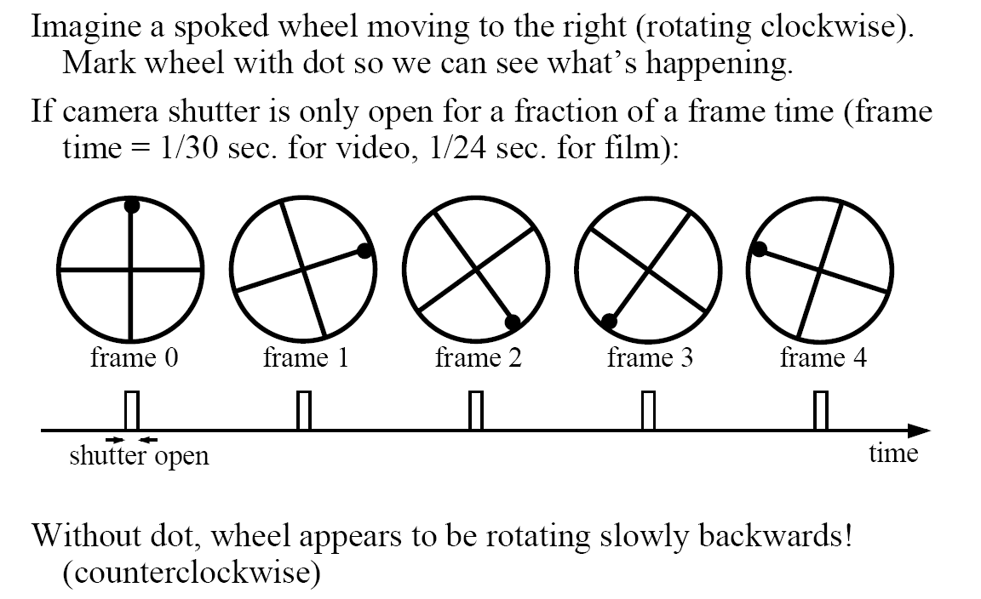
Wagon-wheel effect
(See http://www.michaelbach.de/ot/mot_wagonWheel/index.html)
Source: L. Zhang

Slide 10
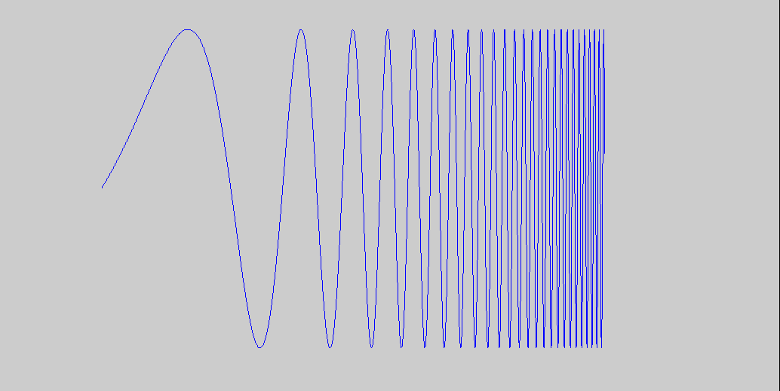
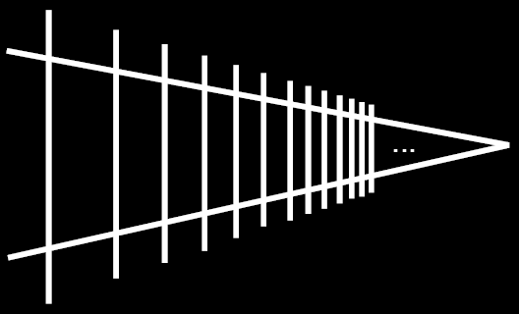
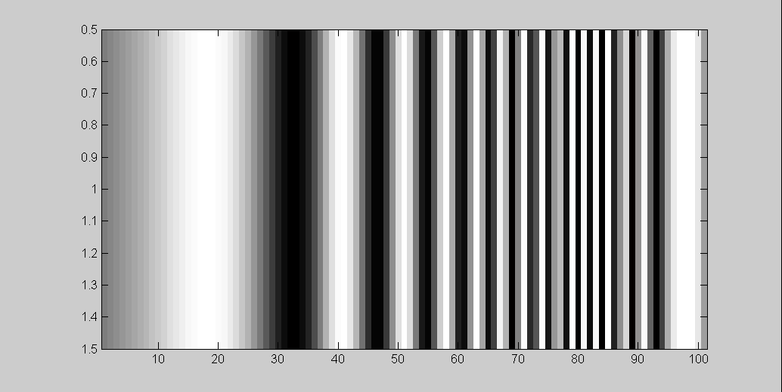
Alias: n., an assumed name
Input signal:
Matlab output:
Picket fence receding
Into the distance will
produce aliasing…
WHY?
x = 0:.05:5; imagesc(sin((2.^x).*x))
Aj-aj-aj:
Alias!
Not enough samples

Slide 11
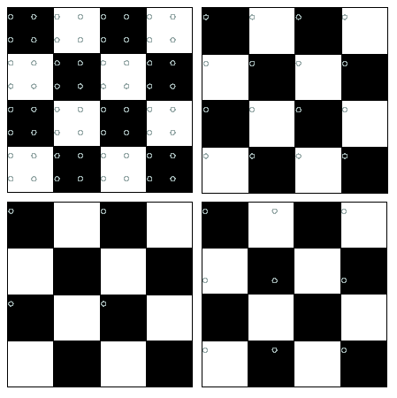
Nyquist limit – 2D example
Good sampling
Bad sampling

Slide 12
Aliasing
When downsampling by a factor of two
  Original image has frequencies that are too high
How can we fix this?

Slide 13



Gaussian pre-filtering
G 1/8
G 1/4
Gaussian 1/2
Solution: filter the image, then subsample
Source: S. Seitz

Slide 14
Subsampling with Gaussian pre-filtering
Gaussian 1/2
G 1/4
G 1/8
Solution: filter the image, then subsample
Source: S. Seitz

Slide 15
Compare with...
1/2
1/4 (2x zoom)
1/8 (4x zoom)
Source: S. Seitz

Slide 16

Upsampling
This image is too small for this screen:
How can we make it 10 times as big?
Simplest approach:
repeat each row
and column 10 times
(“Nearest neighbor
interpolation”)

Slide 17


Image interpolation
d = 1 in this
example
1
2
3
4
5
Recall how a digital image is formed
  It is a discrete point-sampling of a continuous function
  If we could somehow reconstruct the original function, any new image could be generated, at any resolution and scale
Adapted from: S. Seitz

Slide 18
Image interpolation
d = 1 in this
example
1
2
3
4
5
Recall how a digital image is formed
  It is a discrete point-sampling of a continuous function
  If we could somehow reconstruct the original function, any new image could be generated, at any resolution and scale
Adapted from: S. Seitz

Slide 19




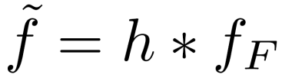
Image interpolation
1
d = 1 in this
example
1
2
2.5
3
4
5
What if we don’t know ?
  Guess an approximation:
  Can be done in a principled way: filtering
  Convert to a continuous function:
  Reconstruct by convolution with a reconstruction filter, h
Adapted from: S. Seitz

Slide 20
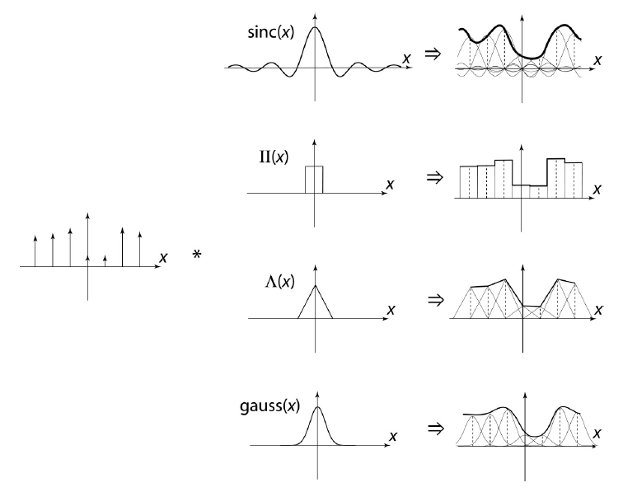
Image interpolation
“Ideal” reconstruction
Nearest-neighbor interpolation
Linear interpolation
Gaussian reconstruction
Source: B. Curless

Slide 21
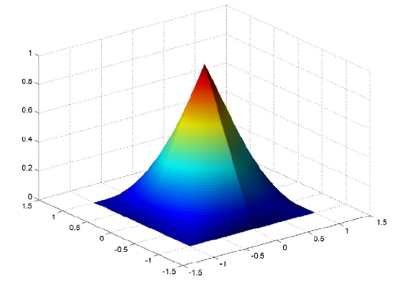



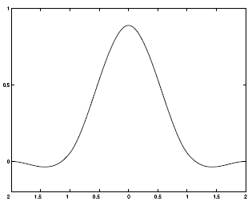
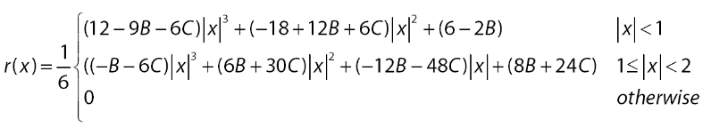
Reconstruction filters
What does the 2D version of this hat function look like?
performs
linear interpolation
(tent function) performs
bilinear interpolation
Often implemented without cross-correlation
  E.g., http://en.wikipedia.org/wiki/Bilinear_interpolation
Better filters give better resampled images
  Bicubic is common choice
Cubic reconstruction filter

Slide 22


Image interpolation
Original image: x 10
Nearest-neighbor interpolation
Bilinear interpolation
Bicubic interpolation

Slide 23

DSP Interpretation
↑

Slide 24
Image resampling
↑
↓
Upsampling
downsampling

Slide 25
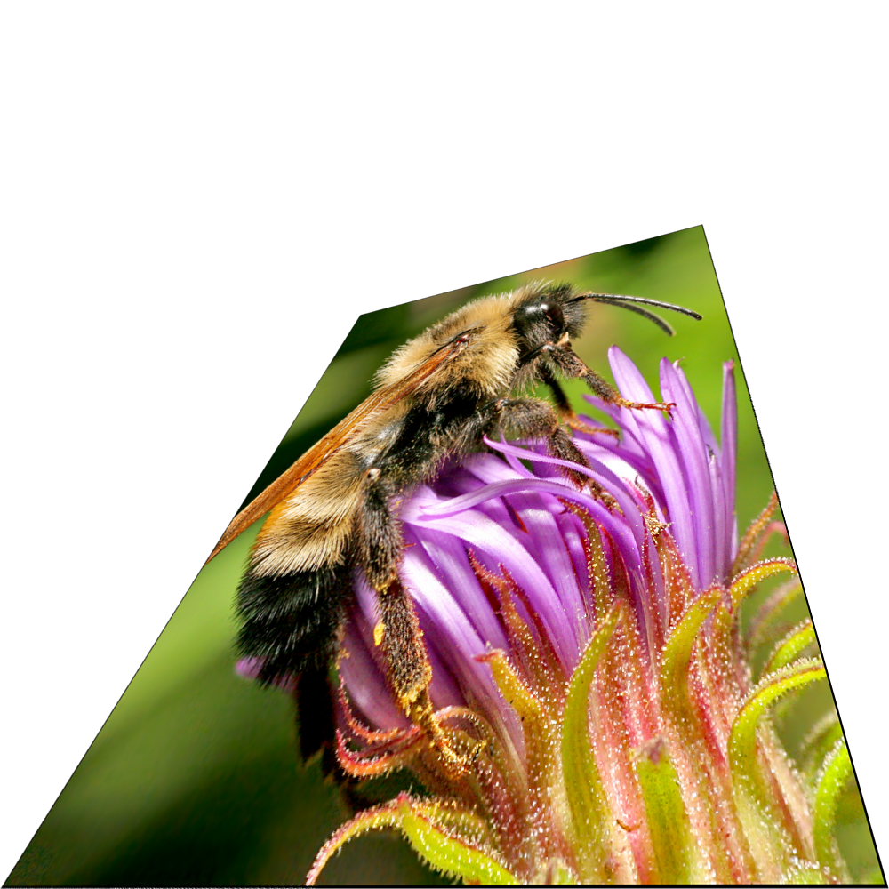
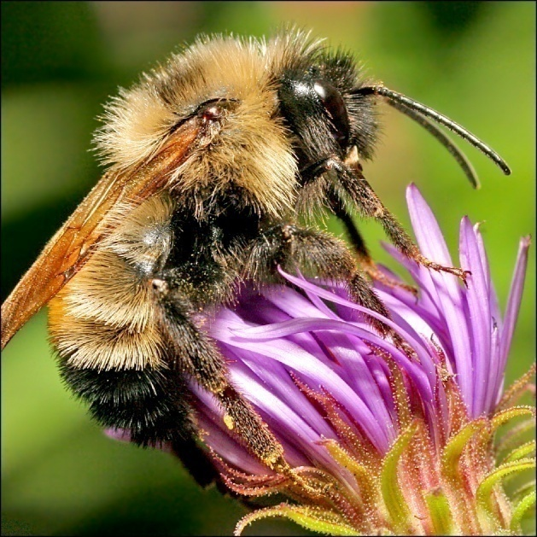
Image interpolation
Also used for resampling

Slide 26
Questions?

Slide 27
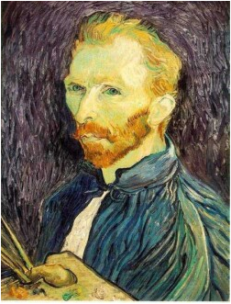







Gaussian pyramid
F₀
F₁
F₂
…
blur
subsample
blur
subsample
F₀ H
F₁ H
*
*

Slide 28
{
Gaussian pyramid
F₀
F₁
F₂
…
blur
subsample
blur
subsample
F₀ H
F₁ H
*
*

Slide 29
{
Gaussian pyramid
F₀
F₁
F₂
…
blur
subsample
blur
subsample
F₀ H
F₁ H
*
*

Slide 30
The Gaussian Pyramid
Low resolution
blur
sub-sample
blur
sub-sample
sub-sample
blur
sub-sample
blur
High resolution

Slide 31
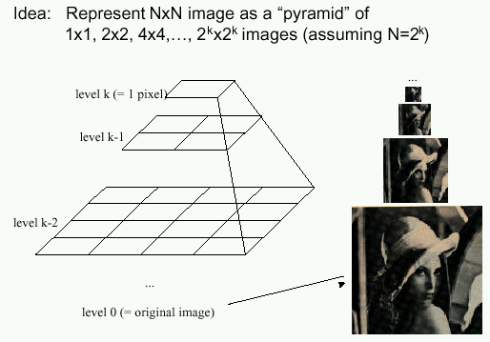
Gaussian pyramids
[Burt and Adelson, 1983]
In computer graphics, a mip map [Williams, 1983]
A precursor to wavelet transform
Gaussian Pyramids have all sorts of applications in computer vision
Source: S. Seitz

Slide 32
Gaussian pyramids
[Burt and Adelson, 1983]
How much space does a Gaussian pyramid take compared to the original image?
Source: S. Seitz

Slide 33
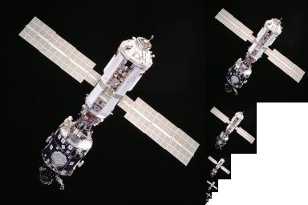
Gaussian Pyramid

