Slide 1
Image Segmentation
Samuel Cheng
Slide credit: Juan Carlos Niebles, Ranjay Krishna, Noah Snavely

Slide 2
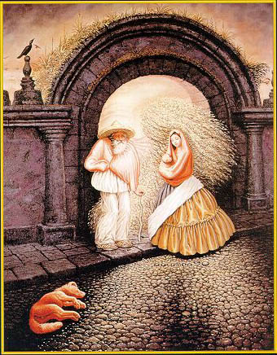

Slide 3
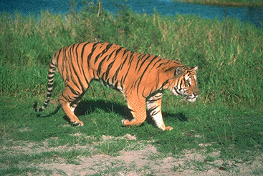
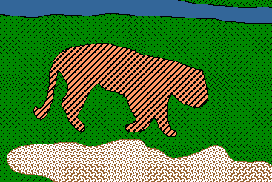
Image Segmentation
Goal: identify groups of pixels that go together
Slide credit: Steve Seitz, Kristen Grauman

Slide 4
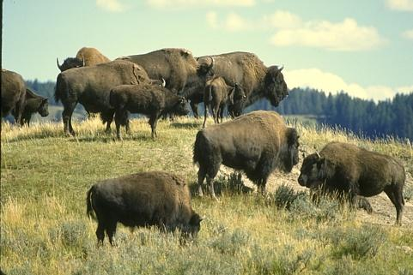
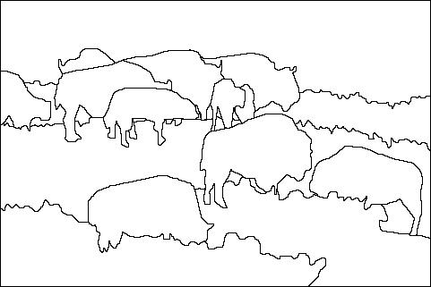
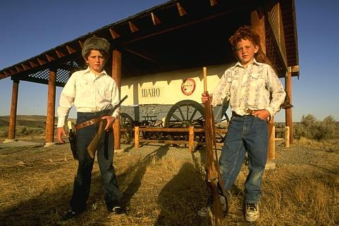
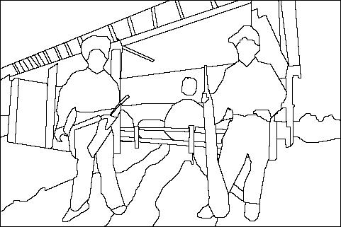
The Goals of Segmentation
Separate image into coherent “objects”
Image
Human segmentation
Slide credit: Svetlana Lazebnik

Slide 5
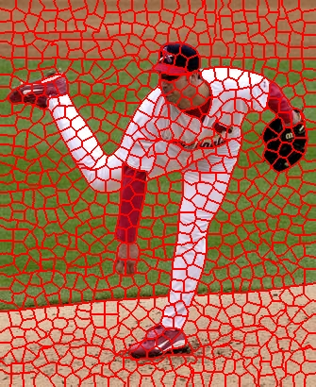
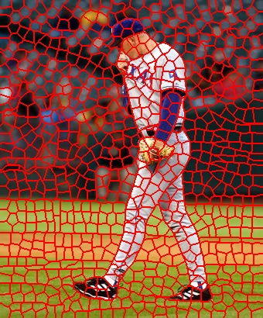
The Goals of Segmentation
Separate image into coherent “objects”
Group together similar-looking pixels for efficiency of further processing
“superpixels”
Slide credit: Svetlana Lazebnik
X. Ren and J. Malik. Learning a classification model for segmentation. ICCV 2003.

Slide 6
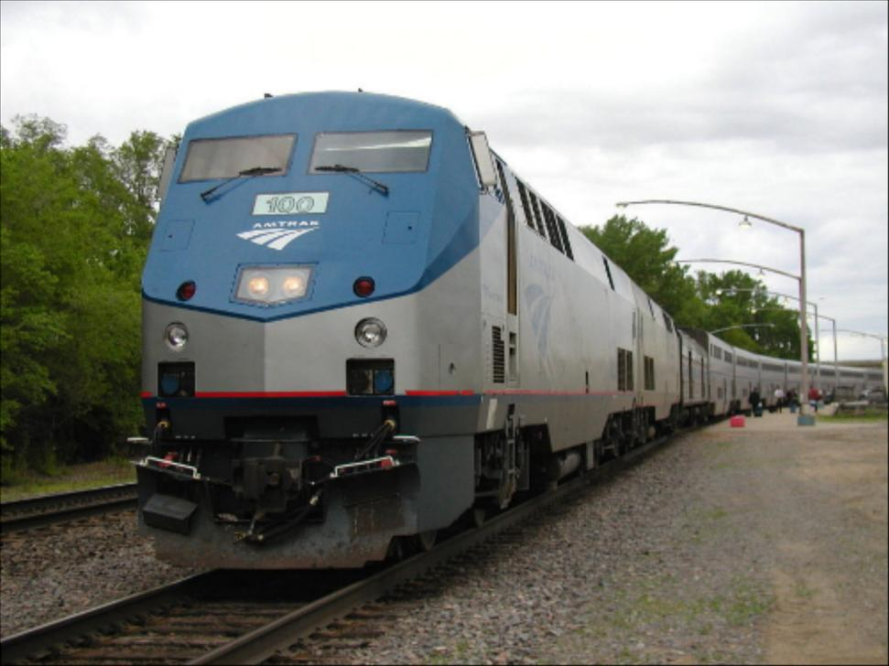
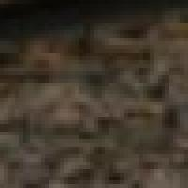
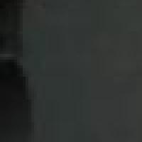
Segmentation for feature support
50x50 Patch
50x50 Patch
Slide: Derek Hoiem

Slide 7
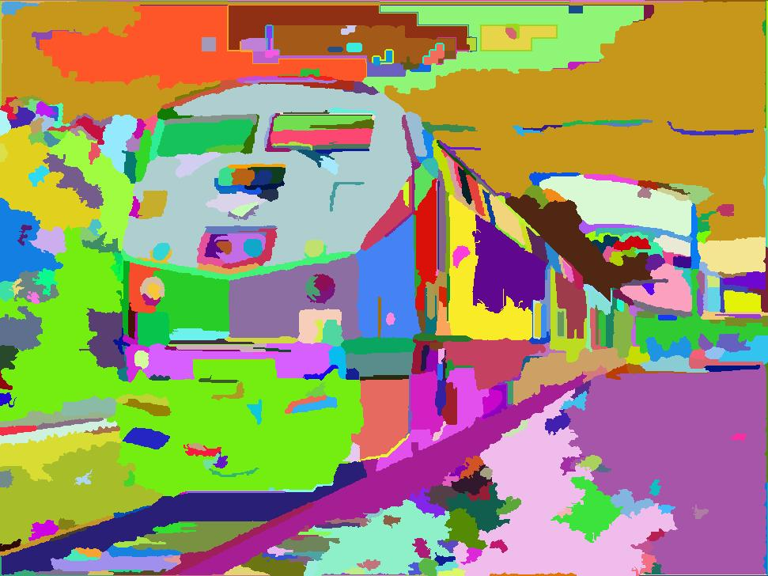
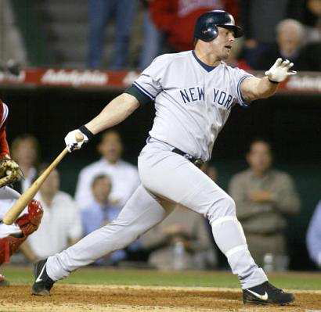
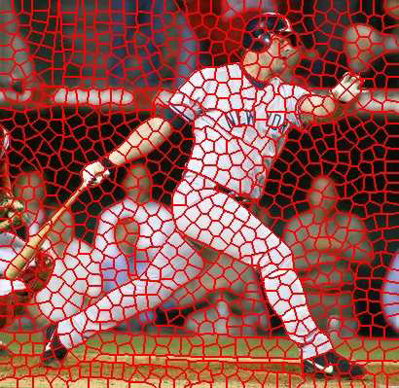
Segmentation for efficiency
[Felzenszwalb and Huttenlocher 2004]
[Hoiem et al. 2005, Mori 2005]
[Shi and Malik 2001]
Slide: Derek Hoiem

Slide 8
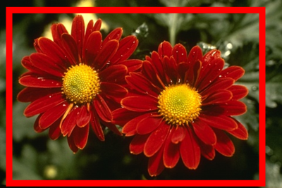
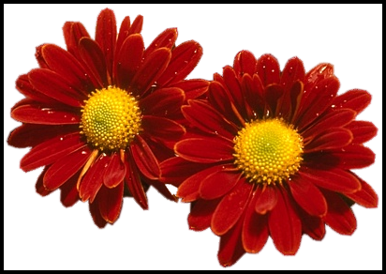
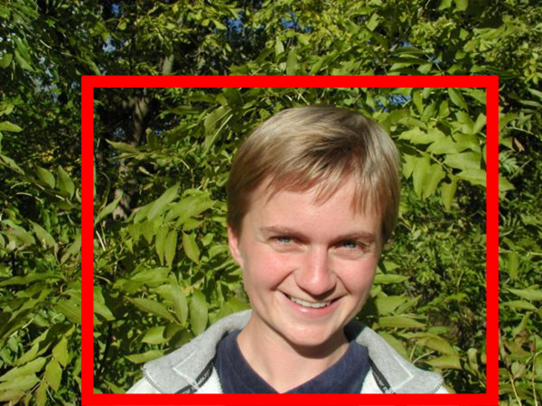
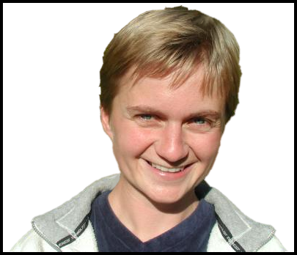
Segmentation as a result
Rother et al. 2004

Slide 9
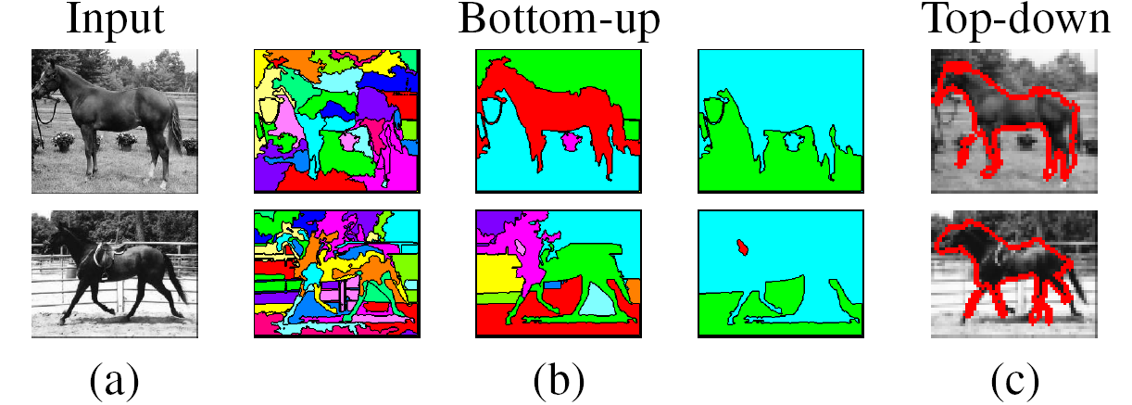
Types of segmentations
Oversegmentation
Undersegmentation
Multiple Segmentations

Slide 10
One way to think about “segmentation” is Clustering
Clustering: group together similar data points and represent them with a single token
Key Challenges:
1) What makes two points/images/patches similar?
2) How do we compute an overall grouping from pairwise similarities?
Slide: Derek Hoiem

Slide 11
Why do we cluster?
Segmentation
  Separate the image into different regions
Summarizing data
  Look at large amounts of data
  Patch-based compression or denoising
  Represent a large continuous vector with the cluster number
Prediction
  Images in the same cluster may have the same labels
Slide: Derek Hoiem

Slide 12
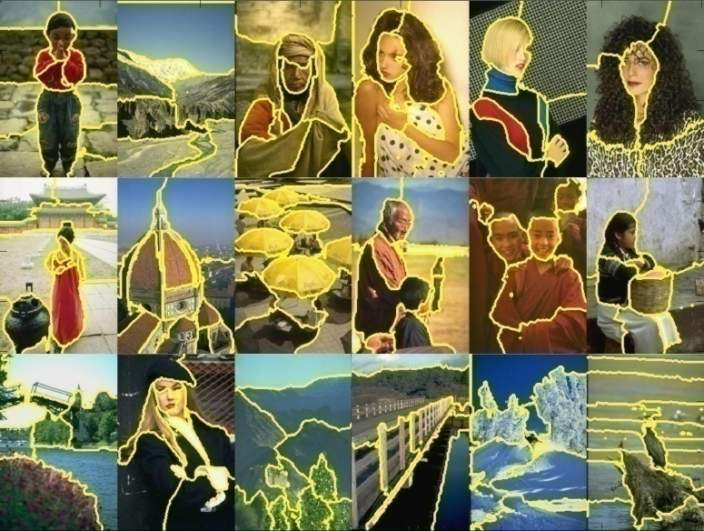
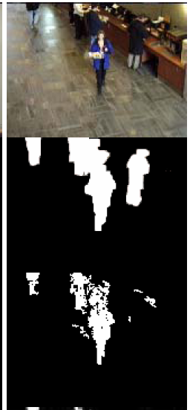
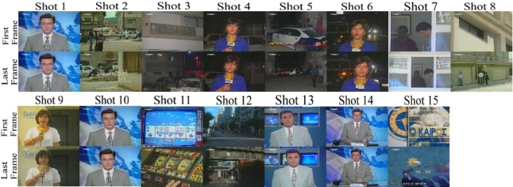
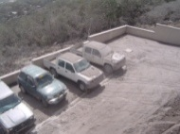
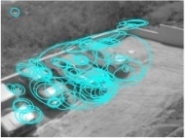
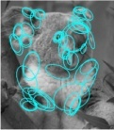
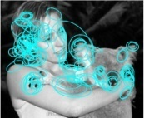
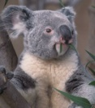
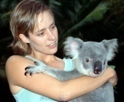
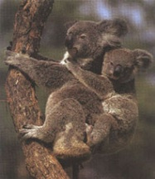
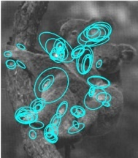
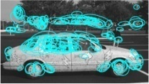
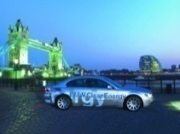
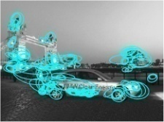




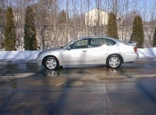
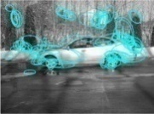
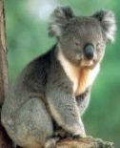
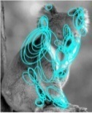
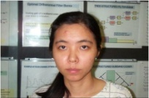
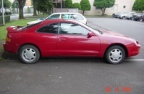
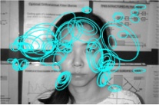
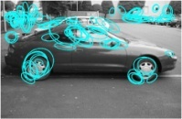
Examples of Grouping in Vision
Grouping video frames into shots
Determining image regions
What things should
be grouped?
Figure-ground
What cues
indicate groups?
Object-level grouping
Slide credit: Kristen Grauman

Slide 13
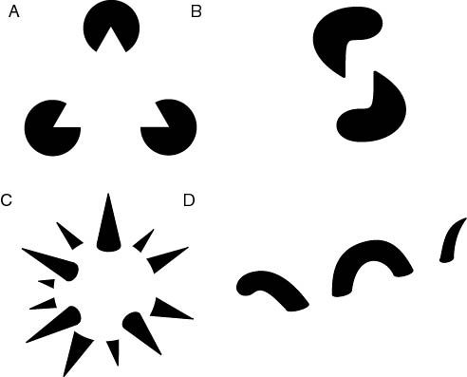
The Gestalt School
Grouping is key to visual perception
Elements in a collection can have properties that result from relationships
  “The whole is greater than the sum of its parts”
Illusory/subjective
contours
Occlusion
Slide credit: Svetlana Lazebnik
Familiar configuration
http://en.wikipedia.org/wiki/Gestalt_psychology

Slide 14
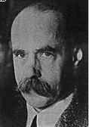
Gestalt Theory
Gestalt: whole or group
  Whole is greater than sum of its parts
  Relationships among parts can yield new properties/features
Psychologists identified series of factors that predispose set of elements to be grouped (by human visual system)
        “I stand at the window and see a house, trees, sky.
        Theoretically I might say there were 327 brightnesses
        and nuances of colour. Do I have "327"? No. I have sky, house, and trees.”
        Max Wertheimer
        (1880-1943)
Untersuchungen zur Lehre von der Gestalt,
Psychologische Forschung, Vol. 4, pp. 301-350, 1923
http://psy.ed.asu.edu/~classics/Wertheimer/Forms/forms.htm

Slide 15
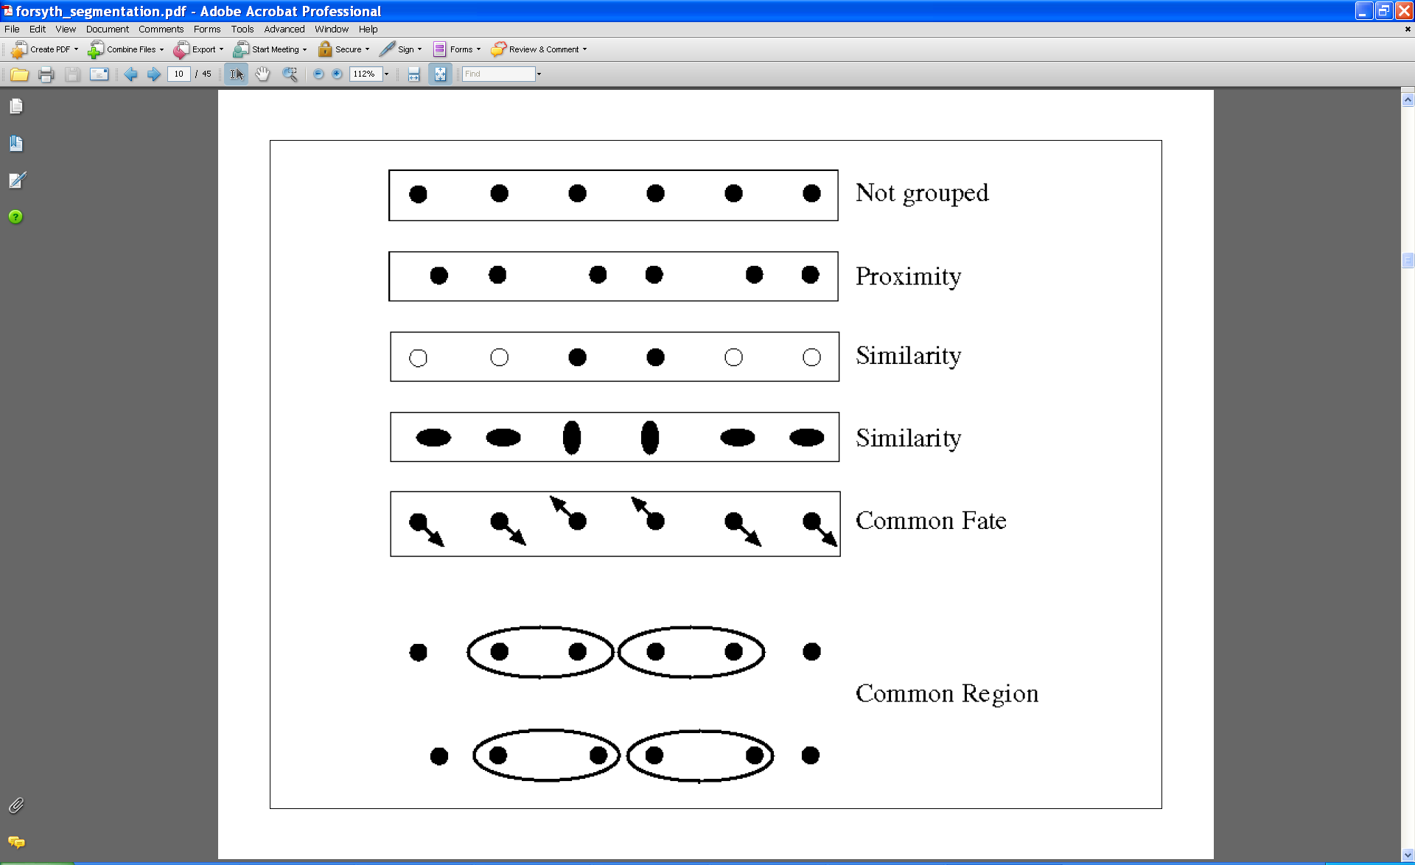
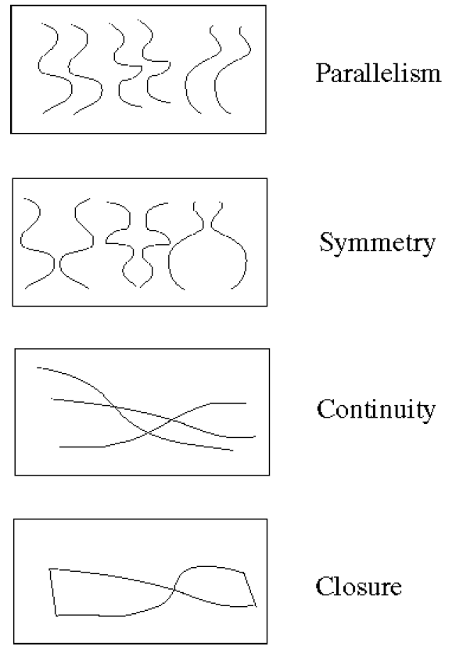
Gestalt Factors
These factors make intuitive sense, but are very difficult to translate into algorithms.
Image source: Forsyth & Ponce

Slide 16
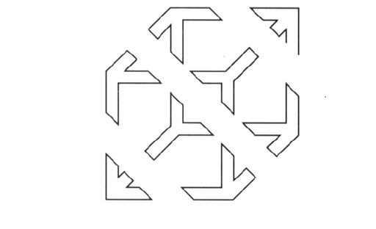
Continuity through Occlusion Cues

Slide 17
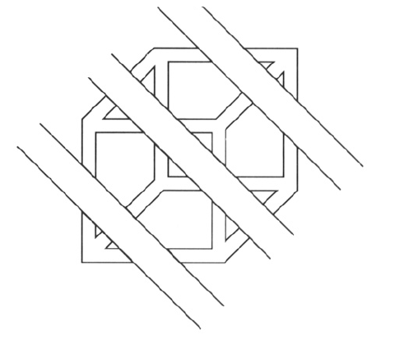
Continuity through Occlusion Cues
Continuity, explanation by occlusion

Slide 18
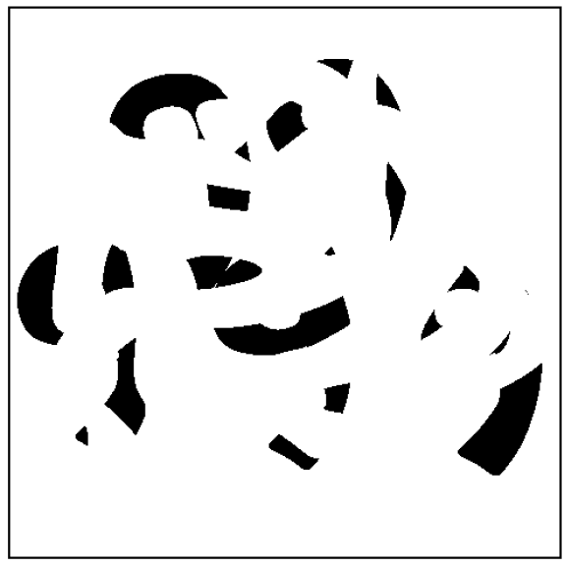
Continuity through Occlusion Cues
Image source: Forsyth & Ponce

Slide 19
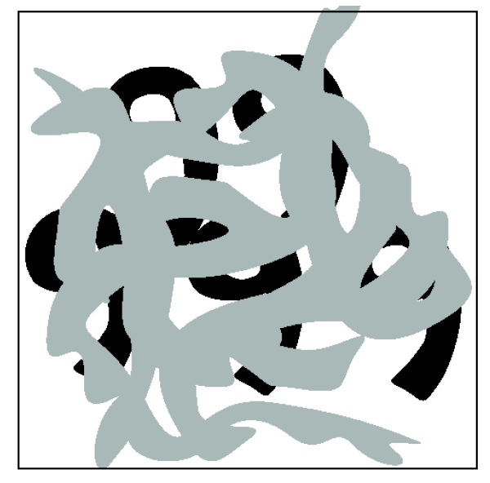
Continuity through Occlusion Cues
Image source: Forsyth & Ponce

Slide 20

Figure-Ground Discrimination

Slide 21

The Ultimate Gestalt?

Slide 22
What we will learn today
Introduction to segmentation and clustering
Gestalt theory for perceptual grouping
Agglomerative clustering
Oversegmentation
K-mean
Mean-shift clustering

Slide 23

What is similarity?
Similarity is hard to define, but… “We know it when we see it” The real meaning of similarity is a philosophical question. We will take a more pragmatic approach.

Slide 24


Clustering: distance measure
Clustering is an unsupervised learning method. Given items
, the goal is to group them into clusters. We need a pairwise distance/similarity function between items, and sometimes the desired number of clusters.
When data (e.g. images, objects, documents) are represented by feature vectors, a commonly used similarity measure is the cosine similarity. Let be two data vectors. There is angle
between the two vectors .

Slide 25

Defining Distance Measures
Let x and x’ be two objects from the universe of possible objects. The distance (similarity) between x and x’ is a real number denoted by sim(x, x’).
The euclidian distance is defined as
In contrast, cosine distance measure would be

Slide 26
Desirable Properties of a Clustering Algorithms
Scalability (in terms of both time and space)
Ability to deal with different data types
Minimal requirements for domain knowledge to determine input parameters
Interpretability and usability Optional
  Incorporation of user-specified constraints

Slide 27


Animated example
source

Slide 28
Animated example
source

Slide 29
Animated example
source

Slide 30

Agglomerative clustering
Slide credit: Andrew Moore

Slide 31

Agglomerative clustering
Slide credit: Andrew Moore

Slide 32

Agglomerative clustering
Slide credit: Andrew Moore

Slide 33

Agglomerative clustering
Slide credit: Andrew Moore

Slide 34

Agglomerative clustering
Slide credit: Andrew Moore

Slide 35

Agglomerative clustering
How to define cluster similarity?
Average distance between points,
maximum distance
minimum distance
Distance between means or medoids
How many clusters?
Clustering creates a dendrogram (a tree)
Threshold based on max number of clusters or based on distance between merges
distance

Slide 36
Conclusions: Agglomerative Clustering
Good
Simple to implement, widespread application.
Clusters have adaptive shapes.
Provides a hierarchy of clusters.
No need to specify number of clusters in advance.
Bad
May have imbalanced clusters.
Still have to choose number of clusters or threshold.
Does not scale well. Runtime of O(n³).
Can get stuck at a local optima.

Slide 37
What we will learn today
Introduction to segmentation and clustering
Gestalt theory for perceptual grouping
Agglomerative clustering
Oversegmentation
K-mean
Mean-shift clustering

Slide 38


Oversegmentation algorithm
Introduced by Felzenszwalb and Huttenlocher in the paper titled Efficient Graph-Based Image Segmentation.

Slide 39

Problem Formulation
Graph G = (V, E)
V is set of nodes (i.e. pixels)
E is a set of undirected edges between pairs of pixels
w(vi , vj ) is the weight of the edge between nodes vi and vj
S is a segmentation of a graph G such that G’ = (V, E’) where E’ ⊂ E.
S divides G into G’ such that it contains distinct clusters C.

Slide 40


Predicate for segmentation
Predicate D determines whether there is a boundary for segmentation.
Where
dif(C1 , C2 ) is the difference between two clusters.
in(C1 , C2 ) is the internal different in the clusters C1 and C2

Slide 41


Predicate for Segmentation
Predicate D determines whether there is a boundary for segmentation.
The different between two components is the minimum weight edge that connects a node vi in clusters C1 to node vj in C2

Slide 42

Predicate for Segmentation
Predicate D determines whether there is a boundary for segmentation.
In(C1, C2) is to the maximum weight edge that connects two nodes in the same component.

Slide 43

Predicate for Segmentation
k/|C| sets the threshold by which the components need to be different from the internal nodes in a component.
Properties of constant k:
  If k is large, it causes a preference of larger objects.
  k does not set a minimum size for components.

Slide 44

Features and weights
Project every pixel into feature space defined by (x, y, r, g, b).
Every pixel is connected to its 8 neighboring pixels and the weights are determined by the difference in intensities.
Weights between pixels are determined using L2 (Euclidian) distance in feature space.
Edges are chosen for only top ten nearest neighbors in feature space to ensure run time of O(n log n) where n is number of pixels.

Slide 45

Results

Slide 46
What we will learn today
Introduction to segmentation and clustering
Gestalt theory for perceptual grouping
Agglomerative clustering
Oversegmentation
K-mean
Mean-shift clustering

Slide 47


Image Segmentation: Toy Example
white pixels
3
black pixels
gray pixels
These intensities define the three groups.
We could label every pixel in the image according to which of these primary intensities it is.
  i.e., segment the image based on the intensity feature.
What if the image isn’t quite so simple?
1
2
input image
intensity
Slide credit: Kristen Grauman

Slide 48


Pixel count
Input image
Intensity
Pixel count
Input image
Intensity
Slide credit: Kristen Grauman

Slide 49
Now how to determine the three main intensities that define our groups?
We need to cluster.
Pixel count
Input image
Intensity
Slide credit: Kristen Grauman

Slide 50
Goal: choose three “centers” as the representative intensities, and label every pixel according to which of these centers it is nearest to.
Best cluster centers are those that minimize Sum of Square Distance (SSD) between all points and their nearest cluster center c_{i}:
0
190
255
Intensity
3
1
2
Slide credit: Kristen Grauman

Slide 51
Clustering for Summarization
Goal: cluster to minimize variance in data given clusters
  Preserve information
Cluster center
Data
Whether is assigned to
Slide: Derek Hoiem

Slide 52
Clustering
With this objective, it is a “chicken and egg” problem:
  If we knew the cluster centers, we could allocate points to groups by assigning each to its closest center.
  If we knew the group memberships, we could get the centers by computing the mean per group.
Slide credit: Kristen Grauman

Slide 53
K-means clustering
Initialize ( ): cluster centers
Compute : assign each point to the closest center
  denotes the set of assignment for each to cluster at iteration t
Computer : update cluster centers as the mean of the points
Update , Repeat Step 2-3 till stopped
Slide: Derek Hoiem

Slide 54
K-means clustering
Initialize ( ): cluster centers
Compute : assign each point to the closest center
Computer : update cluster centers as the mean of the points
Update , Repeat Step 2-3 till stopped
Commonly used: random initialization
Or greedily choose K to minimize residual
Typical distance measure:
  Euclidean
  Cosine
  Others
doesn’t change anymore.
Slide: Derek Hoiem

Slide 55




K-means clustering
1. Initialize Cluster Centers
2. Assign Points to Clusters
3. Re-compute Means
Repeat (2) and (3)
Java demo:
http://home.dei.polimi.it/matteucc/Clustering/tutorial_html/AppletKM.html
Illustration Source: wikipedia

Slide 56


K-means clustering
Converges to a local minimum solution
  Initialize multiple runs
Better fit for spherical data
Need to pick K (# of clusters)

Slide 57



Segmentation as Clustering
2 clusters
Original image
3 clusters

Slide 58
K-Means++
Can we prevent arbitrarily bad local minima?
Randomly choose first center.
Pick new center with prob. proportional to
  (Contribution of x to total error)
Repeat until K centers.
Expected error * optimal
Slide credit: Steve Seitz
Arthur & Vassilvitskii 2007

Slide 59
Feature Space
Depending on what we choose as the feature space, we can group pixels in different ways.
Grouping pixels based on
intensity similarity
Feature space: intensity value (1D)
Slide credit: Kristen Grauman

Slide 60

Feature Space
Depending on what we choose as the feature space, we can group pixels in different ways.
Grouping pixels based
on color similarity
Feature space: color value (3D)
R=255
G=200
B=250
B
G
R=245
G=220
B=248
R
R=15
G=189
B=2
R=3
G=12
B=2
Slide credit: Kristen Grauman

Slide 61

Feature Space
Depending on what we choose as the feature space, we can group pixels in different ways.
Grouping pixels based
on texture similarity
Feature space: filter bank responses (e.g., 24D)
F₁
F₂
Filter bank of 24 filters
…
F₂₄
Slide credit: Kristen Grauman

Slide 62

Smoothing Out Cluster Assignments
Assigning a cluster label per pixel may yield outliers:
How can we ensure they
are spatially smooth?
Original
Labeled by cluster center’s intensity
?
3
1
2
Slide credit: Kristen Grauman

Slide 63
Segmentation as Clustering
Depending on what we choose as the feature space, we can group pixels in different ways.
Grouping pixels based on
intensity+position similarity
⇒ Way to encode both similarity and proximity.
Intensity
Y
X
Slide credit: Kristen Grauman
Notes:
Both regions are black, but if we also include position (x,y), then we could group the two into distinct segments; way to encode both similarity & proximity.

Slide 64



K-Means Clustering Results
K-means clustering based on intensity or color is essentially vector quantization of the image attributes
  Clusters don’t have to be spatially coherent
Image
Intensity-based clusters
Color-based clusters
Image source: Forsyth & Ponce

Slide 65





K-Means Clustering Results
K-means clustering based on intensity or color is essentially vector quantization of the image attributes
  Clusters don’t have to be spatially coherent
Clustering based on (r,g,b,x,y) values enforces more spatial coherence
Image source: Forsyth & Ponce

Slide 66
How to evaluate clusters?
Generative
  How well are points reconstructed from the clusters?
Discriminative
  How well do the clusters correspond to labels?
    Can we correctly classify which pixels belong to the panda?
  Note: unsupervised clustering does not aim to be discriminative as we don’t have the labels.
Slide: Derek Hoiem

Slide 67

How to choose the number of clusters?
Try different numbers of clusters in a validation set and look at performance.
Slide: Derek Hoiem

Slide 68


K-Means pros and cons
Pros
  Finds cluster centers that minimize conditional variance (good representation of data)
  Simple and fast, Easy to implement
Cons
  Need to choose K
  Sensitive to outliers
  Prone to local minima
  All clusters have the same parameters (e.g., distance measure is non-adaptive)
  *Can be slow: each iteration is O(KNd) for N d-dimensional points
Usage
  Unsupervised clustering
  Rarely used for pixel segmentation

Slide 69
What we will learn today
Introduction to segmentation and clustering
Gestalt theory for perceptual grouping
Agglomerative clustering
Oversegmentation
K-mean
Mean-shift clustering

Slide 70

Mean-Shift Segmentation
An advanced and versatile technique for clustering-based segmentation
Slide credit: Svetlana Lazebnik
http://www.caip.rutgers.edu/~comanici/MSPAMI/msPamiResults.html
D. Comaniciu and P. Meer, Mean Shift: A Robust Approach toward Feature Space Analysis, PAMI 2002.

Slide 71


Mean-Shift Algorithm
Iterative Mode Search
  Initialize random seed, and window W
  Calculate center of gravity (the “mean”) of W:
  Shift the search window to the mean
  Repeat Step 2 until convergence
Slide credit: Steve Seitz

Slide 72
Mean-Shift
Region of
interest
Center of
mass
Mean Shift
vector
Slide by Y. Ukrainitz & B. Sarel

Slide 73
Mean-Shift
Region of
interest
Center of
mass
Mean Shift
vector
Slide by Y. Ukrainitz & B. Sarel

Slide 74
Mean-Shift
Region of
interest
Center of
mass
Mean Shift
vector
Slide by Y. Ukrainitz & B. Sarel

Slide 75
Mean-Shift
Region of
interest
Center of
mass
Mean Shift
vector
Slide by Y. Ukrainitz & B. Sarel

Slide 76
Mean-Shift
Region of
interest
Center of
mass
Mean Shift
vector
Slide by Y. Ukrainitz & B. Sarel

Slide 77
Mean-Shift
Region of
interest
Center of
mass
Mean Shift
vector
Slide by Y. Ukrainitz & B. Sarel

Slide 78
Mean-Shift
Region of
interest
Center of
mass
Slide by Y. Ukrainitz & B. Sarel

Slide 79
Real Modality Analysis
Slide by Y. Ukrainitz & B. Sarel
Tessellate the space with windows
Run the procedure in parallel

Slide 80
Real Modality Analysis
Slide by Y. Ukrainitz & B. Sarel
The blue data points were traversed by the windows towards the mode.

Slide 81

Mean-Shift Clustering
Cluster: all data points in the attraction basin of a mode
Attraction basin: the region for which all trajectories lead to the same mode
Slide by Y. Ukrainitz & B. Sarel

Slide 82

Mean-Shift Clustering/Segmentation
Find features (color, gradients, texture, etc)
Initialize windows at individual pixel locations
Perform mean shift for each window until convergence
Merge windows that end up near the same “peak” or mode
Slide credit: Svetlana Lazebnik

Slide 83




Mean-Shift Segmentation Results
Slide credit: Svetlana Lazebnik
http://www.caip.rutgers.edu/~comanici/MSPAMI/msPamiResults.html

Slide 84

More Results
Slide credit: Svetlana Lazebnik

Slide 85


More Results

Slide 86
Problem: Computational Complexity
Need to shift many windows…
Many computations will be redundant.
Slide credit: Bastian Leibe

Slide 87
Speedups: Basin of Attraction
Assign all points within radius r of end point to the mode.
r
Slide credit: Bastian Leibe

Slide 88
Speedups
Assign all points within radius r/c of the search path to the mode -> reduce the number of data points to search.
Slide credit: Bastian Leibe

Slide 89


Technical Details
Comaniciu & Meer, 2002

Slide 90
Technical Details
Term1: this is proportional to the density estimate at x (similar to equation 1 from the previous slide).
Term2: this is the mean-shift vector that points towards the direction of maximum density.
Comaniciu & Meer, 2002

Slide 91
Technical Details
Finally, the mean shift procedure from a given point x_{t} is:
Computer the mean shirt vector m:
Translate the density window:
Iterate steps 1 and 2 until convergence.
Comaniciu & Meer, 2002

Slide 92
Summary Mean-Shift
Pros
  General, application-independent tool
  Model-free, does not assume any prior shape (spherical, elliptical, etc.) on data clusters
  Just a single parameter (window size h)
    h has a physical meaning (unlike k-means)
  Finds variable number of modes
  Robust to outliers
Cons
  Output depends on window size
  Window size (bandwidth) selection is not trivial
  Computationally (relatively) expensive (~2s/image)
  Does not scale well with dimension of feature space
Slide credit: Svetlana Lazebnik

Slide 93
What we learned today
Introduction to segmentation and clustering
Gestalt theory for perceptual grouping
Agglomerative clustering
Oversegmentation
K-mean
Mean-shift clustering

