Slide 1
Optical Flow
Samuel Cheng
Slide credit: Juan Carlos Niebles and Ranjay Krishna

Slide 2
What we will learn today?
Optical flow
Lucas-Kanade method
Horn-Schunk method
Gunnar-Farneback method
Pyramids for large motion
Applications
Reading: [Szeliski] Chapters: 8.4, 8.5
[Fleet & Weiss, 2005]
http://www.cs.toronto.edu/pub/jepson/teaching/vision/2503/opticalFlow.pdf

Slide 3
What we will learn today?
Optical flow
Lucas-Kanade method
Horn-Schunk method
Gunnar Farneback method
Pyramids for large motion
Applications
Reading: [Szeliski] Chapters: 8.4, 8.5
[Fleet & Weiss, 2005]
http://www.cs.toronto.edu/pub/jepson/teaching/vision/2503/opticalFlow.pdf

Slide 4
From images to videos
A video is a sequence of frames captured over time
Now our image data is a function of space (x, y) and time (t)

Slide 5
Why is motion useful?

Slide 6
Why is motion useful?

Slide 7
Optical flow
Definition: optical flow is the apparent motion of brightness patterns in the image
Note: apparent motion can be caused by lighting changes without any actual motion
Think of a uniform rotating sphere under fixed lighting vs. a stationary sphere under moving illumination
GOAL: Recover image motion at each pixel from optical flow
Source: Silvio Savarese

Slide 8
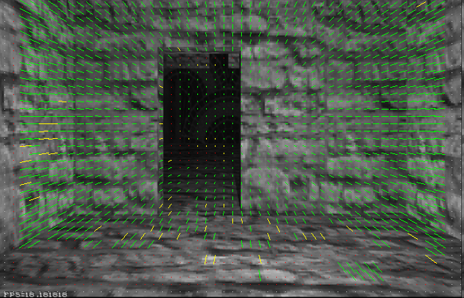
Optical flow
Vector field function of the spatio-temporal image brightness variations
Picture courtesy of Selim Temizer - Learning and Intelligent Systems (LIS) Group, MIT

Slide 9
Estimating optical flow
I(x,y,t–1)
I(x,y,t)
Given two subsequent frames, estimate the apparent motion field u(x,y), v(x,y) between them
Key assumptions
Brightness constancy: projection of the same point looks the same in every frame
Small motion: points do not move very far
Spatial coherence: points move like their neighbors
Source: Silvio Savarese

Slide 10
Key Assumptions: small motions
* Slide from Michael Black, CS143 2003

Slide 11
Key Assumptions: spatial coherence
* Slide from Michael Black, CS143 2003

Slide 12
Key Assumptions: brightness Constancy
* Slide from Michael Black, CS143 2003

Slide 13
The brightness constancy constraint
I(x,y,t–1)
I(x,y,t)
Brightness Constancy Equation:
Linearizing the right side using Taylor expansion:
Image derivative along x
Source: Silvio Savarese
Hence,

Slide 14
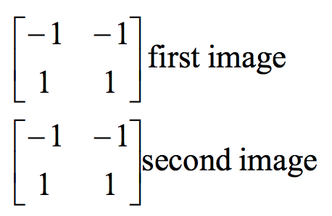
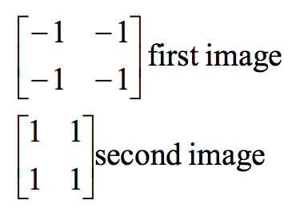
Filters used to find the derivatives
$$I_{x}$$
$$I_{y}$$
$$I_{t}$$

Slide 15
The brightness constancy constraint
Can we use this equation to recover image motion (u,v) at each pixel?
How many equations and unknowns per pixel?
One equation (this is a scalar equation!), two unknowns (u,v)
The component of the flow perpendicular to the gradient (i.e., parallel to the edge) cannot be measured
gradient
If (u, v ) satisfies the equation, so does (u+u’, v+v’ ) if
(u,v)
Source: Silvio Savarese
(u’,v’)
(u+u’,v+v’)
edge
Notes:
A: u and v are unknown, 1 equation

Slide 16
The aperture problem
Source: Silvio Savarese
Actual motion

Slide 17
The aperture problem
Source: Silvio Savarese
Perceived motion

Slide 18
The barber pole illusion
Source: Silvio Savarese
http://en.wikipedia.org/wiki/Barberpole_illusion

Slide 19
The barber pole illusion
Source: Silvio Savarese
http://en.wikipedia.org/wiki/Barberpole_illusion

Slide 20
The barber pole illusion
Source: Silvio Savarese
http://en.wikipedia.org/wiki/Barberpole_illusion

Slide 21
What we will learn today?
Optical flow
Lucas-Kanade method
Horn-Schunk method
Gunnar Farneback method
Pyramids for large motion
Applications
Reading: [Szeliski] Chapters: 8.4, 8.5
[Fleet & Weiss, 2005]
http://www.cs.toronto.edu/pub/jepson/teaching/vision/2503/opticalFlow.pdf

Slide 22
Solving the ambiguity…
B. Lucas and T. Kanade. An iterative image registration technique with an application to stereo vision. In Proceedings of the International Joint Conference on Artificial Intelligence, pp. 674–679, 1981.
How to get more equations for a pixel?
Spatial coherence constraint:
Assume the pixel’s neighbors have the same (u,v)
If we use a 5x5 window, that gives us 25 equations per pixel
Source: Silvio Savarese

Slide 23
Lucas-Kanade flow
Overconstrained linear system:
Source: Silvio Savarese

Slide 24
Lucas-Kanade flow
Overconstrained linear system
Least squares solution for d given by
Source: Silvio Savarese
The summations are over all pixels in the K x K window

Slide 25
Conditions for solvability
Optimal (u, v) satisfies Lucas-Kanade equation
When is This Solvable?
A^{T}A should be invertible
A^{T}A should not be too small due to noise
eigenvalues λ₁ and λ ₂ of A^{T}A should not be too small
A^{T}A should be well-conditioned
λ ₁/ λ ₂ should not be too large (λ ₁ = larger eigenvalue)
Source: Silvio Savarese
Does this remind anything to you?

Slide 26
M = A^{T}A is the second moment matrix !
(Harris corner detector…)
Eigenvectors and eigenvalues of A^{T}A relate to edge direction and magnitude
The eigenvector associated with the larger eigenvalue points in the direction of fastest intensity change
The other eigenvector is orthogonal to it
Source: Silvio Savarese
Notes:
Suppose M = vv^T . What are the eigenvectors and eigenvalues? Start by considering Mv

Slide 27
Interpreting the eigenvalues
Classification of image points using eigenvalues of the second moment matrix:
λ₂
“Edge” λ₂ >> λ₁
“Corner” λ₁ and λ₂ are large, λ₁ ~ λ₂
Source: Silvio Savarese
λ₁ and λ₂ are small
“Edge” λ₁ >> λ₂
“Flat” region
λ₁

Slide 28
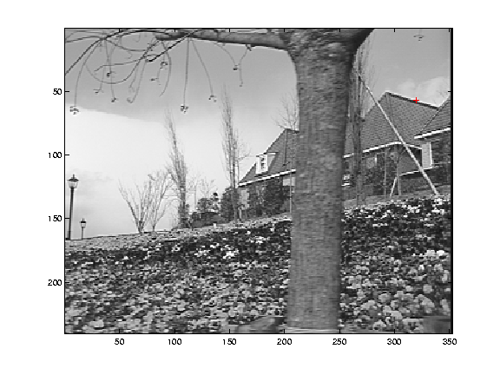
Edge
Source: Silvio Savarese
gradients very large or very small
large λ₁, small λ₂

Slide 29
Low-texture region
Source: Silvio Savarese
gradients have small magnitude
small λ₁, small λ₂

Slide 30
High-texture region
Source: Silvio Savarese
gradients are different, large magnitudes
large λ₁, large λ₂

Slide 31
Errors in Lucas-Kanade
What are the potential causes of errors in this procedure?
Suppose A^{T}A is easily invertible
Suppose there is not much noise in the image
When our assumptions are violated
Brightness constancy is not satisfied
The motion is not small
A point does not move like its neighbors
window size is too large
what is the ideal window size?
* From Khurram Hassan-Shafique CAP5415 Computer Vision 2003

Slide 32
Improving accuracy
Recall our small motion assumption
I_{t-1}(x,y)
I_{t-1}(x,y)
This is not exact
To do better, we need to add higher order terms back in:
I_{t-1}(x,y)
This is a polynomial root finding problem
Can solve using Newton’s method (out of scope for this class)
Lucas-Kanade method does one iteration of Newton’s method
Better results are obtained via more iterations
* From Khurram Hassan-Shafique CAP5415 Computer Vision 2003

Slide 33
Iterative Refinement
Iterative Lucas-Kanade Algorithm
Estimate velocity at each pixel by solving Lucas-Kanade equations
Warp I(t-1) towards I(t) using the estimated flow field
- use image warping techniques
Repeat until convergence
* From Khurram Hassan-Shafique CAP5415 Computer Vision 2003

Slide 34
What we will learn today?
Optical flow
Lucas-Kanade method
Horn-Schunk method
Gunnar Farneback method
Pyramids for large motion
Applications
Reading: [Szeliski] Chapters: 8.4, 8.5
[Fleet & Weiss, 2005]
http://www.cs.toronto.edu/pub/jepson/teaching/vision/2503/opticalFlow.pdf

Slide 35
Horn-Schunk method for optical flow
The flow is formulated as a global energy function which is should be minimized:

Slide 36
Horn-Schunk method for optical flow
The flow is formulated as a global energy function which is should be minimized:
The first part of the function is the brightness consistency.

Slide 37
Horn-Schunk method for optical flow
The flow is formulated as a global energy function which is should be minimized:
The second part is the smoothness constraint. It’s trying to make sure that the changes between frames are small.

Slide 38
Horn-Schunk method for optical flow
The flow is formulated as a global energy function which is should be minimized:
$α$ is a regularization constant. Larger values of $α$ lead to smoother flow.

Slide 39
Horn-Schunk method for optical flow
The flow is formulated as a global energy function which is should be minimized:
We want to find $u$, $v$ to minimize E. Note that $u$, $v$ themselves are function. E is a “functional” of $u$, $v$. By calculus of variation, as ϵ→0

Slide 40
Horn-Schunk method for optical flow

Slide 41
Horn-Schunk method for optical flow
Using integration by part,

Slide 42
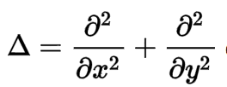
Horn-Schunk method for optical flow
Where is the Laplace operator. In practice, it is often computed as
where is the weighted average of u measured at (x,y).

Slide 43
Horn-Schunk method for optical flow
Now we substitute in:
We get:
Which is linear in u and v and can be solved for each pixel individually.

Slide 44
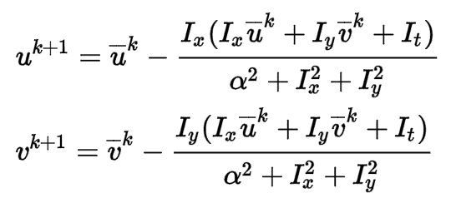
Iterative Horn-Schunk
But since the solution depends on the neighboring values of the flow field, it must be repeated once the neighbors have been updated.
So instead, we can iteratively solve for u and v using:

Slide 45
What does the smoothness regularization do anyway?
It’s a sum of squared terms (a Euclidian distance measure).
We’re putting it in the expression to be minimized.
=> In texture free regions, there is no optical flow
=> On edges, points will flow to nearest points, solving the aperture problem.
Regularized flow
Optical flow
Slide credit: Sebastian Thurn

Slide 46
Dense Optical Flow with Michael Black’s method
Michael Black took Horn-Schunk’s method one step further, starting from the regularization constant:
Which looks like a quadratic:
And replaced it with this:
Why does this regularization work better?

Slide 47
What we will learn today?
Optical flow
Lucas-Kanade method
Horn-Schunk method
Gunnar Farneback method
Pyramids for large motion
Applications

Slide 48
Gunnar Farneback Optical Flow
Model image intensity with quadratic function
Image 1:
Image 2:

Slide 49
Gunnar Farneback Optical Flow
A’s and b’s should vary with location. Thus
Consider a window instead, and minimizes

Slide 50
Gunnar Farneback Optical Flow
Model displacement by
Rewrite with

Slide 51
Iterative update
Assume previous some a priori displacement field

Slide 52
What we will learn today?
Optical flow
Lucas-Kanade method
Horn-Schunk method
Gunnar Farneback method
Pyramids for large motion
Applications

Slide 53
Recap
Key assumptions (Errors in Lucas-Kanade)
Small motion: points do not move very far
Brightness constancy: projection of the same point looks the same in every frame
Spatial coherence: points move like their neighbors
Source: Silvio Savarese

Slide 54
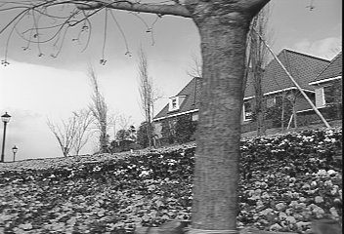
Revisiting the small motion assumption
* From Khurram Hassan-Shafique CAP5415 Computer Vision 2003
Is this motion small enough?
Probably not—it’s much larger than one pixel (2nd order terms dominate)
How might we solve this problem?

Slide 55
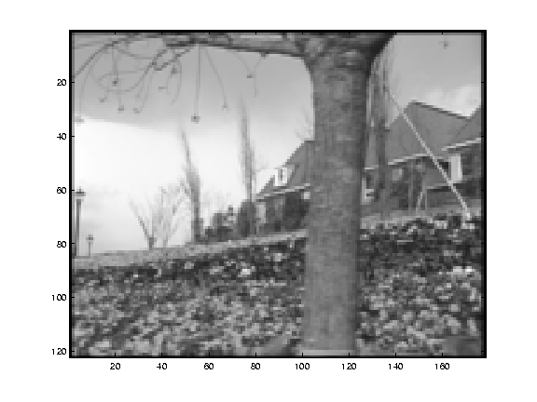
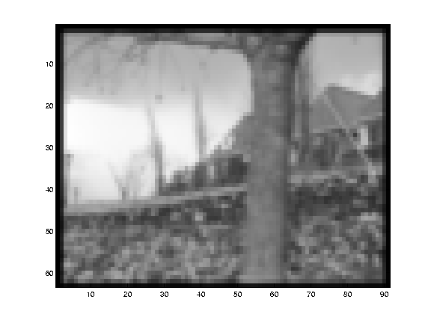
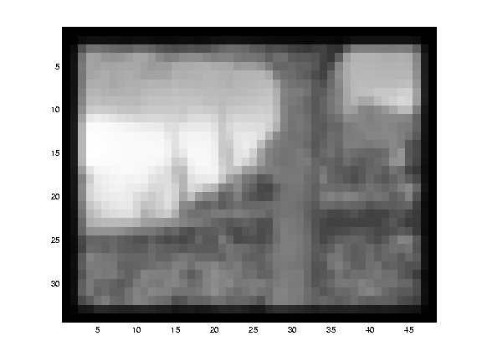
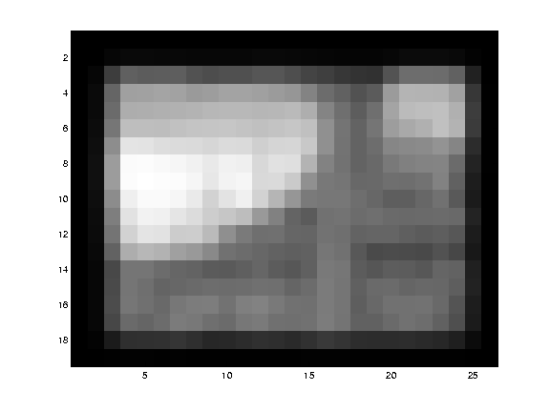
Reduce the resolution!
* From Khurram Hassan-Shafique CAP5415 Computer Vision 2003

Slide 56
Coarse-to-fine optical flow estimation
u=1.25 pixels
u=2.5 pixels
u=5 pixels
image H
u=10 pixels
image I
image 1
image 2
Source: Silvio Savarese
Gaussian pyramid of image 1
Gaussian pyramid of image 2

Slide 57
Coarse-to-fine optical flow estimation
run iterative L-K
warp & upsample
run iterative L-K
.
.
.
image J
image I
image 1
image 2
Source: Silvio Savarese
Gaussian pyramid of image 1 (t)
Gaussian pyramid of image 2 (t+1)

Slide 58
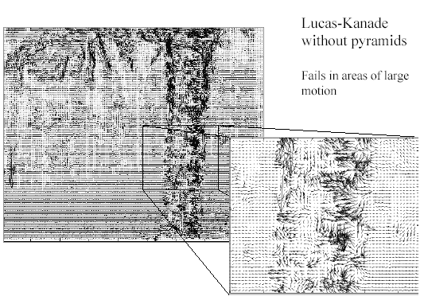
Optical Flow Results
* From Khurram Hassan-Shafique CAP5415 Computer Vision 2003

Slide 59
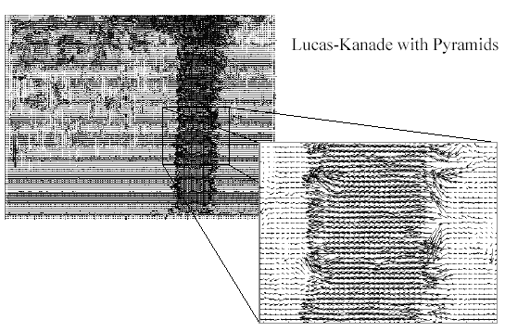
Optical Flow Results
* From Khurram Hassan-Shafique CAP5415 Computer Vision 2003
http://www.ces.clemson.edu/~stb/klt/
OpenCV

Slide 60
What we will learn today?
Optical flow
Lucas-Kanade method
Horn-Schunk method
Pyramids for large motion
Common fate
Applications

Slide 61
Recap
Key assumptions (Errors in Lucas-Kanade)
Small motion: points do not move very far
Brightness constancy: projection of the same point looks the same in every frame
Spatial coherence: points move like their neighbors
Source: Silvio Savarese

Slide 62
Reminder: Gestalt – common fate

Slide 63
Motion segmentation
How do we represent the motion in this scene?
Source: Silvio Savarese

Slide 64
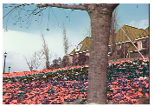
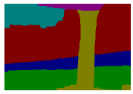
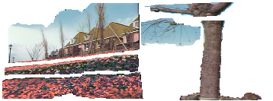
Motion segmentation
J. Wang and E. Adelson. Layered Representation for Motion Analysis. CVPR 1993.
Break image sequence into “layers” each of which has a coherent (affine) motion
Source: Silvio Savarese

Slide 65
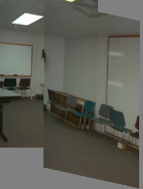
Affine motion
Substituting into the brightness constancy equation:
Source: Silvio Savarese

Slide 66
Affine motion
Substituting into the brightness constancy equation:
Each pixel provides 1 linear constraint in 6 unknowns
Least squares minimization:
Source: Silvio Savarese

Slide 67
How do we estimate the layers?
1. Obtain a set of initial affine motion hypotheses
Divide the image into blocks and estimate affine motion parameters in each block by least squares
Eliminate hypotheses with high residual error
Map into motion parameter space
Perform k-means clustering on affine motion parameters
Merge clusters that are close and retain the largest clusters to obtain a smaller set of hypotheses to describe all the motions in the scene
Source: Silvio Savarese

Slide 68
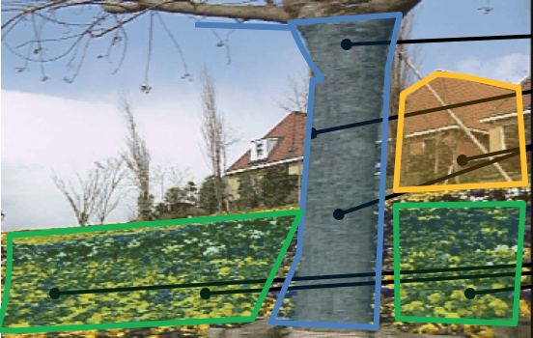
How do we estimate the layers?
1. Obtain a set of initial affine motion hypotheses
Divide the image into blocks and estimate affine motion parameters in each block by least squares
Eliminate hypotheses with high residual error
Map into motion parameter space
Perform k-means clustering on affine motion parameters
Merge clusters that are close and retain the largest clusters to obtain a smaller set of hypotheses to describe all the motions in the scene
Source: Silvio Savarese

Slide 69
How do we estimate the layers?
1. Obtain a set of initial affine motion hypotheses
Divide the image into blocks and estimate affine motion parameters in each block by least squares
Eliminate hypotheses with high residual error
Map into motion parameter space
Perform k-means clustering on affine motion parameters
Merge clusters that are close and retain the largest clusters to obtain a smaller set of hypotheses to describe all the motions in the scene
2. Iterate until convergence:
Assign each pixel to best hypothesis
Pixels with high residual error remain unassigned
Perform region filtering to enforce spatial constraints
Re-estimate affine motions in each region
Source: Silvio Savarese

Slide 70
Example result
Source: Silvio Savarese
J. Wang and E. Adelson. Layered Representation for Motion Analysis. CVPR 1993.

Slide 71
What we will learn today?
Optical flow
Lucas-Kanade method
Horn-Schunk method
Gunnar Farneback method
Pyramids for large motion
Applications

Slide 72
Uses of motion
Tracking features
Segmenting objects based on motion cues
Learning dynamical models
Improving video quality
Motion stabilization
Super resolution
Tracking objects
Recognizing events and activities

Slide 73
Estimating 3D structure
Source: Silvio Savarese

Slide 74
Segmenting objects based on motion cues
Background subtraction
A static camera is observing a scene
Goal: separate the static background from the moving foreground
Source: Silvio Savarese

Slide 75
Segmenting objects based on motion cues
Motion segmentation
Segment the video into multiple coherently moving objects
Source: Silvio Savarese
S. J. Pundlik and S. T. Birchfield, Motion Segmentation at Any Speed, Proceedings of the British Machine Vision Conference (BMVC) 2006

Slide 76
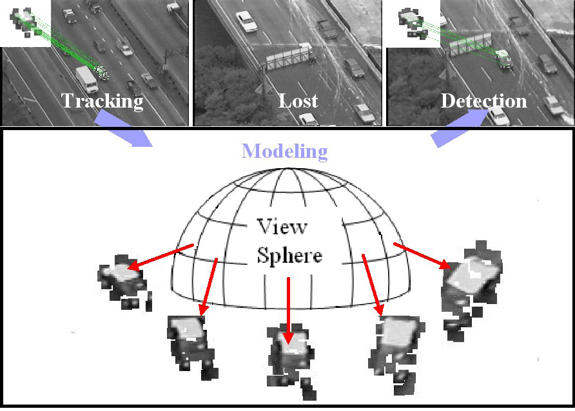
Tracking objects
Source: Silvio Savarese
Z.Yin and R.Collins, "On-the-fly Object Modeling while Tracking," IEEE Computer Vision and Pattern Recognition (CVPR '07), Minneapolis, MN, June 2007.

Slide 77
Synthesizing dynamic textures

Slide 78
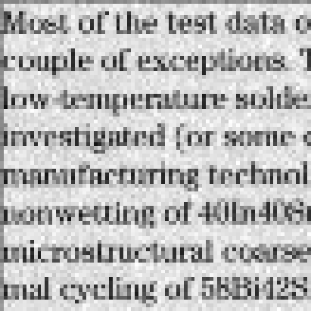
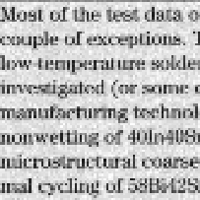
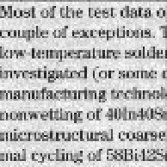
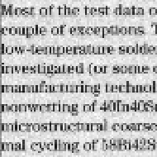
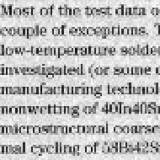
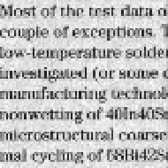
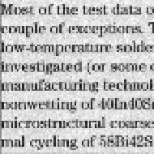
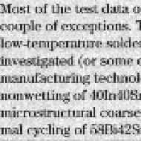
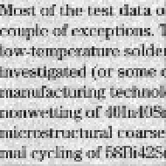
Super-resolution
Example: A set of low quality images
Source: Silvio Savarese

Slide 79
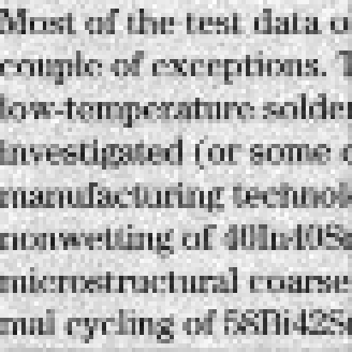
Super-resolution
Each of these images looks like this:
Source: Silvio Savarese

Slide 80
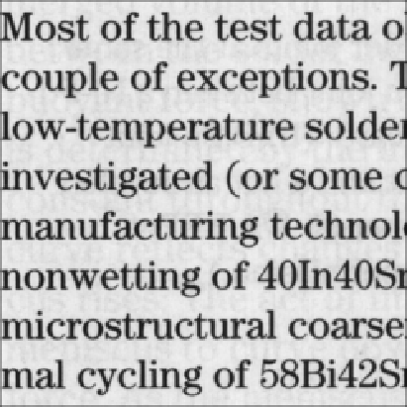
Super-resolution
The recovery result:
Source: Silvio Savarese

Slide 81
Recognizing events and activities
Tracker
Source: Silvio Savarese
D. Ramanan, D. Forsyth, and A. Zisserman. Tracking People by Learning their Appearance. PAMI 2007.

Slide 82
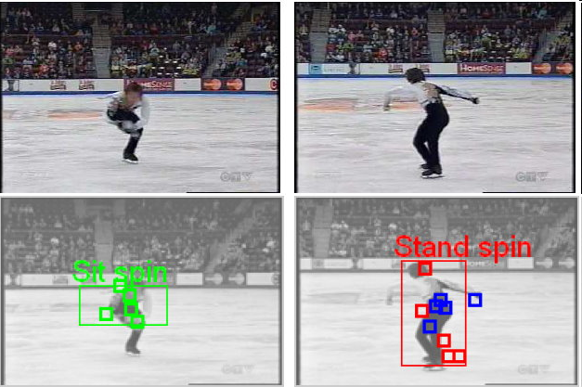
Recognizing events and activities
Juan Carlos Niebles, Hongcheng Wang and Li Fei-Fei, Unsupervised Learning of Human Action Categories Using Spatial-Temporal Words, (BMVC), Edinburgh, 2006.

Slide 83
Recognizing events and activities
Crossing – Talking – Queuing – Dancing – jogging
Source: Silvio Savarese
W. Choi & K. Shahid & S. Savarese WMC 2010
Notes:
15’ from last point

Slide 84
W. Choi, K. Shahid, S. Savarese, "What are they doing? : Collective Activity Classification Using Spatio-Temporal Relationship Among People", 9th International Workshop on Visual Surveillance (VSWS09) in conjuction with ICCV 09

Slide 85
When do the optical flow assumptions fail?
In other words, in what situations does the displacement of pixel patches
not represent physical movement of points in space?
1. Well, TV is based on illusory motion
– the set is stationary yet things seem to move
2. A uniform rotating sphere
– nothing seems to move, yet it is rotating
3. Changing directions or intensities of lighting can make things seem to move
– for example, if the specular highlight on a rotating sphere moves.
4. Muscle movement can make some spots on a cheetah move opposite direction of motion.
– And infinitely more break downs of optical flow.

Slide 86
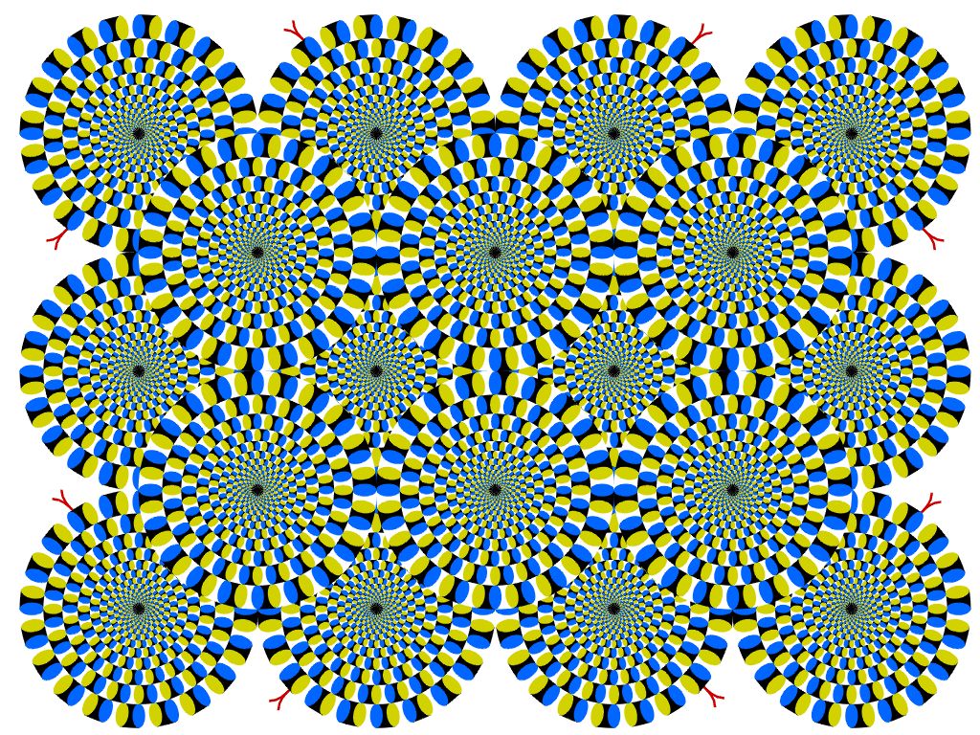
Optical flow without motion!

Slide 87
What we have learned today?
Optical flow
Lucas-Kanade method
Horn-Schunk method
Gunnar-Farneback method
Pyramids for large motion
Applications
Reading: [Szeliski] Chapters: 8.4, 8.5
[Fleet & Weiss, 2005]
http://www.cs.toronto.edu/pub/jepson/teaching/vision/2503/opticalFlow.pdf

