Slide 1
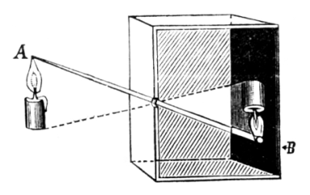
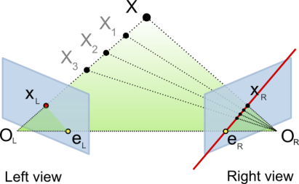
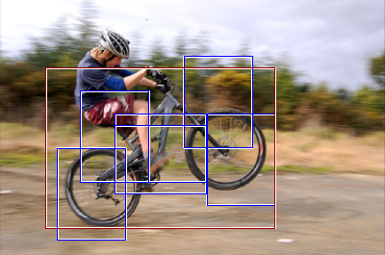
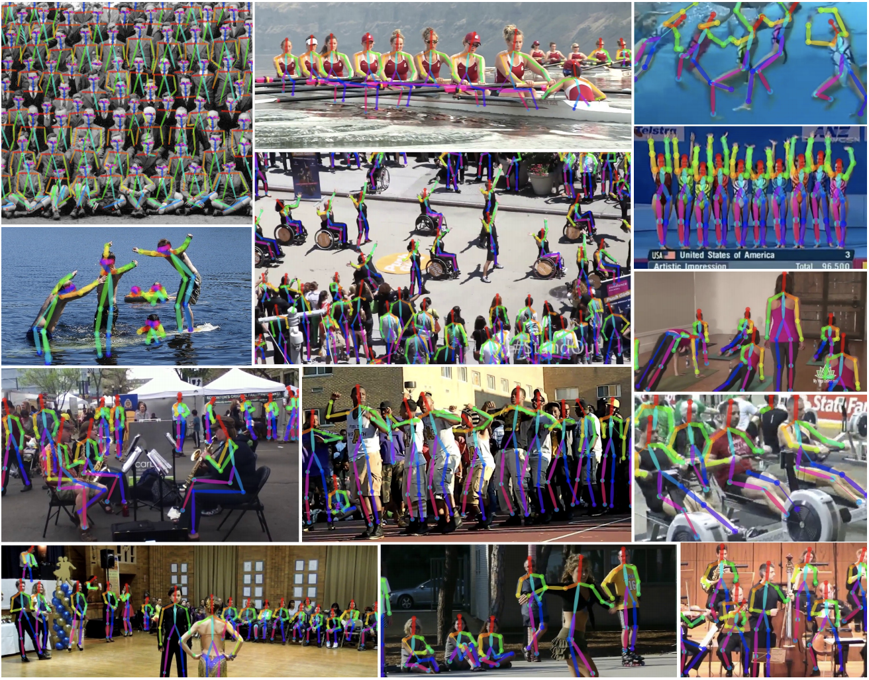
Course overview
Low-level vision
  image processing, edge detection, feature detection, cameras, color, image segmentation, image formation
Geometry and algorithms
  projective geometry, stereo, structure from motion, Markov random fields
Recognition
  face detection / recognition, category recognition, segmentation
Recent topics
Notes:
<number>

Slide 2
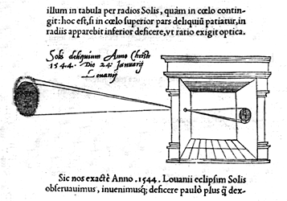


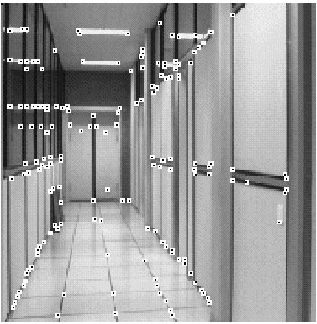
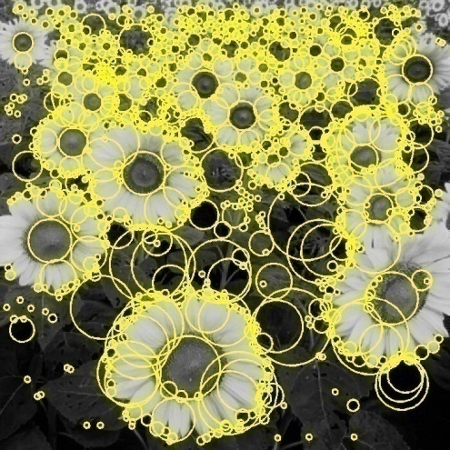
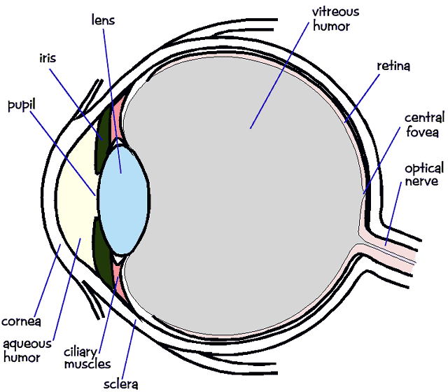
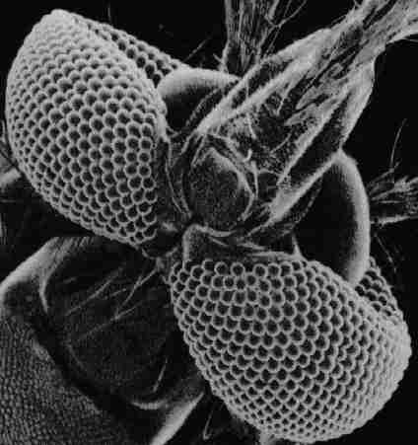
1. Low-level vision
Basic image processing and image formation
*
=
Filtering, edge detection
Feature extraction
Image formation
Notes:
<number>

Slide 3
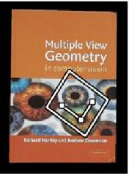
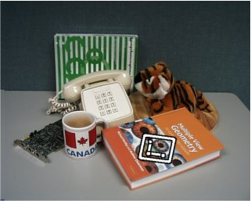


Project: Feature detection and matching

Slide 4
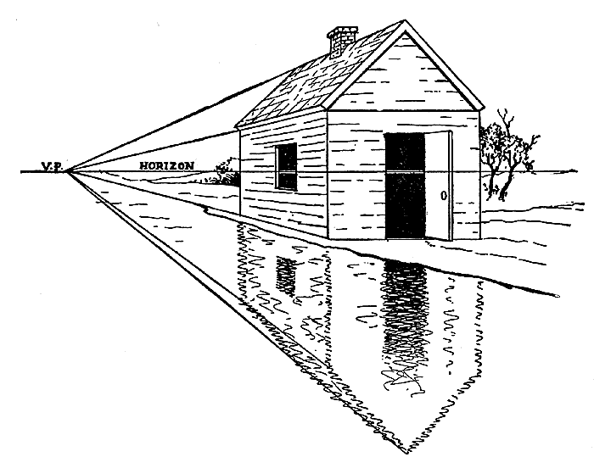
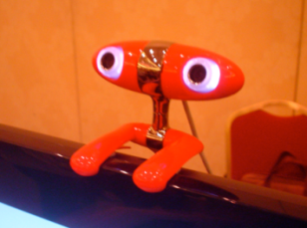
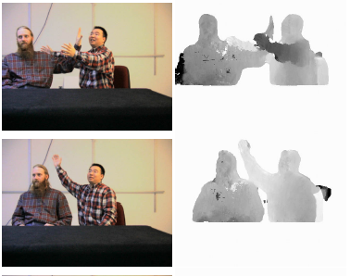
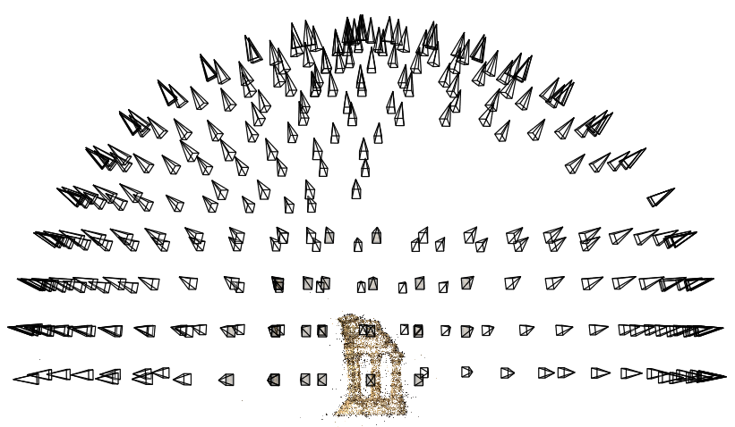
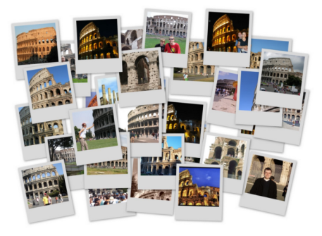
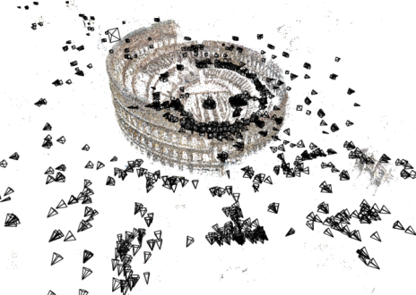
2. Geometry
Projective geometry
Stereo
Multi-view stereo
Structure from motion
Notes:
<number>

Slide 5
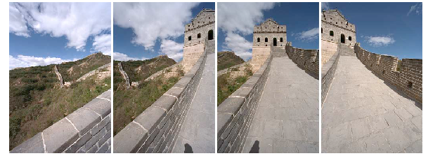
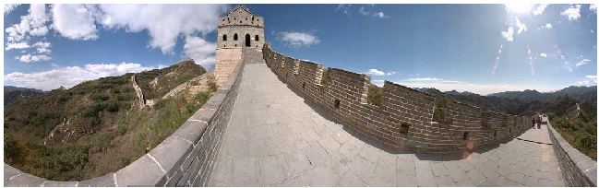
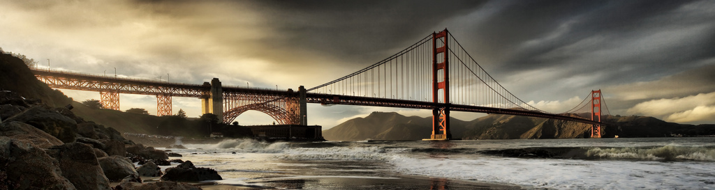
Project: Creating panoramas

Slide 6
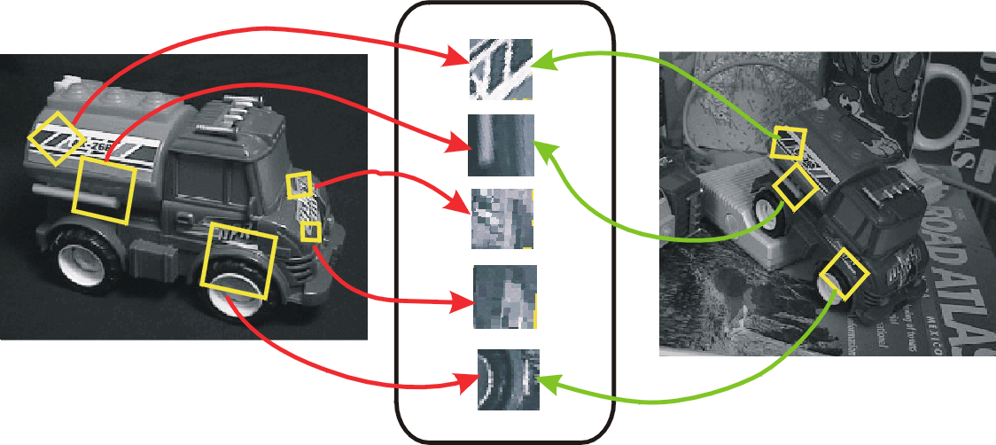
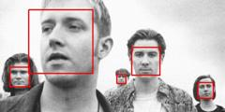
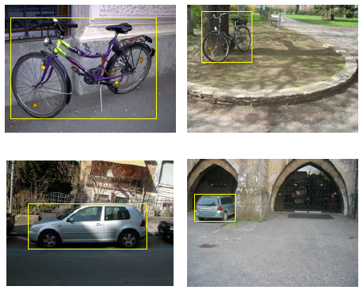
3. Recognition
Face detection and recognition
Single instance recognition
Category recognition
Sources: D. Lowe, L. Fei-Fei
Notes:
<number>

Slide 7
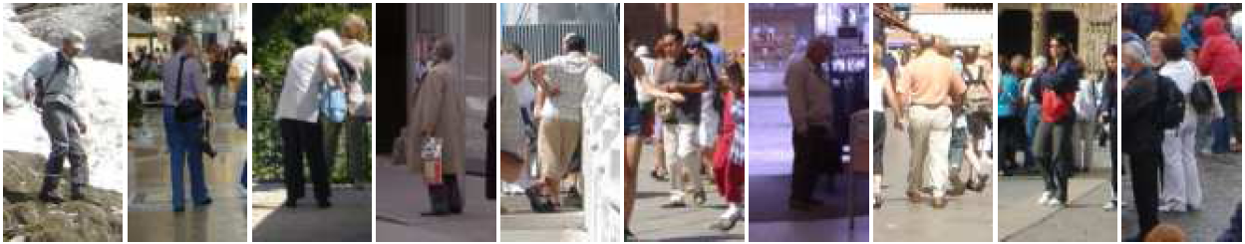
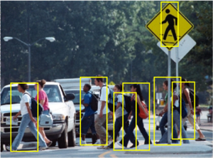
Project: Pedestrian Detection

Slide 8
4. Recent topics

Slide 9
Sign up piazza now!
https://piazza.com/class/jqvgvzzpu2m1iv
Notes:
<number>

Slide 10
Color
Samuel Cheng
Slide credits: James Thompkin, Juan Carlos Niebles and Ranjay Krishna

Slide 11
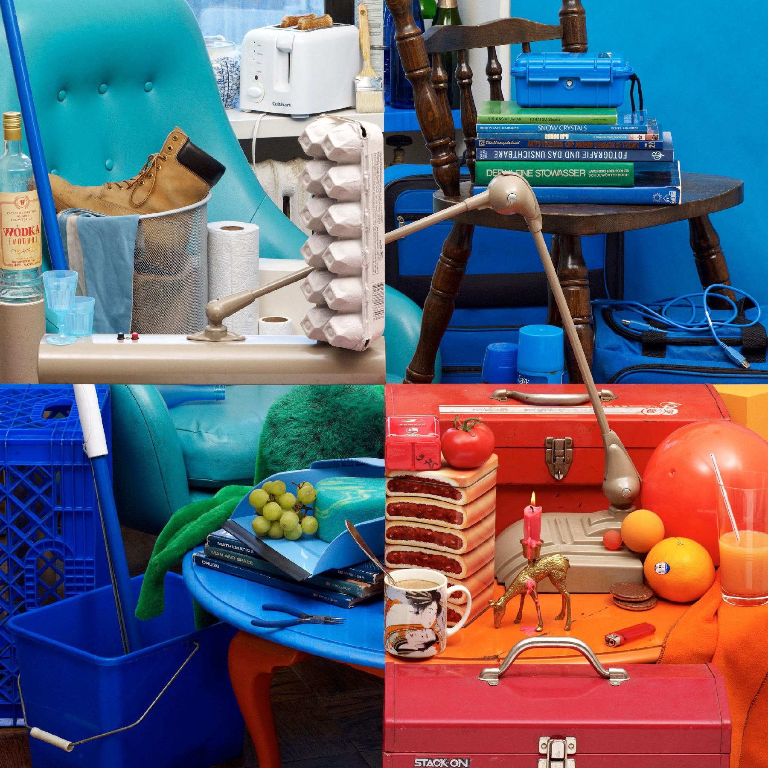
Bela Borsodi
Notes:
To start us off, let’s look at these four colorful images.
Think for a minute - what can you tell me about the differences between these images?
http://www.belaborsodi.com/
<number>

Slide 12
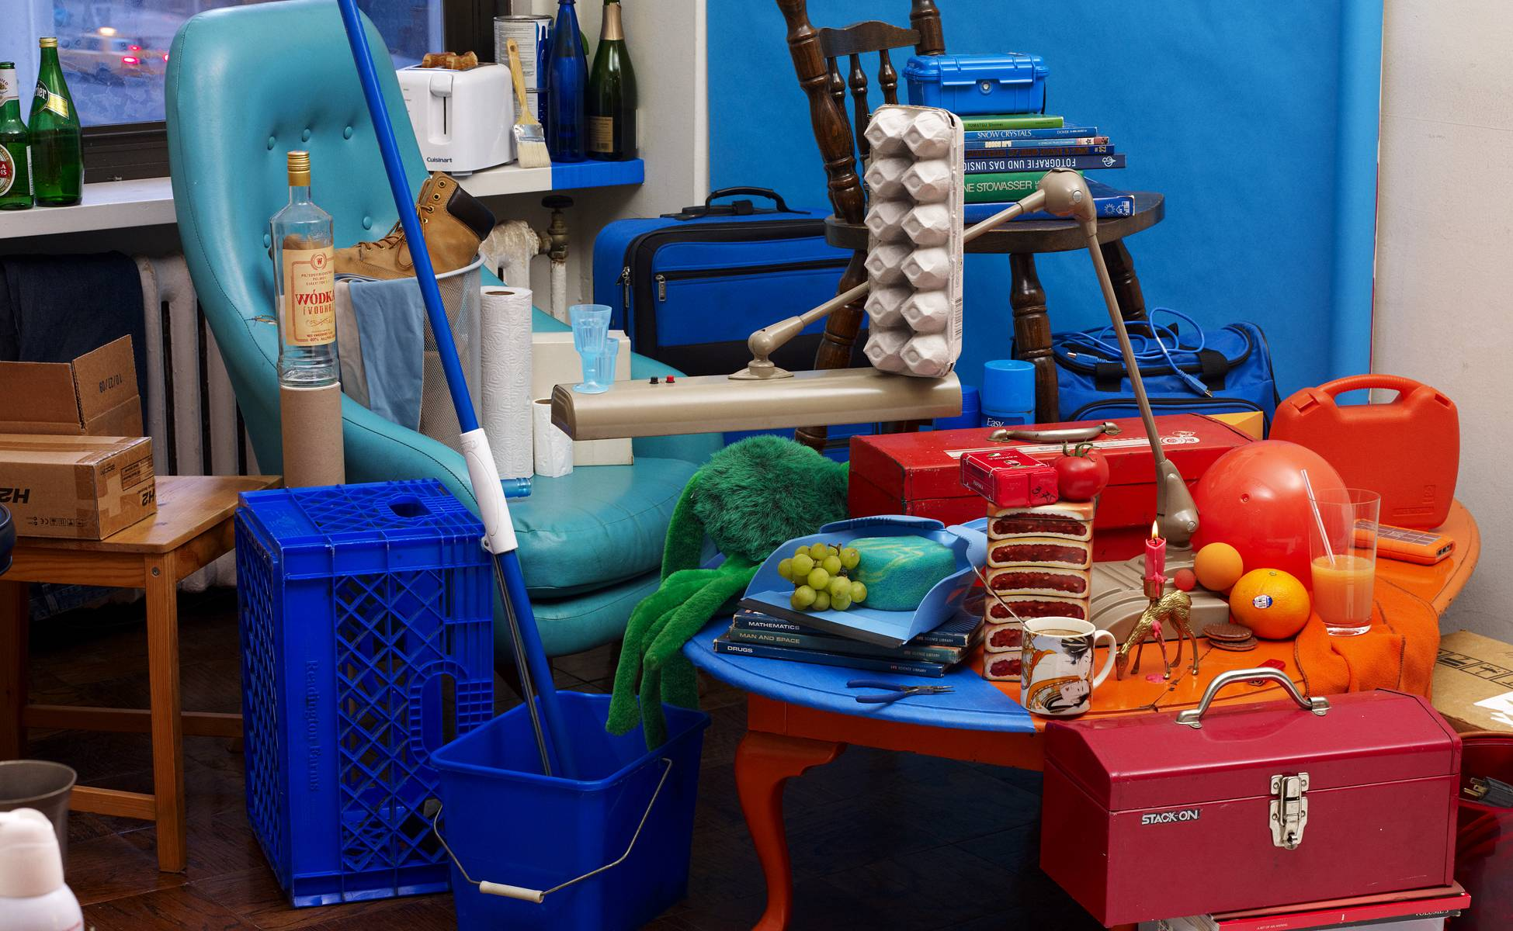
Bela Borsodi
Notes:
Major trick. The scene was arranged by looking through the viewfinder of the camera, which, as like the image, offers a fixed perspective which makes this possible.
http://youtube.com/watch?v=oJGN6sX5Ekg
Later on, we’re going to
<number>

Slide 13
What Is an Image?

Slide 14
>> I = rand(256,256);
Think-Pair-Share:
What is this? What does it look like?
Which values does it take?
How many values can it take?
Is it an image?

Slide 15
>> I = rand(256,256);
>> imshow(I);
Danny Alexander
Notes:
<number>

Slide 16
Dimensionality of an Image
@ 8bit = 256 values ^ 65,536
  Computer says ‘Inf’ combinations.
Some depiction of all possible scenes
would fit into this memory.
Notes:
Zoran and Weiss: “In the context of this work, a natural image would be the result of taking an ordinary digital camera, pointing it somewhere in the world and pressing the shutter button.“
<number>

Slide 17
Dimensionality of an Image
@ 8bit = 256 values ^ 65,536
  Computer says ‘Inf’ combinations.
Some depiction of all possible scenes
would fit into this memory.
Computer vision as making sense of an extremely high-dimensional space.
  Subspace of ‘natural’ images.
  Deriving low-dimensional, explainable models.
Notes:
Zoran and Weiss: “In the context of this work, a natural image would be the result of taking an ordinary digital camera, pointing it somewhere in the world and pressing the shutter button.“
<number>

Slide 18

What is each part of an image?
y
x
Notes:
What is a pixel?
<number>

Slide 19
What is each part of an image?
Pixel -> picture element
‘138’
y
I(x,y)
x
Notes:
What is a pixel?
<number>

Slide 20
Image as a 2D sampling of signal
Signal: function depending on some variable with physical meaning.
Image: sampling of that function.
  2 variables: xy coordinates
  3 variables: xy + time (video)
  ‘Brightness’ is the value of the function for visible light
Can be other physical values too: temperature, pressure, depth …
Danny Alexander
Notes:
Danny Alexander, UCL
<number>

Slide 21
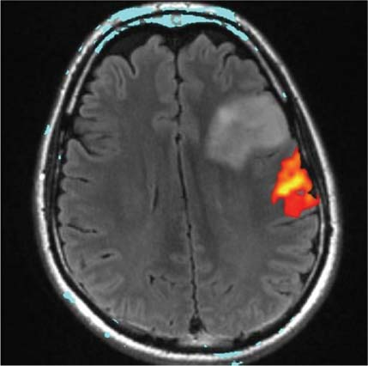
Example 2D Images
Danny Alexander
Notes:
fMRI - changes in blood flow in the brain associated with neural activity
http://radiologykey.com/wp-content/uploads/2016/01/9781604063325_c014_f004.jpg
<number>

Slide 22




Quantization Effects – Radiometric Resolution
8 bit – 256 levels
4 bit – 16 levels
2 bit – 4 levels
1 bit – 2 levels

Slide 23
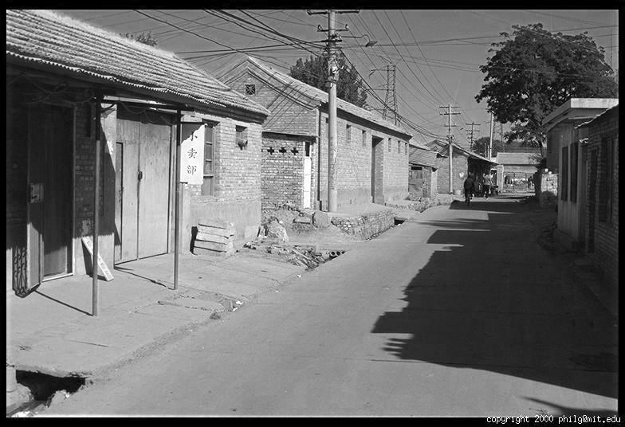
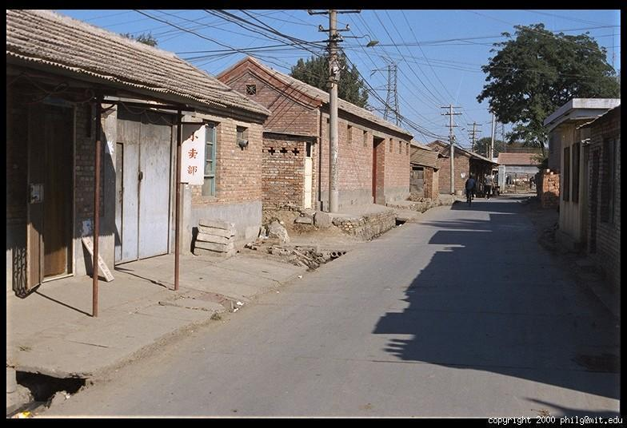
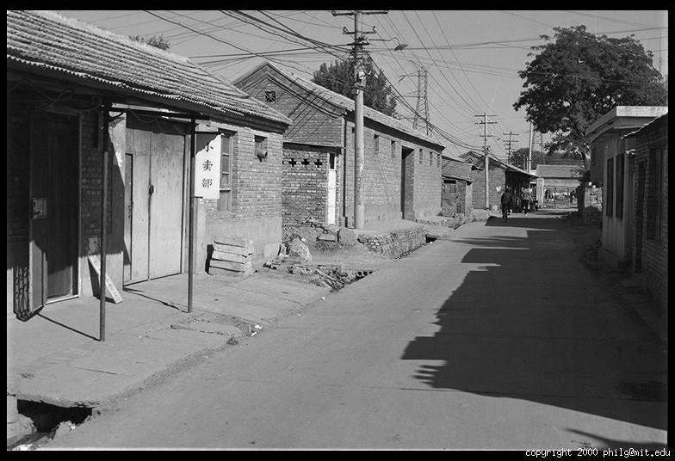
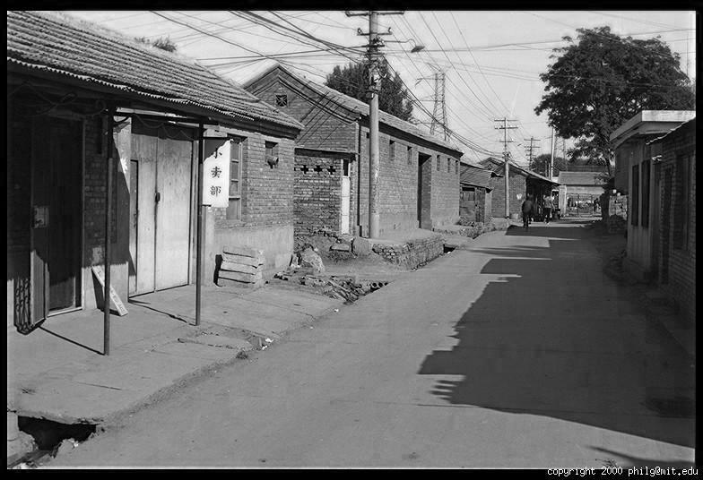
Color
R
G
B
James Hays

Slide 24
Images in Matlab
NxM RGB “im”
  im(1,1,1) = top-left pixel value in R-channel
  im(y, x, b) = y pixels down, x pixels to right in the b^{th} channel
  im(N, M, 3) = bottom-right pixel in B-channel
imread(filename) returns a uint8 image (values 0 to 255)
  Convert to double format (values 0 to 1) with im2double
column
row
R
0.92 | 0.93 | 0.94 | 0.97 | 0.62 | 0.37 | 0.85 | 0.97 | 0.93 | 0.92 | 0.99
0.95 | 0.89 | 0.82 | 0.89 | 0.56 | 0.31 | 0.75 | 0.92 | 0.81 | 0.95 | 0.91
0.89 | 0.72 | 0.51 | 0.55 | 0.51 | 0.42 | 0.57 | 0.41 | 0.49 | 0.91 | 0.92
0.96 | 0.95 | 0.88 | 0.94 | 0.56 | 0.46 | 0.91 | 0.87 | 0.90 | 0.97 | 0.95
0.71 | 0.81 | 0.81 | 0.87 | 0.57 | 0.37 | 0.80 | 0.88 | 0.89 | 0.79 | 0.85
0.49 | 0.62 | 0.60 | 0.58 | 0.50 | 0.60 | 0.58 | 0.50 | 0.61 | 0.45 | 0.33
0.86 | 0.84 | 0.74 | 0.58 | 0.51 | 0.39 | 0.73 | 0.92 | 0.91 | 0.49 | 0.74
0.96 | 0.67 | 0.54 | 0.85 | 0.48 | 0.37 | 0.88 | 0.90 | 0.94 | 0.82 | 0.93
0.69 | 0.49 | 0.56 | 0.66 | 0.43 | 0.42 | 0.77 | 0.73 | 0.71 | 0.90 | 0.99
0.79 | 0.73 | 0.90 | 0.67 | 0.33 | 0.61 | 0.69 | 0.79 | 0.73 | 0.93 | 0.97
0.91 | 0.94 | 0.89 | 0.49 | 0.41 | 0.78 | 0.78 | 0.77 | 0.89 | 0.99 | 0.93
G
0.92 | 0.93 | 0.94 | 0.97 | 0.62 | 0.37 | 0.85 | 0.97 | 0.93 | 0.92 | 0.99
0.95 | 0.89 | 0.82 | 0.89 | 0.56 | 0.31 | 0.75 | 0.92 | 0.81 | 0.95 | 0.91
0.89 | 0.72 | 0.51 | 0.55 | 0.51 | 0.42 | 0.57 | 0.41 | 0.49 | 0.91 | 0.92
0.96 | 0.95 | 0.88 | 0.94 | 0.56 | 0.46 | 0.91 | 0.87 | 0.90 | 0.97 | 0.95
0.71 | 0.81 | 0.81 | 0.87 | 0.57 | 0.37 | 0.80 | 0.88 | 0.89 | 0.79 | 0.85
0.49 | 0.62 | 0.60 | 0.58 | 0.50 | 0.60 | 0.58 | 0.50 | 0.61 | 0.45 | 0.33
0.86 | 0.84 | 0.74 | 0.58 | 0.51 | 0.39 | 0.73 | 0.92 | 0.91 | 0.49 | 0.74
0.96 | 0.67 | 0.54 | 0.85 | 0.48 | 0.37 | 0.88 | 0.90 | 0.94 | 0.82 | 0.93
0.69 | 0.49 | 0.56 | 0.66 | 0.43 | 0.42 | 0.77 | 0.73 | 0.71 | 0.90 | 0.99
0.79 | 0.73 | 0.90 | 0.67 | 0.33 | 0.61 | 0.69 | 0.79 | 0.73 | 0.93 | 0.97
0.91 | 0.94 | 0.89 | 0.49 | 0.41 | 0.78 | 0.78 | 0.77 | 0.89 | 0.99 | 0.93
B
0.92 | 0.93 | 0.94 | 0.97 | 0.62 | 0.37 | 0.85 | 0.97 | 0.93 | 0.92 | 0.99
0.95 | 0.89 | 0.82 | 0.89 | 0.56 | 0.31 | 0.75 | 0.92 | 0.81 | 0.95 | 0.91
0.89 | 0.72 | 0.51 | 0.55 | 0.51 | 0.42 | 0.57 | 0.41 | 0.49 | 0.91 | 0.92
0.96 | 0.95 | 0.88 | 0.94 | 0.56 | 0.46 | 0.91 | 0.87 | 0.90 | 0.97 | 0.95
0.71 | 0.81 | 0.81 | 0.87 | 0.57 | 0.37 | 0.80 | 0.88 | 0.89 | 0.79 | 0.85
0.49 | 0.62 | 0.60 | 0.58 | 0.50 | 0.60 | 0.58 | 0.50 | 0.61 | 0.45 | 0.33
0.86 | 0.84 | 0.74 | 0.58 | 0.51 | 0.39 | 0.73 | 0.92 | 0.91 | 0.49 | 0.74
0.96 | 0.67 | 0.54 | 0.85 | 0.48 | 0.37 | 0.88 | 0.90 | 0.94 | 0.82 | 0.93
0.69 | 0.49 | 0.56 | 0.66 | 0.43 | 0.42 | 0.77 | 0.73 | 0.71 | 0.90 | 0.99
0.79 | 0.73 | 0.90 | 0.67 | 0.33 | 0.61 | 0.69 | 0.79 | 0.73 | 0.93 | 0.97
0.91 | 0.94 | 0.89 | 0.49 | 0.41 | 0.78 | 0.78 | 0.77 | 0.89 | 0.99 | 0.93
James Hays

Slide 25
Color in human vision
Anatomy

Slide 26
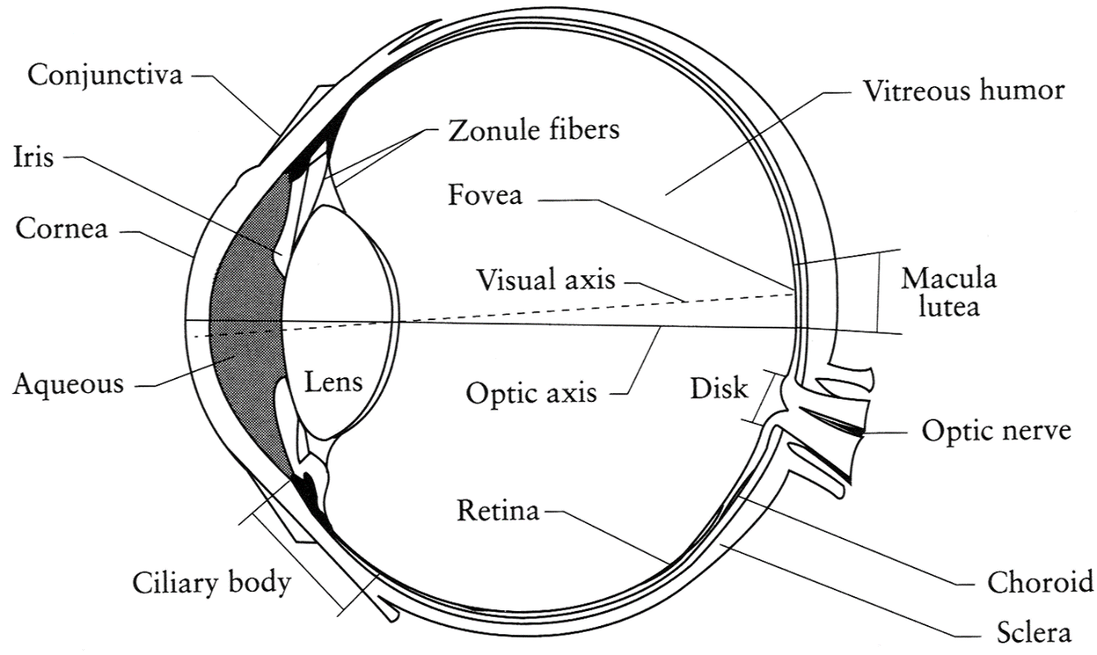
The Eye
The human eye is a camera
  Iris - colored annulus with radial muscles
  Pupil - the hole (aperture) whose size is controlled by the iris
  What’s the sensor?
    photoreceptor cells (rods and cones) in the retina
Slide by Steve Seitz

Slide 27
Two types of light-sensitive receptors
Cones
cone-shaped
less sensitive
operate in high light
color vision
Rods
rod-shaped
highly sensitive
operate at night
gray-scale vision
© Stephen E. Palmer, 2002
James Hays

Slide 28
Distribution of Rods and Cones
Night Sky: why are there more stars off-center?
Averted vision: http://en.wikipedia.org/wiki/Averted_vision
© Stephen E. Palmer, 2002
James Hays
Notes:
<number>

Slide 29
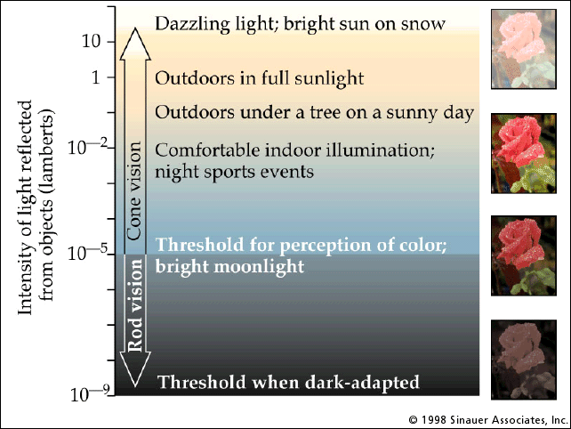
Rod / Cone sensitivity
Notes:
Motivation for HDR -> show range of intensity that an 8-bit image can capture.
<number>

Slide 30
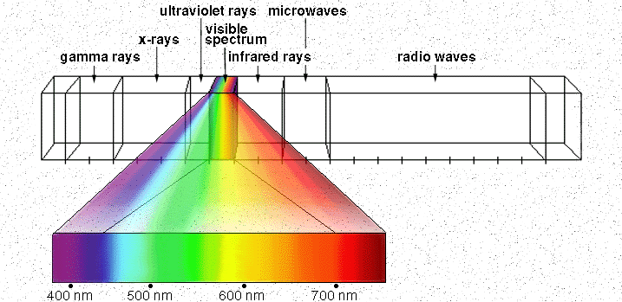
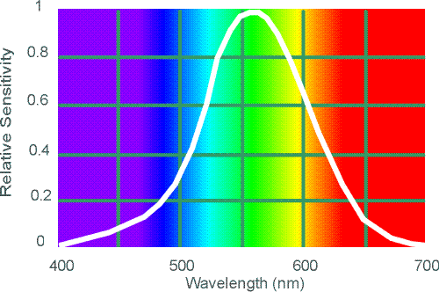
Electromagnetic Spectrum
Human Luminance Sensitivity Function
http://www.yorku.ca/eye/photopik.htm
Notes:
<number>
At least 3 spectral bands required (e.g. R,G,B)

Slide 31
Sun temperature makes it emit yellow light more than any other color.
Notes:
The Sun is the dominant source for visible-light waves our eyes receive. The outer-most layer of the Sun's atmosphere, the corona, can be seen in visible light. But it is so faint it cannot not be seen except during a total solar eclipse because the bright photosphere overwhelms it. The tapered patterns—coronal streamers—around the Sun are formed by the outward flow of plasma that is shaped by magnetic field lines extending millions of miles into space.
As objects grow hotter, they radiate energy dominated by shorter wavelengths, changing color before our eyes. A flame on a blow torch shifts from reddish to bluish in color as it is adjusted to burn hotter. In the same way, the color of stars tells scientists about their temperature.
<number>

Slide 32
Visible Light
Plank’s law for Blackbody radiation
Surface of the sun: ~5800K
Why do we see light of these wavelengths?
…because that’s where the
Sun radiates EM energy
© Stephen E. Palmer, 2002
Notes:
Because that’s where the Sun’s peak radiation was
Because the atmosphere is fairly transparent in that range
Because biology has many important markers in that range (but that’s because of the previous two reasons)
<number>

Slide 33
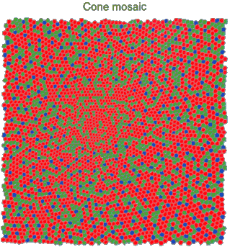
Physiology of Color Vision
Three kinds of cones:
© Stephen E. Palmer, 2002

Slide 34
The Physics of Light
Any patch of light can be completely described
physically by its spectrum: the number of photons
(per time unit) at each wavelength 400 - 700 nm.
© Stephen E. Palmer, 2002

Slide 35
The Physics of Light
Some examples of the spectra of light sources
© Stephen E. Palmer, 2002

Slide 36
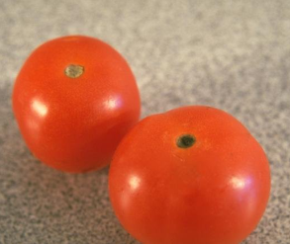
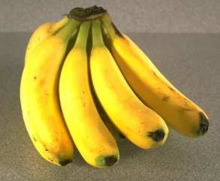
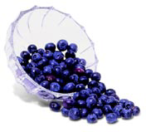
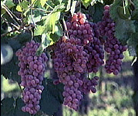
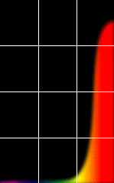
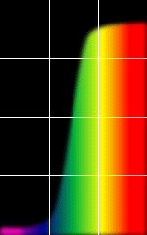
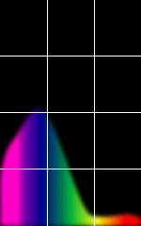
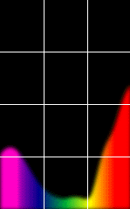
The Physics of Light
Some examples of the reflectance spectra of surfaces
Red
Yellow
Blue
Purple
% Photons Reflected
400 700
400 700
400 700
400 700
Wavelength (nm)
© Stephen E. Palmer, 2002

Slide 37
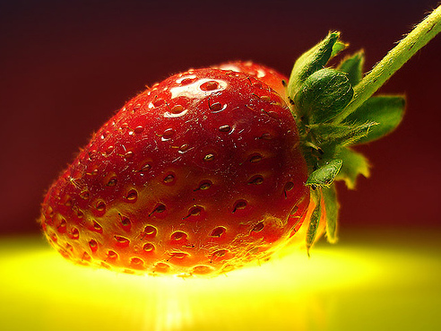
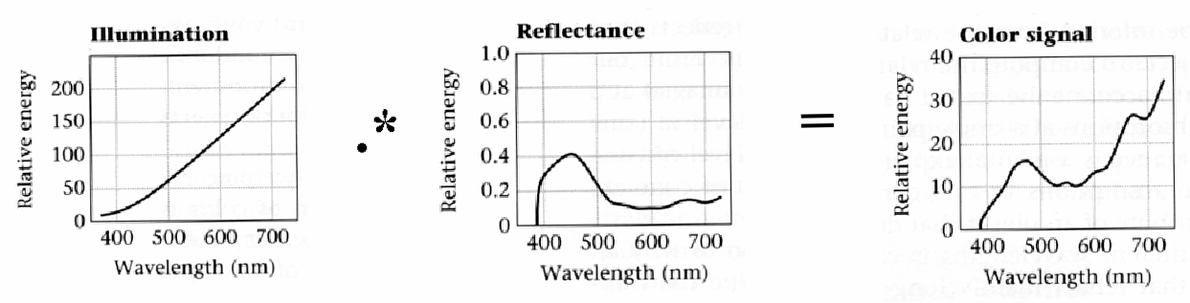
Interaction of light and surfaces
Reflected color is the result of interaction of light source spectrum with surface reflectance
Spectral radiometry
  All definitions and units are now “per unit wavelength”
  All terms are now “spectral”
From Foundation of Vision by Brian Wandell, Sinauer Associates, 1995
Notes:
<number>

Slide 38
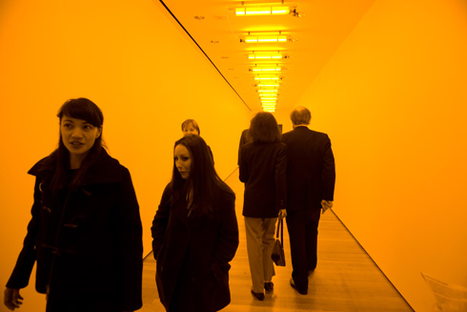
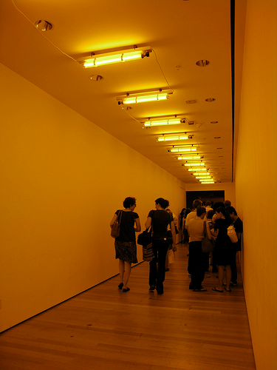
Interaction of light and surfaces
What is the observed color of any surface under monochromatic light?
Olafur Eliasson, Room for one color
Slide by S. Lazebnik
Notes:
<number>

Slide 40
Physiology of Color Vision
Three kinds of cones:
Why are M and L cones so close?
Why are there 3?
© Stephen E. Palmer, 2002

Slide 41
S are more different from the M and L
The population of the S cones is much smaller than that of the L or M cones.
  ~10% S cones (peak at 420 nm, bluish-violet)
  ~60% L cones (peak at 564 nm, yellowish-green)
  ~20% M cones (peak at 534 nm, bluish-green)
S cones are totally absent in the foveal area (and so are the rods) where there is a high concentration of M and L cones.
Notes:
The S cone's sensitivity curve (with peak at 437 mm) is very different from the sensitivity curves of the L and M cones which are quite similar with their peaks very close to each other (at 564 mm and 533 mm respectively) and overlap over a wide range of the visible wavelengths.
are L and M cones, with 2 to 4 times more L cones than M cones.
<number>

Slide 42
S are more different from the M and L
The genes of the photoreceptors lie on different chromosomes
  rod lies on chromosome 8,
  S cone lies on chromosome 7
  Both L and M cones lie on the X chromosome, one of the two sex chromosomes (X and Y)
    This is why red/green color blindness is much more common than other color blindness and also why the probability of color blindness is much higher in male (XY) than in female (XX).
Evidences show that the difference between the S cones and the M/L cones is due to evolutionary reasons
  The separation of the S cones and the M/L cones probably occurred much earlier than the separation of the M and L cones
Notes:
The S cone's sensitivity curve (with peak at 437 mm) is very different from the sensitivity curves of the L and M cones which are quite similar with their peaks very close to each other (at 564 mm and 533 mm respectively) and overlap over a wide range of the visible wavelengths.
<number>

Slide 43
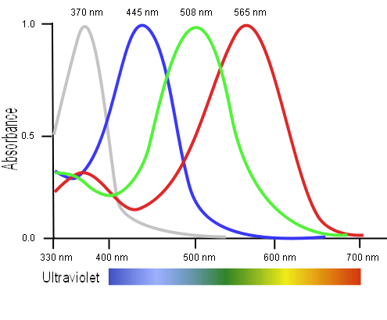
Tetrachromatism
Bird cone responses
Most birds, and many other animals, have cones for ultraviolet light.
Some humans seem to have four cones (12% of females).
True tetrachromatism is rare; requires learning.
James Hays
Notes:
http://www.sciencealert.com/scientists-have-found-a-woman-whose-eyes-have-a-whole-new-type-of-colour-receptor
Assuming that colour blind men pass this fourth cone cell onto their daughters, Mollon estimated that around 12 percent of the female population should be tetrachromats.
But all of his tests showed that these women could only perceive the same colours as the rest of us - which meant only three of their cone cell types were working, so they weren't true tetrachromats.
<number>

Slide 44

Bee vision
Notes:
Does color exist?
http://www.askamathematician.com/2012/06/q-do-colors-exist/
http://www.radiolab.org/story/211178-rip-rainbow/
<number>

Slide 45

Notes:
Does color exist?
<number>

Slide 46

Magenta is a ``fake” color
You won’t see Magenta in a rainbow
Colour Mixing: The Mystery of Magenta

Slide 47
COLOR SENSING IN CAMERA

Slide 48


Color Sensing in Camera (RGB)
3-chip vs. 1-chip: quality vs. cost
Why 3 colors?
http://www.cooldictionary.com/words/Bayer-filter.wikipedia
Slide by Steve Seitz

Slide 49

Camera Color Response
MaxMax.com
Notes:
https://www.quora.com/Why-is-there-a-significant-difference-between-image-sensors-and-human-eyes-Spectral-response
http://www.maxmax.com/ndvi_camera_technical.htm
http://www.maxmax.com/faq/camera-tech/spectral-response
NOTE the strong response into long wavelengths (near IR). Many camera sensors can see into infrared range, but the lens system includes an IR low-pass filter which blocks incoming IR light.
<number>

Slide 50
color SPACES
Notes:
https://arcsecond.wordpress.com/2008/10/06/calculoergosum/
Has certain properties of vector spaces, e.g., we can make a new basis from a different set of colors, like cyan, magenta, and yellow for instance.
But, it’s clamped at 1, and it doesn’t have negative values.
<number>

Slide 51

Color spaces
How can we represent color?
http://en.wikipedia.org/wiki/File:RGB_illumination.jpg

Slide 52





Color spaces: RGB
Default color space
0,1,0
R = 1
(G=0,B=0)
1,0,0
G = 1
(R=0,B=0)
0,0,1
B = 1
(R=0,G=0)
Any color = r*R + g*G + b*B
Strongly correlated channels
Non-perceptual
Image from: http://en.wikipedia.org/wiki/File:RGB_color_solid_cube.png

Slide 53

Color spaces: HSV
Intuitive color space

Slide 54
If you had to choose, would you rather go without luminance or chrominance?

Slide 55

Most information in intensity
Only color shown – constant intensity
James Hays

Slide 56

Most information in intensity
Only intensity shown – constant color
James Hays

Slide 57
Most information in intensity
Original image
James Hays

Slide 58



Color spaces: HSV
Intuitive color space
H
(S=1,V=1)
S
(H=1,V=1)
V
(H=1,S=0)
James Hays
Notes:
<number>

Slide 59






Color spaces: YCbCr
Fast to compute, good for compression, used by TV
Y=0
Y=0.5
Y
(Cb=0.5,Cr=0.5)
Cr
Cb
(Y=0.5,Cr=0.5)
Cb
Y=1
Cr
(Y=0.5,Cb=05)
James Hays
Notes:
The colorimetric difference between a given color in a television picture and a standard color of equal luminance.
<number>

Slide 60

Most JPEG images & videos
subsample chroma
Notes:
http://users.wfu.edu/matthews/misc/jpg_vs_gif/JpgCompTest/
<number>

Slide 61




Color spaces: L*a*b*
“Perceptually uniform”* color space
L
(a=0,b=0)
a
(L=65,b=0)
b
(L=65,a=0)
James Hays
Notes:
* almost
<number>

Slide 62

XKCD

Slide 63
White BALANCING

Slide 64


White balance
When looking at a picture on screen or print, we adapt to the illuminant of the room, not to that of the scene in the picture
When the white balance is not correct, the picture will have an unnatural color “cast”
incorrect white balance
correct white balance
http://www.cambridgeincolour.com/tutorials/white-balance.htm
Notes:
<number>
White balance (WB) is the process of removing unrealistic color casts, so that objects which appear white in person are rendered white in your photo.

Slide 65

White balance
Film cameras:
  Different types of film or different filters for different illumination conditions
Digital cameras:
  Automatic white balance
  White balance settings corresponding to
  several common illuminants
  Custom white balance using a reference
  object
http://www.cambridgeincolour.com/tutorials/white-balance.htm
Slide: F. Durand
Notes:
<number>

Slide 66
White balance
Von Kries adaptation
  Multiply each channel by a gain factor
  A more general transformation would correspond to an arbitrary 3x3 matrix
Slide: F. Durand
Notes:
<number>
The von Kries coefficient law in color adaptation describes the relationship between the illuminant and the human visual system sensitivity.

Slide 67

White balance
Von Kries adaptation
  Multiply each channel by a gain factor
  A more general transformation would correspond to an arbitrary 3x3 matrix
Best way: gray card
  Take a picture of a neutral object (white or gray)
  Deduce the weight of each channel
    If the object is recoded as r_{w}, g_{w}, b_{w}
    use weights 1/r_{w}, 1/g_{w}, 1/b_{w}
Slide: F. Durand
Notes:
<number>

Slide 68

White balance
Without gray cards: we need to “guess” which pixels correspond to white objects
Gray world assumption
  The image average r_{ave}, g_{ave}, b_{ave} is gray
  Use weights 1/r_{ave}, 1/g_{ave}, 1/b_{ave}
Brightest pixel assumption (non-saturated)
  Highlights usually have the color of the light source
  Use weights inversely proportional to the values of the brightest pixels
Gamut mapping
  Gamut: convex hull of all pixel colors in an image
  Find the transformation that matches the gamut of the image to the gamut of a “typical” image under white light
Slide: F. Durand
Notes:
<number>

Slide 69
Uses OF COLOR IN COMPUTER VISION

Slide 70
Uses of color in computer vision
Color histograms for indexing and retrieval
Swain and Ballard, Color Indexing, IJCV 1991.
Notes:
<number>

Slide 71
Uses of color in computer vision
Skin detection
M. Jones and J. Rehg, Statistical Color Models with Application to Skin Detection, IJCV 2002.
Source: S. Lazebnik
Notes:
<number>

Slide 72

Uses of color in computer vision
Nude people detection
Forsyth, D.A. and Fleck, M. M., ``Automatic Detection of Human Nudes,'' International Journal of Computer Vision , 32 , 1, 63-77, August, 1999
Notes:
<number>

Slide 73
Uses of color in computer vision
Image segmentation and retrieval
C. Carson, S. Belongie, H. Greenspan, and Ji. Malik, Blobworld: Image segmentation using Expectation-Maximization and its application to image querying, ICVIS 1999.
Source: S. Lazebnik
Notes:
<number>

Slide 74


Uses of color in computer vision
Robot soccer
M. Sridharan and P. Stone, Towards Eliminating Manual Color Calibration at RoboCup. RoboCup-2005: Robot Soccer World Cup IX, Springer Verlag, 2006
Source: K. Grauman
Notes:
<number>

Slide 75
Uses of color in computer vision
Building appearance models for tracking
D. Ramanan, D. Forsyth, and A. Zisserman. Tracking People by Learning their Appearance. PAMI 2007.
Source: S. Lazebnik
Notes:
<number>

Slide 76
SOME Past and Ongoing projects

