Slide 1
Image Filters
Samuel Cheng
Slide credits: Juan Carlos Niebles, Ranjay Krishna, James Hays, Noah Snavely

Slide 2
What we will learn today?
Image sampling and quantization
Image histograms
Images as functions
Linear systems (filters)
Convolution and correlation
Gaussian filter
Median filter

Slide 3
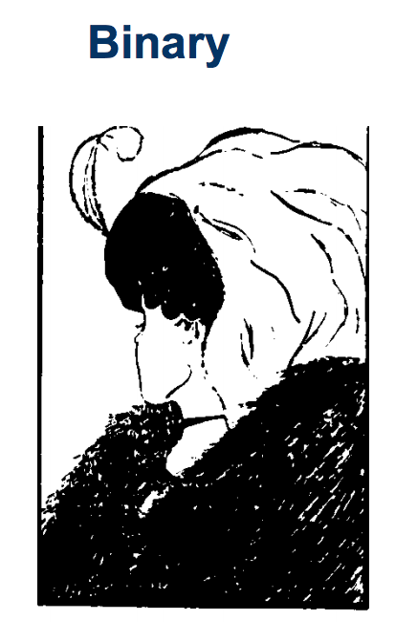
Types of Images

Slide 4
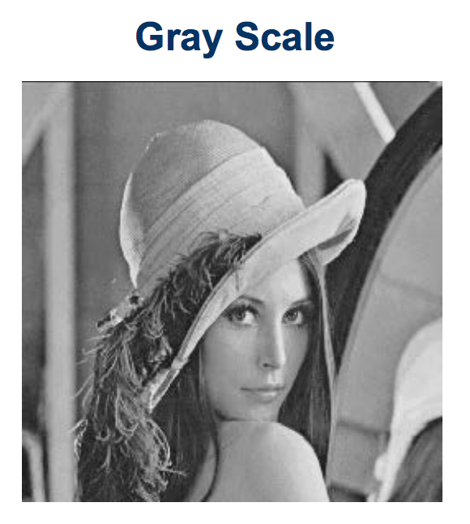
Types of Images

Slide 5
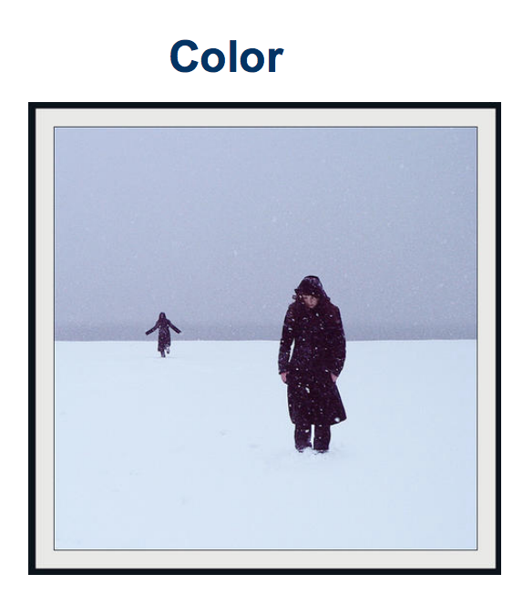
Types of Images

Slide 6
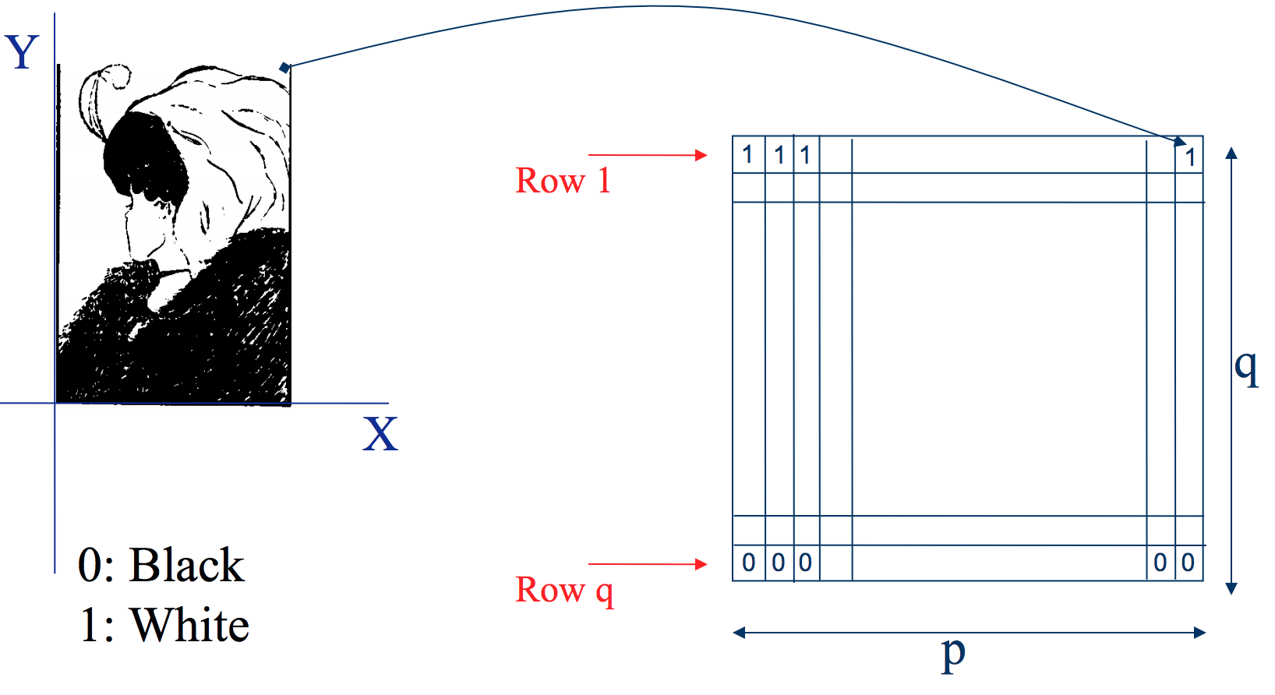
Binary image representation
Slide credit: Ulas Bagci

Slide 7
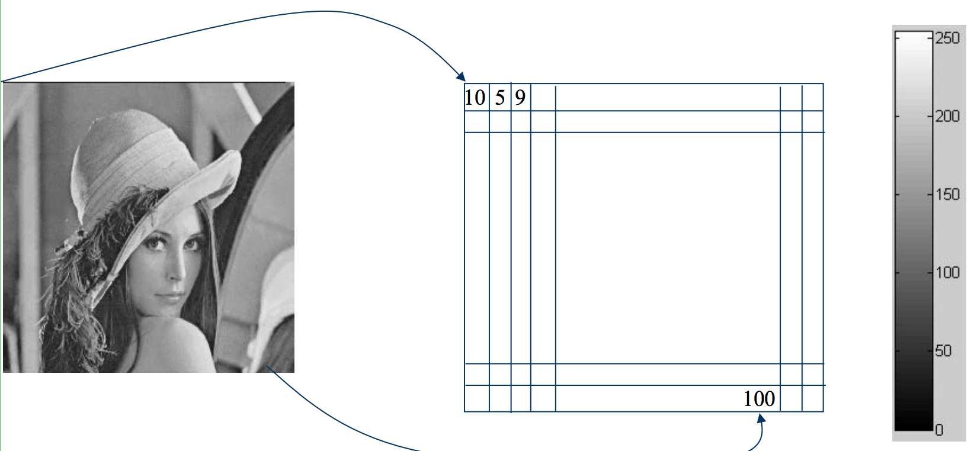
Grayscale image representation
Slide credit: Ulas Bagci

Slide 8
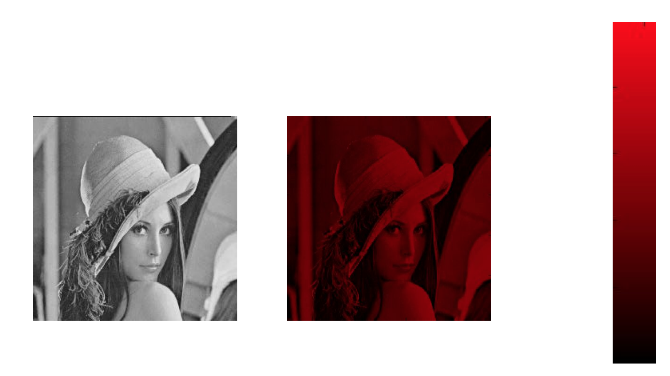
Color Image - one channel
Slide credit: Ulas Bagci

Slide 9
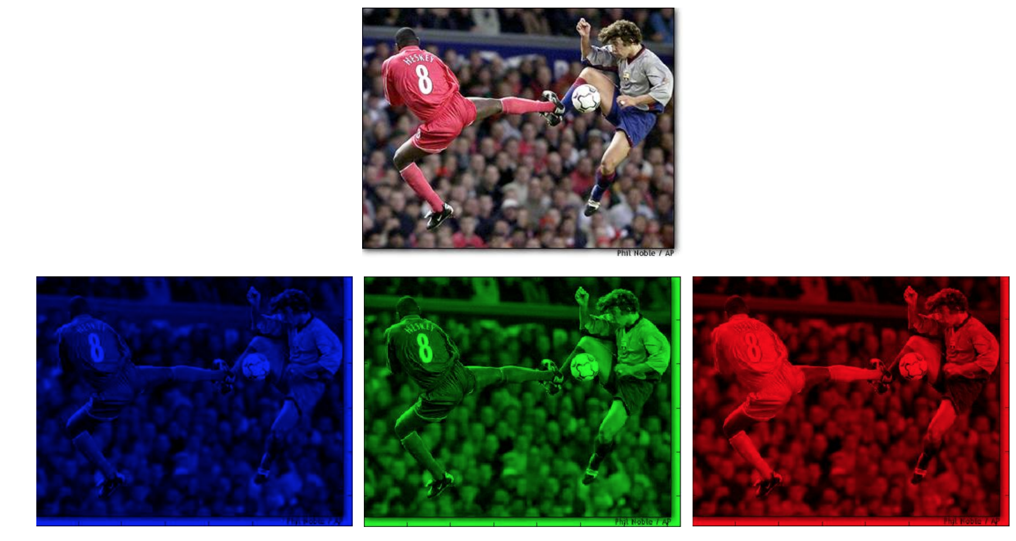
Color image representation
Slide credit: Ulas Bagci

Slide 10
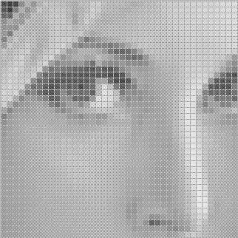
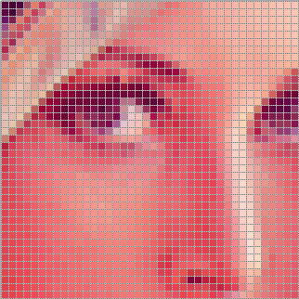
Images are sampled
What happens when we zoom into the images we capture?

Slide 11
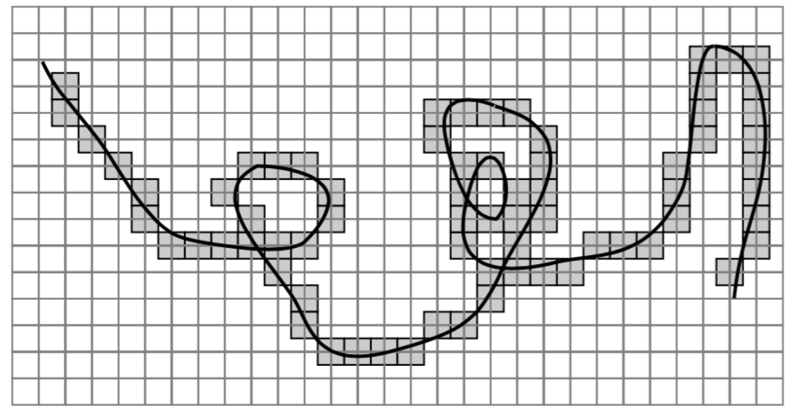
Errors due Sampling
Slide credit: Ulas Bagci

Slide 12

Resolution
is a sampling parameter, defined in dots per inch (DPI) or equivalent measures of spatial pixel density, and its standard value for recent screen technologies is 72 dpi
Slide credit: Ulas Bagci

Slide 13
Images are Sampled and Quantized
An image contains discrete number of pixels
  A simple example
  Pixel value:
    “grayscale”
    (or “intensity”): [0,255]
75
231
148
Notes:
Last time: Images as Matrices
intensity
temperature
depth

Slide 14
Images are Sampled and Quantized
An image contains discrete number of pixels
  A simple example
  Pixel value:
    “grayscale”
    (or “intensity”): [0,255]
    “color”
      RGB: [R, G, B]
      Lab: [L, a, b]
      HSV: [H, S, V]
[90, 0, 53]
[249, 215, 203]
[213, 60, 67]

Slide 15

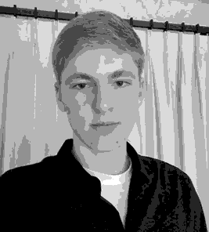

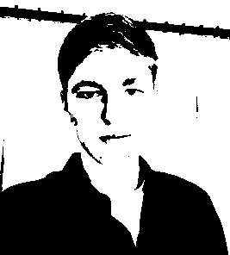
Image resolution vs radiometric Resolution
8 bit – 256 levels
4 bit – 16 levels
2 bit – 4 levels
1 bit – 2 levels

Slide 16
What we have learned today?
Image sampling and quantization
Image histograms
Images as functions
Linear systems (filters)
Convolution and correlation
Gaussian filter
Median filter

Slide 17
Histogram
Histogram of an image provides the frequency of the brightness (intensity) value in the image.
function h=histogram(im)
h=zeros(1,255);
for row=1:size(im,1)
for col=1:size(im,2)
val = im(row,col)+1;
h(val)=h(val)+1;
end
end
end
def histogram(im):
h = np.zeros(255)
for row in im.shape[0]:
for col in im.shape[1]:
val = im[row, col]
h[val] += 1

Slide 18
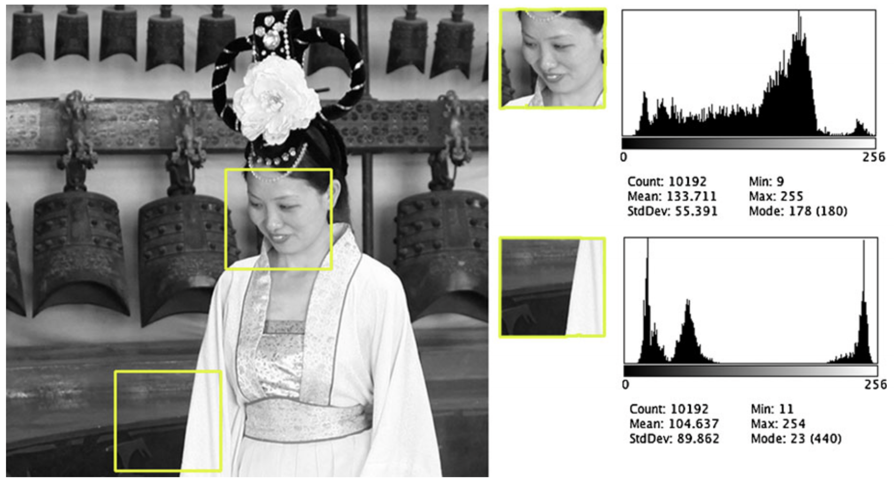
Histogram
Slide credit: Dr. Mubarak Shah

Slide 19
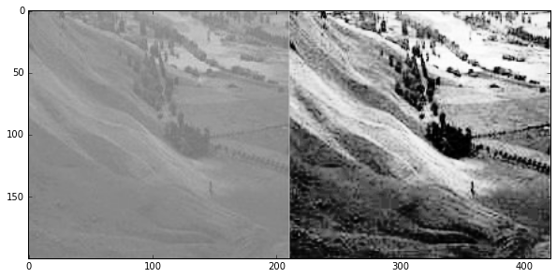
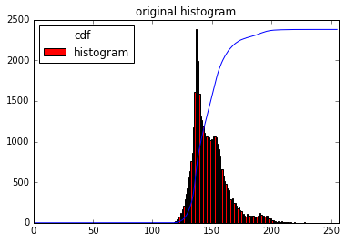
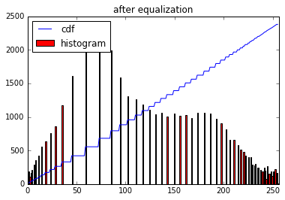
A use case: histogram equalization

Slide 20
What we have learned today?
Image sampling and quantization
Image histograms
Images as functions
Linear systems (filters)
Convolution and correlation
Gaussian filter
Median filter

Slide 21

Images as functions
Images are usually digital (discrete):
  Sample the 2D space on a regular grid
Represented as a matrix of integer values
pixel

Slide 22
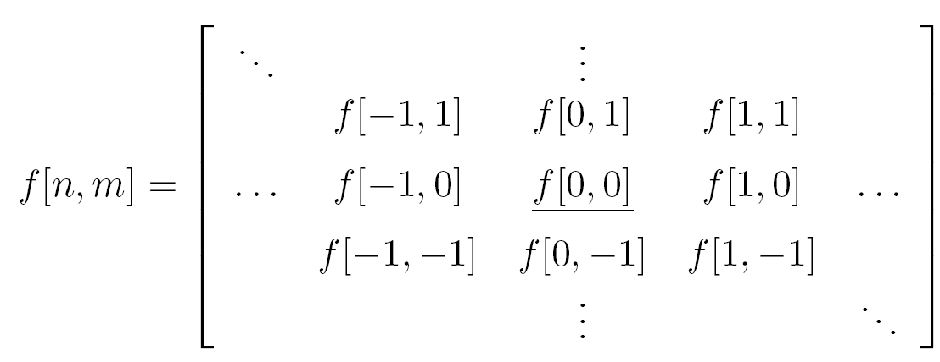
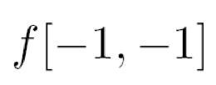







Images as functions
Cartesian coordinates
Notation for
discrete
functions

Slide 23
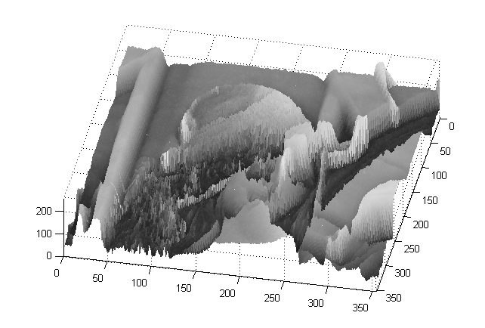
Images as functions
An Image as a function f from R² to R^{M}:
  f( x, y ) gives the intensity at position ( x, y )
  Defined over a rectangle, with a finite range:
    f: [a,b] x [c,d ] → [0,255]
Domain
support
range

Slide 24
Images as functions
An Image as a function f from R² to R^{M}:
  f( x, y ) gives the intensity at position ( x, y )
  Defined over a rectangle, with a finite range:
    f: [a,b] x [c,d ] → [0,255]
Domain
support
range
A color image:
Notes:
Each r, g, b are functions that like the one above

Slide 25
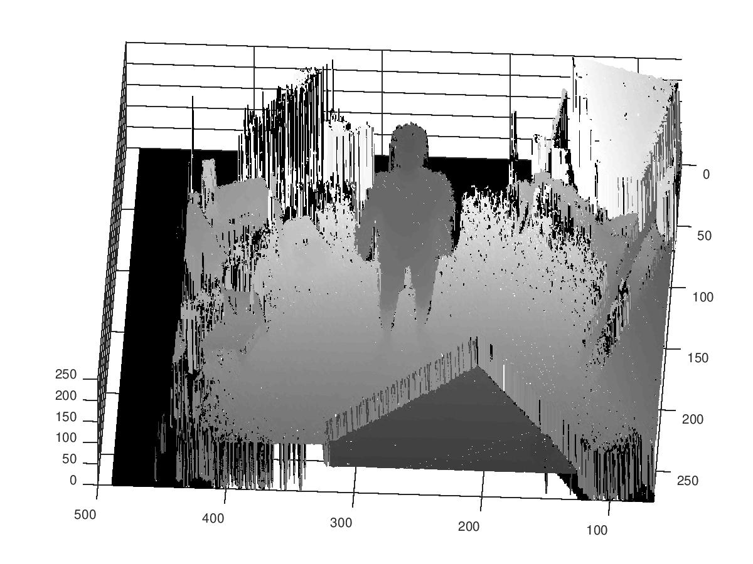
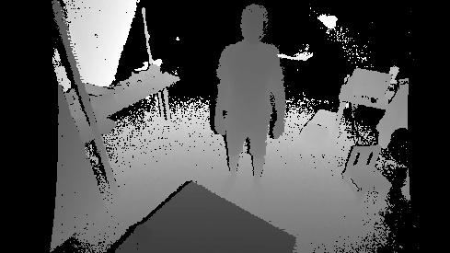
Images as functions
An Image as a function f from R² to R^{M}:
  f( x, y ) gives the depth at position ( x, y )
  Defined over a rectangle, with a finite range:
    f: [a,b] x [c,d ] → [0,255]
Domain
support
range

Slide 26
What we have learned today?
Image sampling and quantization
Image histograms
Images as functions
Linear systems (filters)
Convolution and correlation
Gaussian filter
Median filter

Slide 27
Systems and Filters
Filtering:
  Forming a new image whose pixel values are transformed from original pixel values
Goals:
Goal is to extract useful information from images, or transform images into another domain where we can modify/enhance image properties
  Features (edges, corners, blobs…)
  super-resolution; in-painting; de-noising

Slide 28

System and Filters
we define a system as a unit that converts an input function f[n,m] into an output (or response) function g[n,m], where (n,m) are the independent variables.
  In the case for images, (n,m) represents the spatial position in the image.

Slide 29

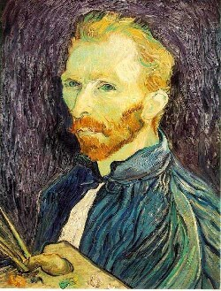
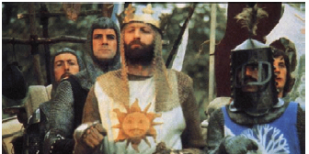
Super-resolution
De-noising
In-painting
Bertamio et al

Slide 30
Images as functions
Cartesian coordinates
Notation for
discrete
functions

Slide 31

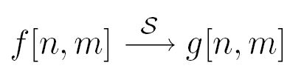
2D discrete-space systems (filters)
S is the system operator, defined as a mapping or assignment of a member of the set of possible outputs g[n,m] to each member of the set of possible inputs f[n,m].

Slide 32
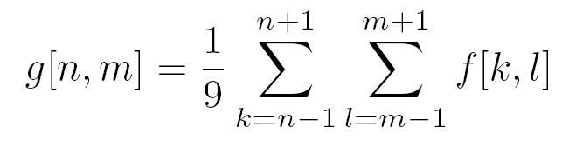

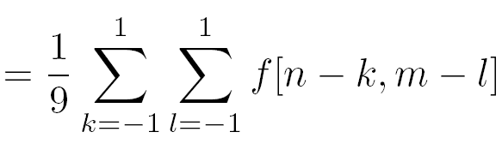
Filter example #1: Box filter
2D DS moving average over a 3 × 3 window of neighborhood
h
1
1
1
1
1
1
1
1
1
Notes:
Board:
Input image
Output image
each pixel results from a neighborhood operation

Slide 33
Image filtering
1
1
1
1
1
1
1
1
1
0 | 0 | 0 | 0 | 0 | 0 | 0 | 0 | 0 | 0
0 | 0 | 0 | 0 | 0 | 0 | 0 | 0 | 0 | 0
0 | 0 | 0 | 90 | 90 | 90 | 90 | 90 | 0 | 0
0 | 0 | 0 | 90 | 90 | 90 | 90 | 90 | 0 | 0
0 | 0 | 0 | 90 | 90 | 90 | 90 | 90 | 0 | 0
0 | 0 | 0 | 90 | 0 | 90 | 90 | 90 | 0 | 0
0 | 0 | 0 | 90 | 90 | 90 | 90 | 90 | 0 | 0
0 | 0 | 0 | 0 | 0 | 0 | 0 | 0 | 0 | 0
0 | 0 | 90 | 0 | 0 | 0 | 0 | 0 | 0 | 0
0 | 0 | 0 | 0 | 0 | 0 | 0 | 0 | 0 | 0
 | 0
0 | 0 | 0 | 0 | 0 | 0 | 0 | 0 | 0 | 0
0 | 0 | 0 | 0 | 0 | 0 | 0 | 0 | 0 | 0
0 | 0 | 0 | 90 | 90 | 90 | 90 | 90 | 0 | 0
0 | 0 | 0 | 90 | 90 | 90 | 90 | 90 | 0 | 0
0 | 0 | 0 | 90 | 90 | 90 | 90 | 90 | 0 | 0
0 | 0 | 0 | 90 | 0 | 90 | 90 | 90 | 0 | 0
0 | 0 | 0 | 90 | 90 | 90 | 90 | 90 | 0 | 0
0 | 0 | 0 | 0 | 0 | 0 | 0 | 0 | 0 | 0
0 | 0 | 90 | 0 | 0 | 0 | 0 | 0 | 0 | 0
0 | 0 | 0 | 0 | 0 | 0 | 0 | 0 | 0 | 0
Credit: S. Seitz
Notes:
ones, divide by 9

Slide 34
Image filtering
1
1
1
1
1
1
1
1
1
0 | 0 | 0 | 0 | 0 | 0 | 0 | 0 | 0 | 0
0 | 0 | 0 | 0 | 0 | 0 | 0 | 0 | 0 | 0
0 | 0 | 0 | 90 | 90 | 90 | 90 | 90 | 0 | 0
0 | 0 | 0 | 90 | 90 | 90 | 90 | 90 | 0 | 0
0 | 0 | 0 | 90 | 90 | 90 | 90 | 90 | 0 | 0
0 | 0 | 0 | 90 | 0 | 90 | 90 | 90 | 0 | 0
0 | 0 | 0 | 90 | 90 | 90 | 90 | 90 | 0 | 0
0 | 0 | 0 | 0 | 0 | 0 | 0 | 0 | 0 | 0
0 | 0 | 90 | 0 | 0 | 0 | 0 | 0 | 0 | 0
0 | 0 | 0 | 0 | 0 | 0 | 0 | 0 | 0 | 0
 | 0 | 10
0 | 0 | 0 | 0 | 0 | 0 | 0 | 0 | 0 | 0
0 | 0 | 0 | 0 | 0 | 0 | 0 | 0 | 0 | 0
0 | 0 | 0 | 90 | 90 | 90 | 90 | 90 | 0 | 0
0 | 0 | 0 | 90 | 90 | 90 | 90 | 90 | 0 | 0
0 | 0 | 0 | 90 | 90 | 90 | 90 | 90 | 0 | 0
0 | 0 | 0 | 90 | 0 | 90 | 90 | 90 | 0 | 0
0 | 0 | 0 | 90 | 90 | 90 | 90 | 90 | 0 | 0
0 | 0 | 0 | 0 | 0 | 0 | 0 | 0 | 0 | 0
0 | 0 | 90 | 0 | 0 | 0 | 0 | 0 | 0 | 0
0 | 0 | 0 | 0 | 0 | 0 | 0 | 0 | 0 | 0
Credit: S. Seitz
Notes:
ones, divide by 9

Slide 35
Image filtering
1
1
1
1
1
1
1
1
1
0 | 0 | 0 | 0 | 0 | 0 | 0 | 0 | 0 | 0
0 | 0 | 0 | 0 | 0 | 0 | 0 | 0 | 0 | 0
0 | 0 | 0 | 90 | 90 | 90 | 90 | 90 | 0 | 0
0 | 0 | 0 | 90 | 90 | 90 | 90 | 90 | 0 | 0
0 | 0 | 0 | 90 | 90 | 90 | 90 | 90 | 0 | 0
0 | 0 | 0 | 90 | 0 | 90 | 90 | 90 | 0 | 0
0 | 0 | 0 | 90 | 90 | 90 | 90 | 90 | 0 | 0
0 | 0 | 0 | 0 | 0 | 0 | 0 | 0 | 0 | 0
0 | 0 | 90 | 0 | 0 | 0 | 0 | 0 | 0 | 0
0 | 0 | 0 | 0 | 0 | 0 | 0 | 0 | 0 | 0
 | 0 | 10 | 20
0 | 0 | 0 | 0 | 0 | 0 | 0 | 0 | 0 | 0
0 | 0 | 0 | 0 | 0 | 0 | 0 | 0 | 0 | 0
0 | 0 | 0 | 90 | 90 | 90 | 90 | 90 | 0 | 0
0 | 0 | 0 | 90 | 90 | 90 | 90 | 90 | 0 | 0
0 | 0 | 0 | 90 | 90 | 90 | 90 | 90 | 0 | 0
0 | 0 | 0 | 90 | 0 | 90 | 90 | 90 | 0 | 0
0 | 0 | 0 | 90 | 90 | 90 | 90 | 90 | 0 | 0
0 | 0 | 0 | 0 | 0 | 0 | 0 | 0 | 0 | 0
0 | 0 | 90 | 0 | 0 | 0 | 0 | 0 | 0 | 0
0 | 0 | 0 | 0 | 0 | 0 | 0 | 0 | 0 | 0
Credit: S. Seitz
Notes:
ones, divide by 9

Slide 36
Image filtering
1
1
1
1
1
1
1
1
1
0 | 0 | 0 | 0 | 0 | 0 | 0 | 0 | 0 | 0
0 | 0 | 0 | 0 | 0 | 0 | 0 | 0 | 0 | 0
0 | 0 | 0 | 90 | 90 | 90 | 90 | 90 | 0 | 0
0 | 0 | 0 | 90 | 90 | 90 | 90 | 90 | 0 | 0
0 | 0 | 0 | 90 | 90 | 90 | 90 | 90 | 0 | 0
0 | 0 | 0 | 90 | 0 | 90 | 90 | 90 | 0 | 0
0 | 0 | 0 | 90 | 90 | 90 | 90 | 90 | 0 | 0
0 | 0 | 0 | 0 | 0 | 0 | 0 | 0 | 0 | 0
0 | 0 | 90 | 0 | 0 | 0 | 0 | 0 | 0 | 0
0 | 0 | 0 | 0 | 0 | 0 | 0 | 0 | 0 | 0
 | 0 | 10 | 20 | 30
0 | 0 | 0 | 0 | 0 | 0 | 0 | 0 | 0 | 0
0 | 0 | 0 | 0 | 0 | 0 | 0 | 0 | 0 | 0
0 | 0 | 0 | 90 | 90 | 90 | 90 | 90 | 0 | 0
0 | 0 | 0 | 90 | 90 | 90 | 90 | 90 | 0 | 0
0 | 0 | 0 | 90 | 90 | 90 | 90 | 90 | 0 | 0
0 | 0 | 0 | 90 | 0 | 90 | 90 | 90 | 0 | 0
0 | 0 | 0 | 90 | 90 | 90 | 90 | 90 | 0 | 0
0 | 0 | 0 | 0 | 0 | 0 | 0 | 0 | 0 | 0
0 | 0 | 90 | 0 | 0 | 0 | 0 | 0 | 0 | 0
0 | 0 | 0 | 0 | 0 | 0 | 0 | 0 | 0 | 0
Credit: S. Seitz
Notes:
ones, divide by 9

Slide 37
Image filtering
1
1
1
1
1
1
1
1
1
0 | 0 | 0 | 0 | 0 | 0 | 0 | 0 | 0 | 0
0 | 0 | 0 | 0 | 0 | 0 | 0 | 0 | 0 | 0
0 | 0 | 0 | 90 | 90 | 90 | 90 | 90 | 0 | 0
0 | 0 | 0 | 90 | 90 | 90 | 90 | 90 | 0 | 0
0 | 0 | 0 | 90 | 90 | 90 | 90 | 90 | 0 | 0
0 | 0 | 0 | 90 | 0 | 90 | 90 | 90 | 0 | 0
0 | 0 | 0 | 90 | 90 | 90 | 90 | 90 | 0 | 0
0 | 0 | 0 | 0 | 0 | 0 | 0 | 0 | 0 | 0
0 | 0 | 90 | 0 | 0 | 0 | 0 | 0 | 0 | 0
0 | 0 | 0 | 0 | 0 | 0 | 0 | 0 | 0 | 0
 | 0 | 10 | 20 | 30 | 30
Credit: S. Seitz
Notes:
ones, divide by 9

Slide 38
Image filtering
1
1
1
1
1
1
1
1
1
0 | 0 | 0 | 0 | 0 | 0 | 0 | 0 | 0 | 0
0 | 0 | 0 | 0 | 0 | 0 | 0 | 0 | 0 | 0
0 | 0 | 0 | 90 | 90 | 90 | 90 | 90 | 0 | 0
0 | 0 | 0 | 90 | 90 | 90 | 90 | 90 | 0 | 0
0 | 0 | 0 | 90 | 90 | 90 | 90 | 90 | 0 | 0
0 | 0 | 0 | 90 | 0 | 90 | 90 | 90 | 0 | 0
0 | 0 | 0 | 90 | 90 | 90 | 90 | 90 | 0 | 0
0 | 0 | 0 | 0 | 0 | 0 | 0 | 0 | 0 | 0
0 | 0 | 90 | 0 | 0 | 0 | 0 | 0 | 0 | 0
0 | 0 | 0 | 0 | 0 | 0 | 0 | 0 | 0 | 0
 | 0 | 10 | 20 | 30 | 30
?
Credit: S. Seitz
Notes:
ones, divide by 9

Slide 39
Image filtering
1
1
1
1
1
1
1
1
1
0 | 0 | 0 | 0 | 0 | 0 | 0 | 0 | 0 | 0
0 | 0 | 0 | 0 | 0 | 0 | 0 | 0 | 0 | 0
0 | 0 | 0 | 90 | 90 | 90 | 90 | 90 | 0 | 0
0 | 0 | 0 | 90 | 90 | 90 | 90 | 90 | 0 | 0
0 | 0 | 0 | 90 | 90 | 90 | 90 | 90 | 0 | 0
0 | 0 | 0 | 90 | 0 | 90 | 90 | 90 | 0 | 0
0 | 0 | 0 | 90 | 90 | 90 | 90 | 90 | 0 | 0
0 | 0 | 0 | 0 | 0 | 0 | 0 | 0 | 0 | 0
0 | 0 | 90 | 0 | 0 | 0 | 0 | 0 | 0 | 0
0 | 0 | 0 | 0 | 0 | 0 | 0 | 0 | 0 | 0
 | 0 | 10 | 20 | 30 | 30
 |  |  |  | 50
?
Credit: S. Seitz
Notes:
ones, divide by 9

Slide 40
Image filtering
1
1
1
1
1
1
1
1
1
0 | 0 | 0 | 0 | 0 | 0 | 0 | 0 | 0 | 0
0 | 0 | 0 | 0 | 0 | 0 | 0 | 0 | 0 | 0
0 | 0 | 0 | 90 | 90 | 90 | 90 | 90 | 0 | 0
0 | 0 | 0 | 90 | 90 | 90 | 90 | 90 | 0 | 0
0 | 0 | 0 | 90 | 90 | 90 | 90 | 90 | 0 | 0
0 | 0 | 0 | 90 | 0 | 90 | 90 | 90 | 0 | 0
0 | 0 | 0 | 90 | 90 | 90 | 90 | 90 | 0 | 0
0 | 0 | 0 | 0 | 0 | 0 | 0 | 0 | 0 | 0
0 | 0 | 90 | 0 | 0 | 0 | 0 | 0 | 0 | 0
0 | 0 | 0 | 0 | 0 | 0 | 0 | 0 | 0 | 0
 | 0 | 10 | 20 | 30 | 30 | 30 | 20 | 10
 | 0 | 20 | 40 | 60 | 60 | 60 | 40 | 20
 | 0 | 30 | 60 | 90 | 90 | 90 | 60 | 30
 | 0 | 30 | 50 | 80 | 80 | 90 | 60 | 30
 | 0 | 30 | 50 | 80 | 80 | 90 | 60 | 30
 | 0 | 20 | 30 | 50 | 50 | 60 | 40 | 20
 | 10 | 20 | 30 | 30 | 30 | 30 | 20 | 10
 | 10 | 10 | 10 | 0 | 0 | 0 | 0 | 0
Credit: S. Seitz

Slide 41
Box Filter
What does it do?
Replaces each pixel with an average of its neighborhood
Achieve smoothing effect (remove sharp features)
1
1
1
1
1
1
1
1
1
Slide credit: David Lowe (UBC)

Slide 42
Box Filter
What does it do?
Replaces each pixel with an average of its neighborhood
Achieve smoothing effect (remove sharp features)
Why does it sum to one?
1
1
1
1
1
1
1
1
1
Slide credit: David Lowe (UBC)

Slide 43
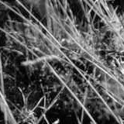
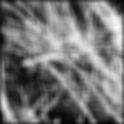
Smoothing with box filter
James Hays

Slide 44
Image filtering
Image filtering:
  Compute function of local neighborhood at each position
Really important!
  Enhance images
    Denoise, resize, increase contrast, etc.
  Extract information from images
    Texture, edges, distinctive points, etc.
  Detect patterns
    Template matching
James Hays

Slide 45
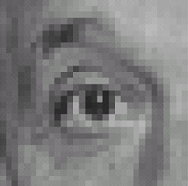

Think-Pair-Share time
0
0
0
1.
0
1
0
0
0
0
0
0
0
2.
0
0
1
0
0
0
1
0
-1
3.
2
0
-2
1
0
-1
0
0
0
-
1
1
1
4.
0
2
0
1
1
1
0
0
0
1
1
1

Slide 46
1. Practice with linear filters
0
0
0
?
0
1
0
0
0
0
Original
Source: D. Lowe

Slide 47
1. Practice with linear filters
0
0
0
0
1
0
0
0
0
Original
Filtered
(no change)
Source: D. Lowe

Slide 48
2. Practice with linear filters
0
0
0
?
0
0
1
0
0
0
Original
Source: D. Lowe

Slide 49
2. Practice with linear filters
0
0
0
0
0
1
0
0
0
Original
Shifted left
By 1 pixel
Source: D. Lowe

Slide 50
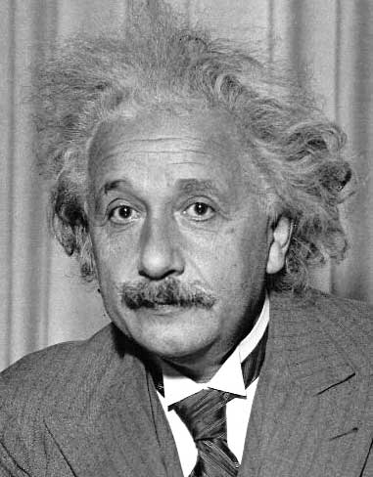
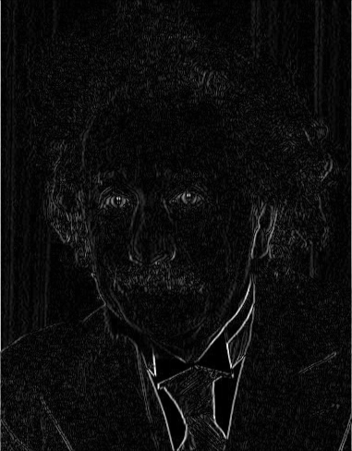
3. Practice with linear filters
1
0
-1
2
0
-2
1
0
-1
Sobel
Vertical Edge
(absolute value)
David Lowe

Slide 51
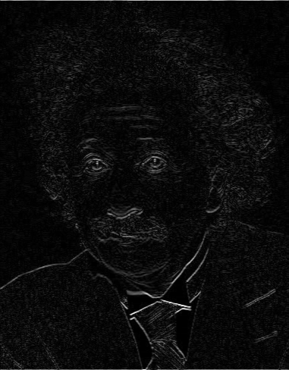
3. Practice with linear filters
1
2
1
0
0
0
-1
-2
-1
Sobel
Horizontal Edge
(absolute value)
David Lowe
Notes:
Questions at this point?

Slide 52
4. Practice with linear filters
0
0
0
-
1
1
1
?
0
2
0
1
1
1
0
0
0
1
1
1
(Note that filter sums to 1)
Original
Source: D. Lowe

Slide 53
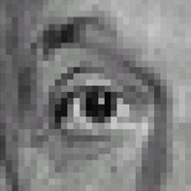
4. Practice with linear filters
0
0
0
-
1
1
1
0
2
0
1
1
1
0
0
0
1
1
1
Original
Sharpening filter
  Accentuates differences with local average
Aka unsharp masking
Source: D. Lowe

Slide 54
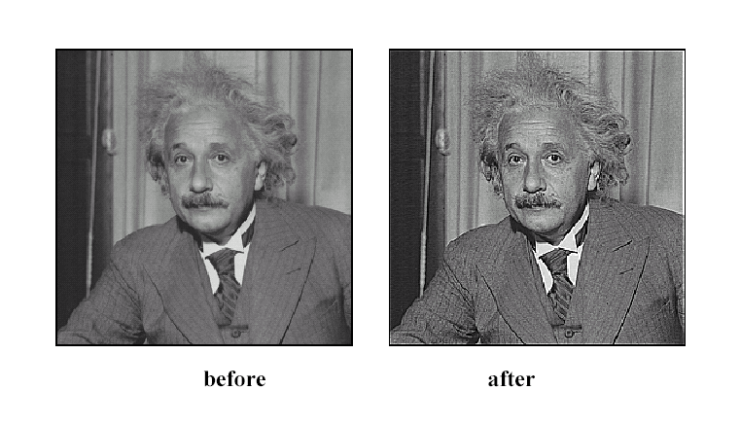
4. Practice with linear filters
Source: D. Lowe

Slide 55
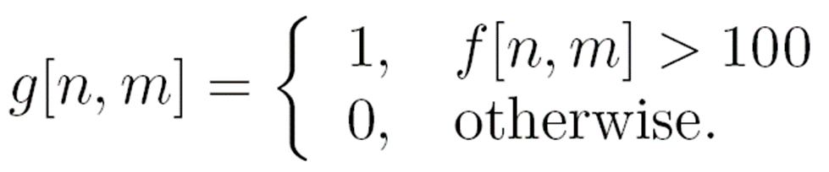

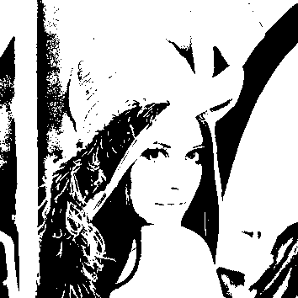
Filter example #2: Image Segmentation
Image segmentation based on a simple threshold:
255,

Slide 56




Properties of systems
Amplitude properties:
  Additivity
  Homogeneity
  Linearity
  (Linearity => additivity)
  Stability
  Invertibility

Slide 57

Properties of systems
Spatial properties
  Causality
  Shift invariance (same behavior regardless of pixel location)
$$\text{for} n<n_{0}, m<m_{0}, \text{if} f\left[n,m\right]=0 \underset{⇒}{} g\left[n_{0},m_{0}\right]=0$$
Equivalently: S(I,shift(f)) = shift(S(I,f))
Notes:
LHS: g[n-no]
RHS: S[f[n-n0]]

Slide 58
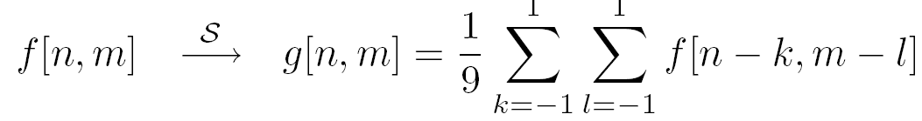
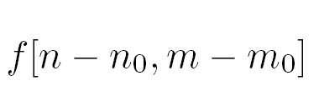
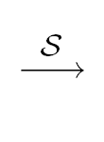
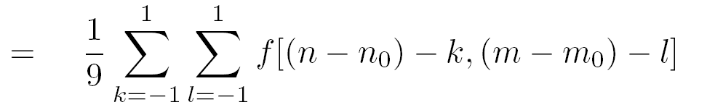

Is the moving average system is shift invariant?
Yes!

Slide 59


Linear Systems (filters)
Is the moving average a linear system?
Is thresholding a linear system?
  f1[n,m] + f2[n,m] > T
  f1[n,m] < T
  f2[n,m]<T
Yes!
$$S\left[f1\left[n,m\right]+f2\left[n,m\right]\right]=1$$
$$S\left[f1\left[n,m\right]]+S[f2\left[n,m\right]\right]=0$$
No!
Notes:
Show on the board equations for moving average.

Slide 60
What we have learned today?
Image sampling and quantization
Image histograms
Images as functions
Linear systems (filters)
Convolution and correlation
Gaussian filter
Median filter

Slide 61



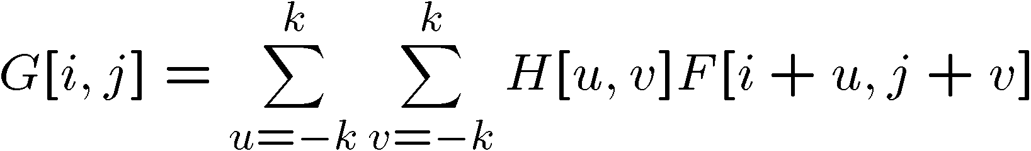

Correlation
Let be the image, be the kernel (of size 2k+1 x 2k+1), and be the output image
Can think of as a “dot product” between local neighborhood and kernel for each pixel
This is called a (cross-)correlation operation:

Slide 62
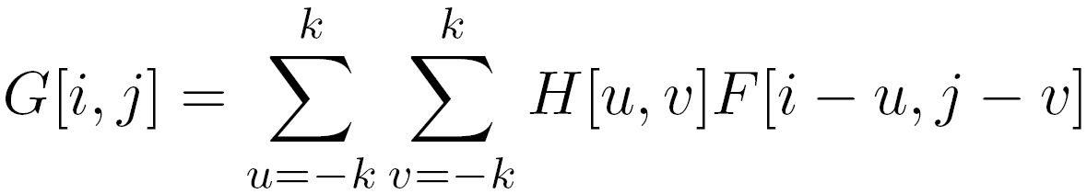
Convolution
Same as cross-correlation, except that the kernel is “flipped” (horizontally and vertically)
This is called a convolution operation:

Slide 63
Commutative property
H*F=F*H if we can ignore the boundary condition (k >> i,j)

Slide 64
Associative property

Slide 65
Convolution properties
Commutative: a * b = b * a
  Conceptually no difference between filter and signal
Associative: a * (b * c) = (a * b) * c
  Often apply several filters one after another: (((a * b₁) * b₂) * b₃)
  This is equivalent to applying one filter: a * (b₁ * b₂ * b₃)
  Correlation is _not_ associative
Distributes over addition: a * (b + c) = (a * b) + (a * c)
Scalars factor out: ka * b = a * kb = k (a * b)
Identity: unit impulse e = [0, 0, 1, 0, 0], a * e = a
Source: S. Lazebnik
Notes:
David Jacobs @ UMD http://www.cs.umd.edu/~djacobs/CMSC426/Convolution.pdf
The key difference between the two is that convolution is associative. That is, if F and G are filters, then F*(G*I) = (F*G)*I. If you don’t believe this, try a simple example, using F=G=(-1 0 1), for example. It is very convenient to have convolution be associative. Suppose, for example, we want to smooth an image and then take its derivative. We could do this by convolving the image with a Gaussian filter, and then convolving it with a derivative filter. But we could alternatively convolve the derivative filter with the Gaussian to produce a filter called a Difference of Gaussian (DOG), and then convolve this with our image. The nice thing about this is that the DOG filter can be precomputed, and we only have to convolve one filter with our image.
In general, people use convolution for image processing operations such as smoothing, and they use correlation to match a template to an image. Then, we don’t mind that correlation isn’t associative, because it doesn’t really make sense to combine two templates into one with correlation, whereas we might often want to combine two filter together for convolution. When discussing the Fourier series as a way of understanding filtering, we will use convolution, so that we can introduce the famous convolution theorem.

Slide 66
Correlation and Convolution
2d correlation
2d convolution
  Imfilter(Imfilter(I,f),g)!= imfilter(I,imfilter(f,g))
  h=filter2(f,I); or h=imfilter(I,f);
  h=conv2(f,I); or h=imfilter(I,f,’conv’);
conv2(I,f)is the same as filter2(rot90(f,2),I)
≡ filter2(fliplr(flipud((f,2)),I)
Correlation and convolution are identical when the filter is symmetric.
James Hays

Slide 67
Key properties of Shift-invariance linear filters
Linearity:
imfilter(I, f₁ + f₂) =
imfilter(I,f₁) + imfilter(I,f₂)
Shift invariance:
Same behavior regardless of pixel location
imfilter(I,shift(f)) = shift(imfilter(I,f))
Any linear, shift-invariant operator can be represented as a convolution
Source: S. Lazebnik
Notes:
f is image

Slide 68
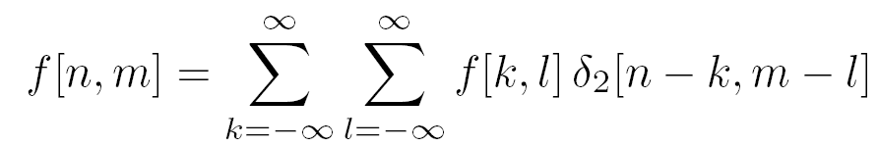
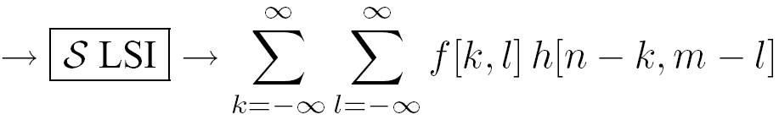
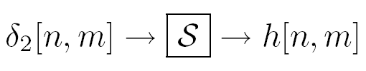
LSI (linear shift invariant) systems
An LSI system is completely specified by its impulse response.
Discrete convolution
Notes:
We can write any function as a sum of impulses…
Let’s pass this function over our system..
Using superposition, we get a sum over the impulse responses…
Final equation: we call this a convolution. Applying the impulse response h to f at all locations.

Slide 69
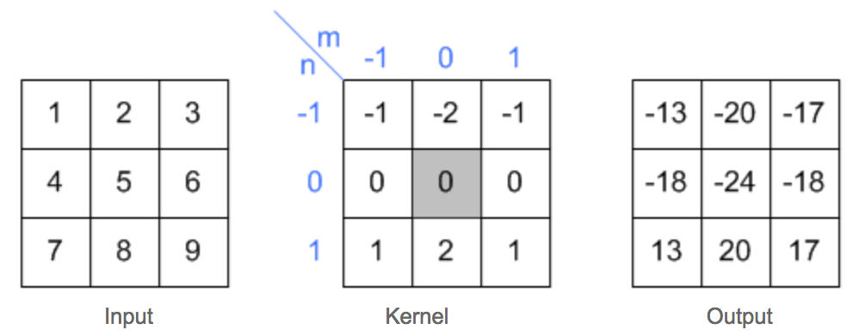
2D convolution example
Slide credit: Song Ho Ahn

Slide 70
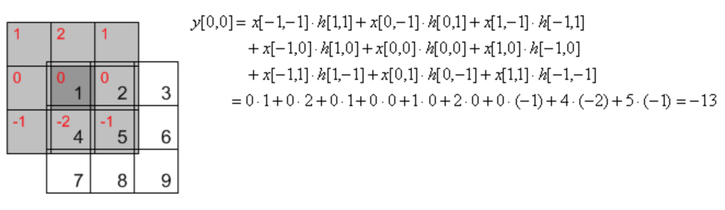
2D convolution example
Slide credit: Song Ho Ahn

Slide 71
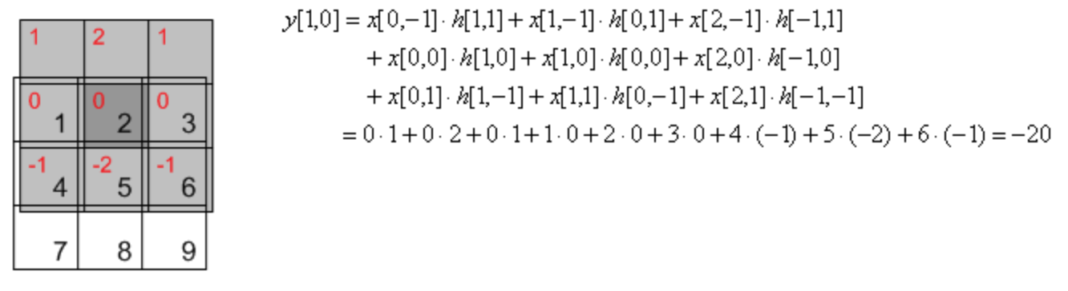
2D convolution example
Slide credit: Song Ho Ahn

Slide 72
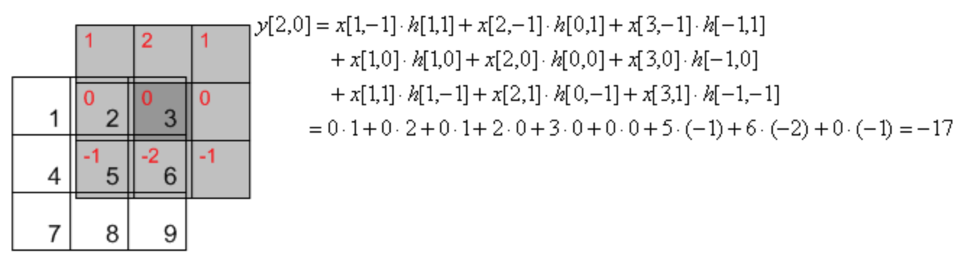
2D convolution example
Slide credit: Song Ho Ahn

Slide 73
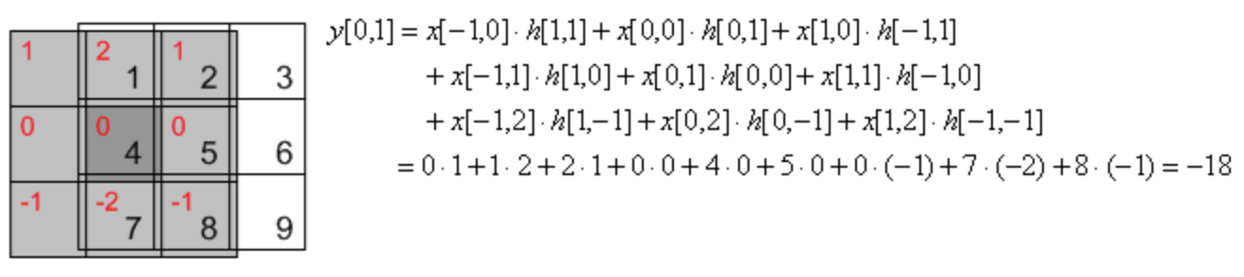
2D convolution example
Slide credit: Song Ho Ahn

Slide 74

2D convolution example
Slide credit: Song Ho Ahn

Slide 75

2D convolution example
Slide credit: Song Ho Ahn

Slide 76
Image support and edge effect
A computer will only convolve finite support signals.
  That is: images that are zero for n,m outside some rectangular region
numpy’s convolution performs 2D convolution of finite-support signals.
=
*
(N1 + N2 − 1) × (M1 +M2 − 1)
N2 ×M2
N1 ×M1

Slide 77
Image support and edge effect
A computer will only convolve finite support signals.
What happens at the edge?
f
• zero “padding”
• edge value replication
• mirror extension
• more (beyond the scope of this class)
-> Matlab conv2 uses zero-padding
h

Slide 78


Slide credit: Wolfram Alpha

Slide 79


properties
• Associative property:
• Distributive property:
The order doesn’t matter!

Slide 80



properties
• Shift property:
• Shift-invariance:

Slide 81
Convolution vs. (Cross) Correlation
A convolution is an integral that expresses the amount of overlap of one function as it is shifted over another function.
  convolution is a filtering operation
Correlation compares the similarity of two sets of data. Correlation computes a measure of similarity of two input signals as they are shifted by one another. The correlation result reaches a maximum at the time when the two signals match best .
  correlation is a measure of relatedness of two signals

Slide 82
Convolution vs. (Cross) Correlation
 | Convolution | Correlation
Associative: (ab)c=a(bc) | Yes | No
Commutative: ab=ba | Yes | No
Distributive: a(b+c)=ab+ac | Yes | Yes
Linear | Yes | Yes
Application | Filtering | Matching
They are equivalent when the filter “kernel” is symmetric

Slide 83
What we have learned today?
Image sampling and quantization
Image histograms
Images as functions
Linear systems (filters)
Convolution and correlation
Gaussian filter
Median filter

Slide 84


Important filter: Gaussian
Weight contributions of neighboring pixels by nearness
x
0.003 0.013 0.022 0.013 0.003
0.013 0.059 0.097 0.059 0.013
0.022 0.097 0.159 0.097 0.022
0.013 0.059 0.097 0.059 0.013
0.003 0.013 0.022 0.013 0.003
y
x
5 x 5, σ = 1
y
Slide credit: Christopher Rasmussen
Notes:
e^0 = 1, e^-1 = .37, e^-2 = .14, etc.

Slide 85

Smoothing with Gaussian filter
James Hays

Slide 86
Smoothing with box filter
James Hays

Slide 87
Gaussian filters
Remove “high-frequency” components from the image (low-pass filter)
  Images become more smooth
Gaussian convolved with Gaussian…
…is another Gaussian
  So can smooth with small-width kernel, repeat, and get same result as larger-width kernel would have
  Convolving two times with Gaussian kernel of width σ is same as convolving once with kernel of width σ√2
Separable kernel
  Factors into product of two 1D Gaussians
Source: K. Grauman
Notes:
Linear vs. quadratic in mask size

Slide 88

Separability of the Gaussian filter
Source: D. Lowe

Slide 89



Separability example
2D convolution
(center location only)
=
The filter factors
into a product of 1D
filters:
Perform convolution
along rows:
*
=
Followed by convolution
along the remaining column:
*
=
Source: K. Grauman
Notes:
Convolution vs filtering doesn’t matter here because the filter is symmetric
9 multiply-add operations at the top for 2D convolution
~11 multiply-add operations at the bottom for the separable 2D convolution

Slide 90
Separability
Why is separability useful in practice?

Slide 91
Separability
Why is separability useful in practice?
MxN image, PxQ filter
2D convolution: ~MNPQ multiply-adds
Separable 2D: ~MN(P+Q) multiply-adds
Speed up = PQ/(P+Q)
9x9 filter = ~4.5x faster
Notes:
https://blogs.mathworks.com/steve/2006/10/04/separable-convolution/

Slide 92
Practical matters
How big should the filter be?
Values at edges should be near zero
Gaussians have infinite extent…
Rule of thumb for Gaussian: set filter half-width to about 3 σ
James Hays

Slide 93
What we have learned today?
Image sampling and quantization
Image histograms
Images as functions
Linear systems (filters)
Convolution and correlation
Gaussian filter
Median filter

Slide 94
Median filters
Operates over a window by selecting the median intensity in the window.
‘Rank’ filter as based on ordering of gray levels
  E.G., min, max, range filters
Steve Seitz, Steve Marschner
Notes:
Better at salt’n’pepper noise
Not convolution: try a region with 1’s and a 2, and then 1’s and a 3

Slide 95
Image filtering - mean
1
1
1
1
1
1
1
1
1
0 | 0 | 0 | 0 | 0 | 0 | 0 | 0 | 0 | 0
0 | 0 | 0 | 0 | 0 | 0 | 0 | 0 | 0 | 0
0 | 0 | 0 | 90 | 90 | 90 | 90 | 90 | 0 | 0
0 | 0 | 0 | 90 | 90 | 90 | 90 | 90 | 0 | 0
0 | 0 | 0 | 90 | 90 | 90 | 90 | 90 | 0 | 0
0 | 0 | 0 | 90 | 0 | 90 | 90 | 90 | 0 | 0
0 | 0 | 0 | 90 | 90 | 90 | 90 | 90 | 0 | 0
0 | 0 | 0 | 0 | 0 | 0 | 0 | 0 | 0 | 0
0 | 0 | 90 | 0 | 0 | 0 | 0 | 0 | 0 | 0
0 | 0 | 0 | 0 | 0 | 0 | 0 | 0 | 0 | 0
 | 0 | 10 | 20 | 30 | 30
?
Credit: S. Seitz
Notes:
ones, divide by 9

Slide 96
Image filtering - mean
1
1
1
1
1
1
1
1
1
0 | 0 | 0 | 0 | 0 | 0 | 0 | 0 | 0 | 0
0 | 0 | 0 | 0 | 0 | 0 | 0 | 0 | 0 | 0
0 | 0 | 0 | 90 | 90 | 90 | 90 | 90 | 0 | 0
0 | 0 | 0 | 90 | 90 | 90 | 90 | 90 | 0 | 0
0 | 0 | 0 | 90 | 90 | 90 | 90 | 90 | 0 | 0
0 | 0 | 0 | 90 | 0 | 90 | 90 | 90 | 0 | 0
0 | 0 | 0 | 90 | 90 | 90 | 90 | 90 | 0 | 0
0 | 0 | 0 | 0 | 0 | 0 | 0 | 0 | 0 | 0
0 | 0 | 90 | 0 | 0 | 0 | 0 | 0 | 0 | 0
0 | 0 | 0 | 0 | 0 | 0 | 0 | 0 | 0 | 0
 | 0 | 10 | 20 | 30 | 30
 |  |  |  | 50
Credit: S. Seitz
Notes:
ones, divide by 9

Slide 97
Median filter?
0 | 0 | 0 | 0 | 0 | 0 | 0 | 0 | 0 | 0
0 | 0 | 0 | 0 | 0 | 0 | 0 | 0 | 0 | 0
0 | 0 | 0 | 90 | 90 | 90 | 90 | 90 | 0 | 0
0 | 0 | 0 | 90 | 90 | 90 | 90 | 90 | 0 | 0
0 | 0 | 0 | 90 | 90 | 90 | 90 | 90 | 0 | 0
0 | 0 | 0 | 90 | 0 | 90 | 90 | 90 | 0 | 0
0 | 0 | 0 | 90 | 90 | 90 | 90 | 90 | 0 | 0
0 | 0 | 0 | 0 | 0 | 0 | 0 | 0 | 0 | 0
0 | 0 | 90 | 0 | 0 | 0 | 0 | 0 | 0 | 0
0 | 0 | 0 | 0 | 0 | 0 | 0 | 0 | 0 | 0
 |  |  |  | ?
Credit: S. Seitz
Notes:
Answer is 90.

Slide 98
Median filters
Operates over a window by selecting the median intensity in the window.
What advantage does a median filter have over a mean filter?
Steve Seitz, Steve Marschner
Notes:
Better at salt’n’pepper noise

Slide 99

Noisy Jack – Salt and Pepper
Notes:
No, not the latest smash hit from early 90’s hip hop group

Slide 100

Mean Jack – 3 x 3 filter

Slide 101

Very Mean Jack – 11 x 11 filter

Slide 102
Noisy Jack – Salt and Pepper
Notes:
No, not the latest smash hit from early 90’s hip hop group

Slide 103

Median Jack – 3 x 3

Slide 104

Very Median Jack – 11 x 11

Slide 105
Median filters
Operates over a window by selecting the median intensity in the window.
What advantage does a median filter have over a mean filter?
Is a median filter a kind of convolution?
Secret: Median filtering is sorting.
Is median filter linear?
Steve Seitz, Steve Marschner
Notes:
Answer: Not convolution: try a region with 1’s and a 2, and then 1’s and a 3

Slide 106
What we have learned today?
Image sampling and quantization
Image histograms
Images as functions
Linear systems (filters)
Convolution and correlation
Gaussian filter
Median filter

Slide 107
Bonus materials

Slide 108



Unsharp masking
The unsharp masking (filtering) is a simple sharpening operator through subtracting an unsharp, or smoothed, version of an image from the original image
=
-

Slide 109

Bilateral filtering
vs
Bilateral filter tries to smooth image but still preserve edges

Slide 110

increasing texture
with Gaussian convolution
H A L O S

Slide 111

increasing texture
with bilateral filter
N O H A L O S

Slide 112




Definition
Gaussian blur
p
space
q
only spatial distance, intensity ignored
space
Bilateral filter
[Aurich 95, Smith 97, Tomasi 98]
p
range
space
range
q
normalization
space
spatial and range distances
weights sum to 1

Slide 113








Example on a Real Image
Kernels can have complex, spatially varying shapes.
input
output
⊗
⊗
⊗

Slide 114
Bilateral Filter is Expensive
Brute-force computation is slow
(several minutes)
  Two nested for loops:
  for each pixel, look at all pixels
  Non-linear, depends on image content
  ⇨ no FFT, no pre-computation…
Fast approximations exist
  E.g., Durand 02, Weiss 06
    Significant loss of accuracy
    No formal understanding of accuracy versus speed
  Better approximation (see this paper)

