Slide 1
Interest Points and Harris Corner Detector
Slide credits: James Tompkin, Rick Szeliski, Svetlana Lazebnik, Derek Hoiem and Grauman&Leibe

Slide 2
Corners
Filtering
Edges
Feature points
Also called interest points, key points, etc. Often described as ‘local’ features.
Szeliski 4.1
Slides from Rick Szeliski, Svetlana Lazebnik, Derek Hoiem and Grauman&Leibe 2008 AAAI Tutorial

Slide 3
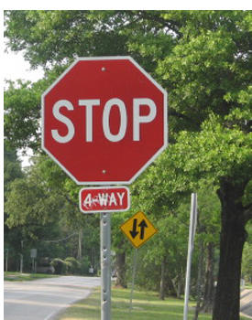
Correspondence across views
Correspondence: matching points, patches, edges, or regions across images.
≈
Hays

Slide 4
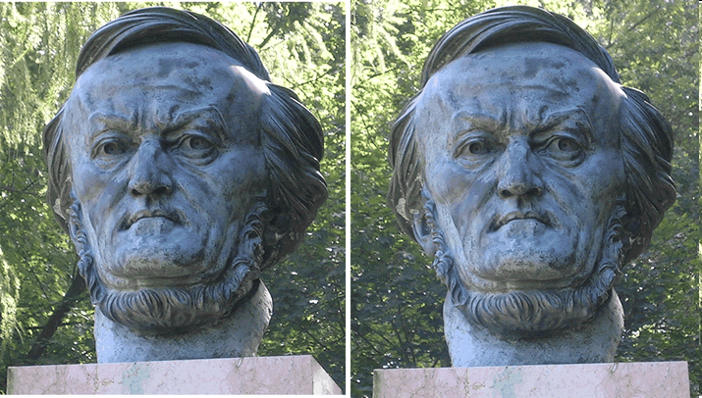
Example: estimate “fundamental matrix” that corresponds two views
Silvio Savarese

Slide 5
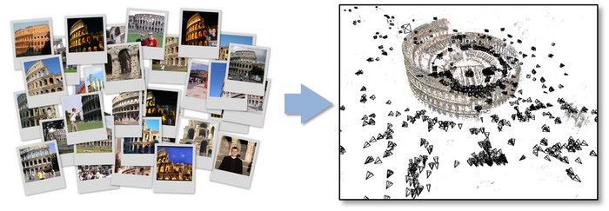
Example: structure from motion

Slide 6
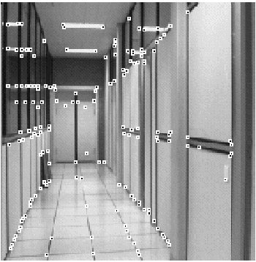
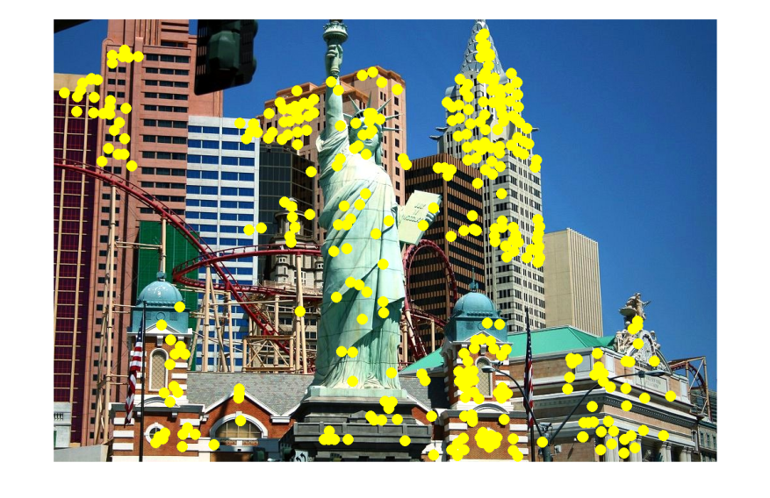
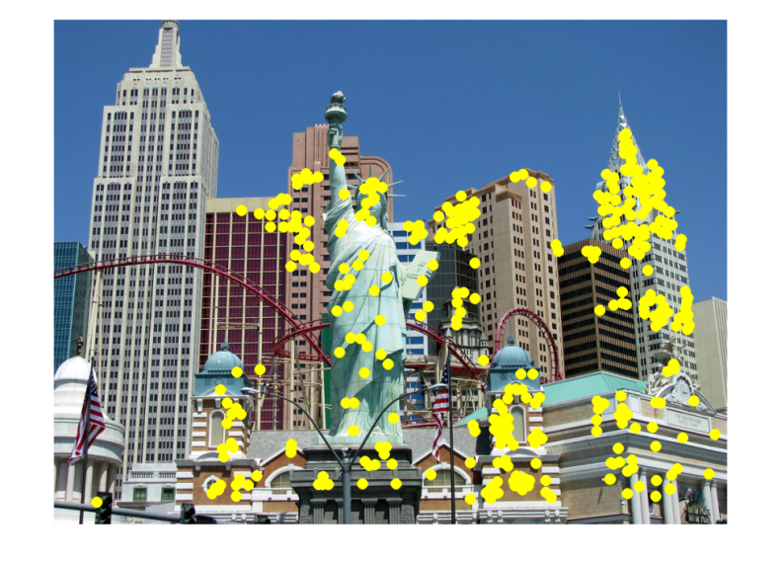
Fundamental to Applications
Feature points are used for:
Image alignment
3D reconstruction
Motion tracking (robots, drones, AR)
Indexing and database retrieval
Object recognition
…
Hays

Slide 7
Example: Invariant Local Features
Detect points that are repeatable and distinctive.
I.E., invariant to image transformations:
appearance variation (brightness, illumination)
geometric variation (translation, rotation, scale).
Keypoint Descriptors
James Hays

Slide 8
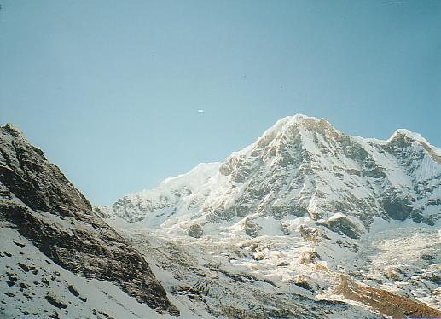
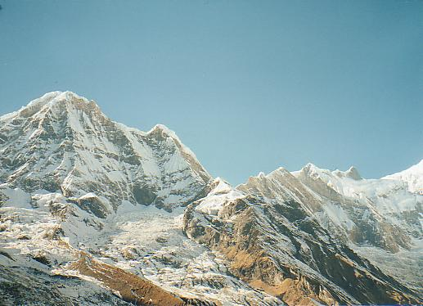
Example application
Panorama stitching
We have two images – how do we combine them?

Slide 9
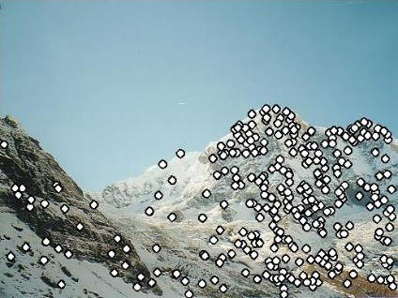
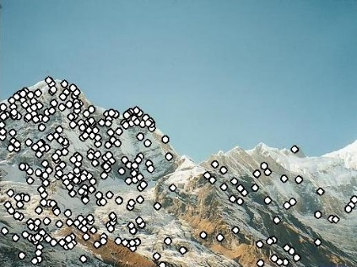
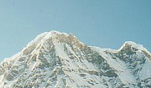
Local features: main components
Detection: Find a set of distinctive key points.
Description: Extract feature descriptor around each interest point as vector.
Matching: Compute distance between feature vectors to find correspondence.

Slide 10
Characteristics of good features
Repeatability
The same feature can be found in several images despite geometric and photometric transformations
Saliency
Each feature is distinctive
Compactness and efficiency
Many fewer features than image pixels
Locality
A feature occupies a relatively small area of the image; robust to clutter and occlusion
Kristen Grauman

Slide 11
Goal: interest operator repeatability
We want to detect (at least some of) the same points in both images.
Yet we have to be able to run the detection procedure independently per image.
With these points, there’s no chance to find true matches!
Kristen Grauman
Notes:
11

Slide 12
Goal: descriptor distinctiveness
We want to be able to reliably determine which point goes with which.
Must provide some invariance to geometric and photometric differences between the two views.
?
Kristen Grauman

Slide 13
Local features: main components
Detection: Find a set of distinctive key points.
Description: Extract feature descriptor around each interest point as vector.
Matching: Compute distance between feature vectors to find correspondence.
Comparing with edges and “flat” regions, corners are more unique

Slide 14
Corner Detection: Basic Idea
We might recognize the point by looking through a small window.
We want a window shift in any direction to give a large change in intensity.
“Flat” region: no change in all directions
“Edge”: no change along the edge direction
“Corner”: significant change in all directions
A. Efros

Slide 15
Corner Detection by Auto-correlation
Change in appearance of window w(x,y) for shift [u,v]:
Window function
Shifted intensity
Intensity
Window function w(x,y) =
or
1 in window, 0 outside
Gaussian
Source: R. Szeliski

Slide 16
Corner Detection by Auto-correlation
Change in appearance of window w(x,y) for shift [u,v]:
Window function
Shifted intensity
Intensity
Warning: sloppy notation! Probably should write
Source: R. Szeliski

Slide 17
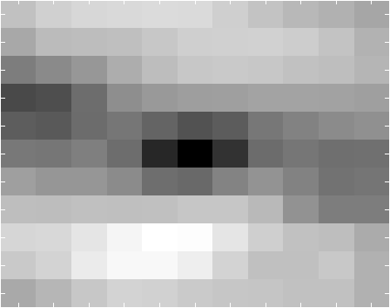
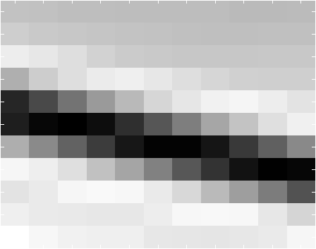
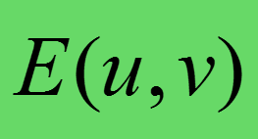
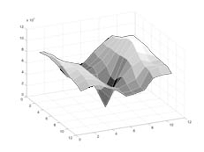
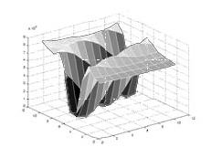
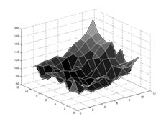
Fun time:
Correspond the three red crosses to (b,c,d).
As a surface
Notes:
Figure 4.5 Three auto-correlation surfaces EAC(u) shown as both grayscale images and surface plots:
The original image is marked with three red crosses to denote where the auto-correlation surfaces were computed;
this patch is from the flower bed (good unique minimum);
this patch is from the roof edge (one-dimensional aperture problem); and
this patch is from the cloud (no good peak).
Each grid point in figures b–d is one value of u.

Slide 18
Finding Corners
Key property: in the region around a corner, image gradient has two or more dominant directions
Corners are repeatable and distinctive
C.Harris and M.Stephens. "A Combined Corner and Edge Detector.“ Proceedings of the 4th Alvey Vision Conference: pages 147--151.

Slide 19
Corner Detection by Auto-correlation
Change in appearance of window w(x,y) for shift [u,v]:
We want to discover how E behaves for small shifts
But this is very slow to compute naively.
O(window_width² * shift_range² * image_width²)
O( 11² * 11² * 600² ) = 5.2 billion of these
14.6 thousand per pixel in your image

Slide 20
Corner Detection by Auto-correlation
Change in appearance of window w(x,y) for shift [u,v]:
We want to discover how E behaves for small shifts
Can speed up using Tayler series expansion

Slide 21
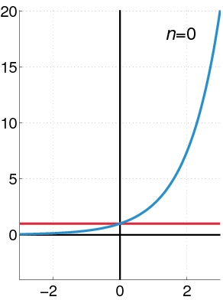
Recall: Taylor series expansion
A function f can be represented by an infinite series of its derivatives at a single point a:
Wikipedia
As we care about window centered, we set a = 0
(MacLaurin series)
Approximation of f(x) = e^{x} centered at f(0)

Slide 22
Approximating $E(u,v)$

Slide 23
Corner Detection: Mathematics
The quadratic approximation simplifies to
where M is a second moment matrix computed from image derivatives:
Notes:
https://en.wikipedia.org/wiki/Image_moment

Slide 24
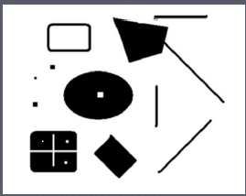
Corners as distinctive interest points
2 x 2 matrix of image derivatives (averaged in neighborhood of a point)
Notation:
James Hays

Slide 25
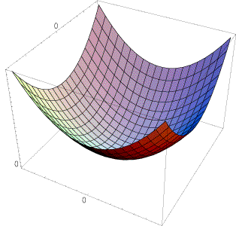
Interpreting the second moment matrix
The surface E(u,v) is locally approximated by a quadratic form. Let’s try to understand its shape.
James Hays

Slide 26
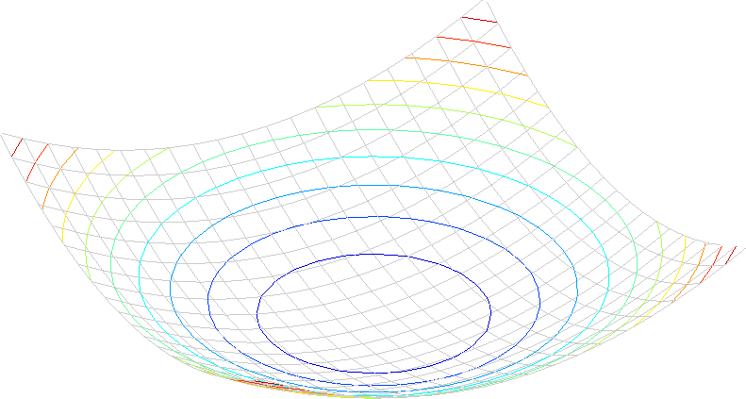
Interpreting the second moment matrix
Consider a horizontal “slice” of E(u, v):
This is the equation of an ellipse.
Recall that E(u,v) is the square difference between shifted patch and itself
James Hays
Notes:
Try to implement Harris using the technique expressed on slide 5 of the 'Local Image Features' session.
The ellipse construct is useful for understanding what M represents.
In this case, we are saying that each time c is a constant, we define an ellipse over (an idealized) E.
E is a small matrix that contains values for the local auto-correlation of an image. Its axes are u,v (the shifts in x and y) - e.g., slide 42 in the 'Interest Points and Corners' session.
E contains a set of values, from 0 (no difference in the image patches) up to the maximal difference (one all black, one all white patch, which is 255 square).
We can 'cut' E at different values in this set, to produce different shapes. E.G., if we imagine E as a 3D valley or hole shape, the shape at c = 20 will be a contour around the valley at a constant 'altitiude'.
Now, when we approximate E using the second-order Taylor approximation, we are idealizing the shape that E takes. This is what we see on slide 59 of the 'Interest Points and Corners' session. Here, our 'idealized' E is a smooth surface which approximates the auto-correlation differences, for which cross sections are ellipses. Each of the isolines on slide 59 represents a different cut at a constant value, or a different ellipse.

Slide 27
Eigenvector and eigenvalue
Scaled eigenvector is still eigenvector with same eigenvalue
Eigenvectors diagonalize the matrix

Slide 28
Eigenvector and eigenvalue
For symmetric M, R can be made orthonormal (orthogonal and normalized)
In particular, if (try at home)
R orthonormal R is a rotation operation
E(u,v) = 1 is a rotated eclipse (by R)

Slide 29
Interpreting the second moment matrix
(λ_{max})^{-1/2}
(λ_{min})^{-1/2}
direction of the fastest change
direction of the slowest change
(λ_{max})^{-1/2}
(λ_{min})^{-1/2}
The axis lengths of the ellipse are determined by the eigenvalues,
and the orientation is determined by a rotation matrix $R$.
James Hays

Slide 30
Fun time
(λ_{max})^{-1/2}
(λ_{min})^{-1/2}
Flat region
Corner
Edge

Slide 31
Classification of image points using eigenvalues of M
λ₂
“Edge” λ₂ >> λ₁
“Corner” λ₁ and λ₂ are large, λ₁ ~ λ₂; E increases in all directions
λ₁ and λ₂ are small; E is almost constant in all directions
“Flat” region
“Edge” λ₁ >> λ₂
λ₁

Slide 32
Classification of image points using eigenvalues of M
Cornerness
λ₂
“Edge” C < 0
“Corner” C > 0
α: constant (0.04 to 0.06)
|C| small
“Flat” region
“Edge” C < 0
λ₁

Slide 33
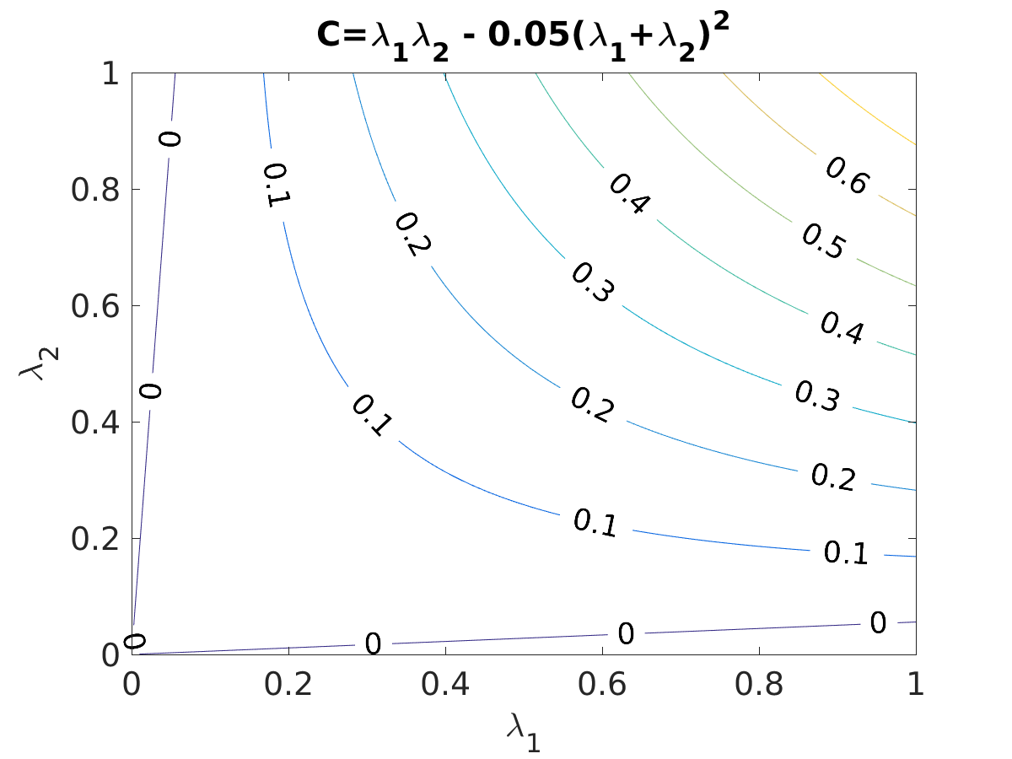
Classification of image points using eigenvalues of M
Cornerness
λ₂
“Edge” C < 0
“Corner” C > 0
α: constant (0.04 to 0.06)
|C| small
“Flat” region
“Edge” C < 0
λ₁

Slide 34
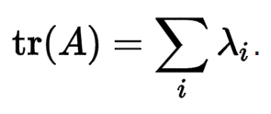
Classification of image points using eigenvalues of M
Cornerness
λ₂
“Edge” C < 0
“Corner” C > 0
α: constant (0.04 to 0.06)
Remember your linear algebra:
Determinant:
Trace:
|C| small
“Flat” region
“Edge” C < 0
λ₁

Slide 35
Harris corner detector
Compute M matrix for each window to recover a cornerness score $C$.
Note: We can find M purely from the per-pixel image derivatives!
Threshold to find pixels which give large corner response ($C$ > threshold).
Find the local maxima pixels, i.e., suppress non-maxima.
C.Harris and M.Stephens. “A Combined Corner and Edge Detector.” Proceedings of the 4th Alvey Vision Conference: pages 147—151, 1988.
Notes:
35

Slide 36
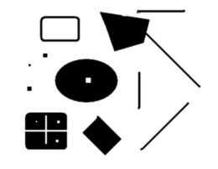
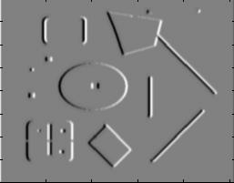
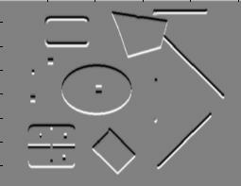
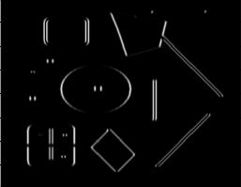
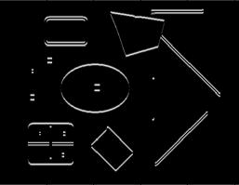
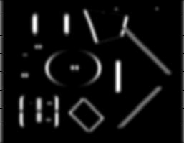
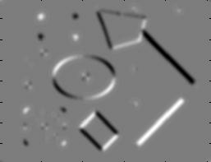
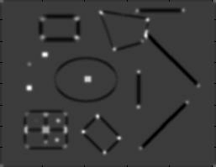
Harris Corner Detector [Harris88]
James Hays
0. Input image We want to compute M at each pixel.
$$I$$
1. Compute image derivatives (optionally, blur first).
$$Ix$$
$$Iy$$
2. Compute $M$ components
as squares of derivatives.
$$I_{x}^{2}$$
$$I_{y}^{2}$$
$$Ixy$$
3. Gaussian filter g() with width σ
$$g(Ix2)$$
$$g(Iy2)$$
$$g(Ix∘Iy)$$
4. Compute cornerness
$$C=\det\left(M\right)−α trace{\left(M\right)}^{2}$$
$$=g\left(I_{x}^{2}\right)∘g\left(I_{y}^{2}\right)−g{\left(I_{x}∘I_{y}\right)}^{2}$$
$−α{\left[g\left(I_{x}^{2}\right)+g\left(I_{y}^{2}\right)\right]}^{2}$
$$R$$
5. Threshold on $C$ to pick high cornerness
6. Non-maxima suppression to pick peaks.
Notes:
$∘$ = https://en.wikipedia.org/wiki/Hadamard_product_(matrices)

Slide 37
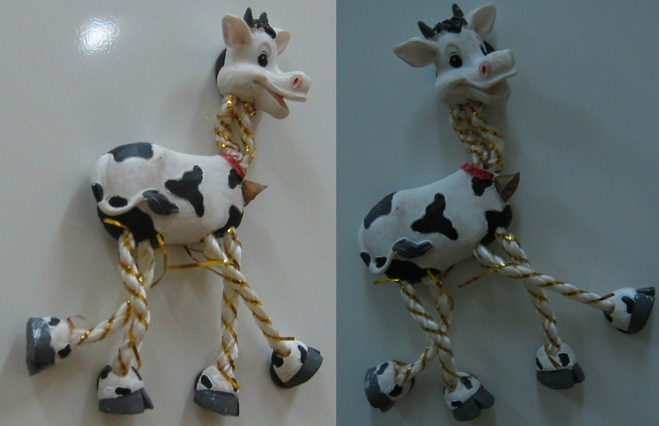
Harris Detector: Steps

Slide 38
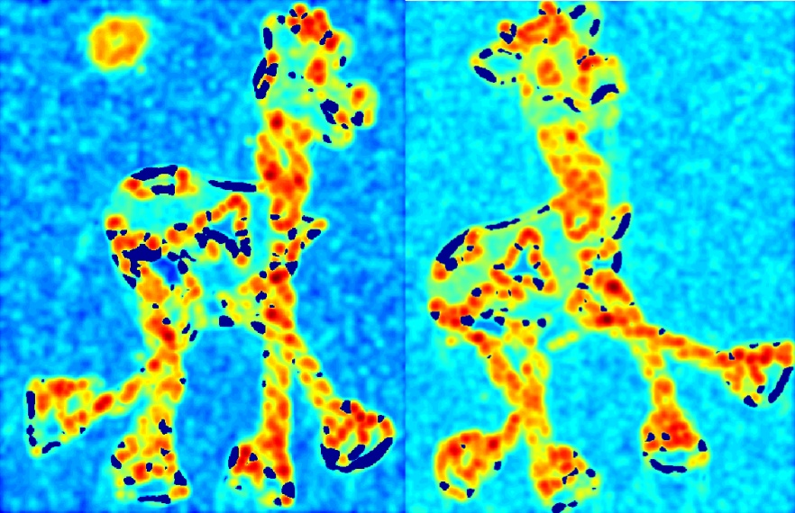
Harris Detector: Steps
Compute corner response $C$

Slide 39
Harris Detector: Steps
Find points with large corner response: $C$ > threshold

Slide 40
Harris Detector: Steps
Take only the points of local maxima of $C$

Slide 41
Harris Detector: Steps

Slide 42
Invariance and covariance
Are locations invariant to photometric transformations
and covariant to geometric transformations?
Invariance: image is transformed and corner locations do not change
Covariance: if we have two transformed versions of the same image, features should be detected in corresponding locations

Slide 43
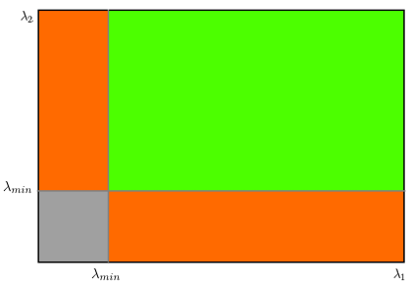
Shi-Tomashi corner detector
Just a slight variation of Harris corner detector
Instead of having
as criterion. We have
instead

Slide 44
Conclusion
Key point, interest point, local feature detection is a staple in computer vision. Uses such as
Image alignment
3D reconstruction
Motion tracking (robots, drones, AR)
Indexing and database retrieval
Object recognition
Harris corner detection is one classic example
More key point detection techniques next time

