Slide 1
Object recognition
Samuel Cheng
Slide credit: James Thompkin

Slide 2
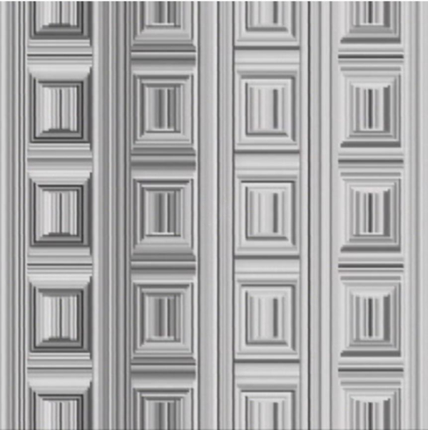
Coffer Illusion
Notes:
Coffer Illusion

Slide 3
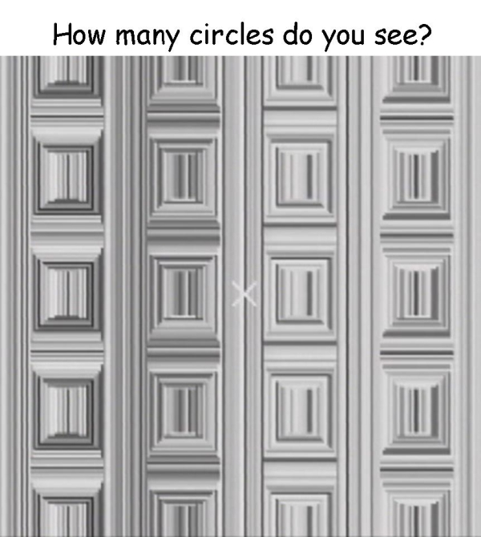
Coffer Illusion
Notes:
Coffer Illusion
16 circles

Slide 4
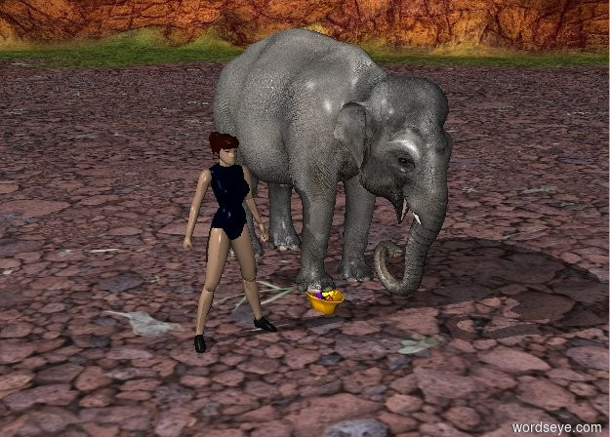
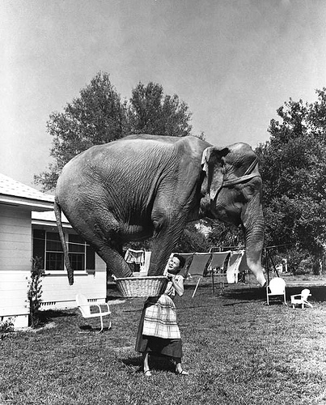
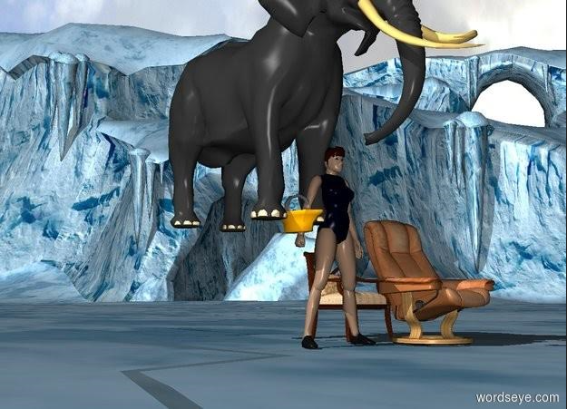
An elephant standing on top of a basket being held by a woman
MS COCO
wordseye.com
Thank you Trent Green

Slide 5
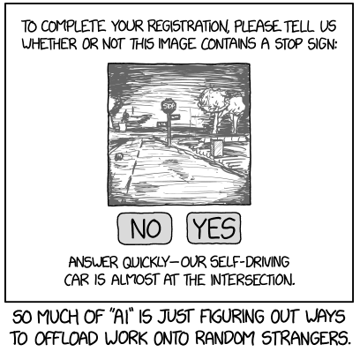
Thanks to Iuliu Balibanu

Slide 6
Alt-text: “Crowdsourced steering” doesn’t sound quite as appealing as “self driving”.

Slide 7
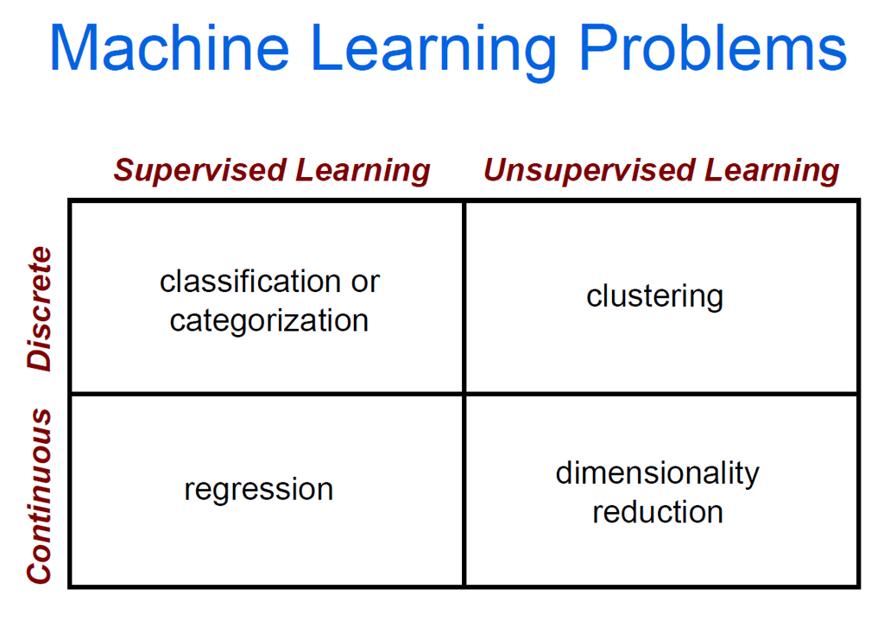

Slide 8
Supervised learning
f(x) = y
Training: Given a training set of labeled examples:
{(x₁,y₁), …, (x_{N},y_{N})}
Estimate the prediction function f by minimizing the prediction error on the training set.
Testing: Apply f to a unseen test example x and output the predicted value y = f(x) to classify x.
Prediction function
Image feature
Output (label)
Slide credit: L. Lazebnik

Slide 9




Image Categorization
Training
Training Labels
Training Images
Image Features
Classifier Training
Trained Classifier

Slide 10
Classifiers
Training
Training Labels
Training Images
Image Features
Classifier Training
Trained Classifier

Slide 11
Learning a classifier
Given a set of features with corresponding labels, learn a function to predict the labels from the features.
+ = Data point from class 1
x2
o = Data point from class 2
+
Each data point has a feature vector (x1,x2).
+
+
+
+
+
o
+
+
o
o
o
o
x1

Slide 12
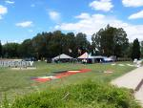
Image Categorization
Training
Training Labels
Training Images
Image Features
Classifier Training
Trained Classifier
Testing
Image Features
Trained Classifier
Prediction
Outdoor
Test Image

Slide 13
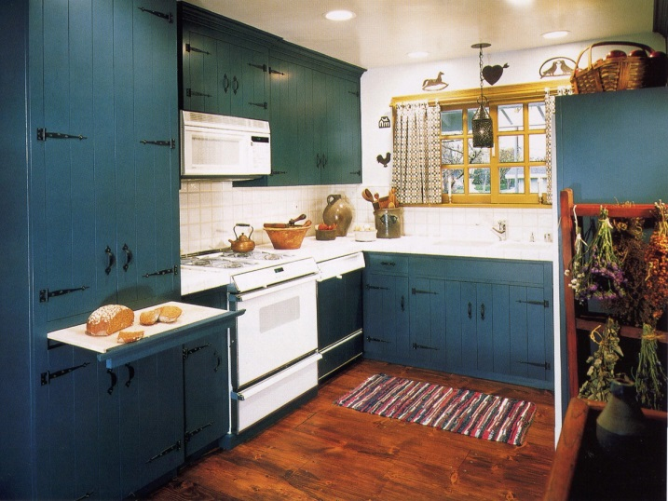

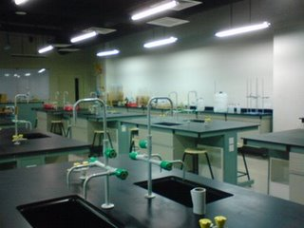
Example: Scene Categorization
Is this a kitchen?

Slide 14
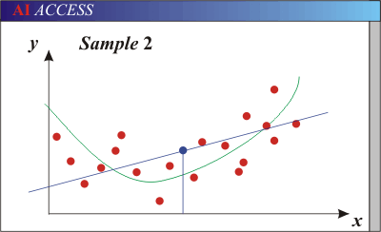
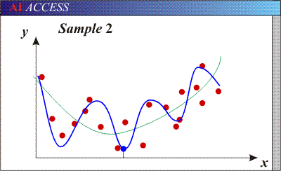
Bias-Variance Trade-off
Bias: error in model assumptions; how much the average model over all training sets differs from the true model.
Variance: how much models estimated from different training sets differ from each other.
Models with too few parameters are inaccurate because of a large bias.
  Not enough flexibility!
Models with too many parameters are inaccurate because of a large variance.
  Too much sensitivity to the sample.
http://www.learnopencv.com/bias-variance-tradeoff-in-machine-learning/
Notes:
http://www.aiaccess.net/English/Glossaries/GlosMod/e_gm_bias_variance.htm

Slide 15
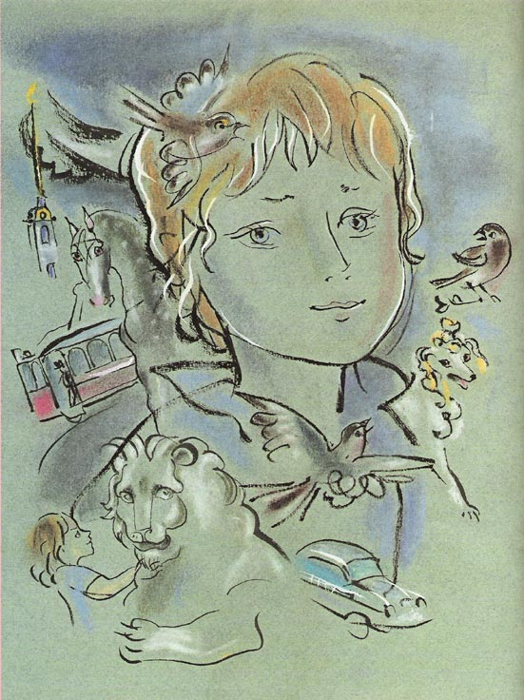
Recognition: Overview and History
Slides from James Hays, Lana Lazebnik, Fei-Fei Li, Rob Fergus, Antonio Torralba, and Jean Ponce

Slide 16
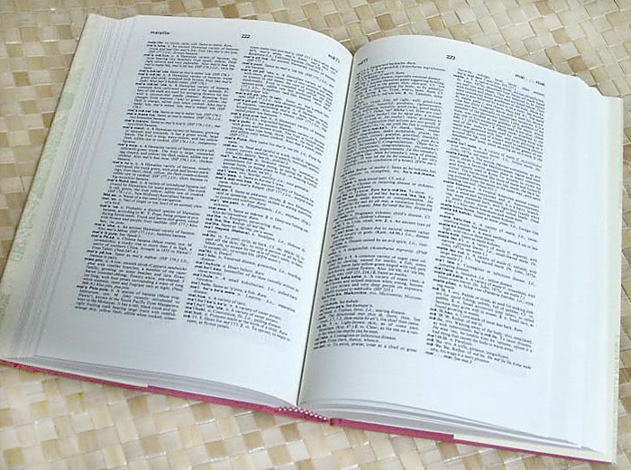

How many visual object categories are there?
~10,000 to 30,000
Biederman 1987
Notes:
1500-3000 basic-level nouns, ~10 types per basic-level category
Alternative explanation (Perona): ~1000 names per domain (broad scene category), 20-30 domains

Slide 17
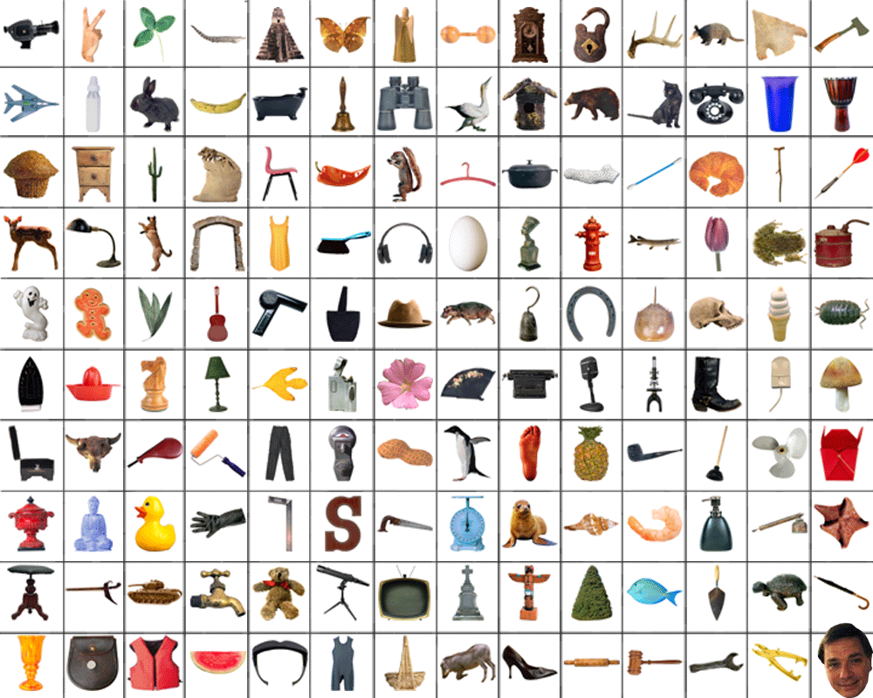
~10,000 to 30,000

Slide 18
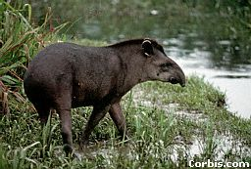
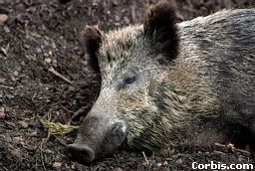
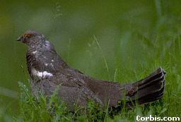
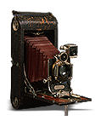
OBJECTS
ANIMALS
PLANTS
INANIMATE
NATURAL
MAN-MADE
…..
VERTEBRATE
MAMMALS
BIRDS
TAPIR
BOAR
GROUSE
CAMERA

Slide 19
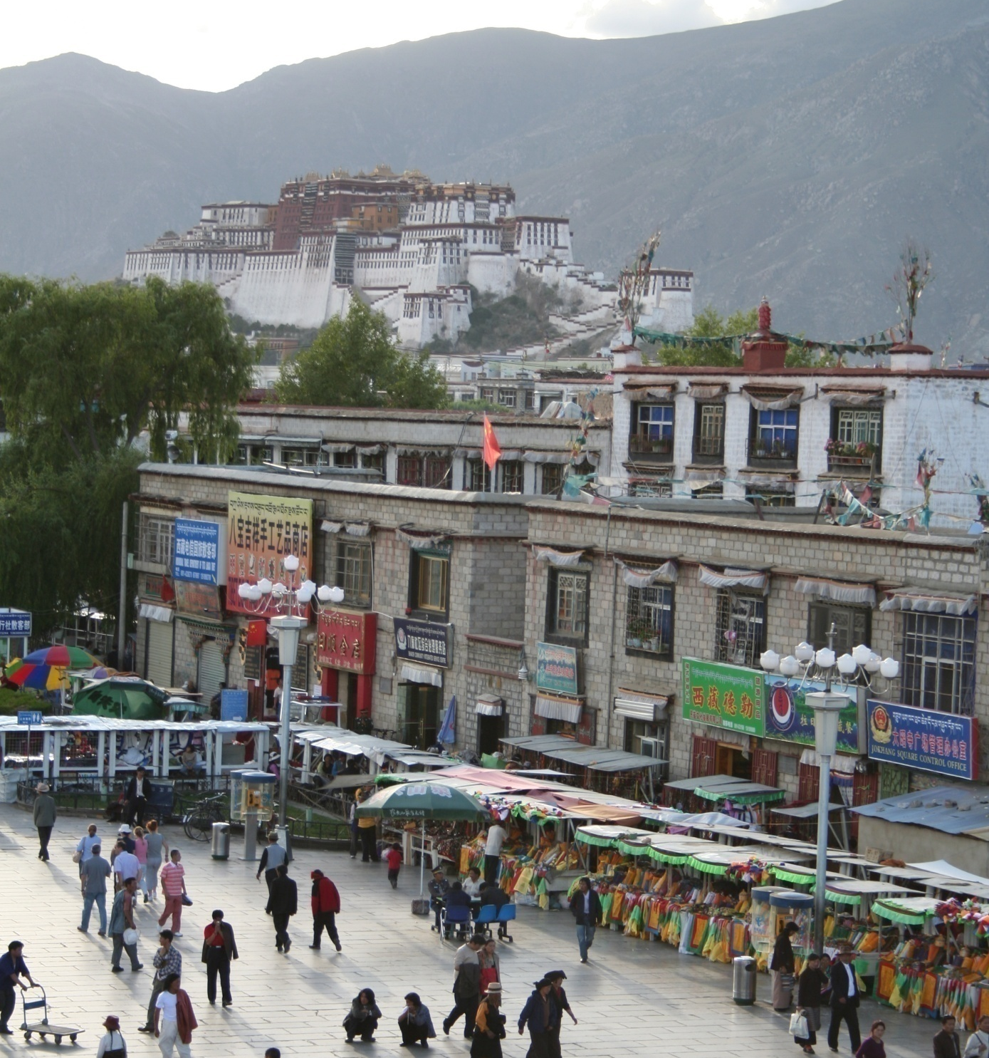
Specific recognition tasks
Svetlana Lazebnik

Slide 20
Scene categorization or classification
outdoor/indoor
city/forest/factory/etc.
Svetlana Lazebnik

Slide 21
Image annotation / tagging / attributes
street
people
building
mountain
tourism
cloudy
brick
…
Svetlana Lazebnik

Slide 22
Object detection
find pedestrians
Svetlana Lazebnik

Slide 23
Image parsing / semantic segmentation
sky
mountain
building
tree
building
banner
street lamp
market
people
Svetlana Lazebnik

Slide 24
Scene understanding?
Svetlana Lazebnik

Slide 25
Recognition is all about modeling variability
Variability:
Camera position
Svetlana Lazebnik
Notes:
One could argue that invariance is the key challenge to computer vision. But is this still true with big data?

Slide 26
Recognition is all about modeling variability
Variability:
Camera position
Illumination
Svetlana Lazebnik
Notes:
One could argue that invariance is the key challenge to computer vision. But is this still true with big data?

Slide 27
Recognition is all about modeling variability
Variability:
Camera position
Illumination
Shape parameters
Svetlana Lazebnik
Notes:
One could argue that invariance is the key challenge to computer vision. But is this still true with big data?

Slide 28
Recognition is all about modeling variability
Variability:
Camera position
Illumination
Shape parameters
Within-class variations?
Svetlana Lazebnik
Notes:
One could argue that invariance is the key challenge to computer vision. But is this still true with big data?
Manifold of natural images

Slide 29
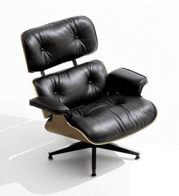
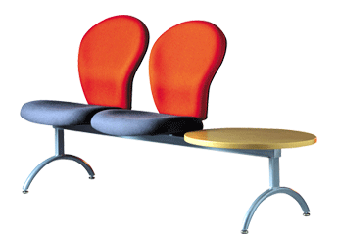
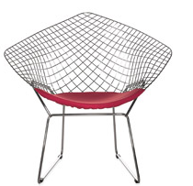
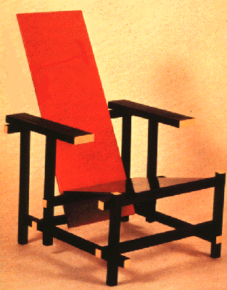
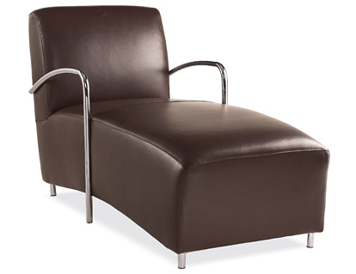
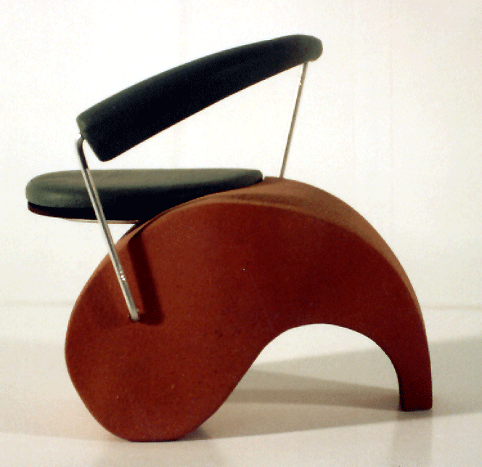
Within-class variations
Svetlana Lazebnik
Notes:
Note English language issues. Try to not let language confound things.

Slide 30
Recognition is all about modeling variability
High-dimensional space
Variability:
Camera position
Illumination
Shape parameters
Within-class variation
Svetlana Lazebnik
Notes:
One could argue that invariance is the key challenge to computer vision. But is this still true with big data?
Manifold of natural images

Slide 31
History of ideas in recognition
1960s – early 1990s: the geometric era
No digital cameras!
Slow compute!
Svetlana Lazebnik

Slide 32
θ
Variability:
Camera position
Illumination
Shape is known
Roberts (1965); Lowe (1987); Faugeras & Hebert (1986); Grimson & Lozano-Perez (1986); Huttenlocher & Ullman (1987)
Svetlana Lazebnik

Slide 33
Alignment
Alignment: fitting a model to a transformation between pairs of features (matches) in two images
x_{i}
x_{i}
Find transformation T
that minimizes
'
T
Svetlana Lazebnik

Slide 34
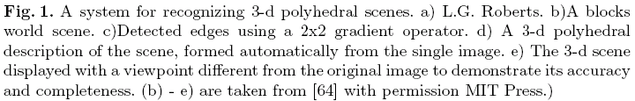
Recognition as an alignment problem:
Block world
L. G. Roberts
Machine Perception of Three Dimensional Solids,
Ph.D. thesis, MIT Department of Electrical Engineering, 1963.
J. Mundy, Object Recognition in the Geometric Era: a Retrospective, 2006

Slide 35
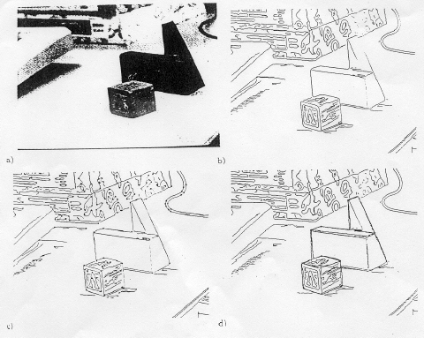
Alignment: Huttenlocher & Ullman (1987)

Slide 36
Variability
Invariance to:
Camera position
Illumination
Internal parameters
Duda & Hart ( 1972); Weiss (1987); Mundy et al. (1992-94);
Rothwell et al. (1992); Burns et al. (1993)
Svetlana Lazebnik

Slide 37
Example: invariant to similarity transformations computed from four points
B
C
D
A
Projective invariants (Rothwell et al., 1992):
General 3D objects do not admit monocular viewpoint
invariants (Burns et al., 1993)

Slide 38






Representing and recognizing object categories is harder...
ACRONYM (Brooks and Binford, 1981)
Binford (1971), Nevatia & Binford (1972), Marr & Nishihara (1978)

Slide 39
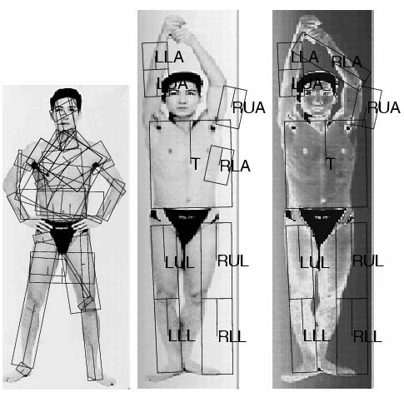
General shape primitives?
Generalized cylinders
Ponce et al. (1989)
Forsyth (2000)
Zisserman et al. (1995)
Svetlana Lazebnik

Slide 40
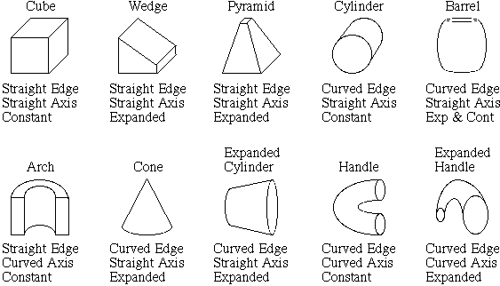
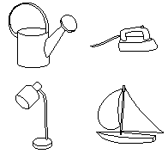
Recognition by components
Biederman (1987)
Primitives (geons)
Objects
http://en.wikipedia.org/wiki/Recognition_by_Components_Theory
Svetlana Lazebnik

Slide 41
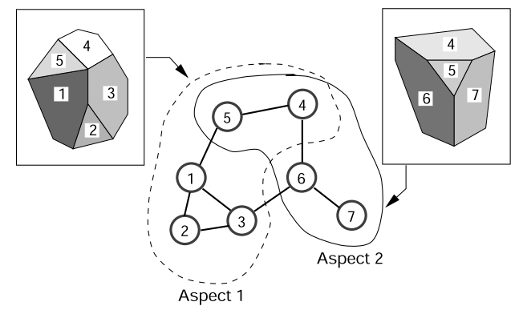
Aspect graph
Network of distinct 2-D views of objects
Number of views increase rapidly with # faces

Slide 42
History of ideas in recognition
1960s – early 1990s: the geometric era
1990s: appearance-based models
No digital cameras!
Slow compute!
Slow compute!
Svetlana Lazebnik

Slide 43
Known target image
Empirical models of image variability
Appearance-based techniques
Turk & Pentland (1991); Murase & Nayar (1995); etc.
Svetlana Lazebnik

Slide 44
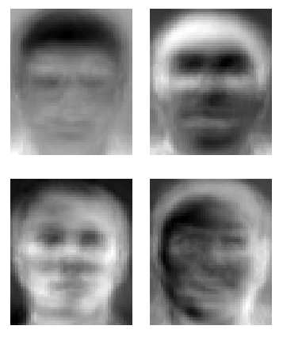
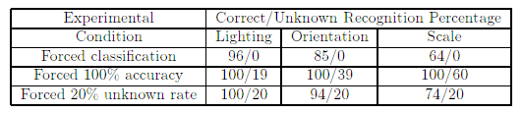
Eigenfaces (Turk & Pentland, 1991)
Svetlana Lazebnik

Slide 45
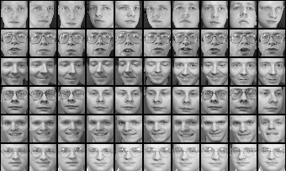
Limitations of global appearance models
Requires global registration of patterns
Not robust to clutter, occlusion, geometric transformations
Svetlana Lazebnik

Slide 46
Color Histograms
Swain and Ballard, Color Indexing, IJCV 1991.
Svetlana Lazebnik

Slide 47
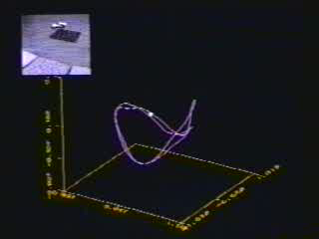
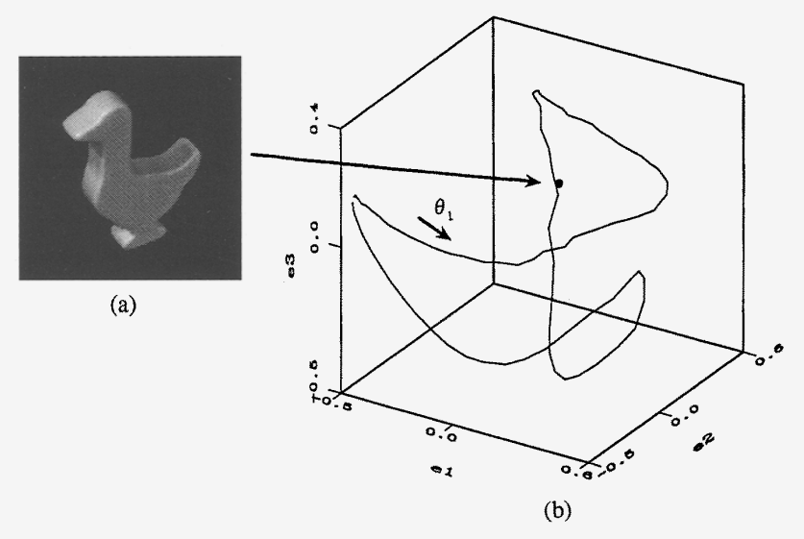
Appearance manifolds
H. Murase and S. Nayar, Visual learning and recognition of 3-d objects from appearance, IJCV 1995

Slide 48
History of ideas in recognition
1960s – early 1990s: the geometric era
1990s: appearance-based models
Mid -1990s: sliding window approaches
No digital cameras!
Slow compute!
Slow compute!
Svetlana Lazebnik

Slide 49
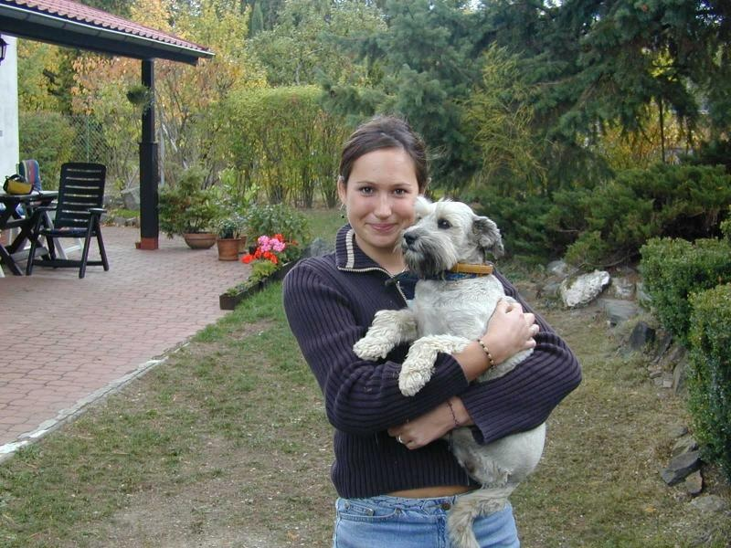
Sliding window approaches

Slide 50
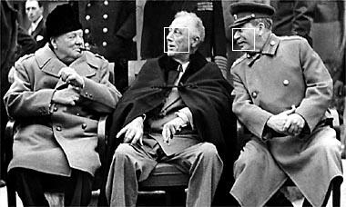
Sliding window approaches
Turk and Pentland, 1991
Belhumeur, Hespanha, & Kriegman, 1997
Schneiderman & Kanade 2004
Viola and Jones, 2000
Schneiderman & Kanade, 2004
Argawal and Roth, 2002
Poggio et al. 1993

Slide 51
History of ideas in recognition
1960s – early 1990s: the geometric era
1990s: appearance-based models
Mid-1990s: sliding window approaches
Late 1990s: local features (e.g., SIFT)
No digital cameras!
Slow compute!
Slow compute!
Svetlana Lazebnik

Slide 52
θ
Variability:
Camera position
Illumination
Shape is partially known
Roberts (1965); Lowe (1987); Faugeras & Hebert (1986); Grimson & Lozano-Perez (1986); Huttenlocher & Ullman (1987)
Svetlana Lazebnik

Slide 53
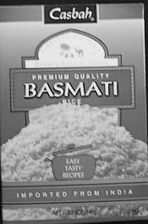
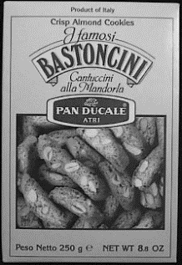

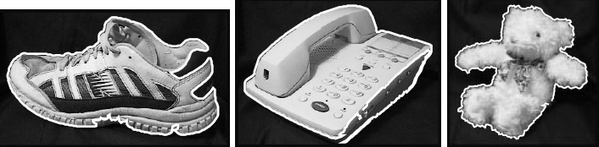
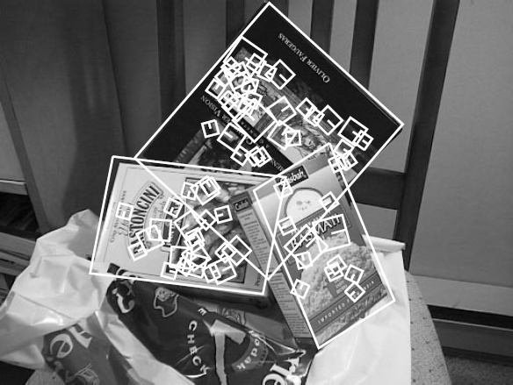
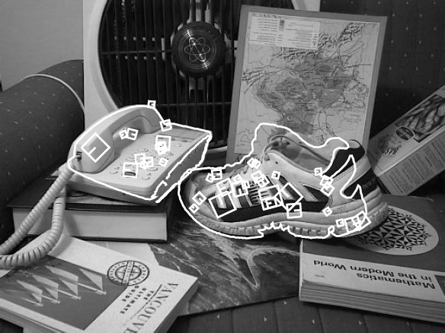
Local features for object instance recognition
D. Lowe (1999, 2004)

Slide 54
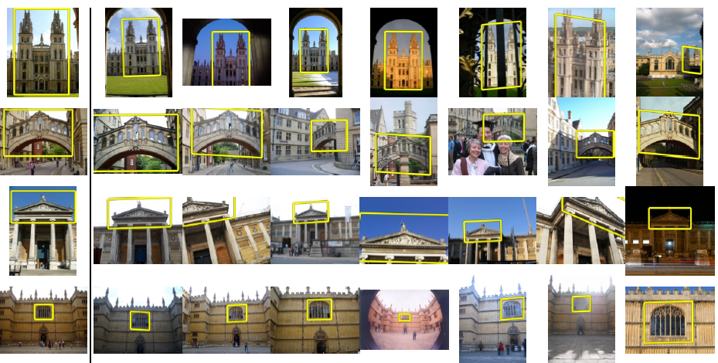
Large-scale image search
Combining local features, indexing, and spatial constraints
Philbin et al. ‘07

Slide 55
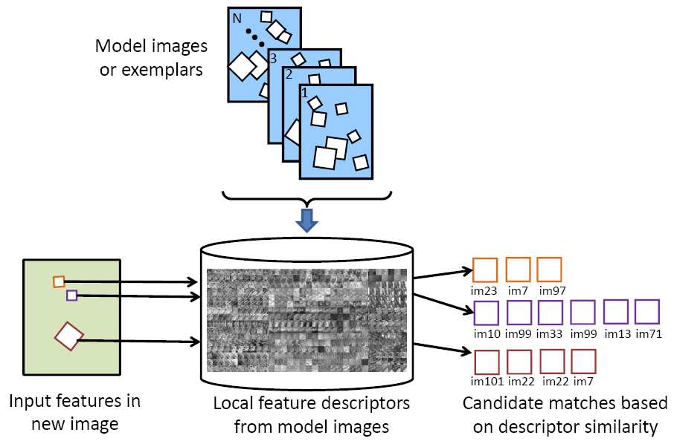
Large-scale image search
Combining local features, indexing, and spatial constraints
Image credit: K. Grauman and B. Leibe

Slide 56
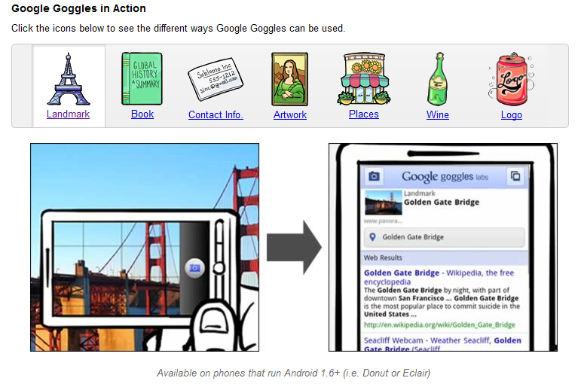
Large-scale image search
Combining local features, indexing, and spatial constraints
Svetlana Lazebnik

Slide 57
History of ideas in recognition
1960s – early 1990s: the geometric era
1990s: appearance-based models
Mid-1990s: sliding window approaches
Late 1990s: local features
Early 2000s: parts-and-shape models

Slide 58
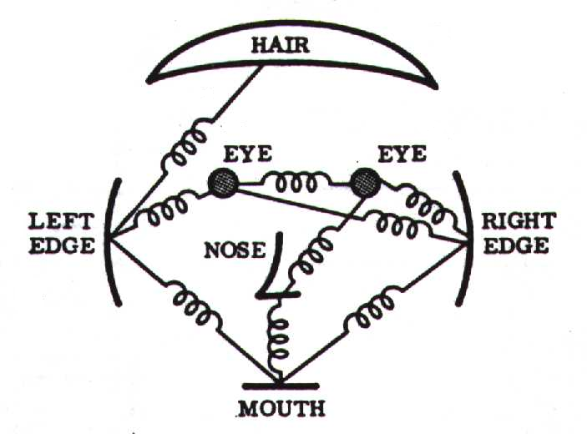
Parts-and-shape models
Model:
  Object as a set of parts
  Relative locations between parts
  Appearance of part
Figure from [Fischler & Elschlager 73]

Slide 59
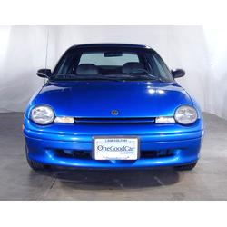
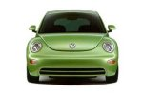


Constellation models
Weber, Welling & Perona (2000), Fergus, Perona & Zisserman (2003)
Notes:
Globally different, but have portions in common

Slide 60

Representing people

Slide 61

Discriminatively trained part-based models
P. Felzenszwalb, R. Girshick, D. McAllester, D. Ramanan, PAMI 2009,
“Object Detection with Discriminatively Trained Part-Based Models”

Slide 62
History of ideas in recognition
1960s – early 1990s: the geometric era
1990s: appearance-based models
Mid-1990s: sliding window approaches
Late 1990s: local features
Early 2000s: parts-and-shape models
Mid-2000s: bags of features
No digital cameras!
Slow compute!
Slow compute!
Early GPU compute.
Svetlana Lazebnik

Slide 63



Bag-of-features models
Bag of ‘words’
Object
Svetlana Lazebnik

Slide 64
Origin 1: Bag-of-words models
Orderless document representation: frequencies of words from a dictionary Salton & McGill (1983)

Slide 65

Origin 1: Bag-of-words models
Orderless document representation: frequencies of words from a dictionary Salton & McGill (1983)
US Presidential Speeches Tag Cloud
http://chir.ag/phernalia/preztags/

Slide 66

Origin 1: Bag-of-words models
Orderless document representation: frequencies of words from a dictionary Salton & McGill (1983)
US Presidential Speeches Tag Cloud
http://chir.ag/phernalia/preztags/

Slide 67

Origin 1: Bag-of-words models
Orderless document representation: frequencies of words from a dictionary Salton & McGill (1983)
US Presidential Speeches Tag Cloud
http://chir.ag/phernalia/preztags/

Slide 68






Origin 2: Texture recognition
Problem: no natural words as in language
  Characterized by repetition of basic elements or textons
For stochastic textures, the identity of textons matters,
not their spatial arrangement
Julesz, 1981; Cula & Dana, 2001; Leung & Malik 2001; Mori, Belongie & Malik, 2001; Schmid 2001; Varma & Zisserman, 2002, 2003; Lazebnik, Schmid & Ponce, 2003

Slide 69




Origin 2: Texture recognition
histogram
Universal texton dictionary
Julesz, 1981; Cula & Dana, 2001; Leung & Malik 2001; Mori, Belongie & Malik, 2001; Schmid 2001; Varma & Zisserman, 2002, 2003; Lazebnik, Schmid & Ponce, 2003

Slide 70


Bag-of-features models
Svetlana Lazebnik

Slide 71



Bag-of-features steps
Feature extraction
Learn “visual vocabulary”
Quantize features using visual vocabulary
Represent images by frequencies of “visual words”

Slide 72


1. Feature extraction
Regular grid or interest regions

Slide 73


1. Feature extraction
Compute descriptor
Extract patch
Detect patches
Slide credit: Josef Sivic

Slide 74

1. Feature extraction
…
Slide credit: Josef Sivic

Slide 75
2. Learning the visual vocabulary
…
Slide credit: Josef Sivic

Slide 76
2. Learning the visual vocabulary
…
Clustering
Slide credit: Josef Sivic

Slide 77
3. Quantize the visual vocabulary
Visual vocabulary
…
Clustering
Slide credit: Josef Sivic

Slide 78
K-means clustering
Want to minimize sum of squared Euclidean distances between points x_{i} and their nearest cluster centers m_{k} :
Algorithm:
Randomly initialize K cluster centers
Iterate until convergence:
  Assign each data point to the nearest center
  Recompute each cluster center as the mean of all points assigned to it

Slide 79
Clustering and vector quantization
Clustering is a common method for learning a visual vocabulary or codebook
  Unsupervised learning process
  Each cluster center produced by k-means becomes a codevector
  Codebook can be learned on separate training set
  Provided the training set is sufficiently representative, the codebook will be “universal”
The codebook is used for quantizing features
  A vector quantizer takes a feature vector and maps it to the index of the nearest codevector in a codebook
  Codebook = visual vocabulary
  Codevector = visual word

Slide 80

















Example codebook
…
Appearance codebook
Source: B. Leibe

Slide 81

Another codebook
…
…
…
…
…
Appearance codebook
Source: B. Leibe

Slide 82
Visual vocabularies: Issues
How to choose vocabulary size?
  Too small: visual words not representative of all patches
  Too large: quantization artifacts, overfitting
Computational efficiency
  Vocabulary trees
  (Nister & Stewenius, 2006)

Slide 83








But what about layout?
All of these are treated as being the same
No distinction between foreground and background: scene recognition?
Svetlana Lazebnik
Notes:
Motivation slide. Clearly location has to help, but bag-of-words doesn’t have it…

Slide 84




An extreme case
All of these images have the same color histogram

Slide 85

Spatial pyramid
Compute histogram in each spatial bin

Slide 86


Spatial pyramid representation
Extension of a bag of features
Locally orderless representation at several levels of resolution
level 0
Lazebnik, Schmid & Ponce (CVPR 2006)

Slide 87




Spatial pyramid representation
Extension of a bag of features
Locally orderless representation at several levels of resolution
level 0
level 1
Lazebnik, Schmid & Ponce (CVPR 2006)

Slide 88
















Spatial pyramid representation
Extension of a bag of features
Locally orderless representation at several levels of resolution
level 0
level 1
level 2
Lazebnik, Schmid & Ponce (CVPR 2006)

Slide 89


Scene category dataset
Multi-class classification results
(100 training images per class)

Slide 90















Caltech101 dataset
http://www.vision.caltech.edu/Image_Datasets/Caltech101/Caltech101.html
Multi-class classification results (30 training images per class)

Slide 91

Bags of features for action recognition
Space-time interest points
Juan Carlos Niebles, Hongcheng Wang and Li Fei-Fei, Unsupervised Learning of Human Action Categories Using Spatial-Temporal Words, IJCV 2008.

Slide 92
History of ideas in recognition
1960s – early 1990s: the geometric era
1990s: appearance-based models
Mid-1990s: sliding window approaches
Late 1990s: local features
Early 2000s: parts-and-shape models
Mid-2000s: bags of features
Present trends:
Combined local and global methods,
context, deep learning
No digital cameras!
Slow compute!
Slow compute!
Early GPU compute.
GPU/cloud compute.
Svetlana Lazebnik

