Slide 1
Image Segmentation
Samuel Cheng
Slide credit: Derek Hoiem, Juan Carlos Niebles, Ranjay Krishna, Noah Snavely, Hsuan-Yi Ko

Slide 2
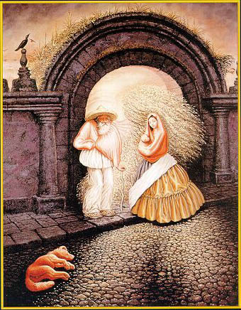

Slide 3
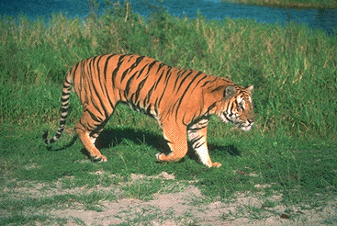
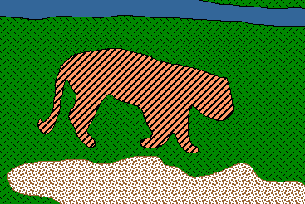
Image Segmentation
Goal: identify groups of pixels that go together
Slide credit: Steve Seitz, Kristen Grauman

Slide 4
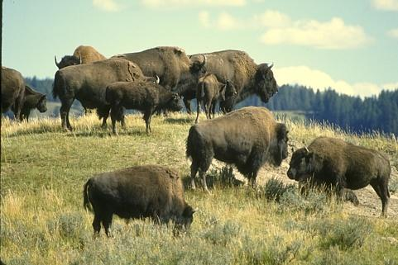
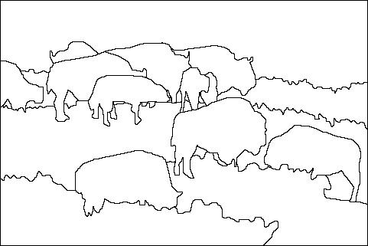
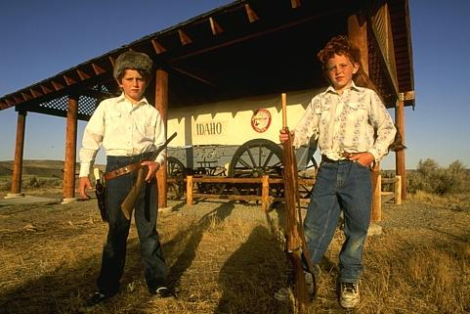
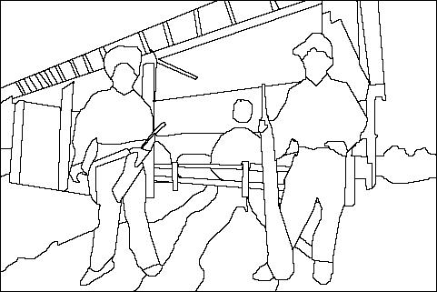
The Goals of Segmentation
Separate image into coherent “objects”
Image
Human segmentation
Slide credit: Svetlana Lazebnik

Slide 5
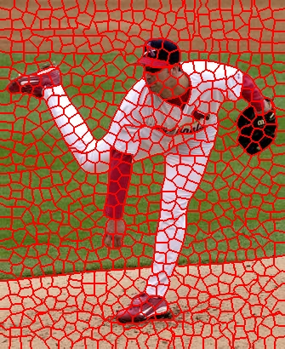
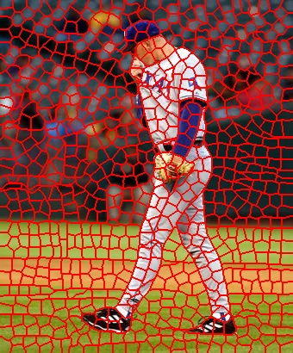
The Goals of Segmentation
Separate image into coherent “objects”
Group together similar-looking pixels for efficiency of further processing
“superpixels”
Slide credit: Svetlana Lazebnik
X. Ren and J. Malik. Learning a classification model for segmentation. ICCV 2003.

Slide 6
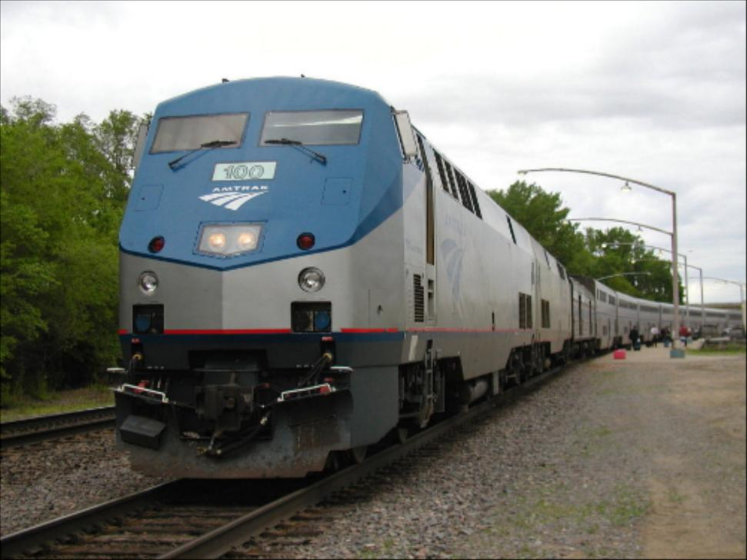
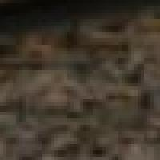
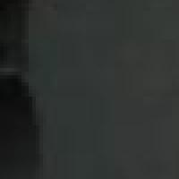
Segmentation for feature support
50x50 Patch
50x50 Patch
Slide: Derek Hoiem

Slide 7
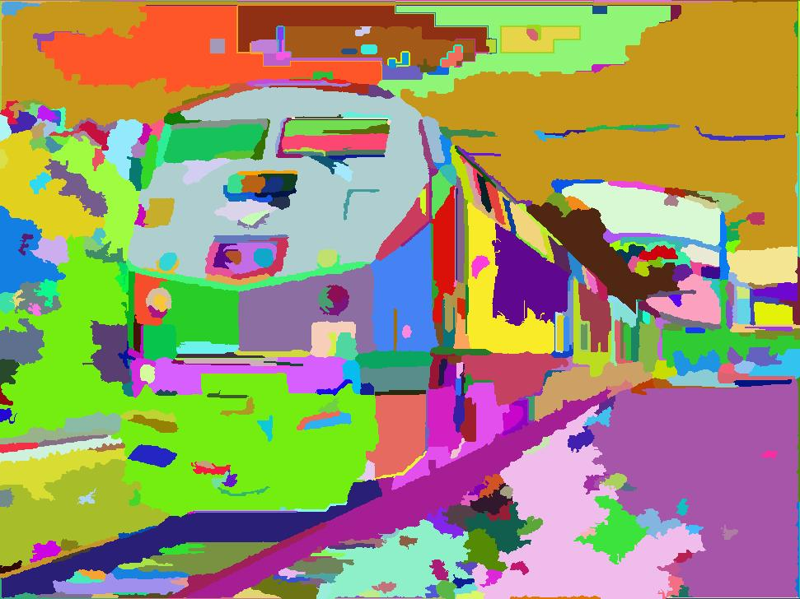
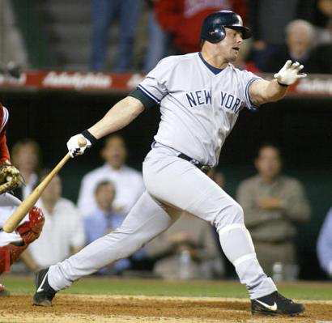
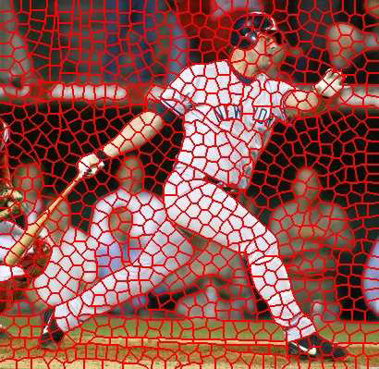
Segmentation for efficiency
[Felzenszwalb and Huttenlocher 2004]
[Hoiem et al. 2005, Mori 2005]
[Shi and Malik 2001]
Slide: Derek Hoiem

Slide 8
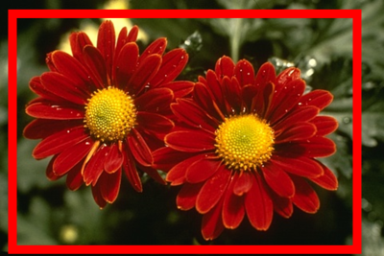
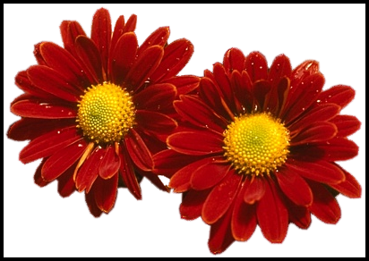
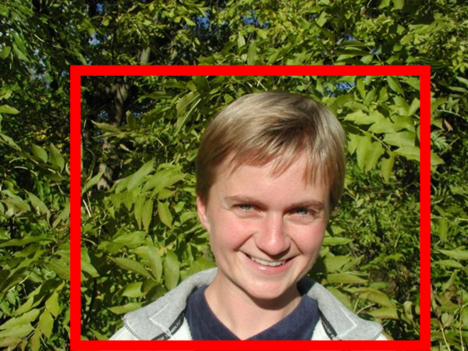
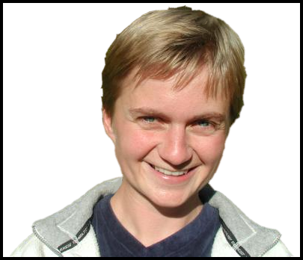
Segmentation as a result
Rother et al. 2004

Slide 9
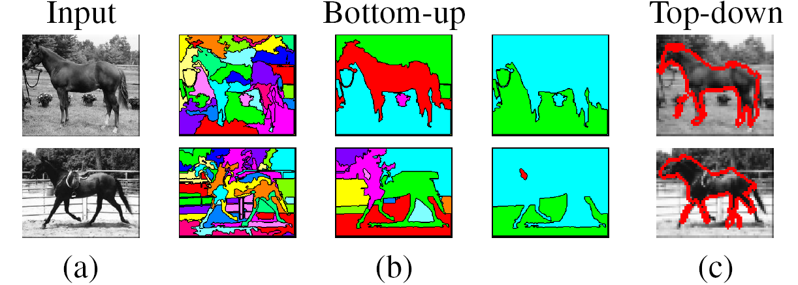
Types of segmentations
Oversegmentation
Undersegmentation
Multiple Segmentations

Slide 10
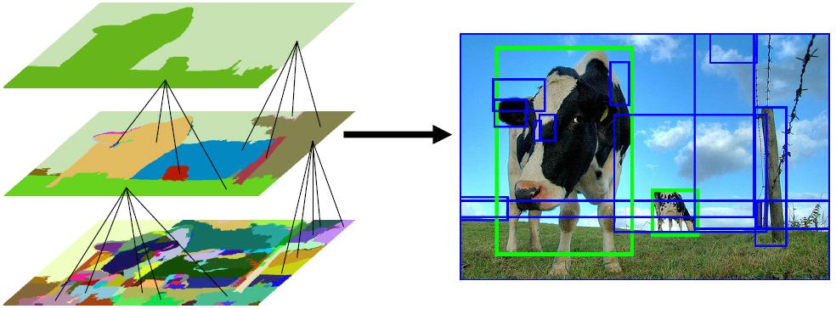
Segmentation for object proposals
“Selective Search” [Sande, Uijlings et al. ICCV 2011, IJCV 2013]
[Endres Hoiem ECCV 2010, IJCV 2014]

Slide 11
One way to think about “segmentation” is Clustering
Clustering: group together similar data points and represent them with a single token
Key Challenges:
1) What makes two points/images/patches similar?
2) How do we compute an overall grouping from pairwise similarities?
Slide: Derek Hoiem

Slide 12
Why do we cluster?
Segmentation
  Separate the image into different regions
Summarizing data
  Look at large amounts of data
  Patch-based compression or denoising
  Represent a large continuous vector with the cluster number
Prediction
  Images in the same cluster may have the same labels
Slide: Derek Hoiem

Slide 13
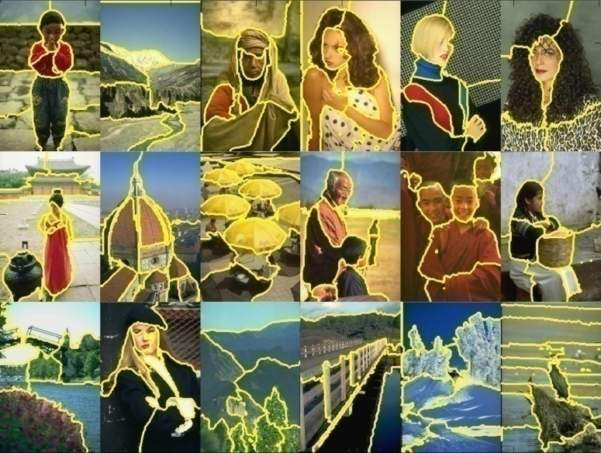
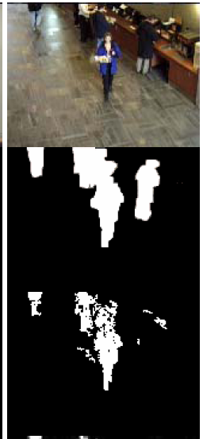
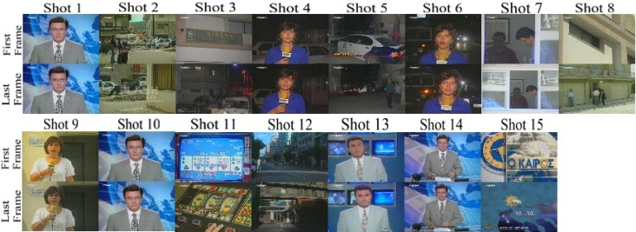
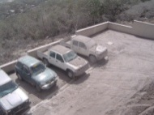
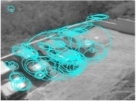
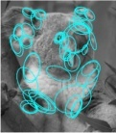
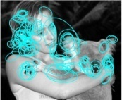
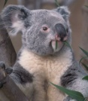
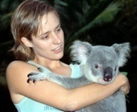
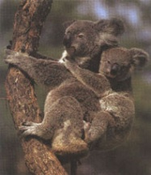
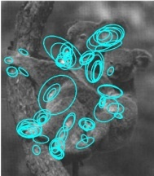
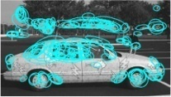
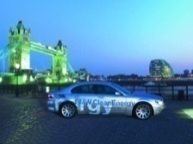
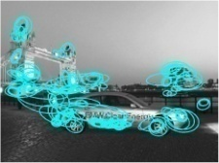




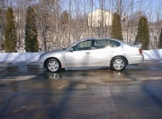
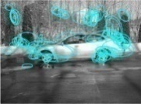
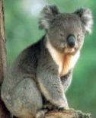
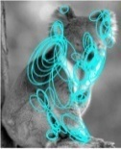
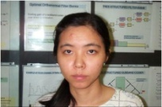
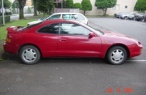
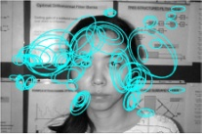
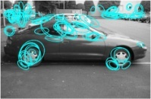
Examples of Grouping in Vision
Grouping video frames into shots
Determining image regions
What things should
be grouped?
Figure-ground
What cues
indicate groups?
Object-level grouping
Slide credit: Kristen Grauman

Slide 14
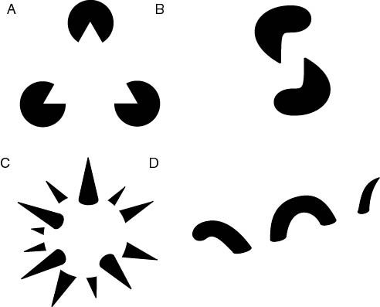
The Gestalt School
Grouping is key to visual perception
Elements in a collection can have properties that result from relationships
  “The whole is greater than the sum of its parts”
Illusory/subjective
contours
Occlusion
Slide credit: Svetlana Lazebnik
Familiar configuration
http://en.wikipedia.org/wiki/Gestalt_psychology

Slide 15
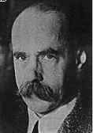
Gestalt Theory
Gestalt: whole or group
  Whole is greater than sum of its parts
  Relationships among parts can yield new properties/features
Psychologists identified series of factors that predispose set of elements to be grouped (by human visual system)
        “I stand at the window and see a house, trees, sky.
        Theoretically I might say there were 327 brightnesses
        and nuances of colour. Do I have "327"? No. I have sky, house, and trees.”
        Max Wertheimer
        (1880-1943)
Untersuchungen zur Lehre von der Gestalt,
Psychologische Forschung, Vol. 4, pp. 301-350, 1923
http://psy.ed.asu.edu/~classics/Wertheimer/Forms/forms.htm

Slide 16
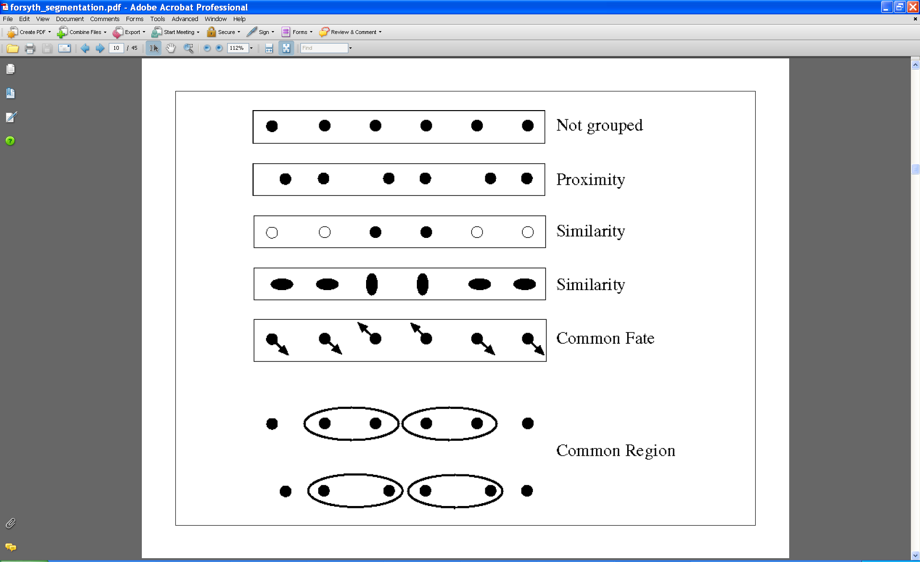
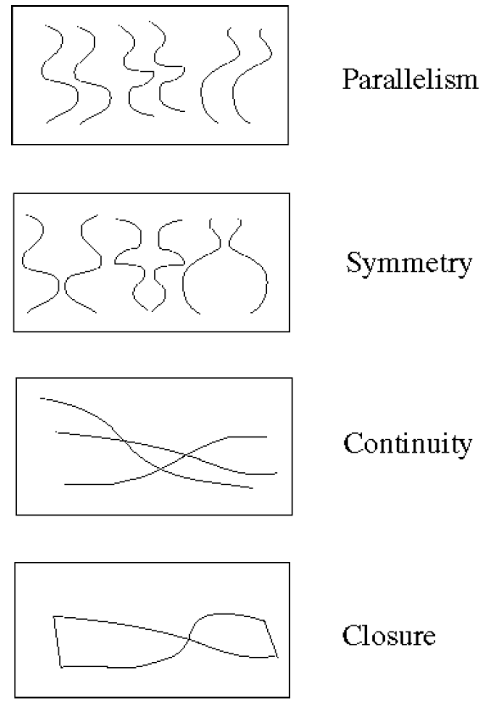
Gestalt Factors
These factors make intuitive sense, but are very difficult to translate into algorithms.
Image source: Forsyth & Ponce

Slide 17
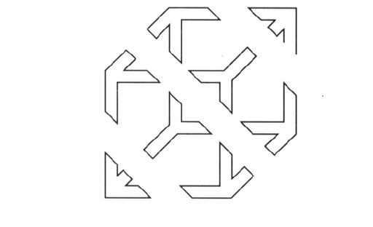
Continuity through Occlusion Cues

Slide 18
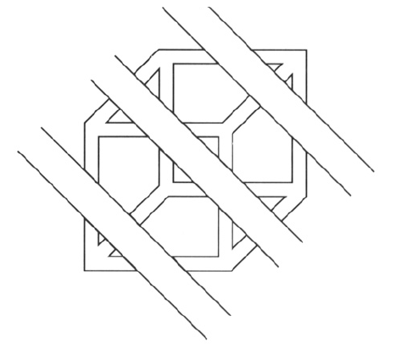
Continuity through Occlusion Cues
Continuity, explanation by occlusion

Slide 19
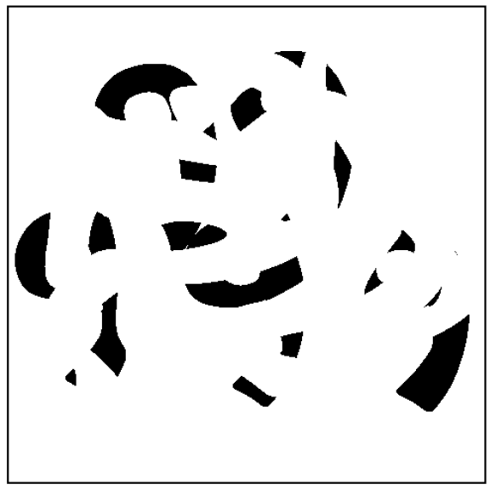
Continuity through Occlusion Cues
Image source: Forsyth & Ponce

Slide 20

Continuity through Occlusion Cues
Image source: Forsyth & Ponce

Slide 21

Figure-Ground Discrimination

Slide 22

The Ultimate Gestalt?

Slide 23
What we will learn today
Introduction to segmentation and clustering
Gestalt theory for perceptual grouping
Agglomerative clustering
K-mean
Mean-shift clustering
Superpixels

Slide 24

What is similarity?
Similarity is hard to define, but… “We know it when we see it” The real meaning of similarity is a philosophical question. We will take a more pragmatic approach.

Slide 25


Clustering: distance measure
Clustering is an unsupervised learning method. Given items
, the goal is to group them into clusters. We need a pairwise distance/similarity function between items, and sometimes the desired number of clusters.
When data (e.g. images, objects, documents) are represented by feature vectors, a commonly used similarity measure is the cosine similarity. Let be two data vectors. There is angle
between the two vectors .

Slide 26

Defining Distance Measures
Let x and x’ be two objects from the universe of possible objects. The distance (similarity) between x and x’ is a real number denoted by sim(x, x’).
The euclidian distance is defined as
In contrast, cosine distance measure would be

Slide 27
Desirable Properties of a Clustering Algorithms
Scalability (in terms of both time and space)
Ability to deal with different data types
Minimal requirements for domain knowledge to determine input parameters
Interpretability and usability Optional
  Incorporation of user-specified constraints

Slide 28


Animated example
source

Slide 29
Animated example
source

Slide 30
Animated example
source

Slide 31

Agglomerative clustering
Slide credit: Andrew Moore

Slide 32

Agglomerative clustering
Slide credit: Andrew Moore

Slide 33

Agglomerative clustering
Slide credit: Andrew Moore

Slide 34

Agglomerative clustering
Slide credit: Andrew Moore

Slide 35

Agglomerative clustering
Slide credit: Andrew Moore

Slide 36

Agglomerative clustering
How to define cluster similarity?
Average distance between points,
maximum distance
minimum distance
Distance between means or medoids
How many clusters?
Clustering creates a dendrogram (a tree)
Threshold based on max number of clusters or based on distance between merges
distance

Slide 37
Conclusions: Agglomerative Clustering
Good
Simple to implement, widespread application.
Clusters have adaptive shapes.
Provides a hierarchy of clusters.
No need to specify number of clusters in advance.
Bad
May have imbalanced clusters.
Still have to choose number of clusters or threshold.
Does not scale well. Runtime of O(n³).
Can get stuck at a local optima.

Slide 38
What we will learn today
Introduction to segmentation and clustering
Gestalt theory for perceptual grouping
Agglomerative clustering
Oversegmentation
K-mean
Mean-shift clustering

Slide 39


Example algorithm
Introduced by Felzenszwalb and Huttenlocher in the paper titled Efficient Graph-Based Image Segmentation.

Slide 40

Problem Formulation
Graph G = (V, E)
V is set of nodes (i.e. pixels)
E is a set of undirected edges between pairs of pixels
w(vi , vj ) is the weight of the edge between nodes vi and vj
S is a segmentation of a graph G such that G’ = (V, E’) where E’ ⊂ E
S divides G into disconnected G’ with distinct clusters

Slide 41


Predicate for segmentation
Predicate D determines whether there is a boundary for segmentation.
Where
dif(C1 , C2 ) is the difference between two clusters.
in(C1 , C2 ) is the internal different in the clusters C1 and C2

Slide 42


Predicate for Segmentation
Predicate D determines whether there is a boundary for segmentation.
The different between two components is the minimum weight edge that connects a node vi in clusters C1 to node vj in C2

Slide 43

Predicate for Segmentation
Predicate D determines whether there is a boundary for segmentation.
In(C1, C2) is to the maximum weight edge that connects two nodes in the same component.

Slide 44

Predicate for Segmentation
k/|C| sets the threshold by which the components need to be different from the internal nodes in a component.
Properties of constant k:
  If k is large, it causes a preference of larger objects.
  k does not set a minimum size for components.

Slide 45
The algorithm
Sort ascendingly edges by weights
Take every vertex as its own cluster
Starting from the shortest edge, loop the following with increasing weight edges
  If the two ends of the edge is in the same cluster: repeat 3 with the next longer edge
  Else
  Let C₁ and C₂ be clusters at the two ends
  if dif(C₁,C₂) < in(C₁,C₂):
  merge clusters C₁,C₂

Slide 46

Feature and weight options
Grid graph weight
  Every pixel is connected to its 8 neighboring pixels and the weights are determined by the difference in intensities
Nearest neighbor graph weight
  Project every pixel into feature space defined by (x, y, r, g, b).
  Weights between pixels are determined using L2 (Euclidian) distance in feature space.
  Edges are chosen for only top ten nearest neighbors in feature space to ensure run time of O(n log n) where n is number of pixels.

Slide 47

Grid graph result

Slide 48

Nearest neighbor graph weight

Slide 49
What we will learn today
Introduction to segmentation and clustering
Gestalt theory for perceptual grouping
Agglomerative clustering
K-mean
Mean-shift clustering
Superpixels

Slide 50


Image Segmentation: Toy Example
white pixels
3
black pixels
gray pixels
These intensities define the three groups.
We could label every pixel in the image according to which of these primary intensities it is.
  i.e., segment the image based on the intensity feature.
What if the image isn’t quite so simple?
1
2
input image
intensity
Slide credit: Kristen Grauman

Slide 51


Pixel count
Input image
Intensity
Pixel count
Input image
Intensity
Slide credit: Kristen Grauman

Slide 52
Now how to determine the three main intensities that define our groups?
We need to cluster.
Pixel count
Input image
Intensity
Slide credit: Kristen Grauman

Slide 53
Goal: choose three “centers” as the representative intensities, and label every pixel according to which of these centers it is nearest to.
Best cluster centers are those that minimize Sum of Square Distance (SSD) between all points and their nearest cluster center c_{i}:
0
190
255
Intensity
3
1
2
Slide credit: Kristen Grauman

Slide 54
Clustering for Summarization
Goal: cluster to minimize variance in data given clusters
  Preserve information
Cluster center
Data
Whether is assigned to
Slide: Derek Hoiem

Slide 55
Clustering
With this objective, it is a “chicken and egg” problem:
  If we knew the cluster centers, we could allocate points to groups by assigning each to its closest center.
  If we knew the group memberships, we could get the centers by computing the mean per group.
Slide credit: Kristen Grauman

Slide 56
K-means clustering
Initialize ( ): cluster centers
Compute : assign each point to the closest center
  denotes the set of assignment for each to cluster at iteration t
Computer : update cluster centers as the mean of the points
Update , Repeat Step 2-3 till stopped
Slide: Derek Hoiem

Slide 57
K-means clustering
Initialize ( ): cluster centers
Compute : assign each point to the closest center
Computer : update cluster centers as the mean of the points
Update , Repeat Step 2-3 till stopped
Commonly used: random initialization
Or greedily choose K to minimize residual
Typical distance measure:
  Euclidean
  Cosine
  Others
doesn’t change anymore.
Slide: Derek Hoiem

Slide 58




K-means clustering
1. Initialize Cluster Centers
2. Assign Points to Clusters
3. Re-compute Means
Repeat (2) and (3)
Java demo:
http://home.dei.polimi.it/matteucc/Clustering/tutorial_html/AppletKM.html
Illustration Source: wikipedia

Slide 59


K-means clustering
Converges to a local minimum solution
  Initialize multiple runs
Better fit for spherical data
Need to pick K (# of clusters)

Slide 60



Segmentation as Clustering
2 clusters
Original image
3 clusters

Slide 61
K-Means++
Can we prevent arbitrarily bad local minima?
Randomly choose first center.
Pick new center with prob. proportional to
  (Contribution of x to total error)
Repeat until K centers.
Expected error * optimal
Slide credit: Steve Seitz
Arthur & Vassilvitskii 2007

Slide 62
Feature Space
Depending on what we choose as the feature space, we can group pixels in different ways.
Grouping pixels based on
intensity similarity
Feature space: intensity value (1D)
Slide credit: Kristen Grauman

Slide 63

Feature Space
Depending on what we choose as the feature space, we can group pixels in different ways.
Grouping pixels based
on color similarity
Feature space: color value (3D)
R=255
G=200
B=250
B
G
R=245
G=220
B=248
R
R=15
G=189
B=2
R=3
G=12
B=2
Slide credit: Kristen Grauman

Slide 64

Feature Space
Depending on what we choose as the feature space, we can group pixels in different ways.
Grouping pixels based
on texture similarity
Feature space: filter bank responses (e.g., 24D)
F₁
F₂
Filter bank of 24 filters
…
F₂₄
Slide credit: Kristen Grauman

Slide 65

Smoothing Out Cluster Assignments
Assigning a cluster label per pixel may yield outliers:
How can we ensure they
are spatially smooth?
Original
Labeled by cluster center’s intensity
?
3
1
2
Slide credit: Kristen Grauman

Slide 66
Segmentation as Clustering
Depending on what we choose as the feature space, we can group pixels in different ways.
Grouping pixels based on
intensity+position similarity
⇒ Way to encode both similarity and proximity.
Intensity
Y
X
Slide credit: Kristen Grauman
Notes:
Both regions are black, but if we also include position (x,y), then we could group the two into distinct segments; way to encode both similarity & proximity.

Slide 67



K-Means Clustering Results
K-means clustering based on intensity or color is essentially vector quantization of the image attributes
  Clusters don’t have to be spatially coherent
Image
Intensity-based clusters
Color-based clusters
Image source: Forsyth & Ponce

Slide 68





K-Means Clustering Results
K-means clustering based on intensity or color is essentially vector quantization of the image attributes
  Clusters don’t have to be spatially coherent
Clustering based on (r,g,b,x,y) values enforces more spatial coherence
Image source: Forsyth & Ponce

Slide 69
How to evaluate clusters?
Generative
  How well are points reconstructed from the clusters?
Discriminative
  How well do the clusters correspond to labels?
    Can we correctly classify which pixels belong to the panda?
  Note: unsupervised clustering does not aim to be discriminative as we don’t have the labels.
Slide: Derek Hoiem

Slide 70

How to choose the number of clusters?
Try different numbers of clusters in a validation set and look at performance.
Slide: Derek Hoiem

Slide 71


K-Means pros and cons
Pros
  Finds cluster centers that minimize conditional variance (good representation of data)
  Simple and fast, Easy to implement
Cons
  Need to choose K
  Sensitive to outliers
  Prone to local minima
  All clusters have the same parameters (e.g., distance measure is non-adaptive)
  *Can be slow: each iteration is O(KNd) for N d-dimensional points
Usage
  Unsupervised clustering
  Rarely used for pixel segmentation

Slide 72
What we will learn today
Introduction to segmentation and clustering
Gestalt theory for perceptual grouping
Agglomerative clustering
K-mean
Mean-shift clustering
Superpixels

Slide 73

Mean-Shift Segmentation
An advanced and versatile technique for clustering-based segmentation
Slide credit: Svetlana Lazebnik
http://www.caip.rutgers.edu/~comanici/MSPAMI/msPamiResults.html
D. Comaniciu and P. Meer, Mean Shift: A Robust Approach toward Feature Space Analysis, PAMI 2002.

Slide 74


Mean-Shift Algorithm
Iterative Mode Search
  Initialize random seed, and window W
  Calculate center of gravity (the “mean”) of W:
  Shift the search window to the mean
  Repeat Step 2 until convergence
Slide credit: Steve Seitz

Slide 75
Mean-Shift
Region of
interest
Center of
mass
Mean Shift
vector
Slide by Y. Ukrainitz & B. Sarel

Slide 76
Mean-Shift
Region of
interest
Center of
mass
Mean Shift
vector
Slide by Y. Ukrainitz & B. Sarel

Slide 77
Mean-Shift
Region of
interest
Center of
mass
Mean Shift
vector
Slide by Y. Ukrainitz & B. Sarel

Slide 78
Mean-Shift
Region of
interest
Center of
mass
Mean Shift
vector
Slide by Y. Ukrainitz & B. Sarel

Slide 79
Mean-Shift
Region of
interest
Center of
mass
Mean Shift
vector
Slide by Y. Ukrainitz & B. Sarel

Slide 80
Mean-Shift
Region of
interest
Center of
mass
Mean Shift
vector
Slide by Y. Ukrainitz & B. Sarel

Slide 81
Mean-Shift
Region of
interest
Center of
mass
Slide by Y. Ukrainitz & B. Sarel

Slide 82
Real Modality Analysis
Slide by Y. Ukrainitz & B. Sarel
Tessellate the space with windows
Run the procedure in parallel

Slide 83
Real Modality Analysis
Slide by Y. Ukrainitz & B. Sarel
The blue data points were traversed by the windows towards the mode.

Slide 84

Mean-Shift Clustering
Cluster: all data points in the attraction basin of a mode
Attraction basin: the region for which all trajectories lead to the same mode
Slide by Y. Ukrainitz & B. Sarel

Slide 85

Mean-Shift Clustering/Segmentation
Find features (color, gradients, texture, etc)
Initialize windows at individual pixel locations
Perform mean shift for each window until convergence
Merge windows that end up near the same “peak” or mode
Slide credit: Svetlana Lazebnik

Slide 86




Mean-Shift Segmentation Results
Slide credit: Svetlana Lazebnik
http://www.caip.rutgers.edu/~comanici/MSPAMI/msPamiResults.html

Slide 87

More Results
Slide credit: Svetlana Lazebnik

Slide 88


More Results

Slide 89
Problem: Computational Complexity
Need to shift many windows…
Many computations will be redundant.
Slide credit: Bastian Leibe

Slide 90
Speedups: Basin of Attraction
Assign all points within radius r of end point to the mode.
r
Slide credit: Bastian Leibe

Slide 91
Speedups
Assign all points within radius r/c of the search path to the mode -> reduce the number of data points to search.
Slide credit: Bastian Leibe

Slide 92


Technical Details
Comaniciu & Meer, 2002

Slide 93
Technical Details
Term1: this is proportional to the density estimate at x (similar to equation 1 from the previous slide).
Term2: this is the mean-shift vector that points towards the direction of maximum density.
Comaniciu & Meer, 2002

Slide 94
Technical Details
Finally, the mean shift procedure from a given point x_{t} is:
Computer the mean shirt vector m:
Translate the density window:
Iterate steps 1 and 2 until convergence.
Comaniciu & Meer, 2002

Slide 95
Summary Mean-Shift
Pros
  General, application-independent tool
  Model-free, does not assume any prior shape (spherical, elliptical, etc.) on data clusters
  Just a single parameter (window size h)
    h has a physical meaning (unlike k-means)
  Finds variable number of modes
  Robust to outliers
Cons
  Output depends on window size
  Window size (bandwidth) selection is not trivial
  Computationally (relatively) expensive (~2s/image)
  Does not scale well with dimension of feature space
Slide credit: Svetlana Lazebnik

Slide 96
What we learned today
Introduction to segmentation and clustering
Gestalt theory for perceptual grouping
Agglomerative clustering
K-mean
Mean-shift clustering
Superpixels

Slide 97


What’s the superpixel?
A cluster of connected pixels with similar features (ex: color, brightness, texture...).
It can be regarded as a result of over segmentation.
The concept was proposed in 2003 but the results of some former methods also can be called superpixels. (ex: watershed, mean shift)
Watershed [1]
TurboPixel [2]

Slide 98
Desirable Properties of Superpixels
Good adherence to object boundaries
Regular shape and similar size
Compute fast and simple to use

Slide 99
Advantage of Superpixels
Regional information
High computational efficiency

Slide 100
Superpixel Methods
Graph-based: Superpixel Lattice、Efficient Graph-based segmentation、Ncut、ERS……
Gradient-based: Watershed、MeanShift、Quick-Shift、TurboPixel、SLIC……

Slide 101

Watershed algorithm

Slide 102
Basic watershed algorithm for superpixel segmentation
Gather seeds (typically local minima), and assign each of them with a unique marker (cluster)
Put all seeds to a priority queue, smaller intensity has higher priority
Draw a pixel from the queue, put all its unprocessed (“unwet”) neighbors in the queue and mark them with its own marker
Repeat 3 until nothing in the queue
N.B. This algorithm does not create a watershed line

Slide 103
Watershed algorithm with watershed line
Gather seeds and assign each of them with a unique marker (cluster)
Put all seeds and its neighbors to a priority queue, smaller intensity has higher priority. And mark everything “wet”
Draw a pixel from the queue,
  If not all of its neighbors were “wet”
    put it back to the queue. Add all its “unwet” neighbors to the queue and with its marker
  Otherwise, check if all its neighbors have same marker as itself
    If not, add pixel to watershed line
Repeat 3 until nothing in the queue

Slide 104




Simple trick
Use Gaussian or median filter to reduce number of regions

Slide 105

SLIC
CIELAB color space
Set initial seeds: distance S and low gradient in 3x3 window
Local clustering by k-means in 5D space
(a)
(b)
(a) standard k-means searches the entire image. (b) SLIC searches a limit region.
[6] Achanta, Radhakrishna, et al. "SLIC superpixels compared to state-of-the-art superpixel methods."
Notes:
N pixels, K superpixels，種子點距離S，避免位在edge上，所以把種子移到3x3 window內較低gradient的地方，每個種子設一個唯一的label
根據距離和LAB計算相似度D，將每個pixel分給最相似的種子並標記
m是用來衡量顏色和空間訊息在相似度的比重
只在2Sx2S的空間中進行K-means 而不是在整張圖分群

Slide 106

Simulation Results
Regular and compact superpixel
Fast and simple
The average superpixel size in the upper left of each image is 100 pixels and is 300 in the lower right.
[6] Achanta, Radhakrishna, et al. "SLIC superpixels compared to state-of-the-art superpixel methods."
Notes:
The average superpixel size in the upper left of each image is 100 pixels and is 300 in the lower right

