Slide 1
Computer Vision Overview
Samuel Cheng
Slide credits: Noah Snavely

Slide 2
Instructor
Samuel Cheng (samuel.cheng@ou.edu)
Office hours:
Tue/Thur 1:10 – 4:30 by reservation
I’ll be teaching from Tulsa occasionally
Will use zoom in those cases
Research interests:
Computer vision
Machine learning/AI
Signal processing

Slide 3
Important personnel
TAs:
Office hours TBA

Slide 4
Other administrative details
Reference:
Rick Szeliski, Computer Vision: Algorithms and Applications
online at: http://szeliski.org/Book/
Course webpage: http://www.samuelcheng.info/computer_vision_2020/index.html
Piazza
https://piazza.com/ou/spring2020/ece49735973
TA
Zhihao Zhao (zhihao.zhao@ou.edu)

Slide 5
Course requirements
Prerequisites
MATLAB/Python
Linear algebra
Vector calculus
Course does not assume prior imaging experience
computer vision, image processing, graphics, etc.

Slide 6
Today
What is computer vision?
Course overview

Slide 7
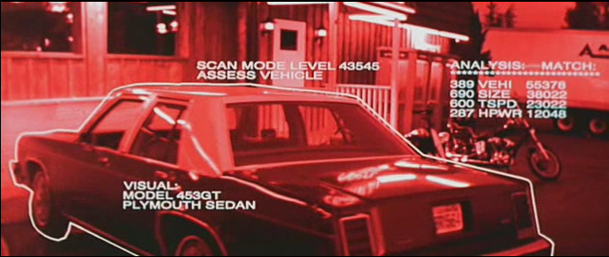
What is computer vision (CV)?
Notes:
This was something first came to mind when I was a kid when I heard of the word computer vision

Slide 8
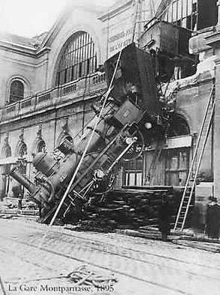
Every image tells a story
CV aims to perceive the “story” behind the picture
Who?
What?
What happened?

Slide 9
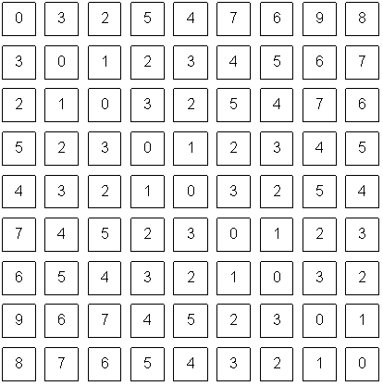
The goal of computer vision

Slide 10
Can the computer match human perception?
Yes and no (mainly no)
computers can be better at “easy” things
humans are much better at “hard” things
But huge progress has been made
Especially in the last 10 years
What is considered “hard” keeps changing

Slide 11
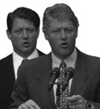
Human perception has its shortcomings
Sinha and Poggio, Nature, 1996

Slide 12
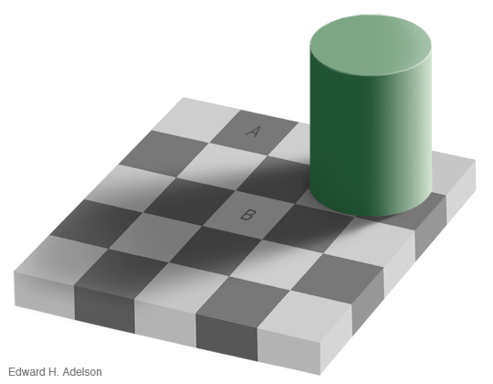

Slide 13
But humans can tell a lot about a scene from a little information…
Source: “80 million tiny images” by Torralba, et al.

Slide 15
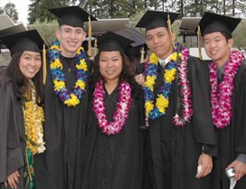
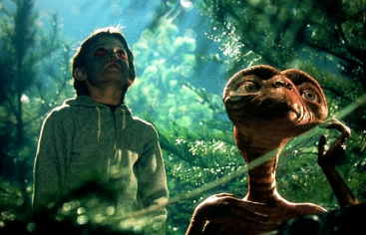
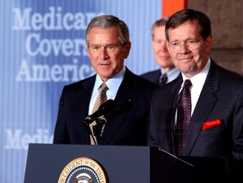
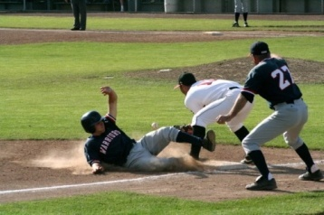
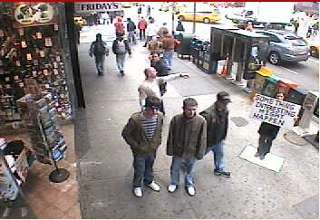
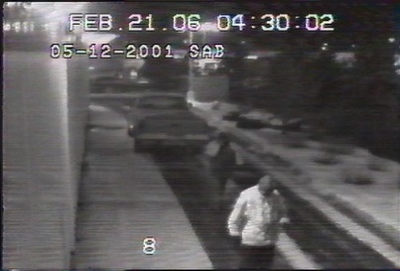
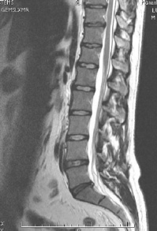
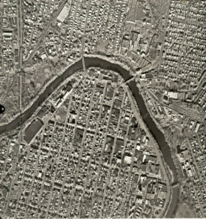
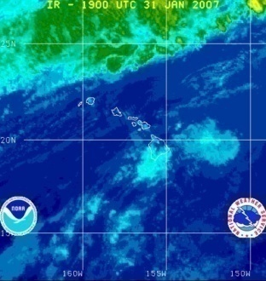
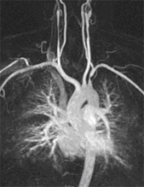
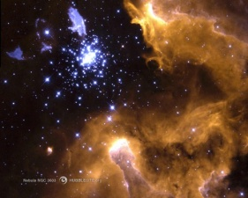
Why study computer vision?
Millions of images being captured all the time
Loads of useful applications

Slide 16
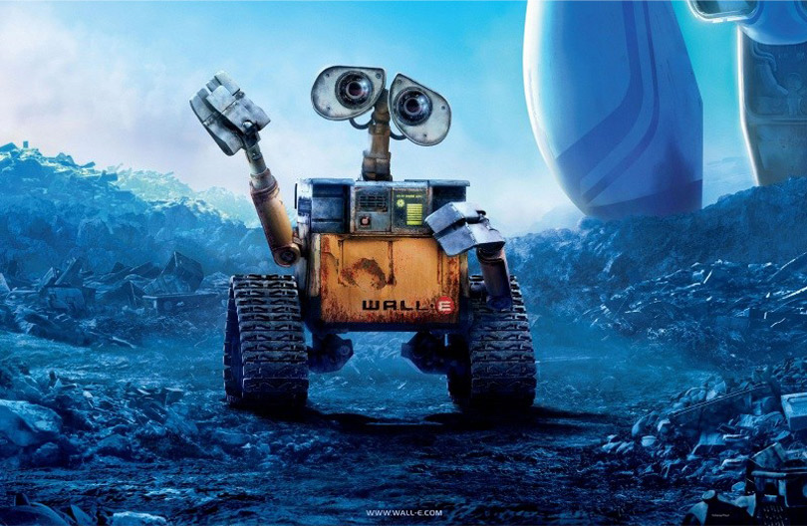
Some uses of computer vision

Slide 17
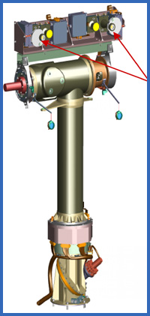
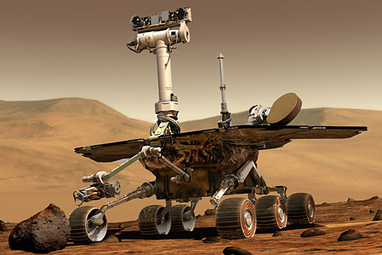
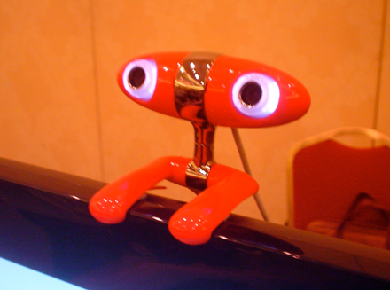
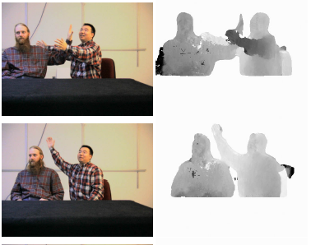
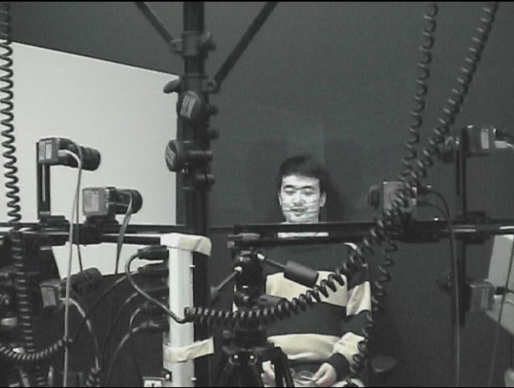
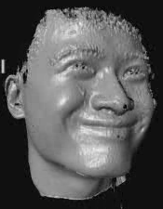
Some uses of computer vision
Computing the 3D shape of the world

Slide 18
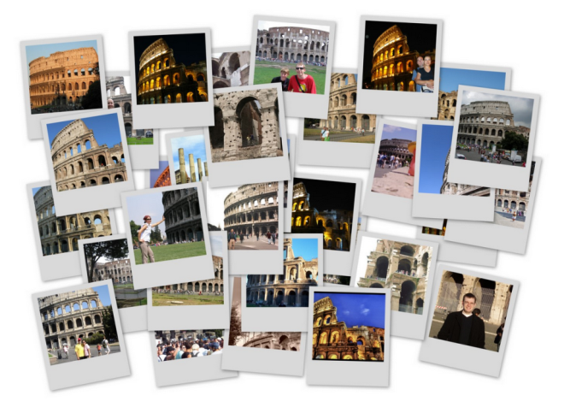
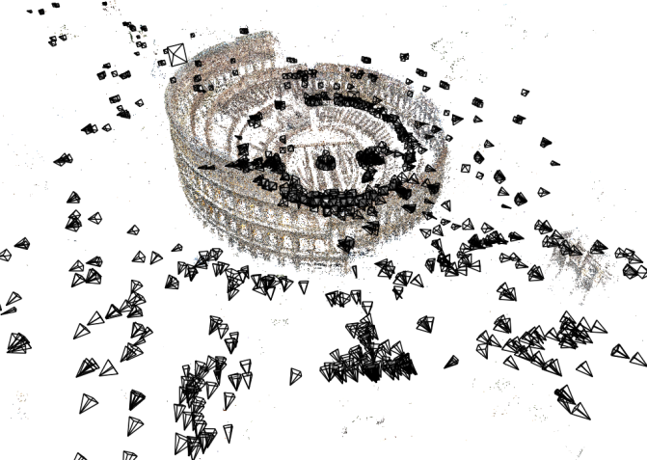
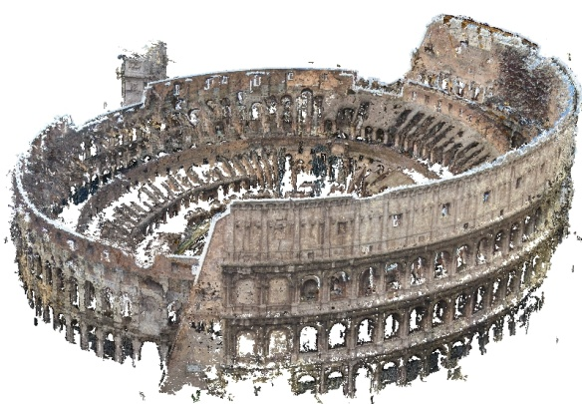
Some uses of computer vision
Computing the 3D shape of the world
Internet Photos (“Colosseum”)
Reconstructed 3D cameras and points
Dense 3D model

Slide 19
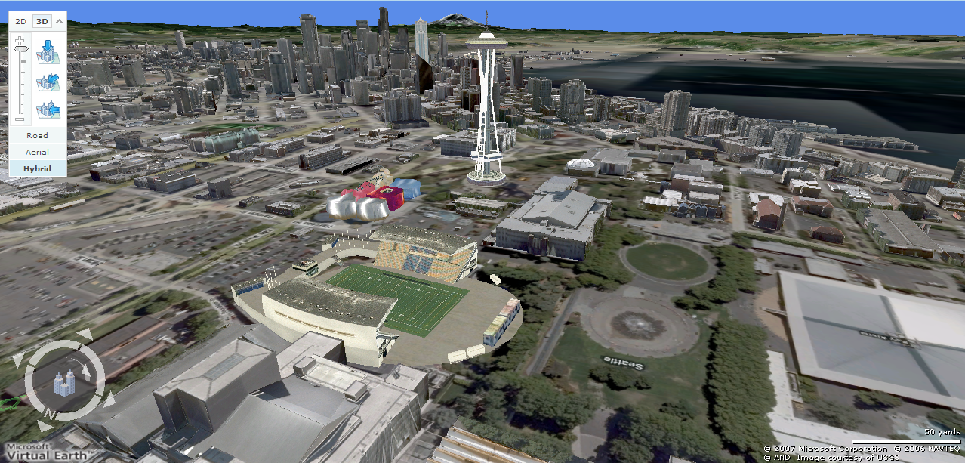
3D urban modeling
Bing maps, Google Streetview
Source: S. Seitz

Slide 20
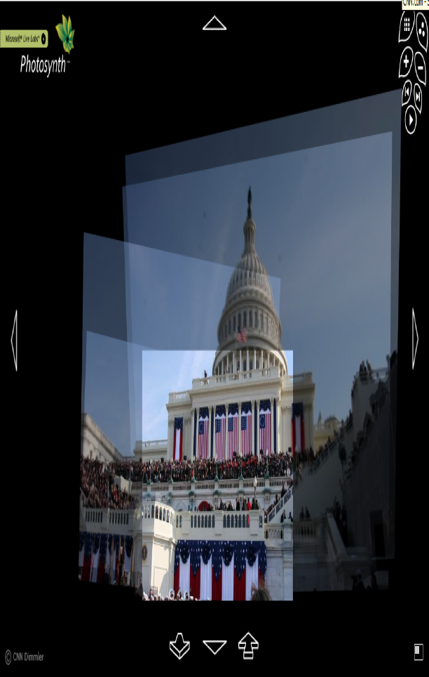
3D urban modeling: Microsoft Photosynth
http://photosynth.net
Source: S. Seitz

Slide 21
Some uses of computer vision
Recognizing objects and people

Slide 22
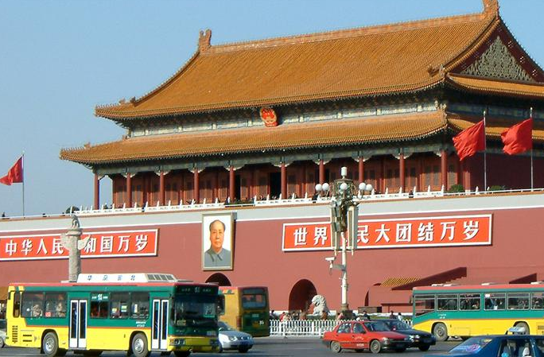
slide credit: Fei-Fei, Fergus & Torralba

Slide 23
sky
building
flag
face
banner
wall
street lamp
bus
bus
cars
slide credit: Fei-Fei, Fergus & Torralba

Slide 24
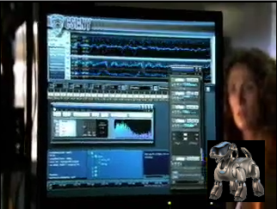
Some uses of computer vision
“Enhancing” images

Slide 25
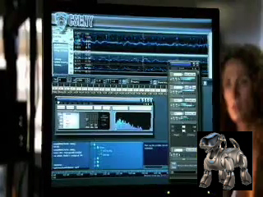

Slide 26
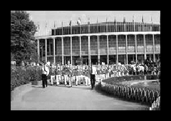
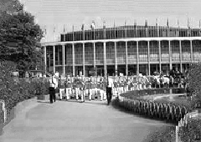
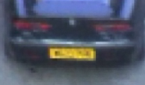
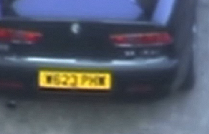
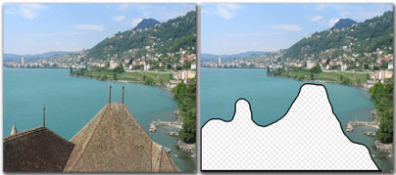
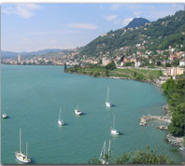
Some uses of computer vision
“Enhancing” images (c.f. Computational Photography)
Texture synthesis / increased field of view (uncropping) (image credit: Efros and Leung)
Super-resolution / denoising (source: 2d3)
Inpainting / image completion (image credit: Hays and Efros)

Slide 27
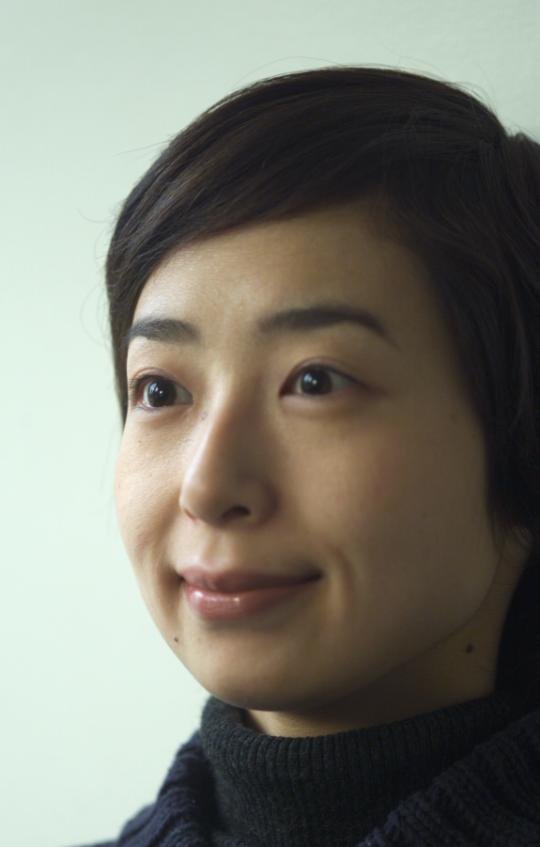
Some uses of computer vision
Forensics
Source: Nayar and Nishino, “Eyes for Relighting”

Slide 28
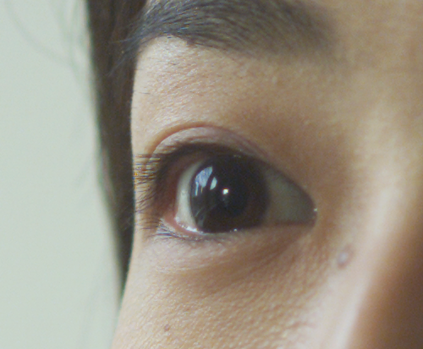
Source: Nayar and Nishino, “Eyes for Relighting”

Slide 29
Source: Nayar and Nishino, “Eyes for Relighting”

Slide 30
Computer Vision Problems

Slide 31
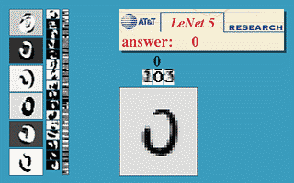
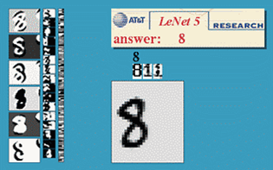
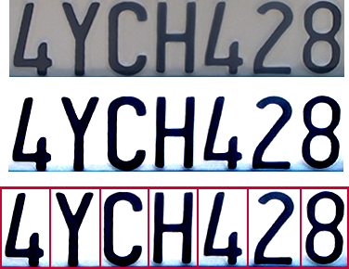
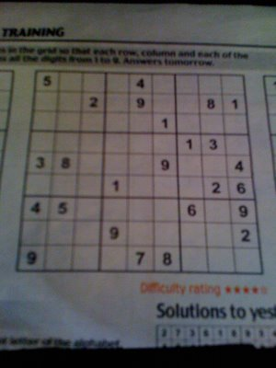
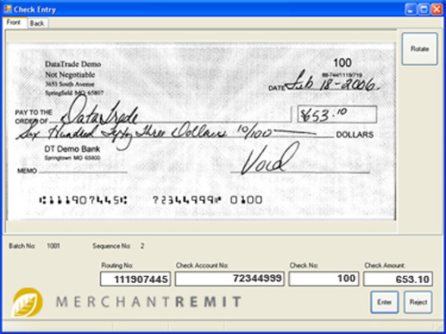
Optical character recognition (OCR)
If you have a scanner, it probably came with OCR software
Digit recognition, AT&T labs
http://www.research.att.com/~yann/
License plate readers
http://en.wikipedia.org/wiki/Automatic_number_plate_recognition
Sudoku grabber
http://sudokugrab.blogspot.com/
Automatic check processing
Source: S. Seitz

Slide 32
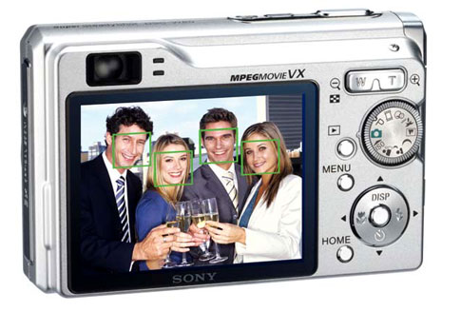
Face detection
Many new digital cameras now detect faces
Canon, Sony, Fuji, …
Source: S. Seitz
Notes:
Why would this be useful? Main reason is focus. Also enables “smart” cropping.

Slide 33
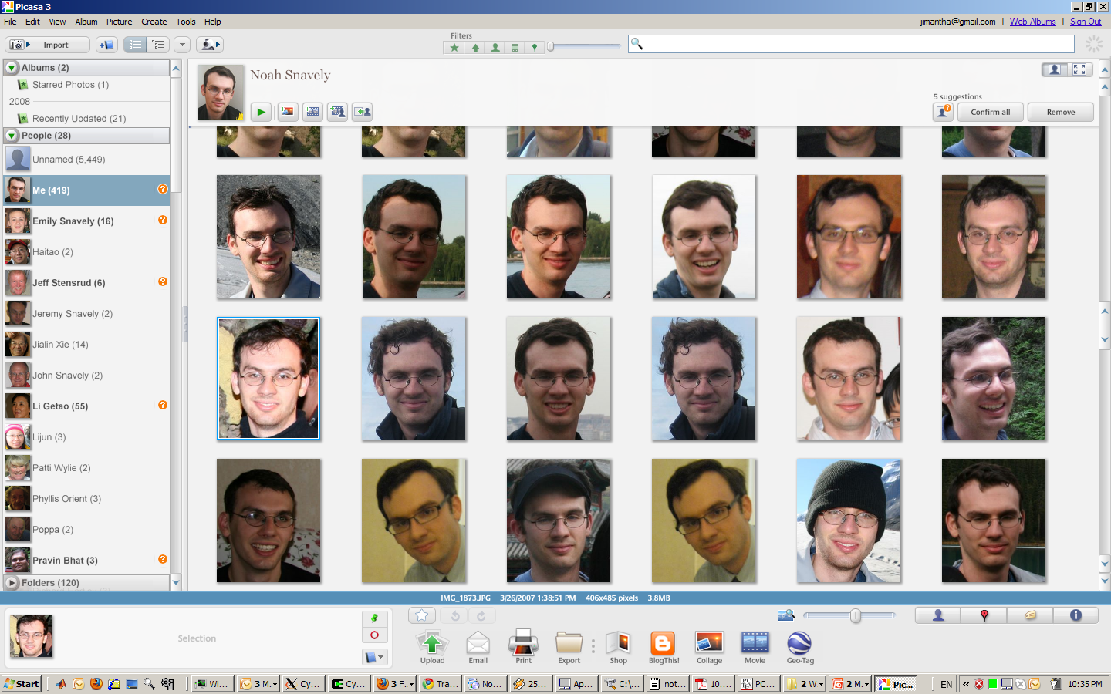
Face recognition

Slide 34
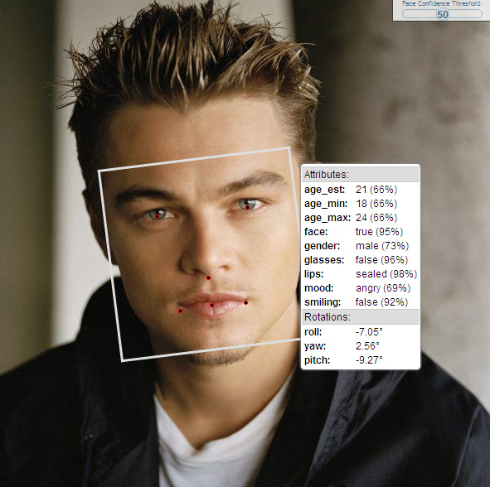
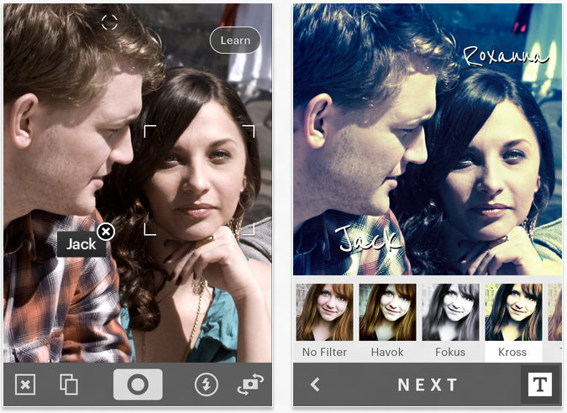
Face Recognition
http://developers.face.com/tools/

Slide 35
Face recognition
Who is she?
Source: S. Seitz

Slide 36
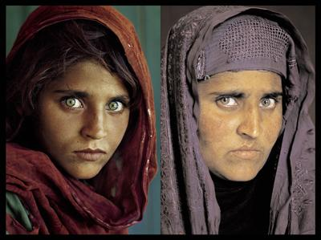
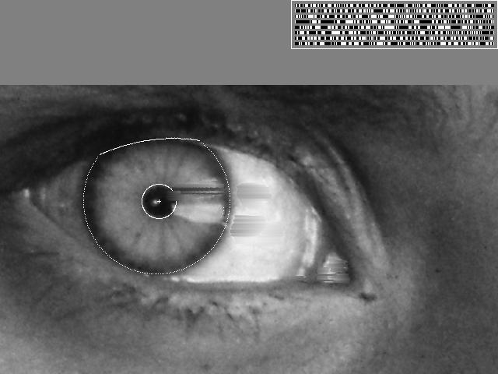
Vision-based biometrics
“How the Afghan Girl was Identified by Her Iris Patterns” Read the story
Source: S. Seitz

Slide 37
Login without a password…
Fingerprint scanners on many new laptops, other devices
Face recognition systems now beginning to appear more widely
Source: S. Seitz

Slide 38
Object recognition (in supermarkets)
LaneHawk by EvolutionRobotics
“A smart camera is flush-mounted in the checkout lane, continuously watching for items. When an item is detected and recognized, the cashier verifies the quantity of items that were found under the basket, and continues to close the transaction. The item can remain under the basket, and with LaneHawk,you are assured to get paid for it… “
Source: S. Seitz

Slide 39
Object recognition (in supermarkets)
Notes:
Amazon Go! https://www.amazon.com/b?ie=UTF8&node=16008589011
Ask – so how does it work?
Think Pair Share!!!

Slide 40
Object recognition (in mobile phones)
Source: S. Seitz

Slide 41
Google Goggles

Slide 42
Google Search by Image
https://images.google.com

Slide 43
Leaf Recognition

Slide 44
Special effects: shape capture
The Matrix movies, ESC Entertainment, XYZRGB, NRC
Source: S. Seitz

Slide 45
Special effects: motion capture
Pirates of the Carribean, Industrial Light and Magic
Source: S. Seitz

Slide 46
Special effects: camera tracking
Boujou, 2d3

Slide 47
Sports
Sportvision first down line
Nice explanation on www.howstuffworks.com
Source: S. Seitz

Slide 48
3D Mapping

Slide 49
Smart and self-driving cars
Mobileye
Vision systems currently in high-end BMW, GM, Volvo models
Sources: A. Shashua, S. Seitz

Slide 50
Robot vison
NASA’s Mars Curiosity Rover (Mars Science Laboratory)
http://en.wikipedia.org/wiki/Spirit_rover
Autonomous RC Car
http://www.cs.cornell.edu/~asaxena/rccar/

Slide 51
Robot vision in space
The Heights of Mount Sharp
http://www.nasa.gov/mission_pages/msl/multimedia/pia16077.html
Panorama captured by Curiosity Rover, August 18, 2012 (Sol 12)
Vision systems (JPL) uses for several tasks
Panorama stitching
3D terrain modeling
Obstacle detection, position tracking
For more, read “Computer Vision on Mars” by Matthies et al.

Slide 52
Medical imaging
3D imaging
MRI, CT
Image guided surgery
Grimson et al., MIT
Source: S. Seitz

Slide 53
Current state of the art
You just saw examples of current systems.
Many of these are less than 5 years old
This is a very active research area, and rapidly changing
Many new applications in the next 5 years
To learn more about vision applications and companies
David Lowe maintains an excellent overview of vision companies
http://www.cs.ubc.ca/spider/lowe/vision.html

Slide 54
Why is CV difficult?

Slide 55
Source: S. Thorpe

Slide 56
Why is computer vision difficult?
Viewpoint variation
Scale
Illumination

Slide 57
Why is computer vision difficult?
Motion (Source: S. Lazebnik)
Intra-class variation
Background clutter
Occlusion

Slide 58
Challenges: local ambiguity
slide credit: Fei-Fei, Fergus & Torralba

Slide 59
But there are lots of cues we can exploit…
Source: S. Lazebnik

Slide 60
Bottom line
Perception is an inherently ambiguous problem
Many different 3D scenes could have given rise to a particular 2D picture
We often need to use prior knowledge about the structure of the world
Image source: F. Durand

Slide 61
Course overview
Project (HW) based. Expected quite a few programming assignments
Buttom-up: Matlab is default. But you can use Python/OpenCV if you wish
Top-down: OpenCV Python/C++
One final project
Presentations are expected if you are taking graduate credits
No exam

Slide 62
Grading
Rough grade breakdown:
Programming/written assignments: 70%
Final project: 30%
Presentation (only for graduate credit): 20% and rest rescaled accordingly

Slide 63
Late policy
Late projects will be penalized by 5% for each day it is late, and penalty capped after 10 days
Penalty is mild and so no exception will be granted
Occasional bonus given to the first correct submission of a more challenging assignment

Slide 64
Academic Integrity
Common sense
Discuss okay (and encouraged) but please do your own work for the final solution. That is the only way to learn
Take advantage piazza. Small bonus will be given to constructive replies of a more challenging questions

Slide 66
Questions?

