Slide 1
Epipolar Geometry
Samuel Cheng
Slide credit: James Tompkin, Naoh Snavely

Slide 2
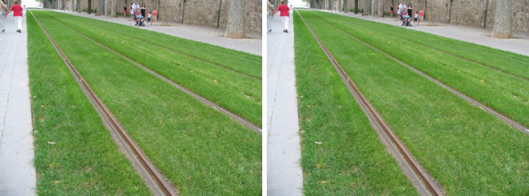
Frederick Kingdom

Slide 3
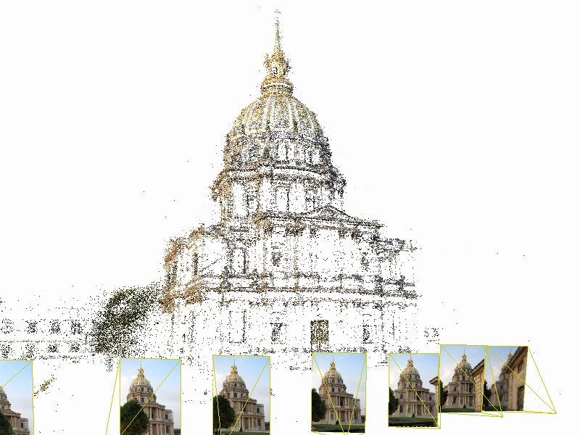
Structure from motion

Slide 4
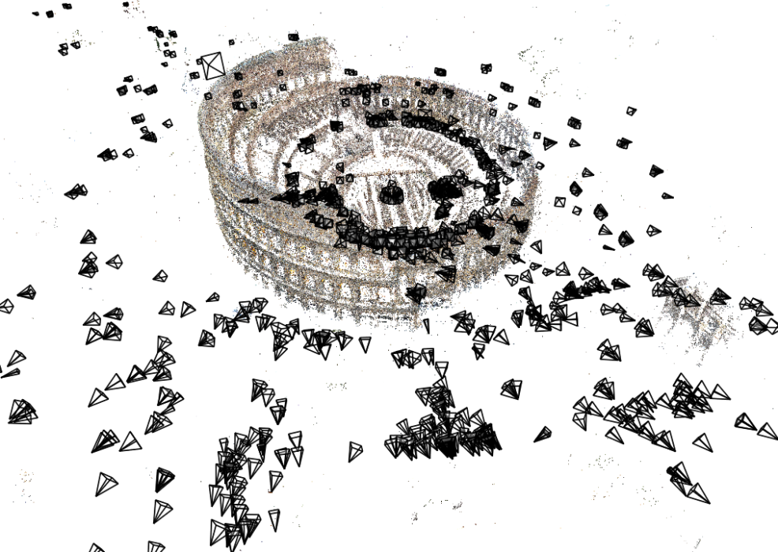
Structure from motion
Given many images, how can we
a) figure out where they were all taken from?
b) build a 3D model of the scene?
This is (roughly) the structure from motion problem

Slide 5
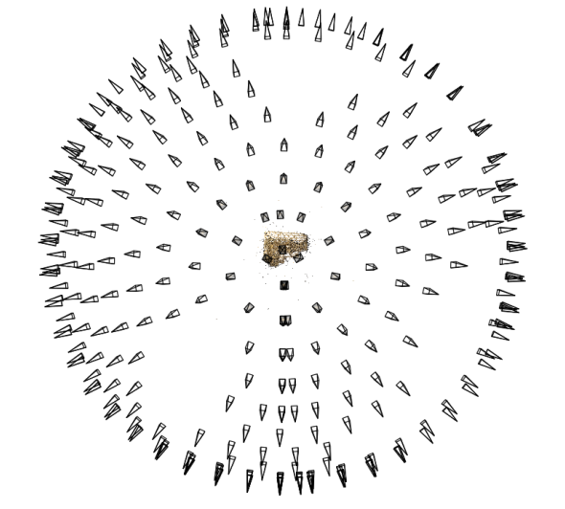
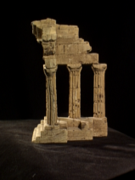
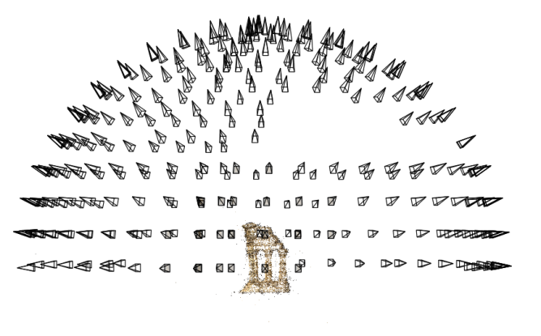
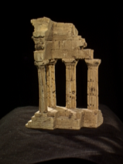
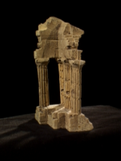
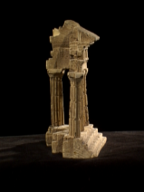
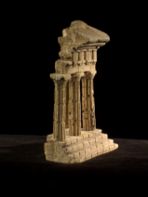
Structure from motion
Reconstruction (side)
(top)
Input: images with points in correspondence p_{i,j} = (u_{i,j},v_{i,j})
Output
structure: 3D location x_{i} for each point p_{i}
motion: camera parameters R_{j} , t_{j} possibly K_{j}
Objective function: minimize reprojection error

Slide 6
What we’ve seen so far…
2D transformations between images
Translations, affine transformations, homographies…
3D coordinates to 2D coordinates
Camera matrix
Today: epipolar geometry and fundamental matrices

Slide 7
Depth from disparity
Goal: recover depth by finding image coordinate x’ that corresponds to x
X
X
x
z
x
x’
x'
f
f
O
Baseline T
O’

Slide 8
Geometry for a simple stereo system
Assume parallel optical axes, known camera parameters (i.e., calibrated cameras). What is expression for Z?
Similar triangles (p_{l}, P, p_{r}) and (O_{l}, P, O_{r}):
$$\frac{T+x_{r}−x_{l}}{Z−f}=\frac{T}{Z}$$
$$Z=f\frac{T}{x_{l}−x_{r}}$$
disparity
Notes:
8

Slide 9
Depth from disparity
Goal: recover depth by finding image coordinate x’ that corresponds to x
Sub-Problems
Calibration: How do we recover the relation of the cameras (if not already known)?
Correspondence: How do we search for the matching point x’?
X
x
x'

Slide 10
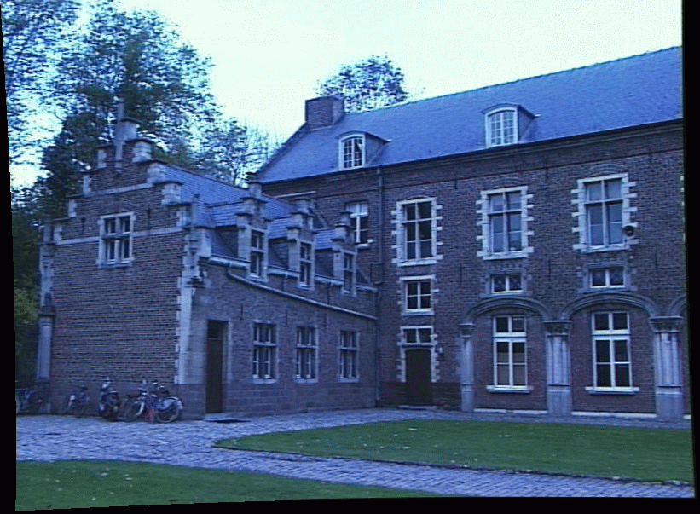
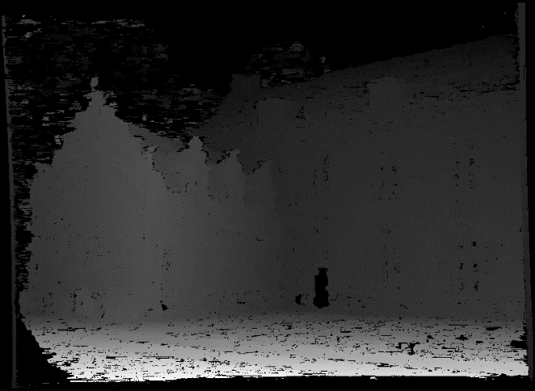
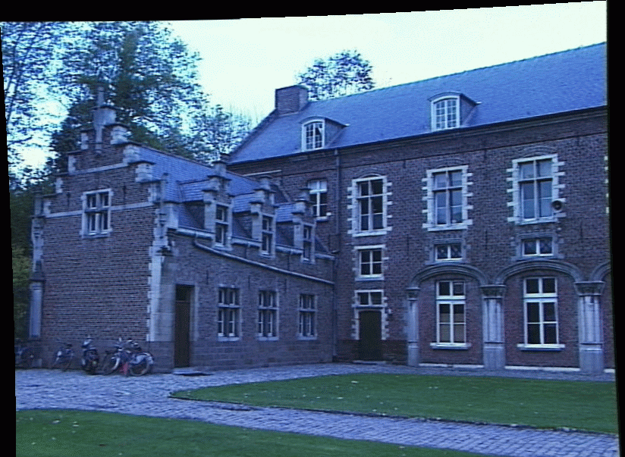
Depth from disparity
image I(x,y)
Disparity map D(x,y)
image I´(x´,y´)
(x´,y´)=(x+D(x,y), y)
If we could find the corresponding points in two images, we could estimate relative depth…
James Hays

Slide 11
What do we need to know?
Calibration for the two cameras.
Intrinsic matrices for both cameras (e.g., f)
Baseline distance T in parallel camera case
R, t in non-parallel case
2. Correspondence for every pixel.

Slide 12
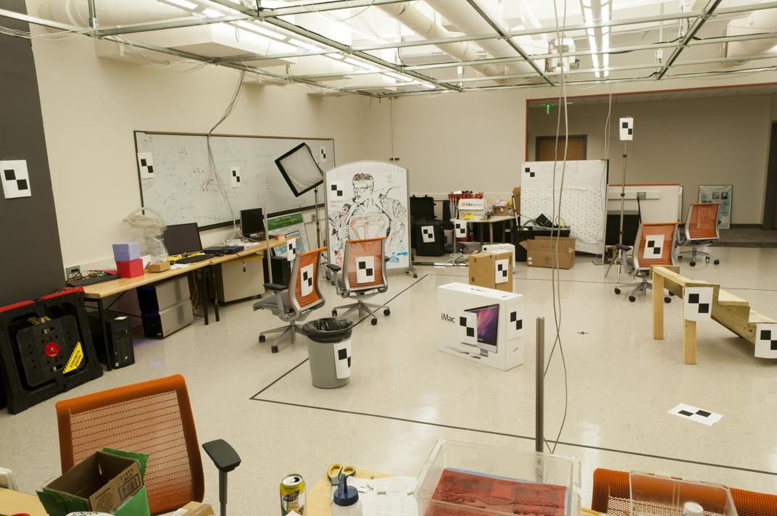
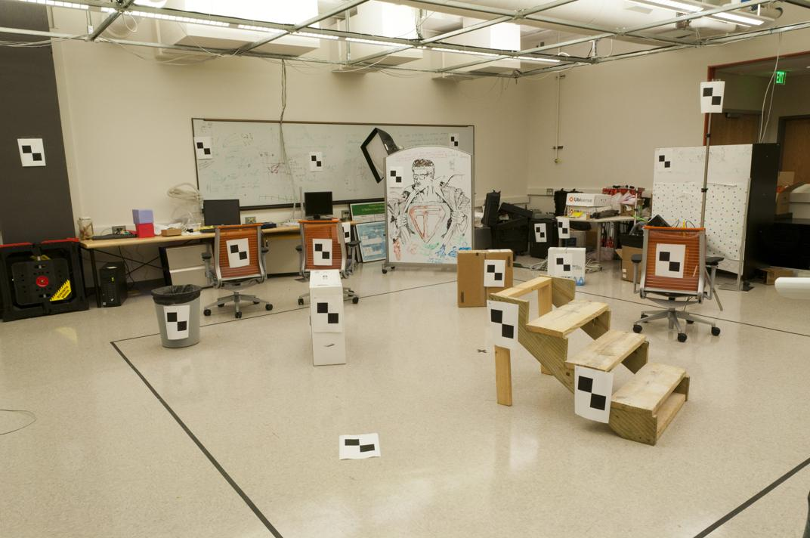
Correspondence for every pixel. Where do we need to search?

Slide 13
Wouldn’t it be nice to know where matches can live? Epipolar geometry Constrains 2D search to 1D

Slide 14
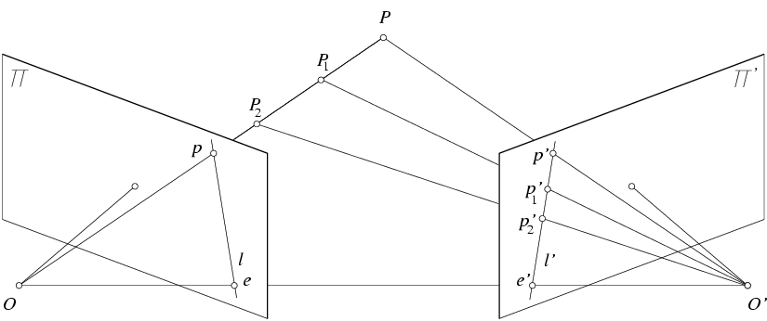
Key idea: Epipolar constraint
X
X
X
x
x’
x’
x’
Potential matches for x’ have to
lie on the corresponding line l.
Potential matches for x have to
lie on the corresponding line l’.

Slide 15
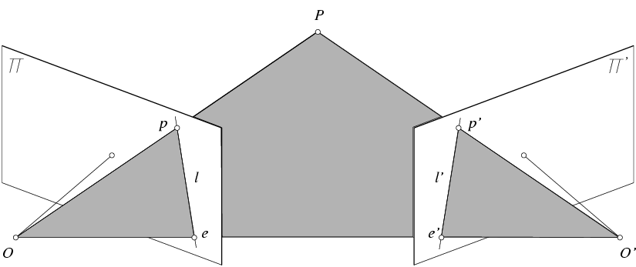
Epipolar geometry: notation
X
x
x’
Baseline – line connecting the two camera centers
Epipoles
= intersections of baseline with image planes
= projections of the other camera center
Epipolar Plane – plane containing baseline (1D family)

Slide 16
Epipolar geometry: notation
X
x
x’
Baseline – line connecting the two camera centers
Epipoles
= intersections of baseline with image planes
= projections of the other camera center
Epipolar Plane – plane containing baseline (1D family)
Epipolar Lines - intersections of epipolar plane with image planes (always come in corresponding pairs)

Slide 17
Think Pair Share
= camera center
Where are the epipoles?
What do the epipolar lines look like?
X
X
a)
b)
X
X
c)
d)

Slide 18
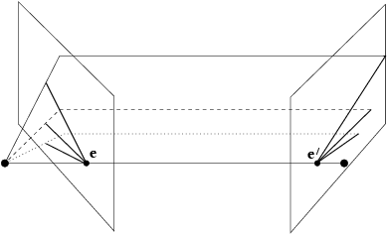
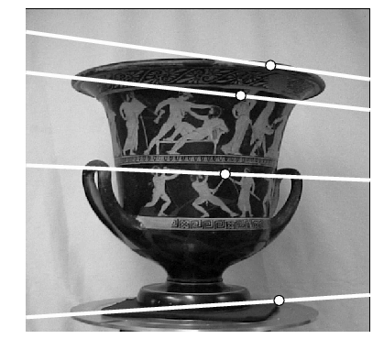
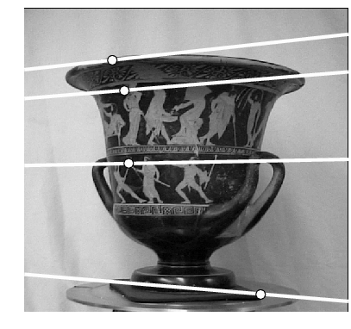
Example: Converging cameras

Slide 19
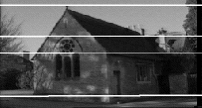
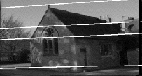
Example: Motion parallel to image plane

Slide 20
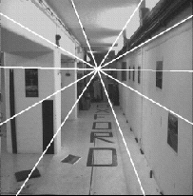
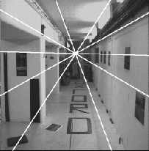
Example: Forward motion
e’
e
Epipole has same coordinates in both images.
Points move along lines radiating from e: “Focus of expansion”

Slide 21
How to find epipolar line of a point?
A little bit more math, but cool math
Essential matrix and fundamental matrix

Slide 22
Essential matrix
X
$$X_{l}$$
$${X_{r}}^{}$$
$$X_{l}: X \text{in} \text{terms} \text{of} \text{Cartesian} \text{coordinate} \text{of} \text{left} \text{camera} \\ X_{r}: X \text{in} \text{terms} \text{of} \text{Cartesian} \text{coordinate} \text{of} \text{right} \text{camera}$$
$$\text{There} \text{exists} E \text{such} \text{that} {X_{l}}^{T}EX_{r}=0$$
Notes:
X’ is X in the second camera’s coordinate system
We can identify the non-homogeneous 3D vectors X and X’ with the homogeneous coordinate vectors x and x’ of the projections of the two points into the two respective images

Slide 23
Review: change of coordinate
How do we change coordinate from one camera to another?
(Center of projection at the origin, x-axis points right, y-axis points up, z-axis points backwards)
Step 1: Translate by -c
0

Slide 24
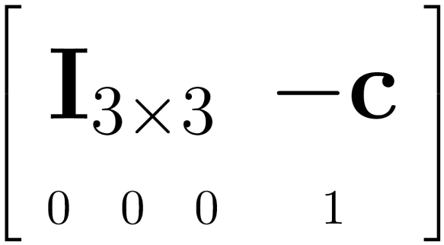
Review: change of coordinate
How do we change coordinate from one camera to another?
(Center of projection at the origin, x-axis points right, y-axis points up, z-axis points backwards)
Step 1: Translate by -c
How do we represent translation as a matrix multiplication?
0

Slide 25
Review: change of coordinate
How do we change coordinate from one camera to another?
(Center of projection at the origin, x-axis points right, y-axis points up, z-axis points backwards)
Step 1: Translate by -c
Step 2: Rotate by R
0
3x3 rotation matrix

Slide 26
Review: change of coordinate
How do we change coordinate from one camera to another?
(Center of projection at the origin, x-axis points right, y-axis points up, z-axis points backwards)
Step 1: Translate by -c
Step 2: Rotate by R
0

Slide 27
Essential matrix (Longuet-Higgins, 1981)
X
$$X_{l}$$
$$X_{r}^{}$$
x
x’
$$\text{Let} R \text{be} \text{rotation} \text{from} \text{left} \text{to} \text{right} \text{camera}\text{, }\text{then} X_{l}=R(X_{r}−t)$$
Notes:
X’ is X in the second camera’s coordinate system
We can identify the non-homogeneous 3D vectors X and X’ with the homogeneous coordinate vectors x and x’ of the projections of the two points into the two respective images

Slide 28
Cross product in matrix representation
Let
$$u=[u_{1},u_{2},u_{3}]^{T},v=[v_{1},v_{2},v_{3}]^{T}$$
$$u×v=\left|\begin{matrix}i & j & k \\ u_{1} & u_{2} & u_{3} \\ v_{1} & v_{2} & v_{3}\end{matrix}\right|=\left|\begin{matrix}u_{2} & u_{3} \\ v_{2} & v_{3}\end{matrix}\right|i−\left|\begin{matrix}u_{1} & u_{3} \\ v_{1} & v_{3}\end{matrix}\right|j+\left|\begin{matrix}u_{1} & u_{2} \\ v_{1} & v_{2}\end{matrix}\right|k$$
$$={\left[\left|\begin{matrix}u_{2} & u_{3} \\ v_{2} & v_{3}\end{matrix}\right|,−\left|\begin{matrix}u_{1} & u_{3} \\ v_{1} & v_{3}\end{matrix}\right|,\left|\begin{matrix}u_{1} & u_{2} \\ v_{1} & v_{2}\end{matrix}\right|\right]}^{⊤}$$
$$=\underset{[u]_{×}}{\underbrace{\left[\begin{matrix}0 & −u_{3} & u_{2} \\ u_{3} & 0 & −u_{1} \\ −u_{2} & u_{1} & 0\end{matrix}\right]}}\left[\begin{aligned}&v_{1} \\ &v_{2} \\ &v_{3}\end{aligned}\right]$$
$$={\left[\begin{matrix}u_{2}v_{3}−u_{3}v_{2} \\ −u_{1}v_{3}+u_{3}v_{1} \\ u_{1}v_{2}−u_{2}v_{1}\end{matrix}\right]}^{}$$

Slide 29
Essential matrix (Longuet-Higgins, 1981)
X
$$X_{l}$$
$$X_{r}^{}$$
x’
x’
$$\text{Let} R \text{be} \text{rotation} \text{from} \text{right} \text{to} \text{left} \text{camera}\text{, }\text{then} X_{l}=R(X_{r}−t)$$
$$\text{Let} E \text{be} R[t]_{×},$$
$$X_{l}^{T}EX_{r}$$
$$={X_{l}}^{T}(R[t]_{×}X_{r})$$
$$=(X_{r}−t)^{T}R^{T}R[t]_{×}X_{r}$$
$$=(X_{r}−t)·(t×X_{r})$$
$$=X_{r}·\left(t×X_{r}\right)−t·\left(t×X_{r}\right)$$
Notes:
X’ is X in the second camera’s coordinate system
We can identify the non-homogeneous 3D vectors X and X’ with the homogeneous coordinate vectors x and x’ of the projections of the two points into the two respective images

Slide 30
Essential matrix (Longuet-Higgins, 1981)
X
$$X_{l}$$
$$X_{r}^{}$$
x’
x’
X₀
$$X_{l}^{0}$$
$$X_{r}^{0}$$
$$EX_{r}^{0}=(R[t]_{×})X_{r}^{0}$$
$$=R(t×X_{r}^{0})$$
$$\underset{[t]_{×}}{\underbrace{\left[\begin{matrix}0 & −t_{3} & t_{2} \\ t_{3} & 0 & −t_{1} \\ −t_{2} & t_{1} & 0\end{matrix}\right]}}$$
$$E^{T}X_{l}^{0}=(R[t]_{×})^{T}R(X_{r}^{0}−t)$$
$$=([t]_{x})^{T}R^{T}R(X_{r}^{0}−t)$$
$$=[−t]_{x}(X_{r}^{0}−t)$$
$$=−t×(X_{r}^{0}−t)$$
Notes:
X’ is X in the second camera’s coordinate system
We can identify the non-homogeneous 3D vectors X and X’ with the homogeneous coordinate vectors x and x’ of the projections of the two points into the two respective images

Slide 31
Fundamental matrix (Faugeras and Luong, 1992)
X
$$X_{l}$$
$$X_{r}^{}$$
$$\hat{x_{l}}$$
$$\hat{x_{r}}$$
$$X_{r}: X \text{in} \text{terms} \text{of} \text{Cartesian} \text{coordinate} \text{of} \text{right} \text{camera}$$
$$X_{l}: X \text{in} \text{terms} \text{of} \text{Cartesian} \text{coordinate} \text{of} \text{left} \text{camera}$$

Slide 32
Recall from last time
James Hays

Slide 33
Fundamental matrix
X
$$X_{l}$$
$$X_{r}^{}$$
$$\hat{x_{l}}$$
$${\hat{x_{r}}}^{}$$
$$X_{l}: X \text{in} \text{terms} \text{of} \text{Cartesian} \text{coordinate} \text{of} \text{left} \text{camera} \\ X_{r}: X \text{in} \text{terms} \text{of} \text{Cartesian} \text{coordinate} \text{of} \text{right} \text{camera}$$
$${\hat{x}}_{l}=K_{l}X_{l}: X\text{ ′}\text{s} \text{homogeneous} \text{coordinate} \text{of} \text{left} \text{view} \\ {\hat{x}}_{r}=K_{r}X_{r}: X\text{ ′}\text{s} \text{homogeneous} \text{coordinate} \text{of} \text{right} \text{view}$$

Slide 34
Epipoles and fundamental matrix
X
X₀
$$X_{l}^{0}$$
$$X_{r}^{0}$$
$$=(K_{l}^{T})^{−1}E{K_{r}}^{−1}\underset{e′}{\underbrace{K_{r}X_{r}^{0}}}=(K_{l}^{T})^{−1}EX_{r}^{0}$$
$$F^{T}e=\underset{F}{\underbrace{(K_{r}^{T})^{−1}E^{T}{K_{l}}^{−1}}}e=(K_{r}^{T})^{−1}E^{T}{K_{l}}^{−1}\underset{e}{\underbrace{K_{l}X_{l}^{0}}}=(K_{r}^{T})^{−1}E^{T}X_{l}^{0}=0$$
Notes:
X’ is X in the second camera’s coordinate system
We can identify the non-homogeneous 3D vectors X and X’ with the homogeneous coordinate vectors x and x’ of the projections of the two points into the two respective images

Slide 35
Review: Essential matrix
X
$$\hat{X_{l}}$$
$${\hat{X_{r}}}^{}$$
Notes:
X’ is X in the second camera’s coordinate system
We can identify the non-homogeneous 3D vectors X and X’ with the homogeneous coordinate vectors x and x’ of the projections of the two points into the two respective images

Slide 36
Review: Fundamental matrix
X
$$\hat{X_{l}}$$
$${\hat{X_{r}}}^{}$$
$$\hat{x_{l}}$$
$${\hat{x_{r}}}^{}$$

Slide 37
Line representation in homogenous coordinate
Line equation: ax + by + c = 0
Can represent a line with vector [a b c]
Then, a point p is on a line l if and only if
Note that

Slide 38
Epipoles and fundamental matrix
X
$$\hat{x_{l}}$$
$${\hat{x_{r}}}^{}$$
X₀
Notes:
X’ is X in the second camera’s coordinate system
We can identify the non-homogeneous 3D vectors X and X’ with the homogeneous coordinate vectors x and x’ of the projections of the two points into the two respective images

Slide 39
Epipoles and fundamental matrix
X
$$\hat{x_{l}}$$
$${\hat{x_{r}}}^{}$$
X₀
Notes:
X’ is X in the second camera’s coordinate system
We can identify the non-homogeneous 3D vectors X and X’ with the homogeneous coordinate vectors x and x’ of the projections of the two points into the two respective images

Slide 40
Epipoles and fundamental matrix
X
$$\hat{x_{l}}$$
$${\hat{x_{r}}}^{}$$
This restrict our search space from 2D to 1D
Notes:
X’ is X in the second camera’s coordinate system
We can identify the non-homogeneous 3D vectors X and X’ with the homogeneous coordinate vectors x and x’ of the projections of the two points into the two respective images

Slide 41
Fundamental matrix
X
F e’ = 0 and F^{T}e = 0 (nullspaces of F = e’; nullspace of F^{T} = e’)
F is singular (rank two): det(F)=0
F has seven degrees of freedom: 9 entries but defined up to scale, det(F)=0

Slide 42
Remark
Since
This is sometimes how essential matrix is introduced

Slide 43
Estimating the Fundamental Matrix
8-point algorithm
Least squares solution using SVD on equations from 8 pairs of correspondences
Enforce det(F)=0 constraint using SVD on F
Note: estimation of F (or E) is degenerate for a planar scene.

Slide 44
8-point algorithm
Solve a system of homogeneous linear equations
Write down the system of equations
$$uu^{′}f_{11}+uv^{′}f_{12}+uf_{13}+vu^{′}f_{21}+vv^{′}f_{22}+vf_{23}+u^{′}f_{31}+v^{′}f_{32}+f_{33}=0$$
$Af=\left[\begin{matrix}u_{1}u_{1}′ & u_{1}v_{1}′ & \begin{matrix}u_{1} & v_{1}u_{1}′ & \begin{matrix}v_{1}v_{1}′ & v_{1} & \begin{matrix}u_{1}′ & v_{1}′ & 1\end{matrix}\end{matrix}\end{matrix} \\ \begin{matrix}⋮ \\ u_{n}u_{v}^{′}\end{matrix} & \begin{matrix}⋮ \\ u_{n}v_{n}′\end{matrix} & \begin{matrix}\begin{matrix}⋮ \\ u_{n}\end{matrix} & \begin{matrix}⋮ \\ v_{n}u_{n}′\end{matrix} & \begin{matrix}\begin{matrix}⋮ \\ v_{n}v_{n}′\end{matrix} & \begin{matrix}⋮ \\ v_{n}\end{matrix} & \begin{matrix}\begin{matrix}⋮ \\ u_{n}′\end{matrix} & \begin{matrix}⋮ \\ v_{n}′\end{matrix} & \begin{matrix}⋮ \\ 1\end{matrix}\end{matrix}\end{matrix}\end{matrix}\end{matrix}\right]\left[\begin{matrix}f_{11} \\ f_{12} \\ \begin{aligned}f_{13} \\ f_{21} \\ ⋮ \\ f_{33}\end{aligned}\end{matrix}\right]$=0

Slide 45
8-point algorithm
Solve a system of homogeneous linear equations
Write down the system of equations
Solve f from Af=0 using SVD
Matlab:
[U, S, V] = svd(A);
f = V(:, end);
F = reshape(f, [3 3])’;

Slide 46
Need to enforce singularity constraint

Slide 47
8-point algorithm
Solve a system of homogeneous linear equations
Write down the system of equations
Solve f from Af=0 using SVD
Resolve det(F) = 0 constraint using SVD
Matlab:
[U, S, V] = svd(A);
f = V(:, end);
F = reshape(f, [3 3])’;
Matlab:
[U, S, V] = svd(F);
S(3,3) = 0;
F = U*S*V’;

Slide 48
Problem with eight-point algorithm

Slide 49
Problem with eight-point algorithm
Poor numerical conditioning
Can be fixed by rescaling the data

Slide 50
The normalized eight-point algorithm
(Hartley, 1995)
Center the image data at the origin, and normalize the coordinates of the data
Use the eight-point algorithm to compute F from the normalized points
Enforce the rank-2 constraint (for example, take SVD of F and throw out the smallest singular value)
Transform fundamental matrix back to original units: if T and T’ are the normalizing transformations in the two images, than the fundamental matrix in original coordinates is T’^{T} F T
Notes:
scale it so the mean squared distance between the origin and the data points is 2 pixels

Slide 51
7-point algorithm
Faster (need fewer points) and could be more robust (fewer points), but also need to check for degenerate cases

Slide 52
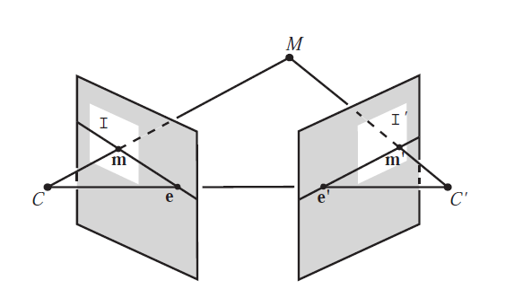
“Gold standard” algorithm
Use 8-point algorithm to get initial value of F
Use F to solve for P and P’ (discussed later)
Jointly solve for 3d points X and F that minimize the squared re-projection error
X
x
x'
See Algorithm 11.2 and Algorithm 11.3 in HZ (pages 284-285) for details

Slide 53
Comparison of estimation algorithms
 | 8-point | Normalized 8-point | Nonlinear least squares
Av. Dist. 1 | 2.33 pixels | 0.92 pixel | 0.86 pixel
Av. Dist. 2 | 2.18 pixels | 0.85 pixel | 0.80 pixel

Slide 54
We can get projection matrices P and P’ up to a projective ambiguity
K’*rotation
K’*translation
Code:
function P = vgg_P_from_F(F)
[U,S,V] = svd(F);
e = U(:,3);
P = [-vgg_contreps(e)*F e];
See HZ p. 255-256
If we know the intrinsic matrices (K and K’), we can resolve the ambiguity

Slide 55
From epipolar geometry to camera calibration
If we know the calibration matrices of the two cameras, we can estimate the essential matrix: E = K^{T}FK’
The essential matrix gives us the relative rotation and translation between the cameras, or their extrinsic parameters.
Fundamental matrix lets us compute relationship up to scale for cameras with unknown intrinsic calibrations.
Estimating the fundamental matrix is a kind of “weak calibration”

Slide 56
DEMO

Slide 57
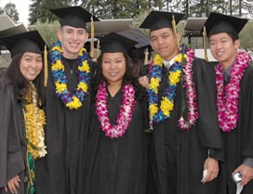
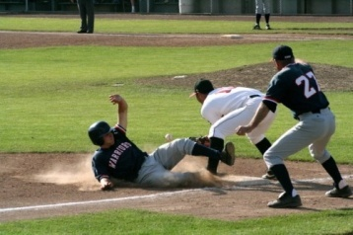
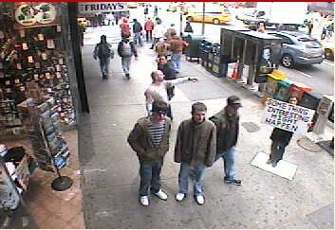
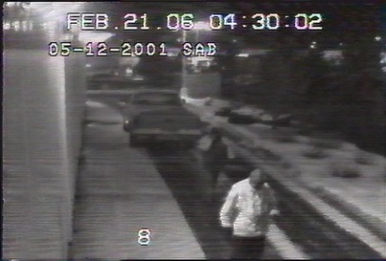
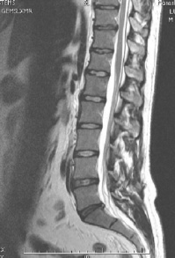
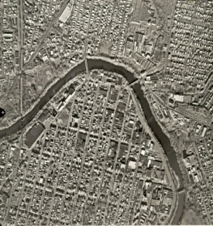
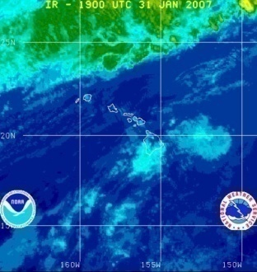
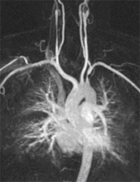
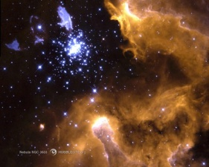
Why study computer vision?
Millions of images being captured all the time
Loads of useful applications

Slide 58
Computer vision and AI
The development of computer vision have benefit enormously from signal processing and “AI”
Three pillars of AI
Symbolic model (expert systems)
Probabilistic (Bayesian) model
Neural networks
We see a little bit of neural networks from the last couple weeks (will look deeper in my ANN class next spring)
More on probabilistic models in ECE 5973: information theory and probabilistic programming

Slide 59
Information theory and Probabilistic programming (coming fall)
Use probabilistic model for inference (prediction)
Organized unknown with graphical models
Infer unknown given observations
Learn variable models
Applications like
Predict stock markets
Recommending products (movies, books, etc.)
Medical diagnosis and prognosis
Predict trend (e.g., COVID-19, when it is going to end?)

Slide 60
Hope to see you all in future classes!
Good luck with finals and have a fruitful summer break!

