Slide 1
Image Filters
Samuel Cheng
Slide credits: Juan Carlos Niebles, Ranjay Krishna, James Hays, Noah Snavely

Slide 2

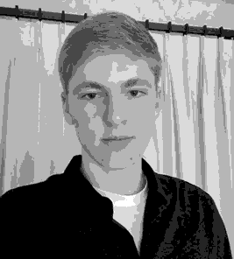

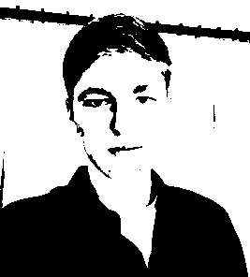
Image resolution vs radiometric Resolution
8 bit – 256 levels
4 bit – 16 levels
2 bit – 4 levels
1 bit – 2 levels

Slide 3
What we have learned today?
Image histograms
Linear systems (filters)
Convolution and correlation
Gaussian filter
Median filter

Slide 4
Systems and Filters
Filtering:
  Forming a new image whose pixel values are transformed from original pixel values
Goals:
Enhance image: super-resolution; in-painting; de-noising
Extract useful information: features (edge, corners, blobs, etc.) extraction
Preprocessing: transform images into another domain for easier processing (Fourier transform)

Slide 5

System and Filters
we define a system as a unit that converts an input signal f[n,m] into an output (or response) signal g[n,m], where (n,m) are the independent variables.
  In the case for images, (n,m) represents the spatial position in the image.

Slide 6

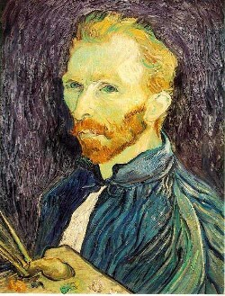
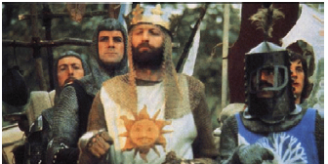
Super-resolution
De-noising
In-painting
Bertamio et al

Slide 7
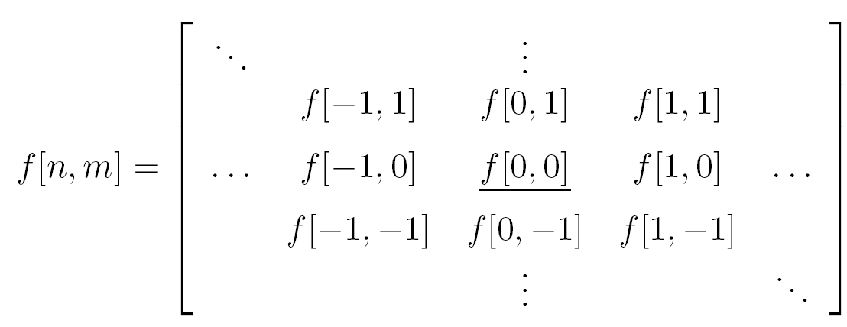
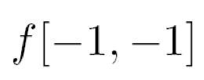







Grayscale images as 2D signals
Cartesian coordinates
Notation for
discrete
signal

Slide 8
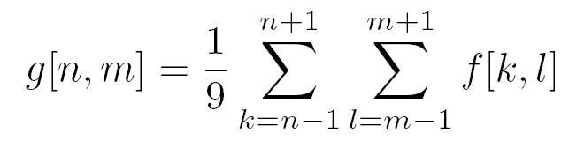

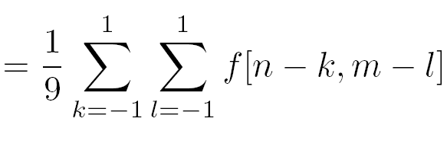
Filter example #1: Box filter
1
1
1
1
1
1
1
1
1
2D DS moving average over a 3 × 3 window of the target pixel’s neighborhood
Notes:
Board:
Input image
Output image
each pixel results from a neighborhood operation

Slide 9
Image filtering
1
1
1
1
1
1
1
1
1
0 | 0 | 0 | 0 | 0 | 0 | 0 | 0 | 0 | 0
0 | 0 | 0 | 0 | 0 | 0 | 0 | 0 | 0 | 0
0 | 0 | 0 | 90 | 90 | 90 | 90 | 90 | 0 | 0
0 | 0 | 0 | 90 | 90 | 90 | 90 | 90 | 0 | 0
0 | 0 | 0 | 90 | 90 | 90 | 90 | 90 | 0 | 0
0 | 0 | 0 | 90 | 0 | 90 | 90 | 90 | 0 | 0
0 | 0 | 0 | 90 | 90 | 90 | 90 | 90 | 0 | 0
0 | 0 | 0 | 0 | 0 | 0 | 0 | 0 | 0 | 0
0 | 0 | 90 | 0 | 0 | 0 | 0 | 0 | 0 | 0
0 | 0 | 0 | 0 | 0 | 0 | 0 | 0 | 0 | 0
 | 0
0 | 0 | 0 | 0 | 0 | 0 | 0 | 0 | 0 | 0
0 | 0 | 0 | 0 | 0 | 0 | 0 | 0 | 0 | 0
0 | 0 | 0 | 90 | 90 | 90 | 90 | 90 | 0 | 0
0 | 0 | 0 | 90 | 90 | 90 | 90 | 90 | 0 | 0
0 | 0 | 0 | 90 | 90 | 90 | 90 | 90 | 0 | 0
0 | 0 | 0 | 90 | 0 | 90 | 90 | 90 | 0 | 0
0 | 0 | 0 | 90 | 90 | 90 | 90 | 90 | 0 | 0
0 | 0 | 0 | 0 | 0 | 0 | 0 | 0 | 0 | 0
0 | 0 | 90 | 0 | 0 | 0 | 0 | 0 | 0 | 0
0 | 0 | 0 | 0 | 0 | 0 | 0 | 0 | 0 | 0
Credit: S. Seitz
Notes:
ones, divide by 9

Slide 10
Image filtering
1
1
1
1
1
1
1
1
1
0 | 0 | 0 | 0 | 0 | 0 | 0 | 0 | 0 | 0
0 | 0 | 0 | 0 | 0 | 0 | 0 | 0 | 0 | 0
0 | 0 | 0 | 90 | 90 | 90 | 90 | 90 | 0 | 0
0 | 0 | 0 | 90 | 90 | 90 | 90 | 90 | 0 | 0
0 | 0 | 0 | 90 | 90 | 90 | 90 | 90 | 0 | 0
0 | 0 | 0 | 90 | 0 | 90 | 90 | 90 | 0 | 0
0 | 0 | 0 | 90 | 90 | 90 | 90 | 90 | 0 | 0
0 | 0 | 0 | 0 | 0 | 0 | 0 | 0 | 0 | 0
0 | 0 | 90 | 0 | 0 | 0 | 0 | 0 | 0 | 0
0 | 0 | 0 | 0 | 0 | 0 | 0 | 0 | 0 | 0
 | 0 | 10
0 | 0 | 0 | 0 | 0 | 0 | 0 | 0 | 0 | 0
0 | 0 | 0 | 0 | 0 | 0 | 0 | 0 | 0 | 0
0 | 0 | 0 | 90 | 90 | 90 | 90 | 90 | 0 | 0
0 | 0 | 0 | 90 | 90 | 90 | 90 | 90 | 0 | 0
0 | 0 | 0 | 90 | 90 | 90 | 90 | 90 | 0 | 0
0 | 0 | 0 | 90 | 0 | 90 | 90 | 90 | 0 | 0
0 | 0 | 0 | 90 | 90 | 90 | 90 | 90 | 0 | 0
0 | 0 | 0 | 0 | 0 | 0 | 0 | 0 | 0 | 0
0 | 0 | 90 | 0 | 0 | 0 | 0 | 0 | 0 | 0
0 | 0 | 0 | 0 | 0 | 0 | 0 | 0 | 0 | 0
Credit: S. Seitz
Notes:
ones, divide by 9

Slide 11
Image filtering
1
1
1
1
1
1
1
1
1
0 | 0 | 0 | 0 | 0 | 0 | 0 | 0 | 0 | 0
0 | 0 | 0 | 0 | 0 | 0 | 0 | 0 | 0 | 0
0 | 0 | 0 | 90 | 90 | 90 | 90 | 90 | 0 | 0
0 | 0 | 0 | 90 | 90 | 90 | 90 | 90 | 0 | 0
0 | 0 | 0 | 90 | 90 | 90 | 90 | 90 | 0 | 0
0 | 0 | 0 | 90 | 0 | 90 | 90 | 90 | 0 | 0
0 | 0 | 0 | 90 | 90 | 90 | 90 | 90 | 0 | 0
0 | 0 | 0 | 0 | 0 | 0 | 0 | 0 | 0 | 0
0 | 0 | 90 | 0 | 0 | 0 | 0 | 0 | 0 | 0
0 | 0 | 0 | 0 | 0 | 0 | 0 | 0 | 0 | 0
 | 0 | 10 | 20
0 | 0 | 0 | 0 | 0 | 0 | 0 | 0 | 0 | 0
0 | 0 | 0 | 0 | 0 | 0 | 0 | 0 | 0 | 0
0 | 0 | 0 | 90 | 90 | 90 | 90 | 90 | 0 | 0
0 | 0 | 0 | 90 | 90 | 90 | 90 | 90 | 0 | 0
0 | 0 | 0 | 90 | 90 | 90 | 90 | 90 | 0 | 0
0 | 0 | 0 | 90 | 0 | 90 | 90 | 90 | 0 | 0
0 | 0 | 0 | 90 | 90 | 90 | 90 | 90 | 0 | 0
0 | 0 | 0 | 0 | 0 | 0 | 0 | 0 | 0 | 0
0 | 0 | 90 | 0 | 0 | 0 | 0 | 0 | 0 | 0
0 | 0 | 0 | 0 | 0 | 0 | 0 | 0 | 0 | 0
Credit: S. Seitz
Notes:
ones, divide by 9

Slide 12
Image filtering
1
1
1
1
1
1
1
1
1
0 | 0 | 0 | 0 | 0 | 0 | 0 | 0 | 0 | 0
0 | 0 | 0 | 0 | 0 | 0 | 0 | 0 | 0 | 0
0 | 0 | 0 | 90 | 90 | 90 | 90 | 90 | 0 | 0
0 | 0 | 0 | 90 | 90 | 90 | 90 | 90 | 0 | 0
0 | 0 | 0 | 90 | 90 | 90 | 90 | 90 | 0 | 0
0 | 0 | 0 | 90 | 0 | 90 | 90 | 90 | 0 | 0
0 | 0 | 0 | 90 | 90 | 90 | 90 | 90 | 0 | 0
0 | 0 | 0 | 0 | 0 | 0 | 0 | 0 | 0 | 0
0 | 0 | 90 | 0 | 0 | 0 | 0 | 0 | 0 | 0
0 | 0 | 0 | 0 | 0 | 0 | 0 | 0 | 0 | 0
 | 0 | 10 | 20 | 30
0 | 0 | 0 | 0 | 0 | 0 | 0 | 0 | 0 | 0
0 | 0 | 0 | 0 | 0 | 0 | 0 | 0 | 0 | 0
0 | 0 | 0 | 90 | 90 | 90 | 90 | 90 | 0 | 0
0 | 0 | 0 | 90 | 90 | 90 | 90 | 90 | 0 | 0
0 | 0 | 0 | 90 | 90 | 90 | 90 | 90 | 0 | 0
0 | 0 | 0 | 90 | 0 | 90 | 90 | 90 | 0 | 0
0 | 0 | 0 | 90 | 90 | 90 | 90 | 90 | 0 | 0
0 | 0 | 0 | 0 | 0 | 0 | 0 | 0 | 0 | 0
0 | 0 | 90 | 0 | 0 | 0 | 0 | 0 | 0 | 0
0 | 0 | 0 | 0 | 0 | 0 | 0 | 0 | 0 | 0
Credit: S. Seitz
Notes:
ones, divide by 9

Slide 13
Image filtering
1
1
1
1
1
1
1
1
1
0 | 0 | 0 | 0 | 0 | 0 | 0 | 0 | 0 | 0
0 | 0 | 0 | 0 | 0 | 0 | 0 | 0 | 0 | 0
0 | 0 | 0 | 90 | 90 | 90 | 90 | 90 | 0 | 0
0 | 0 | 0 | 90 | 90 | 90 | 90 | 90 | 0 | 0
0 | 0 | 0 | 90 | 90 | 90 | 90 | 90 | 0 | 0
0 | 0 | 0 | 90 | 0 | 90 | 90 | 90 | 0 | 0
0 | 0 | 0 | 90 | 90 | 90 | 90 | 90 | 0 | 0
0 | 0 | 0 | 0 | 0 | 0 | 0 | 0 | 0 | 0
0 | 0 | 90 | 0 | 0 | 0 | 0 | 0 | 0 | 0
0 | 0 | 0 | 0 | 0 | 0 | 0 | 0 | 0 | 0
 | 0 | 10 | 20 | 30 | 30
Credit: S. Seitz
Notes:
ones, divide by 9

Slide 14
Image filtering
1
1
1
1
1
1
1
1
1
0 | 0 | 0 | 0 | 0 | 0 | 0 | 0 | 0 | 0
0 | 0 | 0 | 0 | 0 | 0 | 0 | 0 | 0 | 0
0 | 0 | 0 | 90 | 90 | 90 | 90 | 90 | 0 | 0
0 | 0 | 0 | 90 | 90 | 90 | 90 | 90 | 0 | 0
0 | 0 | 0 | 90 | 90 | 90 | 90 | 90 | 0 | 0
0 | 0 | 0 | 90 | 0 | 90 | 90 | 90 | 0 | 0
0 | 0 | 0 | 90 | 90 | 90 | 90 | 90 | 0 | 0
0 | 0 | 0 | 0 | 0 | 0 | 0 | 0 | 0 | 0
0 | 0 | 90 | 0 | 0 | 0 | 0 | 0 | 0 | 0
0 | 0 | 0 | 0 | 0 | 0 | 0 | 0 | 0 | 0
 | 0 | 10 | 20 | 30 | 30
?
Credit: S. Seitz
Notes:
ones, divide by 9

Slide 15
Image filtering
1
1
1
1
1
1
1
1
1
0 | 0 | 0 | 0 | 0 | 0 | 0 | 0 | 0 | 0
0 | 0 | 0 | 0 | 0 | 0 | 0 | 0 | 0 | 0
0 | 0 | 0 | 90 | 90 | 90 | 90 | 90 | 0 | 0
0 | 0 | 0 | 90 | 90 | 90 | 90 | 90 | 0 | 0
0 | 0 | 0 | 90 | 90 | 90 | 90 | 90 | 0 | 0
0 | 0 | 0 | 90 | 0 | 90 | 90 | 90 | 0 | 0
0 | 0 | 0 | 90 | 90 | 90 | 90 | 90 | 0 | 0
0 | 0 | 0 | 0 | 0 | 0 | 0 | 0 | 0 | 0
0 | 0 | 90 | 0 | 0 | 0 | 0 | 0 | 0 | 0
0 | 0 | 0 | 0 | 0 | 0 | 0 | 0 | 0 | 0
 | 0 | 10 | 20 | 30 | 30
 |  |  |  | 50
?
Credit: S. Seitz
Notes:
ones, divide by 9

Slide 16
Image filtering
1
1
1
1
1
1
1
1
1
0 | 0 | 0 | 0 | 0 | 0 | 0 | 0 | 0 | 0
0 | 0 | 0 | 0 | 0 | 0 | 0 | 0 | 0 | 0
0 | 0 | 0 | 90 | 90 | 90 | 90 | 90 | 0 | 0
0 | 0 | 0 | 90 | 90 | 90 | 90 | 90 | 0 | 0
0 | 0 | 0 | 90 | 90 | 90 | 90 | 90 | 0 | 0
0 | 0 | 0 | 90 | 0 | 90 | 90 | 90 | 0 | 0
0 | 0 | 0 | 90 | 90 | 90 | 90 | 90 | 0 | 0
0 | 0 | 0 | 0 | 0 | 0 | 0 | 0 | 0 | 0
0 | 0 | 90 | 0 | 0 | 0 | 0 | 0 | 0 | 0
0 | 0 | 0 | 0 | 0 | 0 | 0 | 0 | 0 | 0
 | 0 | 10 | 20 | 30 | 30 | 30 | 20 | 10
 | 0 | 20 | 40 | 60 | 60 | 60 | 40 | 20
 | 0 | 30 | 60 | 90 | 90 | 90 | 60 | 30
 | 0 | 30 | 50 | 80 | 80 | 90 | 60 | 30
 | 0 | 30 | 50 | 80 | 80 | 90 | 60 | 30
 | 0 | 20 | 30 | 50 | 50 | 60 | 40 | 20
 | 10 | 20 | 30 | 30 | 30 | 30 | 20 | 10
 | 10 | 10 | 10 | 0 | 0 | 0 | 0 | 0
Credit: S. Seitz

Slide 17
Box Filter
What does it do?
Replaces each pixel with an average of its neighborhood
Achieve smoothing effect (remove sharp features)
1
1
1
1
1
1
1
1
1
Slide credit: David Lowe (UBC)

Slide 18
Box Filter
What does it do?
Replaces each pixel with an average of its neighborhood
Achieve smoothing effect (remove sharp features)
Why does it sum to one?
1
1
1
1
1
1
1
1
1
Slide credit: David Lowe (UBC)

Slide 19
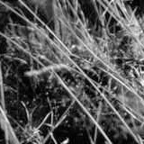
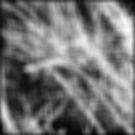
Smoothing with box filter
James Hays

Slide 20
Image filtering
Image filtering:
  Compute function of local neighborhood at each position
Really important!
  Enhance images
    Denoise, resize, increase contrast, etc.
  Extract information from images
    Texture, edges, distinctive points, etc.
  Detect patterns
    Template matching
James Hays

Slide 21




Linear filter
Additive?
Homogeneous?
Stable?
Invertible?

Slide 22
Properties of systems
Amplitude properties:
  Additivity
  Homogeneity
  Linearity
  (Linearity => additivity)
  Stability
  Invertibility

Slide 23
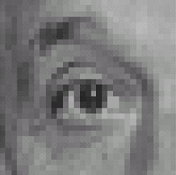

Think-Pair-Share time
0
0
0
1.
0
1
0
0
0
0
0
0
0
2.
0
0
1
0
0
0
1
0
-1
3.
2
0
-2
1
0
-1
0
0
0
-
1
1
1
4.
0
2
0
1
1
1
0
0
0
1
1
1

Slide 24
1. Practice with linear filters
0
0
0
?
0
1
0
0
0
0
Original
Source: D. Lowe

Slide 25
1. Practice with linear filters
0
0
0
0
1
0
0
0
0
Original
Filtered
(no change)
Source: D. Lowe

Slide 26
2. Practice with linear filters
0
0
0
?
0
0
1
0
0
0
Original
Source: D. Lowe

Slide 27
2. Practice with linear filters
0
0
0
0
0
1
0
0
0
Original
Shifted left
By 1 pixel
Source: D. Lowe

Slide 28
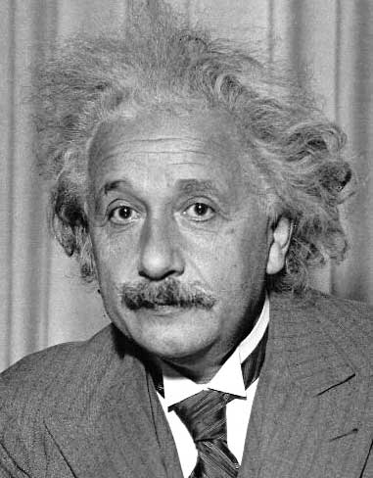
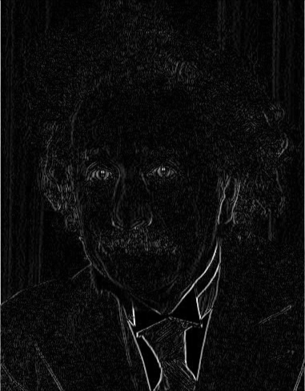
3. Practice with linear filters
1
0
-1
2
0
-2
1
0
-1
Sobel
Vertical Edge
(absolute value)
David Lowe

Slide 29
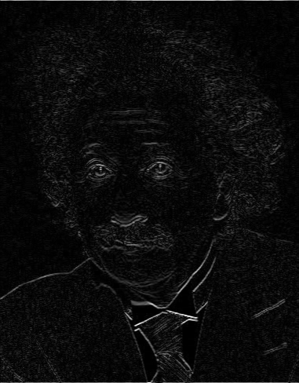
3. Practice with linear filters
1
2
1
0
0
0
-1
-2
-1
Sobel
Horizontal Edge
(absolute value)
David Lowe
Notes:
Questions at this point?

Slide 30
4. Practice with linear filters
0
0
0
-
1
1
1
?
0
2
0
1
1
1
0
0
0
1
1
1
(Note that filter sums to 1)
Original
Source: D. Lowe

Slide 31
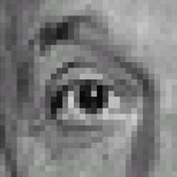
4. Practice with linear filters
0
0
0
-
1
1
1
0
2
0
1
1
1
0
0
0
1
1
1
Original
Sharpening filter
  Accentuates differences with local average
Aka unsharp masking
Source: D. Lowe

Slide 32
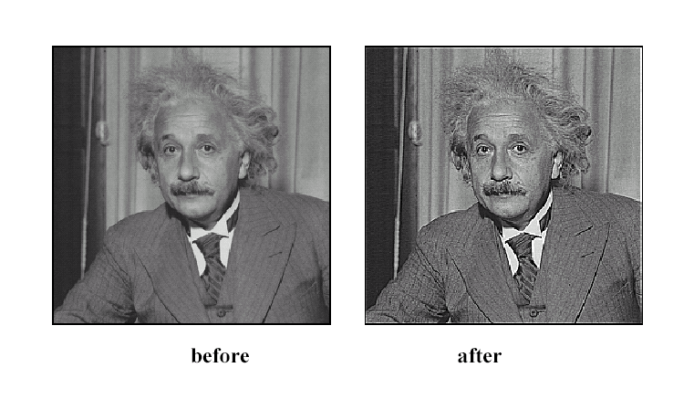
4. Practice with linear filters
Source: D. Lowe

Slide 33
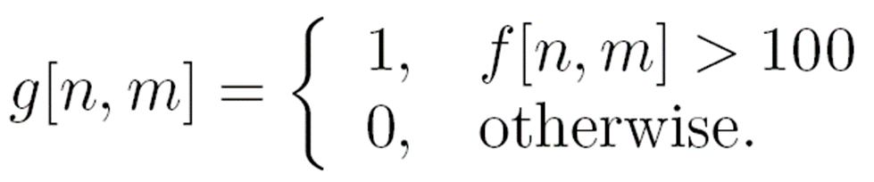

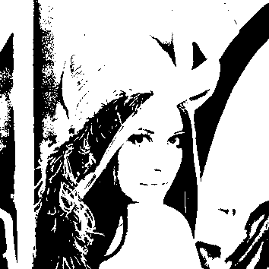
Filter example #2: Image Segmentation
Image segmentation based on a simple threshold:
255,

Slide 34

Properties of systems
Spatial properties
  Shift invariance (same behavior regardless of pixel location)
Equivalently: S(I,shift(f)) = shift(S(I,f))
Notes:
LHS: g[n-no]
RHS: S[f[n-n0]]

Slide 35
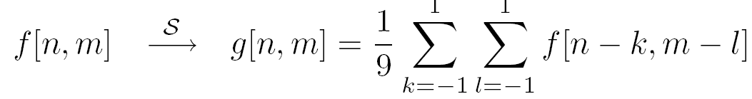
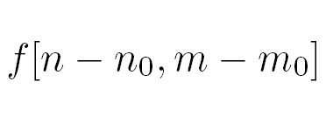
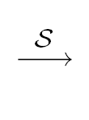
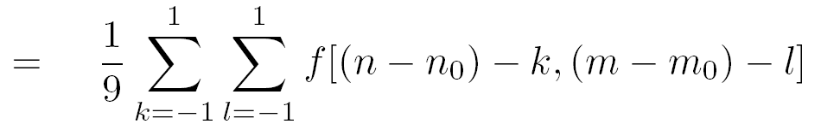

Is the moving average system is shift invariant?
Yes!

Slide 36


Linear Systems (filters)
Is the moving average a linear system?
Is thresholding a linear system?
  f1[n,m] + f2[n,m] > T
  f1[n,m] < T
  f2[n,m]<T
Yes!
$$S\left[f1\left[n,m\right]+f2\left[n,m\right]\right]=1$$
$$S\left[f1\left[n,m\right]]+S[f2\left[n,m\right]\right]=0$$
No!
Notes:
Show on the board equations for moving average.

Slide 37
What we have learned today?
Image histograms
Linear systems (filters)
Convolution and correlation
Gaussian filter
Median filter

Slide 38



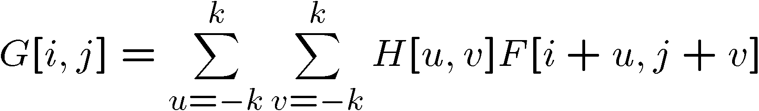

Correlation
Let be the image, be the kernel (of size 2k+1 x 2k+1), and be the output image
Can think of as a “dot product” between local neighborhood and kernel for each pixel
This is called a (cross-)correlation operation:

Slide 39
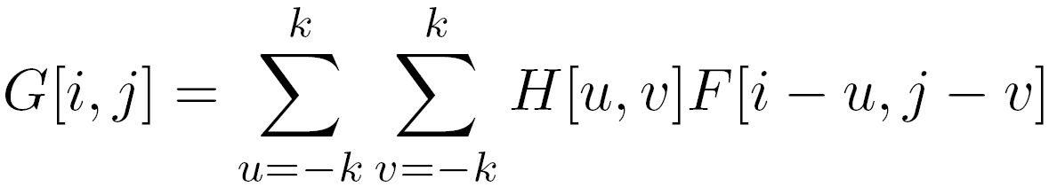
Convolution
Same as cross-correlation, except that the kernel is “flipped” (horizontally and vertically)
This is called a convolution operation:

Slide 40
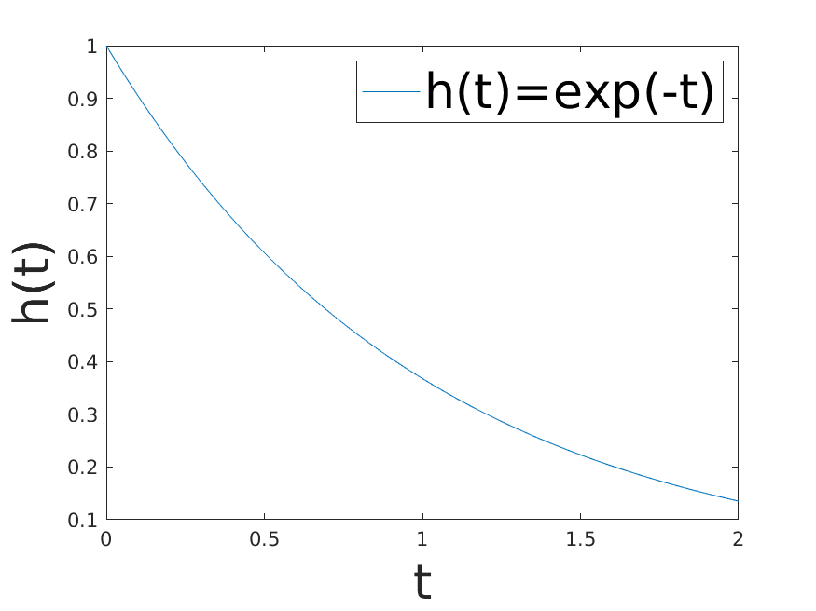
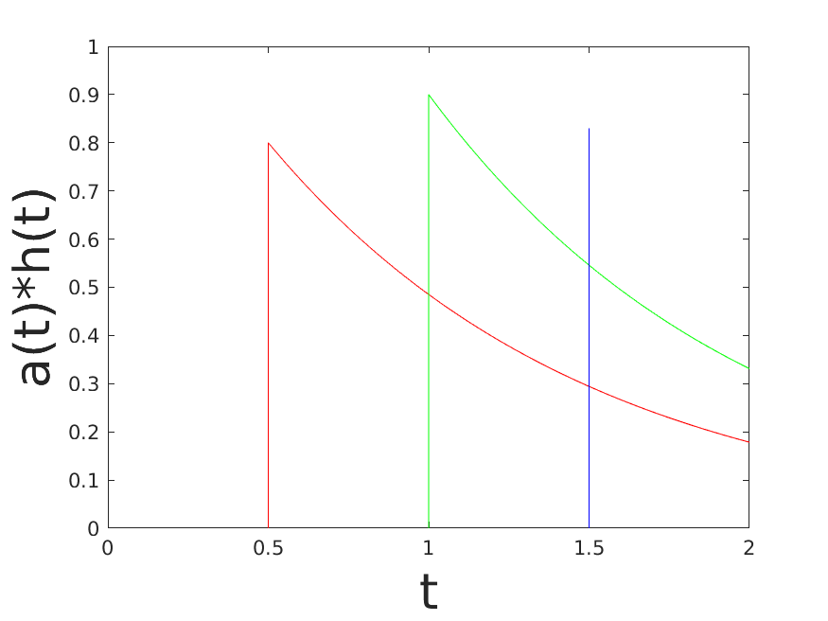
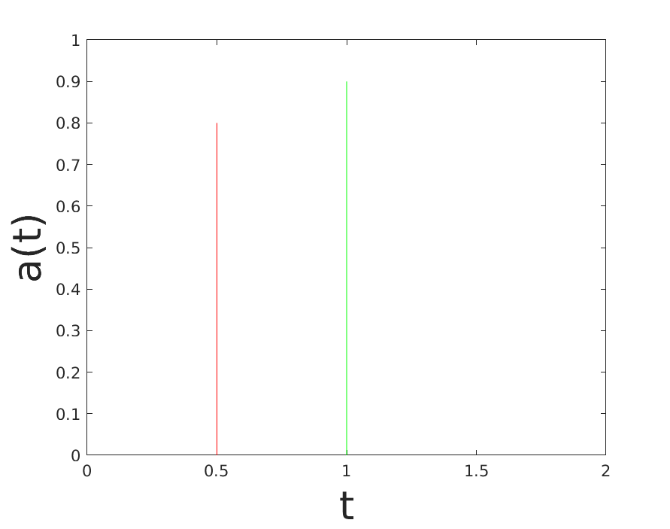
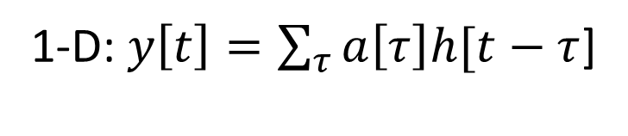
Where is convolution coming from?
1-D: $y\left[t\right]=\sum_{τ}{a\left[τ\right]h[t−τ}$]

Slide 41
Commutative property
H*F=F*H if we can ignore the boundary condition (k >> i,j)

Slide 42
Associative property

Slide 43
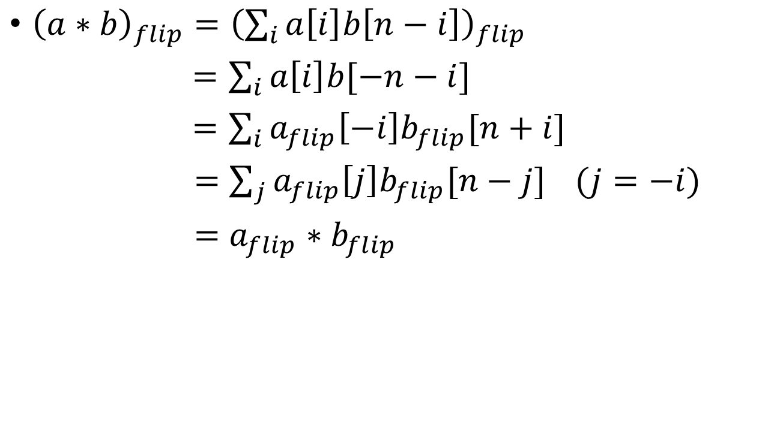

What is ${\left(a∗b\right)}_{flip}$?
${\left(a∗b\right)}_{flip}={\left(\sum_{i}{a\left[i\right]b\left[n−i\right]}\right)}_{flip}$
$=\sum_{i}{a\left[i\right]b[−n−i]}$
$=\sum_{i}{a_{flip}\left[−i\right]b_{flip}[n+i]}$
$=\sum_{j}{a_{flip}\left[j\right]b_{flip}[n−j]} (j=−i)$
$=a_{flip}∗b_{flip}$

Slide 44
Convolution properties
Commutative: a * b = b * a
  Conceptually no difference between filter and signal
Associative: a * (b * c) = (a * b) * c
  Often apply several filters one after another: (((a * b₁) * b₂) * b₃)
  This is equivalent to applying one filter: a * (b₁ * b₂ * b₃)
  Correlation is _not_ associative
Distributes over addition: a * (b + c) = (a * b) + (a * c)
Scalars factor out: ka * b = a * kb = k (a * b)
Identity: unit impulse e = [0, 0, 1, 0, 0], a * e = a
Source: S. Lazebnik
Notes:
David Jacobs @ UMD http://www.cs.umd.edu/~djacobs/CMSC426/Convolution.pdf
The key difference between the two is that convolution is associative. That is, if F and G are filters, then F*(G*I) = (F*G)*I. If you don’t believe this, try a simple example, using F=G=(-1 0 1), for example. It is very convenient to have convolution be associative. Suppose, for example, we want to smooth an image and then take its derivative. We could do this by convolving the image with a Gaussian filter, and then convolving it with a derivative filter. But we could alternatively convolve the derivative filter with the Gaussian to produce a filter called a Difference of Gaussian (DOG), and then convolve this with our image. The nice thing about this is that the DOG filter can be precomputed, and we only have to convolve one filter with our image.
In general, people use convolution for image processing operations such as smoothing, and they use correlation to match a template to an image. Then, we don’t mind that correlation isn’t associative, because it doesn’t really make sense to combine two templates into one with correlation, whereas we might often want to combine two filter together for convolution. When discussing the Fourier series as a way of understanding filtering, we will use convolution, so that we can introduce the famous convolution theorem.

Slide 45
Correlation and Convolution
2d correlation
2d convolution
  Imfilter(Imfilter(I,f),g)!= imfilter(I,imfilter(f,g))
  h=filter2(f,I); or h=imfilter(I,f);
  h=conv2(f,I); or h=imfilter(I,f,’conv’);
conv2(I,f)is the same as filter2(rot90(f,2),I)
≡ filter2(fliplr(flipud((f,2)),I)
Correlation and convolution are identical when the filter is symmetric.
James Hays

Slide 46
Key properties of Shift-invariance linear filters
Linearity:
imfilter(I, f₁ + f₂) =
imfilter(I,f₁) + imfilter(I,f₂)
Shift invariance:
Same behavior regardless of pixel location
imfilter(I,shift(f)) = shift(imfilter(I,f))
Any linear, shift-invariant operator can be represented as a convolution (and specified by its impulse response)
Source: S. Lazebnik
Notes:
f is image

Slide 47
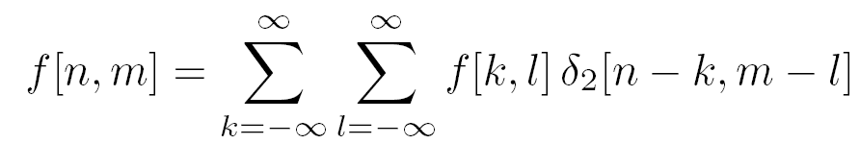
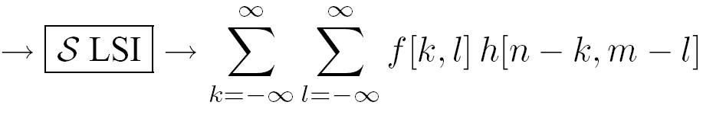
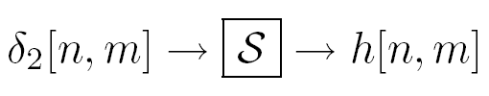
LSI (linear shift invariant) systems
An LSI system is completely specified by its impulse response.
Discrete convolution
Notes:
We can write any function as a sum of impulses…
Let’s pass this function over our system..
Using superposition, we get a sum over the impulse responses…
Final equation: we call this a convolution. Applying the impulse response h to f at all locations.

Slide 48
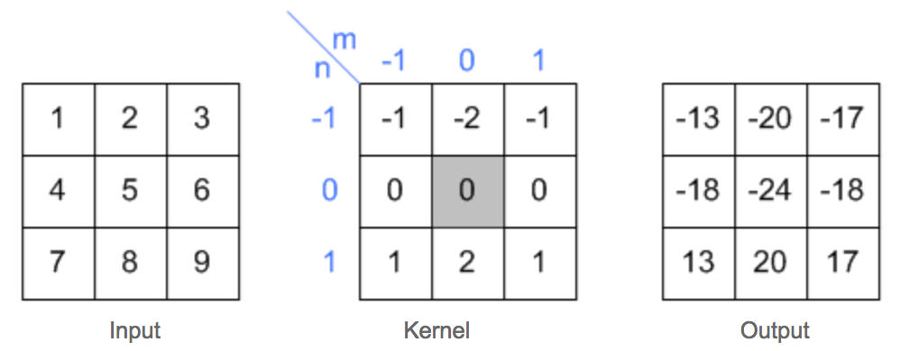
2D convolution example
Slide credit: Song Ho Ahn

Slide 49
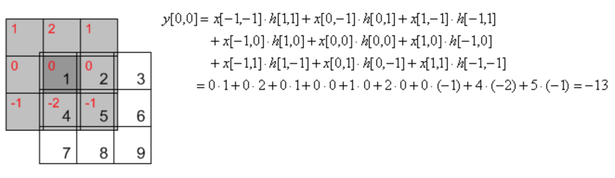
2D convolution example
Slide credit: Song Ho Ahn

Slide 50
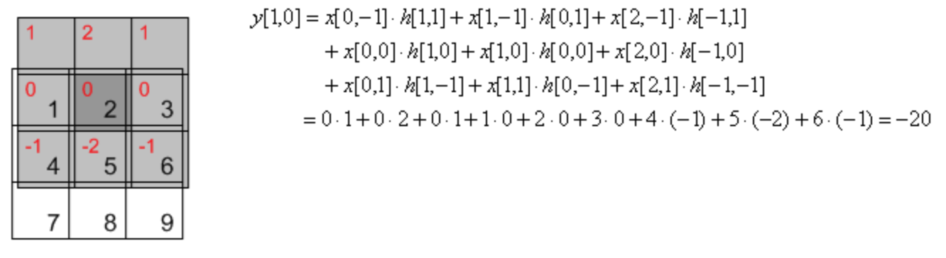
2D convolution example
Slide credit: Song Ho Ahn

Slide 51
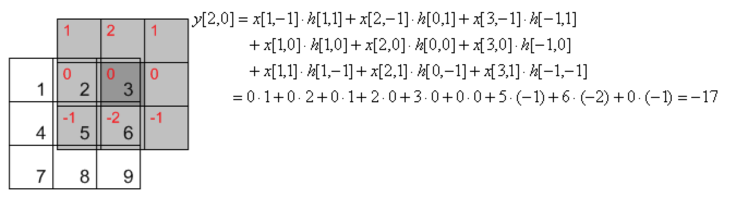
2D convolution example
Slide credit: Song Ho Ahn

Slide 52
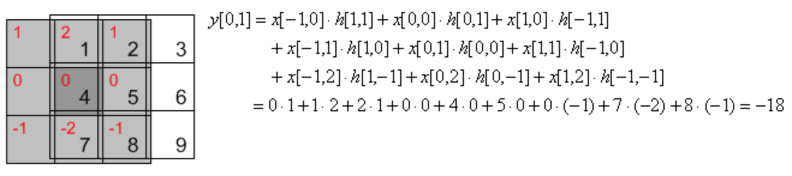
2D convolution example
Slide credit: Song Ho Ahn

Slide 53
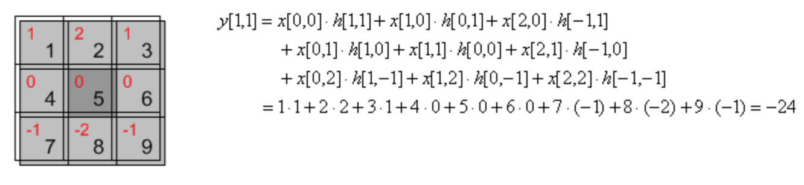
2D convolution example
Slide credit: Song Ho Ahn

Slide 54
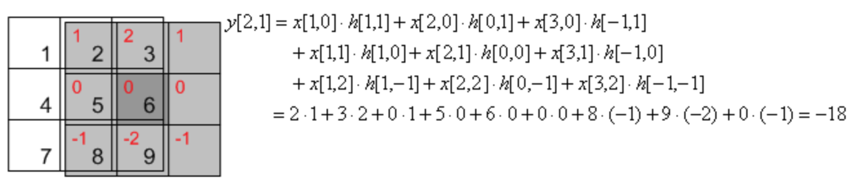
2D convolution example
Slide credit: Song Ho Ahn

Slide 55
Image support and edge effect
A computer will only convolve finite support signals.
  That is: images that are zero for n,m outside some rectangular region
numpy’s convolution performs 2D convolution of finite-support signals.
=
*
(N1 + N2 − 1) × (M1 +M2 − 1)
N2 ×M2
N1 ×M1

Slide 56
Image support and edge effect
A computer will only convolve finite support signals.
What happens at the edge?
f
• zero “padding”
• edge value replication
• mirror extension
• more (beyond the scope of this class)
-> Matlab conv2 uses zero-padding
h

Slide 57
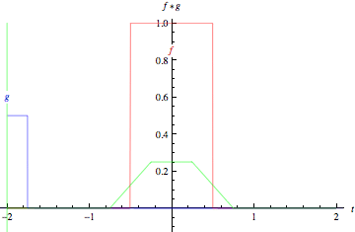
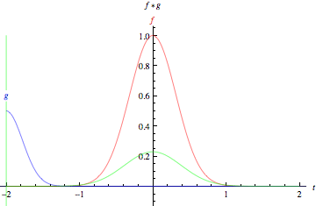
Slide credit: Wolfram Alpha

Slide 58


properties
• Associative property:
• Distributive property:
The order doesn’t matter!

Slide 59
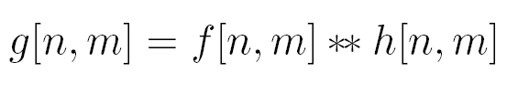


properties
• Shift property:
• Shift-invariance:

Slide 60
Convolution vs. (Cross) Correlation
A convolution is an integral that expresses the amount of overlap of one function as it is shifted over another function.
  convolution is a filtering operation
Correlation compares the similarity of two sets of data. Correlation computes a measure of similarity of two input signals as they are shifted by one another. The correlation result reaches a maximum at the time when the two signals match best .
  correlation is a measure of relatedness of two signals

Slide 61
Convolution vs. (Cross) Correlation
 | Convolution | Correlation
Associative: (ab)c=a(bc) | Yes | No
Commutative: ab=ba | Yes | No
Distributive: a(b+c)=ab+ac | Yes | Yes
Linear | Yes | Yes
Application | Filtering | Matching
They are equivalent when the filter “kernel” is symmetric
In CV, most filters (not all) we considered are symmetric. So they are the same.
N.B. cv2.filter2D implements correlation rather than conv

Slide 62
What we have learned today?
Image histograms
Linear systems (filters)
Convolution and correlation
Gaussian filter
Median filter

Slide 63
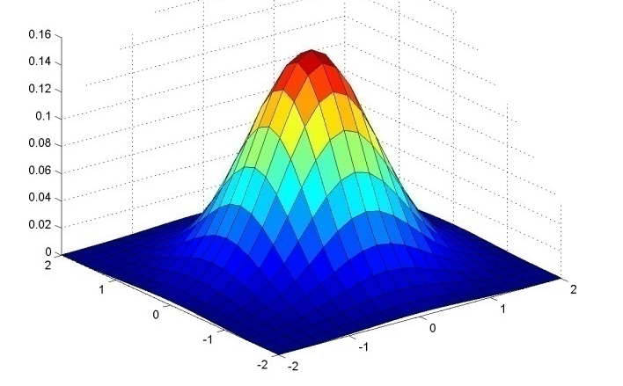
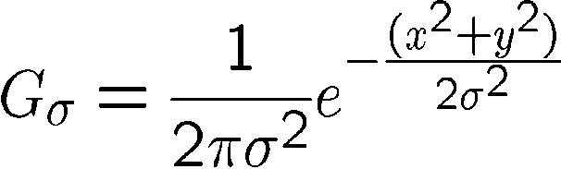
Important filter: Gaussian
Weight contributions of neighboring pixels by nearness
x
0.003 0.013 0.022 0.013 0.003
0.013 0.059 0.097 0.059 0.013
0.022 0.097 0.159 0.097 0.022
0.013 0.059 0.097 0.059 0.013
0.003 0.013 0.022 0.013 0.003
y
x
5 x 5, σ = 1
y
Slide credit: Christopher Rasmussen
Notes:
e^0 = 1, e^-1 = .37, e^-2 = .14, etc.

Slide 64

Smoothing with Gaussian filter
James Hays

Slide 65
Smoothing with box filter
James Hays

Slide 66
Gaussian filters
Remove “high-frequency” components from the image (low-pass filter)
  Images become more smooth
Gaussian convolved with Gaussian…
…is another Gaussian
  So can smooth with small-width kernel, repeat, and get same result as larger-width kernel would have
  Convolving two times with Gaussian kernel of width σ is same as convolving once with kernel of width σ√2
Separable kernel
  Factors into product of two 1D Gaussians
Source: K. Grauman
Notes:
Linear vs. quadratic in mask size

Slide 67
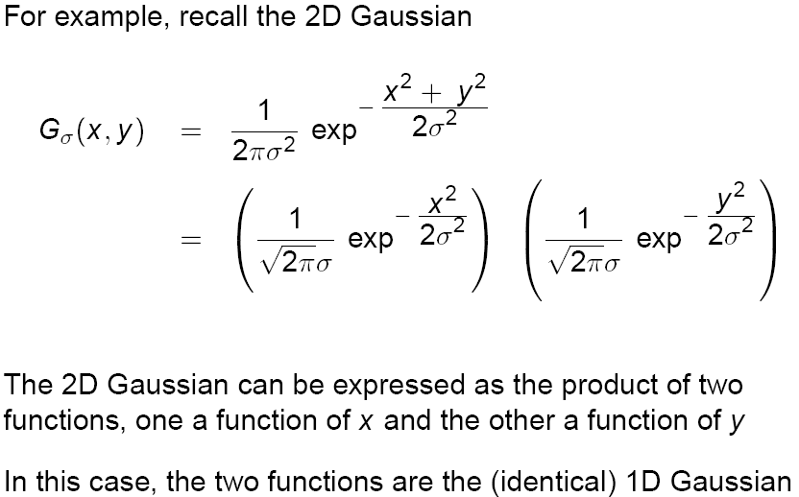
Separability of the Gaussian filter
Source: D. Lowe

Slide 68
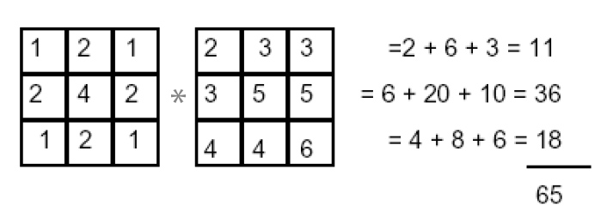
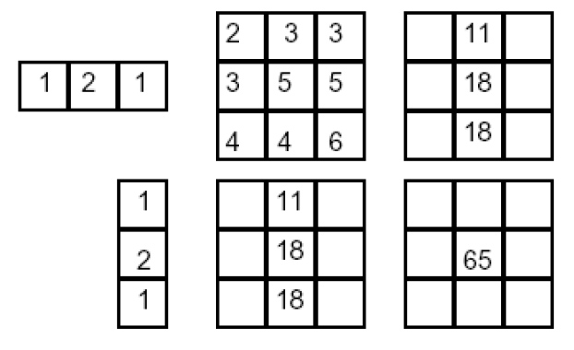
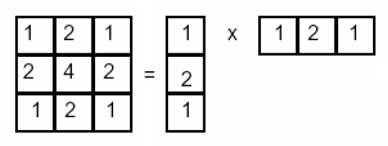
Separability example
2D convolution
(center location only)
=
The filter factors
into a product of 1D
filters:
Perform convolution
along rows:
*
=
Followed by convolution
along the remaining column:
*
=
Source: K. Grauman
Notes:
Convolution vs filtering doesn’t matter here because the filter is symmetric
9 multiply-add operations at the top for 2D convolution
~11 multiply-add operations at the bottom for the separable 2D convolution

Slide 69
Separability
Why is separability useful in practice?

Slide 70
Separability
Why is separability useful in practice?
MxN image, PxQ filter
2D convolution: ~MNPQ multiply-adds
Separable 2D: ~MN(P+Q) multiply-adds
Speed up = PQ/(P+Q)
9x9 filter = ~4.5x faster
Notes:
https://blogs.mathworks.com/steve/2006/10/04/separable-convolution/

Slide 71
Practical matters
How big should the filter be?
Values at edges should be near zero
Gaussians have infinite extent…
Rule of thumb for Gaussian: set filter half-width to about 3 σ
James Hays

Slide 72
What we have learned today?
Image histograms
Linear systems (filters)
Convolution and correlation
Gaussian filter
Median filter

Slide 73
Median filters
Operates over a window by selecting the median intensity in the window.
‘Rank’ filter as based on ordering of gray levels
  E.G., min, max, range filters
Steve Seitz, Steve Marschner
Notes:
Better at salt’n’pepper noise
Not convolution: try a region with 1’s and a 2, and then 1’s and a 3

Slide 74
Image filtering - mean
1
1
1
1
1
1
1
1
1
0 | 0 | 0 | 0 | 0 | 0 | 0 | 0 | 0 | 0
0 | 0 | 0 | 0 | 0 | 0 | 0 | 0 | 0 | 0
0 | 0 | 0 | 90 | 90 | 90 | 90 | 90 | 0 | 0
0 | 0 | 0 | 90 | 90 | 90 | 90 | 90 | 0 | 0
0 | 0 | 0 | 90 | 90 | 90 | 90 | 90 | 0 | 0
0 | 0 | 0 | 90 | 0 | 90 | 90 | 90 | 0 | 0
0 | 0 | 0 | 90 | 90 | 90 | 90 | 90 | 0 | 0
0 | 0 | 0 | 0 | 0 | 0 | 0 | 0 | 0 | 0
0 | 0 | 90 | 0 | 0 | 0 | 0 | 0 | 0 | 0
0 | 0 | 0 | 0 | 0 | 0 | 0 | 0 | 0 | 0
 | 0 | 10 | 20 | 30 | 30
?
Credit: S. Seitz
Notes:
ones, divide by 9

Slide 75
Image filtering - mean
1
1
1
1
1
1
1
1
1
0 | 0 | 0 | 0 | 0 | 0 | 0 | 0 | 0 | 0
0 | 0 | 0 | 0 | 0 | 0 | 0 | 0 | 0 | 0
0 | 0 | 0 | 90 | 90 | 90 | 90 | 90 | 0 | 0
0 | 0 | 0 | 90 | 90 | 90 | 90 | 90 | 0 | 0
0 | 0 | 0 | 90 | 90 | 90 | 90 | 90 | 0 | 0
0 | 0 | 0 | 90 | 0 | 90 | 90 | 90 | 0 | 0
0 | 0 | 0 | 90 | 90 | 90 | 90 | 90 | 0 | 0
0 | 0 | 0 | 0 | 0 | 0 | 0 | 0 | 0 | 0
0 | 0 | 90 | 0 | 0 | 0 | 0 | 0 | 0 | 0
0 | 0 | 0 | 0 | 0 | 0 | 0 | 0 | 0 | 0
 | 0 | 10 | 20 | 30 | 30
 |  |  |  | 50
Credit: S. Seitz
Notes:
ones, divide by 9

Slide 76
Median filter?
0 | 0 | 0 | 0 | 0 | 0 | 0 | 0 | 0 | 0
0 | 0 | 0 | 0 | 0 | 0 | 0 | 0 | 0 | 0
0 | 0 | 0 | 90 | 90 | 90 | 90 | 90 | 0 | 0
0 | 0 | 0 | 90 | 90 | 90 | 90 | 90 | 0 | 0
0 | 0 | 0 | 90 | 90 | 90 | 90 | 90 | 0 | 0
0 | 0 | 0 | 90 | 0 | 90 | 90 | 90 | 0 | 0
0 | 0 | 0 | 90 | 90 | 90 | 90 | 90 | 0 | 0
0 | 0 | 0 | 0 | 0 | 0 | 0 | 0 | 0 | 0
0 | 0 | 90 | 0 | 0 | 0 | 0 | 0 | 0 | 0
0 | 0 | 0 | 0 | 0 | 0 | 0 | 0 | 0 | 0
 |  |  |  | ?
Credit: S. Seitz
Notes:
Answer is 90.

Slide 77
Median filters
Operates over a window by selecting the median intensity in the window.
What advantage does a median filter have over a mean filter?
Steve Seitz, Steve Marschner
Notes:
Better at salt’n’pepper noise

Slide 78
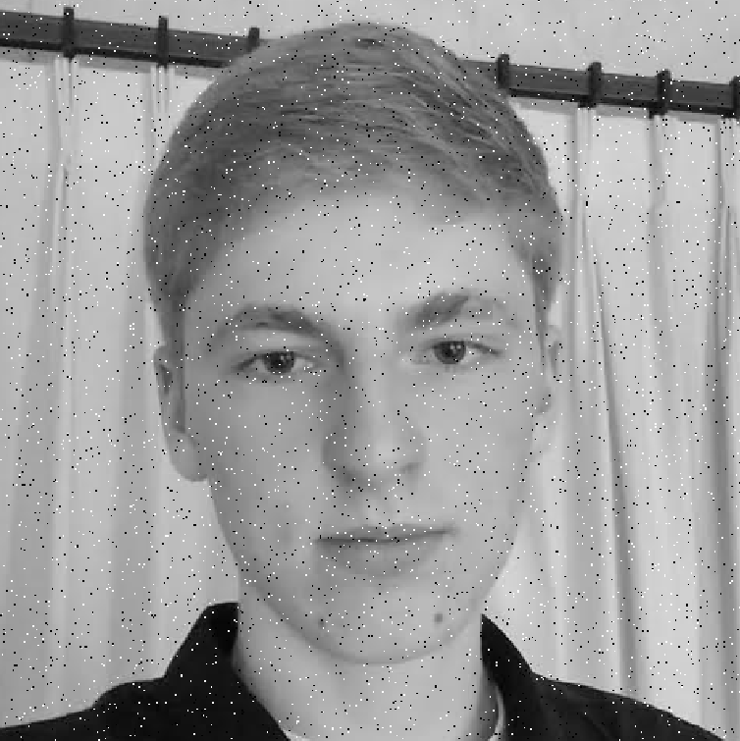
Noisy Jack – Salt and Pepper
Notes:
No, not the latest smash hit from early 90’s hip hop group

Slide 79

Mean Jack – 3 x 3 filter

Slide 80

Very Mean Jack – 11 x 11 filter

Slide 81
Noisy Jack – Salt and Pepper
Notes:
No, not the latest smash hit from early 90’s hip hop group

Slide 82

Median Jack – 3 x 3

Slide 83

Very Median Jack – 11 x 11

Slide 84
Median filters
Operates over a window by selecting the median intensity in the window.
What advantage does a median filter have over a mean filter?
Is a median filter a kind of convolution?
Secret: Median filtering is sorting.
Is median filter linear?
Steve Seitz, Steve Marschner
Notes:
Answer: Not convolution: try a region with 1’s and a 2, and then 1’s and a 3

Slide 85
What we have learned today?
Image histograms
Linear systems (filters)
Convolution and correlation
Gaussian filter
Median filter

Slide 86
Bonus materials

Slide 87
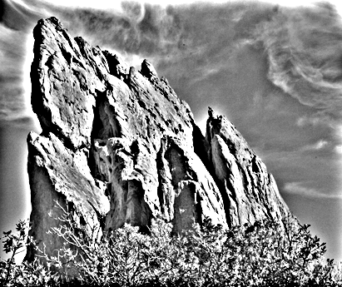


Unsharp masking
The unsharp masking (filtering) is a simple sharpening operator through subtracting an unsharp, or smoothed, version of an image from the original image
=
-

Slide 88

Bilateral filtering
vs
Bilateral filter tries to smooth image but still preserve edges

Slide 89

increasing texture
with Gaussian convolution
H A L O S

Slide 90

increasing texture
with bilateral filter
N O H A L O S

Slide 91




Definition
Gaussian blur
p
space
q
only spatial distance, intensity ignored
space
Bilateral filter
[Aurich 95, Smith 97, Tomasi 98]
p
range
space
range
q
normalization
space
spatial and range distances
weights sum to 1

Slide 92








Example on a Real Image
Kernels can have complex, spatially varying shapes
Linear? Shift-invariant?
input
output
⊗
⊗
⊗

Slide 93
Bilateral Filter is Expensive
Brute-force computation is slow
(several minutes)
  Two nested for loops:
  for each pixel, look at all pixels
  Non-linear, depends on image content
  ⇨ no FFT, no pre-computation…
Fast approximations exist
  E.g., Durand 02, Weiss 06
    Significant loss of accuracy
    No formal understanding of accuracy versus speed
  Better approximation (see this paper)

Slide 94
What we have learned today?
Image histograms
Linear systems (filters)
Convolution and correlation
Gaussian filter
Median filter

Slide 95
Histogram
Histogram of an image provides the frequency of the brightness (intensity) value in the image.
function h=histogram(im)
h=zeros(1,255);
for row=1:size(im,1)
for col=1:size(im,2)
val = im(row,col)+1;
h(val)=h(val)+1;
end
end
end
def histogram(im):
h = np.zeros(255)
for row in im.shape[0]:
for col in im.shape[1]:
val = im[row, col]
h[val] += 1

Slide 96

Histogram
Slide credit: Dr. Mubarak Shah

Slide 97



A use case: histogram equalization

