Slide 1
Resampling
Samuel Cheng
Slide credits: Noah Snavely

Slide 2
Tentative presentation schedule
Date | Location | # presentations
March 5 | Norman | 2
March 7 | Norman | 2
March 12 | Norman | 2
March 14 | Norman | 2
March 26 | Tulsa | 1
Title and abstract due: Feb 21
Speaker schedule TBD: next Tuesday

Slide 3
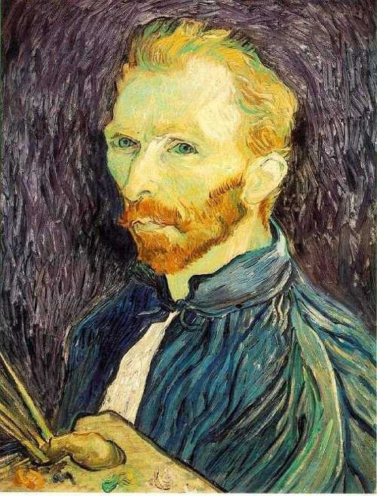
Image Scaling
This image is too big to fit on the screen. How can we generate a half-sized version?
Source: S. Seitz

Slide 4

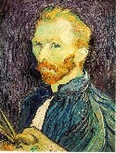

Image sub-sampling
1/8
1/4
Throw away every other row and column to create a 1/2 size image
  - called image sub-sampling
Source: S. Seitz

Slide 5
Image sub-sampling
1/2
1/4 (2x zoom)
1/8 (4x zoom)
Why does this look so crufty?
Source: S. Seitz

Slide 6
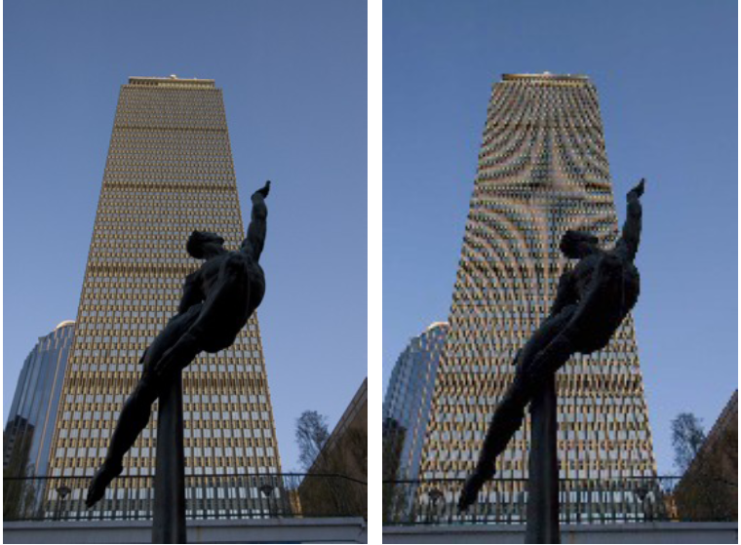
Image sub-sampling
Source: F. Durand

Slide 7
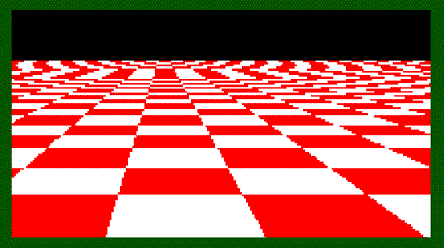
Even worse for synthetic images
Source: L. Zhang

Slide 8
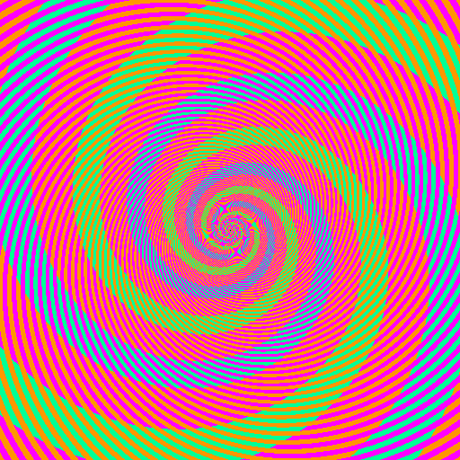

Slide 9
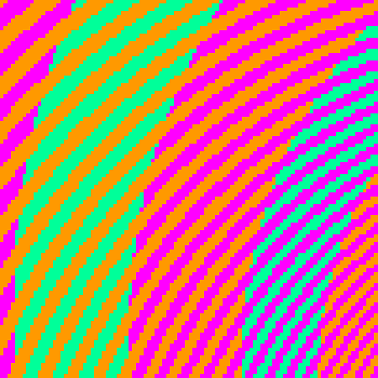
The blue and green colors are actually the same
http://blogs.discovermagazine.com/badastronomy/2009/06/24/the-blue-and-the-green/

Slide 10
Sampling and aliasing

Slide 11
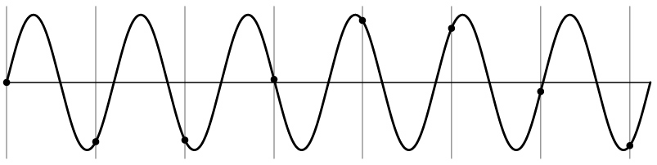
Aliasing problem
1D example (sinewave):
Source: S. Marschner

Slide 12
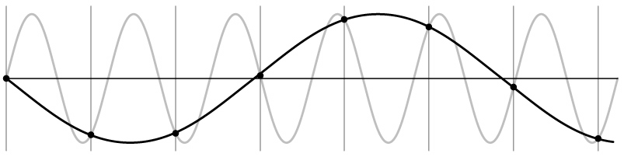
Aliasing problem
1D example (sinewave):
Source: S. Marschner

Slide 13
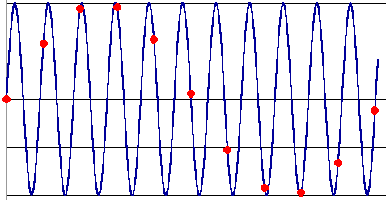
Aliasing
Occurs when your sampling rate is not high enough to capture the amount of detail in your image
Can give you the wrong signal/image—an alias
To avoid aliasing:
  sampling rate ≥ 2 * max frequency in the image
    said another way: ≥ two samples per cycle
  This minimum sampling rate is called the Nyquist rate
Source: L. Zhang

Slide 14
Nyquist-Shannon Sampling Theorem
When sampling a signal at discrete intervals, the sampling frequency must be ≥ 2 × f_{max}
f_{max} = max frequency of the input signal
This will allows to reconstruct the original perfectly from the sampled version
v
v
v
good
bad

Slide 15
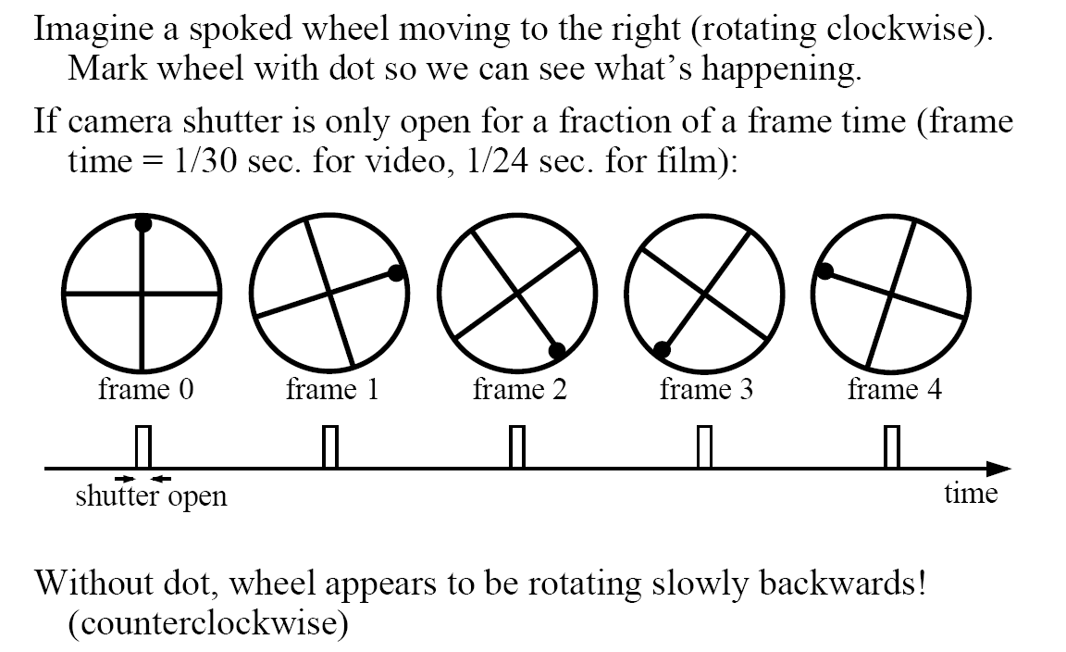
Wagon-wheel effect
(See http://www.michaelbach.de/ot/mot_wagonWheel/index.html)
Source: L. Zhang

Slide 16
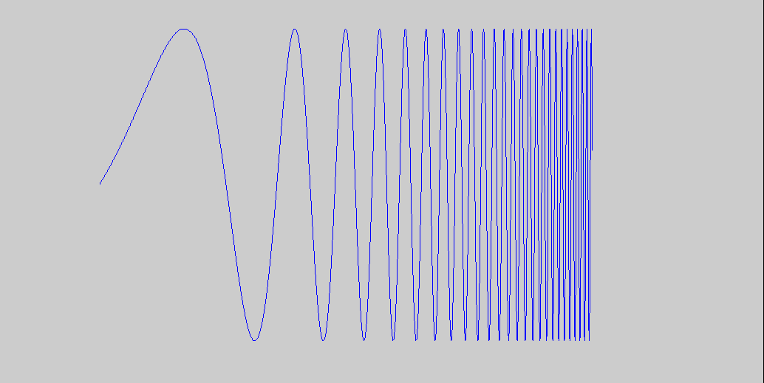
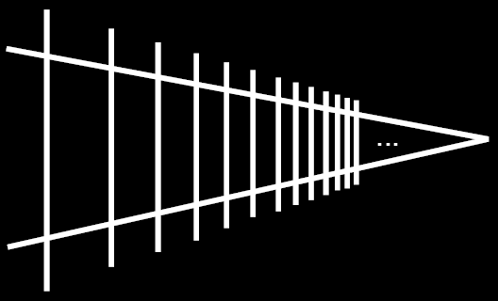
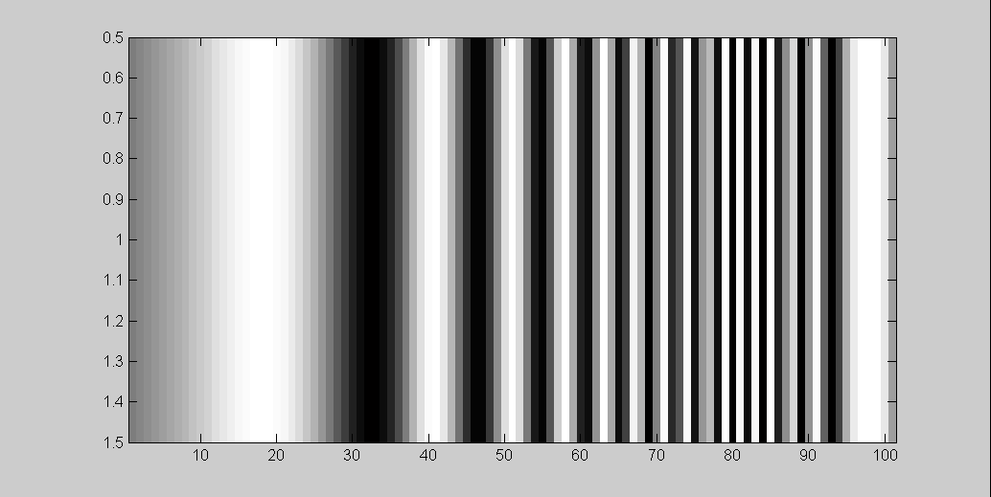
Alias: n., an assumed name
Input signal:
Matlab output:
Picket fence receding
Into the distance will
produce aliasing…
WHY?
x = 0:.05:5; imagesc(sin((2.^x).*x))
Aj-aj-aj:
Alias!
Not enough samples

Slide 17
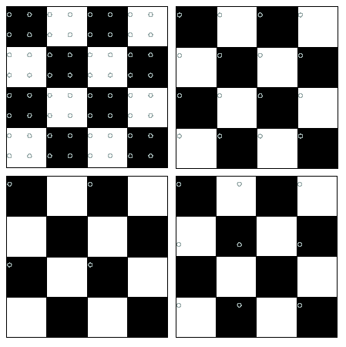
Nyquist limit – 2D example
Good sampling
Bad sampling

Slide 18
Aliasing
When downsampling by a factor of two
  Original image has frequencies that are too high
How can we fix this?

Slide 19
How to fix aliasing?
Solutions?

Slide 20
Better sensors
Solutions:
Sample more often

Slide 21
Anti-aliasing
Solutions:
Sample more often
Get rid of all frequencies that are greater than half the new sampling frequency
  Will lose information
  But it’s better than aliasing
  Apply a smoothing (low pass) filter
Hays

Slide 22
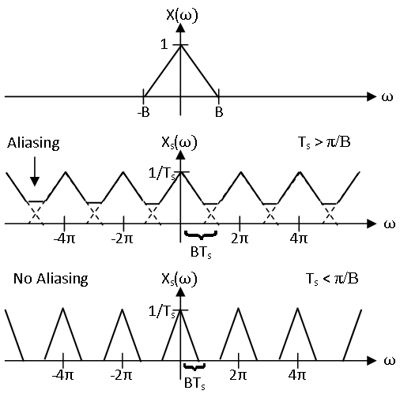
FT under different sampling rates

Slide 23
How about down sampling?
How does the frequency representation changes after downsampling?

Slide 24
Anti-aliasing
Forsyth and Ponce 2002

Slide 25



Gaussian pre-filtering
G 1/8
G 1/4
Gaussian 1/2
Solution: filter the image, then subsample
Source: S. Seitz

Slide 26
Subsampling with Gaussian pre-filtering
Gaussian 1/2
G 1/4
G 1/8
Solution: filter the image, then subsample
Source: S. Seitz

Slide 27
Compare with...
1/2
1/4 (2x zoom)
1/8 (4x zoom)
Source: S. Seitz

Slide 28
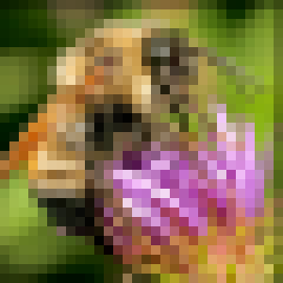
Upsampling
This image is too small for this screen:
How can we make it 10 times as big?
Simplest approach:
repeat each row
and column 10 times
(“Nearest neighbor
interpolation”)

Slide 29


Image interpolation
d = 1 in this
example
1
2
3
4
5
Recall how a digital image is formed
  It is a discrete point-sampling of a continuous function
  If we could somehow reconstruct the original function, any new image could be generated, at any resolution and scale
Adapted from: S. Seitz

Slide 30
Image interpolation
d = 1 in this
example
1
2
3
4
5
Recall how a digital image is formed
  It is a discrete point-sampling of a continuous function
  If we could somehow reconstruct the original function, any new image could be generated, at any resolution and scale
Adapted from: S. Seitz

Slide 31




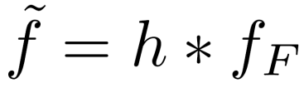
Image interpolation
1
d = 1 in this
example
1
2
2.5
3
4
5
What if we don’t know ?
  Guess an approximation:
  Can be done in a principled way: filtering
  Convert to a continuous function:
  Reconstruct by convolution with a reconstruction filter, h
Adapted from: S. Seitz

Slide 32
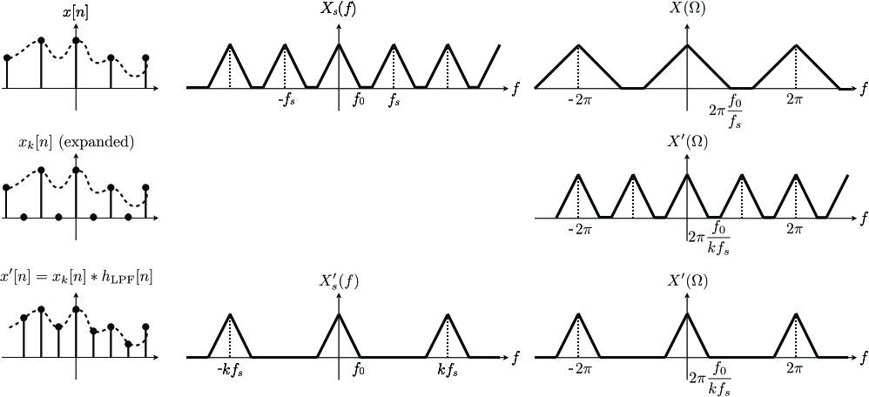
DSP perspective

Slide 33
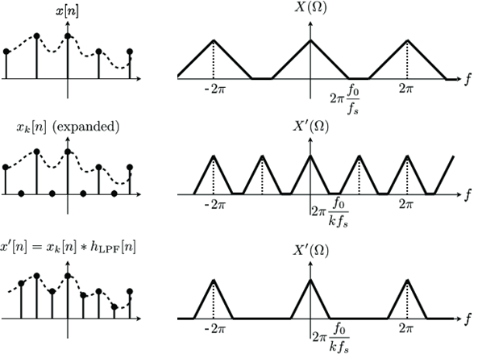
Frequency representation

Slide 34
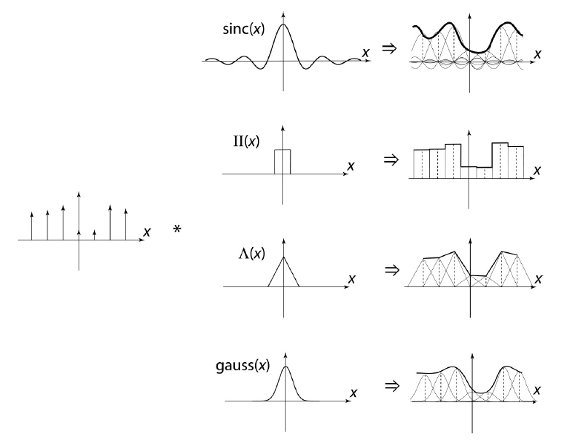
Image interpolation
“Ideal” reconstruction
Nearest-neighbor interpolation
Linear interpolation
Gaussian reconstruction
Source: B. Curless

Slide 35
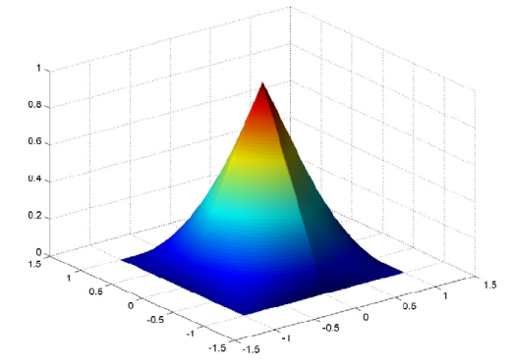



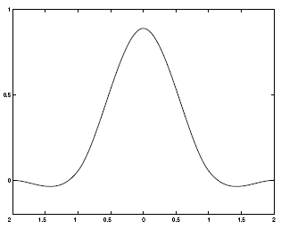
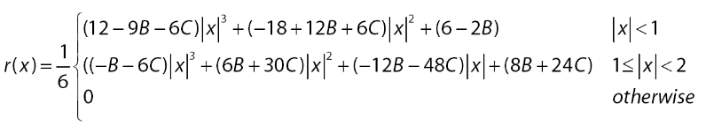
Reconstruction filters
What does the 2D version of this hat function look like?
performs
linear interpolation
(tent function) performs
bilinear interpolation
Often implemented without cross-correlation
  E.g., http://en.wikipedia.org/wiki/Bilinear_interpolation
Better filters give better resampled images
  Bicubic is common choice
Cubic reconstruction filter

Slide 36


Image interpolation
Original image: x 10
Nearest-neighbor interpolation
Bilinear interpolation
Bicubic interpolation

Slide 37
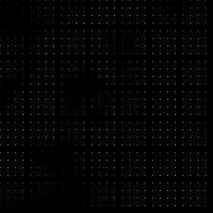
DSP Interpretation
↑

Slide 38
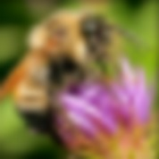
Image resampling
↑
↓
Upsampling
downsampling

Slide 39
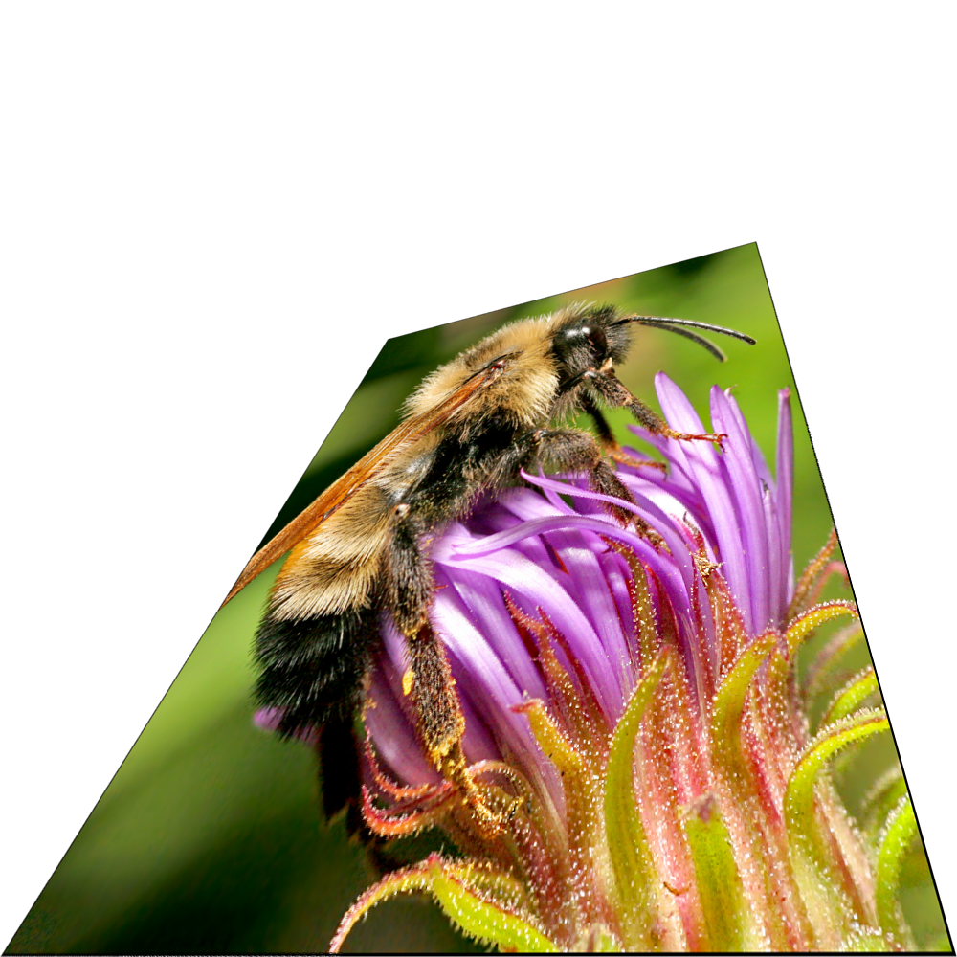
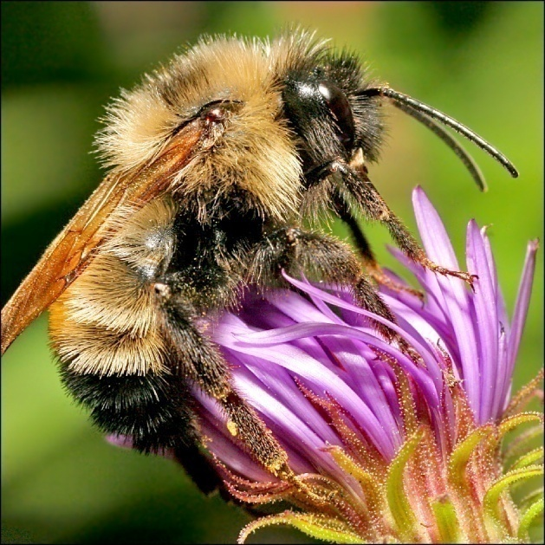
Image interpolation
Also used for resampling

Slide 40
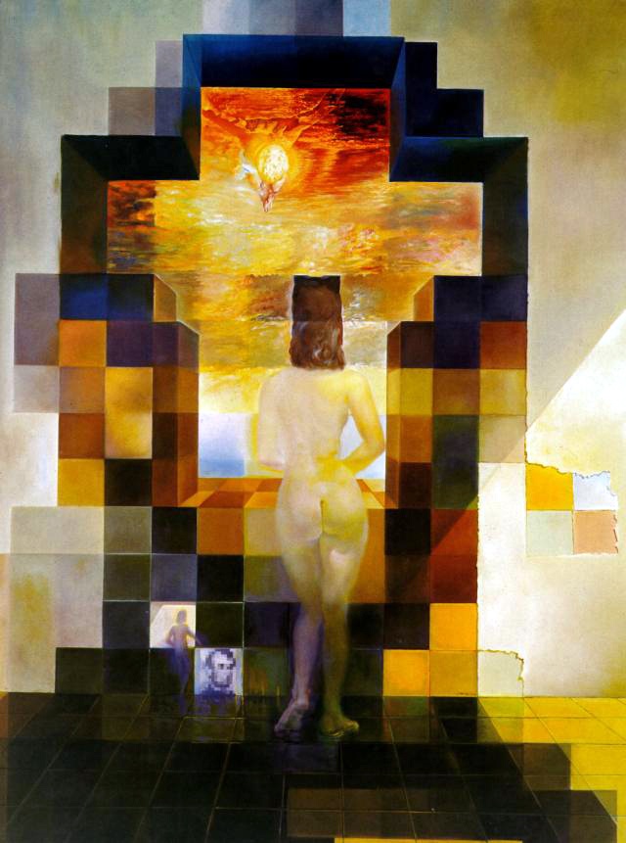
Hybrid Image
Salvador Dali, 1976

Slide 41
Another example
Who is (s)he?

Slide 42
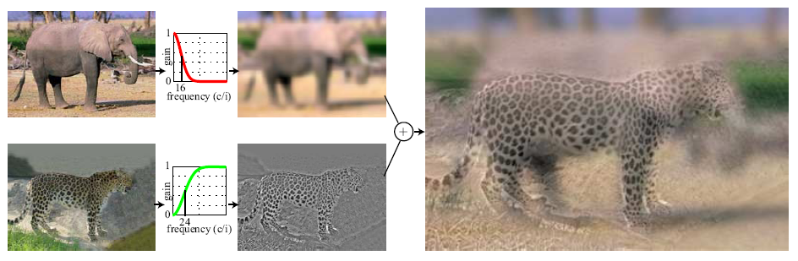
Hybrid Images
Hays
A. Oliva, A. Torralba, P.G. Schyns,
“Hybrid Images,” SIGGRAPH 2006

Slide 43
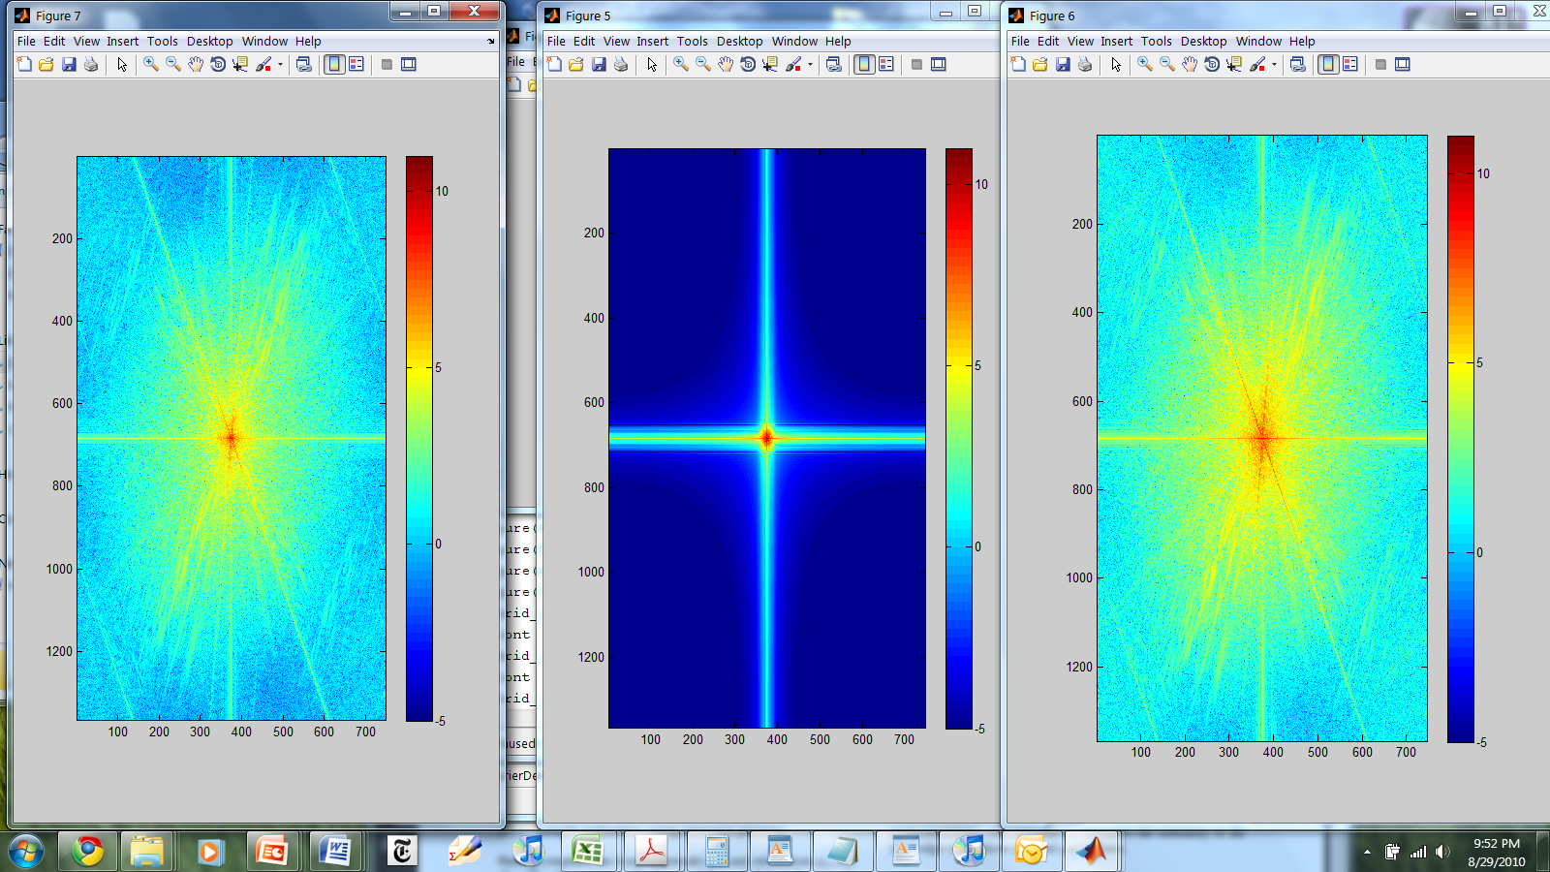
Hybrid Image in FFT
Hybrid Image
Low-passed Image
High-passed Image

Slide 44
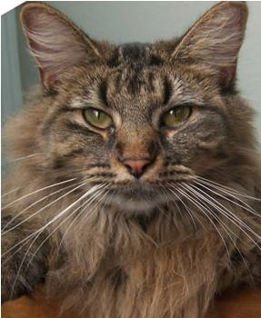
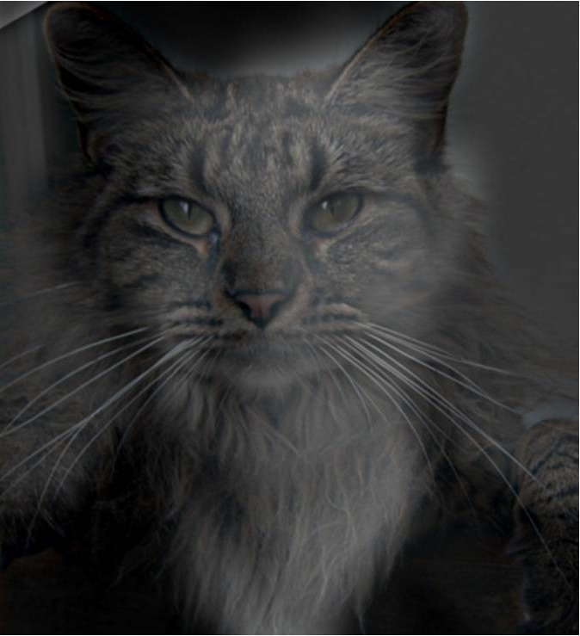
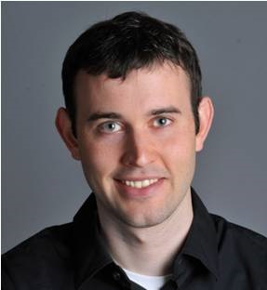
Why do we get different, distance-dependent interpretations of hybrid images?
?
Hays

Slide 45
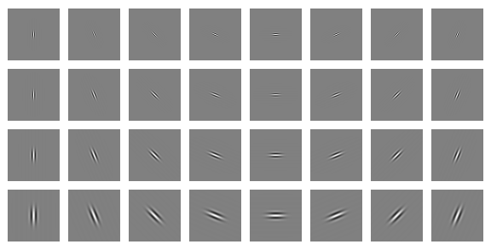
Clues from Human Perception
Early processing in humans filters for orientations and scales of frequency.
Early Visual Processing: Multi-scale edge and blob filters

Slide 46
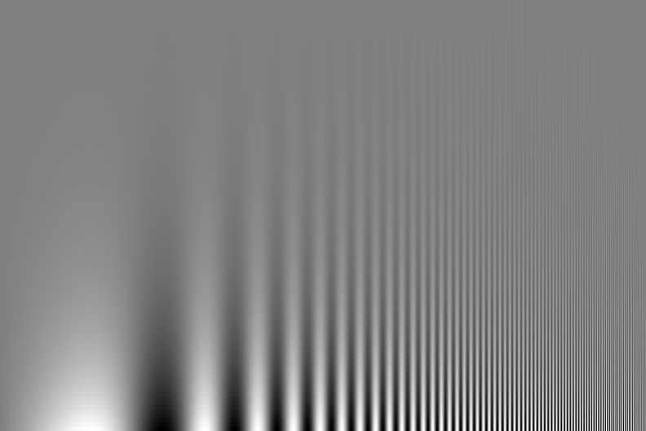
Campbell-Robson contrast sensitivity curve
Perceptual cues in the mid-high frequencies dominate perception.
Contrast decrease (log)
Frequency increase (log)
Notes:
Ask students to look at the image and think about where the line of constant response is -

Slide 47
Questions?

Slide 48
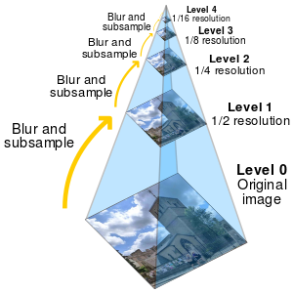
Image Pyramids
Project 1 function:
vis_hybrid_image.m
Wikipedia – Image Pyramids

Slide 49
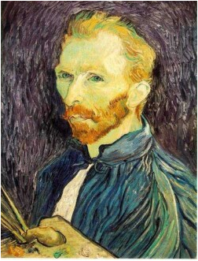







Gaussian pyramid
F₀
F₁
F₂
…
blur
subsample
blur
subsample
F₀ H
F₁ H
*
*

Slide 50
{
Gaussian pyramid
F₀
F₁
F₂
…
blur
subsample
blur
subsample
F₀ H
F₁ H
*
*

Slide 51
{
Gaussian pyramid
F₀
F₁
F₂
…
blur
subsample
blur
subsample
F₀ H
F₁ H
*
*

Slide 52
The Gaussian Pyramid
Low resolution
blur
sub-sample
blur
sub-sample
sub-sample
blur
sub-sample
blur
High resolution

Slide 53
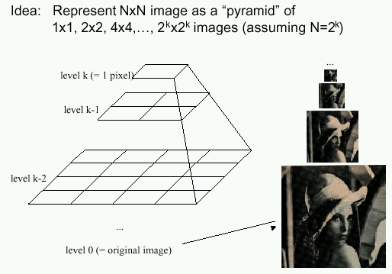
Gaussian pyramids
[Burt and Adelson, 1983]
In computer graphics, a mip map [Williams, 1983]
A precursor to wavelet transform
Gaussian Pyramids have all sorts of applications in computer vision
Source: S. Seitz

Slide 54
Gaussian pyramids
[Burt and Adelson, 1983]
How much space does a Gaussian pyramid take compared to the original image?
Source: S. Seitz

Slide 55
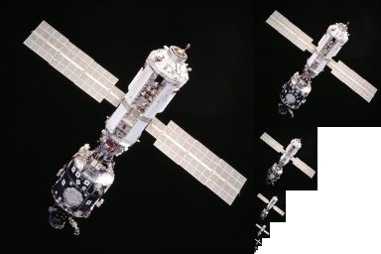
Gaussian Pyramid

Slide 56
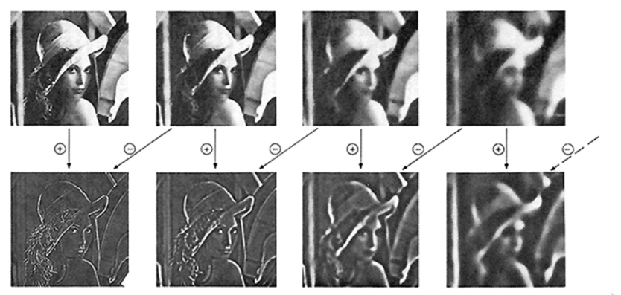
Laplace Pyramid
Derive from Gaussian pyramid
  G1=pydn(G0); G2=pydn(G1), …
  One level of laplace pyramid is difference between approximated and original Gaussian pyramid levels
  L0=G0-pyup(G1); L1 = G1-pyup(G2)

Slide 57
Compression example
Encoding
Compute Gaussian pyramid
  G0, G1, G2
Compute Laplacian pyramid
  L0=G0-pyup(G1)
  L1=G1-pyup(G2)
  L2=G2
Quantize and code Laplacian pyramid
Decoding
Decode Laplacian pyramid L0,L1,L2
Recover Gaussian pyramid
  G2=L2
  G1=L1+pyup(G2)
  G0=L0+pyup(G1)
Output G0

Slide 58

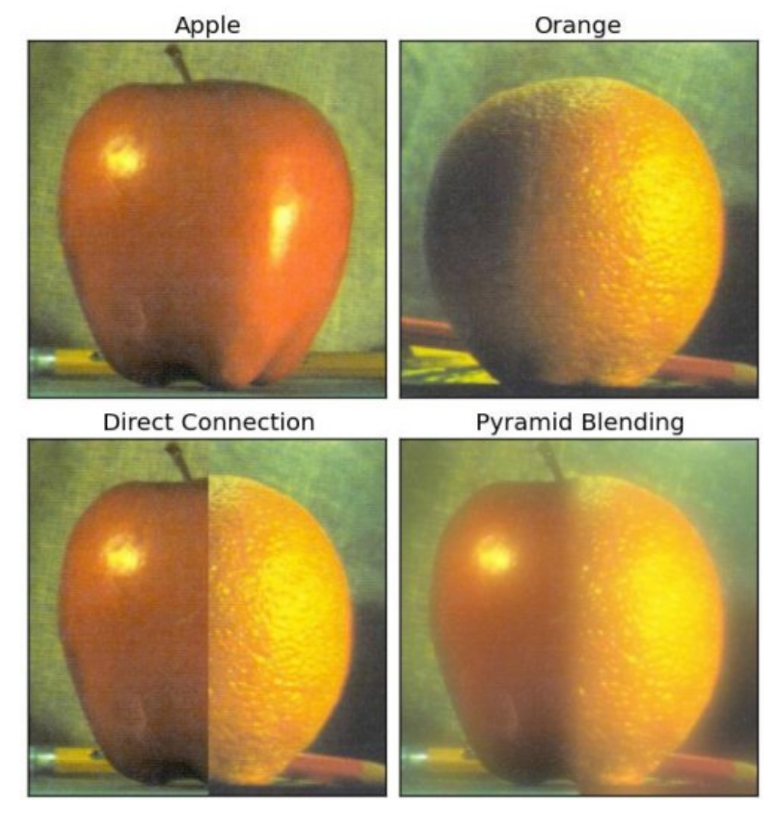
Image composting
Generate L-pyramid of orange
Generate L-pyramid of apple
Combine two pyramids
  For all levels, one half from one pyramid, the other half from another
Reconstruct image from combine pyramid

