Slide 1
Tracking
Samuel Cheng
Slide credit: Juan Carlos Niebles and Ranjay Krishna

Slide 2
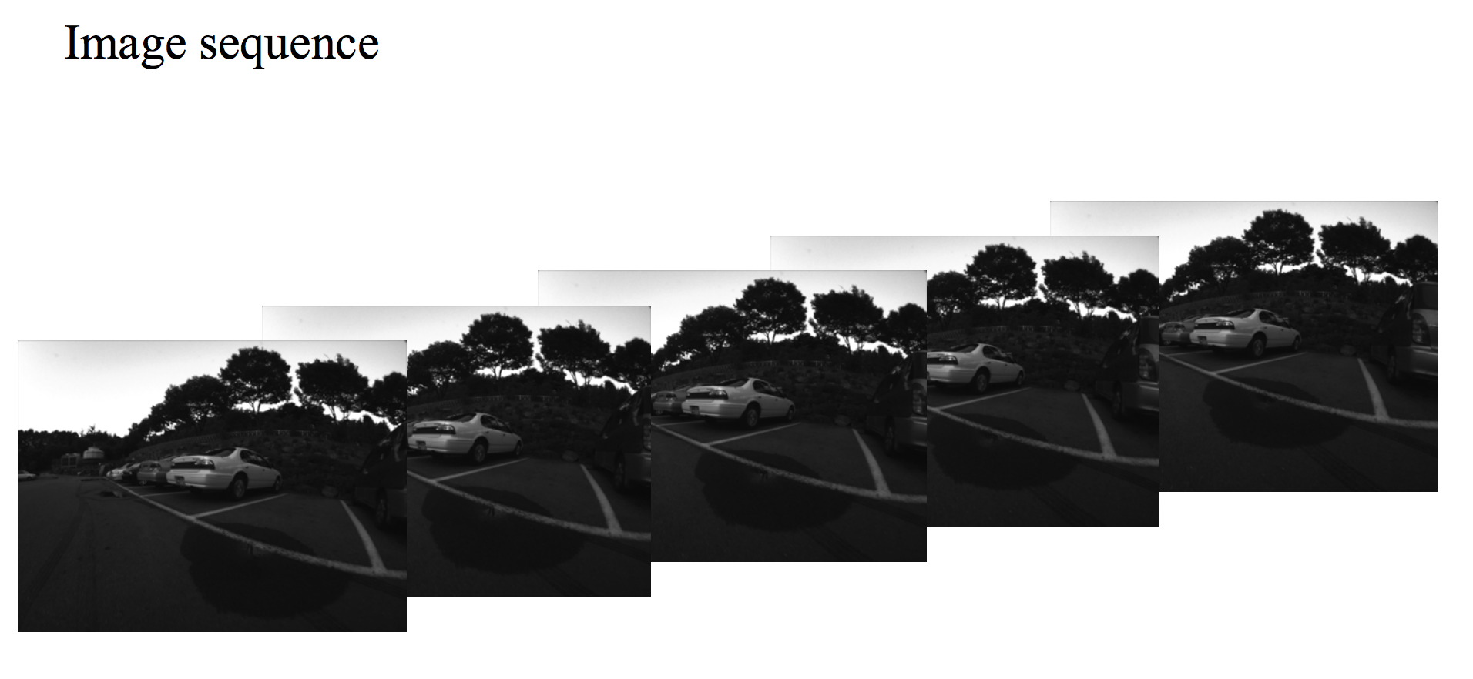
Problem statement
Slide credit: Yonsei Univ.

Slide 3
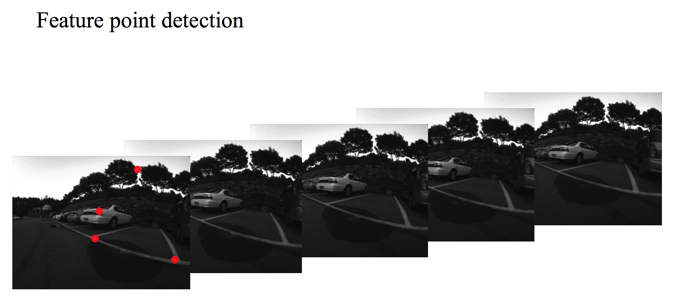
Problem statement
Slide credit: Yonsei Univ.

Slide 4
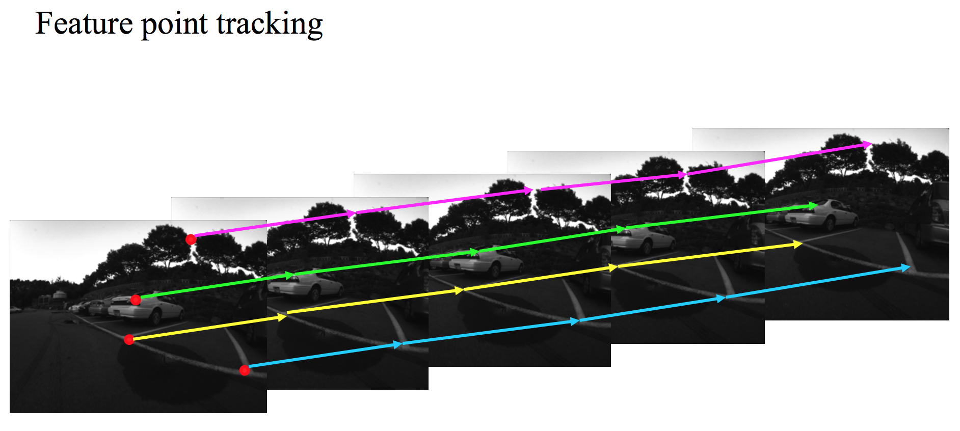
Problem statement
Slide credit: Yonsei Univ.

Slide 5
Why track, why not just detect?
Tracking is theoretically faster than detection
Tracking can help when detection fails
Tracking preserves identity

Slide 6
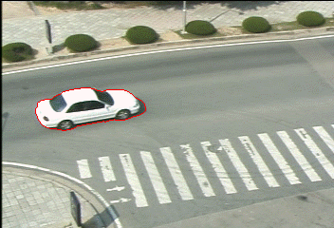
Single object tracking

Slide 7
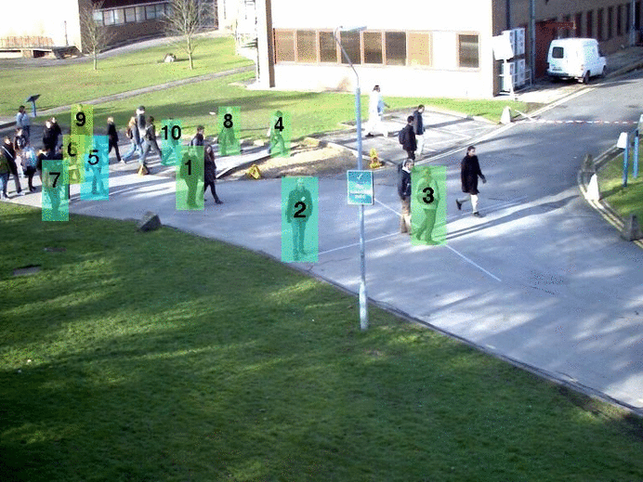
Multiple object tracking

Slide 8
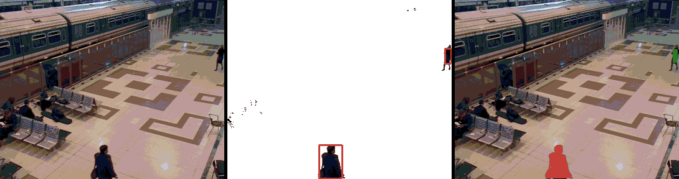
Tracking with a fixed camera

Slide 9
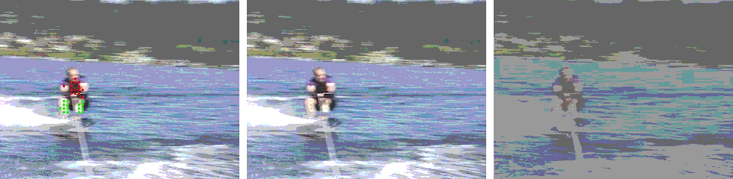
Tracking with a moving camera

Slide 10
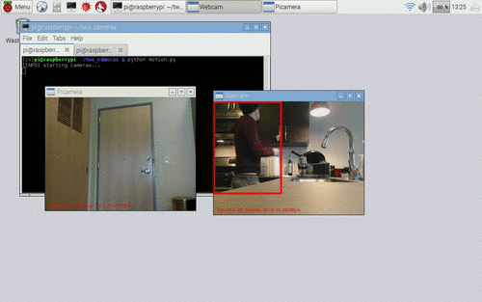
Tracking with multiple cameras

Slide 11
Challenges in Feature tracking
Figure out which features can be tracked
  Efficiently track across frames
Some points may change appearance over time
  e.g., due to rotation, moving into shadows, etc.
Drift: small errors can accumulate as appearance model is updated
Occulsion: Points may appear or disappear.
  need to be able to add/delete tracked points.

Slide 12
What are good features to track?
Intuitively, we want to avoid smooth regions and edges. But is there a more is principled way to define good features?
What kinds of image regions can we detect easily and consistently? Think about what you learnt earlier in the class.

Slide 13
What are good features to track?
Can measure “quality” of features from just a single image.
Hence: tracking Harris corners (or equivalent) guarantees small error sensitivity!
Source: Silvio Savarese

Slide 14
Motion estimation techniques
Optical flow
  Recover image motion at each pixel from spatio-temporal image brightness variations (optical flow)
Feature-tracking
  Extract visual features (corners, textured areas) and “track” them over multiple frames

Slide 15
Optical flow can help track features
Once we have the features we want to track, lucas-kanade or other optical flow algorithm can help track those features

Slide 16
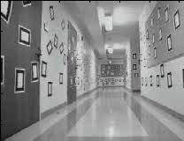
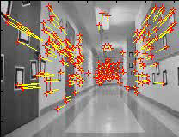
Feature-tracking
Courtesy of Jean-Yves Bouguet – Vision Lab, California Institute of Technology

Slide 17
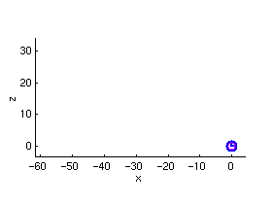
Feature-tracking
Courtesy of Jean-Yves Bouguet – Vision Lab, California Institute of Technology

Slide 18
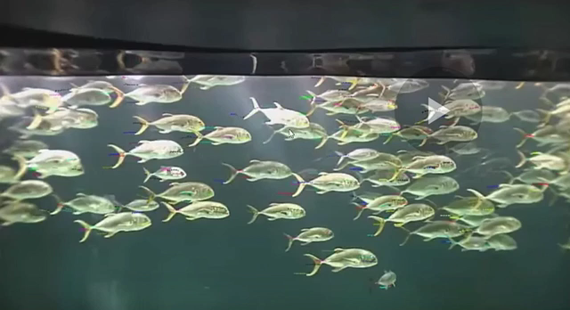
KLT tracker for fish
Video credit: Kanade

Slide 19
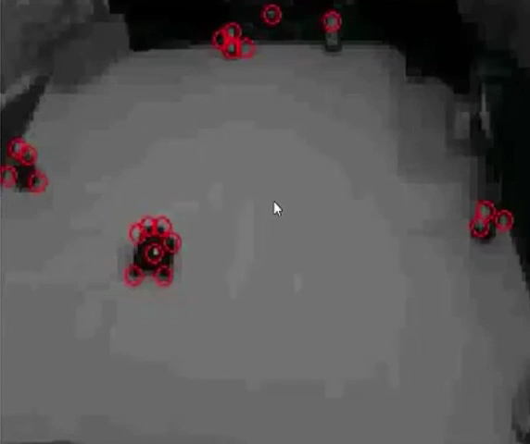
Tracking cars
Video credit: Kanade

Slide 20
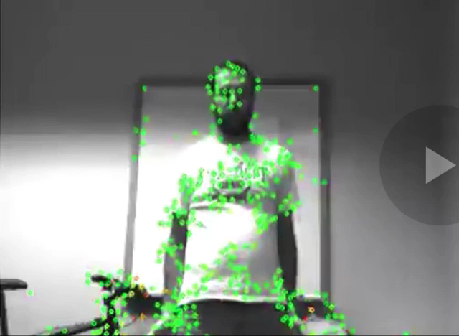
Tracking movement
Video credit: Kanade

