Slide 1
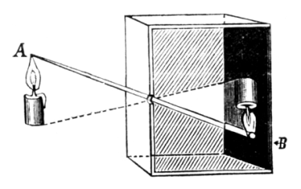
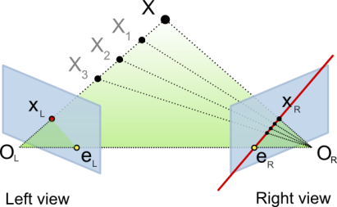
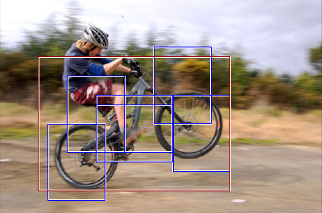
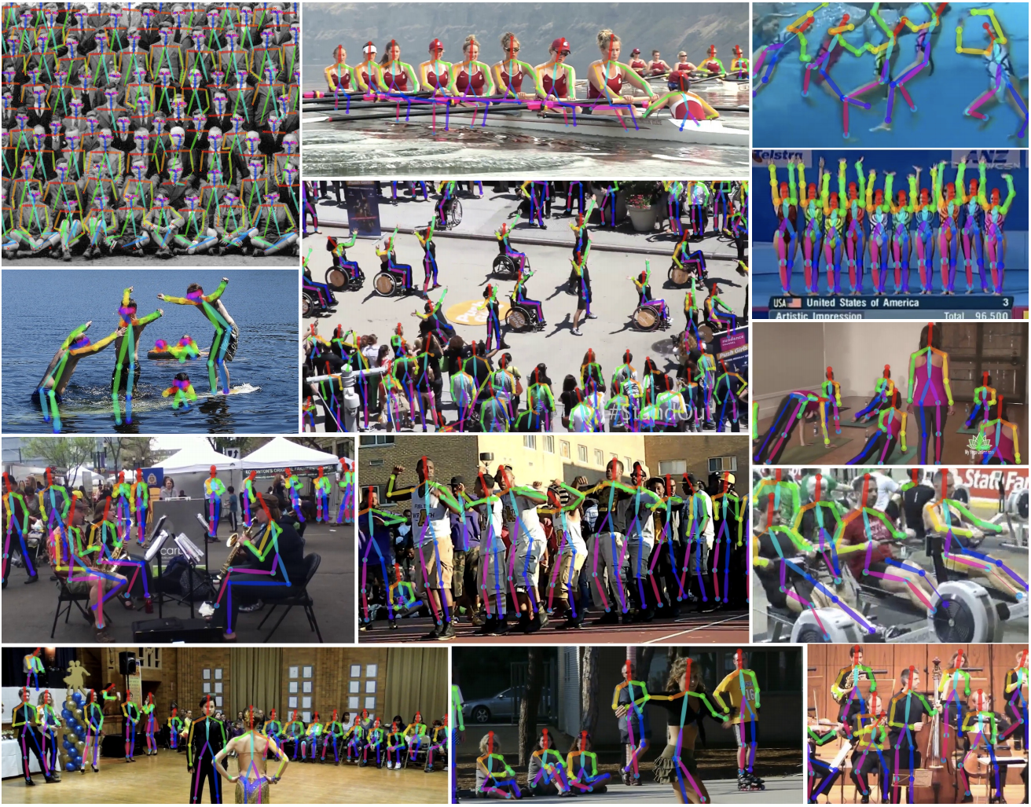
Course overview
Low-level vision
  image processing, edge detection, feature detection, cameras, color, image segmentation, image formation
Geometry and algorithms
  projective geometry, stereo, structure from motion, Markov random fields
Recognition
  face detection / recognition, category recognition, segmentation
Recent topics

Slide 2
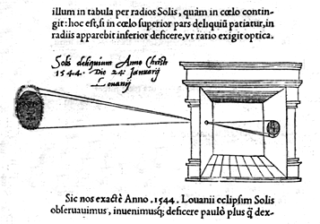


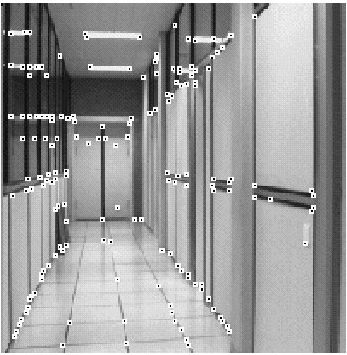
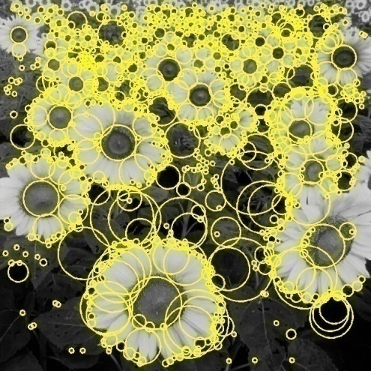
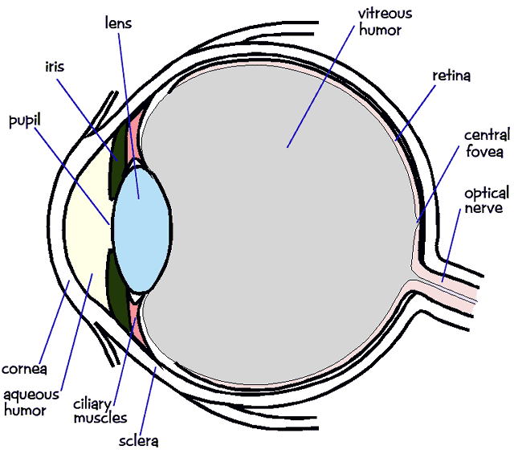
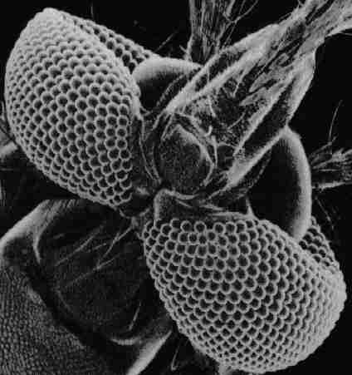
1. Low-level vision
Basic image processing and image formation
*
=
Filtering, edge detection
Feature extraction
Image formation

Slide 3
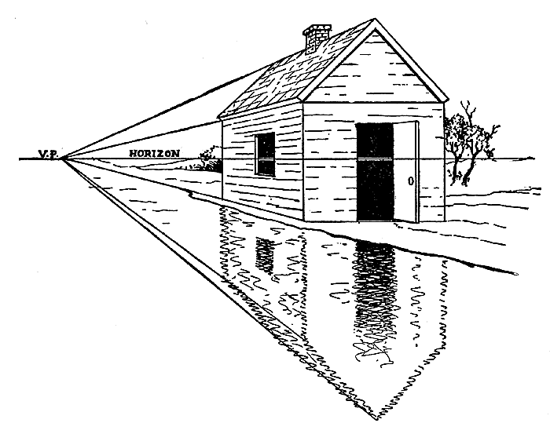
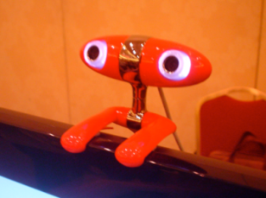
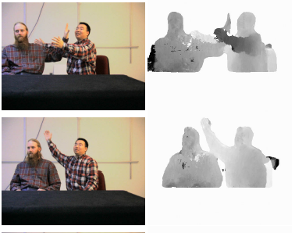
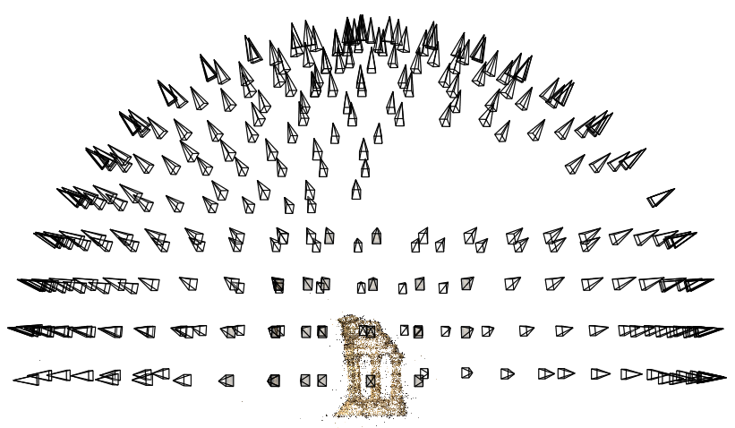
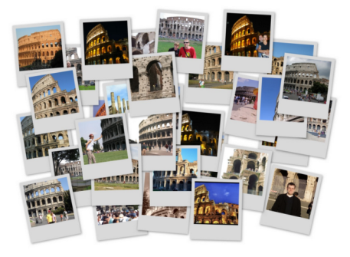
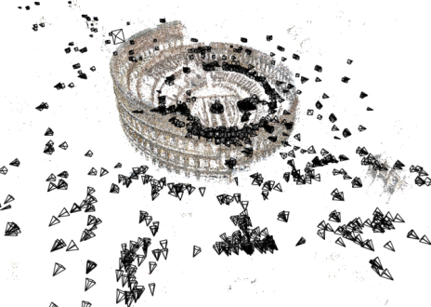
2. Geometry
Projective geometry
Stereo
Multi-view stereo
Structure from motion

Slide 4
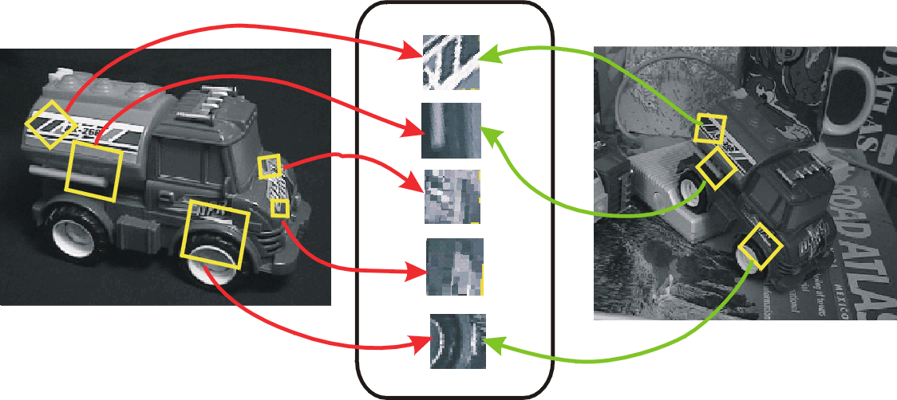
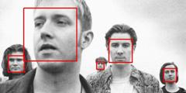
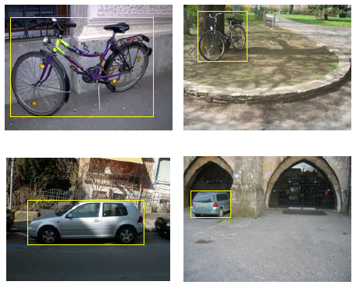
3. Recognition
Face detection and recognition
Single instance recognition
Category recognition
Sources: D. Lowe, L. Fei-Fei

Slide 5
4. Recent topics

Slide 6
ECE 4973: Lecture 2
Color and representation
Samuel Cheng
Slide credits: James Thompkin, Juan Carlos Niebles and Ranjay Krishna

Slide 7
What Is an Image?

Slide 8
Image as a 2D sampling of signal
Signal: function depending on some variable with physical meaning.
Image: sampling of that function.
  2 variables: xy coordinates
  3 variables: xy + time (video)
  ‘Brightness’ is the value of the function for visible light
Can be other physical values too: temperature, pressure, depth …
Danny Alexander
Notes:
Danny Alexander, UCL

Slide 9
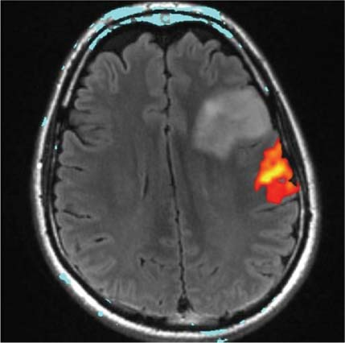
Example 2D Images
Danny Alexander
Notes:
fMRI - changes in blood flow in the brain associated with neural activity
http://radiologykey.com/wp-content/uploads/2016/01/9781604063325_c014_f004.jpg

Slide 10
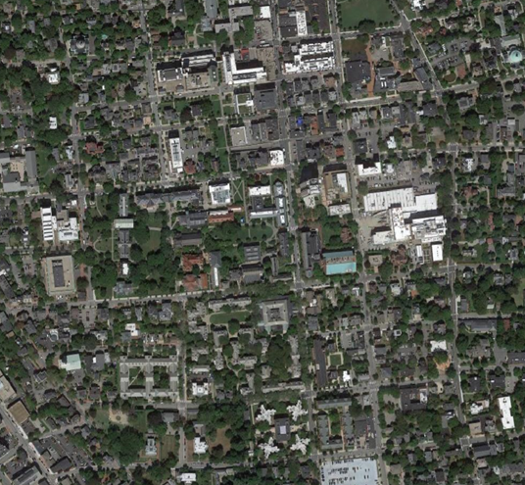
What is each part of a photograph?
Pixel -> picture element
‘127’
y
I(x,y)
x
Notes:
What is a pixel?

Slide 11

What is each part of a greyscale image?
y
x
Notes:
What is a pixel?

Slide 12
What is each part of a greyscale image?
Pixel -> picture element
‘138’
y
I(x,y)
x
Notes:
What is a pixel?

Slide 13
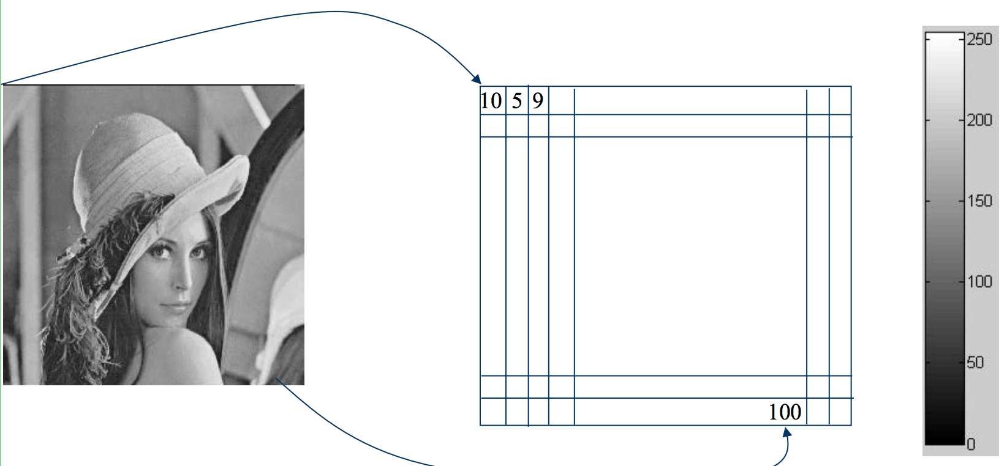
Another example: Lena
Slide credit: Ulas Bagci

Slide 14
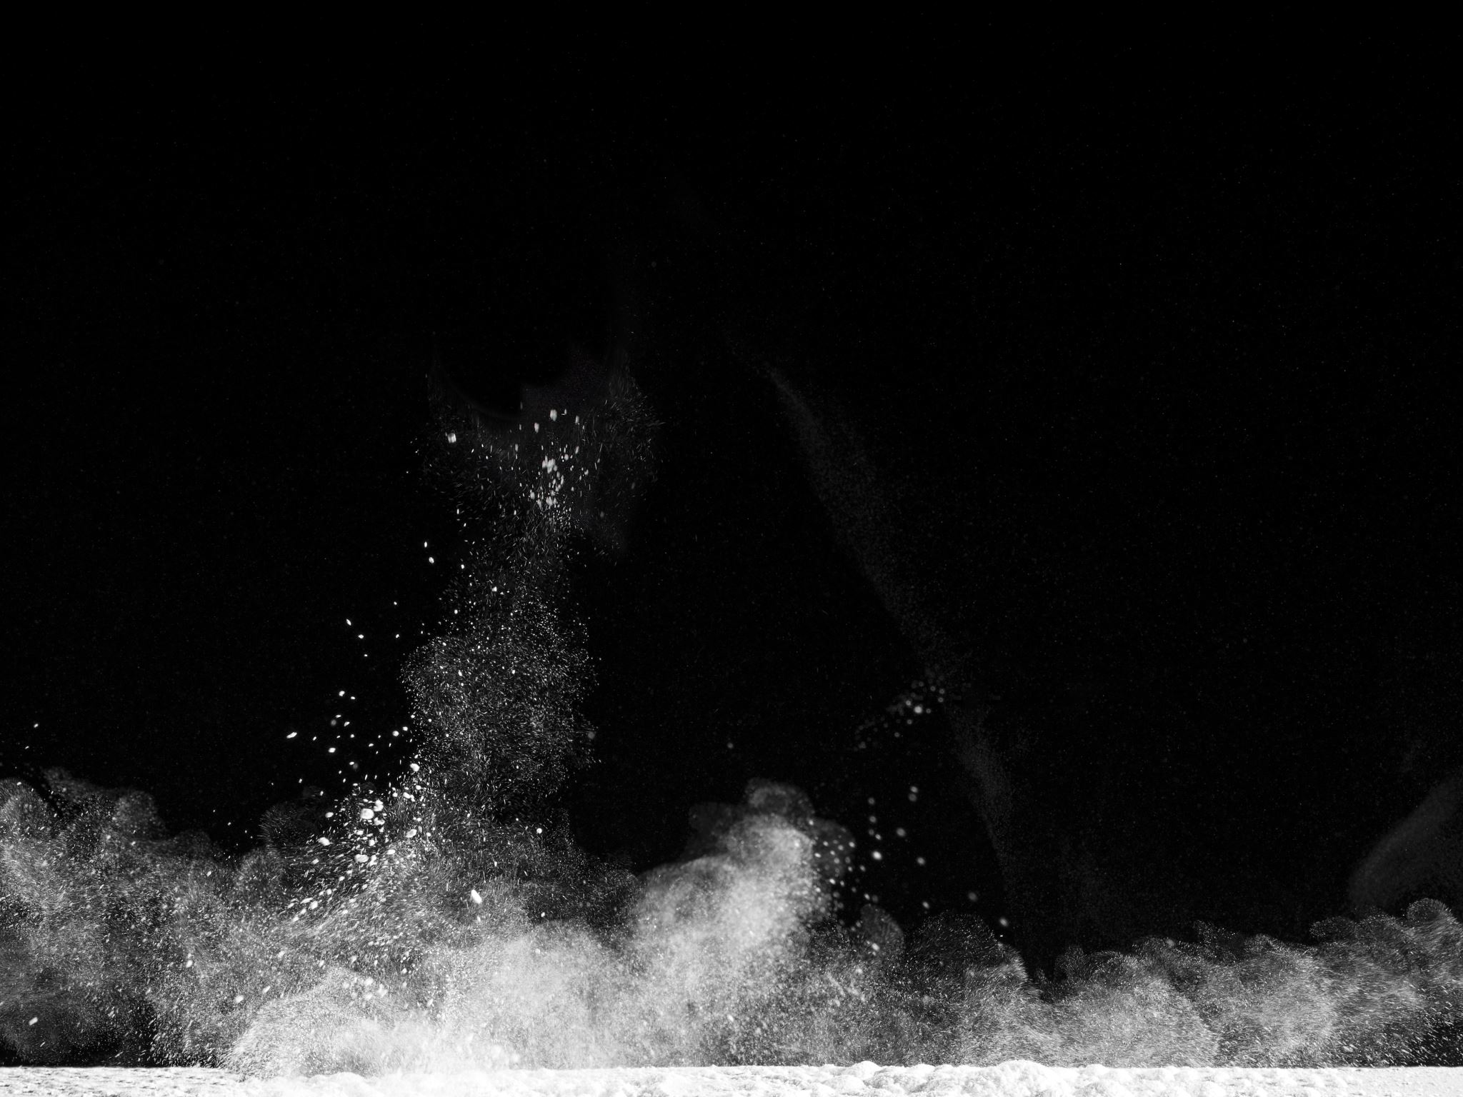
Computer vision as making sense of an extremely high-dimensional space
Notes:
# combination of an image of size 256x256
@ 8bit = 256 values ^ 65,536
Computer says ‘Inf’ combinations.
Computer vision as making sense of an extremely high-dimensional space.
Subspace of ‘natural’ images.
Deriving low-dimensional, explainable models.
Zoran and Weiss: “In the context of this work, a natural image would be the result of taking an ordinary digital camera, pointing it somewhere in the world and pressing the shutter button.“

Slide 15

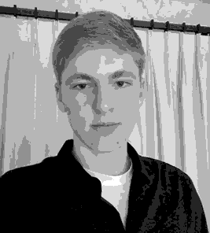

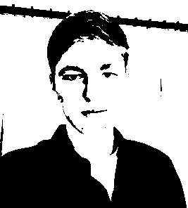
Quantization Effects – Radiometric Resolution
8 bit – 256 levels
4 bit – 16 levels
2 bit – 4 levels
1 bit – 2 levels

Slide 16
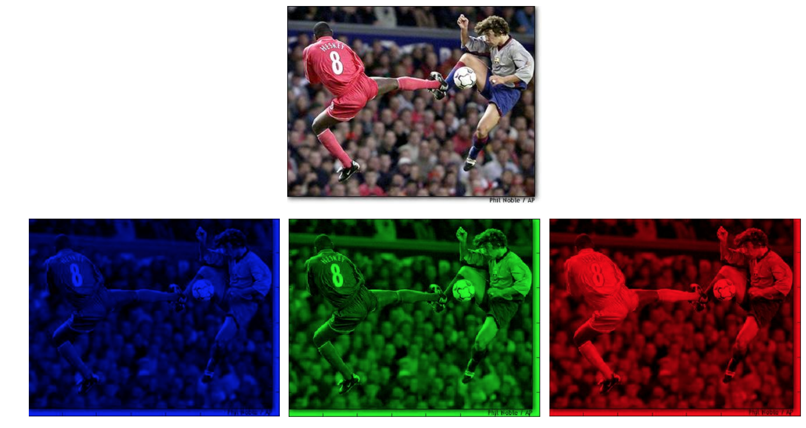
Color image representation
Slide credit: Ulas Bagci

Slide 17
Images in Matlab
NxM RGB “im”
  im(1,1,1) = top-left pixel value in R-channel
  im(y, x, b) = y pixels down, x pixels to right in the b^{th} channel
  im(N, M, 3) = bottom-right pixel in B-channel
imread(filename) returns a uint8 image (values 0 to 255)
  Convert to double format (values 0 to 1) with im2double
column
row
R
0.92 | 0.93 | 0.94 | 0.97 | 0.62 | 0.37 | 0.85 | 0.97 | 0.93 | 0.92 | 0.99
0.95 | 0.89 | 0.82 | 0.89 | 0.56 | 0.31 | 0.75 | 0.92 | 0.81 | 0.95 | 0.91
0.89 | 0.72 | 0.51 | 0.55 | 0.51 | 0.42 | 0.57 | 0.41 | 0.49 | 0.91 | 0.92
0.96 | 0.95 | 0.88 | 0.94 | 0.56 | 0.46 | 0.91 | 0.87 | 0.90 | 0.97 | 0.95
0.71 | 0.81 | 0.81 | 0.87 | 0.57 | 0.37 | 0.80 | 0.88 | 0.89 | 0.79 | 0.85
0.49 | 0.62 | 0.60 | 0.58 | 0.50 | 0.60 | 0.58 | 0.50 | 0.61 | 0.45 | 0.33
0.86 | 0.84 | 0.74 | 0.58 | 0.51 | 0.39 | 0.73 | 0.92 | 0.91 | 0.49 | 0.74
0.96 | 0.67 | 0.54 | 0.85 | 0.48 | 0.37 | 0.88 | 0.90 | 0.94 | 0.82 | 0.93
0.69 | 0.49 | 0.56 | 0.66 | 0.43 | 0.42 | 0.77 | 0.73 | 0.71 | 0.90 | 0.99
0.79 | 0.73 | 0.90 | 0.67 | 0.33 | 0.61 | 0.69 | 0.79 | 0.73 | 0.93 | 0.97
0.91 | 0.94 | 0.89 | 0.49 | 0.41 | 0.78 | 0.78 | 0.77 | 0.89 | 0.99 | 0.93
G
0.92 | 0.93 | 0.94 | 0.97 | 0.62 | 0.37 | 0.85 | 0.97 | 0.93 | 0.92 | 0.99
0.95 | 0.89 | 0.82 | 0.89 | 0.56 | 0.31 | 0.75 | 0.92 | 0.81 | 0.95 | 0.91
0.89 | 0.72 | 0.51 | 0.55 | 0.51 | 0.42 | 0.57 | 0.41 | 0.49 | 0.91 | 0.92
0.96 | 0.95 | 0.88 | 0.94 | 0.56 | 0.46 | 0.91 | 0.87 | 0.90 | 0.97 | 0.95
0.71 | 0.81 | 0.81 | 0.87 | 0.57 | 0.37 | 0.80 | 0.88 | 0.89 | 0.79 | 0.85
0.49 | 0.62 | 0.60 | 0.58 | 0.50 | 0.60 | 0.58 | 0.50 | 0.61 | 0.45 | 0.33
0.86 | 0.84 | 0.74 | 0.58 | 0.51 | 0.39 | 0.73 | 0.92 | 0.91 | 0.49 | 0.74
0.96 | 0.67 | 0.54 | 0.85 | 0.48 | 0.37 | 0.88 | 0.90 | 0.94 | 0.82 | 0.93
0.69 | 0.49 | 0.56 | 0.66 | 0.43 | 0.42 | 0.77 | 0.73 | 0.71 | 0.90 | 0.99
0.79 | 0.73 | 0.90 | 0.67 | 0.33 | 0.61 | 0.69 | 0.79 | 0.73 | 0.93 | 0.97
0.91 | 0.94 | 0.89 | 0.49 | 0.41 | 0.78 | 0.78 | 0.77 | 0.89 | 0.99 | 0.93
B
0.92 | 0.93 | 0.94 | 0.97 | 0.62 | 0.37 | 0.85 | 0.97 | 0.93 | 0.92 | 0.99
0.95 | 0.89 | 0.82 | 0.89 | 0.56 | 0.31 | 0.75 | 0.92 | 0.81 | 0.95 | 0.91
0.89 | 0.72 | 0.51 | 0.55 | 0.51 | 0.42 | 0.57 | 0.41 | 0.49 | 0.91 | 0.92
0.96 | 0.95 | 0.88 | 0.94 | 0.56 | 0.46 | 0.91 | 0.87 | 0.90 | 0.97 | 0.95
0.71 | 0.81 | 0.81 | 0.87 | 0.57 | 0.37 | 0.80 | 0.88 | 0.89 | 0.79 | 0.85
0.49 | 0.62 | 0.60 | 0.58 | 0.50 | 0.60 | 0.58 | 0.50 | 0.61 | 0.45 | 0.33
0.86 | 0.84 | 0.74 | 0.58 | 0.51 | 0.39 | 0.73 | 0.92 | 0.91 | 0.49 | 0.74
0.96 | 0.67 | 0.54 | 0.85 | 0.48 | 0.37 | 0.88 | 0.90 | 0.94 | 0.82 | 0.93
0.69 | 0.49 | 0.56 | 0.66 | 0.43 | 0.42 | 0.77 | 0.73 | 0.71 | 0.90 | 0.99
0.79 | 0.73 | 0.90 | 0.67 | 0.33 | 0.61 | 0.69 | 0.79 | 0.73 | 0.93 | 0.97
0.91 | 0.94 | 0.89 | 0.49 | 0.41 | 0.78 | 0.78 | 0.77 | 0.89 | 0.99 | 0.93
James Hays

Slide 18
>> I = rand(256,256);
Think-Pair-Share:
What is this? What does it look like?
Which values does it take?
How many values can it take?
Is it an image?

Slide 19
>> I = rand(256,256);
>> imshow(I);
Danny Alexander

Slide 20
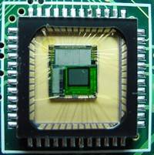
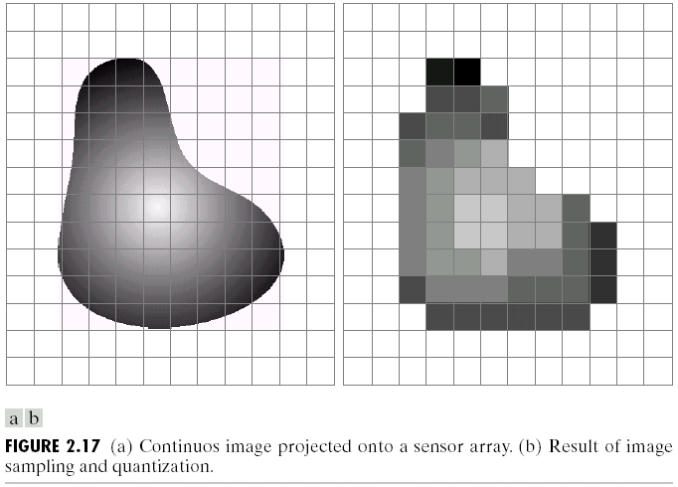
Sensor Array
CMOS sensor
James Hays

Slide 21
Anatomy
Color in human vision

Slide 22
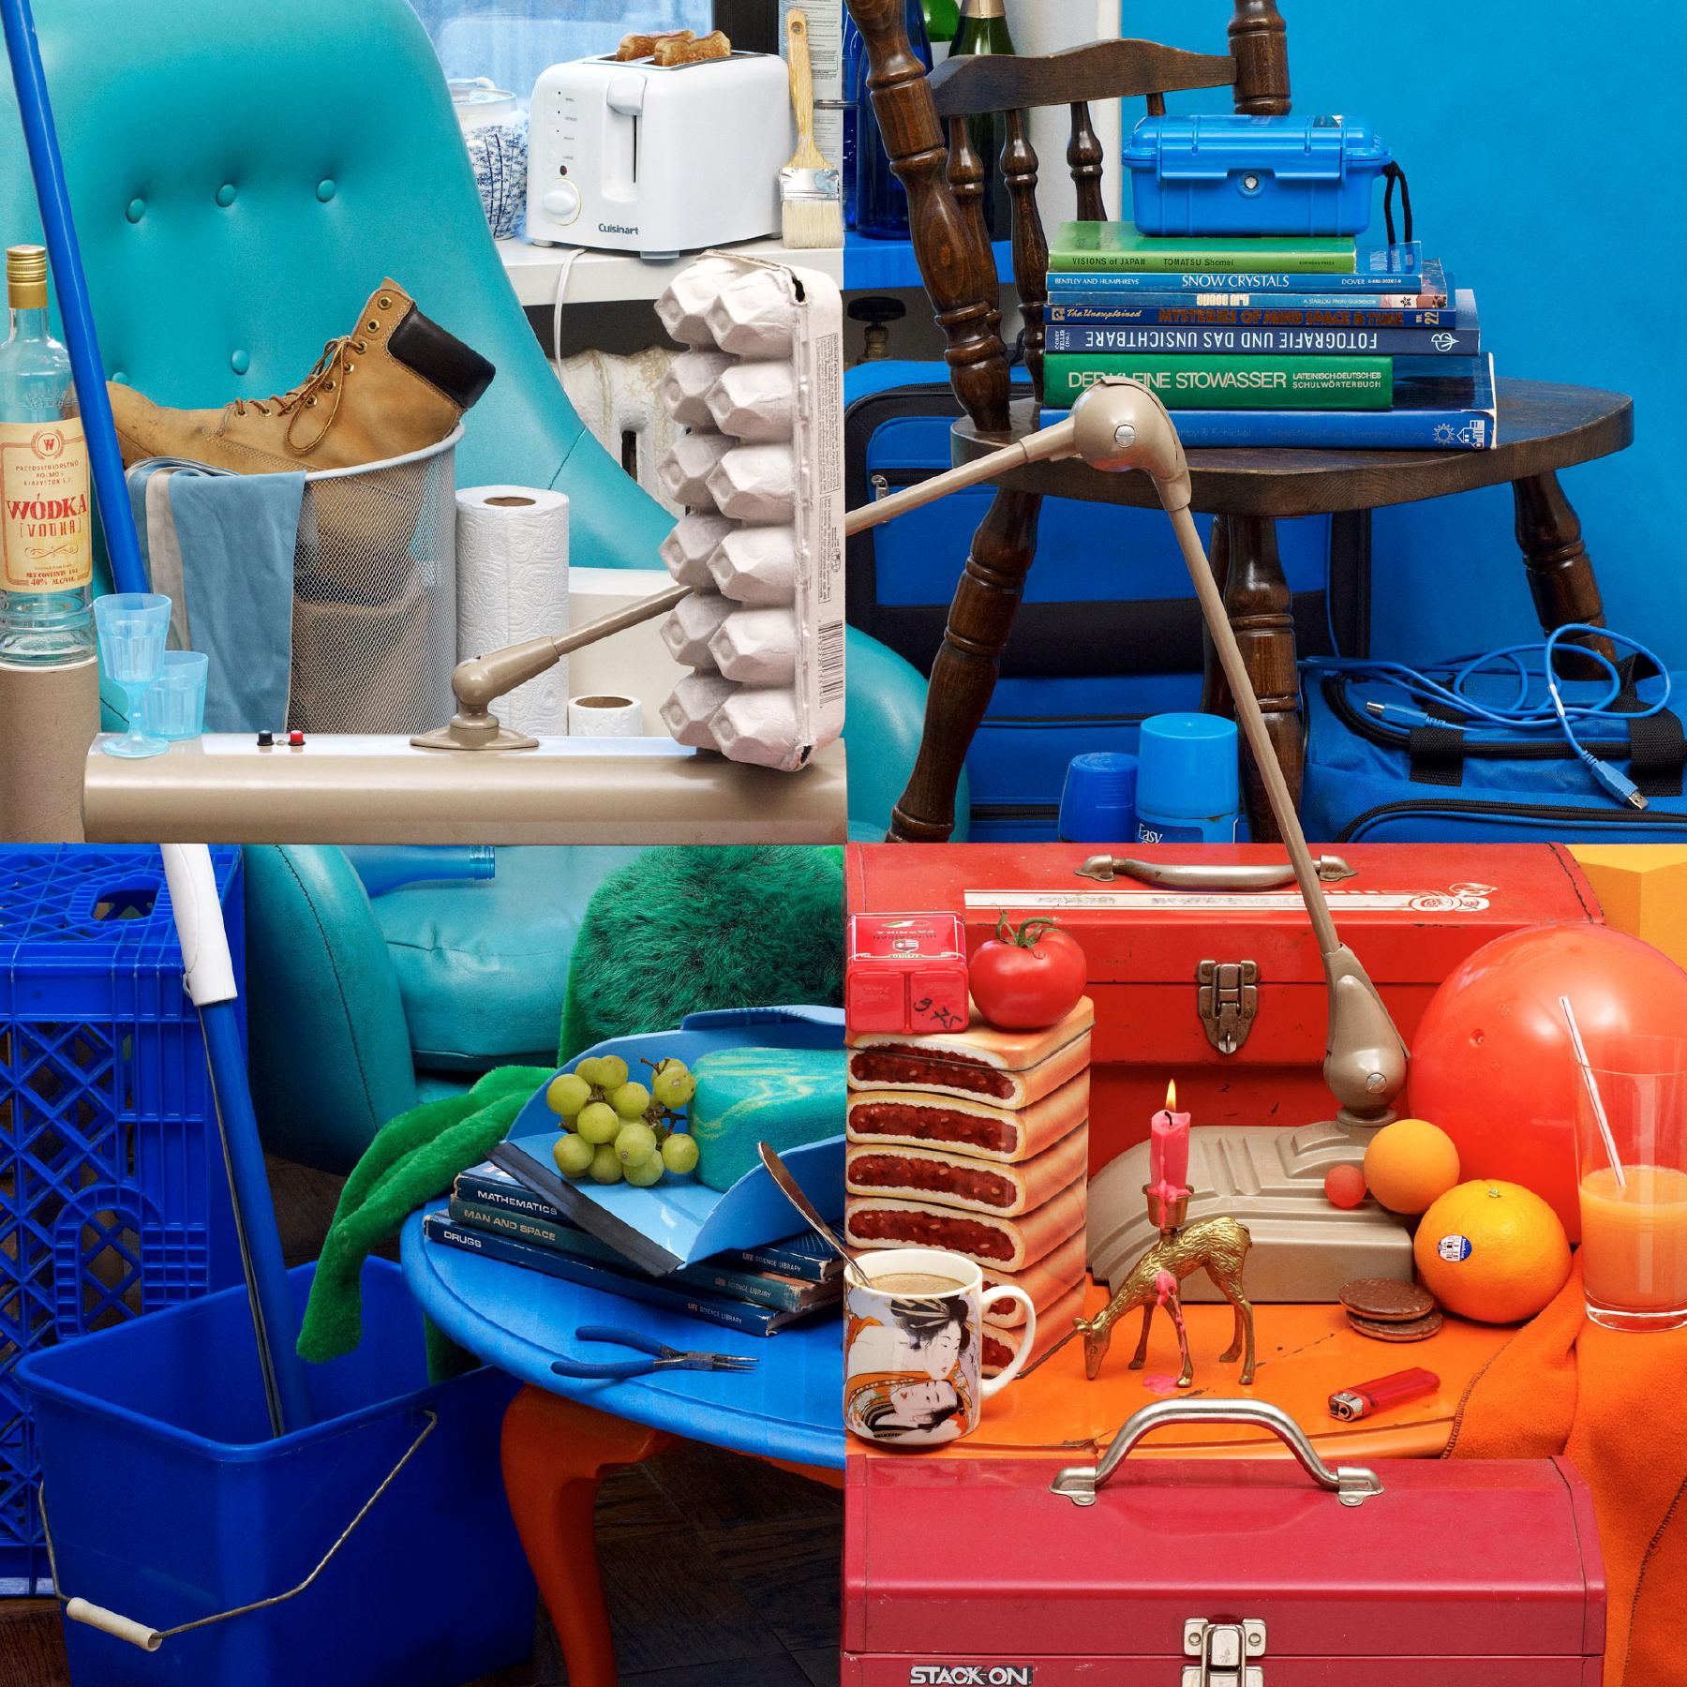
Bela Borsodi
Notes:
To start us off, let’s look at these four colorful images.
Think for a minute - what can you tell me about the differences between these images?
http://www.belaborsodi.com/

Slide 23
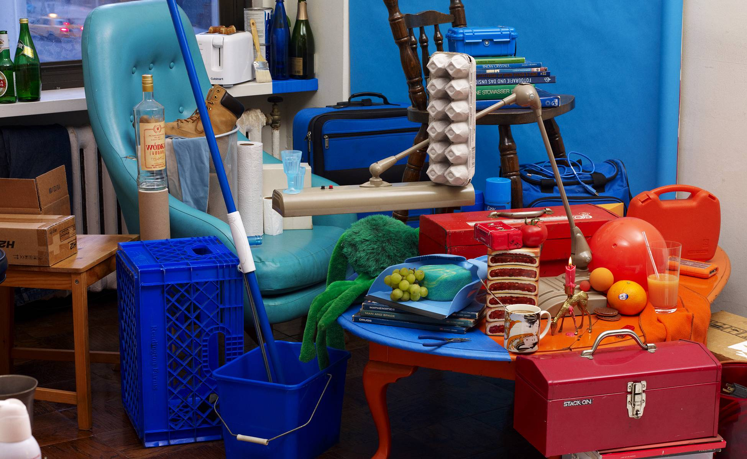
Bela Borsodi
Notes:
Major trick. The scene was arranged by looking through the viewfinder of the camera, which, as like the image, offers a fixed perspective which makes this possible.
http://youtube.com/watch?v=oJGN6sX5Ekg
Later on, we’re going to

Slide 24
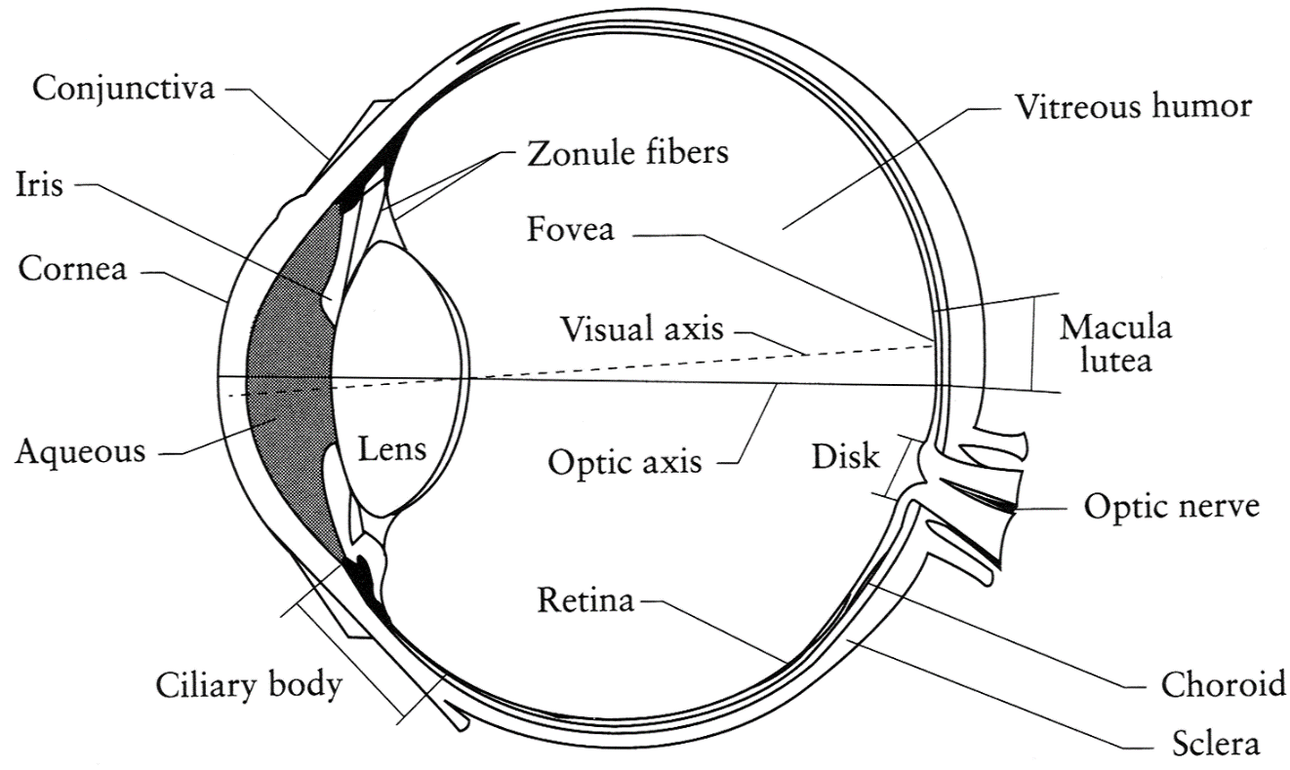
The Eye
The human eye is a camera
  Iris - colored annulus with radial muscles
  Pupil - the hole (aperture) whose size is controlled by the iris
  What’s the sensor?
    photoreceptor cells (rods and cones) in the retina
Slide by Steve Seitz

Slide 25
The Retina

Slide 26
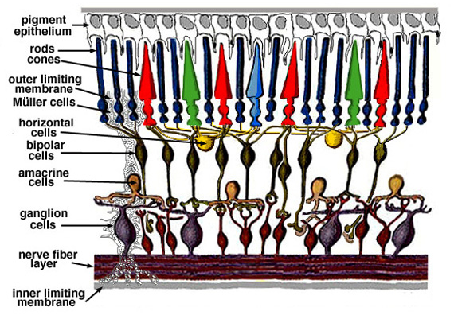
Retina up-close
Light
Notes:
Tapetum lucidum

Slide 27
Wait, the blood vessels are in front of the photoreceptors??
https://www.youtube.com/watch?v=L_W-IXqoxHA
Notes:
Yes, and you can see them!

Slide 28
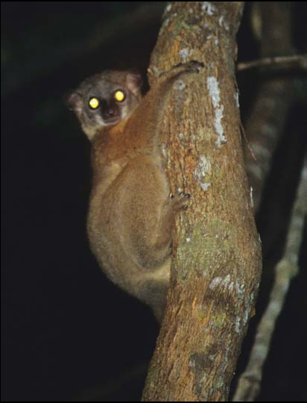
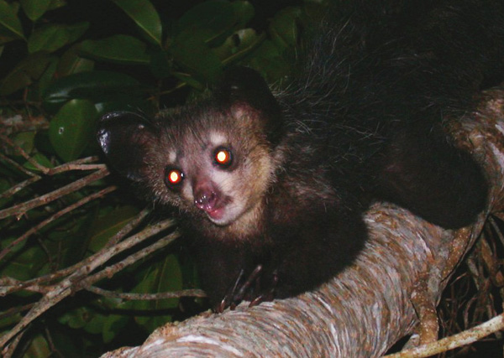
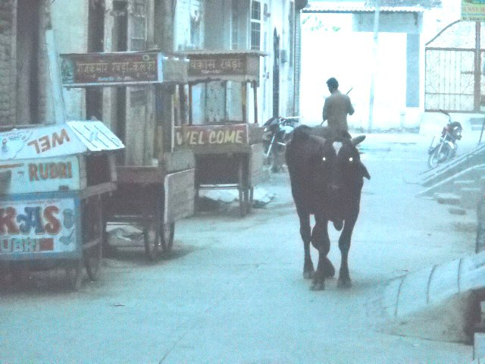
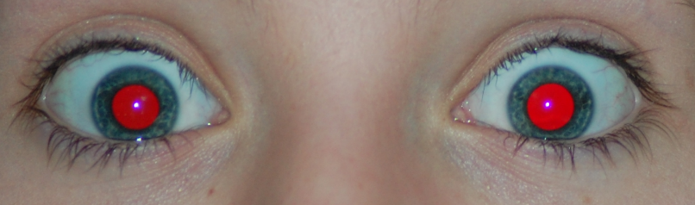
What humans don’t have: tapetum lucidum
Human eyes can reflect a tiny bit and blood in the retina makes this reflection red.
James Hays
Notes:
Animals with Tapetum Lucidum also have RPE, just not in the same part of the eye.
The tapetum lucidum /təˈpiːtəm/ (Latin: "bright tapestry; coverlet", plural tapeta lucida)^{[1]} is a layer of tissue in the eye of many vertebrates.^{[2]} Lying immediately behind the retina, it reflects visible light back through the retina, increasing the light available to the photoreceptors, though blurring the initial image of the light on focus. The tapetum lucidum contributes to the superior night vision of some animals. Many of these animals are nocturnal, especially carnivores that hunt their prey at night, while others are deep sea animals.

Slide 29
Two types of light-sensitive receptors
Cones
cone-shaped
less sensitive
operate in high light
color vision
Rods
rod-shaped
highly sensitive
operate at night
gray-scale vision
© Stephen E. Palmer, 2002
James Hays

Slide 30
Distribution of Rods and Cones
Night Sky: why are there more stars off-center?
Averted vision: http://en.wikipedia.org/wiki/Averted_vision
© Stephen E. Palmer, 2002
James Hays

Slide 31
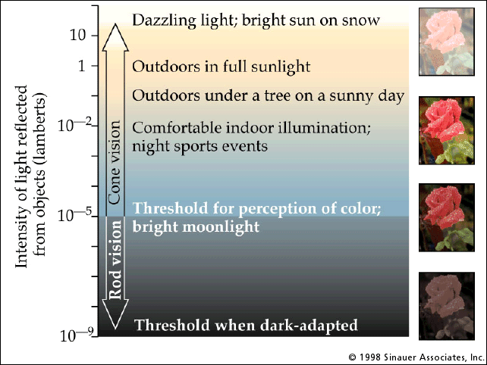
Rod / Cone sensitivity
Notes:
Motivation for HDR -> show range of intensity that an 8-bit image can capture.

Slide 32
Eye Movements
Saccades
Can be consciously controlled. Related to perceptual attention.
200ms to initiation, 20 to 200ms to carry out. Large amplitude.
Microsaccades
Involuntary. Smaller amplitude. Especially evident during prolonged fixation. Function debated.
Ocular microtremor (OMT)
involuntary. high frequency (up to 80Hz), small amplitude.
Smooth pursuit – tracking an object
James Hays

Slide 33
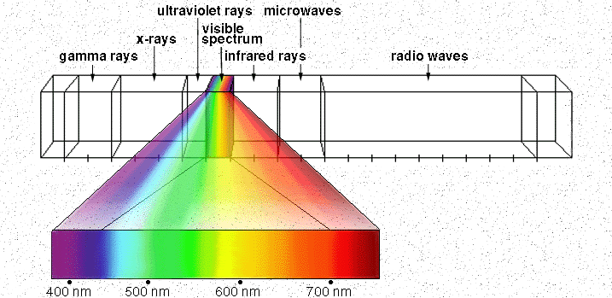
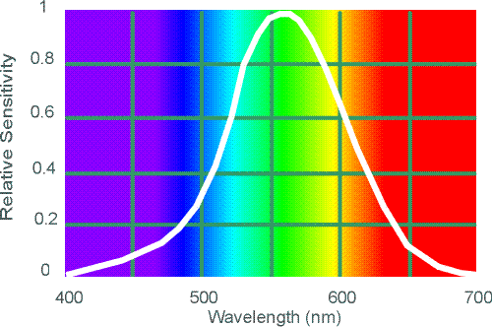
Electromagnetic Spectrum
Human Luminance Sensitivity Function
http://www.yorku.ca/eye/photopik.htm
Notes:
At least 3 spectral bands required (e.g. R,G,B)

Slide 34
Sun temperature makes it emit yellow light more than any other color.
Notes:
The Sun is the dominant source for visible-light waves our eyes receive. The outer-most layer of the Sun's atmosphere, the corona, can be seen in visible light. But it is so faint it cannot not be seen except during a total solar eclipse because the bright photosphere overwhelms it. The tapered patterns—coronal streamers—around the Sun are formed by the outward flow of plasma that is shaped by magnetic field lines extending millions of miles into space.
As objects grow hotter, they radiate energy dominated by shorter wavelengths, changing color before our eyes. A flame on a blow torch shifts from reddish to bluish in color as it is adjusted to burn hotter. In the same way, the color of stars tells scientists about their temperature.

Slide 35
Visible Light
Plank’s law for Blackbody radiation
Surface of the sun: ~5800K
Why do we see light of these wavelengths?
…because that’s where the
Sun radiates EM energy
© Stephen E. Palmer, 2002
Notes:
Because that’s where the Sun’s peak radiation was
Because the atmosphere is fairly transparent in that range
Because biology has many important markers in that range (but that’s because of the previous two reasons)

Slide 36
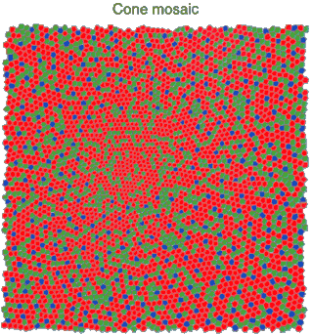
Physiology of Color Vision
Three kinds of cones:
© Stephen E. Palmer, 2002

Slide 37
The Physics of Light
Any patch of light can be completely specified
physically by its spectrum: the number of photons
(per time unit) at each wavelength 400 - 700 nm.
© Stephen E. Palmer, 2002

Slide 38
The Physics of Light
Some examples of the spectra of light sources
© Stephen E. Palmer, 2002

Slide 39
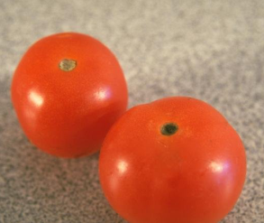
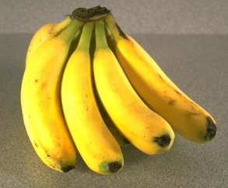
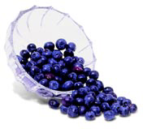
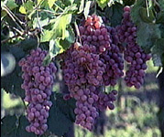
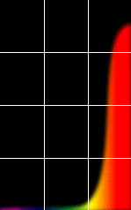
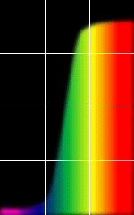
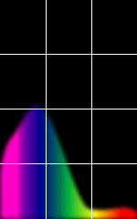
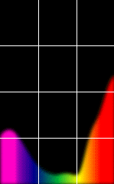
The Physics of Light
Some examples of the reflectance spectra of surfaces
Red
Yellow
Blue
Purple
% Photons Reflected
400 700
400 700
400 700
400 700
Wavelength (nm)
© Stephen E. Palmer, 2002

Slide 40
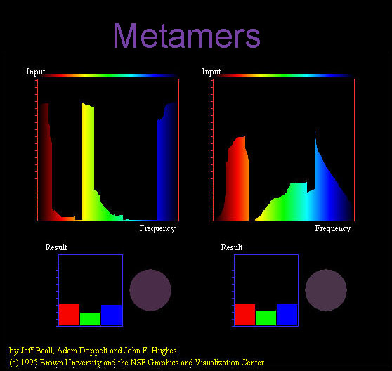
Notes:
Does color exist?

Slide 41
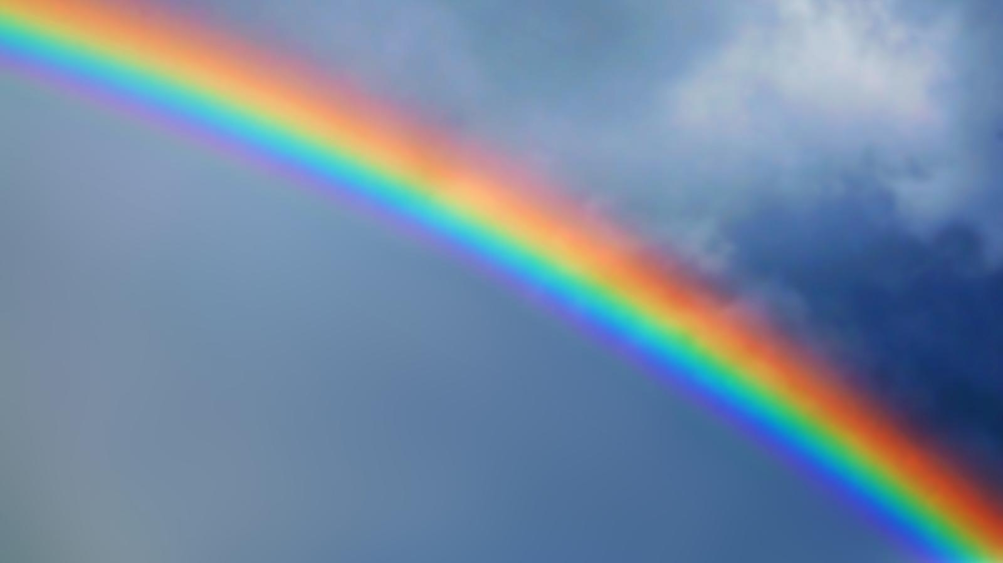
Magenta is a ``fake” color
You won’t see Magenta in a rainbow
Color Mixing: The Mystery of Magenta

Slide 42
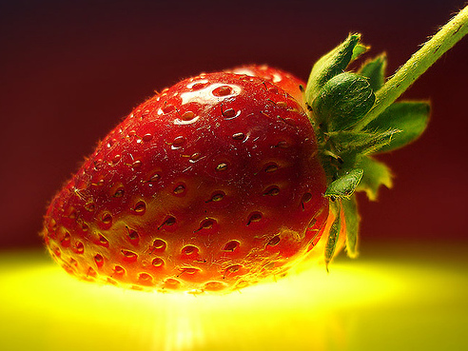

Interaction of light and surfaces
From Foundation of Vision by Brian Wandell, Sinauer Associates, 1995
Notes:
-Reflected color is the result of interaction of light source spectrum with surface reflectance
-Spectral radiometry
All definitions and units are now “per unit wavelength”
All terms are now “spectral”

Slide 43


Under monochromatic light
Olafur Eliasson, Room for one color
Slide by S. Lazebnik
Notes:
What is the observed color of any surface under monochromatic light?

Slide 45
The Psychophysical Correspondence
There is no simple functional description for the perceived
color of all lights under all viewing conditions, but …...
A helpful constraint:
Consider only physical spectra with normal distributions
mean
area
variance
© Stephen E. Palmer, 2002

Slide 46
The Psychophysical Correspondence
Mean
Hue
# Photons
Wavelength
© Stephen E. Palmer, 2002

Slide 47
The Psychophysical Correspondence
Variance
Saturation
# Photons
Wavelength
© Stephen E. Palmer, 2002

Slide 48
The Psychophysical Correspondence
Area
Brightness
# Photons
Wavelength
© Stephen E. Palmer, 2002

Slide 49
Physiology of Color Vision
Three kinds of cones:
Why are M and L cones so close?
Why are there 3?
© Stephen E. Palmer, 2002

Slide 50
S are more different from the M and L
  S cones (peak at 420 nm, bluish-violet)
  M cones (peak at 534 nm, bluish-green)
  L cones (peak at 564 nm, yellowish-green)
S cones and rods are totally absent in the foveal area
Note that both M and L are sensitive to green
Notes:
The S cone's sensitivity curve (with peak at 437 mm) is very different from the sensitivity curves of the L and M cones which are quite similar with their peaks very close to each other (at 564 mm and 533 mm respectively) and overlap over a wide range of the visible wavelengths.
are L and M cones, with 2 to 4 times more L cones than M cones.

Slide 51
S are more different from the M and L
The genes of the photoreceptors lie on different chromosomes
  rod lies on chromosome 8,
  S cone lies on chromosome 7
  Both L and M cones lie on the X chromosome
Notes:
- The separation of the S cones and the M/L cones probably occurred much earlier than the separation of the M and L cones
- This is why the probability of red/green color blindness is much higher in male (XY) than in female (XX).
The S cone's sensitivity curve (with peak at 437 mm) is very different from the sensitivity curves of the L and M cones which are quite similar with their peaks very close to each other (at 564 mm and 533 mm respectively) and overlap over a wide range of the visible wavelengths.

Slide 52

Tetrachromatism
Bird cone responses
Most birds, and many other animals, have cones for ultraviolet light.
Some humans seem to have four cones (12% of females).
True tetrachromatism is rare; requires learning.
James Hays
Notes:
http://www.sciencealert.com/scientists-have-found-a-woman-whose-eyes-have-a-whole-new-type-of-colour-receptor
Assuming that colour blind men pass this fourth cone cell onto their daughters, Mollon estimated that around 12 percent of the female population should be tetrachromats.
But all of his tests showed that these women could only perceive the same colours as the rest of us - which meant only three of their cone cell types were working, so they weren't true tetrachromats.

Slide 53

Bee vision
Notes:
Does color exist?
http://www.askamathematician.com/2012/06/q-do-colors-exist/
http://www.radiolab.org/story/211178-rip-rainbow/

Slide 54

More Spectra
metamers
James Hays
Notes:
Metamerism can be illuminant based or observer based. Color blindness produced well known instances of metamerism.

Slide 55
COLOR SENSING IN CAMERA

Slide 56


Color Sensing in Camera (RGB)
3-chip vs. 1-chip: quality vs. cost
Why more green?
Why 3 colors?
http://www.cooldictionary.com/words/Bayer-filter.wikipedia
Slide by Steve Seitz

Slide 57


Practical Color Sensing: Bayer Grid
Estimate RGB
at ‘G’ cells from neighboring values
Slide by Steve Seitz

Slide 58

Camera Color Response
MaxMax.com
Notes:
https://www.quora.com/Why-is-there-a-significant-difference-between-image-sensors-and-human-eyes-Spectral-response
http://www.maxmax.com/ndvi_camera_technical.htm
http://www.maxmax.com/faq/camera-tech/spectral-response
NOTE the strong response into long wavelengths (near IR). Many camera sensors can see into infrared range, but the lens system includes an IR low-pass filter which blocks incoming IR light.

Slide 59
color SPACES
Notes:
https://arcsecond.wordpress.com/2008/10/06/calculoergosum/
Has certain properties of vector spaces, e.g., we can make a new basis from a different set of colors, like cyan, magenta, and yellow for instance.
But, it’s clamped at 1, and it doesn’t have negative values.

Slide 60

Color spaces
How can we represent color?
http://en.wikipedia.org/wiki/File:RGB_illumination.jpg

Slide 61





Color spaces: RGB
Default color space
0,1,0
R = 1
(G=0,B=0)
1,0,0
G = 1
(R=0,B=0)
0,0,1
B = 1
(R=0,G=0)
Any color = r*R + g*G + b*B
Strongly correlated channels
Non-perceptual
Image from: http://en.wikipedia.org/wiki/File:RGB_color_solid_cube.png

Slide 62

Color spaces: HSV
Intuitive color space

Slide 63
If you had to choose, would you rather go without:
- intensity (‘value’), or
- hue + saturation (‘chroma’)?
Think-Pair-Share
James Hays
Notes:
Think Pair Share

Slide 64
If you had to choose, would you rather go without luminance or chrominance?

Slide 65

Most information in intensity
Only color shown – constant intensity
James Hays

Slide 66

Most information in intensity
Only intensity shown – constant color
James Hays

Slide 67

Most information in intensity
Original image
James Hays

Slide 68



Color spaces: HSV
Intuitive color space
H
(S=1,V=1)
S
(H=1,V=1)
V
(H=1,S=0)
James Hays

Slide 69






Color spaces: YCbCr
Fast to compute, good for compression, used by TV
Y=0
Y=0.5
Y
(Cb=0.5,Cr=0.5)
Cr
Cb
(Y=0.5,Cr=0.5)
Cb
Y=1
Cr
(Y=0.5,Cb=05)
James Hays
Notes:
The colorimetric difference between a given color in a television picture and a standard color of equal luminance.

Slide 70

Most JPEG images & videos subsample chroma
Notes:
http://users.wfu.edu/matthews/misc/jpg_vs_gif/JpgCompTest/

Slide 71

Notes:
Mapping linear scales to hue does not produce smooth perceptual changes.
It looks like there are sharp changes across these ranges, e.g., red, yellow, green, cyan, blue, purple.
Rainbow Color Map (Still) Considered Harmful
http://people.renci.org/~borland/pdfs/RainbowColorMap_VisViewpoints.pdf

Slide 72
Rainbow color map considered harmful
Borland and Taylor
Notes:
In actual fact, these are smooth uniformly increasing functions (gradients), with no such boundaries.
Rainbow Color Map (Still) Considered Harmful
http://people.renci.org/~borland/pdfs/RainbowColorMap_VisViewpoints.pdf

Slide 73




Color spaces: L*a*b*
“Perceptually uniform”* color space
L
(a=0,b=0)
a
(L=65,b=0)
b
(L=65,a=0)
James Hays
Notes:
* almost

Slide 74
Why Does color look like it
Maps smoothly to a circle?
“Intuitive” color space?
Wait a minute…

Slide 75

XKCD

Slide 76

Image histograms

Slide 77

Histogram
Slide credit: Dr. Mubarak Shah

Slide 78
Histogram
Histogram of an image provides the frequency of the brightness (intensity) value in the image.
function h=histogram(im)
h=zeros(1,255);
for row=1:size(im,1)
for col=1:size(im,2)
val = im(row,col)+1;
h(val)=h(val)+1;
end
end
end
def histogram(im):
h = np.zeros(255)
for row in im.shape[0]:
for col in im.shape[1]:
val = im[row, col]
h[val] += 1

Slide 79



A use case: histogram equalization

Slide 80
White BALANCING

Slide 81


White balance
When looking at a picture on screen or print, we adapt to the illuminant of the room, not to that of the scene in the picture
When the white balance is not correct, the picture will have an unnatural color “cast”
incorrect white balance
correct white balance
http://www.cambridgeincolour.com/tutorials/white-balance.htm
Notes:
White balance (WB) is the process of removing unrealistic color casts, so that objects which appear white in person are rendered white in your photo.

Slide 82

White balance
Film cameras:
  Different types of film or different filters for different illumination conditions
Digital cameras:
  Automatic white balance
  White balance settings corresponding to
  several common illuminants
  Custom white balance using a reference
  object
http://www.cambridgeincolour.com/tutorials/white-balance.htm
Slide: F. Durand

Slide 83
White balance
Von Kries adaptation
  Multiply each channel by a gain factor
  A more general transformation would correspond to an arbitrary 3x3 matrix
Slide: F. Durand
Notes:
The von Kries coefficient law in color adaptation describes the relationship between the illuminant and the human visual system sensitivity.

Slide 84

White balance
Von Kries adaptation
  Multiply each channel by a gain factor
  A more general transformation would correspond to an arbitrary 3x3 matrix
Best way: gray card
  Take a picture of a neutral object (white or gray)
  Deduce the weight of each channel
    If the object is recoded as r_{w}, g_{w}, b_{w}
    use weights 1/r_{w}, 1/g_{w}, 1/b_{w}
Slide: F. Durand

