Slide 1
Computer Vision Overview
Samuel Cheng
Slide credits: Noah Snavely

Slide 2
Instructor
Samuel Cheng
Office hours:
  By reservation
  Please contact me through Discord (signup link on Canvas)
Research interests:
  Computer vision
  Machine learning/AI
  Signal processing

Slide 3

Other administrative details
Reference:
  Rick Szeliski, Computer Vision: Algorithms and Applications
  online at: http://szeliski.org/Book/
Course webpage: http://www.samuelcheng.info/computer_vision_2021
Discussion forum (Discord signup link on Canvas)
TA
  Zhihao Zhao (zhihao.zhao@ou.edu)
Extra credit: in-class participation and quizzes

Slide 4
Course requirements
Prerequisites
  Python
  Linear algebra
  Vector calculus
  Will review some materials when used
Course does not assume prior imaging experience
  computer vision, image processing, graphics, etc.

Slide 5
Today
What is computer vision?
Course overview

Slide 6
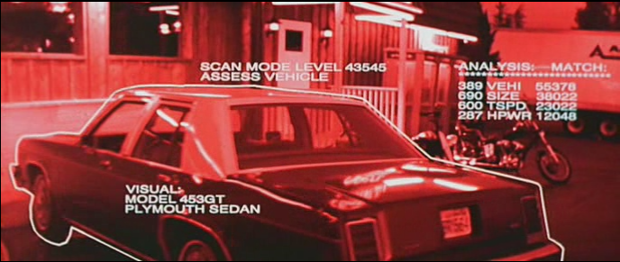
What is computer vision (CV)?
Notes:
This was something first came to mind when I was a kid when I heard of the word computer vision

Slide 7
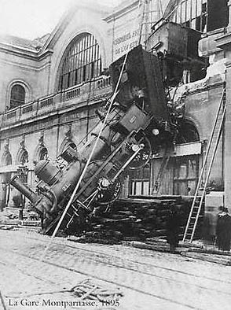
Every image tells a story
CV aims to perceive the “story” behind the picture
  Who?
  What?
  What happened?

Slide 8
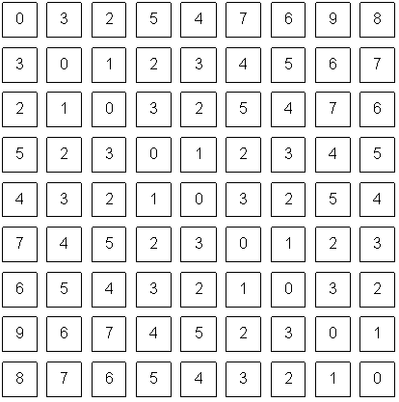
CV is difficult in nature

Slide 9
Can the computer match human perception?
Yes and no (mainly no)
  computers can be better at “easy” things
  humans are much better at “hard” things
But huge progress has been made
  Especially in the last 10 years
  What is considered “hard” keeps changing

Slide 10
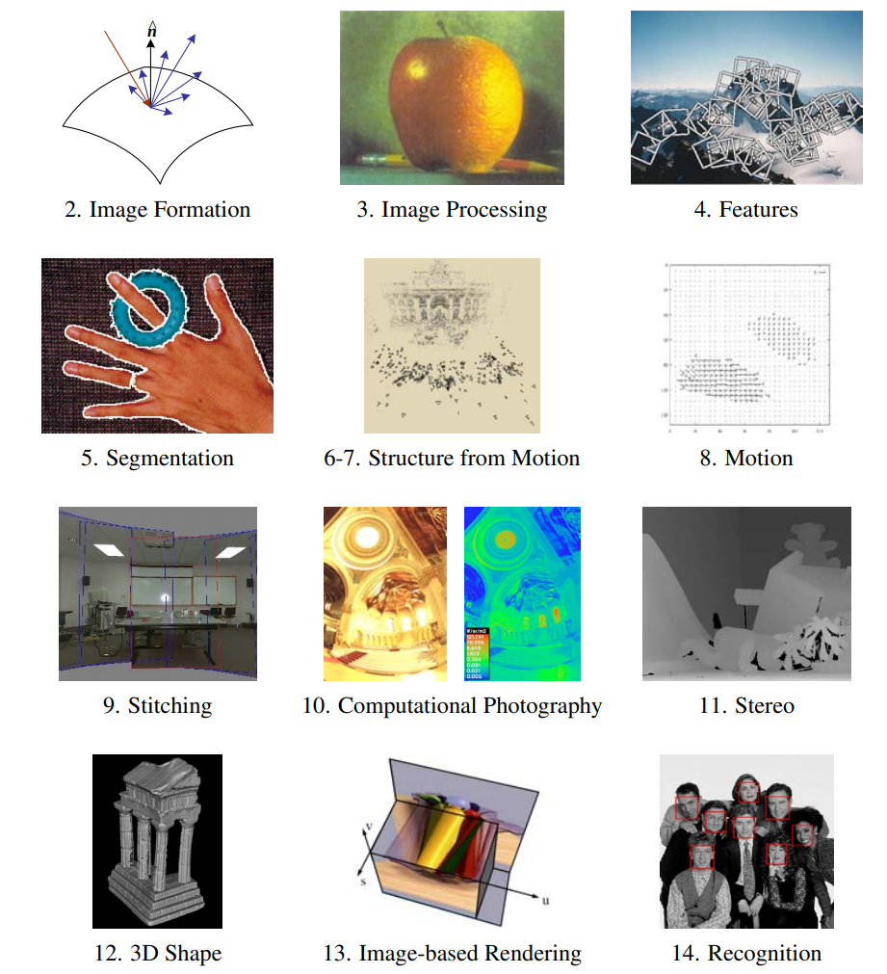
CV covers lots of topics

Slide 11
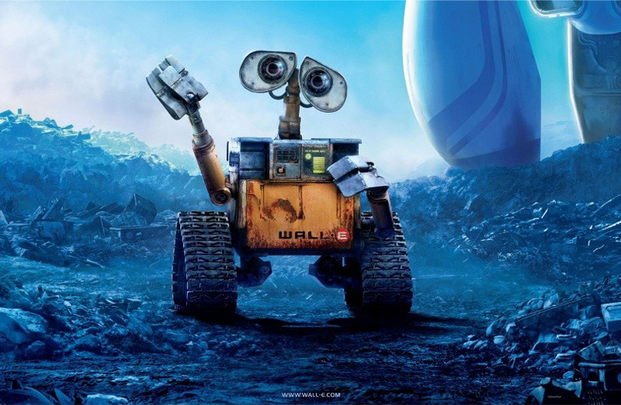
Some CV applications

Slide 12
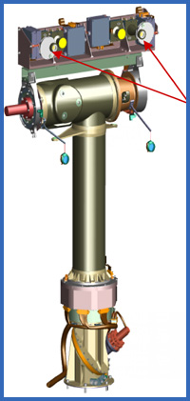
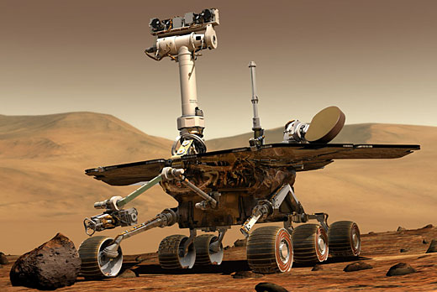
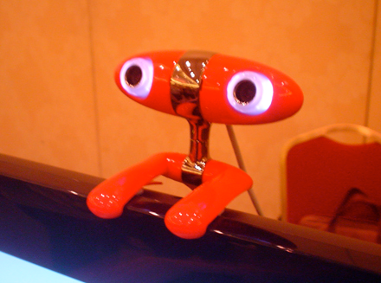
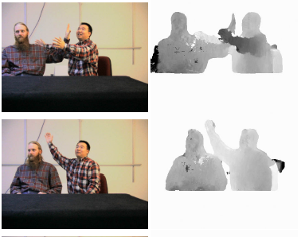
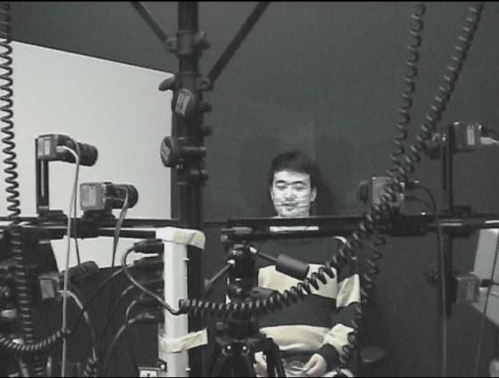
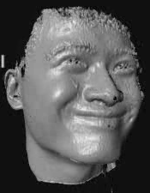
3D Modeling

Slide 13
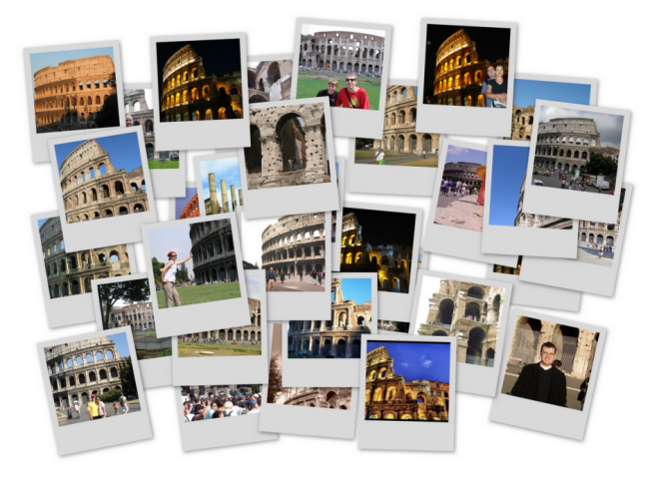
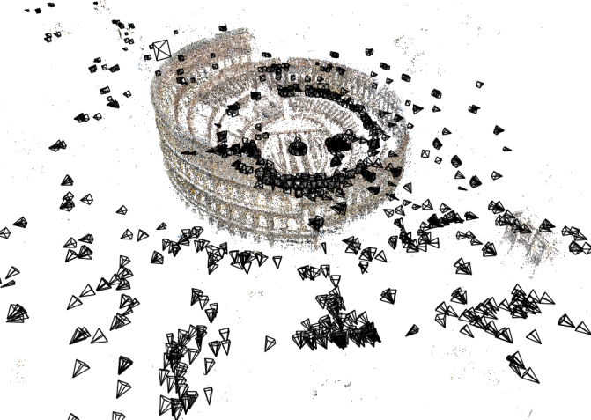
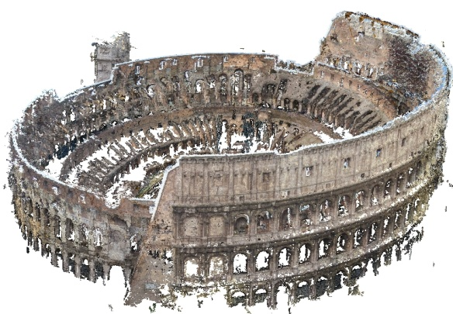
Some uses of computer vision
Computing the 3D shape of the world
Internet Photos (“Colosseum”)
Reconstructed 3D cameras and points
Dense 3D model

Slide 14
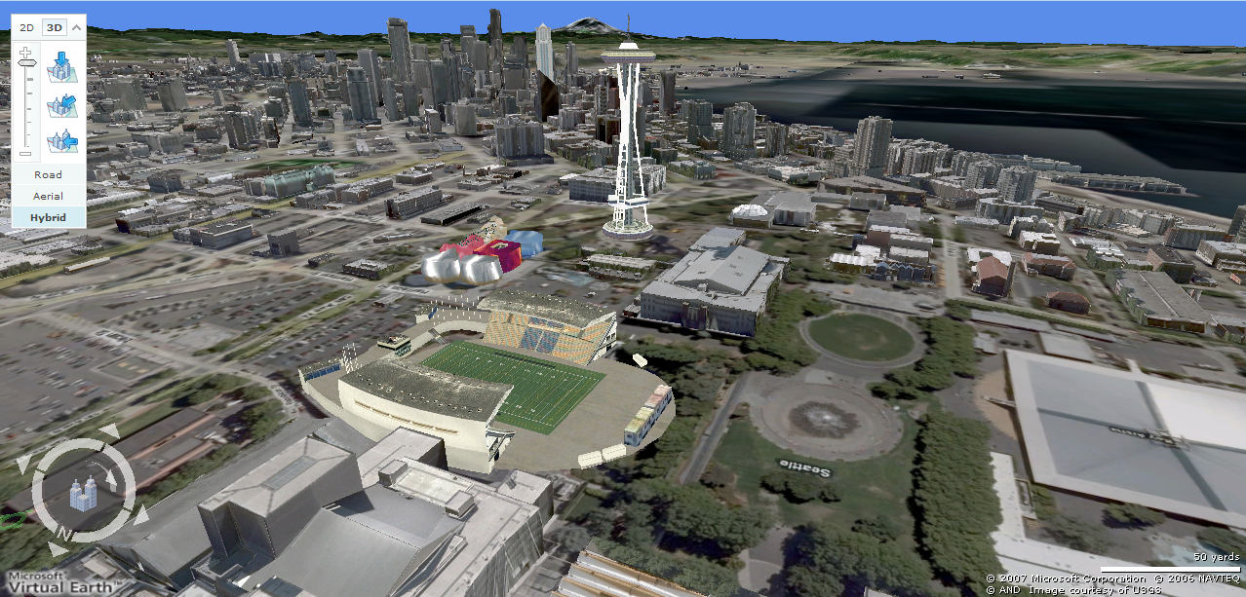
3D urban modeling
Bing maps, Google Streetview
Source: S. Seitz

Slide 15
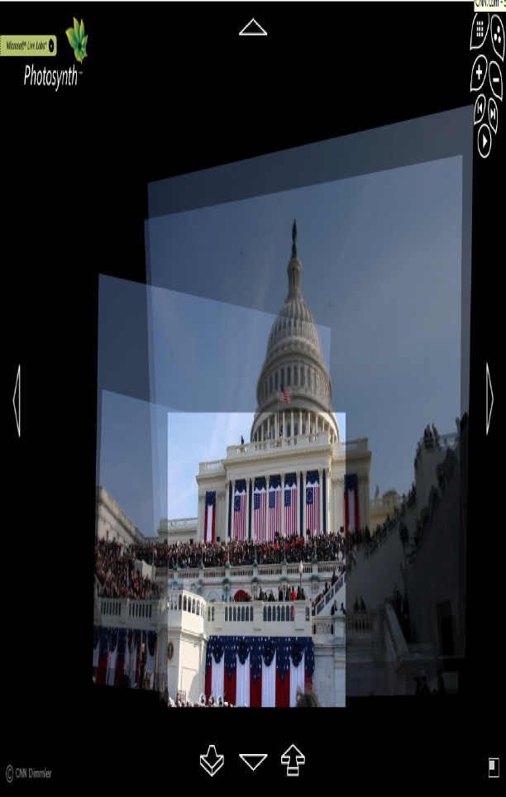
3D urban modeling: Microsoft Photosynth
http://photosynth.net
Source: S. Seitz

Slide 16
Some CV applications
Recognizing objects and people

Slide 17
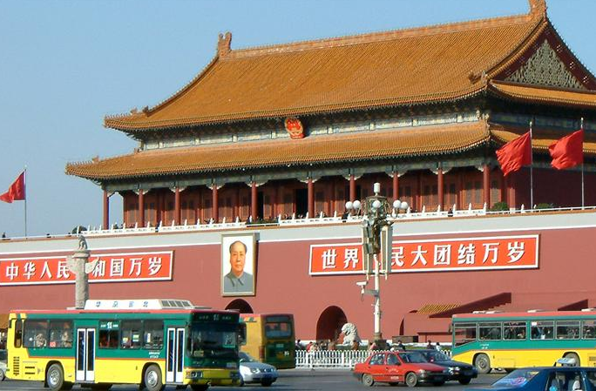
slide credit: Fei-Fei, Fergus & Torralba

Slide 18
sky
building
flag
face
banner
wall
street lamp
bus
bus
cars
slide credit: Fei-Fei, Fergus & Torralba

Slide 19
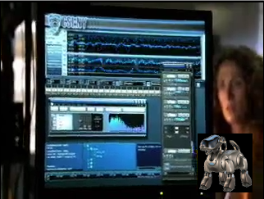
Some CV applications
“Enhancing” images

Slide 20
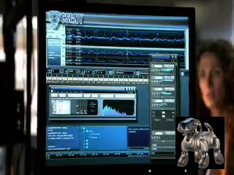

Slide 21
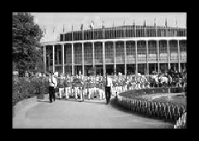
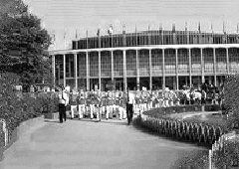
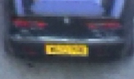
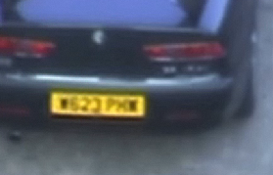
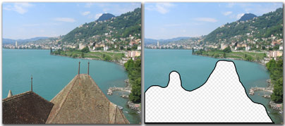
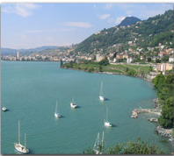
Some CV applications
“Enhancing” images (c.f. Computational Photography)
Texture synthesis / increased field of view (uncropping) (image credit: Efros and Leung)
Super-resolution / denoising (source: 2d3)
Inpainting / image completion (image credit: Hays and Efros)

Slide 22
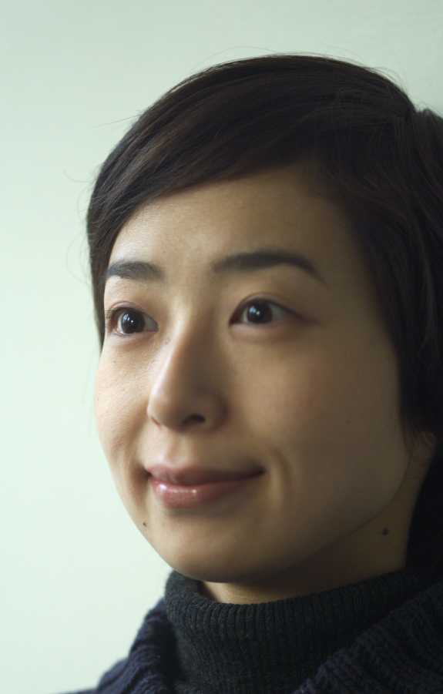
Some CV applications
Forensics
Source: Nayar and Nishino, “Eyes for Relighting”

Slide 23
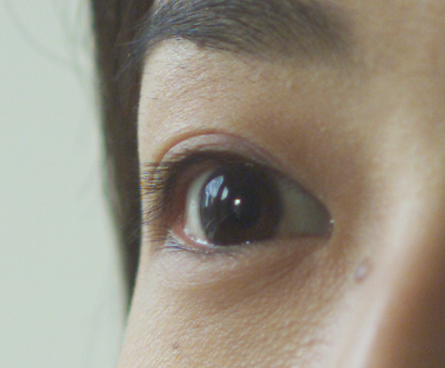

Source: Nayar and Nishino, “Eyes for Relighting”

Slide 24
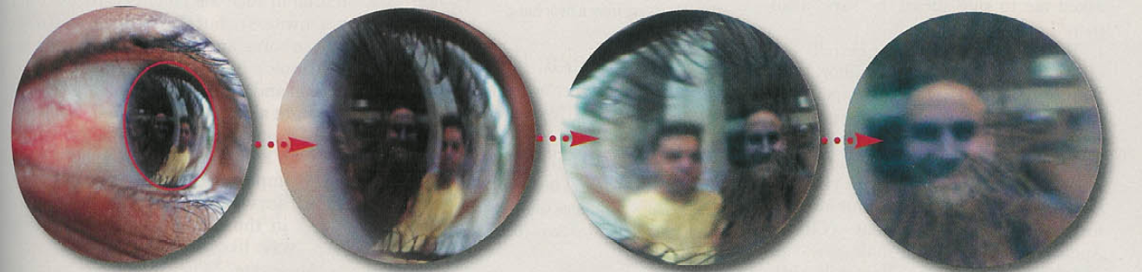
Source: Nayar and Nishino, “Eyes for Relighting”

Slide 25
Computer Vision Problems

Slide 26
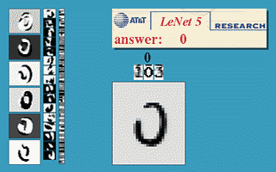

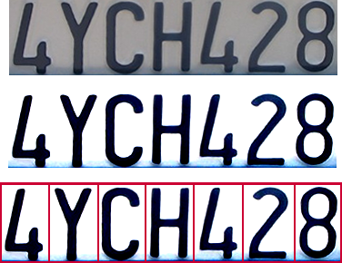
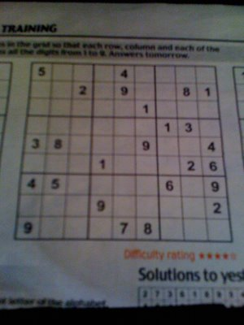
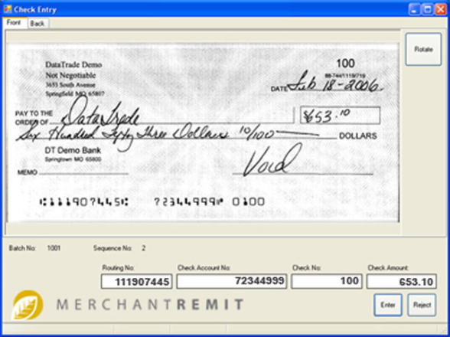
Optical character recognition (OCR)
  If you have a scanner, it probably came with OCR software
Digit recognition, AT&T labs
http://www.research.att.com/~yann/
License plate readers
http://en.wikipedia.org/wiki/Automatic_number_plate_recognition
Sudoku grabber
http://sudokugrab.blogspot.com/
Automatic check processing
Source: S. Seitz

Slide 27
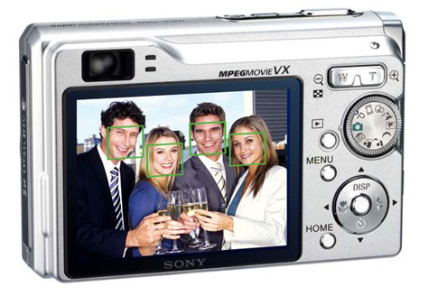
Face detection
Many new digital cameras now detect faces
  Canon, Sony, Fuji, …
Source: S. Seitz
Notes:
Why would this be useful? Main reason is focus. Also enables “smart” cropping.

Slide 28
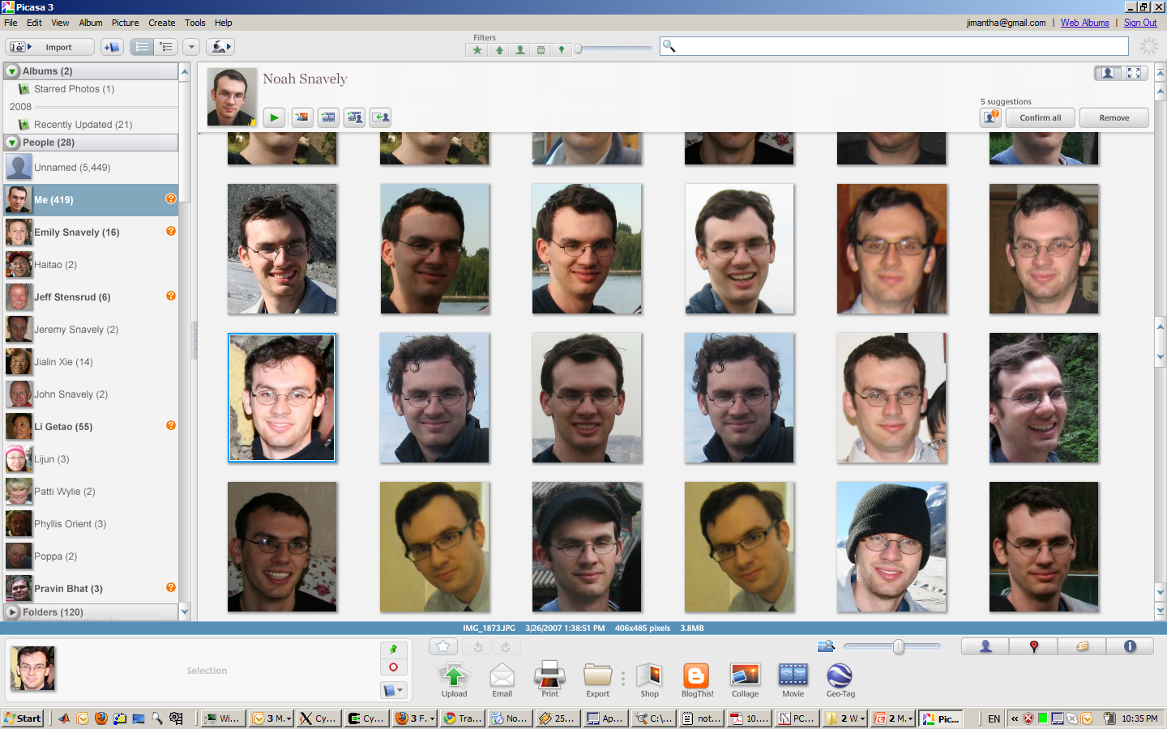
Face recognition

Slide 29

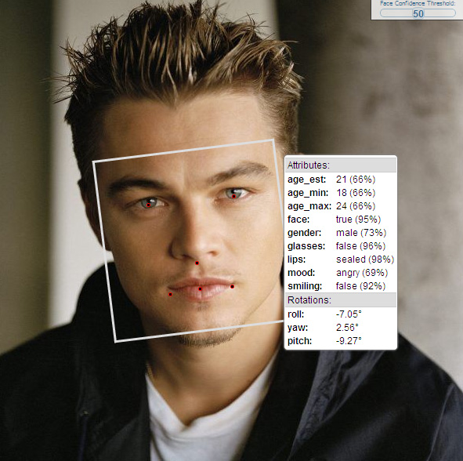
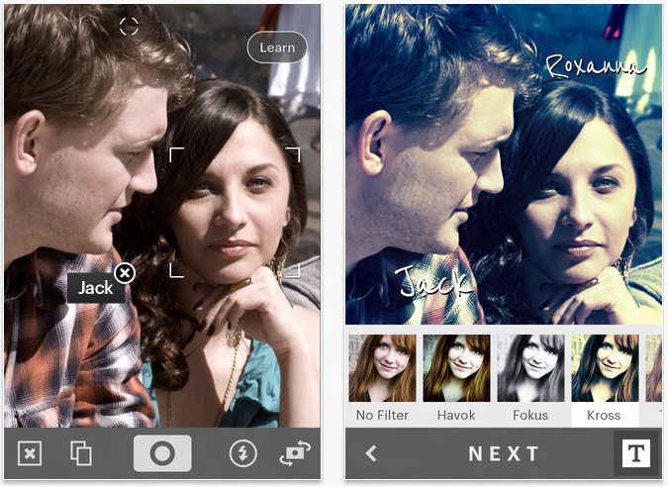
Face Recognition
http://developers.face.com/tools/

Slide 30

Face recognition
Who is she?
Source: S. Seitz

Slide 31
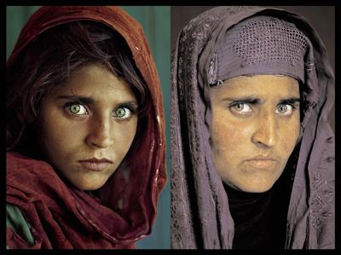
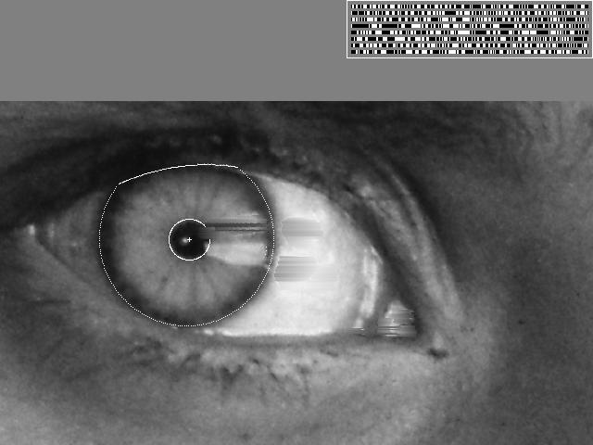
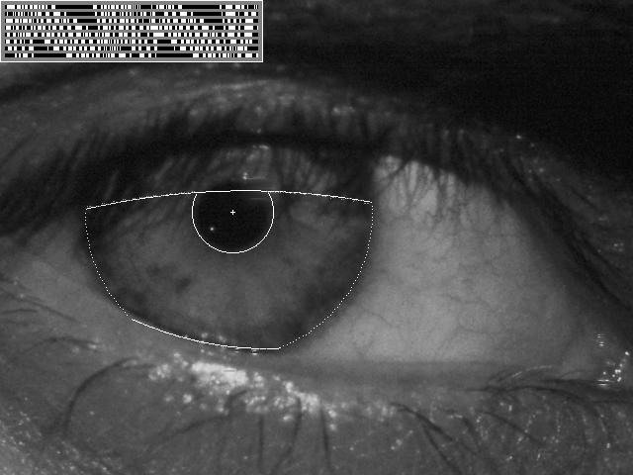
Vision-based biometrics
“How the Afghan Girl was Identified by Her Iris Patterns” Read the story
Source: S. Seitz

Slide 32
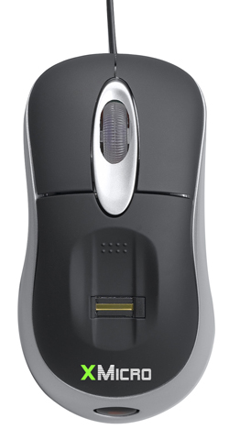
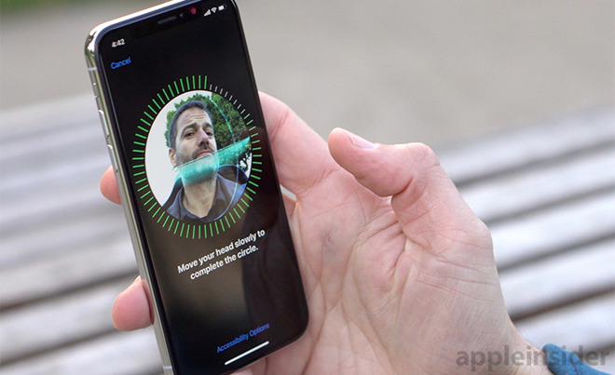
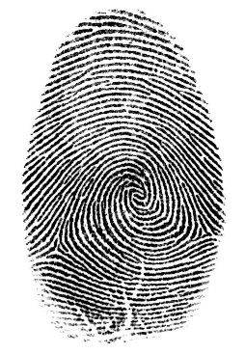
Login without a password…
Fingerprint scanners on many new laptops,
other devices
Face recognition systems now beginning to appear more widely
Source: S. Seitz

Slide 33
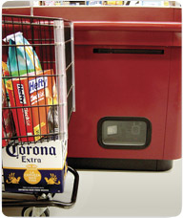
Object recognition (in supermarkets)
LaneHawk by EvolutionRobotics
“A smart camera is flush-mounted in the checkout lane, continuously watching for items. When an item is detected and recognized, the cashier verifies the quantity of items that were found under the basket, and continues to close the transaction. The item can remain under the basket, and with LaneHawk,you are assured to get paid for it… “
Source: S. Seitz

Slide 34
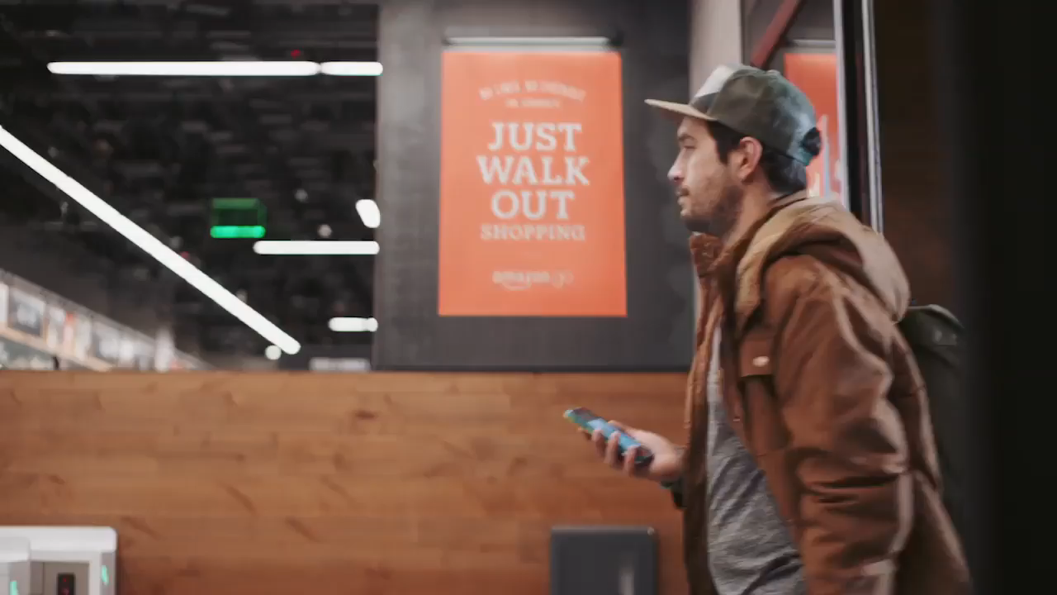
Object recognition (in supermarkets)
Notes:
Amazon Go! https://www.amazon.com/b?ie=UTF8&node=16008589011
Ask – so how does it work?
Think Pair Share!!!

Slide 35
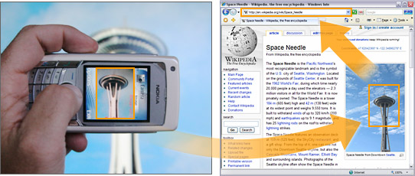
Object recognition (in mobile phones)
Source: S. Seitz

Slide 36
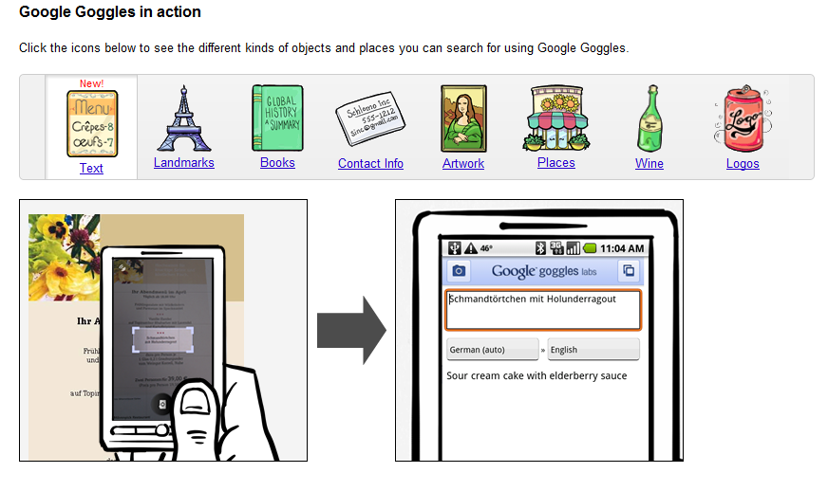
Google Goggles

Slide 37
Google Search by Image
https://images.google.com

Slide 38
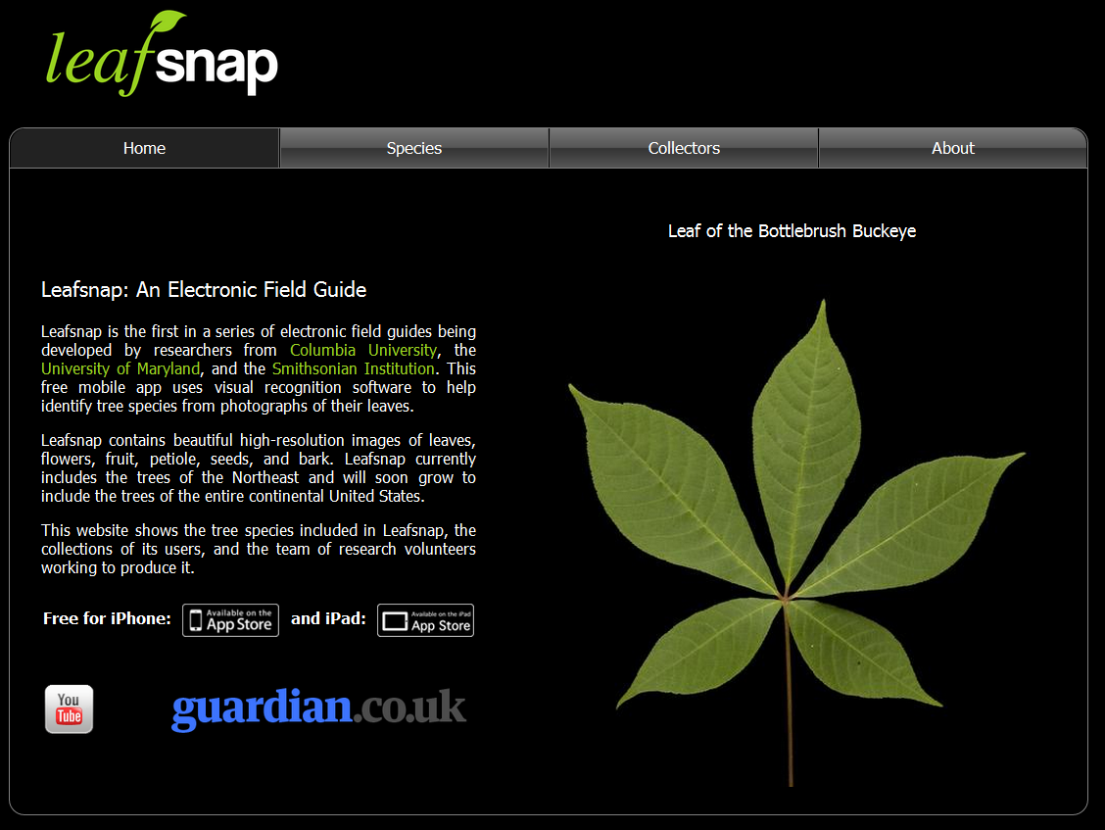
Leaf Recognition

Slide 39
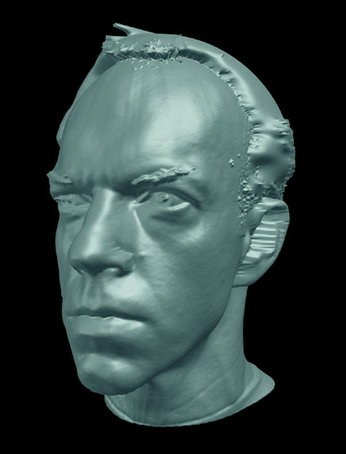
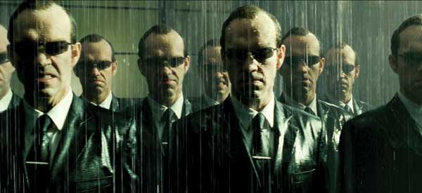
Special effects: shape capture
The Matrix movies, ESC Entertainment, XYZRGB, NRC
Source: S. Seitz

Slide 40
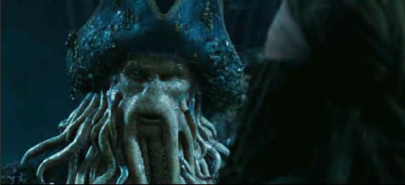

Special effects: motion capture
Pirates of the Carribean, Industrial Light and Magic
Source: S. Seitz

Slide 41

Special effects: camera tracking
Boujou, 2d3

Slide 42


Sports
Sportvision first down line
Nice explanation on www.howstuffworks.com
Source: S. Seitz

Slide 43

3D Mapping

Slide 44

Smart and self-driving cars
Mobileye
  Vision systems currently in high-end BMW, GM, Volvo models
Sources: A. Shashua, S. Seitz

Slide 45


Robot vison
NASA’s Mars Curiosity Rover (Mars Science Laboratory)
http://en.wikipedia.org/wiki/Spirit_rover
Autonomous RC Car
http://www.cs.cornell.edu/~asaxena/rccar/

Slide 46

Robot vision in space
The Heights of Mount Sharp
http://www.nasa.gov/mission_pages/msl/multimedia/pia16077.html
Panorama captured by Curiosity Rover, August 18, 2012 (Sol 12)
Vision systems (JPL) uses for several tasks
  Panorama stitching
  3D terrain modeling
  Obstacle detection, position tracking
  For more, read “Computer Vision on Mars” by Matthies et al.

Slide 47


Medical imaging
3D imaging
MRI, CT
Image guided surgery
Grimson et al., MIT
Source: S. Seitz

Slide 48
Current state of the art
You just saw examples of current systems.
  Many of these are less than 5 years old
This is a very active research area, and rapidly changing
  Many new applications in the next 5 years
To learn more about vision applications and companies
  David Lowe maintains an excellent overview of vision companies
    http://www.cs.ubc.ca/spider/lowe/vision.html

Slide 49
Why is CV difficult?

Slide 50




Source: S. Thorpe

Slide 51







Why is computer vision difficult?
Viewpoint variation
Scale
Illumination

Slide 52






Why is computer vision difficult?
Motion (Source: S. Lazebnik)
Intra-class variation
Background clutter
Occlusion

Slide 53


Challenges: local ambiguity
slide credit: Fei-Fei, Fergus & Torralba

Slide 54



Slide 55

But there are lots of cues we can exploit…
Source: S. Lazebnik

Slide 56

Bottom line
Perception is an inherently ambiguous problem
  Many different 3D scenes could have given rise to a particular 2D picture
  We often need to use prior knowledge about the structure of the world
Image source: F. Durand

Slide 57

Human perception has its “shortcomings”
Sinha and Poggio, Nature, 1996

Slide 58


Slide 59

But humans can tell a lot about a scene from a little information…
Source: “80 million tiny images” by Torralba, et al.

Slide 60



















Why study CV?
Millions of images being captured all the time
Loads of useful applications

Slide 61
Expected outcomes
Able to implement simple low-level operations on images and videos (manipulate them directly as matrices and tensors)
Able to use OpenCV create simple applications
Expose to sufficient theoretical background to understand current research

Slide 62
Course overview
Project (HW) based. Expected quite a few programming assignments
  Buttom-up: implement simple filter
  Top-down: camera calibration
Final project of your choice
Presentations if taking graduate credits
Extra credit: in-class participation
No exam

Slide 63
Grading
Please see course website for detail breakdown

Slide 64
Late policy
Late projects will be penalized by 5% for each day it is late, and penalty capped after 10 days
  Penalty is mild and so no exception will be granted

Slide 65
Academic Integrity
Common sense
Discuss okay (and encouraged) but please do your own work for the final solution. That is the only way to learn
  Take advantage of Discord

Slide 66


Slide 67
Questions?

