Slide 1

Epipolar Geometry
Samuel Cheng
Slide credit: James Tompkin, Naoh Snavely

Slide 2
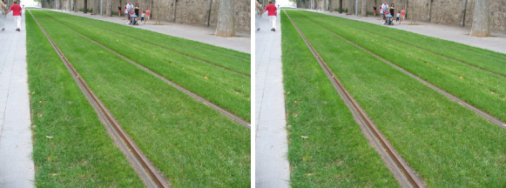
Frederick Kingdom

Slide 3
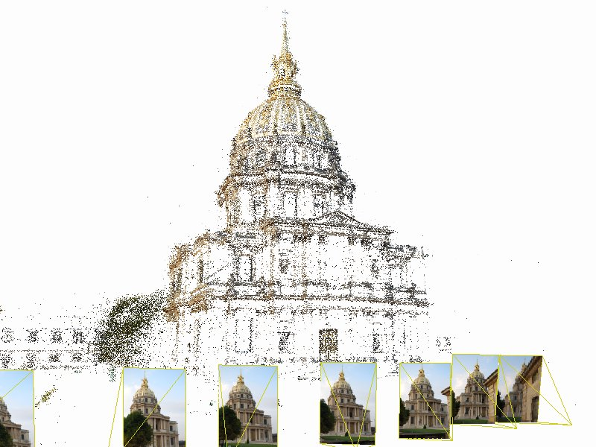
Structure from motion

Slide 4

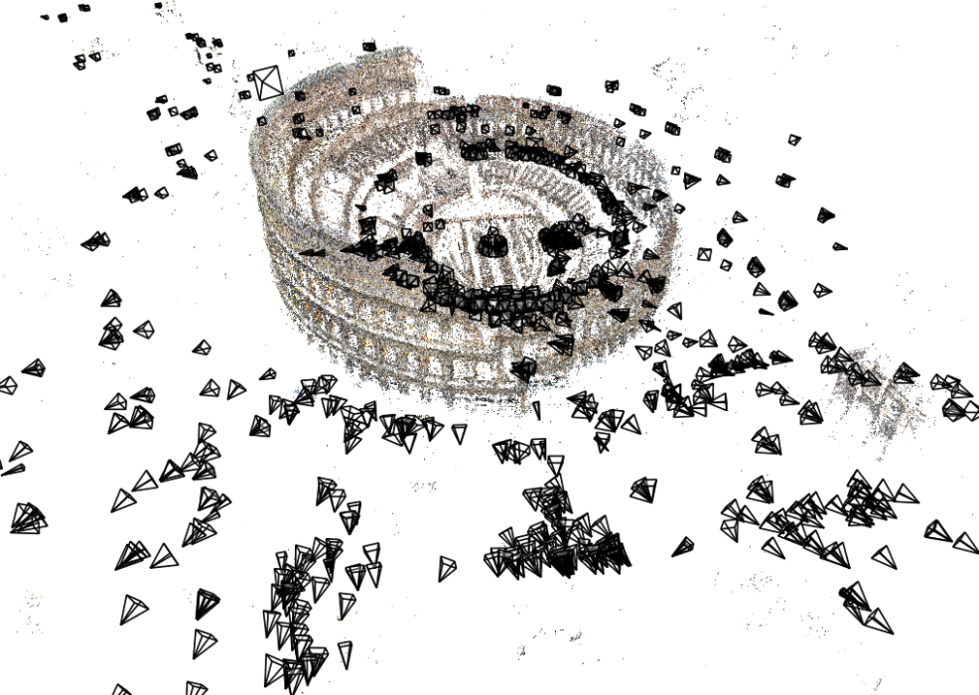
Structure from motion
Given many images, how can we
  a) figure out where they were all taken from?
  b) build a 3D model of the scene?
  This is (roughly) the structure from motion problem

Slide 5
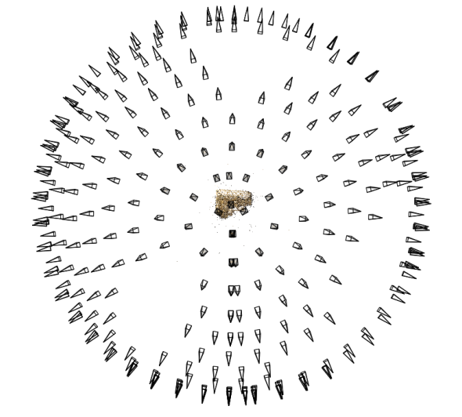
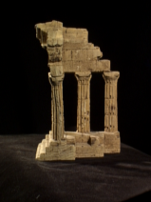
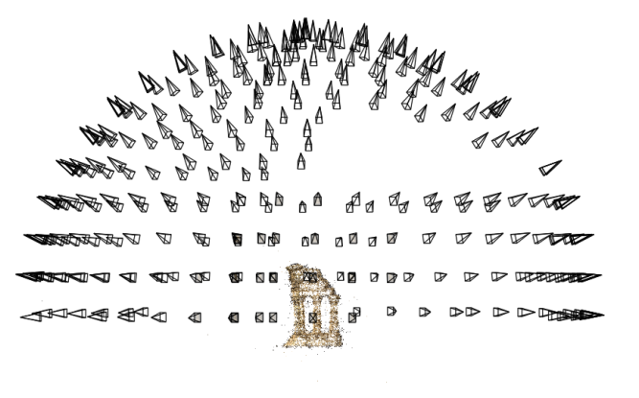
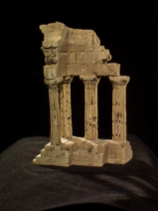
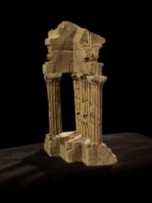
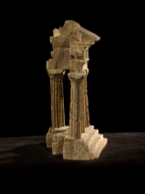
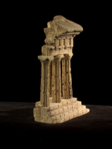
Structure from motion
Reconstruction (side)
(top)
Input: images with points in correspondence p_{i,j} = (u_{i,j},v_{i,j})
Output
  structure: 3D location x_{i} for each point p_{i}
  motion: camera parameters R_{j} , t_{j} possibly K_{j}
Objective function: minimize reprojection error

Slide 6
What we’ve seen so far…
2D transformations between images
  Translations, affine transformations, homographies…
3D coordinates to 2D coordinates
  Camera matrix
Today: epipolar geometry and fundamental matrices

Slide 7
Depth from disparity
Goal: recover depth by finding image coordinate x’ that corresponds to x
X
X
x
z
x
x’
x'
f
f
O
Baseline
T
O’

Slide 8
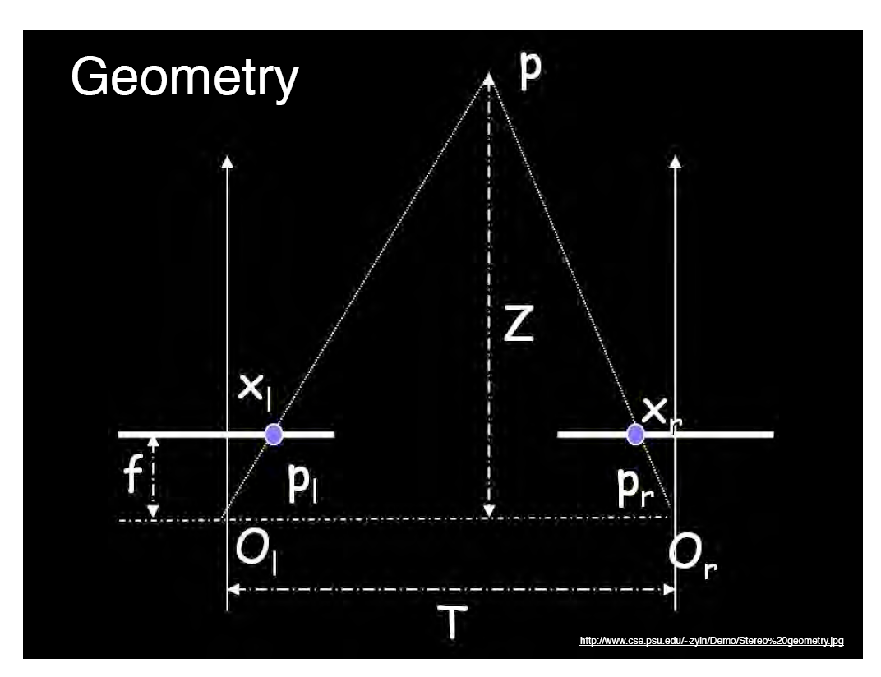
Geometry for a simple stereo system
Assume parallel optical axes, known camera parameters (i.e., calibrated cameras). What is expression for Z?

Slide 9
Geometry for a simple stereo system
Assume parallel optical axes, known camera parameters (i.e., calibrated cameras). What is expression for Z?

Slide 10
Geometry for a simple stereo system
Assume parallel optical axes, known camera parameters (i.e., calibrated cameras). What is expression for Z?

Slide 11
Geometry for a simple stereo system
Assume parallel optical axes, known camera parameters (i.e., calibrated cameras). What is expression for Z?

Slide 12


Geometry for a simple stereo system
Assume parallel optical axes, known camera parameters (i.e., calibrated cameras). What is expression for Z?
$$\frac{T+x_{r}−x_{l}}{Z−f}=\frac{T}{Z}$$
$$Z=f\frac{T}{x_{l}−x_{r}}$$

Slide 13


Geometry for a simple stereo system
Assume parallel optical axes, known camera parameters (i.e., calibrated cameras). What is expression for Z?
Similar triangles (p_{l}, P, p_{r}) and (O_{l}, P, O_{r}):
$$\frac{T+x_{r}−x_{l}}{Z−f}=\frac{T}{Z}$$
$$Z=f\frac{T}{x_{l}−x_{r}}$$

Slide 14
Geometry for a simple stereo system
Assume parallel optical axes, known camera parameters (i.e., calibrated cameras). What is expression for Z?
Similar triangles (p_{l}, P, p_{r}) and (O_{l}, P, O_{r}):
$$\frac{T+x_{r}−x_{l}}{Z−f}=\frac{T}{Z}$$
$$Z=f\frac{T}{x_{l}−x_{r}}$$
disparity

Slide 15
Depth from disparity
Goal: recover depth by finding image coordinate x’ that corresponds to x
Sub-Problems
  Calibration: How do we recover the relation of the cameras (if not already known)?
  Correspondence: How do we search for the matching point x’?
X
x
x'

Slide 16
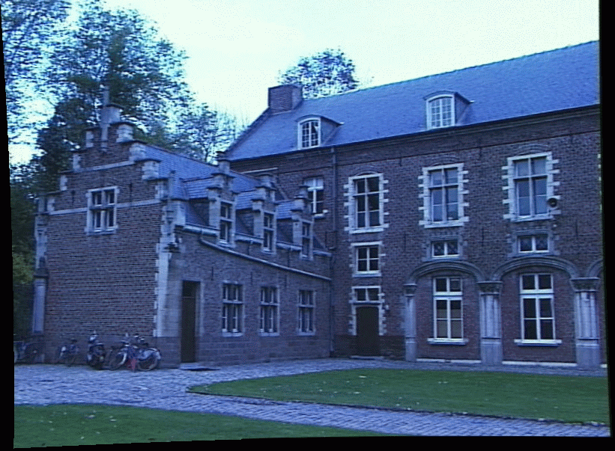
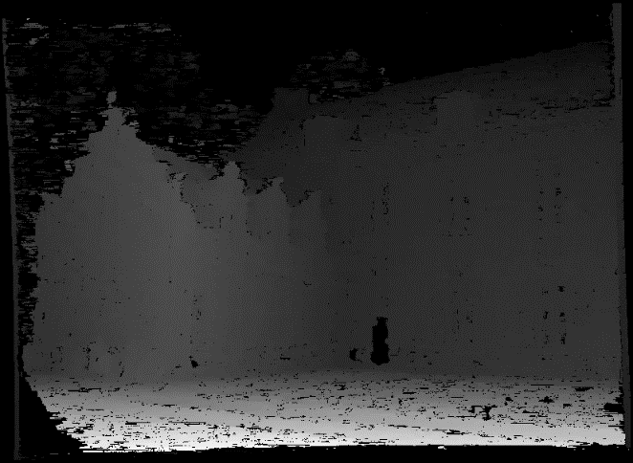
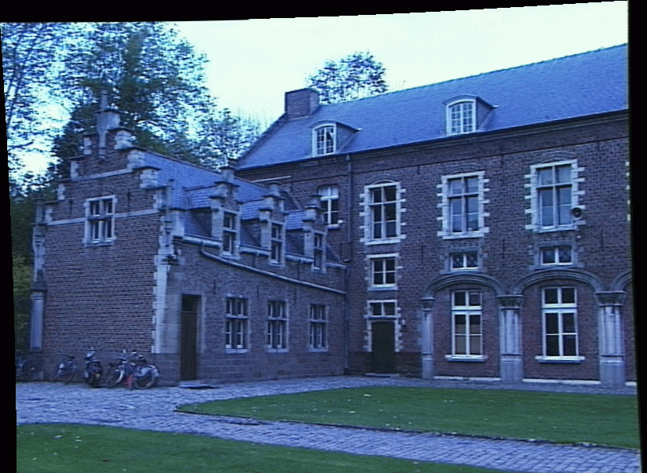
Depth from disparity
image I(x,y)
Disparity map D(x,y)
image I´(x´,y´)
(x´,y´)=(x+D(x,y), y)
James Hays

Slide 17
Depth from disparity
image I(x,y)
Disparity map D(x,y)
image I´(x´,y´)
(x´,y´)=(x+D(x,y), y)
If we could find the corresponding points in two images, we could estimate relative depth…
James Hays

Slide 18
What do we need to know?
Calibration for the two cameras.
  Intrinsic matrices for both cameras (e.g., f)
  Baseline distance T in parallel camera case
  R, t in non-parallel case
2. Correspondence for every pixel.

Slide 19
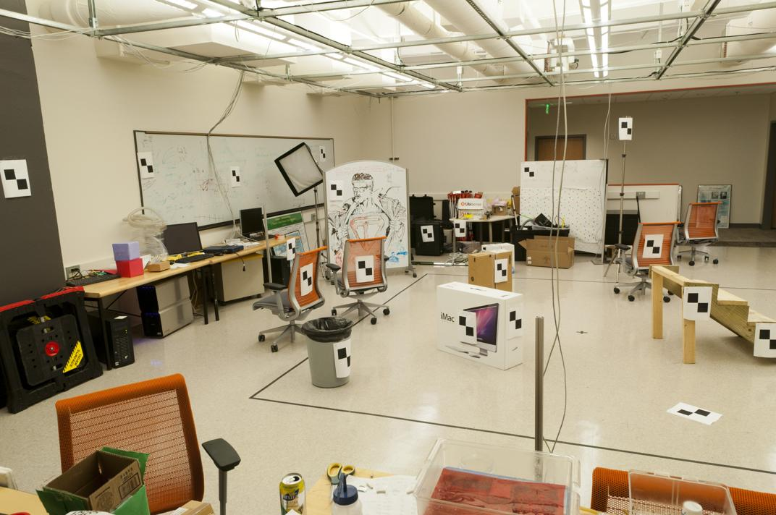
Correspondence for every pixel.
Where do we need to search?

Slide 20
Correspondence for every pixel.
Where do we need to search?

Slide 21
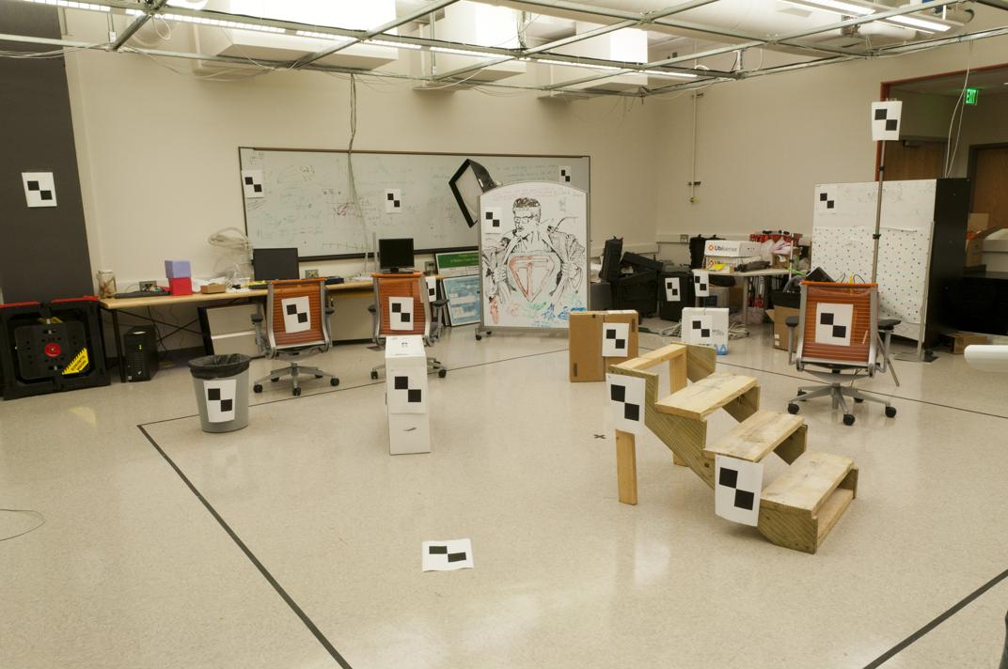
Correspondence for every pixel.
Where do we need to search?

Slide 22
Correspondence for every pixel.
Where do we need to search?

Slide 23
Correspondence for every pixel.
Where do we need to search?

Slide 24
Correspondence for every pixel.
Where do we need to search?

Slide 25
Correspondence for every pixel.
Where do we need to search?

Slide 26
Correspondence for every pixel.
Where do we need to search?

Slide 27
Correspondence for every pixel.
Where do we need to search?

Slide 28
Correspondence for every pixel.
Where do we need to search?

Slide 29
Correspondence for every pixel.
Where do we need to search?

Slide 30
Correspondence for every pixel.
Where do we need to search?

Slide 31
Wouldn’t it be nice to know where matches can live?
Epipolar geometry
Constrains 2D search to 1D

Slide 32
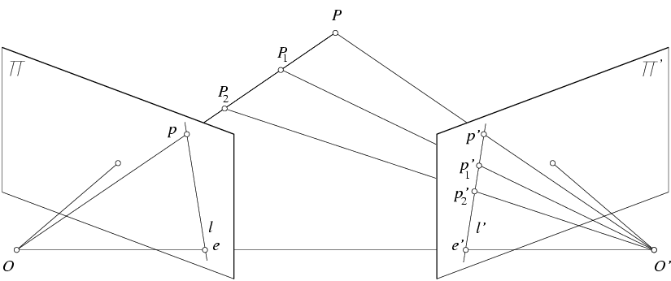


Key idea: Epipolar constraint
X
x
x’
$$e^{l}$$
$${\begin{aligned}e^{r} \\ \end{aligned}}^{}$$

Slide 33
Key idea: Epipolar constraint
X
x
x’
$$e^{l}$$
$${\begin{aligned}e^{r} \\ \end{aligned}}^{}$$
Potential matches for x have to
lie on the corresponding line l’.

Slide 34
Key idea: Epipolar constraint
X
x
x’
$$e^{l}$$
$${\begin{aligned}e^{r} \\ \end{aligned}}^{}$$
Potential matches for x have to
lie on the corresponding line l’.

Slide 35
Key idea: Epipolar constraint
X
x
x’
$$e^{l}$$
$${\begin{aligned}e^{r} \\ \end{aligned}}^{}$$
Potential matches for x have to
lie on the corresponding line l’.

Slide 36
Key idea: Epipolar constraint
X
X
x
x’
x’
$$e^{l}$$
$${\begin{aligned}e^{r} \\ \end{aligned}}^{}$$
Potential matches for x have to
lie on the corresponding line l’.

Slide 37
Key idea: Epipolar constraint
X
X
x
x’
x’
$$e^{l}$$
$${\begin{aligned}e^{r} \\ \end{aligned}}^{}$$
Potential matches for x’ have to
lie on the corresponding line l.
Potential matches for x have to
lie on the corresponding line l’.

Slide 38
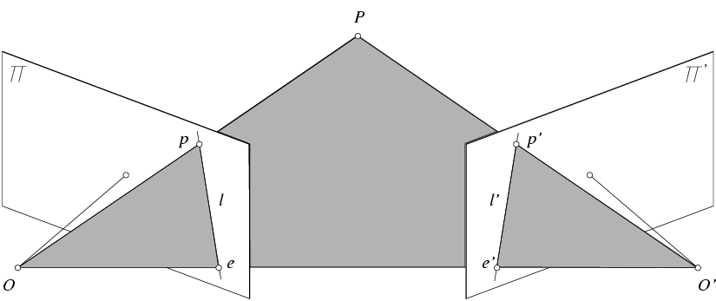


Epipolar geometry: notation
X
x
x’
$${\begin{aligned}e^{r} \\ \end{aligned}}^{}$$
$$e^{l}$$

Slide 39
Epipolar geometry: notation
X
x
x’
$${\begin{aligned}e^{r} \\ \end{aligned}}^{}$$
$$e^{l}$$
Baseline – line connecting the two camera centers

Slide 40
Epipolar geometry: notation
X
x
x’
$${\begin{aligned}e^{r} \\ \end{aligned}}^{}$$
$$e^{l}$$
Baseline – line connecting the two camera centers
Epipoles
= intersections of baseline with image planes
= projections of the other camera center

Slide 41

Epipolar geometry: notation
X
x
x’
$${\begin{aligned}e^{r} \\ \end{aligned}}^{}$$
$$e^{l}$$
Baseline – line connecting the two camera centers
Epipoles
= intersections of baseline with image planes
= projections of the other camera center
Epipolar Plane – plane containing baseline (1D family)

Slide 42

Epipolar geometry: notation
X
x
x’
$$e^{l}$$
$${\begin{aligned}e^{r} \\ \end{aligned}}^{}$$
Baseline – line connecting the two camera centers
Epipoles
= intersections of baseline with image planes
= projections of the other camera center
Epipolar Plane – plane containing baseline (1D family)
Epipolar Lines - intersections of epipolar plane with image
planes (always come in corresponding pairs)

Slide 43
Think Pair Share
= camera center
Where are the epipoles?
What do the epipolar lines look like?
X
X
a)
b)
X
X
c)
d)

Slide 44
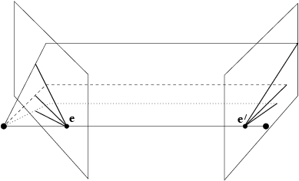
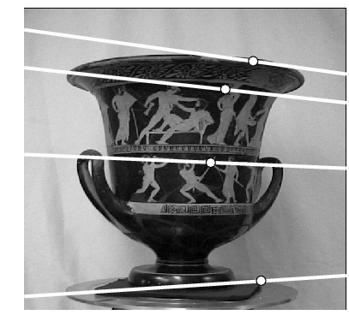
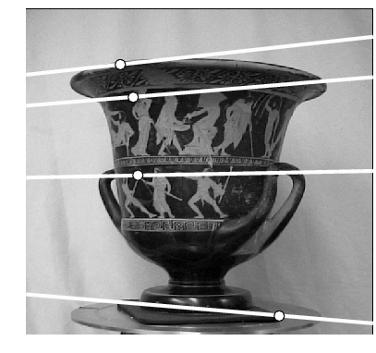
Example: Converging cameras

Slide 45
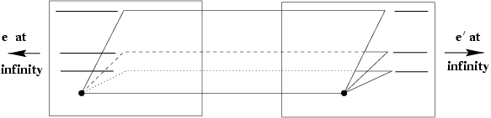
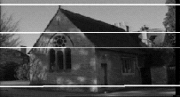
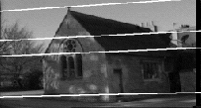
Example: Motion parallel to image plane

Slide 46
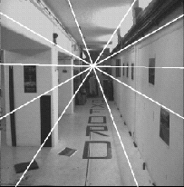
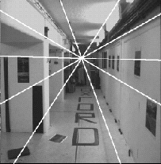
Example: Forward motion
e’
e
Epipole has same coordinates in both images.
Points move along lines radiating from e: “Focus of expansion”

Slide 47
How to find epipolar line of a point?
A little bit more math, but cool math
Essential matrix and fundamental matrix

Slide 48


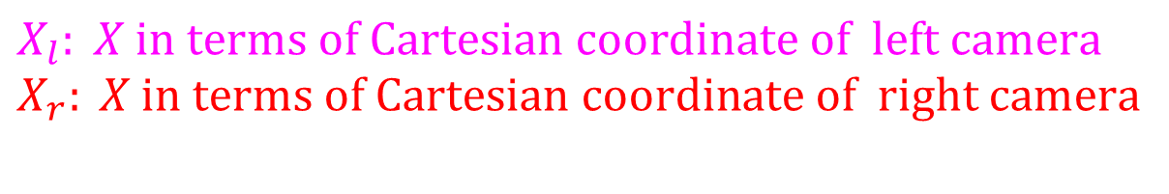


Essential matrix
X
$$X_{l}$$
$${X_{r}}^{}$$
$$e^{l}$$
$${\begin{aligned}e^{r} \\ \end{aligned}}^{}$$
$$X_{l}: X \text{in} \text{terms} \text{of} \text{Cartesian} \text{coordinate} \text{of} \text{left} \text{camera} \\ X_{r}: X \text{in} \text{terms} \text{of} \text{Cartesian} \text{coordinate} \text{of} \text{right} \text{camera}$$
$$\text{There} \text{exists} E \text{such} \text{that} {X_{l}}^{T}EX_{r}=0$$

Slide 49
Essential matrix
X
$$X_{l}$$
$${X_{r}}^{}$$
$$e^{l}$$
$${\begin{aligned}e^{r} \\ \end{aligned}}^{}$$
$$X_{l}: X \text{in} \text{terms} \text{of} \text{Cartesian} \text{coordinate} \text{of} \text{left} \text{camera} \\ X_{r}: X \text{in} \text{terms} \text{of} \text{Cartesian} \text{coordinate} \text{of} \text{right} \text{camera}$$
$$\text{There} \text{exists} E \text{such} \text{that} {X_{l}}^{T}EX_{r}=0$$

Slide 50







Review: change of coordinate
How do we change coordinate from one camera to another?
  (Center of projection at the origin, x-axis points right, y-axis points up, z-axis points backwards)
0

Slide 51
Review: change of coordinate
How do we change coordinate from one camera to another?
  (Center of projection at the origin, x-axis points right, y-axis points up, z-axis points backwards)
Step 1: Translate by -c
0

Slide 52
Review: change of coordinate
How do we change coordinate from one camera to another?
  (Center of projection at the origin, x-axis points right, y-axis points up, z-axis points backwards)
Step 1: Translate by -c
0

Slide 53
Review: change of coordinate
How do we change coordinate from one camera to another?
  (Center of projection at the origin, x-axis points right, y-axis points up, z-axis points backwards)
Step 1: Translate by -c
How do we represent translation as a matrix multiplication?
0

Slide 54
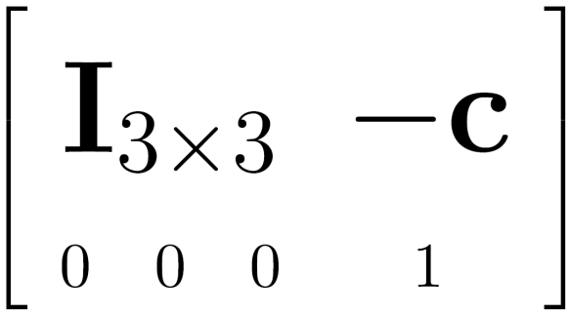

Review: change of coordinate
How do we change coordinate from one camera to another?
  (Center of projection at the origin, x-axis points right, y-axis points up, z-axis points backwards)
Step 1: Translate by -c
How do we represent translation as a matrix multiplication?
0

Slide 55
Review: change of coordinate
How do we change coordinate from one camera to another?
  (Center of projection at the origin, x-axis points right, y-axis points up, z-axis points backwards)
0

Slide 56
Review: change of coordinate
How do we change coordinate from one camera to another?
  (Center of projection at the origin, x-axis points right, y-axis points up, z-axis points backwards)
Step 1: Translate by -c
Step 2: Rotate by R
0
3x3 rotation matrix

Slide 57
Review: change of coordinate
How do we change coordinate from one camera to another?
  (Center of projection at the origin, x-axis points right, y-axis points up, z-axis points backwards)
Step 1: Translate by -c
Step 2: Rotate by R
0

Slide 58




Essential matrix (Longuet-Higgins, 1981)
X
$$X_{l}$$
$$X_{r}^{}$$
x
x’
$$e^{l}$$
$${\begin{aligned}e^{r} \\ \end{aligned}}^{}$$
$$\text{Let} R \text{be} \text{rotation} \text{from} \text{left} \text{to} \text{right} \text{camera}\text{, }\text{then} X_{l}=R(X_{r}−t)$$

Slide 59

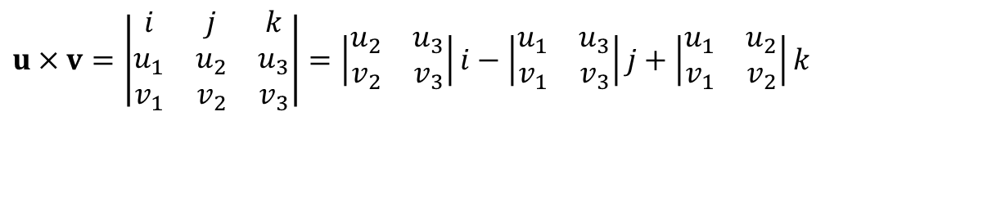
Cross product in matrix representation
Let
$$u=[u_{1},u_{2},u_{3}]^{T},v=[v_{1},v_{2},v_{3}]^{T}$$
$$u×v=\left|\begin{matrix}i & j & k \\ u_{1} & u_{2} & u_{3} \\ v_{1} & v_{2} & v_{3}\end{matrix}\right|=\left|\begin{matrix}u_{2} & u_{3} \\ v_{2} & v_{3}\end{matrix}\right|i−\left|\begin{matrix}u_{1} & u_{3} \\ v_{1} & v_{3}\end{matrix}\right|j+\left|\begin{matrix}u_{1} & u_{2} \\ v_{1} & v_{2}\end{matrix}\right|k$$

Slide 60
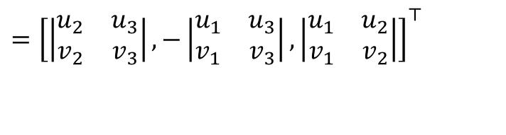
Cross product in matrix representation
Let
$$u=[u_{1},u_{2},u_{3}]^{T},v=[v_{1},v_{2},v_{3}]^{T}$$
$$u×v=\left|\begin{matrix}i & j & k \\ u_{1} & u_{2} & u_{3} \\ v_{1} & v_{2} & v_{3}\end{matrix}\right|=\left|\begin{matrix}u_{2} & u_{3} \\ v_{2} & v_{3}\end{matrix}\right|i−\left|\begin{matrix}u_{1} & u_{3} \\ v_{1} & v_{3}\end{matrix}\right|j+\left|\begin{matrix}u_{1} & u_{2} \\ v_{1} & v_{2}\end{matrix}\right|k$$
$$={\left[\left|\begin{matrix}u_{2} & u_{3} \\ v_{2} & v_{3}\end{matrix}\right|,−\left|\begin{matrix}u_{1} & u_{3} \\ v_{1} & v_{3}\end{matrix}\right|,\left|\begin{matrix}u_{1} & u_{2} \\ v_{1} & v_{2}\end{matrix}\right|\right]}^{⊤}$$

Slide 61
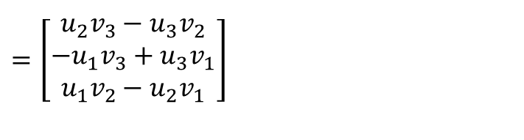
Cross product in matrix representation
Let
$$u=[u_{1},u_{2},u_{3}]^{T},v=[v_{1},v_{2},v_{3}]^{T}$$
$$u×v=\left|\begin{matrix}i & j & k \\ u_{1} & u_{2} & u_{3} \\ v_{1} & v_{2} & v_{3}\end{matrix}\right|=\left|\begin{matrix}u_{2} & u_{3} \\ v_{2} & v_{3}\end{matrix}\right|i−\left|\begin{matrix}u_{1} & u_{3} \\ v_{1} & v_{3}\end{matrix}\right|j+\left|\begin{matrix}u_{1} & u_{2} \\ v_{1} & v_{2}\end{matrix}\right|k$$
$$={\left[\left|\begin{matrix}u_{2} & u_{3} \\ v_{2} & v_{3}\end{matrix}\right|,−\left|\begin{matrix}u_{1} & u_{3} \\ v_{1} & v_{3}\end{matrix}\right|,\left|\begin{matrix}u_{1} & u_{2} \\ v_{1} & v_{2}\end{matrix}\right|\right]}^{⊤}$$
$$={\left[\begin{matrix}u_{2}v_{3}−u_{3}v_{2} \\ −u_{1}v_{3}+u_{3}v_{1} \\ u_{1}v_{2}−u_{2}v_{1}\end{matrix}\right]}^{}$$

Slide 62

Cross product in matrix representation
Let
$$u=[u_{1},u_{2},u_{3}]^{T},v=[v_{1},v_{2},v_{3}]^{T}$$
$$u×v=\left|\begin{matrix}i & j & k \\ u_{1} & u_{2} & u_{3} \\ v_{1} & v_{2} & v_{3}\end{matrix}\right|=\left|\begin{matrix}u_{2} & u_{3} \\ v_{2} & v_{3}\end{matrix}\right|i−\left|\begin{matrix}u_{1} & u_{3} \\ v_{1} & v_{3}\end{matrix}\right|j+\left|\begin{matrix}u_{1} & u_{2} \\ v_{1} & v_{2}\end{matrix}\right|k$$
$$={\left[\left|\begin{matrix}u_{2} & u_{3} \\ v_{2} & v_{3}\end{matrix}\right|,−\left|\begin{matrix}u_{1} & u_{3} \\ v_{1} & v_{3}\end{matrix}\right|,\left|\begin{matrix}u_{1} & u_{2} \\ v_{1} & v_{2}\end{matrix}\right|\right]}^{⊤}$$
$$=\underset{[u]_{×}}{\underbrace{\left[\begin{matrix}0 & −u_{3} & u_{2} \\ u_{3} & 0 & −u_{1} \\ −u_{2} & u_{1} & 0\end{matrix}\right]}}\left[\begin{aligned}&v_{1} \\ &v_{2} \\ &v_{3}\end{aligned}\right]$$
$$={\left[\begin{matrix}u_{2}v_{3}−u_{3}v_{2} \\ −u_{1}v_{3}+u_{3}v_{1} \\ u_{1}v_{2}−u_{2}v_{1}\end{matrix}\right]}^{}$$

Slide 63
Cross product in matrix representation
Let
$$u=[u_{1},u_{2},u_{3}]^{T},v=[v_{1},v_{2},v_{3}]^{T}$$
$$u×v=\left|\begin{matrix}i & j & k \\ u_{1} & u_{2} & u_{3} \\ v_{1} & v_{2} & v_{3}\end{matrix}\right|=\left|\begin{matrix}u_{2} & u_{3} \\ v_{2} & v_{3}\end{matrix}\right|i−\left|\begin{matrix}u_{1} & u_{3} \\ v_{1} & v_{3}\end{matrix}\right|j+\left|\begin{matrix}u_{1} & u_{2} \\ v_{1} & v_{2}\end{matrix}\right|k$$
$$={\left[\left|\begin{matrix}u_{2} & u_{3} \\ v_{2} & v_{3}\end{matrix}\right|,−\left|\begin{matrix}u_{1} & u_{3} \\ v_{1} & v_{3}\end{matrix}\right|,\left|\begin{matrix}u_{1} & u_{2} \\ v_{1} & v_{2}\end{matrix}\right|\right]}^{⊤}$$
$$=\underset{[u]_{×}}{\underbrace{\left[\begin{matrix}0 & −u_{3} & u_{2} \\ u_{3} & 0 & −u_{1} \\ −u_{2} & u_{1} & 0\end{matrix}\right]}}\left[\begin{aligned}&v_{1} \\ &v_{2} \\ &v_{3}\end{aligned}\right]$$
$$={\left[\begin{matrix}u_{2}v_{3}−u_{3}v_{2} \\ −u_{1}v_{3}+u_{3}v_{1} \\ u_{1}v_{2}−u_{2}v_{1}\end{matrix}\right]}^{}$$

Slide 64
Cross product in matrix representation
Let
$$u=[u_{1},u_{2},u_{3}]^{T},v=[v_{1},v_{2},v_{3}]^{T}$$
$$u×v=\left|\begin{matrix}i & j & k \\ u_{1} & u_{2} & u_{3} \\ v_{1} & v_{2} & v_{3}\end{matrix}\right|=\left|\begin{matrix}u_{2} & u_{3} \\ v_{2} & v_{3}\end{matrix}\right|i−\left|\begin{matrix}u_{1} & u_{3} \\ v_{1} & v_{3}\end{matrix}\right|j+\left|\begin{matrix}u_{1} & u_{2} \\ v_{1} & v_{2}\end{matrix}\right|k$$
$$={\left[\left|\begin{matrix}u_{2} & u_{3} \\ v_{2} & v_{3}\end{matrix}\right|,−\left|\begin{matrix}u_{1} & u_{3} \\ v_{1} & v_{3}\end{matrix}\right|,\left|\begin{matrix}u_{1} & u_{2} \\ v_{1} & v_{2}\end{matrix}\right|\right]}^{⊤}$$
$$=\underset{[u]_{×}}{\underbrace{\left[\begin{matrix}0 & −u_{3} & u_{2} \\ u_{3} & 0 & −u_{1} \\ −u_{2} & u_{1} & 0\end{matrix}\right]}}\left[\begin{aligned}&v_{1} \\ &v_{2} \\ &v_{3}\end{aligned}\right]$$
$$={\left[\begin{matrix}u_{2}v_{3}−u_{3}v_{2} \\ −u_{1}v_{3}+u_{3}v_{1} \\ u_{1}v_{2}−u_{2}v_{1}\end{matrix}\right]}^{}$$

Slide 65


Essential matrix (Longuet-Higgins, 1981)
X
$$X_{l}$$
$$X_{r}^{}$$
x’
x’
$$e^{l}$$
$${\begin{aligned}e^{r} \\ \end{aligned}}^{}$$
$$\text{Let} R \text{be} \text{rotation} \text{from} \text{right} \text{to} \text{left} \text{camera}\text{, }\text{then} X_{l}=R(X_{r}−t)$$
$$\text{Let} E \text{be} R[t]_{×},$$
$$X_{l}^{T}EX_{r}$$

Slide 66

Essential matrix (Longuet-Higgins, 1981)
X
$$X_{l}$$
$$X_{r}^{}$$
x’
x’
$$e^{l}$$
$${\begin{aligned}e^{r} \\ \end{aligned}}^{}$$
$$\text{Let} R \text{be} \text{rotation} \text{from} \text{right} \text{to} \text{left} \text{camera}\text{, }\text{then} X_{l}=R(X_{r}−t)$$
$$\text{Let} E \text{be} R[t]_{×},$$
$$X_{l}^{T}EX_{r}$$
$$={X_{l}}^{T}(R[t]_{×}X_{r})$$

Slide 67

Essential matrix (Longuet-Higgins, 1981)
X
$$X_{l}$$
$$X_{r}^{}$$
x’
x’
$$e^{l}$$
$${\begin{aligned}e^{r} \\ \end{aligned}}^{}$$
$$\text{Let} R \text{be} \text{rotation} \text{from} \text{right} \text{to} \text{left} \text{camera}\text{, }\text{then} X_{l}=R(X_{r}−t)$$
$$\text{Let} E \text{be} R[t]_{×},$$
$$X_{l}^{T}EX_{r}$$
$$={X_{l}}^{T}(R[t]_{×}X_{r})$$
$$=(X_{r}−t)^{T}R^{T}R[t]_{×}X_{r}$$

Slide 68

Essential matrix (Longuet-Higgins, 1981)
X
$$X_{l}$$
$$X_{r}^{}$$
x’
x’
$$e^{l}$$
$${\begin{aligned}e^{r} \\ \end{aligned}}^{}$$
$$\text{Let} R \text{be} \text{rotation} \text{from} \text{right} \text{to} \text{left} \text{camera}\text{, }\text{then} X_{l}=R(X_{r}−t)$$
$$\text{Let} E \text{be} R[t]_{×},$$
$$X_{l}^{T}EX_{r}$$
$$={X_{l}}^{T}(R[t]_{×}X_{r})$$
$$=(X_{r}−t)^{T}R^{T}R[t]_{×}X_{r}$$
$$=(X_{r}−t)·(t×X_{r})$$

Slide 69

Essential matrix (Longuet-Higgins, 1981)
X
$$X_{l}$$
$$X_{r}^{}$$
x’
x’
$$e^{l}$$
$${\begin{aligned}e^{r} \\ \end{aligned}}^{}$$
$$\text{Let} R \text{be} \text{rotation} \text{from} \text{right} \text{to} \text{left} \text{camera}\text{, }\text{then} X_{l}=R(X_{r}−t)$$
$$\text{Let} E \text{be} R[t]_{×},$$
$$X_{l}^{T}EX_{r}$$
$$={X_{l}}^{T}(R[t]_{×}X_{r})$$
$$=(X_{r}−t)^{T}R^{T}R[t]_{×}X_{r}$$
$$=(X_{r}−t)·(t×X_{r})$$
$$=X_{r}·\left(t×X_{r}\right)−t·\left(t×X_{r}\right)$$

Slide 70
Essential matrix (Longuet-Higgins, 1981)
X
$$X_{l}$$
$$X_{r}^{}$$
x’
x’
$$e^{l}$$
$${\begin{aligned}e^{r} \\ \end{aligned}}^{}$$
$$\text{Let} R \text{be} \text{rotation} \text{from} \text{right} \text{to} \text{left} \text{camera}\text{, }\text{then} X_{l}=R(X_{r}−t)$$
$$\text{Let} E \text{be} R[t]_{×},$$
$$X_{l}^{T}EX_{r}$$
$$={X_{l}}^{T}(R[t]_{×}X_{r})$$
$$=(X_{r}−t)^{T}R^{T}R[t]_{×}X_{r}$$
$$=(X_{r}−t)·(t×X_{r})$$
$$=X_{r}·\left(t×X_{r}\right)−t·\left(t×X_{r}\right)$$

Slide 71
Essential matrix (Longuet-Higgins, 1981)
X
$$X_{l}$$
$$X_{r}^{}$$
x’
x’
$$e^{l}$$
$${\begin{aligned}e^{r} \\ \end{aligned}}^{}$$
$$\text{Let} R \text{be} \text{rotation} \text{from} \text{right} \text{to} \text{left} \text{camera}\text{, }\text{then} X_{l}=R(X_{r}−t)$$
$$\text{Let} E \text{be} R[t]_{×},$$
$$X_{l}^{T}EX_{r}$$
$$={X_{l}}^{T}(R[t]_{×}X_{r})$$
$$=(X_{r}−t)^{T}R^{T}R[t]_{×}X_{r}$$
$$=(X_{r}−t)·(t×X_{r})$$
$$=X_{r}·\left(t×X_{r}\right)−t·\left(t×X_{r}\right)$$

Slide 72




Essential matrix (Longuet-Higgins, 1981)
X
$$X_{l}$$
$$X_{r}^{}$$
x’
x’
$$e^{l}$$
$${\begin{aligned}e^{r} \\ \end{aligned}}^{}$$
X₀

Slide 73


Essential matrix (Longuet-Higgins, 1981)
X
$$X_{l}$$
$$X_{r}^{}$$
x’
x’
$$e^{l}$$
$${\begin{aligned}e^{r} \\ \end{aligned}}^{}$$
X₀
$$X_{r}^{0}$$

Slide 74

Essential matrix (Longuet-Higgins, 1981)
X
$$X_{l}$$
$$X_{r}^{}$$
x’
x’
$$e^{l}$$
$${\begin{aligned}e^{r} \\ \end{aligned}}^{}$$
X₀
$$X_{r}^{0}$$
$$EX_{r}^{0}=(R[t]_{×})X_{r}^{0}$$

Slide 75

Essential matrix (Longuet-Higgins, 1981)
X
$$X_{l}$$
$$X_{r}^{}$$
x’
x’
$$e^{l}$$
$${\begin{aligned}e^{r} \\ \end{aligned}}^{}$$
X₀
$$X_{r}^{0}$$
$$EX_{r}^{0}=(R[t]_{×})X_{r}^{0}$$
$$=R(t×X_{r}^{0})$$

Slide 76
Essential matrix (Longuet-Higgins, 1981)
X
$$X_{l}$$
$$X_{r}^{}$$
x’
x’
$$e^{l}$$
$${\begin{aligned}e^{r} \\ \end{aligned}}^{}$$
X₀
$$X_{r}^{0}$$
$$EX_{r}^{0}=(R[t]_{×})X_{r}^{0}$$
$$=R(t×X_{r}^{0})$$

Slide 77


Essential matrix (Longuet-Higgins, 1981)
X
$$X_{l}$$
$$X_{r}^{}$$
x’
x’
$$e^{l}$$
$${\begin{aligned}e^{r} \\ \end{aligned}}^{}$$
X₀
$$X_{l}^{0}$$
$$X_{r}^{0}$$
$$EX_{r}^{0}=(R[t]_{×})X_{r}^{0}$$
$$=R(t×X_{r}^{0})$$
$$E^{T}X_{l}^{0}=(R[t]_{×})^{T}R(X_{r}^{0}−t)$$

Slide 78

Essential matrix (Longuet-Higgins, 1981)
X
$$X_{l}$$
$$X_{r}^{}$$
x’
x’
$$e^{l}$$
$${\begin{aligned}e^{r} \\ \end{aligned}}^{}$$
X₀
$$X_{l}^{0}$$
$$X_{r}^{0}$$
$$EX_{r}^{0}=(R[t]_{×})X_{r}^{0}$$
$$=R(t×X_{r}^{0})$$
$$E^{T}X_{l}^{0}=(R[t]_{×})^{T}R(X_{r}^{0}−t)$$
$$=([t]_{×})^{T}R^{T}R(X_{r}^{0}−t)$$

Slide 79
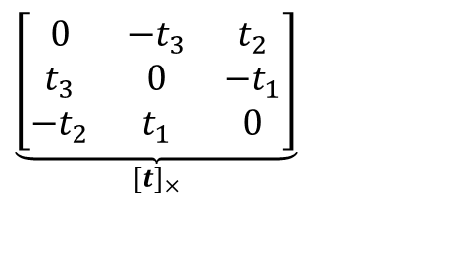
Essential matrix (Longuet-Higgins, 1981)
X
$$X_{l}$$
$$X_{r}^{}$$
x’
x’
$$e^{l}$$
$${\begin{aligned}e^{r} \\ \end{aligned}}^{}$$
X₀
$$X_{l}^{0}$$
$$X_{r}^{0}$$
$$EX_{r}^{0}=(R[t]_{×})X_{r}^{0}$$
$$=R(t×X_{r}^{0})$$
$$\underset{[t]_{×}}{\underbrace{\left[\begin{matrix}0 & −t_{3} & t_{2} \\ t_{3} & 0 & −t_{1} \\ −t_{2} & t_{1} & 0\end{matrix}\right]}}$$
$$E^{T}X_{l}^{0}=(R[t]_{×})^{T}R(X_{r}^{0}−t)$$
$$=([t]_{×})^{T}R^{T}R(X_{r}^{0}−t)$$

Slide 80

Essential matrix (Longuet-Higgins, 1981)
X
$$X_{l}$$
$$X_{r}^{}$$
x’
x’
$$e^{l}$$
$${\begin{aligned}e^{r} \\ \end{aligned}}^{}$$
X₀
$$X_{l}^{0}$$
$$X_{r}^{0}$$
$$EX_{r}^{0}=(R[t]_{×})X_{r}^{0}$$
$$=R(t×X_{r}^{0})$$
$$\underset{[t]_{×}}{\underbrace{\left[\begin{matrix}0 & −t_{3} & t_{2} \\ t_{3} & 0 & −t_{1} \\ −t_{2} & t_{1} & 0\end{matrix}\right]}}$$
$$E^{T}X_{l}^{0}=(R[t]_{×})^{T}R(X_{r}^{0}−t)$$
$$=([t]_{×})^{T}R^{T}R(X_{r}^{0}−t)$$
$$=[−t]_{×}(X_{r}^{0}−t)$$

Slide 81
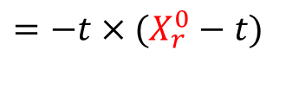
Essential matrix (Longuet-Higgins, 1981)
X
$$X_{l}$$
$$X_{r}^{}$$
x’
x’
$$e^{l}$$
$${\begin{aligned}e^{r} \\ \end{aligned}}^{}$$
X₀
$$X_{l}^{0}$$
$$X_{r}^{0}$$
$$EX_{r}^{0}=(R[t]_{×})X_{r}^{0}$$
$$=R(t×X_{r}^{0})$$
$$\underset{[t]_{×}}{\underbrace{\left[\begin{matrix}0 & −t_{3} & t_{2} \\ t_{3} & 0 & −t_{1} \\ −t_{2} & t_{1} & 0\end{matrix}\right]}}$$
$$E^{T}X_{l}^{0}=(R[t]_{×})^{T}R(X_{r}^{0}−t)$$
$$=([t]_{×})^{T}R^{T}R(X_{r}^{0}−t)$$
$$=[−t]_{×}(X_{r}^{0}−t)$$
$$=−t×(X_{r}^{0}−t)$$

Slide 82
Essential matrix (Longuet-Higgins, 1981)
X
$$X_{l}$$
$$X_{r}^{}$$
x’
x’
$$e^{l}$$
$${\begin{aligned}e^{r} \\ \end{aligned}}^{}$$
X₀
$$X_{l}^{0}$$
$$X_{r}^{0}$$
$$EX_{r}^{0}=(R[t]_{×})X_{r}^{0}$$
$$=R(t×X_{r}^{0})$$
$$\underset{[t]_{×}}{\underbrace{\left[\begin{matrix}0 & −t_{3} & t_{2} \\ t_{3} & 0 & −t_{1} \\ −t_{2} & t_{1} & 0\end{matrix}\right]}}$$
$$E^{T}X_{l}^{0}=(R[t]_{×})^{T}R(X_{r}^{0}−t)$$
$$=([t]_{×})^{T}R^{T}R(X_{r}^{0}−t)$$
$$=[−t]_{×}(X_{r}^{0}−t)$$
$$=−t×(X_{r}^{0}−t)$$

Slide 83


Fundamental matrix (Faugeras and Luong, 1992)
X
$$e^{l}$$
$${\begin{aligned}e^{r} \\ \end{aligned}}^{}$$

Slide 84

Fundamental matrix (Faugeras and Luong, 1992)
X
$$X_{r}^{}$$
$$e^{l}$$
$${\begin{aligned}e^{r} \\ \end{aligned}}^{}$$
$$X_{r}: X \text{in} \text{terms} \text{of} \text{Cartesian} \text{coordinate} \text{of} \text{right} \text{camera}$$

Slide 85
Fundamental matrix (Faugeras and Luong, 1992)
X
$$X_{l}$$
$$X_{r}^{}$$
$$e^{l}$$
$${\begin{aligned}e^{r} \\ \end{aligned}}^{}$$
$$X_{r}: X \text{in} \text{terms} \text{of} \text{Cartesian} \text{coordinate} \text{of} \text{right} \text{camera}$$
$$X_{l}: X \text{in} \text{terms} \text{of} \text{Cartesian} \text{coordinate} \text{of} \text{left} \text{camera}$$

Slide 86

Fundamental matrix (Faugeras and Luong, 1992)
X
$$X_{l}$$
$$X_{r}^{}$$
$$\hat{x_{r}}$$
$$e^{l}$$
$${\begin{aligned}e^{r} \\ \end{aligned}}^{}$$
$$X_{r}: X \text{in} \text{terms} \text{of} \text{Cartesian} \text{coordinate} \text{of} \text{right} \text{camera}$$
$$X_{l}: X \text{in} \text{terms} \text{of} \text{Cartesian} \text{coordinate} \text{of} \text{left} \text{camera}$$

Slide 87

Fundamental matrix (Faugeras and Luong, 1992)
X
$$X_{l}$$
$$X_{r}^{}$$
$$\hat{x_{l}}$$
$$\hat{x_{r}}$$
$$e^{l}$$
$${\begin{aligned}e^{r} \\ \end{aligned}}^{}$$
$$X_{r}: X \text{in} \text{terms} \text{of} \text{Cartesian} \text{coordinate} \text{of} \text{right} \text{camera}$$
$$X_{l}: X \text{in} \text{terms} \text{of} \text{Cartesian} \text{coordinate} \text{of} \text{left} \text{camera}$$

Slide 88
Fundamental matrix (Faugeras and Luong, 1992)
X
$$X_{l}$$
$$X_{r}^{}$$
$$\hat{x_{l}}$$
$$\hat{x_{r}}$$
$$e^{l}$$
$${\begin{aligned}e^{r} \\ \end{aligned}}^{}$$
$$X_{r}: X \text{in} \text{terms} \text{of} \text{Cartesian} \text{coordinate} \text{of} \text{right} \text{camera}$$
$$X_{l}: X \text{in} \text{terms} \text{of} \text{Cartesian} \text{coordinate} \text{of} \text{left} \text{camera}$$

Slide 89
Recall from last time
James Hays

Slide 90
Recall from last time
James Hays

Slide 91
Recall from last time
James Hays

Slide 92
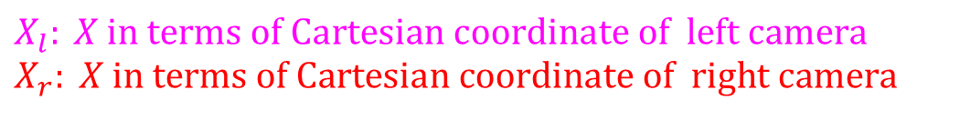
Fundamental matrix
X
$$X_{l}$$
$$X_{r}^{}$$
$$e^{l}$$
$${\begin{aligned}e^{r} \\ \end{aligned}}^{}$$
$$X_{l}: X \text{in} \text{terms} \text{of} \text{Cartesian} \text{coordinate} \text{of} \text{left} \text{camera} \\ X_{r}: X \text{in} \text{terms} \text{of} \text{Cartesian} \text{coordinate} \text{of} \text{right} \text{camera}$$

Slide 93


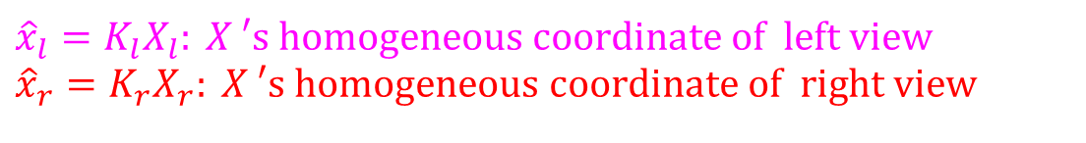
Fundamental matrix
X
$$X_{l}$$
$$X_{r}^{}$$
$$\hat{x_{l}}$$
$${\hat{x_{r}}}^{}$$
$$e^{l}$$
$${\begin{aligned}e^{r} \\ \end{aligned}}^{}$$
$$X_{l}: X \text{in} \text{terms} \text{of} \text{Cartesian} \text{coordinate} \text{of} \text{left} \text{camera} \\ X_{r}: X \text{in} \text{terms} \text{of} \text{Cartesian} \text{coordinate} \text{of} \text{right} \text{camera}$$
$${\hat{x}}_{l}=K_{l}X_{l}: X\text{ ′}\text{s} \text{homogeneous} \text{coordinate} \text{of} \text{left} \text{view} \\ {\hat{x}}_{r}=K_{r}X_{r}: X\text{ ′}\text{s} \text{homogeneous} \text{coordinate} \text{of} \text{right} \text{view}$$

Slide 94
Fundamental matrix
X
$$X_{l}$$
$$X_{r}^{}$$
$$\hat{x_{l}}$$
$${\hat{x_{r}}}^{}$$
$$e^{l}$$
$${\begin{aligned}e^{r} \\ \end{aligned}}^{}$$
$$X_{l}: X \text{in} \text{terms} \text{of} \text{Cartesian} \text{coordinate} \text{of} \text{left} \text{camera} \\ X_{r}: X \text{in} \text{terms} \text{of} \text{Cartesian} \text{coordinate} \text{of} \text{right} \text{camera}$$
$${\hat{x}}_{l}=K_{l}X_{l}: X\text{ ′}\text{s} \text{homogeneous} \text{coordinate} \text{of} \text{left} \text{view} \\ {\hat{x}}_{r}=K_{r}X_{r}: X\text{ ′}\text{s} \text{homogeneous} \text{coordinate} \text{of} \text{right} \text{view}$$

Slide 95
Fundamental matrix
X
$$X_{l}$$
$$X_{r}^{}$$
$$\hat{x_{l}}$$
$${\hat{x_{r}}}^{}$$
$$e^{l}$$
$${\begin{aligned}e^{r} \\ \end{aligned}}^{}$$
$$X_{l}: X \text{in} \text{terms} \text{of} \text{Cartesian} \text{coordinate} \text{of} \text{left} \text{camera} \\ X_{r}: X \text{in} \text{terms} \text{of} \text{Cartesian} \text{coordinate} \text{of} \text{right} \text{camera}$$
$${\hat{x}}_{l}=K_{l}X_{l}: X\text{ ′}\text{s} \text{homogeneous} \text{coordinate} \text{of} \text{left} \text{view} \\ {\hat{x}}_{r}=K_{r}X_{r}: X\text{ ′}\text{s} \text{homogeneous} \text{coordinate} \text{of} \text{right} \text{view}$$

Slide 96
Fundamental matrix
X
$$X_{l}$$
$$X_{r}^{}$$
$$\hat{x_{l}}$$
$${\hat{x_{r}}}^{}$$
$$e^{l}$$
$${\begin{aligned}e^{r} \\ \end{aligned}}^{}$$
$$X_{l}: X \text{in} \text{terms} \text{of} \text{Cartesian} \text{coordinate} \text{of} \text{left} \text{camera} \\ X_{r}: X \text{in} \text{terms} \text{of} \text{Cartesian} \text{coordinate} \text{of} \text{right} \text{camera}$$
$${\hat{x}}_{l}=K_{l}X_{l}: X\text{ ′}\text{s} \text{homogeneous} \text{coordinate} \text{of} \text{left} \text{view} \\ {\hat{x}}_{r}=K_{r}X_{r}: X\text{ ′}\text{s} \text{homogeneous} \text{coordinate} \text{of} \text{right} \text{view}$$

Slide 97
Fundamental matrix
X
$$X_{l}$$
$$X_{r}^{}$$
$$\hat{x_{l}}$$
$${\hat{x_{r}}}^{}$$
$$e^{l}$$
$${\begin{aligned}e^{r} \\ \end{aligned}}^{}$$
$$X_{l}: X \text{in} \text{terms} \text{of} \text{Cartesian} \text{coordinate} \text{of} \text{left} \text{camera} \\ X_{r}: X \text{in} \text{terms} \text{of} \text{Cartesian} \text{coordinate} \text{of} \text{right} \text{camera}$$
$${\hat{x}}_{l}=K_{l}X_{l}: X\text{ ′}\text{s} \text{homogeneous} \text{coordinate} \text{of} \text{left} \text{view} \\ {\hat{x}}_{r}=K_{r}X_{r}: X\text{ ′}\text{s} \text{homogeneous} \text{coordinate} \text{of} \text{right} \text{view}$$

Slide 98


Epipoles and fundamental matrix
X
$${\begin{aligned}e^{r} \\ \end{aligned}}^{}$$
$$e^{l}$$
X₀
$$X_{r}^{0}$$

Slide 99
Epipoles and fundamental matrix
X
$${\begin{aligned}e^{r} \\ \end{aligned}}^{}$$
$$e^{l}$$
X₀
$$X_{r}^{0}$$

Slide 100
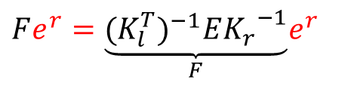
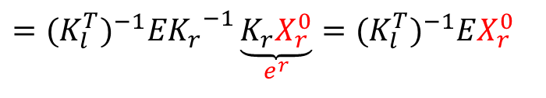
Epipoles and fundamental matrix
X
$${\begin{aligned}e^{r} \\ \end{aligned}}^{}$$
$$e^{l}$$
X₀
$$X_{r}^{0}$$
$$Fe^{r}=\underset{F}{\underbrace{(K_{l}^{T})^{−1}E{K_{r}}^{−1}}}e^{r}$$
$$=(K_{l}^{T})^{−1}E{K_{r}}^{−1}\underset{e^{r}}{\underbrace{K_{r}X_{r}^{0}}}=(K_{l}^{T})^{−1}EX_{r}^{0}$$

Slide 101
Epipoles and fundamental matrix
X
$${\begin{aligned}e^{r} \\ \end{aligned}}^{}$$
$$e^{l}$$
X₀
$$X_{r}^{0}$$
$$Fe^{r}=\underset{F}{\underbrace{(K_{l}^{T})^{−1}E{K_{r}}^{−1}}}e^{r}$$
$$=(K_{l}^{T})^{−1}E{K_{r}}^{−1}\underset{e^{r}}{\underbrace{K_{r}X_{r}^{0}}}=(K_{l}^{T})^{−1}EX_{r}^{0}$$

Slide 102

Epipoles and fundamental matrix
X
$${\begin{aligned}e^{r} \\ \end{aligned}}^{}$$
$$e^{l}$$
X₀
$$X_{l}^{0}$$
$$X_{r}^{0}$$
$$Fe^{r}=\underset{F}{\underbrace{(K_{l}^{T})^{−1}E{K_{r}}^{−1}}}e^{r}$$
$$=(K_{l}^{T})^{−1}E{K_{r}}^{−1}\underset{e^{r}}{\underbrace{K_{r}X_{r}^{0}}}=(K_{l}^{T})^{−1}EX_{r}^{0}$$
$$F^{T}e^{l}=\underset{F}{\underbrace{(K_{r}^{T})^{−1}E^{T}{K_{l}}^{−1}}}e^{l}=(K_{r}^{T})^{−1}E^{T}{K_{l}}^{−1}\underset{e^{l}}{\underbrace{K_{l}X_{l}^{0}}}=(K_{r}^{T})^{−1}E^{T}X_{l}^{0}=0$$

Slide 103




Review: Essential matrix
X
$$\hat{X_{l}}$$
$${\hat{X_{r}}}^{}$$
$$e^{l}$$
$${\begin{aligned}e^{r} \\ \end{aligned}}^{}$$

Slide 104
Review: Essential matrix
X
$$\hat{X_{l}}$$
$${\hat{X_{r}}}^{}$$
$$e^{l}$$
$${\begin{aligned}e^{r} \\ \end{aligned}}^{}$$

Slide 105
Review: Fundamental matrix
X
$$\hat{X_{l}}$$
$${\hat{X_{r}}}^{}$$
$$e^{l}$$
$${\begin{aligned}e^{r} \\ \end{aligned}}^{}$$

Slide 106
Review: Fundamental matrix
X
$$\hat{X_{l}}$$
$${\hat{X_{r}}}^{}$$
$$\hat{x_{l}}$$
$${\hat{x_{r}}}^{}$$
$$e^{l}$$
$${\begin{aligned}e^{r} \\ \end{aligned}}^{}$$

Slide 107
Review: Fundamental matrix
X
$$\hat{X_{l}}$$
$${\hat{X_{r}}}^{}$$
$$\hat{x_{l}}$$
$${\hat{x_{r}}}^{}$$
$$e^{l}$$
$${\begin{aligned}e^{r} \\ \end{aligned}}^{}$$

Slide 108
Review: Fundamental matrix
X
$$\hat{X_{l}}$$
$${\hat{X_{r}}}^{}$$
$$\hat{x_{l}}$$
$${\hat{x_{r}}}^{}$$
$$e^{l}$$
$${\begin{aligned}e^{r} \\ \end{aligned}}^{}$$

Slide 109
Review: Fundamental matrix
X
$$\hat{X_{l}}$$
$${\hat{X_{r}}}^{}$$
$$\hat{x_{l}}$$
$${\hat{x_{r}}}^{}$$
$$e^{l}$$
$${\begin{aligned}e^{r} \\ \end{aligned}}^{}$$

Slide 110
Review: Fundamental matrix
X
$$\hat{X_{l}}$$
$${\hat{X_{r}}}^{}$$
$$\hat{x_{l}}$$
$${\hat{x_{r}}}^{}$$
$$e^{l}$$
$${\begin{aligned}e^{r} \\ \end{aligned}}^{}$$

Slide 111
Line representation in homogenous coordinate
Line equation: ax + by + c = 0
  Can represent a line with vector [a b c]
Then, a point p is on a line l if and only if
Note that

Slide 112
Line representation in homogenous coordinate
Line equation: ax + by + c = 0
  Can represent a line with vector [a b c]
Then, a point p is on a line l if and only if
Note that

Slide 113
Line representation in homogenous coordinate
Line equation: ax + by + c = 0
  Can represent a line with vector [a b c]
Then, a point p is on a line l if and only if
Note that

Slide 114
Line representation in homogenous coordinate
Line equation: ax + by + c = 0
  Can represent a line with vector [a b c]
Then, a point p is on a line l if and only if
Note that

Slide 115



Epipoles and fundamental matrix
X
$$\hat{x_{l}}$$
$${\hat{x_{r}}}^{}$$
$$e^{l}$$
$${\begin{aligned}e^{r} \\ \end{aligned}}^{}$$
X₀

Slide 116

Epipoles and fundamental matrix
X
$$\hat{x_{l}}$$
$${\hat{x_{r}}}^{}$$
$$e^{l}$$
$${\begin{aligned}e^{r} \\ \end{aligned}}^{}$$
X₀
$$\text{and} \text{recall} \text{that} Fe^{r}=F^{T}e^{l}=0$$

Slide 117
Epipoles and fundamental matrix
X
$$\hat{x_{l}}$$
$${\hat{x_{r}}}^{}$$
$$e^{l}$$
$${\begin{aligned}e^{r} \\ \end{aligned}}^{}$$
X₀
$$\text{and} \text{recall} \text{that} Fe^{r}=F^{T}e^{l}=0$$

Slide 118
Epipoles and fundamental matrix
X
$$\hat{x_{l}}$$
$${\hat{x_{r}}}^{}$$
$$e^{l}$$
$${\begin{aligned}e^{r} \\ \end{aligned}}^{}$$
X₀
$$\text{and} \text{recall} \text{that} Fe^{r}=F^{T}e^{l}=0$$

Slide 119
Epipoles and fundamental matrix
X
$$\hat{x_{l}}$$
$${\hat{x_{r}}}^{}$$
$$e^{l}$$
$${\begin{aligned}e^{r} \\ \end{aligned}}^{}$$
X₀
$$\text{and} \text{recall} \text{that} Fe^{r}=F^{T}e^{l}=0$$

Slide 120


Epipoles and fundamental matrix
X
$$\hat{x_{l}}$$
$${\hat{x_{r}}}^{}$$
$$e^{l}$$
$${\begin{aligned}e^{r} \\ \end{aligned}}^{}$$
X₀
$$\text{and} \text{recall} \text{that} Fe^{r}=F^{T}e^{l}=0$$

Slide 121

Epipoles and fundamental matrix
X
$$\hat{x_{l}}$$
$${\hat{x_{r}}}^{}$$
$$e^{l}$$
$${\begin{aligned}e^{r} \\ \end{aligned}}^{}$$
X₀
$$\text{and} \text{recall} \text{that} Fe^{r}=F^{T}e^{l}=0$$
$$⇒e^{r}F^{T}{\hat{x}}_{l}=(Fe^{r})^{T}{\hat{x}}_{l}=0$$

Slide 122

Epipoles and fundamental matrix
X
$$\hat{x_{l}}$$
$${\hat{x_{r}}}^{}$$
$$e^{l}$$
$${\begin{aligned}e^{r} \\ \end{aligned}}^{}$$
X₀
$$\text{and} \text{recall} \text{that} Fe′=F^{T}e^{l}=0$$
$$⇒e^{r}F^{T}{\hat{x}}_{l}=(Fe^{r})^{T}{\hat{x}}_{l}=0$$

Slide 123
Epipoles and fundamental matrix
X
$$\hat{x_{l}}$$
$${\hat{x_{r}}}^{}$$
$$e^{l}$$
$${\begin{aligned}e^{r} \\ \end{aligned}}^{}$$
X₀
$$\text{and} \text{recall} \text{that} Fe′=F^{T}e^{l}=0$$
$$⇒e^{r}F^{T}{\hat{x}}_{l}=(Fe^{r})^{T}{\hat{x}}_{l}=0$$

Slide 124
Epipoles and fundamental matrix
X
$$\hat{x_{l}}$$
$${\hat{x_{r}}}^{}$$
$$e^{l}$$
$${\begin{aligned}e^{r} \\ \end{aligned}}^{}$$

Slide 125
Epipoles and fundamental matrix
X
$$\hat{x_{l}}$$
$${\hat{x_{r}}}^{}$$
$$e^{l}$$
$${\begin{aligned}e^{r} \\ \end{aligned}}^{}$$

Slide 126
Epipoles and fundamental matrix
X
$$\hat{x_{l}}$$
$${\hat{x_{r}}}^{}$$
$$e^{l}$$
$${\begin{aligned}e^{r} \\ \end{aligned}}^{}$$

Slide 127
Epipoles and fundamental matrix
X
$$\hat{x_{l}}$$
$${\hat{x_{r}}}^{}$$
$$e^{l}$$
$${\begin{aligned}e^{r} \\ \end{aligned}}^{}$$

Slide 128
Epipoles and fundamental matrix
X
$$\hat{x_{l}}$$
$${\hat{x_{r}}}^{}$$
$$e^{l}$$
$${\begin{aligned}e^{r} \\ \end{aligned}}^{}$$

Slide 129
Epipoles and fundamental matrix
X
$$\hat{x_{l}}$$
$${\hat{x_{r}}}^{}$$
$$e^{l}$$
$${\begin{aligned}e^{r} \\ \end{aligned}}^{}$$
This restrict our search space from 2D to 1D

Slide 130


Fundamental matrix
X
$$e^{l}$$
$${\begin{aligned}e^{r} \\ \end{aligned}}^{}$$

Slide 131

Fundamental matrix
X
$$e^{l}$$
$${\begin{aligned}e^{r} \\ \end{aligned}}^{}$$
F e^{r} = 0 and F^{T}e^{l} = 0 (nullspaces of F = e^{r}; nullspace of F^{T} = e^{l})
F is singular (rank two): det(F)=0
F has seven degrees of freedom: 9 entries but defined up to scale, det(F)=0

Slide 132
Fundamental matrix
X
$$e^{l}$$
$${\begin{aligned}e^{r} \\ \end{aligned}}^{}$$
F e^{r} = 0 and F^{T}e^{l} = 0 (nullspaces of F = e^{r}; nullspace of F^{T} = e^{l})
F is singular (rank two): det(F)=0
F has seven degrees of freedom: 9 entries but defined up to scale, det(F)=0

Slide 133
Remark
Since

Slide 134
Remark
Since

Slide 135
Remark
Since

Slide 136
Remark
Since
This is sometimes how essential matrix is introduced

Slide 137
Estimating the Fundamental Matrix
8-point algorithm
  Least squares solution using SVD on equations from 8 pairs of correspondences
  Enforce det(F)=0 constraint using SVD on F

Slide 138
Estimating the Fundamental Matrix
8-point algorithm
  Least squares solution using SVD on equations from 8 pairs of correspondences
  Enforce det(F)=0 constraint using SVD on F
Note: estimation of F (or E) is degenerate for a planar scene.

Slide 139
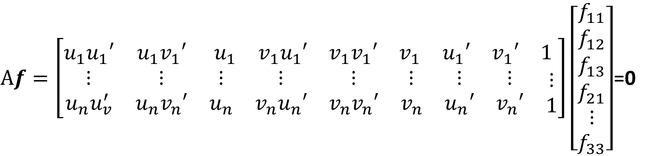
8-point algorithm
Solve a system of homogeneous linear equations
  Write down the system of equations
$$uu^{′}f_{11}+uv^{′}f_{12}+uf_{13}+vu^{′}f_{21}+vv^{′}f_{22}+vf_{23}+u^{′}f_{31}+v^{′}f_{32}+f_{33}=0$$
$Af=\left[\begin{matrix}u_{1}u_{1}′ & u_{1}v_{1}′ & \begin{matrix}u_{1} & v_{1}u_{1}′ & \begin{matrix}v_{1}v_{1}′ & v_{1} & \begin{matrix}u_{1}′ & v_{1}′ & 1\end{matrix}\end{matrix}\end{matrix} \\ \begin{matrix}⋮ \\ u_{n}u_{v}^{′}\end{matrix} & \begin{matrix}⋮ \\ u_{n}v_{n}′\end{matrix} & \begin{matrix}\begin{matrix}⋮ \\ u_{n}\end{matrix} & \begin{matrix}⋮ \\ v_{n}u_{n}′\end{matrix} & \begin{matrix}\begin{matrix}⋮ \\ v_{n}v_{n}′\end{matrix} & \begin{matrix}⋮ \\ v_{n}\end{matrix} & \begin{matrix}\begin{matrix}⋮ \\ u_{n}′\end{matrix} & \begin{matrix}⋮ \\ v_{n}′\end{matrix} & \begin{matrix}⋮ \\ 1\end{matrix}\end{matrix}\end{matrix}\end{matrix}\end{matrix}\right]\left[\begin{matrix}f_{11} \\ f_{12} \\ \begin{aligned}f_{13} \\ f_{21} \\ ⋮ \\ f_{33}\end{aligned}\end{matrix}\right]$=0

Slide 140
8-point algorithm
Solve a system of homogeneous linear equations
  Write down the system of equations
  Solve f from Af=0 using SVD
Matlab:
[U, S, V] = svd(A);
f = V(:, end);
F = reshape(f, [3 3])’;

Slide 141
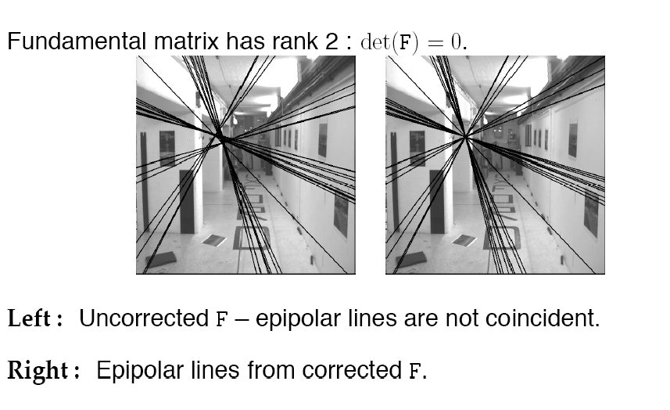
Need to enforce singularity constraint

Slide 142
8-point algorithm
Solve a system of homogeneous linear equations
  Write down the system of equations
  Solve f from Af=0 using SVD
Resolve det(F) = 0 constraint using SVD
Matlab:
[U, S, V] = svd(A);
f = V(:, end);
F = reshape(f, [3 3])’;
Matlab:
[U, S, V] = svd(F);
S(3,3) = 0;
F = U*S*V’;

Slide 143
Problem with eight-point algorithm

Slide 144
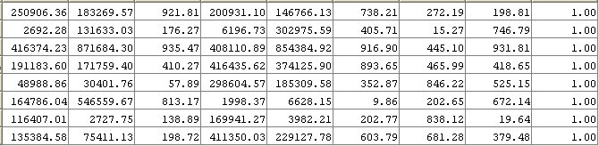
Problem with eight-point algorithm

Slide 145
Problem with eight-point algorithm
Poor numerical conditioning
Can be fixed by rescaling the data

Slide 146
Problem with eight-point algorithm
Poor numerical conditioning
Can be fixed by rescaling the data

Slide 147
From epipolar geometry to camera calibration

Slide 148
From epipolar geometry to camera calibration
If we know the calibration matrices of the two cameras, we can estimate the essential matrix: E = K^{T}FK’
The essential matrix gives us the relative rotation and translation between the cameras, or their extrinsic parameters.
Fundamental matrix lets us compute relationship up to scale for cameras with unknown intrinsic calibrations.
Estimating the fundamental matrix is a kind of “weak calibration”

Slide 149
From epipolar geometry to camera calibration
If we know the calibration matrices of the two cameras, we can estimate the essential matrix: E = K^{T}FK’
The essential matrix gives us the relative rotation and translation between the cameras, or their extrinsic parameters.
Fundamental matrix lets us compute relationship up to scale for cameras with unknown intrinsic calibrations.
Estimating the fundamental matrix is a kind of “weak calibration”

Slide 150
From epipolar geometry to camera calibration
If we know the calibration matrices of the two cameras, we can estimate the essential matrix: E = K^{T}FK’
The essential matrix gives us the relative rotation and translation between the cameras, or their extrinsic parameters.
Fundamental matrix lets us compute relationship up to scale for cameras with unknown intrinsic calibrations.
Estimating the fundamental matrix is a kind of “weak calibration”

Slide 151
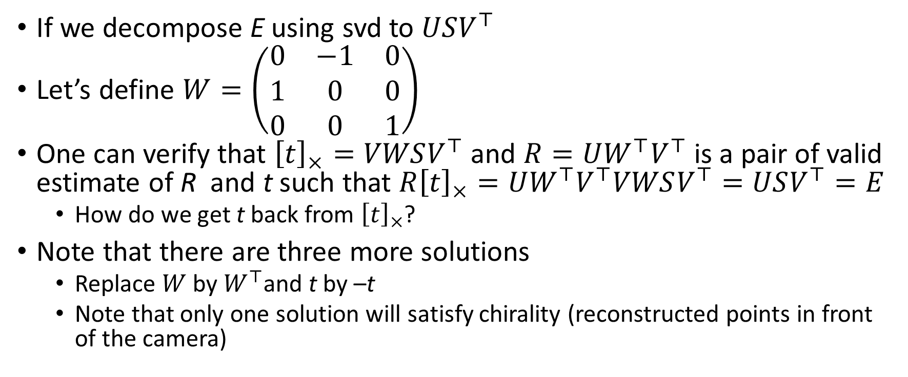
From E to get back R and t
If we decompose E using svd to $USV^{⊤}$
Let’s define $W=\left(\begin{matrix}0 & −1 & 0 \\ 1 & 0 & 0 \\ 0 & 0 & 1\end{matrix}\right)$
One can verify that ${\left[t\right]}_{×}=VWSV^{⊤}$ and $R=UW^{⊤}V^{⊤}$ is a pair of valid estimate of R and t such that $R{\left[t\right]}_{×}=UW^{⊤}V^{⊤}VWSV^{⊤}=USV^{⊤}=E$
  How do we get t back from ${\left[t\right]}_{×}$?
Note that there are three more solutions
  Replace $W$ by $W^{⊤}$and t by –t
  Note that only one solution will satisfy chirality (reconstructed points in front of the camera)

Slide 152
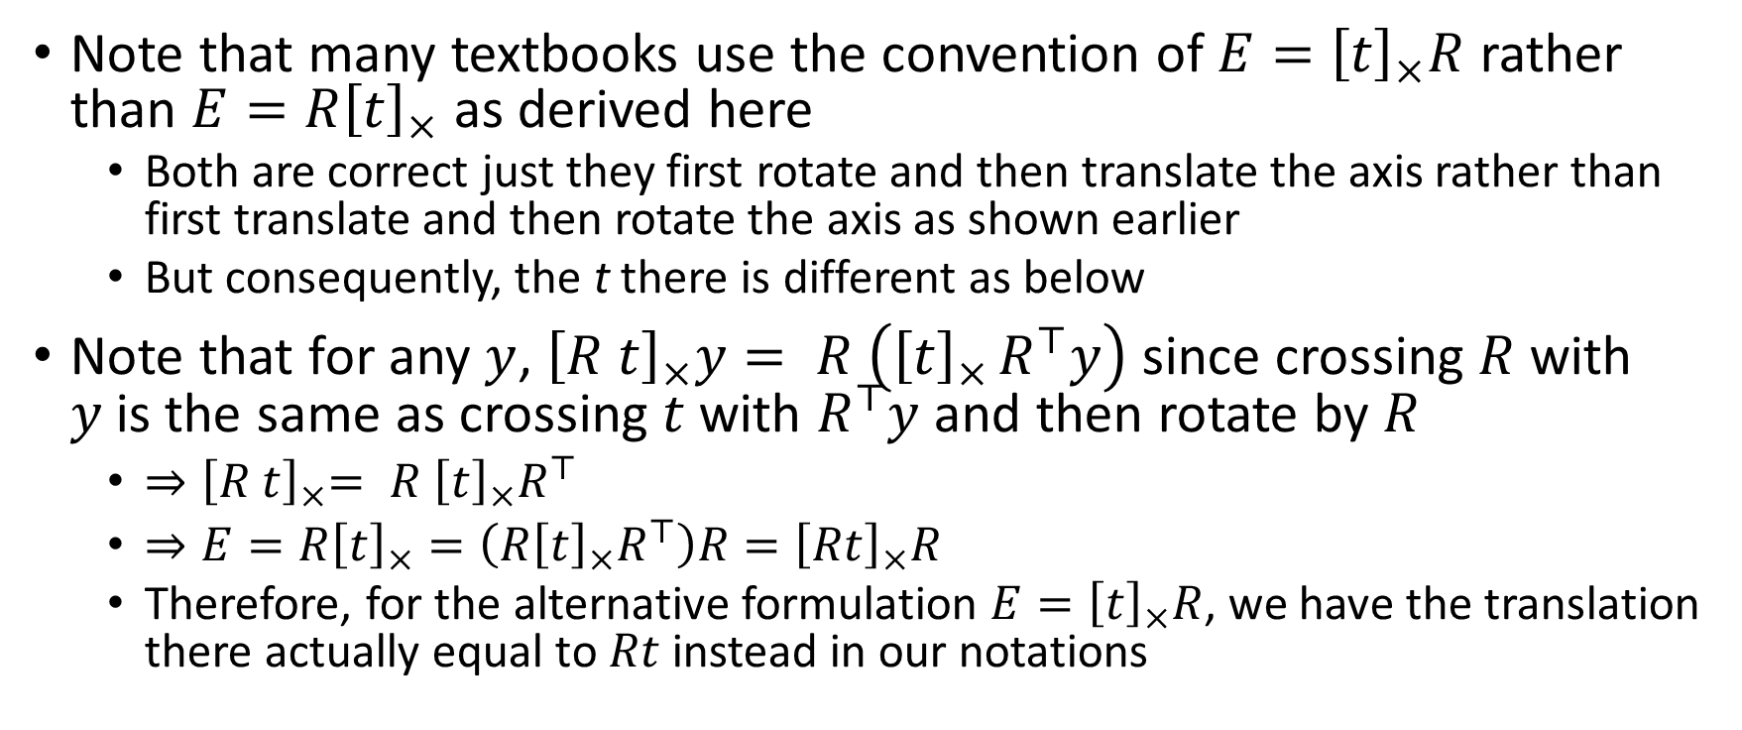
Caveat
Note that many textbooks use the convention of $E={\left[t\right]}_{×}R$ rather than $E={R\left[t\right]}_{×}$ as derived here
  Both are correct just they first rotate and then translate the axis rather than first translate and then rotate the axis as shown earlier
  But consequently, the t there is different as below
Note that for any $y$, ${\left[R t\right]}_{×}y= R \left({\left[t\right]}_{×}^{}R^{⊤}y\right)$ since crossing $R$ with $y$is the same as crossing $t$ with $R^{⊤}y$ and then rotate by $R$
  ${⇒\left[R t\right]}_{×}= R {\left[t\right]}_{×}R^{⊤}$
  $⇒E=R{\left[t\right]}_{×}=\left(R{\left[t\right]}_{×}R^{⊤}\right)R={\left[Rt\right]}_{×}R$
  Therefore, for the alternative formulation $E={\left[t\right]}_{×}R$, we have the translation there actually equal to $Rt$ instead in our notations

Slide 153
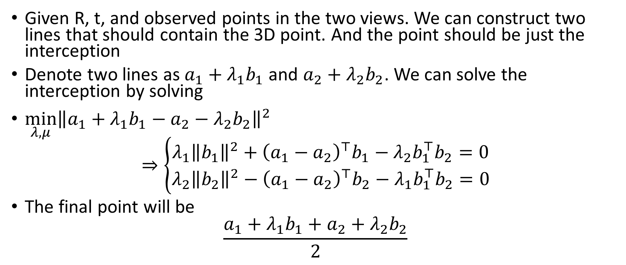
Compute 3D point location
Given R, t, and observed points in the two views. We can construct two lines that should contain the 3D point. And the point should be just the interception
Denote two lines as $a_{1}+λ_{1}b_{1}$ and $a_{2}+λ_{2}b_{2}$. We can solve the interception by solving
$\min_{λ,μ}{\left\|a_{1}+λ_{1}b_{1}−a_{2}−λ_{2}b_{2}\right\|}^{2}$
$$⇒\left\{\begin{aligned}λ_{1}{\left\|b_{1}\right\|}^{2}+{\left(a_{1}−a_{2}\right)}^{⊤}b_{1}−λ_{2}b_{1}^{⊤}b_{2}=0 \\ λ_{2}{\left\|b_{2}\right\|}^{2}−{\left(a_{1}−a_{2}\right)}^{⊤}b_{2}−λ_{1}b_{1}^{⊤}b_{2}=0\end{aligned}\right.$$
The final point will be
$$\frac{a_{1}+λ_{1}b_{1}+a_{2}+λ_{2}b_{2}}{2}$$

Slide 154
DEMO

