Slide 1
ECE 4973: Lecture 3 Image Filters
Samuel Cheng
Slide credits: Juan Carlos Niebles, Ranjay Krishna, James Hays, Noah Snavely

Slide 2




Image resolution vs radiometric Resolution
8 bit – 256 levels
4 bit – 16 levels
2 bit – 4 levels
1 bit – 2 levels

Slide 3
What we have learned today?
Image histograms
Linear systems (filters)
Convolution and correlation
Gaussian filter
Median filter

Slide 4
Systems and Filters
Filtering:
  Forming a new image whose pixel values are transformed from original pixel values
Goals:
Enhance image: super-resolution; in-painting; de-noising
Extract useful information: features (edge, corners, blobs, etc.) extraction
Preprocessing: transform images into another domain for easier processing (Fourier transform)

Slide 5

System and Filters
Notes:
we define a system as a unit that converts an input signal f[n,m] into an output (or response) signal g[n,m], where (n,m) are the independent variables.
In the case for images, (n,m) represents the spatial position in the image.

Slide 6

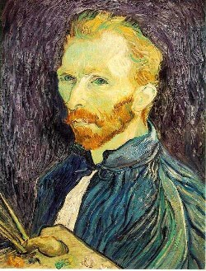
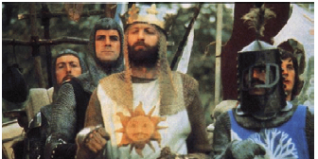
Super-resolution
De-noising
In-painting
Bertamio et al

Slide 7
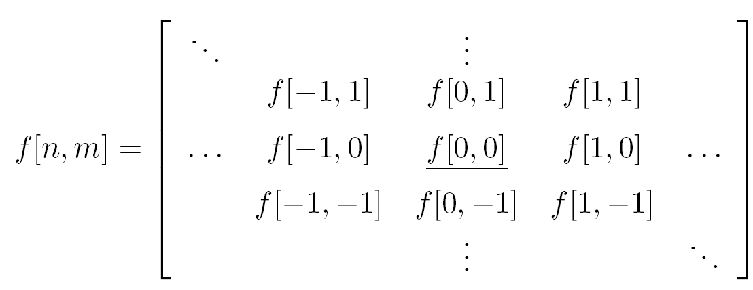
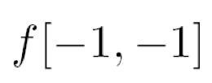







Grayscale images as 2D signals
Cartesian coordinates
Notation for
discrete
signal

Slide 8
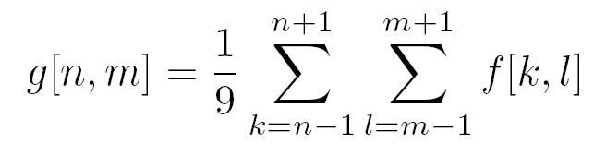

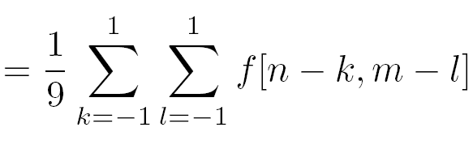
Filter example #1: Box filter
1
1
1
1
1
1
1
1
1
2D DS moving average over a 3 × 3 window of the target pixel’s neighborhood
Notes:
Board:
Input image
Output image
each pixel results from a neighborhood operation

Slide 9
Image filtering
Image filtering:
  Compute function of local neighborhood at each position
Really important!
  Enhance images
    Denoise, resize, increase contrast, etc.
  Extract information from images
    Texture, edges, distinctive points, etc.
  Detect patterns
    Template matching
James Hays

Slide 10
Image filtering
1
1
1
1
1
1
1
1
1
0 | 0 | 0 | 0 | 0 | 0 | 0 | 0 | 0 | 0
0 | 0 | 0 | 0 | 0 | 0 | 0 | 0 | 0 | 0
0 | 0 | 0 | 90 | 90 | 90 | 90 | 90 | 0 | 0
0 | 0 | 0 | 90 | 90 | 90 | 90 | 90 | 0 | 0
0 | 0 | 0 | 90 | 90 | 90 | 90 | 90 | 0 | 0
0 | 0 | 0 | 90 | 0 | 90 | 90 | 90 | 0 | 0
0 | 0 | 0 | 90 | 90 | 90 | 90 | 90 | 0 | 0
0 | 0 | 0 | 0 | 0 | 0 | 0 | 0 | 0 | 0
0 | 0 | 90 | 0 | 0 | 0 | 0 | 0 | 0 | 0
0 | 0 | 0 | 0 | 0 | 0 | 0 | 0 | 0 | 0
 | 0
0 | 0 | 0 | 0 | 0 | 0 | 0 | 0 | 0 | 0
0 | 0 | 0 | 0 | 0 | 0 | 0 | 0 | 0 | 0
0 | 0 | 0 | 90 | 90 | 90 | 90 | 90 | 0 | 0
0 | 0 | 0 | 90 | 90 | 90 | 90 | 90 | 0 | 0
0 | 0 | 0 | 90 | 90 | 90 | 90 | 90 | 0 | 0
0 | 0 | 0 | 90 | 0 | 90 | 90 | 90 | 0 | 0
0 | 0 | 0 | 90 | 90 | 90 | 90 | 90 | 0 | 0
0 | 0 | 0 | 0 | 0 | 0 | 0 | 0 | 0 | 0
0 | 0 | 90 | 0 | 0 | 0 | 0 | 0 | 0 | 0
0 | 0 | 0 | 0 | 0 | 0 | 0 | 0 | 0 | 0
Credit: S. Seitz
Notes:
ones, divide by 9

Slide 11
Image filtering
1
1
1
1
1
1
1
1
1
0 | 0 | 0 | 0 | 0 | 0 | 0 | 0 | 0 | 0
0 | 0 | 0 | 0 | 0 | 0 | 0 | 0 | 0 | 0
0 | 0 | 0 | 90 | 90 | 90 | 90 | 90 | 0 | 0
0 | 0 | 0 | 90 | 90 | 90 | 90 | 90 | 0 | 0
0 | 0 | 0 | 90 | 90 | 90 | 90 | 90 | 0 | 0
0 | 0 | 0 | 90 | 0 | 90 | 90 | 90 | 0 | 0
0 | 0 | 0 | 90 | 90 | 90 | 90 | 90 | 0 | 0
0 | 0 | 0 | 0 | 0 | 0 | 0 | 0 | 0 | 0
0 | 0 | 90 | 0 | 0 | 0 | 0 | 0 | 0 | 0
0 | 0 | 0 | 0 | 0 | 0 | 0 | 0 | 0 | 0
 | 0 | 10
0 | 0 | 0 | 0 | 0 | 0 | 0 | 0 | 0 | 0
0 | 0 | 0 | 0 | 0 | 0 | 0 | 0 | 0 | 0
0 | 0 | 0 | 90 | 90 | 90 | 90 | 90 | 0 | 0
0 | 0 | 0 | 90 | 90 | 90 | 90 | 90 | 0 | 0
0 | 0 | 0 | 90 | 90 | 90 | 90 | 90 | 0 | 0
0 | 0 | 0 | 90 | 0 | 90 | 90 | 90 | 0 | 0
0 | 0 | 0 | 90 | 90 | 90 | 90 | 90 | 0 | 0
0 | 0 | 0 | 0 | 0 | 0 | 0 | 0 | 0 | 0
0 | 0 | 90 | 0 | 0 | 0 | 0 | 0 | 0 | 0
0 | 0 | 0 | 0 | 0 | 0 | 0 | 0 | 0 | 0
Credit: S. Seitz
Notes:
ones, divide by 9

Slide 12
Image filtering
1
1
1
1
1
1
1
1
1
0 | 0 | 0 | 0 | 0 | 0 | 0 | 0 | 0 | 0
0 | 0 | 0 | 0 | 0 | 0 | 0 | 0 | 0 | 0
0 | 0 | 0 | 90 | 90 | 90 | 90 | 90 | 0 | 0
0 | 0 | 0 | 90 | 90 | 90 | 90 | 90 | 0 | 0
0 | 0 | 0 | 90 | 90 | 90 | 90 | 90 | 0 | 0
0 | 0 | 0 | 90 | 0 | 90 | 90 | 90 | 0 | 0
0 | 0 | 0 | 90 | 90 | 90 | 90 | 90 | 0 | 0
0 | 0 | 0 | 0 | 0 | 0 | 0 | 0 | 0 | 0
0 | 0 | 90 | 0 | 0 | 0 | 0 | 0 | 0 | 0
0 | 0 | 0 | 0 | 0 | 0 | 0 | 0 | 0 | 0
 | 0 | 10 | 20
0 | 0 | 0 | 0 | 0 | 0 | 0 | 0 | 0 | 0
0 | 0 | 0 | 0 | 0 | 0 | 0 | 0 | 0 | 0
0 | 0 | 0 | 90 | 90 | 90 | 90 | 90 | 0 | 0
0 | 0 | 0 | 90 | 90 | 90 | 90 | 90 | 0 | 0
0 | 0 | 0 | 90 | 90 | 90 | 90 | 90 | 0 | 0
0 | 0 | 0 | 90 | 0 | 90 | 90 | 90 | 0 | 0
0 | 0 | 0 | 90 | 90 | 90 | 90 | 90 | 0 | 0
0 | 0 | 0 | 0 | 0 | 0 | 0 | 0 | 0 | 0
0 | 0 | 90 | 0 | 0 | 0 | 0 | 0 | 0 | 0
0 | 0 | 0 | 0 | 0 | 0 | 0 | 0 | 0 | 0
Credit: S. Seitz
Notes:
ones, divide by 9

Slide 13
Image filtering
1
1
1
1
1
1
1
1
1
0 | 0 | 0 | 0 | 0 | 0 | 0 | 0 | 0 | 0
0 | 0 | 0 | 0 | 0 | 0 | 0 | 0 | 0 | 0
0 | 0 | 0 | 90 | 90 | 90 | 90 | 90 | 0 | 0
0 | 0 | 0 | 90 | 90 | 90 | 90 | 90 | 0 | 0
0 | 0 | 0 | 90 | 90 | 90 | 90 | 90 | 0 | 0
0 | 0 | 0 | 90 | 0 | 90 | 90 | 90 | 0 | 0
0 | 0 | 0 | 90 | 90 | 90 | 90 | 90 | 0 | 0
0 | 0 | 0 | 0 | 0 | 0 | 0 | 0 | 0 | 0
0 | 0 | 90 | 0 | 0 | 0 | 0 | 0 | 0 | 0
0 | 0 | 0 | 0 | 0 | 0 | 0 | 0 | 0 | 0
 | 0 | 10 | 20 | 30
0 | 0 | 0 | 0 | 0 | 0 | 0 | 0 | 0 | 0
0 | 0 | 0 | 0 | 0 | 0 | 0 | 0 | 0 | 0
0 | 0 | 0 | 90 | 90 | 90 | 90 | 90 | 0 | 0
0 | 0 | 0 | 90 | 90 | 90 | 90 | 90 | 0 | 0
0 | 0 | 0 | 90 | 90 | 90 | 90 | 90 | 0 | 0
0 | 0 | 0 | 90 | 0 | 90 | 90 | 90 | 0 | 0
0 | 0 | 0 | 90 | 90 | 90 | 90 | 90 | 0 | 0
0 | 0 | 0 | 0 | 0 | 0 | 0 | 0 | 0 | 0
0 | 0 | 90 | 0 | 0 | 0 | 0 | 0 | 0 | 0
0 | 0 | 0 | 0 | 0 | 0 | 0 | 0 | 0 | 0
Credit: S. Seitz
Notes:
ones, divide by 9

Slide 14
Image filtering
1
1
1
1
1
1
1
1
1
0 | 0 | 0 | 0 | 0 | 0 | 0 | 0 | 0 | 0
0 | 0 | 0 | 0 | 0 | 0 | 0 | 0 | 0 | 0
0 | 0 | 0 | 90 | 90 | 90 | 90 | 90 | 0 | 0
0 | 0 | 0 | 90 | 90 | 90 | 90 | 90 | 0 | 0
0 | 0 | 0 | 90 | 90 | 90 | 90 | 90 | 0 | 0
0 | 0 | 0 | 90 | 0 | 90 | 90 | 90 | 0 | 0
0 | 0 | 0 | 90 | 90 | 90 | 90 | 90 | 0 | 0
0 | 0 | 0 | 0 | 0 | 0 | 0 | 0 | 0 | 0
0 | 0 | 90 | 0 | 0 | 0 | 0 | 0 | 0 | 0
0 | 0 | 0 | 0 | 0 | 0 | 0 | 0 | 0 | 0
 | 0 | 10 | 20 | 30 | 30
Credit: S. Seitz
Notes:
ones, divide by 9

Slide 15
Image filtering
1
1
1
1
1
1
1
1
1
0 | 0 | 0 | 0 | 0 | 0 | 0 | 0 | 0 | 0
0 | 0 | 0 | 0 | 0 | 0 | 0 | 0 | 0 | 0
0 | 0 | 0 | 90 | 90 | 90 | 90 | 90 | 0 | 0
0 | 0 | 0 | 90 | 90 | 90 | 90 | 90 | 0 | 0
0 | 0 | 0 | 90 | 90 | 90 | 90 | 90 | 0 | 0
0 | 0 | 0 | 90 | 0 | 90 | 90 | 90 | 0 | 0
0 | 0 | 0 | 90 | 90 | 90 | 90 | 90 | 0 | 0
0 | 0 | 0 | 0 | 0 | 0 | 0 | 0 | 0 | 0
0 | 0 | 90 | 0 | 0 | 0 | 0 | 0 | 0 | 0
0 | 0 | 0 | 0 | 0 | 0 | 0 | 0 | 0 | 0
 | 0 | 10 | 20 | 30 | 30
?
Credit: S. Seitz
Notes:
ones, divide by 9

Slide 16
Image filtering
1
1
1
1
1
1
1
1
1
0 | 0 | 0 | 0 | 0 | 0 | 0 | 0 | 0 | 0
0 | 0 | 0 | 0 | 0 | 0 | 0 | 0 | 0 | 0
0 | 0 | 0 | 90 | 90 | 90 | 90 | 90 | 0 | 0
0 | 0 | 0 | 90 | 90 | 90 | 90 | 90 | 0 | 0
0 | 0 | 0 | 90 | 90 | 90 | 90 | 90 | 0 | 0
0 | 0 | 0 | 90 | 0 | 90 | 90 | 90 | 0 | 0
0 | 0 | 0 | 90 | 90 | 90 | 90 | 90 | 0 | 0
0 | 0 | 0 | 0 | 0 | 0 | 0 | 0 | 0 | 0
0 | 0 | 90 | 0 | 0 | 0 | 0 | 0 | 0 | 0
0 | 0 | 0 | 0 | 0 | 0 | 0 | 0 | 0 | 0
 | 0 | 10 | 20 | 30 | 30
 |  |  |  | 50
?
Credit: S. Seitz
Notes:
ones, divide by 9

Slide 17
Image filtering
1
1
1
1
1
1
1
1
1
0 | 0 | 0 | 0 | 0 | 0 | 0 | 0 | 0 | 0
0 | 0 | 0 | 0 | 0 | 0 | 0 | 0 | 0 | 0
0 | 0 | 0 | 90 | 90 | 90 | 90 | 90 | 0 | 0
0 | 0 | 0 | 90 | 90 | 90 | 90 | 90 | 0 | 0
0 | 0 | 0 | 90 | 90 | 90 | 90 | 90 | 0 | 0
0 | 0 | 0 | 90 | 0 | 90 | 90 | 90 | 0 | 0
0 | 0 | 0 | 90 | 90 | 90 | 90 | 90 | 0 | 0
0 | 0 | 0 | 0 | 0 | 0 | 0 | 0 | 0 | 0
0 | 0 | 90 | 0 | 0 | 0 | 0 | 0 | 0 | 0
0 | 0 | 0 | 0 | 0 | 0 | 0 | 0 | 0 | 0
 | 0 | 10 | 20 | 30 | 30 | 30 | 20 | 10
 | 0 | 20 | 40 | 60 | 60 | 60 | 40 | 20
 | 0 | 30 | 60 | 90 | 90 | 90 | 60 | 30
 | 0 | 30 | 50 | 80 | 80 | 90 | 60 | 30
 | 0 | 30 | 50 | 80 | 80 | 90 | 60 | 30
 | 0 | 20 | 30 | 50 | 50 | 60 | 40 | 20
 | 10 | 20 | 30 | 30 | 30 | 30 | 20 | 10
 | 10 | 10 | 10 | 0 | 0 | 0 | 0 | 0
Credit: S. Seitz

Slide 18
Box Filter
What does it do?
Replaces each pixel with an average of its neighborhood
Achieve smoothing effect (remove sharp features)
1
1
1
1
1
1
1
1
1
Slide credit: David Lowe (UBC)

Slide 19
Box Filter
What does it do?
Replaces each pixel with an average of its neighborhood
Achieve smoothing effect (remove sharp features)
Why does it sum to one?
1
1
1
1
1
1
1
1
1
Slide credit: David Lowe (UBC)

Slide 20
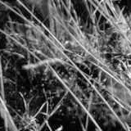
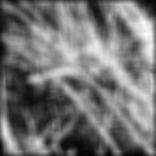
Smoothing with box filter
James Hays

Slide 21




Linear filter
Additive?
Homogeneous?
Stable?
Invertible?

Slide 22
Properties of systems
Amplitude properties:
  Additivity
  Homogeneity
  Linearity
  (Linearity => additivity)
  Stability
  Invertibility

Slide 23
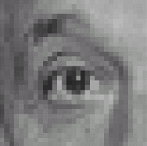

Think-Pair-Share time
0
0
0
1.
0
1
0
0
0
0
0
0
0
2.
0
0
1
0
0
0
1
0
-1
3.
2
0
-2
1
0
-1
0
0
0
-
1
1
1
4.
0
2
0
1
1
1
0
0
0
1
1
1

Slide 24
1. Practice with linear filters
0
0
0
?
0
1
0
0
0
0
Original
Source: D. Lowe

Slide 25
1. Practice with linear filters
0
0
0
0
1
0
0
0
0
Original
Filtered
(no change)
Source: D. Lowe

Slide 26
2. Practice with linear filters
0
0
0
?
0
0
1
0
0
0
Original
Source: D. Lowe

Slide 27
2. Practice with linear filters
0
0
0
0
0
1
0
0
0
Original
Shifted left
By 1 pixel
Source: D. Lowe

Slide 28
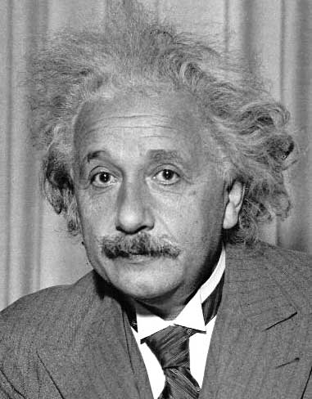
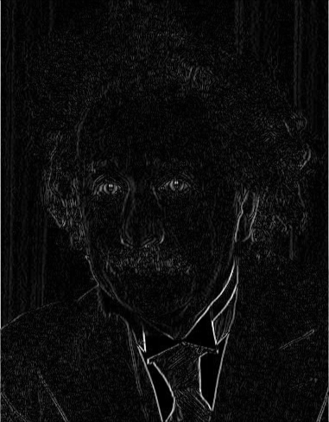
3. Practice with linear filters
Sobel
1
0
-1
2
0
-2
1
0
-1
=
1
2
1
*
1 | 0 | -1
Vertical Edge
(absolute value)
David Lowe

Slide 29
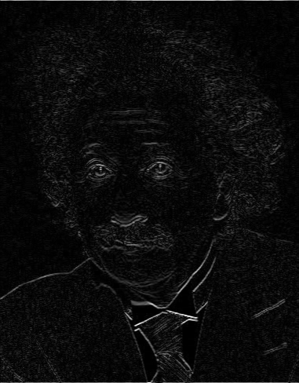
3. Practice with linear filters
1
2
1
0
0
0
-1
-2
-1
Sobel
Horizontal Edge
(absolute value)
David Lowe
Notes:
Questions at this point?

Slide 30
4. Practice with linear filters
0
0
0
-
1
1
1
?
0
2
0
1
1
1
0
0
0
1
1
1
(Note that filter sums to 1)
Original
Source: D. Lowe

Slide 31
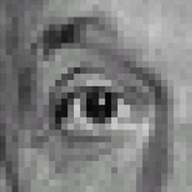
4. Practice with linear filters
0
0
0
-
1
1
1
0
2
0
1
1
1
0
0
0
1
1
1
Original
Sharpening filter
  Accentuates differences with local average
Aka unsharp masking
Source: D. Lowe

Slide 32
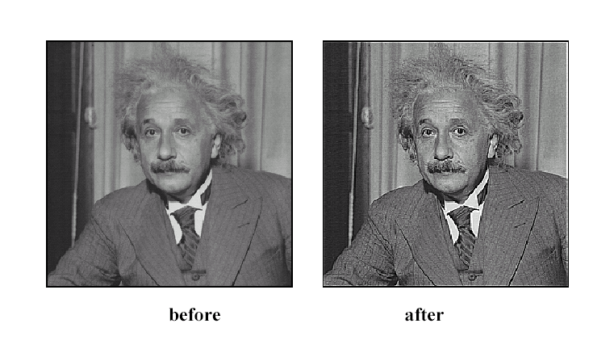
4. Practice with linear filters
Source: D. Lowe

Slide 33

Shift-invariance and linearity

Slide 34

Two important properties of systems
Shift invariance (same behavior regardless of pixel location)
Linearity
Equivalently: S(I,shift(f)) = shift(S(I,f))
Notes:
LHS: g[n-no]
RHS: S[f[n-n0]]

Slide 35
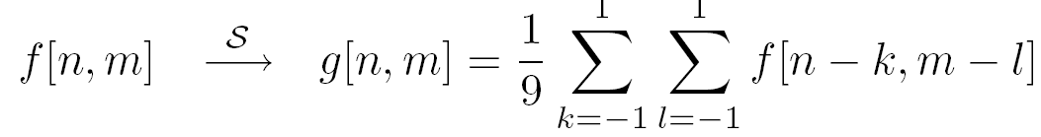
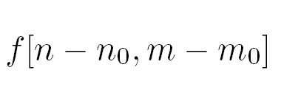
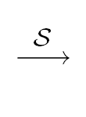
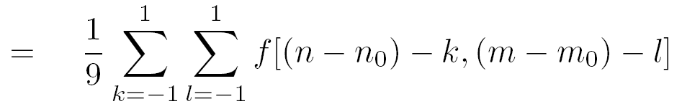

Is the moving average system is shift invariant?
Yes!

Slide 36
Linear Systems (filters)
Is the moving average a linear system?
Yes!
Notes:
Show on the board equations for moving average.

Slide 37
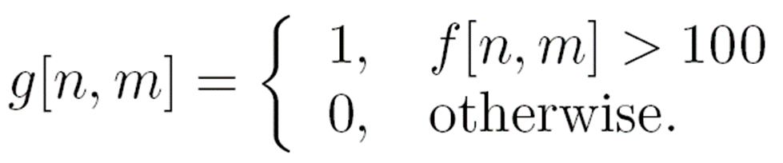

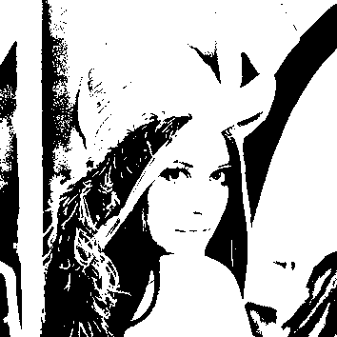
Filter example #2: Image Segmentation
Image segmentation based on a simple threshold:
255,

Slide 38


Simple thresholding
Is thresholding shift-invariant?
Is thresholding a linear system?
  f1[n,m] + f2[n,m] > T
  f1[n,m] < T
  f2[n,m]<T
Yes!
$$S\left[f1\left[n,m\right]+f2\left[n,m\right]\right]=1$$
$$S\left[f1\left[n,m\right]]+S[f2\left[n,m\right]\right]=0$$
No!
Notes:
Show on the board equations for moving average.

Slide 39
Convolution and correlation

Slide 40



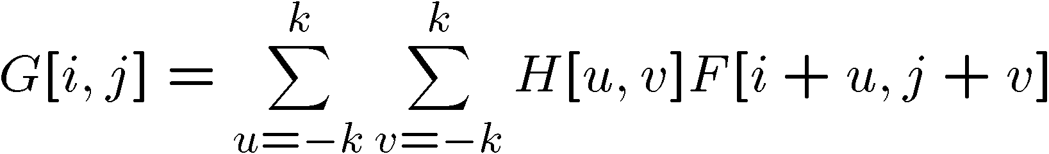

Correlation (we are doing so far)
Let be the image, be the kernel (filter), and be the output image
Can think of as a “dot product” between local neighborhood and kernel for each pixel
This is called a (cross-)correlation operation:

Slide 41
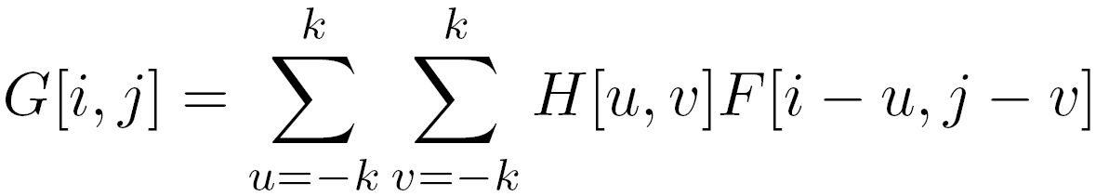
Convolution
Same as cross-correlation, except that the kernel is “flipped” (horizontally and vertically)
This is called a convolution operation:

Slide 42
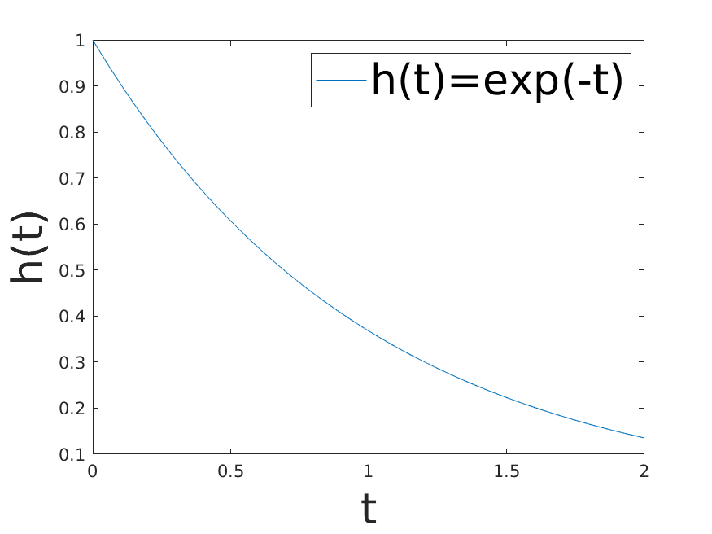
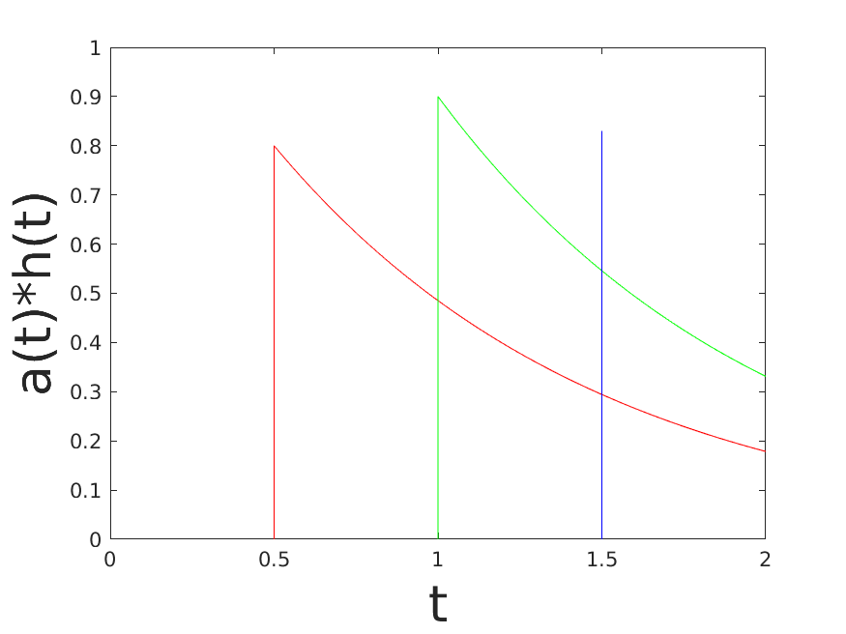
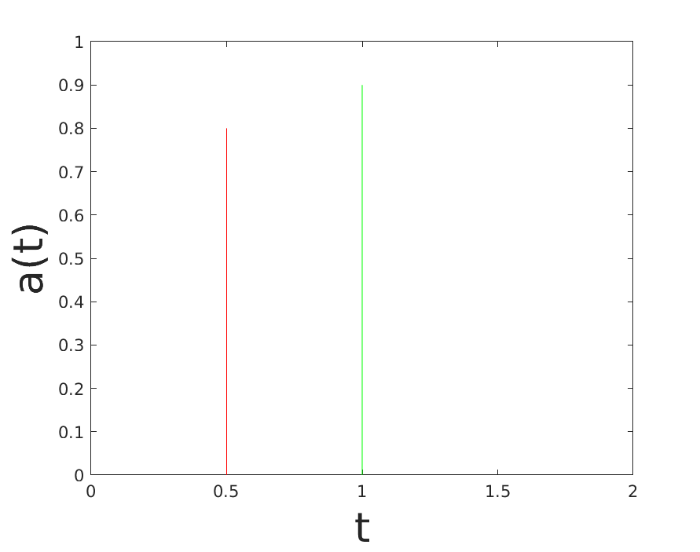
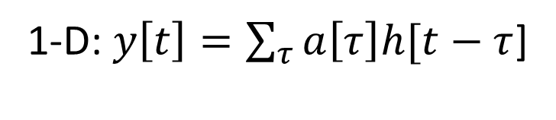
Where is convolution coming from?
1-D: $y\left[t\right]=\sum_{τ}{a\left[τ\right]h[t−τ}$]

Slide 43
Why do mathematicians and signal processing researchers like convolution?
Any linear and shift-invariant operator can be represented as a convolution (and specified by its impulse response)
Source: S. Lazebnik
Notes:
f is image

Slide 44
Commutative property
H*F=F*H if we can ignore the boundary condition (k >> i,j)

Slide 45
Associative property

Slide 46
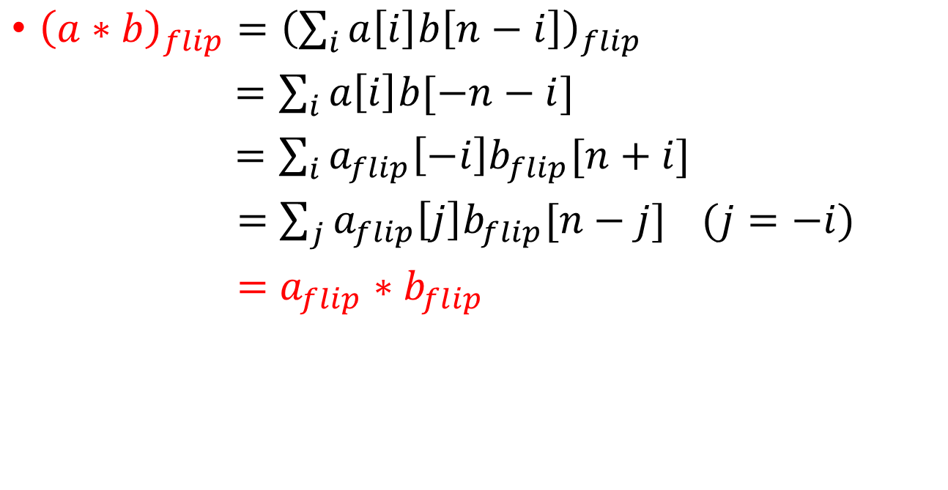

What is ${\left(a∗b\right)}_{flip}$? A result we need in the next slide …
${\left(a∗b\right)}_{flip}={\left(\sum_{i}{a\left[i\right]b\left[n−i\right]}\right)}_{flip}$
$=\sum_{i}{a\left[i\right]b[−n−i]}$
$=\sum_{i}{a_{flip}\left[−i\right]b_{flip}[n+i]}$
$=\sum_{j}{a_{flip}\left[j\right]b_{flip}[n−j]} (j=−i)$
$=a_{flip}∗b_{flip}$

Slide 47
Convolution properties
Commutative: a * b = b * a
  Conceptually no difference between filter and signal
Associative: a * (b * c) = (a * b) * c
  Often apply several filters one after another: (((a * b₁) * b₂) * b₃)
  This is equivalent to applying one filter: a * (b₁ * b₂ * b₃)
  Correlation is NOT associative
Distributes over addition: a * (b + c) = (a * b) + (a * c)
Scalars factor out: ka * b = a * kb = k (a * b)
Identity: unit impulse e = [0, 0, 1, 0, 0], a * e = a
Source: S. Lazebnik
Notes:
David Jacobs @ UMD http://www.cs.umd.edu/~djacobs/CMSC426/Convolution.pdf
The key difference between the two is that convolution is associative. That is, if F and G are filters, then F*(G*I) = (F*G)*I. If you don’t believe this, try a simple example, using F=G=(-1 0 1), for example. It is very convenient to have convolution be associative. Suppose, for example, we want to smooth an image and then take its derivative. We could do this by convolving the image with a Gaussian filter, and then convolving it with a derivative filter. But we could alternatively convolve the derivative filter with the Gaussian to produce a filter called a Difference of Gaussian (DOG), and then convolve this with our image. The nice thing about this is that the DOG filter can be precomputed, and we only have to convolve one filter with our image.
In general, people use convolution for image processing operations such as smoothing, and they use correlation to match a template to an image. Then, we don’t mind that correlation isn’t associative, because it doesn’t really make sense to combine two templates into one with correlation, whereas we might often want to combine two filter together for convolution. When discussing the Fourier series as a way of understanding filtering, we will use convolution, so that we can introduce the famous convolution theorem.

Slide 48
Correlation and Convolution
2d correlation
2d convolution
  Imfilter(Imfilter(I,f),g)!= imfilter(I,imfilter(f,g))
  h=filter2(f,I); or h=imfilter(I,f);
  h=conv2(f,I); or h=imfilter(I,f,’conv’);
conv2(I,f)is the same as filter2(rot90(f,2),I)
≡ filter2(fliplr(flipud((f,2)),I)
Correlation and convolution are identical when the filter is symmetric.
James Hays

Slide 49
Image support and edge effect
A computer will only convolve finite support signals.
  That is: images that are zero for n,m outside some rectangular region
numpy’s convolution performs 2D convolution of finite-support signals.
=
*
(N1 + N2 − 1) × (M1 +M2 − 1)
N2 ×M2
N1 ×M1

Slide 50
Image support and edge effect
A computer will only convolve finite support signals.
What happens at the edge?
f
• zero “padding”
• edge value replication
• mirror extension
• more (beyond the scope of this class)
-> Matlab conv2 uses zero-padding
h

Slide 51
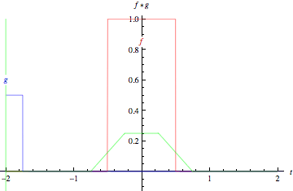
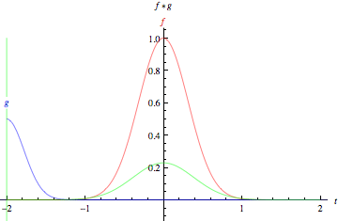
Slide credit: Wolfram Alpha

Slide 52


properties
• Associative property:
• Distributive property:
The order doesn’t matter!

Slide 53
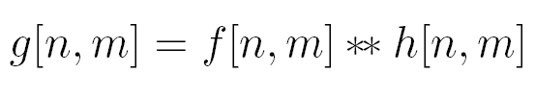


properties
• Shift property:
• Shift-invariance:

Slide 54
Convolution vs. (Cross) Correlation
A convolution is a filtering operation
Correlation compares the similarity of two sets of data
Notes:
. The correlation result reaches a maximum at the time when the two signals match best .
correlation is a measure of relatedness of two signals

Slide 55
Convolution vs. (Cross) Correlation
 | Convolution | Correlation
Associative: (ab)c=a(bc) | Yes | No
Commutative: ab=ba | Yes | No
Distributive: a(b+c)=ab+ac | Yes | Yes
Linear | Yes | Yes
Application | Filtering | Matching
They are equivalent when the filter “kernel” is symmetric
N.B. cv2.filter2D implements correlation rather than conv
Notes:
In CV, most filters (not all) we considered are symmetric. So they are the same.

