Slide 1
Epipolar Geometry
Samuel Cheng
Slide credit: James Tompkin, Naoh Snavely

Slide 2
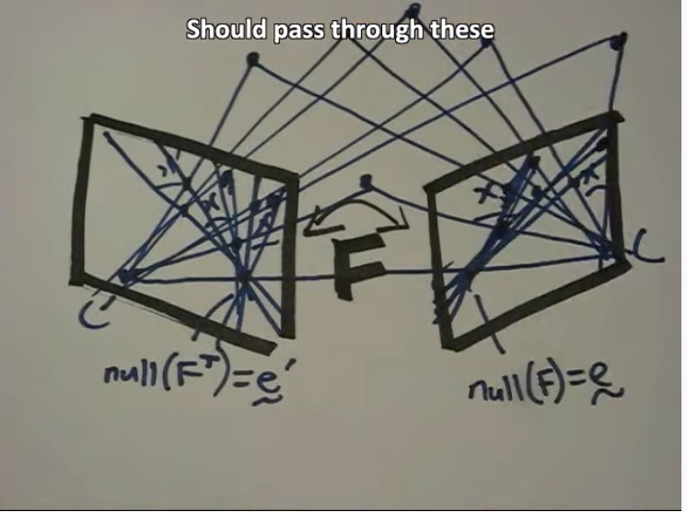
Fundamental matrix song

Slide 3
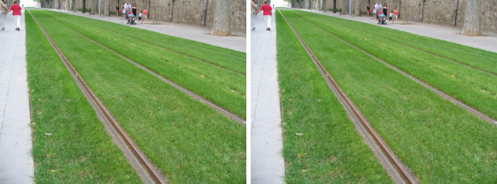
Frederick Kingdom

Slide 4
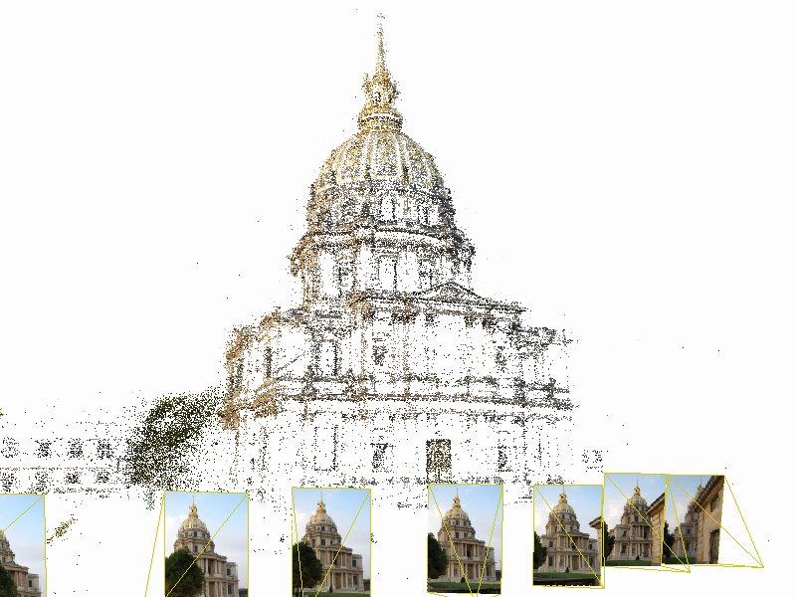
Structure from motion

Slide 5
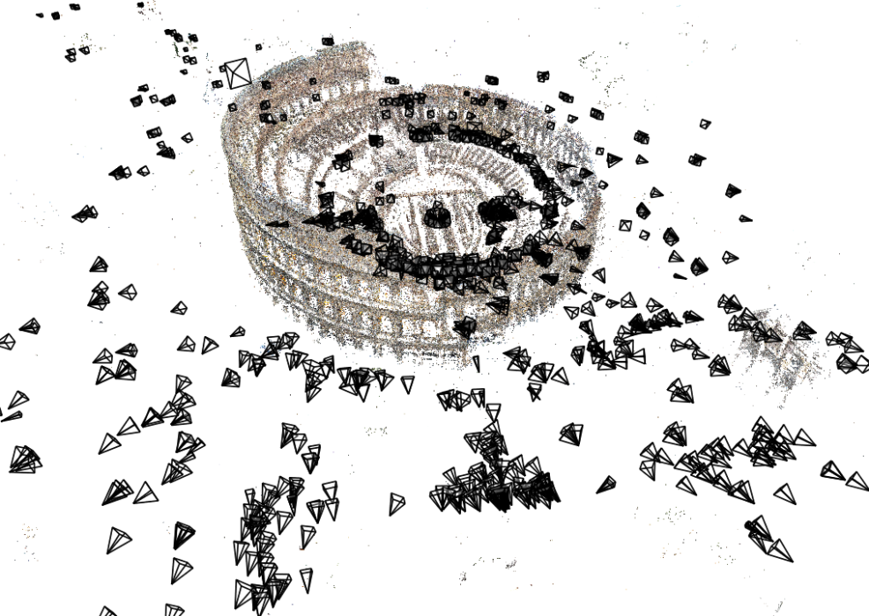
Structure from motion
Given many images, how can we
a) figure out where they were all taken from?
b) build a 3D model of the scene?
This is (roughly) the structure from motion problem

Slide 6
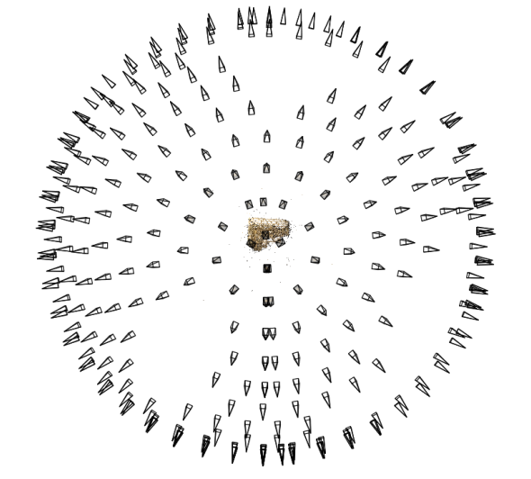
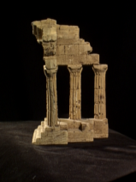
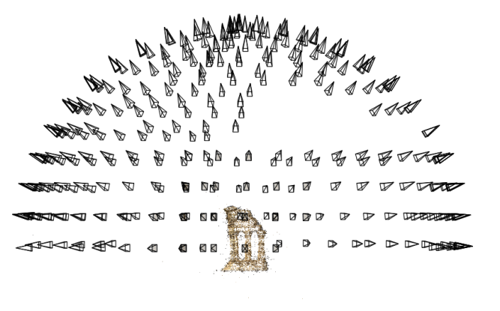
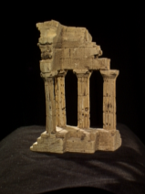
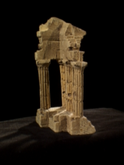
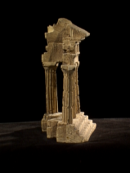
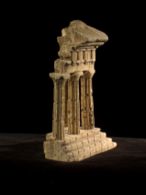
Structure from motion
Reconstruction (side)
(top)
Input: images with points in correspondence p_{i,j} = (u_{i,j},v_{i,j})
Output
structure: 3D location x_{i} for each point p_{i}
motion: camera parameters R_{j} , t_{j} possibly K_{j}
Objective function: minimize reprojection error

Slide 7
What we’ve seen so far…
2D transformations between images
Translations, affine transformations, homographies…
3D coordinates to 2D coordinates
Camera matrix
Today: epipolar geometry and fundamental matrices

Slide 8
Depth from disparity
Goal: recover depth by finding image coordinate x’ that corresponds to x
X
X
x
z
x
x’
x'
f
f
O
Baseline T
O’

Slide 9
Geometry for a simple stereo system
Assume parallel optical axes, known camera parameters (i.e., calibrated cameras). What is expression for Z?

Slide 10
Geometry for a simple stereo system
Assume parallel optical axes, known camera parameters (i.e., calibrated cameras). What is expression for Z?

Slide 11
Geometry for a simple stereo system
Assume parallel optical axes, known camera parameters (i.e., calibrated cameras). What is expression for Z?

Slide 12
Geometry for a simple stereo system
Assume parallel optical axes, known camera parameters (i.e., calibrated cameras). What is expression for Z?

Slide 13
Geometry for a simple stereo system
Assume parallel optical axes, known camera parameters (i.e., calibrated cameras). What is expression for Z?
$$\frac{T+x_{r}−x_{l}}{Z−f}=\frac{T}{Z}$$
$$Z=f\frac{T}{x_{l}−x_{r}}$$

Slide 14
Geometry for a simple stereo system
Assume parallel optical axes, known camera parameters (i.e., calibrated cameras). What is expression for Z?
Similar triangles (p_{l}, P, p_{r}) and (O_{l}, P, O_{r}):
$$\frac{T+x_{r}−x_{l}}{Z−f}=\frac{T}{Z}$$
$$Z=f\frac{T}{x_{l}−x_{r}}$$

Slide 15
Geometry for a simple stereo system
Assume parallel optical axes, known camera parameters (i.e., calibrated cameras). What is expression for Z?
Similar triangles (p_{l}, P, p_{r}) and (O_{l}, P, O_{r}):
$$\frac{T+x_{r}−x_{l}}{Z−f}=\frac{T}{Z}$$
$$Z=f\frac{T}{x_{l}−x_{r}}$$
disparity

Slide 16
Depth from disparity
Goal: recover depth by finding image coordinate x’ that corresponds to x
Sub-Problems
Calibration: How do we recover the relation of the cameras (if not already known)?
Correspondence: How do we search for the matching point x’?
X
x
x'

Slide 17
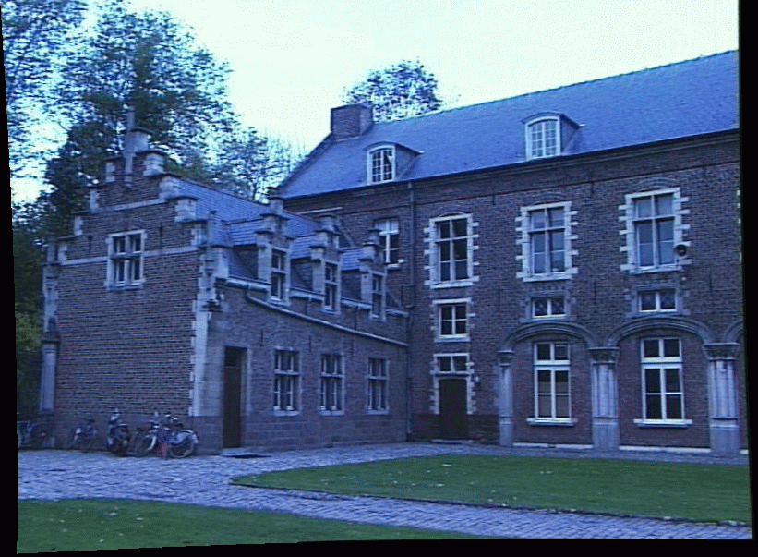
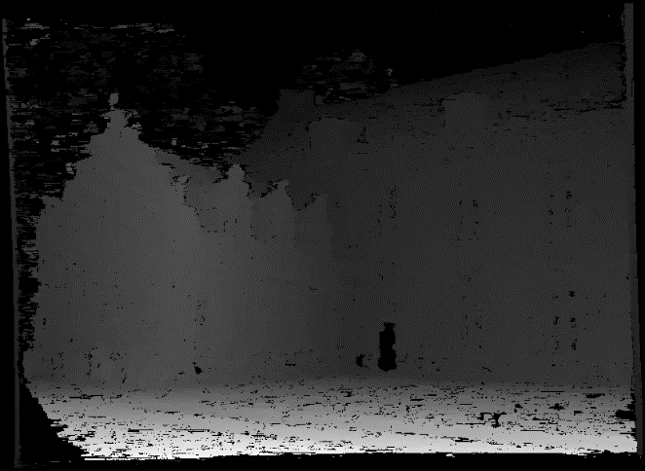
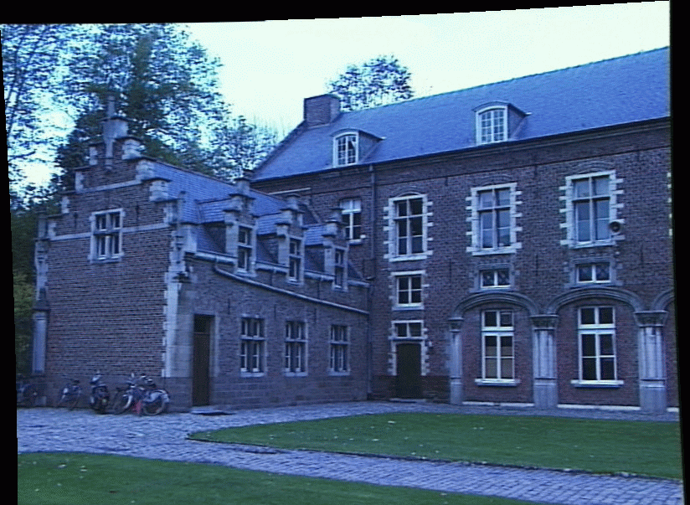
Depth from disparity
image I(x,y)
Disparity map D(x,y)
image I´(x´,y´)
(x´,y´)=(x+D(x,y), y)
James Hays

Slide 18
Depth from disparity
image I(x,y)
Disparity map D(x,y)
image I´(x´,y´)
(x´,y´)=(x+D(x,y), y)
If we could find the corresponding points in two images, we could estimate relative depth…
James Hays

Slide 19
What do we need to know?
Calibration for the two cameras.
Intrinsic matrices for both cameras (e.g., f)
Baseline distance T in parallel camera case
R, t in non-parallel case
2. Correspondence for every pixel.

Slide 20
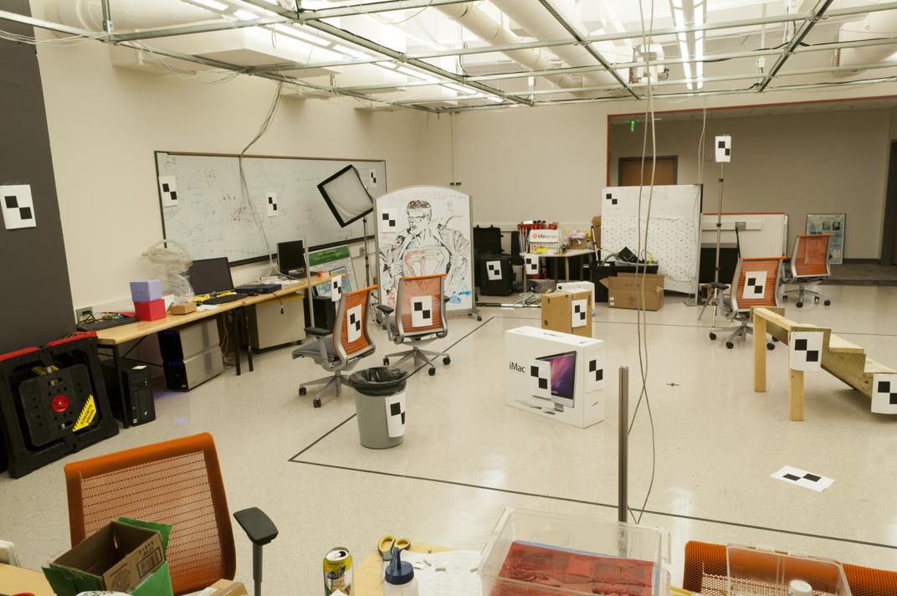
Correspondence for every pixel. Where do we need to search?

Slide 21
Correspondence for every pixel. Where do we need to search?

Slide 22
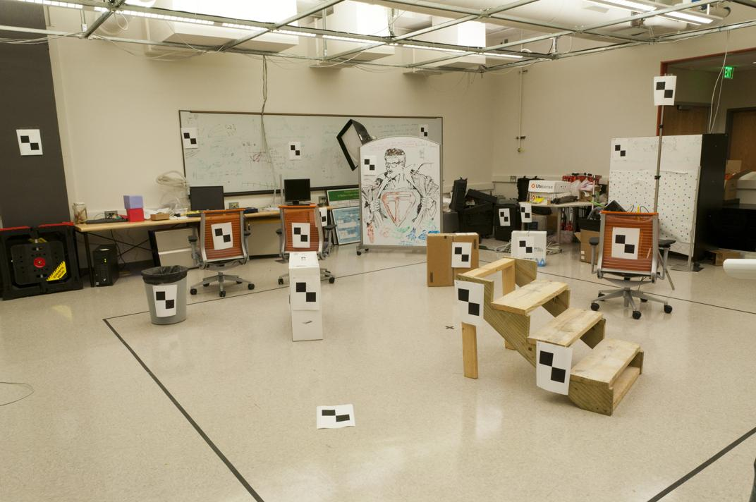
Correspondence for every pixel. Where do we need to search?

Slide 23
Correspondence for every pixel. Where do we need to search?

Slide 24
Correspondence for every pixel. Where do we need to search?

Slide 25
Correspondence for every pixel. Where do we need to search?

Slide 26
Correspondence for every pixel. Where do we need to search?

Slide 27
Correspondence for every pixel. Where do we need to search?

Slide 28
Correspondence for every pixel. Where do we need to search?

Slide 29
Correspondence for every pixel. Where do we need to search?

Slide 30
Correspondence for every pixel. Where do we need to search?

Slide 31
Correspondence for every pixel. Where do we need to search?

Slide 32
Wouldn’t it be nice to know where matches can live? Epipolar geometry Constrains 2D search to 1D

Slide 33
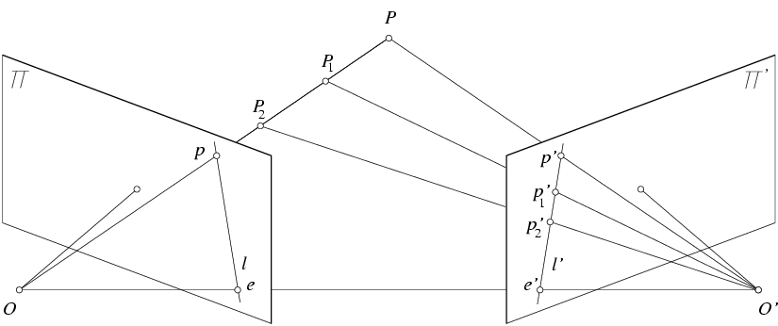
Key idea: Epipolar constraint
X
x
x’
$$e^{l}$$
$${\begin{aligned}e^{r} \\ \end{aligned}}^{}$$

Slide 34
Key idea: Epipolar constraint
X
x
x’
$$e^{l}$$
$${\begin{aligned}e^{r} \\ \end{aligned}}^{}$$
Potential matches for x have to
lie on the corresponding line l’.

Slide 35
Key idea: Epipolar constraint
X
x
x’
$$e^{l}$$
$${\begin{aligned}e^{r} \\ \end{aligned}}^{}$$
Potential matches for x have to
lie on the corresponding line l’.

Slide 36
Key idea: Epipolar constraint
X
x
x’
$$e^{l}$$
$${\begin{aligned}e^{r} \\ \end{aligned}}^{}$$
Potential matches for x have to
lie on the corresponding line l’.

Slide 37
Key idea: Epipolar constraint
X
X
x
x’
x’
$$e^{l}$$
$${\begin{aligned}e^{r} \\ \end{aligned}}^{}$$
Potential matches for x have to
lie on the corresponding line l’.

Slide 38
Key idea: Epipolar constraint
X
X
x
x’
x’
$$e^{l}$$
$${\begin{aligned}e^{r} \\ \end{aligned}}^{}$$
Potential matches for x’ have to
lie on the corresponding line l.
Potential matches for x have to
lie on the corresponding line l’.

Slide 39
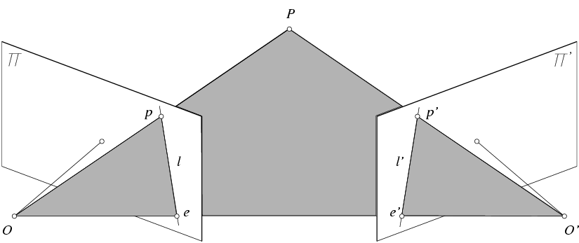
Epipolar geometry: notation
X
x
x’
$${\begin{aligned}e^{r} \\ \end{aligned}}^{}$$
$$e^{l}$$

Slide 40
Epipolar geometry: notation
X
x
x’
$${\begin{aligned}e^{r} \\ \end{aligned}}^{}$$
$$e^{l}$$
Baseline – line connecting the two camera centers

Slide 41
Epipolar geometry: notation
X
x
x’
$${\begin{aligned}e^{r} \\ \end{aligned}}^{}$$
$$e^{l}$$
Baseline – line connecting the two camera centers
Epipoles
= intersections of baseline with image planes
= projections of the other camera center

Slide 42
Epipolar geometry: notation
X
x
x’
$${\begin{aligned}e^{r} \\ \end{aligned}}^{}$$
$$e^{l}$$
Baseline – line connecting the two camera centers
Epipoles
= intersections of baseline with image planes
= projections of the other camera center
Epipolar Plane – plane containing baseline (1D family)

Slide 43
Epipolar geometry: notation
X
x
x’
$$e^{l}$$
$${\begin{aligned}e^{r} \\ \end{aligned}}^{}$$
Baseline – line connecting the two camera centers
Epipoles
= intersections of baseline with image planes
= projections of the other camera center
Epipolar Plane – plane containing baseline (1D family)
Epipolar Lines - intersections of epipolar plane with image planes (always come in corresponding pairs)

Slide 44
Think Pair Share
= camera center
Where are the epipoles?
What do the epipolar lines look like?
X
X
a)
b)
X
X
c)
d)

Slide 45
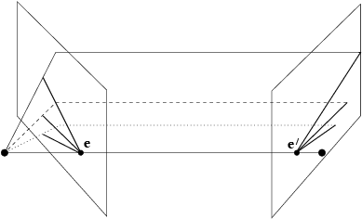
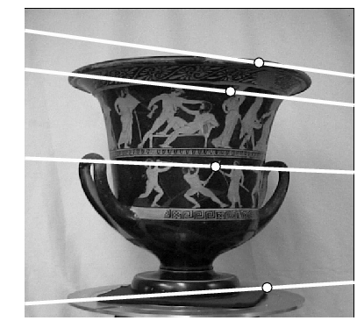
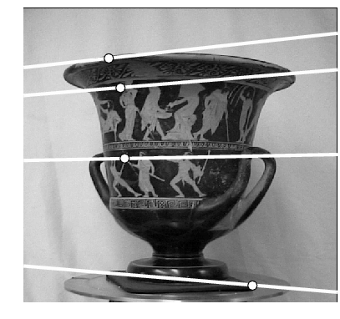
Example: Converging cameras

Slide 46
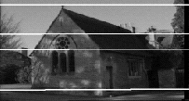
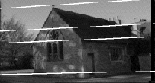
Example: Motion parallel to image plane

Slide 47
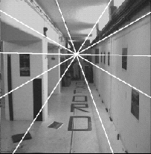
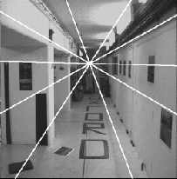
Example: Forward motion
e’
e
Epipole has same coordinates in both images.
Points move along lines radiating from e: “Focus of expansion”

Slide 48
How to find epipolar line of a point?
A little bit more math, but cool math
Essential matrix and fundamental matrix

Slide 49
Essential matrix
X
$$X_{l}$$
$${X_{r}}^{}$$
$$e^{l}$$
$${\begin{aligned}e^{r} \\ \end{aligned}}^{}$$
$$X_{l}: X \text{in} \text{terms} \text{of} \text{Cartesian} \text{coordinate} \text{of} \text{left} \text{camera} \\ X_{r}: X \text{in} \text{terms} \text{of} \text{Cartesian} \text{coordinate} \text{of} \text{right} \text{camera}$$
$$\text{There} \text{exists} E \text{such} \text{that} {X_{l}}^{T}EX_{r}=0$$

Slide 50
Essential matrix
X
$$X_{l}$$
$${X_{r}}^{}$$
$$e^{l}$$
$${\begin{aligned}e^{r} \\ \end{aligned}}^{}$$
$$X_{l}: X \text{in} \text{terms} \text{of} \text{Cartesian} \text{coordinate} \text{of} \text{left} \text{camera} \\ X_{r}: X \text{in} \text{terms} \text{of} \text{Cartesian} \text{coordinate} \text{of} \text{right} \text{camera}$$
$$\text{There} \text{exists} E \text{such} \text{that} {X_{l}}^{T}EX_{r}=0$$

Slide 51
Review: change of coordinate
How do we change coordinate from one camera to another?
(Center of projection at the origin, x-axis points right, y-axis points up, z-axis points backwards)
0

Slide 52
Review: change of coordinate
How do we change coordinate from one camera to another?
(Center of projection at the origin, x-axis points right, y-axis points up, z-axis points backwards)
Step 1: Translate by -c
0

Slide 53
Review: change of coordinate
How do we change coordinate from one camera to another?
(Center of projection at the origin, x-axis points right, y-axis points up, z-axis points backwards)
Step 1: Translate by -c
0

Slide 54
Review: change of coordinate
How do we change coordinate from one camera to another?
(Center of projection at the origin, x-axis points right, y-axis points up, z-axis points backwards)
Step 1: Translate by -c
How do we represent translation as a matrix multiplication?
0

Slide 55
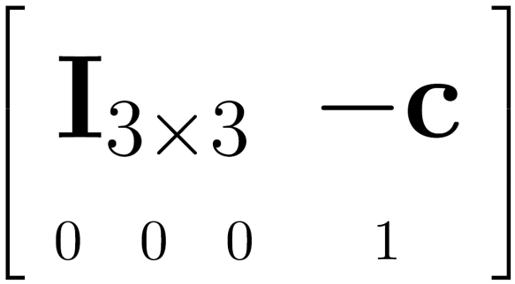
Review: change of coordinate
How do we change coordinate from one camera to another?
(Center of projection at the origin, x-axis points right, y-axis points up, z-axis points backwards)
Step 1: Translate by -c
How do we represent translation as a matrix multiplication?
0

Slide 56
Review: change of coordinate
How do we change coordinate from one camera to another?
(Center of projection at the origin, x-axis points right, y-axis points up, z-axis points backwards)
0

Slide 57
Review: change of coordinate
How do we change coordinate from one camera to another?
(Center of projection at the origin, x-axis points right, y-axis points up, z-axis points backwards)
Step 1: Translate by -c
Step 2: Rotate by R
0
3x3 rotation matrix

Slide 58
Review: change of coordinate
How do we change coordinate from one camera to another?
(Center of projection at the origin, x-axis points right, y-axis points up, z-axis points backwards)
Step 1: Translate by -c
Step 2: Rotate by R
0

Slide 59
Essential matrix (Longuet-Higgins, 1981)
X
$$X_{l}$$
$$X_{r}^{}$$
x
x’
$$e^{l}$$
$${\begin{aligned}e^{r} \\ \end{aligned}}^{}$$
$$\text{Let} R \text{be} \text{rotation} \text{from} \text{right} \text{to} \text{left} \text{camera}\text{, }\text{then} X_{l}=R(X_{r}−t)$$

Slide 60
Cross product in matrix representation
Let
$$u=[u_{1},u_{2},u_{3}]^{T},v=[v_{1},v_{2},v_{3}]^{T}$$
$$u×v=\left|\begin{matrix}i & j & k \\ u_{1} & u_{2} & u_{3} \\ v_{1} & v_{2} & v_{3}\end{matrix}\right|=\left|\begin{matrix}u_{2} & u_{3} \\ v_{2} & v_{3}\end{matrix}\right|i−\left|\begin{matrix}u_{1} & u_{3} \\ v_{1} & v_{3}\end{matrix}\right|j+\left|\begin{matrix}u_{1} & u_{2} \\ v_{1} & v_{2}\end{matrix}\right|k$$

Slide 61
Cross product in matrix representation
Let
$$u=[u_{1},u_{2},u_{3}]^{T},v=[v_{1},v_{2},v_{3}]^{T}$$
$$u×v=\left|\begin{matrix}i & j & k \\ u_{1} & u_{2} & u_{3} \\ v_{1} & v_{2} & v_{3}\end{matrix}\right|=\left|\begin{matrix}u_{2} & u_{3} \\ v_{2} & v_{3}\end{matrix}\right|i−\left|\begin{matrix}u_{1} & u_{3} \\ v_{1} & v_{3}\end{matrix}\right|j+\left|\begin{matrix}u_{1} & u_{2} \\ v_{1} & v_{2}\end{matrix}\right|k$$
$$={\left[\left|\begin{matrix}u_{2} & u_{3} \\ v_{2} & v_{3}\end{matrix}\right|,−\left|\begin{matrix}u_{1} & u_{3} \\ v_{1} & v_{3}\end{matrix}\right|,\left|\begin{matrix}u_{1} & u_{2} \\ v_{1} & v_{2}\end{matrix}\right|\right]}^{⊤}$$

Slide 62
Cross product in matrix representation
Let
$$u=[u_{1},u_{2},u_{3}]^{T},v=[v_{1},v_{2},v_{3}]^{T}$$
$$u×v=\left|\begin{matrix}i & j & k \\ u_{1} & u_{2} & u_{3} \\ v_{1} & v_{2} & v_{3}\end{matrix}\right|=\left|\begin{matrix}u_{2} & u_{3} \\ v_{2} & v_{3}\end{matrix}\right|i−\left|\begin{matrix}u_{1} & u_{3} \\ v_{1} & v_{3}\end{matrix}\right|j+\left|\begin{matrix}u_{1} & u_{2} \\ v_{1} & v_{2}\end{matrix}\right|k$$
$$={\left[\left|\begin{matrix}u_{2} & u_{3} \\ v_{2} & v_{3}\end{matrix}\right|,−\left|\begin{matrix}u_{1} & u_{3} \\ v_{1} & v_{3}\end{matrix}\right|,\left|\begin{matrix}u_{1} & u_{2} \\ v_{1} & v_{2}\end{matrix}\right|\right]}^{⊤}$$
$$={\left[\begin{matrix}u_{2}v_{3}−u_{3}v_{2} \\ −u_{1}v_{3}+u_{3}v_{1} \\ u_{1}v_{2}−u_{2}v_{1}\end{matrix}\right]}^{}$$

Slide 63
Cross product in matrix representation
Let
$$u=[u_{1},u_{2},u_{3}]^{T},v=[v_{1},v_{2},v_{3}]^{T}$$
$$u×v=\left|\begin{matrix}i & j & k \\ u_{1} & u_{2} & u_{3} \\ v_{1} & v_{2} & v_{3}\end{matrix}\right|=\left|\begin{matrix}u_{2} & u_{3} \\ v_{2} & v_{3}\end{matrix}\right|i−\left|\begin{matrix}u_{1} & u_{3} \\ v_{1} & v_{3}\end{matrix}\right|j+\left|\begin{matrix}u_{1} & u_{2} \\ v_{1} & v_{2}\end{matrix}\right|k$$
$$={\left[\left|\begin{matrix}u_{2} & u_{3} \\ v_{2} & v_{3}\end{matrix}\right|,−\left|\begin{matrix}u_{1} & u_{3} \\ v_{1} & v_{3}\end{matrix}\right|,\left|\begin{matrix}u_{1} & u_{2} \\ v_{1} & v_{2}\end{matrix}\right|\right]}^{⊤}$$
$$=\underset{[u]_{×}}{\underbrace{\left[\begin{matrix}0 & −u_{3} & u_{2} \\ u_{3} & 0 & −u_{1} \\ −u_{2} & u_{1} & 0\end{matrix}\right]}}\left[\begin{aligned}&v_{1} \\ &v_{2} \\ &v_{3}\end{aligned}\right]$$
$$={\left[\begin{matrix}u_{2}v_{3}−u_{3}v_{2} \\ −u_{1}v_{3}+u_{3}v_{1} \\ u_{1}v_{2}−u_{2}v_{1}\end{matrix}\right]}^{}$$

Slide 64
Cross product in matrix representation
Let
$$u=[u_{1},u_{2},u_{3}]^{T},v=[v_{1},v_{2},v_{3}]^{T}$$
$$u×v=\left|\begin{matrix}i & j & k \\ u_{1} & u_{2} & u_{3} \\ v_{1} & v_{2} & v_{3}\end{matrix}\right|=\left|\begin{matrix}u_{2} & u_{3} \\ v_{2} & v_{3}\end{matrix}\right|i−\left|\begin{matrix}u_{1} & u_{3} \\ v_{1} & v_{3}\end{matrix}\right|j+\left|\begin{matrix}u_{1} & u_{2} \\ v_{1} & v_{2}\end{matrix}\right|k$$
$$={\left[\left|\begin{matrix}u_{2} & u_{3} \\ v_{2} & v_{3}\end{matrix}\right|,−\left|\begin{matrix}u_{1} & u_{3} \\ v_{1} & v_{3}\end{matrix}\right|,\left|\begin{matrix}u_{1} & u_{2} \\ v_{1} & v_{2}\end{matrix}\right|\right]}^{⊤}$$
$$=\underset{[u]_{×}}{\underbrace{\left[\begin{matrix}0 & −u_{3} & u_{2} \\ u_{3} & 0 & −u_{1} \\ −u_{2} & u_{1} & 0\end{matrix}\right]}}\left[\begin{aligned}&v_{1} \\ &v_{2} \\ &v_{3}\end{aligned}\right]$$
$$={\left[\begin{matrix}u_{2}v_{3}−u_{3}v_{2} \\ −u_{1}v_{3}+u_{3}v_{1} \\ u_{1}v_{2}−u_{2}v_{1}\end{matrix}\right]}^{}$$

Slide 65
Cross product in matrix representation
Let
$$u=[u_{1},u_{2},u_{3}]^{T},v=[v_{1},v_{2},v_{3}]^{T}$$
$$u×v=\left|\begin{matrix}i & j & k \\ u_{1} & u_{2} & u_{3} \\ v_{1} & v_{2} & v_{3}\end{matrix}\right|=\left|\begin{matrix}u_{2} & u_{3} \\ v_{2} & v_{3}\end{matrix}\right|i−\left|\begin{matrix}u_{1} & u_{3} \\ v_{1} & v_{3}\end{matrix}\right|j+\left|\begin{matrix}u_{1} & u_{2} \\ v_{1} & v_{2}\end{matrix}\right|k$$
$$={\left[\left|\begin{matrix}u_{2} & u_{3} \\ v_{2} & v_{3}\end{matrix}\right|,−\left|\begin{matrix}u_{1} & u_{3} \\ v_{1} & v_{3}\end{matrix}\right|,\left|\begin{matrix}u_{1} & u_{2} \\ v_{1} & v_{2}\end{matrix}\right|\right]}^{⊤}$$
$$=\underset{[u]_{×}}{\underbrace{\left[\begin{matrix}0 & −u_{3} & u_{2} \\ u_{3} & 0 & −u_{1} \\ −u_{2} & u_{1} & 0\end{matrix}\right]}}\left[\begin{aligned}&v_{1} \\ &v_{2} \\ &v_{3}\end{aligned}\right]$$
$$={\left[\begin{matrix}u_{2}v_{3}−u_{3}v_{2} \\ −u_{1}v_{3}+u_{3}v_{1} \\ u_{1}v_{2}−u_{2}v_{1}\end{matrix}\right]}^{}$$

Slide 66
Essential matrix (Longuet-Higgins, 1981)
X
$$X_{l}$$
$$X_{r}^{}$$
x’
x’
$$e^{l}$$
$${\begin{aligned}e^{r} \\ \end{aligned}}^{}$$
$$\text{Let} R \text{be} \text{rotation} \text{from} \text{right} \text{to} \text{left} \text{camera}\text{, }\text{then} X_{l}=R(X_{r}−t)$$
$$\text{Let} E \text{be} R[t]_{×},$$
$$X_{l}^{T}EX_{r}$$

Slide 67
Essential matrix (Longuet-Higgins, 1981)
X
$$X_{l}$$
$$X_{r}^{}$$
x’
x’
$$e^{l}$$
$${\begin{aligned}e^{r} \\ \end{aligned}}^{}$$
$$\text{Let} R \text{be} \text{rotation} \text{from} \text{right} \text{to} \text{left} \text{camera}\text{, }\text{then} X_{l}=R(X_{r}−t)$$
$$\text{Let} E \text{be} R[t]_{×},$$
$$X_{l}^{T}EX_{r}$$
$$={X_{l}}^{T}(R[t]_{×}X_{r})$$

Slide 68
Essential matrix (Longuet-Higgins, 1981)
X
$$X_{l}$$
$$X_{r}^{}$$
x’
x’
$$e^{l}$$
$${\begin{aligned}e^{r} \\ \end{aligned}}^{}$$
$$\text{Let} R \text{be} \text{rotation} \text{from} \text{right} \text{to} \text{left} \text{camera}\text{, }\text{then} X_{l}=R(X_{r}−t)$$
$$\text{Let} E \text{be} R[t]_{×},$$
$$X_{l}^{T}EX_{r}$$
$$={X_{l}}^{T}(R[t]_{×}X_{r})$$
$$=(X_{r}−t)^{T}R^{T}R[t]_{×}X_{r}$$

Slide 69
Essential matrix (Longuet-Higgins, 1981)
X
$$X_{l}$$
$$X_{r}^{}$$
x’
x’
$$e^{l}$$
$${\begin{aligned}e^{r} \\ \end{aligned}}^{}$$
$$\text{Let} R \text{be} \text{rotation} \text{from} \text{right} \text{to} \text{left} \text{camera}\text{, }\text{then} X_{l}=R(X_{r}−t)$$
$$\text{Let} E \text{be} R[t]_{×},$$
$$X_{l}^{T}EX_{r}$$
$$={X_{l}}^{T}(R[t]_{×}X_{r})$$
$$=(X_{r}−t)^{T}R^{T}R[t]_{×}X_{r}$$
$$=(X_{r}−t)·(t×X_{r})$$

Slide 70
Essential matrix (Longuet-Higgins, 1981)
X
$$X_{l}$$
$$X_{r}^{}$$
x’
x’
$$e^{l}$$
$${\begin{aligned}e^{r} \\ \end{aligned}}^{}$$
$$\text{Let} R \text{be} \text{rotation} \text{from} \text{right} \text{to} \text{left} \text{camera}\text{, }\text{then} X_{l}=R(X_{r}−t)$$
$$\text{Let} E \text{be} R[t]_{×},$$
$$X_{l}^{T}EX_{r}$$
$$={X_{l}}^{T}(R[t]_{×}X_{r})$$
$$=(X_{r}−t)^{T}R^{T}R[t]_{×}X_{r}$$
$$=(X_{r}−t)·(t×X_{r})$$
$$=X_{r}·\left(t×X_{r}\right)−t·\left(t×X_{r}\right)$$

Slide 71
Essential matrix (Longuet-Higgins, 1981)
X
$$X_{l}$$
$$X_{r}^{}$$
x’
x’
$$e^{l}$$
$${\begin{aligned}e^{r} \\ \end{aligned}}^{}$$
$$\text{Let} R \text{be} \text{rotation} \text{from} \text{right} \text{to} \text{left} \text{camera}\text{, }\text{then} X_{l}=R(X_{r}−t)$$
$$\text{Let} E \text{be} R[t]_{×},$$
$$X_{l}^{T}EX_{r}$$
$$={X_{l}}^{T}(R[t]_{×}X_{r})$$
$$=(X_{r}−t)^{T}R^{T}R[t]_{×}X_{r}$$
$$=(X_{r}−t)·(t×X_{r})$$
$$=X_{r}·\left(t×X_{r}\right)−t·\left(t×X_{r}\right)$$

Slide 72
Essential matrix (Longuet-Higgins, 1981)
X
$$X_{l}$$
$$X_{r}^{}$$
x’
x’
$$e^{l}$$
$${\begin{aligned}e^{r} \\ \end{aligned}}^{}$$
$$\text{Let} R \text{be} \text{rotation} \text{from} \text{right} \text{to} \text{left} \text{camera}\text{, }\text{then} X_{l}=R(X_{r}−t)$$
$$\text{Let} E \text{be} R[t]_{×},$$
$$X_{l}^{T}EX_{r}$$
$$={X_{l}}^{T}(R[t]_{×}X_{r})$$
$$=(X_{r}−t)^{T}R^{T}R[t]_{×}X_{r}$$
$$=(X_{r}−t)·(t×X_{r})$$
$$=X_{r}·\left(t×X_{r}\right)−t·\left(t×X_{r}\right)$$

Slide 73
Essential matrix (Longuet-Higgins, 1981)
X
$$X_{l}$$
$$X_{r}^{}$$
x’
x’
$$e^{l}$$
$${\begin{aligned}e^{r} \\ \end{aligned}}^{}$$
X₀

Slide 74
Essential matrix (Longuet-Higgins, 1981)
X
$$X_{l}$$
$$X_{r}^{}$$
x’
x’
$$e^{l}$$
$${\begin{aligned}e^{r} \\ \end{aligned}}^{}$$
X₀
$$X_{r}^{0}$$

Slide 75
Essential matrix (Longuet-Higgins, 1981)
X
$$X_{l}$$
$$X_{r}^{}$$
x’
x’
$$e^{l}$$
$${\begin{aligned}e^{r} \\ \end{aligned}}^{}$$
X₀
$$X_{r}^{0}$$
$$EX_{r}^{0}=(R[t]_{×})X_{r}^{0}$$

Slide 76
Essential matrix (Longuet-Higgins, 1981)
X
$$X_{l}$$
$$X_{r}^{}$$
x’
x’
$$e^{l}$$
$${\begin{aligned}e^{r} \\ \end{aligned}}^{}$$
X₀
$$X_{r}^{0}$$
$$EX_{r}^{0}=(R[t]_{×})X_{r}^{0}$$
$$=R(t×X_{r}^{0})$$

Slide 77
Essential matrix (Longuet-Higgins, 1981)
X
$$X_{l}$$
$$X_{r}^{}$$
x’
x’
$$e^{l}$$
$${\begin{aligned}e^{r} \\ \end{aligned}}^{}$$
X₀
$$X_{r}^{0}$$
$$EX_{r}^{0}=(R[t]_{×})X_{r}^{0}$$
$$=R(t×X_{r}^{0})$$

Slide 78
Essential matrix (Longuet-Higgins, 1981)
X
$$X_{l}$$
$$X_{r}^{}$$
x’
x’
$$e^{l}$$
$${\begin{aligned}e^{r} \\ \end{aligned}}^{}$$
X₀
$$X_{l}^{0}$$
$$X_{r}^{0}$$
$$EX_{r}^{0}=(R[t]_{×})X_{r}^{0}$$
$$=R(t×X_{r}^{0})$$
$$E^{T}X_{l}^{0}=(R[t]_{×})^{T}R(X_{r}^{0}−t)$$

Slide 79
Essential matrix (Longuet-Higgins, 1981)
X
$$X_{l}$$
$$X_{r}^{}$$
x’
x’
$$e^{l}$$
$${\begin{aligned}e^{r} \\ \end{aligned}}^{}$$
X₀
$$X_{l}^{0}$$
$$X_{r}^{0}$$
$$EX_{r}^{0}=(R[t]_{×})X_{r}^{0}$$
$$=R(t×X_{r}^{0})$$
$$E^{T}X_{l}^{0}=(R[t]_{×})^{T}R(X_{r}^{0}−t)$$
$$=([t]_{×})^{T}R^{T}R(X_{r}^{0}−t)$$

Slide 80
Essential matrix (Longuet-Higgins, 1981)
X
$$X_{l}$$
$$X_{r}^{}$$
x’
x’
$$e^{l}$$
$${\begin{aligned}e^{r} \\ \end{aligned}}^{}$$
X₀
$$X_{l}^{0}$$
$$X_{r}^{0}$$
$$EX_{r}^{0}=(R[t]_{×})X_{r}^{0}$$
$$=R(t×X_{r}^{0})$$
$$\underset{[t]_{×}}{\underbrace{\left[\begin{matrix}0 & −t_{3} & t_{2} \\ t_{3} & 0 & −t_{1} \\ −t_{2} & t_{1} & 0\end{matrix}\right]}}$$
$$E^{T}X_{l}^{0}=(R[t]_{×})^{T}R(X_{r}^{0}−t)$$
$$=([t]_{×})^{T}R^{T}R(X_{r}^{0}−t)$$

Slide 81
Essential matrix (Longuet-Higgins, 1981)
X
$$X_{l}$$
$$X_{r}^{}$$
x’
x’
$$e^{l}$$
$${\begin{aligned}e^{r} \\ \end{aligned}}^{}$$
X₀
$$X_{l}^{0}$$
$$X_{r}^{0}$$
$$EX_{r}^{0}=(R[t]_{×})X_{r}^{0}$$
$$=R(t×X_{r}^{0})$$
$$\underset{[t]_{×}}{\underbrace{\left[\begin{matrix}0 & −t_{3} & t_{2} \\ t_{3} & 0 & −t_{1} \\ −t_{2} & t_{1} & 0\end{matrix}\right]}}$$
$$E^{T}X_{l}^{0}=(R[t]_{×})^{T}R(X_{r}^{0}−t)$$
$$=([t]_{×})^{T}R^{T}R(X_{r}^{0}−t)$$
$$=[−t]_{×}(X_{r}^{0}−t)$$

Slide 82
Essential matrix (Longuet-Higgins, 1981)
X
$$X_{l}$$
$$X_{r}^{}$$
x’
x’
$$e^{l}$$
$${\begin{aligned}e^{r} \\ \end{aligned}}^{}$$
X₀
$$X_{l}^{0}$$
$$X_{r}^{0}$$
$$EX_{r}^{0}=(R[t]_{×})X_{r}^{0}$$
$$=R(t×X_{r}^{0})$$
$$\underset{[t]_{×}}{\underbrace{\left[\begin{matrix}0 & −t_{3} & t_{2} \\ t_{3} & 0 & −t_{1} \\ −t_{2} & t_{1} & 0\end{matrix}\right]}}$$
$$E^{T}X_{l}^{0}=(R[t]_{×})^{T}R(X_{r}^{0}−t)$$
$$=([t]_{×})^{T}R^{T}R(X_{r}^{0}−t)$$
$$=[−t]_{×}(X_{r}^{0}−t)$$
$$=−t×(X_{r}^{0}−t)$$

Slide 83
Essential matrix (Longuet-Higgins, 1981)
X
$$X_{l}$$
$$X_{r}^{}$$
x’
x’
$$e^{l}$$
$${\begin{aligned}e^{r} \\ \end{aligned}}^{}$$
X₀
$$X_{l}^{0}$$
$$X_{r}^{0}$$
$$EX_{r}^{0}=(R[t]_{×})X_{r}^{0}$$
$$=R(t×X_{r}^{0})$$
$$\underset{[t]_{×}}{\underbrace{\left[\begin{matrix}0 & −t_{3} & t_{2} \\ t_{3} & 0 & −t_{1} \\ −t_{2} & t_{1} & 0\end{matrix}\right]}}$$
$$E^{T}X_{l}^{0}=(R[t]_{×})^{T}R(X_{r}^{0}−t)$$
$$=([t]_{×})^{T}R^{T}R(X_{r}^{0}−t)$$
$$=[−t]_{×}(X_{r}^{0}−t)$$
$$=−t×(X_{r}^{0}−t)$$

Slide 84
Fundamental matrix (Faugeras and Luong, 1992)
X
$$e^{l}$$
$${\begin{aligned}e^{r} \\ \end{aligned}}^{}$$

Slide 85
Fundamental matrix (Faugeras and Luong, 1992)
X
$$X_{r}^{}$$
$$e^{l}$$
$${\begin{aligned}e^{r} \\ \end{aligned}}^{}$$
$$X_{r}: X \text{in} \text{terms} \text{of} \text{Cartesian} \text{coordinate} \text{of} \text{right} \text{camera}$$

Slide 86
Fundamental matrix (Faugeras and Luong, 1992)
X
$$X_{l}$$
$$X_{r}^{}$$
$$e^{l}$$
$${\begin{aligned}e^{r} \\ \end{aligned}}^{}$$
$$X_{r}: X \text{in} \text{terms} \text{of} \text{Cartesian} \text{coordinate} \text{of} \text{right} \text{camera}$$
$$X_{l}: X \text{in} \text{terms} \text{of} \text{Cartesian} \text{coordinate} \text{of} \text{left} \text{camera}$$

Slide 87
Fundamental matrix (Faugeras and Luong, 1992)
X
$$X_{l}$$
$$X_{r}^{}$$
$$\hat{x_{r}}$$
$$e^{l}$$
$${\begin{aligned}e^{r} \\ \end{aligned}}^{}$$
$$X_{r}: X \text{in} \text{terms} \text{of} \text{Cartesian} \text{coordinate} \text{of} \text{right} \text{camera}$$
$$X_{l}: X \text{in} \text{terms} \text{of} \text{Cartesian} \text{coordinate} \text{of} \text{left} \text{camera}$$

Slide 88
Fundamental matrix (Faugeras and Luong, 1992)
X
$$X_{l}$$
$$X_{r}^{}$$
$$\hat{x_{l}}$$
$$\hat{x_{r}}$$
$$e^{l}$$
$${\begin{aligned}e^{r} \\ \end{aligned}}^{}$$
$$X_{r}: X \text{in} \text{terms} \text{of} \text{Cartesian} \text{coordinate} \text{of} \text{right} \text{camera}$$
$$X_{l}: X \text{in} \text{terms} \text{of} \text{Cartesian} \text{coordinate} \text{of} \text{left} \text{camera}$$

Slide 89
Fundamental matrix (Faugeras and Luong, 1992)
X
$$X_{l}$$
$$X_{r}^{}$$
$$\hat{x_{l}}$$
$$\hat{x_{r}}$$
$$e^{l}$$
$${\begin{aligned}e^{r} \\ \end{aligned}}^{}$$
$$X_{r}: X \text{in} \text{terms} \text{of} \text{Cartesian} \text{coordinate} \text{of} \text{right} \text{camera}$$
$$X_{l}: X \text{in} \text{terms} \text{of} \text{Cartesian} \text{coordinate} \text{of} \text{left} \text{camera}$$

Slide 90
Recall from last time
James Hays

Slide 91
Recall from last time
James Hays

Slide 92
Recall from last time
James Hays

Slide 93
Fundamental matrix
X
$$X_{l}$$
$$X_{r}^{}$$
$$e^{l}$$
$${\begin{aligned}e^{r} \\ \end{aligned}}^{}$$
$$X_{l}: X \text{in} \text{terms} \text{of} \text{Cartesian} \text{coordinate} \text{of} \text{left} \text{camera} \\ X_{r}: X \text{in} \text{terms} \text{of} \text{Cartesian} \text{coordinate} \text{of} \text{right} \text{camera}$$

Slide 94
Fundamental matrix
X
$$X_{l}$$
$$X_{r}^{}$$
$$\hat{x_{l}}$$
$${\hat{x_{r}}}^{}$$
$$e^{l}$$
$${\begin{aligned}e^{r} \\ \end{aligned}}^{}$$
$$X_{l}: X \text{in} \text{terms} \text{of} \text{Cartesian} \text{coordinate} \text{of} \text{left} \text{camera} \\ X_{r}: X \text{in} \text{terms} \text{of} \text{Cartesian} \text{coordinate} \text{of} \text{right} \text{camera}$$
$${\hat{x}}_{l}=K_{l}X_{l}: X\text{ ′}\text{s} \text{homogeneous} \text{coordinate} \text{of} \text{left} \text{view} \\ {\hat{x}}_{r}=K_{r}X_{r}: X\text{ ′}\text{s} \text{homogeneous} \text{coordinate} \text{of} \text{right} \text{view}$$

Slide 95
Fundamental matrix
X
$$X_{l}$$
$$X_{r}^{}$$
$$\hat{x_{l}}$$
$${\hat{x_{r}}}^{}$$
$$e^{l}$$
$${\begin{aligned}e^{r} \\ \end{aligned}}^{}$$
$$X_{l}: X \text{in} \text{terms} \text{of} \text{Cartesian} \text{coordinate} \text{of} \text{left} \text{camera} \\ X_{r}: X \text{in} \text{terms} \text{of} \text{Cartesian} \text{coordinate} \text{of} \text{right} \text{camera}$$
$${\hat{x}}_{l}=K_{l}X_{l}: X\text{ ′}\text{s} \text{homogeneous} \text{coordinate} \text{of} \text{left} \text{view} \\ {\hat{x}}_{r}=K_{r}X_{r}: X\text{ ′}\text{s} \text{homogeneous} \text{coordinate} \text{of} \text{right} \text{view}$$

Slide 96
Fundamental matrix
X
$$X_{l}$$
$$X_{r}^{}$$
$$\hat{x_{l}}$$
$${\hat{x_{r}}}^{}$$
$$e^{l}$$
$${\begin{aligned}e^{r} \\ \end{aligned}}^{}$$
$$X_{l}: X \text{in} \text{terms} \text{of} \text{Cartesian} \text{coordinate} \text{of} \text{left} \text{camera} \\ X_{r}: X \text{in} \text{terms} \text{of} \text{Cartesian} \text{coordinate} \text{of} \text{right} \text{camera}$$
$${\hat{x}}_{l}=K_{l}X_{l}: X\text{ ′}\text{s} \text{homogeneous} \text{coordinate} \text{of} \text{left} \text{view} \\ {\hat{x}}_{r}=K_{r}X_{r}: X\text{ ′}\text{s} \text{homogeneous} \text{coordinate} \text{of} \text{right} \text{view}$$

Slide 97
Fundamental matrix
X
$$X_{l}$$
$$X_{r}^{}$$
$$\hat{x_{l}}$$
$${\hat{x_{r}}}^{}$$
$$e^{l}$$
$${\begin{aligned}e^{r} \\ \end{aligned}}^{}$$
$$X_{l}: X \text{in} \text{terms} \text{of} \text{Cartesian} \text{coordinate} \text{of} \text{left} \text{camera} \\ X_{r}: X \text{in} \text{terms} \text{of} \text{Cartesian} \text{coordinate} \text{of} \text{right} \text{camera}$$
$${\hat{x}}_{l}=K_{l}X_{l}: X\text{ ′}\text{s} \text{homogeneous} \text{coordinate} \text{of} \text{left} \text{view} \\ {\hat{x}}_{r}=K_{r}X_{r}: X\text{ ′}\text{s} \text{homogeneous} \text{coordinate} \text{of} \text{right} \text{view}$$

Slide 98
Fundamental matrix
X
$$X_{l}$$
$$X_{r}^{}$$
$$\hat{x_{l}}$$
$${\hat{x_{r}}}^{}$$
$$e^{l}$$
$${\begin{aligned}e^{r} \\ \end{aligned}}^{}$$
$$X_{l}: X \text{in} \text{terms} \text{of} \text{Cartesian} \text{coordinate} \text{of} \text{left} \text{camera} \\ X_{r}: X \text{in} \text{terms} \text{of} \text{Cartesian} \text{coordinate} \text{of} \text{right} \text{camera}$$
$${\hat{x}}_{l}=K_{l}X_{l}: X\text{ ′}\text{s} \text{homogeneous} \text{coordinate} \text{of} \text{left} \text{view} \\ {\hat{x}}_{r}=K_{r}X_{r}: X\text{ ′}\text{s} \text{homogeneous} \text{coordinate} \text{of} \text{right} \text{view}$$

Slide 99
Epipoles and fundamental matrix
X
$${\begin{aligned}e^{r} \\ \end{aligned}}^{}$$
$$e^{l}$$
X₀
$$X_{r}^{0}$$

Slide 100
Epipoles and fundamental matrix
X
$${\begin{aligned}e^{r} \\ \end{aligned}}^{}$$
$$e^{l}$$
X₀
$$X_{r}^{0}$$

Slide 101
Epipoles and fundamental matrix
X
$${\begin{aligned}e^{r} \\ \end{aligned}}^{}$$
$$e^{l}$$
X₀
$$X_{r}^{0}$$
$$Fe^{r}=\underset{F}{\underbrace{(K_{l}^{T})^{−1}E{K_{r}}^{−1}}}e^{r}$$
$$=(K_{l}^{T})^{−1}E{K_{r}}^{−1}\underset{e^{r}}{\underbrace{K_{r}X_{r}^{0}}}=(K_{l}^{T})^{−1}EX_{r}^{0}$$

Slide 102
Epipoles and fundamental matrix
X
$${\begin{aligned}e^{r} \\ \end{aligned}}^{}$$
$$e^{l}$$
X₀
$$X_{r}^{0}$$
$$Fe^{r}=\underset{F}{\underbrace{(K_{l}^{T})^{−1}E{K_{r}}^{−1}}}e^{r}$$
$$=(K_{l}^{T})^{−1}E{K_{r}}^{−1}\underset{e^{r}}{\underbrace{K_{r}X_{r}^{0}}}=(K_{l}^{T})^{−1}EX_{r}^{0}$$

Slide 103
Epipoles and fundamental matrix
X
$${\begin{aligned}e^{r} \\ \end{aligned}}^{}$$
$$e^{l}$$
X₀
$$X_{l}^{0}$$
$$X_{r}^{0}$$
$$Fe^{r}=\underset{F}{\underbrace{(K_{l}^{T})^{−1}E{K_{r}}^{−1}}}e^{r}$$
$$=(K_{l}^{T})^{−1}E{K_{r}}^{−1}\underset{e^{r}}{\underbrace{K_{r}X_{r}^{0}}}=(K_{l}^{T})^{−1}EX_{r}^{0}$$
$$F^{T}e^{l}=\underset{F}{\underbrace{(K_{r}^{T})^{−1}E^{T}{K_{l}}^{−1}}}e^{l}=(K_{r}^{T})^{−1}E^{T}{K_{l}}^{−1}\underset{e^{l}}{\underbrace{K_{l}X_{l}^{0}}}=(K_{r}^{T})^{−1}E^{T}X_{l}^{0}=0$$

Slide 104
Review: Essential matrix
X
$$\hat{X_{l}}$$
$${\hat{X_{r}}}^{}$$
$$e^{l}$$
$${\begin{aligned}e^{r} \\ \end{aligned}}^{}$$

Slide 105
Review: Essential matrix
X
$$\hat{X_{l}}$$
$${\hat{X_{r}}}^{}$$
$$e^{l}$$
$${\begin{aligned}e^{r} \\ \end{aligned}}^{}$$

Slide 106
Review: Fundamental matrix
X
$$\hat{X_{l}}$$
$${\hat{X_{r}}}^{}$$
$$e^{l}$$
$${\begin{aligned}e^{r} \\ \end{aligned}}^{}$$

Slide 107
Review: Fundamental matrix
X
$$\hat{X_{l}}$$
$${\hat{X_{r}}}^{}$$
$$\hat{x_{l}}$$
$${\hat{x_{r}}}^{}$$
$$e^{l}$$
$${\begin{aligned}e^{r} \\ \end{aligned}}^{}$$

Slide 108
Review: Fundamental matrix
X
$$\hat{X_{l}}$$
$${\hat{X_{r}}}^{}$$
$$\hat{x_{l}}$$
$${\hat{x_{r}}}^{}$$
$$e^{l}$$
$${\begin{aligned}e^{r} \\ \end{aligned}}^{}$$

Slide 109
Review: Fundamental matrix
X
$$\hat{X_{l}}$$
$${\hat{X_{r}}}^{}$$
$$\hat{x_{l}}$$
$${\hat{x_{r}}}^{}$$
$$e^{l}$$
$${\begin{aligned}e^{r} \\ \end{aligned}}^{}$$

Slide 110
Review: Fundamental matrix
X
$$\hat{X_{l}}$$
$${\hat{X_{r}}}^{}$$
$$\hat{x_{l}}$$
$${\hat{x_{r}}}^{}$$
$$e^{l}$$
$${\begin{aligned}e^{r} \\ \end{aligned}}^{}$$

Slide 111
Review: Fundamental matrix
X
$$\hat{X_{l}}$$
$${\hat{X_{r}}}^{}$$
$$\hat{x_{l}}$$
$${\hat{x_{r}}}^{}$$
$$e^{l}$$
$${\begin{aligned}e^{r} \\ \end{aligned}}^{}$$

Slide 112
Line representation in homogenous coordinate
Line equation: ax + by + c = 0
Can represent a line with vector [a b c]
Then, a point p is on a line l if and only if
Note that

Slide 113
Line representation in homogenous coordinate
Line equation: ax + by + c = 0
Can represent a line with vector [a b c]
Then, a point p is on a line l if and only if
Note that

Slide 114
Line representation in homogenous coordinate
Line equation: ax + by + c = 0
Can represent a line with vector [a b c]
Then, a point p is on a line l if and only if
Note that

Slide 115
Line representation in homogenous coordinate
Line equation: ax + by + c = 0
Can represent a line with vector [a b c]
Then, a point p is on a line l if and only if
Note that

Slide 116
Epipoles and fundamental matrix
X
$$\hat{x_{l}}$$
$${\hat{x_{r}}}^{}$$
$$e^{l}$$
$${\begin{aligned}e^{r} \\ \end{aligned}}^{}$$
X₀

Slide 117
Epipoles and fundamental matrix
X
$$\hat{x_{l}}$$
$${\hat{x_{r}}}^{}$$
$$e^{l}$$
$${\begin{aligned}e^{r} \\ \end{aligned}}^{}$$
X₀
$$\text{and} \text{recall} \text{that} Fe^{r}=F^{T}e^{l}=0$$

Slide 118
Epipoles and fundamental matrix
X
$$\hat{x_{l}}$$
$${\hat{x_{r}}}^{}$$
$$e^{l}$$
$${\begin{aligned}e^{r} \\ \end{aligned}}^{}$$
X₀
$$\text{and} \text{recall} \text{that} Fe^{r}=F^{T}e^{l}=0$$

Slide 119
Epipoles and fundamental matrix
X
$$\hat{x_{l}}$$
$${\hat{x_{r}}}^{}$$
$$e^{l}$$
$${\begin{aligned}e^{r} \\ \end{aligned}}^{}$$
X₀
$$\text{and} \text{recall} \text{that} Fe^{r}=F^{T}e^{l}=0$$

Slide 120
Epipoles and fundamental matrix
X
$$\hat{x_{l}}$$
$${\hat{x_{r}}}^{}$$
$$e^{l}$$
$${\begin{aligned}e^{r} \\ \end{aligned}}^{}$$
X₀
$$\text{and} \text{recall} \text{that} Fe^{r}=F^{T}e^{l}=0$$

Slide 121
Epipoles and fundamental matrix
X
$$\hat{x_{l}}$$
$${\hat{x_{r}}}^{}$$
$$e^{l}$$
$${\begin{aligned}e^{r} \\ \end{aligned}}^{}$$
X₀
$$\text{and} \text{recall} \text{that} Fe^{r}=F^{T}e^{l}=0$$

Slide 122
Epipoles and fundamental matrix
X
$$\hat{x_{l}}$$
$${\hat{x_{r}}}^{}$$
$$e^{l}$$
$${\begin{aligned}e^{r} \\ \end{aligned}}^{}$$
X₀
$$\text{and} \text{recall} \text{that} Fe^{r}=F^{T}e^{l}=0$$
$$⇒e^{r}F^{T}{\hat{x}}_{l}=(Fe^{r})^{T}{\hat{x}}_{l}=0$$

Slide 123
Epipoles and fundamental matrix
X
$$\hat{x_{l}}$$
$${\hat{x_{r}}}^{}$$
$$e^{l}$$
$${\begin{aligned}e^{r} \\ \end{aligned}}^{}$$
X₀
$$\text{and} \text{recall} \text{that} Fe′=F^{T}e^{l}=0$$
$$⇒e^{r}F^{T}{\hat{x}}_{l}=(Fe^{r})^{T}{\hat{x}}_{l}=0$$

Slide 124
Epipoles and fundamental matrix
X
$$\hat{x_{l}}$$
$${\hat{x_{r}}}^{}$$
$$e^{l}$$
$${\begin{aligned}e^{r} \\ \end{aligned}}^{}$$
X₀
$$\text{and} \text{recall} \text{that} Fe′=F^{T}e^{l}=0$$
$$⇒e^{r}F^{T}{\hat{x}}_{l}=(Fe^{r})^{T}{\hat{x}}_{l}=0$$

Slide 125
Epipoles and fundamental matrix
X
$$\hat{x_{l}}$$
$${\hat{x_{r}}}^{}$$
$$e^{l}$$
$${\begin{aligned}e^{r} \\ \end{aligned}}^{}$$

Slide 126
Epipoles and fundamental matrix
X
$$\hat{x_{l}}$$
$${\hat{x_{r}}}^{}$$
$$e^{l}$$
$${\begin{aligned}e^{r} \\ \end{aligned}}^{}$$

Slide 127
Epipoles and fundamental matrix
X
$$\hat{x_{l}}$$
$${\hat{x_{r}}}^{}$$
$$e^{l}$$
$${\begin{aligned}e^{r} \\ \end{aligned}}^{}$$

Slide 128
Epipoles and fundamental matrix
X
$$\hat{x_{l}}$$
$${\hat{x_{r}}}^{}$$
$$e^{l}$$
$${\begin{aligned}e^{r} \\ \end{aligned}}^{}$$

Slide 129
Epipoles and fundamental matrix
X
$$\hat{x_{l}}$$
$${\hat{x_{r}}}^{}$$
$$e^{l}$$
$${\begin{aligned}e^{r} \\ \end{aligned}}^{}$$

Slide 130
Epipoles and fundamental matrix
X
$$\hat{x_{l}}$$
$${\hat{x_{r}}}^{}$$
$$e^{l}$$
$${\begin{aligned}e^{r} \\ \end{aligned}}^{}$$
This restrict our search space from 2D to 1D

Slide 131
Fundamental matrix
X
$$e^{l}$$
$${\begin{aligned}e^{r} \\ \end{aligned}}^{}$$

Slide 132
Fundamental matrix
X
$$e^{l}$$
$${\begin{aligned}e^{r} \\ \end{aligned}}^{}$$
F e^{r} = 0 and F^{T}e^{l} = 0 (nullspaces of F = e^{r}; nullspace of F^{T} = e^{l})
F is singular (rank two): det(F)=0
F has seven degrees of freedom: 9 entries but defined up to scale, det(F)=0

Slide 133
Fundamental matrix
X
$$e^{l}$$
$${\begin{aligned}e^{r} \\ \end{aligned}}^{}$$
F e^{r} = 0 and F^{T}e^{l} = 0 (nullspaces of F = e^{r}; nullspace of F^{T} = e^{l})
F is singular (rank two): det(F)=0
F has seven degrees of freedom: 9 entries but defined up to scale, det(F)=0

Slide 134
Remark
Since

Slide 135
Remark
Since

Slide 136
Remark
Since

Slide 137
Remark
Since
This is sometimes how essential matrix is introduced

Slide 138
Estimating the Fundamental Matrix
8-point algorithm
Least squares solution using SVD on equations from 8 pairs of correspondences
Enforce det(F)=0 constraint using SVD on F

Slide 139
Estimating the Fundamental Matrix
8-point algorithm
Least squares solution using SVD on equations from 8 pairs of correspondences
Enforce det(F)=0 constraint using SVD on F
Note: estimation of F (or E) is degenerate for a planar scene.

Slide 140
8-point algorithm
Solve a system of homogeneous linear equations
Write down the system of equations
$$uu^{′}f_{11}+uv^{′}f_{12}+uf_{13}+vu^{′}f_{21}+vv^{′}f_{22}+vf_{23}+u^{′}f_{31}+v^{′}f_{32}+f_{33}=0$$
$Af=\left[\begin{matrix}u_{1}u_{1}′ & u_{1}v_{1}′ & \begin{matrix}u_{1} & v_{1}u_{1}′ & \begin{matrix}v_{1}v_{1}′ & v_{1} & \begin{matrix}u_{1}′ & v_{1}′ & 1\end{matrix}\end{matrix}\end{matrix} \\ \begin{matrix}⋮ \\ u_{n}u_{v}^{′}\end{matrix} & \begin{matrix}⋮ \\ u_{n}v_{n}′\end{matrix} & \begin{matrix}\begin{matrix}⋮ \\ u_{n}\end{matrix} & \begin{matrix}⋮ \\ v_{n}u_{n}′\end{matrix} & \begin{matrix}\begin{matrix}⋮ \\ v_{n}v_{n}′\end{matrix} & \begin{matrix}⋮ \\ v_{n}\end{matrix} & \begin{matrix}\begin{matrix}⋮ \\ u_{n}′\end{matrix} & \begin{matrix}⋮ \\ v_{n}′\end{matrix} & \begin{matrix}⋮ \\ 1\end{matrix}\end{matrix}\end{matrix}\end{matrix}\end{matrix}\right]\left[\begin{matrix}f_{11} \\ f_{12} \\ \begin{aligned}f_{13} \\ f_{21} \\ ⋮ \\ f_{33}\end{aligned}\end{matrix}\right]$=0

Slide 141
8-point algorithm
Solve a system of homogeneous linear equations
Write down the system of equations
Solve f from Af=0 using SVD
Matlab:
[U, S, V] = svd(A);
f = V(:, end);
F = reshape(f, [3 3])’;

Slide 142
Need to enforce singularity constraint

Slide 143
8-point algorithm
Solve a system of homogeneous linear equations
Write down the system of equations
Solve f from Af=0 using SVD
Resolve det(F) = 0 constraint using SVD
Matlab:
[U, S, V] = svd(A);
f = V(:, end);
F = reshape(f, [3 3])’;
Matlab:
[U, S, V] = svd(F);
S(3,3) = 0;
F = U*S*V’;

Slide 144
Problem with eight-point algorithm

Slide 145
Problem with eight-point algorithm

Slide 146
Problem with eight-point algorithm
Poor numerical conditioning
Can be fixed by rescaling the data

Slide 147
Problem with eight-point algorithm
Poor numerical conditioning
Can be fixed by rescaling the data

Slide 148
From epipolar geometry to camera calibration

Slide 149
From epipolar geometry to camera calibration
If we know the calibration matrices of the two cameras, we can estimate the essential matrix: E = K^{T}FK’
The essential matrix gives us the relative rotation and translation between the cameras, or their extrinsic parameters.
Fundamental matrix lets us compute relationship up to scale for cameras with unknown intrinsic calibrations.
Estimating the fundamental matrix is a kind of “weak calibration”

Slide 150
From epipolar geometry to camera calibration
If we know the calibration matrices of the two cameras, we can estimate the essential matrix: E = K^{T}FK’
The essential matrix gives us the relative rotation and translation between the cameras, or their extrinsic parameters.
Fundamental matrix lets us compute relationship up to scale for cameras with unknown intrinsic calibrations.
Estimating the fundamental matrix is a kind of “weak calibration”

Slide 151
From epipolar geometry to camera calibration
If we know the calibration matrices of the two cameras, we can estimate the essential matrix: E = K^{T}FK’
The essential matrix gives us the relative rotation and translation between the cameras, or their extrinsic parameters.
Fundamental matrix lets us compute relationship up to scale for cameras with unknown intrinsic calibrations.
Estimating the fundamental matrix is a kind of “weak calibration”

Slide 152
From E to get back R and t
If we decompose E using svd to $USV^{⊤}$
Let’s define $W=\left(\begin{matrix}0 & −1 & 0 \\ 1 & 0 & 0 \\ 0 & 0 & 1\end{matrix}\right)$
One can verify that ${\left[t\right]}_{×}=VWSV^{⊤}$ and $R=UW^{⊤}V^{⊤}$ is a pair of valid estimate of R and t such that $R{\left[t\right]}_{×}=UW^{⊤}V^{⊤}VWSV^{⊤}=USV^{⊤}=E$
How do we get t back from ${\left[t\right]}_{×}$?
Note that there are three more solutions
Replace $W$ by $W^{⊤}$and t by –t
Note that only one solution will satisfy chirality (reconstructed points in front of the camera)

Slide 153
Caveat
Note that many textbooks use the convention of $E={\left[t\right]}_{×}R$ rather than $E={R\left[t\right]}_{×}$ as derived here
Both are correct just they first rotate and then translate the axis rather than first translate and then rotate the axis as shown earlier
But consequently, the t there is different as below
Note that for any $y$, ${\left[R t\right]}_{×}y= R \left({\left[t\right]}_{×}^{}R^{⊤}y\right)$ since crossing $R$ with $y$is the same as crossing $t$ with $R^{⊤}y$ and then rotate by $R$
${⇒\left[R t\right]}_{×}= R {\left[t\right]}_{×}R^{⊤}$
$⇒E=R{\left[t\right]}_{×}=\left(R{\left[t\right]}_{×}R^{⊤}\right)R={\left[Rt\right]}_{×}R$
Therefore, for the alternative formulation $E={\left[t\right]}_{×}R$, we have the translation there actually equal to $Rt$ instead in our notations

Slide 154
Compute 3D point location
Given R, t, and observed points in the two views. We can construct two lines that should contain the 3D point. And the point should be just the interception
Denote two lines as $a_{1}+λ_{1}b_{1}$ and $a_{2}+λ_{2}b_{2}$. We can solve the interception by solving
$\min_{λ,μ}{\left\|a_{1}+λ_{1}b_{1}−a_{2}−λ_{2}b_{2}\right\|}^{2}$
$$⇒\left\{\begin{aligned}λ_{1}{\left\|b_{1}\right\|}^{2}+{\left(a_{1}−a_{2}\right)}^{⊤}b_{1}−λ_{2}b_{1}^{⊤}b_{2}=0 \\ λ_{2}{\left\|b_{2}\right\|}^{2}−{\left(a_{1}−a_{2}\right)}^{⊤}b_{2}−λ_{1}b_{1}^{⊤}b_{2}=0\end{aligned}\right.$$
The final point will be
$$\frac{a_{1}+λ_{1}b_{1}+a_{2}+λ_{2}b_{2}}{2}$$

Slide 155
DEMO

Slide 156
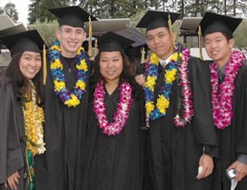
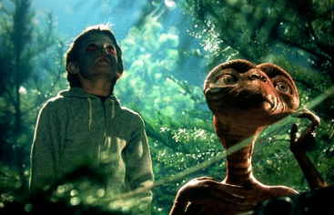
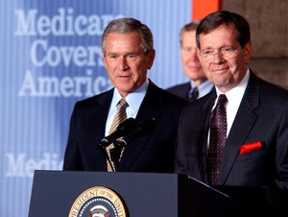
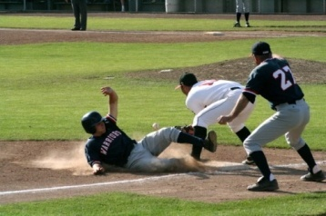
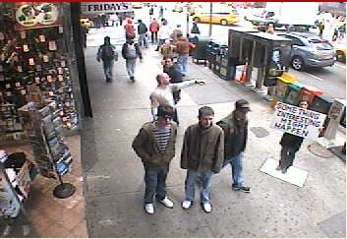
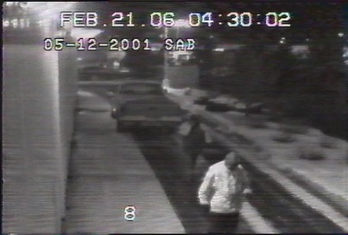
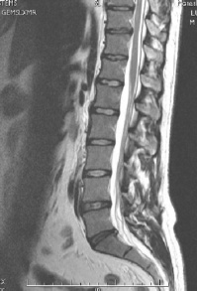
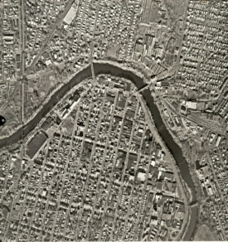
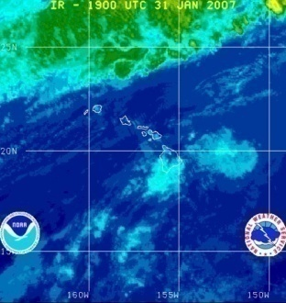
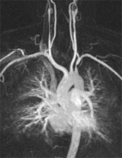
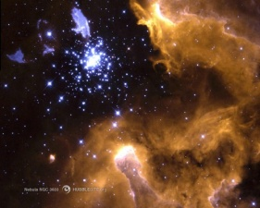
Why study computer vision?
Millions of images being captured all the time
Loads of useful applications

Slide 157
Computer vision and AI
The development of computer vision have benefit enormously from signal processing and “AI”
Three pillars of AI
Symbolic model (expert systems)
Probabilistic (Bayesian) model
Neural networks
We see a little bit of neural networks from the last couple weeks (will look deeper in my ANN class next spring)
More on probabilistic models in ECE 5973: information theory and probabilistic programming

Slide 158
Information theory and Probabilistic programming (coming fall)
Use probabilistic model for inference (prediction)
Organized unknown with graphical models
Infer unknown given observations
Learn variable models
Applications like
Predict stock markets
Recommending products (movies, books, etc.)
Medical diagnosis and prognosis

Slide 159
Hope to see you all in future classes!
Good luck with finals and have a fruitful summer break!

