Slide 1
Artificial Neural Networks
Deep Learning Overview
Samuel Cheng
With many slides borrowed from
Stanford CS 231n
Hinton’s coursera course

Slide 2
Instructor
Samuel Cheng (samuel.cheng@ou.edu)
Office hours:
  TBA(?), catch me after class for the moment
  I’ll be teaching from both Norman and Tulsa
Research interests:
  Computer vision
  Machine learning
  Signal processing

Slide 3
What is this course about?
Look into some history, techniques, applications of neural networks
Will explore quite a bit on so-called ``deep learning”. A hyped-word of artificial neural networks
This is offered the second time (course renamed from deep learning to artificial neural networks and applications)
  Things advance extremely fast. We will explore the topics together ☺
Many students applied what was learned to their research directly last year
Hope this will help your research!

Slide 4
Quick Logistics
“Homework” ~ 30%
Programming assignment ~ 30%
Final Project ~ 40%
Textbook: Ian Goodfellow, Yoshua Bengio and Aaron Courville, Deep Learning, MIT Press
  I won’t follow it closely but it is a good reference in general
Course website: http://www.samuelcheng.info/deeplearning_2018/index.html
Piazza:
https://piazza.com/ou/spring2018/ece5973

Slide 5
Backgrounds
ECE
CS
ME
Others?

Slide 6
Your Research Directions
Image Processing/Computer Vision/Imaging:
Medical Imaging:
Natural language processing (NLP):
Others: ?

Slide 7
Exposure to deep learning courses
Hinton’s coursera course
Stanford CS 231n
Oxford’s course
U Toronto’s course
Larochelle’s course
Others?

Slide 8
Exposure to deep learning packages?
Caffe:
Torch:
Tensorflow:
Theano:
Keras:
Lasagne:
Matconvnet:
Mxnet:
Others:

Slide 9
Programming Languages?
Python/Numpy (required but quite easy)
C/C++
Lua
Matlab
Java
Others
None at all

Slide 10
Platforms?
Linux
Windows
Mac
GPUs?

Slide 11
Grading
“Homework” and presentations ~ 30%
Programming assignment: (Important) ~ 30%
  mostly based on Stanford CS231n, maybe more
  require screenshot submission, preferably screencast
  “sample-ly” graded
Final Project: Any target problem, can be group project ~ 40%
  Proposal required near mid semester
  Partially peer graded, precise scoring mechanism TBD

Slide 12
Coverage (tentative)
Overview of machine learning
Overview of supervised learning
Neural network basics
Backpropagation algorithm
Regularization
Optimization methods
CNN
Weight visualization
Recurrent neural networks
Deep learning/neural networks packages (mostly presented by you all)
Applications: computer vision, natural language processing
Restricted Boltzmann machine, autoencoder, deep belief networks
Deep reinforcement learning
Capsule networks (?)

Slide 13
Prerequisite
Python proficiency
  We will borrow homework from Stanford CS231n, they are all based on Python and Numpy
  If you have programmed before and are familiar with one of those high-level languages, you should be fine
  Check out this for a quick tutorial: http://cs231n.github.io/python-numpy-tutorial/
College calculus and linear algebra
  Won’t explore proof much but better math foundation definitely eases understanding of many topics

Slide 14
Deep learning in 1 slide
Wide sense
  (machine) learning goes deep (with layers of representation)
Narrow sense
  (Artificial) neural networks with more than one hidden layers
Why so popular?
  Probably the most powerful machine learning technique at this moment
  Won machine learning competition across wide categories with large margins

Slide 15
AI/Machine Learning/Deep Learning
Artificial Intelligence
Machine Learning
Deep Learning

Slide 16
AI
Strong-AI: fully human-like
  Consciousness?
  Turing test
  Coffee test
  … not what we try to study here
Weak-AI
  Trying to tackle some (very) specific tasks

Slide 17
AI Tasks
Playing chess :
Playing strategy games (e.g., Starcraft) :
Playing GO :
Solve Sudoku :
Find a cat in a picture :
Describe a picture :
Solve a calculus problem :
Understand a story:

Slide 18
AI Tasks
Playing chess : relatively easy
Playing strategy games (e.g., Starcraft) : hard
Playing GO : hard
Solve Sudoku : easy
Find a cat in a picture : quite hard if it needs to be perfect
Describe a picture : hard
Solve a calculus problem : easy
Understand a story: very hard

Slide 19
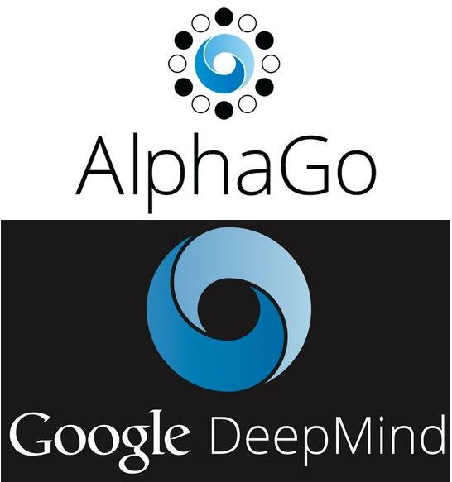
Go was considered one of most difficult broad games
It was thought that machine wouldn’t be able to beat professional human players for at least another decade
AlphaGo defeated Fan Hui in October 2015, the then European champion
It then defeated Sedol Lee in April 2016, ranked second in terms of international titles
Beat Ke Jie in 2017. The world no.1 rank player at the moment. AlphaGo retired
DeepMind published AlphaGo Zero in October 2017, which does not use human data
Monte-Carlo tree search + Deep neural networks

Slide 20
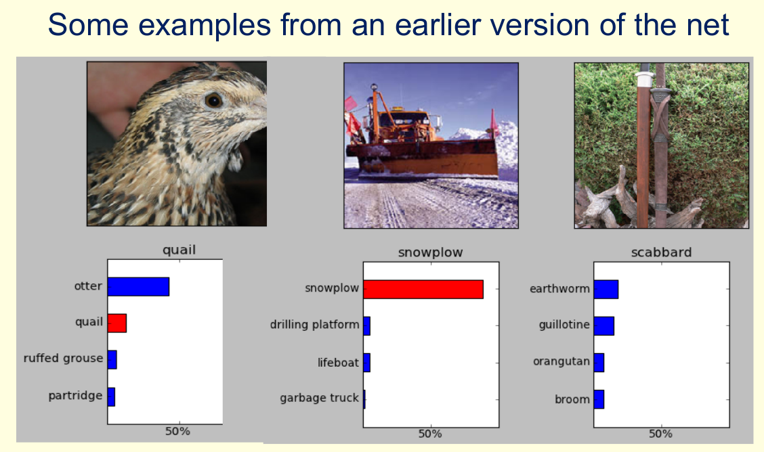
From Hinton’s coursera course

Slide 21
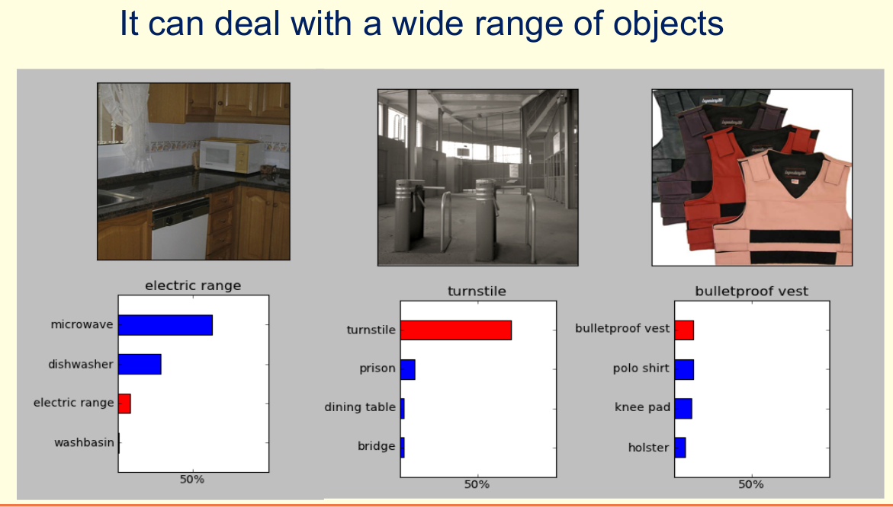
From Hinton’s coursera course

Slide 22
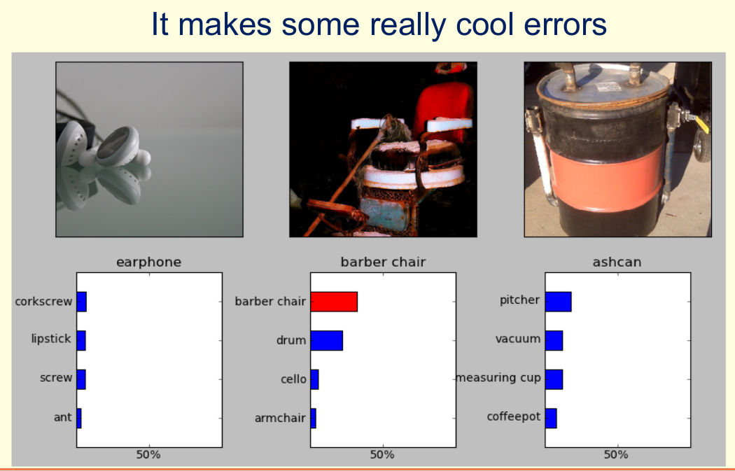
From Hinton’s coursera course

Slide 23
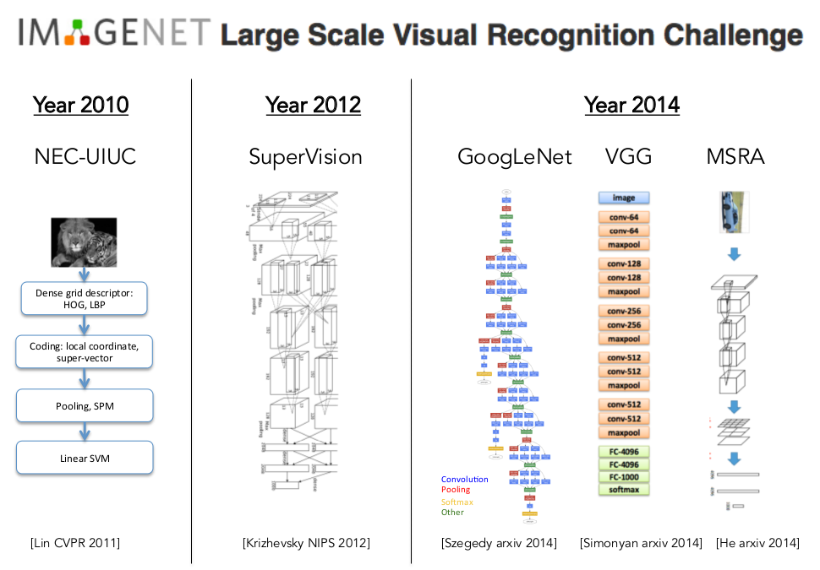
From Stanford CS231n

Slide 24
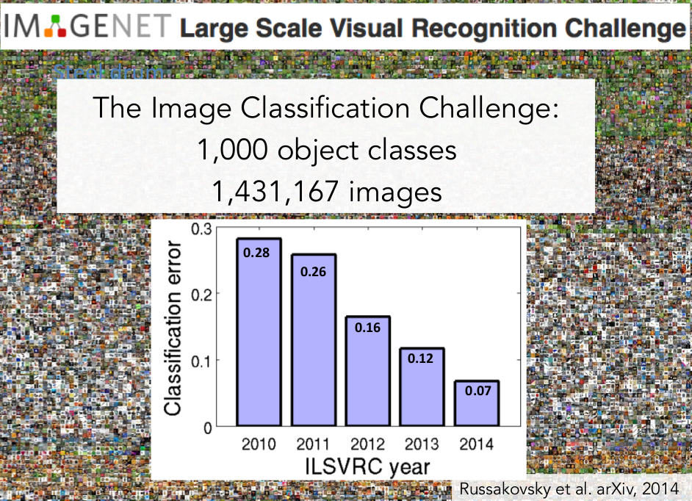
From Stanford CS231n

Slide 25
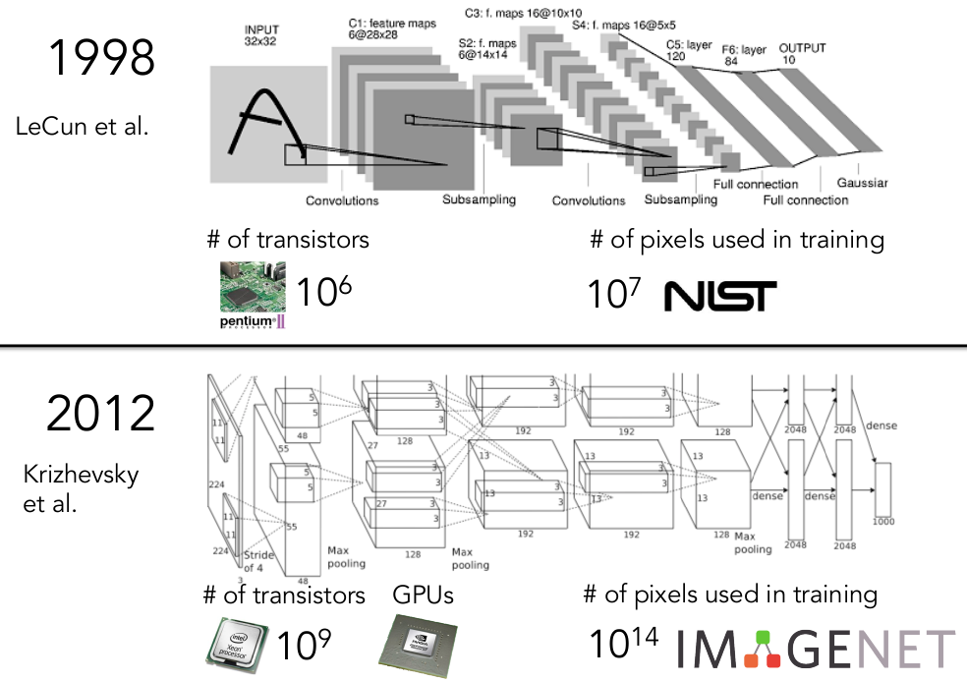
From Stanford CS231n

Slide 26
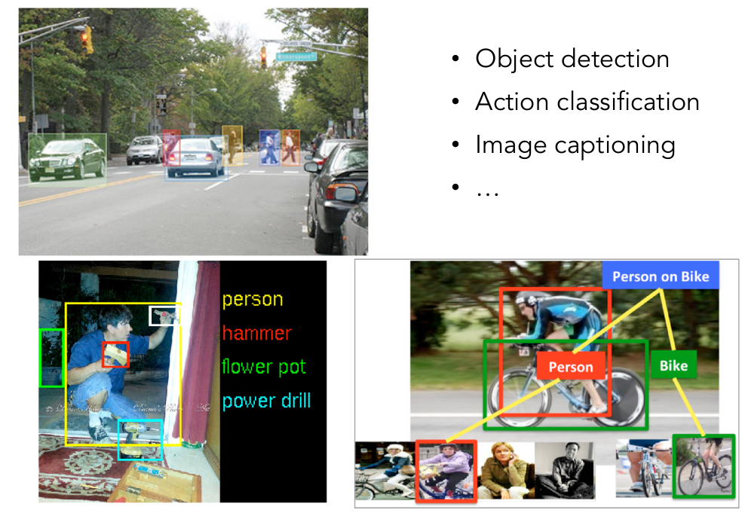
From Stanford CS231n

Slide 27
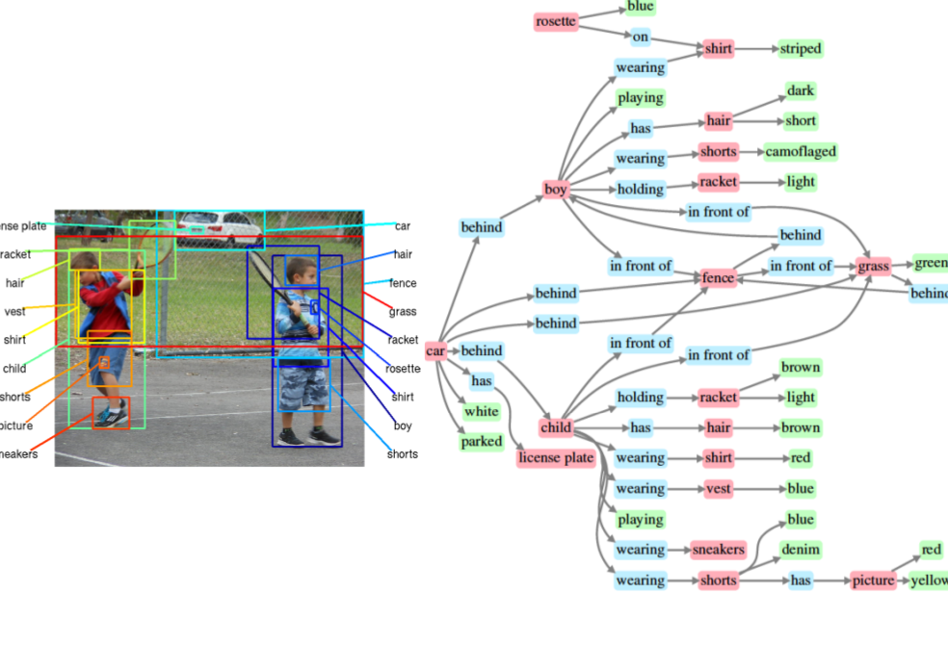
From Stanford CS231n

Slide 28
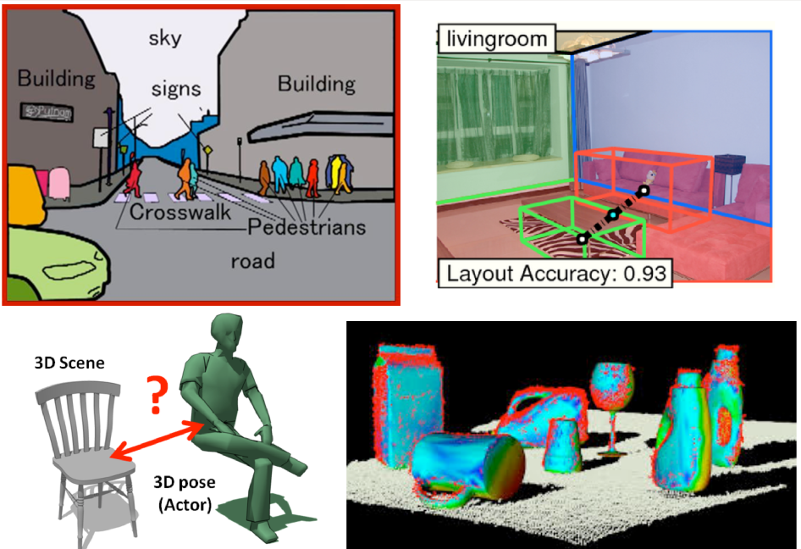
From Stanford CS231n

Slide 29
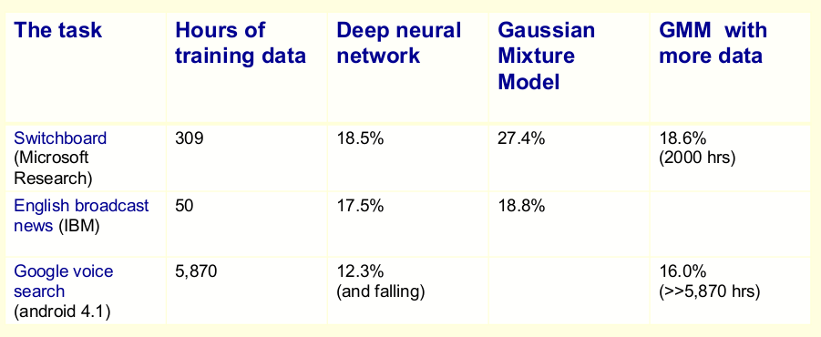
Natural language processing too…
From Hinton’s coursera course

Slide 30
Machine learning overview
As the name suggests, have machine learned (from data)
Machine learning is only a part of AI
  Other such as planning and search
  But machine learning is one key component (tool)

Slide 31
Why and when do we need machine learning?
Program a machine to recognize a cat
  We don’t know how we manage to do it
  So there is no clue how to program such machine
  Even if we know how to do it, the program is probably extremely complicated
Compute the probability of a credit card fraud
  No one simple rule. Need to combine many weak rules
  It is a moving target

Slide 32
Three types of machine learning
Supervised learning
  Learn to predict output when given an input
  Example pairs (desired output for an input) are given
Unsupervised learning
  Learn to discover good internal representation of the input
  No example output is given
Reinforcement learning
  Learn to select an action to maximize payoff
  No example output (desired action) is given for any input
  Some hints if you are doing good or bad are given though

Slide 33
Two types of supervised learning
Regression: the desired output is a real number or a real vector
  Price of a stock 6 months later
  Temperature at noon tomorrow
Classification: the output (label) is discrete
  Whether a picture includes a cat
  Types of object in a photo (can be from a set of different labels, a dog, a cat, a raccoon, etc.)

Slide 34
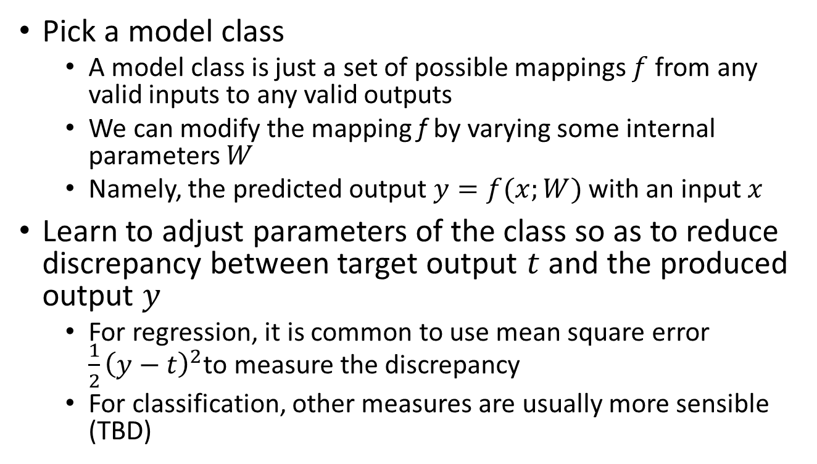
Supervised learning in action
Pick a model class
  A model class is just a set of possible mappings $f$ from any valid inputs to any valid outputs
  We can modify the mapping f by varying some internal parameters $W$
  Namely, the predicted output $y=f(x;W)$ with an input $x$
Learn to adjust parameters of the class so as to reduce discrepancy between target output $t$ and the produced output $y$
  For regression, it is common to use mean square error $\frac{1}{2}{\left(y−t\right)}^{2}$to measure the discrepancy
  For classification, other measures are usually more sensible (TBD)

Slide 35
Reinforcement learning
In reinforcement learning, output is an action or sequences of action but only the desired outcome instead of the actual action would be told
  Desired output is usually given as a reward score
  The learning goal is to select actions respective to inputs to maximize expected sum of future rewards
Reinforcement learning is difficult
  Rewards are typically delayed and so it is hard to know where we went wrong (or right)
  A scalar reward does not supply much information

Slide 36
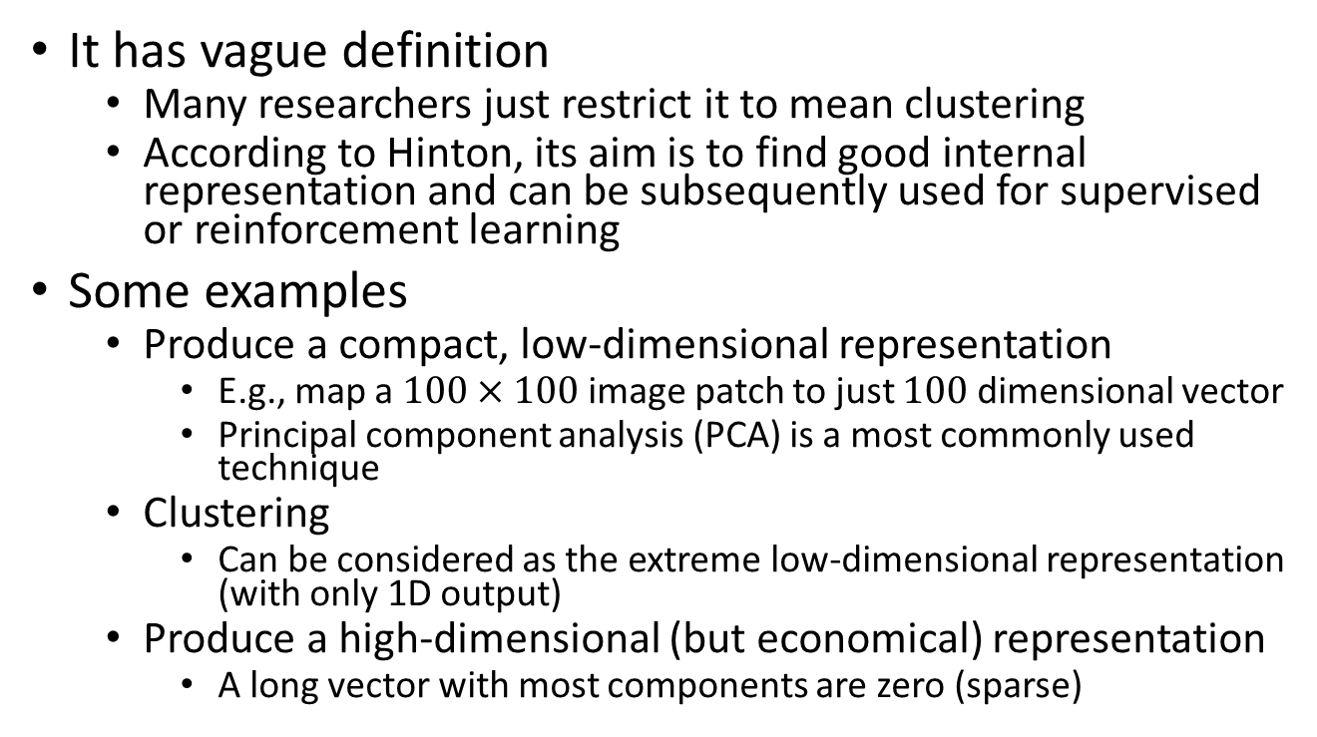
Unsupervised learning
It has vague definition
  Many researchers just restrict it to mean clustering
  According to Hinton, its aim is to find good internal representation and can be subsequently used for supervised or reinforcement learning
Some examples
  Produce a compact, low-dimensional representation
    E.g., map a $100×100$ image patch to just $100$ dimensional vector
    Principal component analysis (PCA) is a most commonly used technique
  Clustering
    Can be considered as the extreme low-dimensional representation (with only 1D output)
  Produce a high-dimensional (but economical) representation
    A long vector with most components are zero (sparse)

Slide 37
(Artificial) neural networks
A computing model inspired by the biological brain
Flexible and very powerful
Can be adjusted for different learning tasks (supervised, unsupervised, etc.)

Slide 38
Reasons to study neural networks
We usually cannot directly study brain
  We can with fMRI and EEG but not everyone can afford it
  There are limitations (yet)
To understand what we are likely good (bad) at
  Supposed to be good at things that we are good at: e.g., vision
  And bad at things that we are bad at: e.g., arithmetic
A powerful paradigm to solve real-world problem (this course)

Slide 39
Our brain
Average weight 1.4 kg, about 2% of total body weight
Responsible ~20% of our energy consumption!
  ~12.6 Watts
  It sounds a like but is extremely efficient. A typical GPU server requires ~1000 Watts
Composed of neurons interconnected to each other

Slide 40
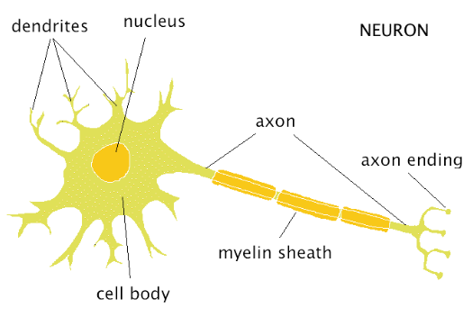
Biological neurons
Dendrites collect chemicals
Neuron may “fire” based on the chemical input
Axon ending will generate chemicals those will in turn be consumed by other neurons

Slide 41
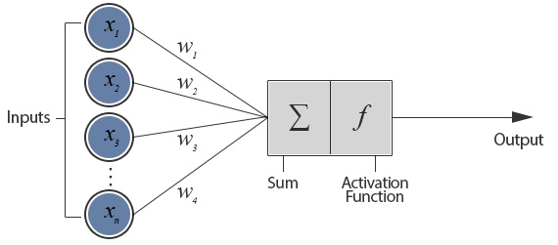
Biological neurons

Slide 42
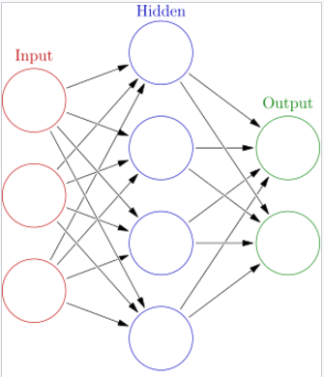
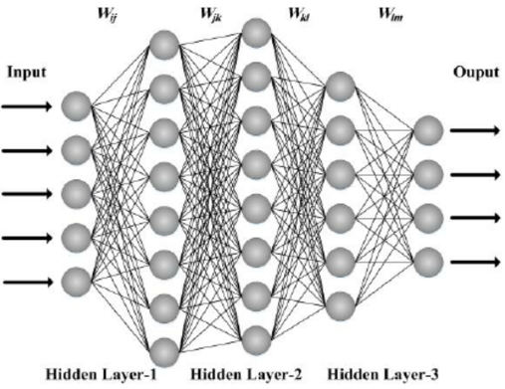
Neural networks
Single layer network
Multiple layer (deep) network

Slide 43
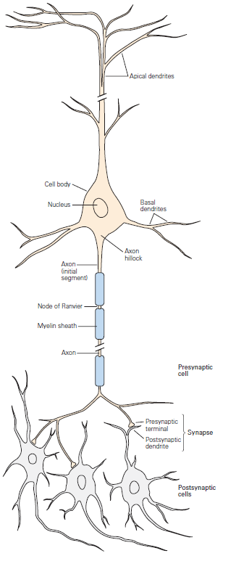

Slide 44
A very brief history of ANN
Warren McCulloch and Walter Pitts introduced Threshold Logic Unit as a computational model of neuron in 1943
Donald Hebb created a hypothesis of learning (Hebbian theory) based on neural plasticity (increase synaptic efficacy by repeated and persistent stimulation) in late 1940’s
Frank Rosenblatt created perceptron in 1958 but no concrete learning method appeared to be described
Bernard Widrow and Marcian Hoff of Stanford developed “ADALINE” and “MADALINE” (Mulitple ADAptive LiINear Elements) in 1959. First neural network to tackle real world problem. It is still used in air traffic control systems (really?)

Slide 45
A very brief history of ANN (con’t)
Perceptron got high expectation in early year but neural science does not catch up. And the traditional von Neumann and Turing architecture took over the computing scene. Ironically, von Neumann himself suggested to imitate neuron function with telegraph relays or vacuum tubes
Neural network research was hit hard by the introduction of the book Perceptrons by Marvin Minsky and Seymour Papert. It proved the limitation of perceptrons but combined with the initial hype, people lost trust of the potential of neural networks and we entered the “first dark age” of neural networks

Slide 46
A very brief history of ANN (con’t)
The interest to neural network slowly revived with the invention of the backpropagation algorithm by Paul Webos in 1974. The algorithm was reinvented by many other such as Parker (1985) and LeCun (1985)
Hopfield popularizes a form of bi-directional networks (Hopfield networks) in the 1980’s and neural network research was blooming in that decade
But as the support vector machine (SVM) by Vladmir Vapnik was popularized in late 1980’s and early 1990’s. Neural network slowly lost favors. SVM took hold instead of neural networks because it has more elegant math and worked better at that time
  Less parameters to tune
  Computers were too slow then and labeled datasets were too small

Slide 47
A very brief history of ANN (con’t)
Neural networks got a come-back for the last decade as recurrent neural networks and deep feedforward neural networks won numerous competitions in both pattern recognition and machine learning domains
Fast GPUs were a key for the come-back. Relatively cheap and powerful computing resources are now widely available. And the wide spread of large public labeled datasets helped a whole lot too

Slide 48
Conclusions
Machine learning allows us to automatically generate programs to solve various tasks by learning from data
Three main machine learning types:
  Supervised learning
  Unsupervised learning
  Reinforcement learning
Deep learning is just neural networks with many layers (hence deep)

Slide 49
Example: image recognition
http://vision.stanford.edu/teaching/cs231n/slides/lecture2.pdf

Slide 50
Next time…
More on supervised learning
  Loss functions
  Regularizations
  Examples
Optimization methods (?)

Slide 51
Questions?

