Slide 1
Keras
An API, built to make it easier
MHD Munzer Alsallakh

Slide 2
Keras
What is Keras
Why use Keras
Keras Vs. TF
Playing with Keras

Slide 3
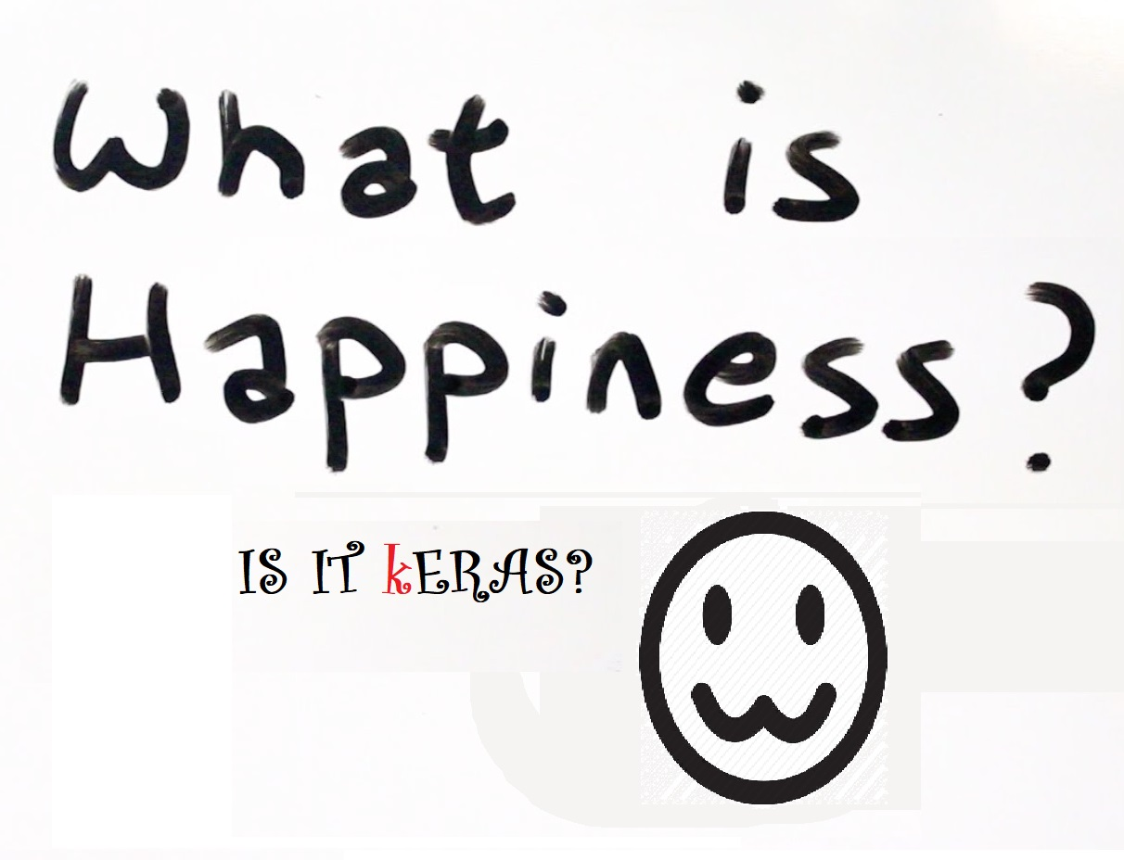
What is Keras
Keras is a high-level neural networks API, written in Python and capable of running on top of TensorFlow, CNTK, or Theano. It was developed with a focus on enabling fast experimentation.
“Being able to go from idea to result with the least possible delay is key to doing good research.”(keras.io)

Slide 4
Why Keras
Rapid prototyping
Easily switching between APIs
Industry best practices are already built in
The default settings are a big help
Prebuilt systems
GPU acceleration

Slide 5
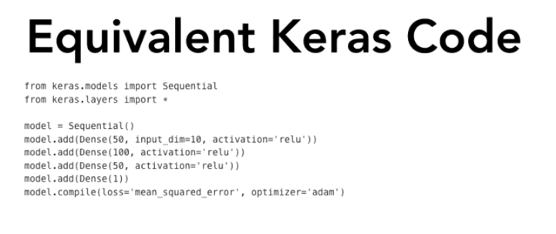
Keras vs. TF
Keras makes it easy to develop a model
Keras is a high level programming API
Keras works for both simple and complex problems
Satan Hides within details

Slide 6
Time for Koding
Building a simple model
Using ResNet50 prebuilt system
Using Keras with tensor board

Slide 7
Photos Credits
https://store.waitbutwhy.com/
http://clipart.info/devil-emoji-png-transparent-icon-4689
https://peru.com/epic/epic-mobile/facebook-messenger-no-solo-pacman-este-emoji-tambien-desaparecio-fotos-noticia-458421
https://www.youtube.com/watch?v=BiD5AhFcNW8
https://www.emojibase.com/emojilist/hooray
https://tensorflow.org
http://deathbattle.wikia.com/wiki/File:Vs.png
https://keras.io

Slide 8
धन्यवाद
Thank you
谢谢
شُكْرَاً لَكُمْ
Terima kasih
Merci a vous
شکریہ

