Slide 1
Torch
02/27/2018
Hyeri Kim
Notes:
Good afternoon, everyone. I’m Hyeri. Today, I’m gonna talk about Torch.

Slide 2
Contents
Introduction to Torch
Strong points of Torch
Core features
Torch structures
PyTorch structures
Compare Torch and PyTorch
Conclusion
Notes:
My presentation is organized with this order.

Slide 3
Introduction to Torch
An open source machine learning library, a scientific computing framework based on the Lua programming language(similar to javascript) with strong CPU and CUDA backends.
Goal: to have maximum flexibility and speed in building your scientific algorithms while making the process extremely simple.
Original author: Ronan Collobert, Koray Kavukcuoglu, Clement Farabet
Initial release: October 2002(NYU/Facebook)
Operating system: Linux, Android, Mac OS X, iOS
Applications
It is used by the Facebook AI research group, IBM, Yandex, and the Idiap Research Institutes.
Notes:
Torch is an open source machine learning library, it’s a scientific computing framework

Slide 4
Strong points of Torch
It’s simple to use, while having maximum flexibility in implementing complex neural network topologies.
Efficient Tensor library with an efficient CUDA backend
Good community and industry support(several hundred community) built and maintained packages
We can make arbitrary graphs of neural networks, and parallelize them over CPUs and GPUs in an efficient manner.
It has tons of built-in modules and loss functions

Slide 5
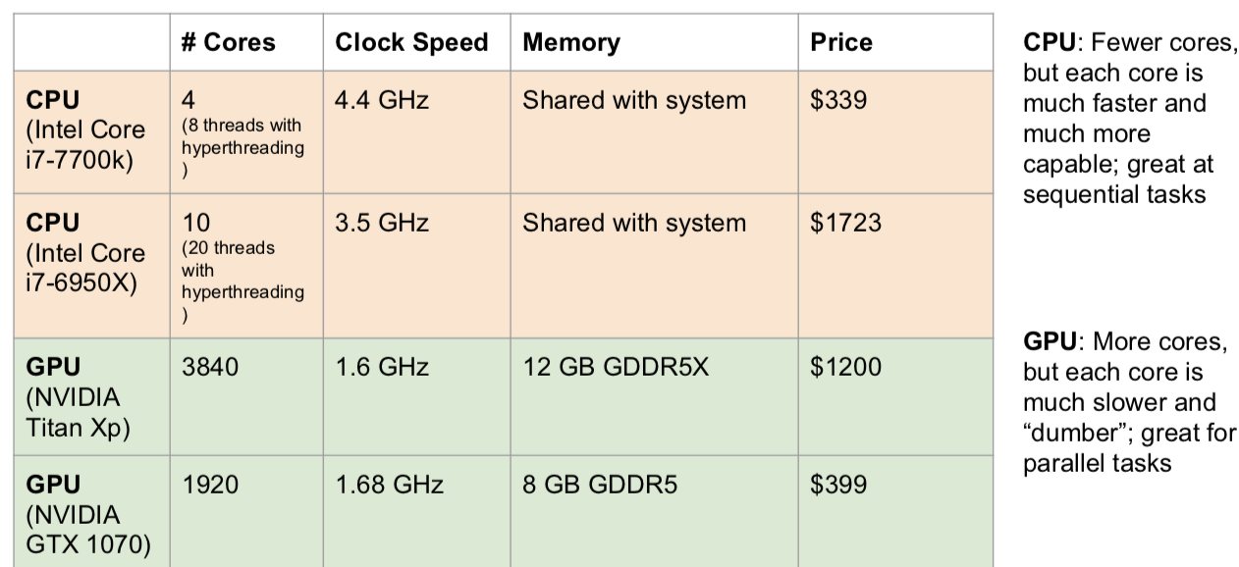
❖ CPU vs GPU
CPU(Central Processing Unit), GPU(Graphics Processing Unit)
* Extracted image from cs231n, Spring 2017: Lecture 8

Slide 6
Core features
A powerful N-dimensional array
Lots of routines for indexing, slicing, and transposing
Amazing interface to C, via LuaJIT
Neural network, and energy-based models
Numeric optimization routines
Fast and efficient GPU support
Embeddable, with ports to iOS and Android backends

Slide 7
Torch structures
[1] Tensors
Tensor is a general name of multi-way array data
It can easily change data type like numpy
It’s easy to use GPU unlike numpy
[2] Modules
Modules are classes written in Lua using tensor methods
It’s easy to read and write
Lots of package
nn: It lets you easily build and train neural networks
cunn: Running on GPU is easy
optim: It implements different update rules to optimize the algorithm
Notes:
Torch has 2 levels: Tensor, Module
Modules are classes written in Lua; easy to read and write
Forward/backward written in Lua using Tensor methods
It has tons of built-in modules and loss functions
It’s easy to write

Slide 8
❖ What is tensors?
Tensor is a general name of multi-way array data
It is defined mathematically, are simply arrays of numbers, or functions, that transform according to certain rules under a change of coordinates.
vector
matrix
cube

Slide 9
Torch structures
[1] Tensors
It can easily change data type like numpy
It’s easy to use GPU unlike numpy
[2] Modules
Modules are classes written in Lua using tensor methods
It’s easy to read and write
Lots of package
nn: It lets you easily build and train neural networks
cunn: Running on GPU is easy
optim: It implements different update rules to optimize the algorithm
Notes:
Torch has 2 levels.
It has tons of built-in modules and loss functions
Direct ancestor of PyTorch
Written in Lua, not Python
Torch has 2 levels: Tensor, Module
Modules are classes written in Lua; easy to read and write
Forward/backward written in Lua using Tensor methods
It has tons of built-in modules and loss functions
It’s easy to write

Slide 10
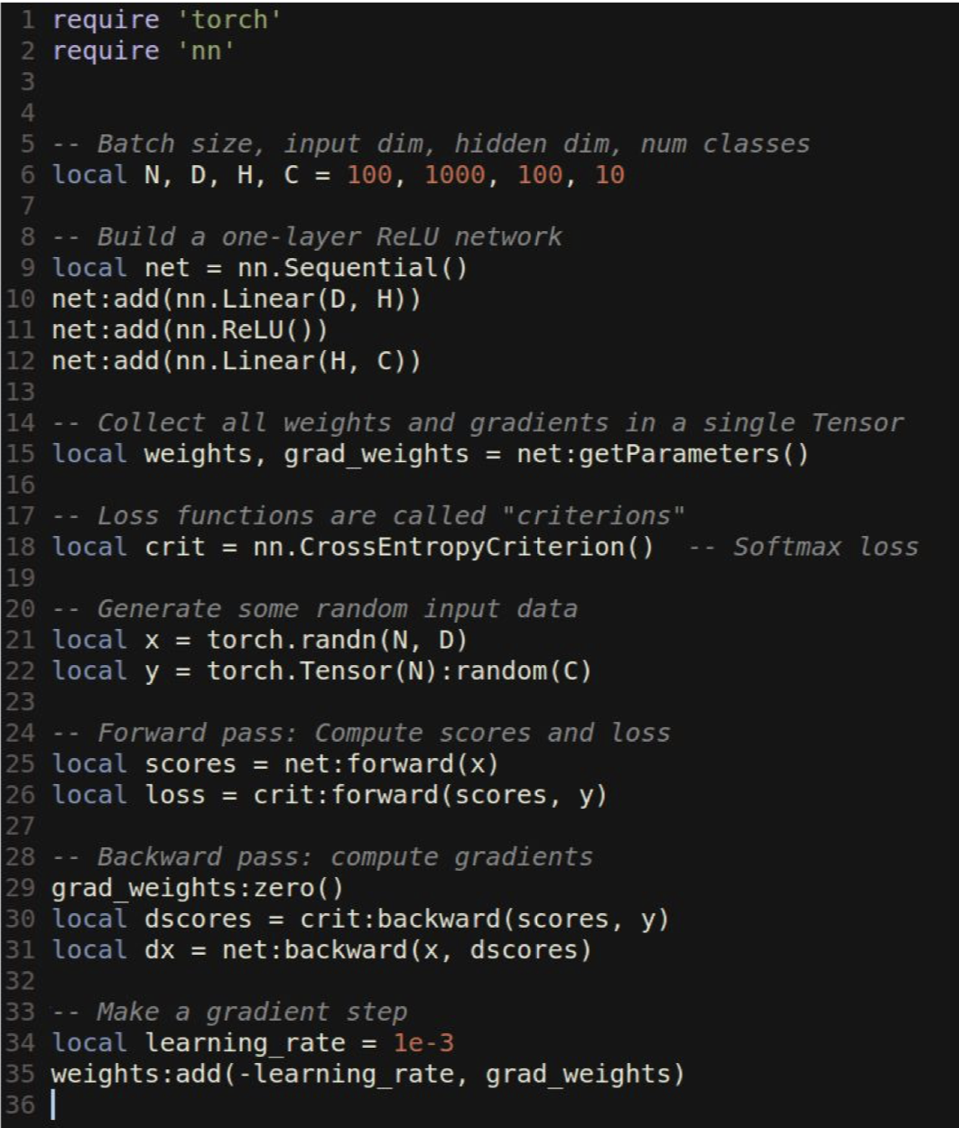
ex) nn modules
Let you easily build and train neural networks
You can easily compute scores and losses in forward pass
In backward pass, you can compute gradients.
* Extracted image from cs231n, Winter 2016: Lecture 12
Notes:
This is an example of the module called “nn”
It lets you easily build and train neu

Slide 11
PyTorch: Three levels of abstraction
[1] Tensor
Imperative N-dimensional array like numpy
But it runs on GPU unlike numpy
[2] Variable
Node in a computational graph
It stores data and gradient
[3] Module
- A neural network layer
- It may store state or learnable weights
Notes:
Torch is direct ancestor of PyTorch.
Torch is based on Lua, but, PyTorch is based on python.
These days, many people use the python, so, PyTorch is getting more popular

Slide 12
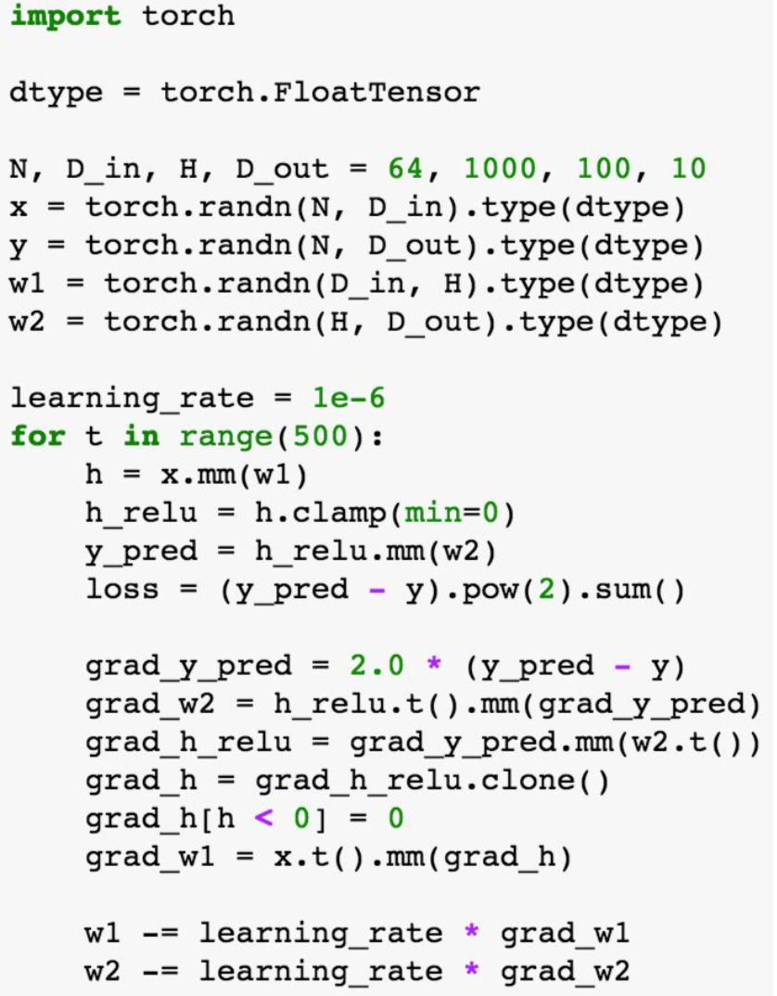
PyTorch: Three levels of abstraction
[1] Tensor
Imperative N-dimensional array like numpy
But it runs on GPU unlike numpy
[2] Variable
Node in a computational graph
It stores data and gradient
[3] Module
- A neural network layer
- It may store state or learnable weights
To run on GPU
dtype=torch.cuda.FloatTensor
* Extracted image from cs231n, Spring 2017: Lecture 8
Notes:
Torch is direct ancestor of PyTorch.
Torch is based on Lua, but, PyTorch is based on python.
These days, many people use the python, so, PyTorch is getting more popular

Slide 13
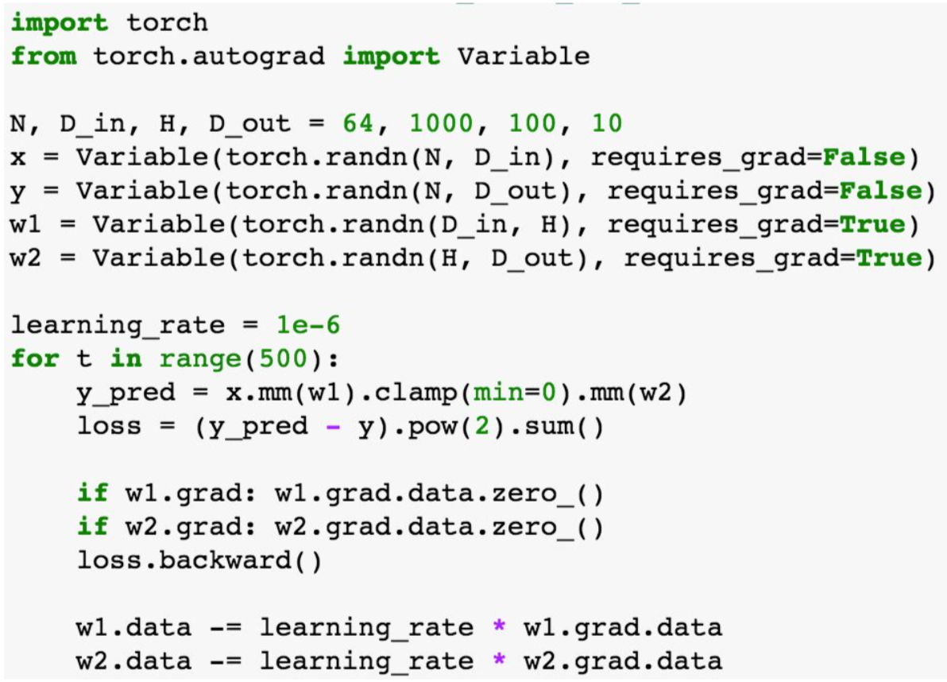
PyTorch: Three levels of abstraction
[1] Tensor
Imperative ndarray like numpy arrays
But it runs on GPU unlike numpy
[2] Variable
Node in a computational graph
It stores data and gradient
[3] Module
- A neural network layer
- It may store state or learnable weights
* Extracted image from cs231n, Spring 2017: Lecture 8
Notes:
PyTorch variable is a node in a computational graph
For example, in this code, x.data is is a Tensor
x.Grad is a variable of gradients
x.grad.data is a tensor of gradients
========
We will not want gradients of loss with respect to data, and we want gradients with respect to weights
Compute gradient of loss with respect to w1 and w2(zero out grads first)
Make gradient step on weights

Slide 14
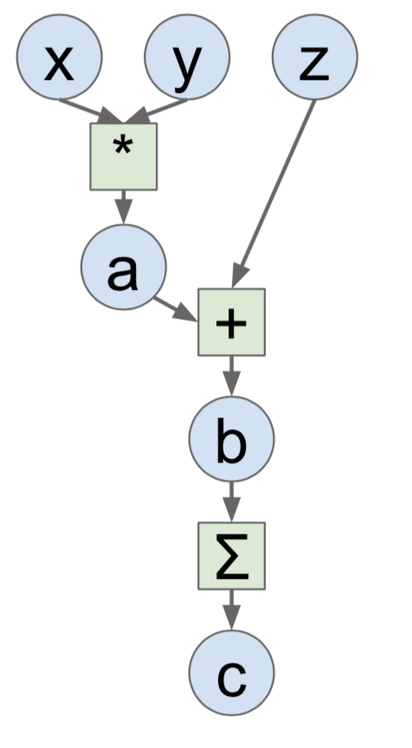
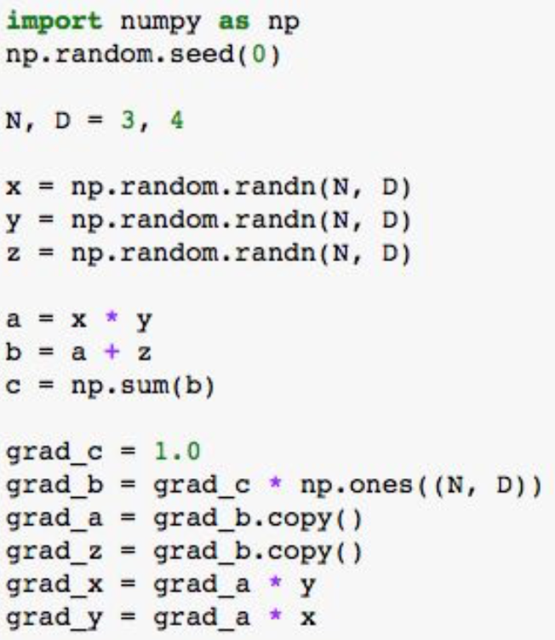
❖ Compare to numpy
Numpy
PyTorch
Define variable
Forward pass
Compute the gradients
* Extracted image from cs231n, Spring 2017: Lecture 8
Computational graphs

Slide 15
❖ Compare to numpy
Numpy
PyTorch
Run on GPU
x = Variable(torch.randn(N,D).cuda(), requires_grad=True)
y= Variable(torch.randn(N,D).cuda(), requires_grad=True)
z = Variable(torch.randn(N,D).cuda(), requires_grad=True)
Define variable
Forward pass
Compute the gradients
* Extracted image from cs231n, Spring 2017: Lecture 8
Computational graphs

Slide 16
PyTorch: Three levels of abstraction
[1] Tensor
Imperative n-dimensional array like numpy
But it runs on GPU unlike numpy
[2] Variable
Node in a computational graph
It stores data and gradient
[3] Module
- A neural network layer
- It may store state or learnable weights
Notes:
Torch is direct ancestor of PyTorch.
Torch is based on Lua, but, PyTorch is based on python.
These days, many people use the python, so, PyTorch is getting more popular

Slide 17
Module example
Define new modules
Initializer sets up two children
Define forward pass using child modules and autograd operations on variables
No need to define backward – autograd will handle it
* Extracted image from cs231n, Spring 2017: Lecture 8
Notes:
In PyTorch, we can define our own autograd function by writing forward and backward for Tensors
We can define

Slide 18
Torch vs PyTorch
Torch | PyTorch
Lua | Python
No autograd | Autograd
More stable | Newer, still changing
Lots of existing code | Less existing code
Fast | Fast
1st generation(developed by academia)
next generation(originated from industry)
(-): red, (+): blue, (0): black
Probably PyTorch use for new project!
Notes:
Torch is 1st generation deep learning framework,
Torch: NYC/Facebook(Academia), PyTorch: Facebook(industry)
Usually, 1st generation of the framework was developed by academia, but, next generation of the framework was all ariginated from industry.
Now, industry is giving us powerful framework to work with. So, it probably use for new project
Torch is in Lua, so, learning Lua(programming language) is a bit of a turn off for some people. It’s older, so, it’s more stable. That means it’s less susceptible to bugs, there’s more example codes for Torch.
PyTorch is in Python, you’ve got autograd which makes it a lot simpler to write complex models. In Lua Torch, you end up writing a lot of your own back propagation code.
But, it’s newer, there is less existing codes. And, it’s still subject to change.

Slide 19
Conclusion
Torch is an open source machine learning library, a scientific computing framework based on the Lua programming language
It provides a wide range of algorithms(modules) for deep M.L.
It can easily change data type like numpy.
It’s easy to use GPU unlike numpy.
PyTorch is the next generation of the Torch based on the python.
It has 3 levels: Tensor, variable, and module

Slide 20
Reference
Cs231n Winter 2016: Lecture 12
Cs231n Spring 2017: Lecture 8
http://torch.ch
https://en.wikipedia.org/wiki/Torch_(machine_learning)

Slide 21
Thank you
Do you have any question?

