Slide 1
Torch – Deep Learning Package
Betsy V. Paul
ECE 5973
02/27/2018

Slide 2
History..
Ronan Collobert has been the main developer
4 versions(old numbers)
Various languages (C,C++, now Lua + C)
Includes lots of packages for neural networks, optimization for graphical models, image processing.
Used in Universities and major research labs(Google, Facebook, Twitter)
Always aimed at large scale learning
Speech, Image and Video Applications
Large-scale machine learning Applications

Slide 3
Introduction
Gives an option to setup deep networks by configuring its hyper parameters and by other useful features.
It’s a library for LuaJIT – popular implementation of LuaJIT programming language.
Provides powerful vectorized implementation of math behind the Deep Learning Algorithm.
In addition there are various libraries that extend the Torch’s functionality for various applications of which are supported by a large community of operations.
To some extend it allows you to setup to run and train a deep net. Once configured a Deep net can be called within the routines of your program.
In this program we use Torch7

Slide 4
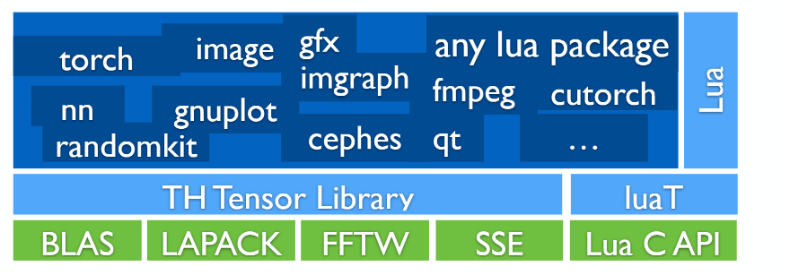

Slide 5
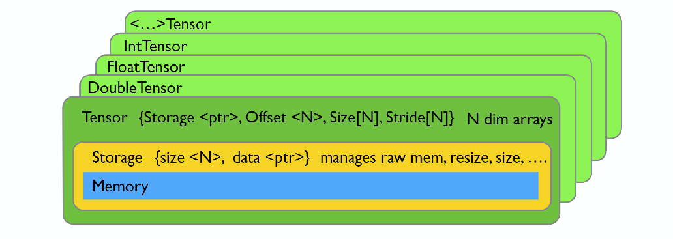
Tensor
It’s a table in Torch. Equivalent to an array in C.
Declared by :
r = torch.DoubleTensor(t):resize(3,8)
Assignment b/w tensor is simply a copy of its reference.
U = t:clone()
U:random() –creates a 1D tensor
V = torch.Tensor(1,2,3,4) – the size of this tensor is 4.
To get the output of the array v:size(1) = 4
W = torch.one(4) –creates a vector of four elements.
X[{{2,4}}] – creates a sub vector.

Slide 6
Commands in Torch
Pow(2) – denotes power of 2
To create a matrix
M = torch.Tensor{{9,6,3,4},
{ 7,2,8,1}} – dimension = 2 and rows =2
To get the summary of all sizes we use #. So that the output will be 2x4
To access the elements m[2][3] = 8 or m[{2,3}]
torch.range(3,8) – creates a tensor of 6 elements from 3 to 8
torch.linspace(3,8,50) -- we’ll get a linear range
To visualize his we need
th>require gnuplot
th>gnuplot.plot(torch.linspace(3,8,50)) – provides linear plot
Th>gnuplot.plot(torch.logspace(3,8,50)) –provides logarithmic plot

Slide 7
Continued..
Another way to create a tensor is by using zeros fn
Torch.zeros(3,5)
Torch.ones(3,2,5)
To create a torch eye
Torch.eye(3) – create an identity matrix of size 3
Gnuplot.hist(torch.randn(1000)
More the number of data points the smoother the graph will be.
If you want to know what a particular command does do “?torch.randn()”
We can do casting of sensors here.
We can also do various image transformations in Torch

Slide 8
NN forward in Torch
NN are performed through Feed Forward Interference (FFI bus).
Perceptron
Embedded threshold
Step Activation Function
We need logistic unit
How to combine multiple logistic unit to create a neural network
Architecture
Equations for the same

Slide 9
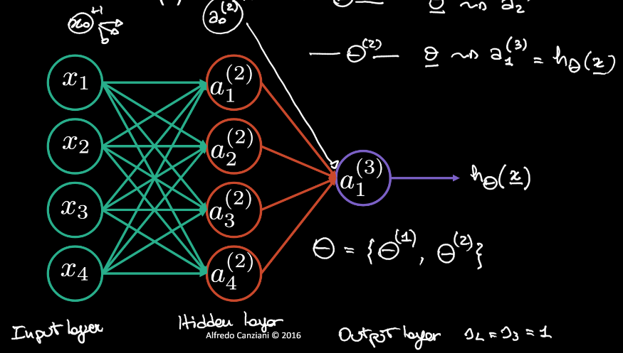
Neural Network
Z= ’.X

Slide 10
Arbitrary models that can be constructed using lego like containers.
nn.Sequential() –sequential module
nn. ParallelTable() --parallel module
nn. ConcatTable() --shared module
nn. SplitTable() --(N) dim Tensor -> Table of N- 1 dim Tensors
nn. joinTable(-1) -- Table of N- 1 dim Tensors -> (N) dim Tensor

Slide 11
nn Package
When training neural nets, autoencoders, linear regressions, convolution of any of these models, we are interested in gradients and loss functions.
The nn package provides a large set of transfer functions such as
upgradeOutput() – compute the output given the input
upgradeGradInput() – compute the derivative of loss w.r.t input
accGradParameters() –compute the derivative of the loss function w.r.to weights.
The nn package provides a set of common loss functions using
upgradeOutput() – compute the output given the input
upgradeGradInput() – compute the derivative of loss w.r.t input

Slide 12
It allows us to do forward and backward propagation using simple commands.
nn.Sequential.add()
nn.Sequential:forward(input)
nn.Criterion():forward(input,target) – fwd o/p of the sequential within our loss function
nn.Criterion():backard(input,target) –used to update the input and to calculate the grad parameters
nn.Sequential():zeroAccParameters()
nn.Sequential():backward(input,gradCriterion)
nn.Sequential():updateParameter(etha)

Slide 13
Training a network
Stochastic Gradient Descent(SGD)
Mini – Batch Gradient Descent (BGD)
We an do this by fwd, bwd, updateGradParameters to zero
nn.StochasticGradient(net,loss)
All we need to do is to ask stochastic gradient to train our network.
nn.StochasticGradient():train(dataset)

Slide 14
Jacobian formulation and Hessian
$\frac{dy}{d\underline{x}}=[\frac{dy}{dx1},\frac{dy}{dx2}, …..\frac{dy}{dxn}]$ $\frac{dy_}{dx}$
$\frac{dy_}{dx_}=\left[combination of the above to matrix\right] −−Jacobain of\frac{i}{p}.$
$\frac{∂E}{∂\overbrace{Θ}l }$ = a($\overset{l+1}{\overbrace{\text{}}}$)Transpose
We use Hessian formulation in torch to avoid this transpose
The weight gets updated by
$Θ= Θ+η\frac{∂E}{∂θ}$

Slide 15
Lets do an example…
th> --Sigmoid unit
th> require nn;
th> n=5
th> k=3
th> lin = nn.linear(n,k)
th> -- to see whats inside the linear
th> {lin}
{
1:
{
gradBias:DoubleTensor – size3
weight: DoubleTensor – size 3x5
_type: “torchDoubleTensor” – type of module
output: DoubleTensor – empty
gradInput:DoubleTensor – size 3x5
gradWeight:DoubleTensor – size 3x5
}
}
th>lin.weight
-0.2607 -0.4467 -0.0150 -0.2823 -0.3858
-0.3918 -0.3297 0.2481 -0.2631 0.3477
0.4386 -0.3514 -0.3062 -0.1706 -0.1231

Slide 16
th>lin.bias
0.4370
-0.2159
-0.2801
[torch.DoubleTensor of size 3]
--Now we’ve to calculate ${\text{}\text{l}}^{1}$ by
th>Theta_1 = torch.cat(lin.bias,lin.weight,2)
0.4370 -0.2607 -0.4467 -0.0150 -0.2823 -0.3859
-0.2159 -0.3918 -0.3297 0.2481 -0.2631 0.3477
-0.2801 0.4386 -0.3514 -0.3062 -0.1706 -0.1231
--And the output will be having 6 columns
--we can double check our change in torch by checking th contents by {lin}
th>gradTheta_1 = torch.cat(lin.gradBias,lin.gradWeight,2)
--the output will be 3x6 zero matrix. If not we need to change it to zero because we need a clean network before we accumulate the parameters to train the network.
--Starting a sigmoid
th>sig = nn.Sigmoid()
th>sig

Slide 17
th>{sig}
{
1:
{
gradInput: DoubleTensor – empty
_type: “torchDoubleTensor”
output: DoubleTensor – empty
}
}
th>require gnuplot;
th> z=torch.linspace(-10,10,21)
--display the plot here
th>gnuplot(z,sig:forward(z))
Th>a1=x
th> h_Theta = sig:forward(lin:forward(x))
0.3613
0.5510
0.2924
--lets try to replace these values’
Z2 = (1) ά1

Slide 18
th> z2 = Theta_1 *torch.cat(torch.ones(1),a1,1)
--we need to apply sigmoid to z2. i.e., a2= σ(z2)
th> a2 = z2:clone():apply(
..>function(z)
..> return 1/(1+math.exp(-z))
..> end
th>a2
-0.3613
0.5510
0.2924
--this is same as the number that we obtained above. i.e, our network computes what we’ve seen in theory

Slide 19
Backward Pass/ Back Propagation
--To define loss function we can use MSE criterion
th> loss =nn.MSECriterion()
th>{loss}
{
1:
{
gradInput: DoubleTensor – empty
sizeAverage: true
Output
}
}
th> loss.sizeAverage = false

Slide 20
th> y = torch.rand(K)
0.5437
0.4579
0.8444
--to see the size of API fn
th> -- forward(input,target)
th> E = loss:forward(h_Theta,y)
th> E
0.34808619152059
--we can verify the result
th>(h_Theta – y):pow(2) :sum()
0.34808619152059
--now we want to compute the P.D w.r.to input
th> dE_dH = loss:updateGradInput(h_Theta,y)
th>dE_dh
-0.3727
0.1862
-1.1040
-- we can verify by 2*(h_Theta – y)
-0.3727
0.0461
-0.2284

Slide 21
--Computing error at the output
th>delta_2 = sig:updateGradInput(z2, dE_dh)
th>delta_2
-0.0860
0.0461
-0.2284
--Now we’ve to calculate the partial derivative of the parameters w.r.to the linear module
th>lin:accGradParameters(x, delta_2)
--we can see the input in torch by th>{lin}
-- to look at the desired partial derivative
th>gradTheta_1 = torch.cat(lin.gradBias,lin.gradWeight,2)
th>gradTheta_1
-0.0860 -0.0615 -0.0706 -0.1241 -0.0527 -0.577
0.0461 0.0329 0.0378 0.0664 0.0282 0.0309
-0.2284 -0.1632 -0.1875 -0.3295 -0.1400 -0.1533
--we can verify our results by
th_delta2: view(-1,1)*torch.cat(torch.ones(1),x,1):view(1,-1)
--Now we’ve to compute the P.D w.r.to the module
th>lin_gradInput = lin:updateGradInput(x,delta_2)
-0.0958
0.1339
0.0826
0.0511
0.0773

Slide 22
Now let’s train the network
--Creating a neural network
th>net = nn.Sequential()
th>net:add(lin)
th>net:add(sig)
th>net
nn.Sequential{
[input ->(1) -> (2) ->output]
(1):nn.Linear(5->3)
(2):nn.Sigmoid
}

Slide 23
--To perform a forward pass
th> pred = net:forward(x)
th>pred
0.3613
0.5510
0.2924
th>h_Theta
0.3613
0.5510
0.2924
--To compute the error
err = loss:forward(pred,y)
th>err
0.34808619152059
th>gradCriterion = loss:backward(pred,y)
th>gradCriterion
-0.3727
0.1862
-1.1040
--this is equivalent to dE_dh that we calculated earlier

Slide 24
--Before we do backward pass we need to clear the backward bias and weight
th>net:get(1) – nn.Linear(5->3)
--to know whats the P.D of the error w.r.to the weight
th>torch.cat(net:get(1).gradBias, net:get(1).gradWeight,2)
th>net:zeroGradParameters()
th>net:backward(x,gradCriterion) = th>lin_gradInput
-0.0958
0.1339
0.0826
0.0511
0.0773
--so we can perform backward step return as i/p gradient to the current nw module
th> torch.cat(net:get(1).gradBias, net:get(1).gradWeight,2)
-0.0860 -0.0615 -0.0706 -0.1241 -0.0527 -0.0577
0.0461 0.0329 0.0378 0.0664 0.0282 0.0309
-0.2284 -0.1632 -0.1875 -0.3295 -0.1400 -0.1533
--to update the parameters
th>etha = 0.01
th>dE_dTheta_1 = torch.cat(net:get(1).gradBias, net:get(1).gradWeight,2);
th>Theta_1 – etha*dE_dTheta_1

Slide 25
0.4379 -0.2601 0.4460 -0.0138 -0.2817 -0.3854
-0.2164 -0.3922 0.3294 0.2474 -0.2634 0.3474
-0.2778 0.4403 -0.3495 -0.3029 -0.1692 -0.1216
--can be verified by torch functions
th>Theta_1_new = torch.cat(lin.Bias, lin.Weight,2)
--the output is same as the above table

Slide 26
How to train a System?
--X be the Design matrix mxn
--Y be the labels/targets/matrix mxk
--Here we use SGD
For i=1,m do
Local pred = net:forward(X[i])
Local err = loss:forward(Y[i])
Net:zeroGradParameters() net:backward(X[i], gradLoss)
Net:updateParameters(etha)
End

Slide 27
Similarly we can train mini-Batch GD
--better in terms of convergence and speeds up, optimization
--computational complexity is high for multi-dimensional i/p
--steps are same expect that we use a batches for input data
Local dataset = {}
Function dataset.size return m end
for i=1,m do
dataset[i] ={X[i],Y[i]}
End
Local trainer = nn.StochasticGradient(net,Loss)
trainer: train(dataset)

Slide 28
Supervised Learning
Pre-process the train and test data to facilitate learning
Describe a model to solve a classification task
Choose a loss function to minimize
Defining a sampling procedure (stochastic, mini-batches) and apply one of several optimization technique to train and modify parameters.
Estimate the models performance on test data.

Slide 29
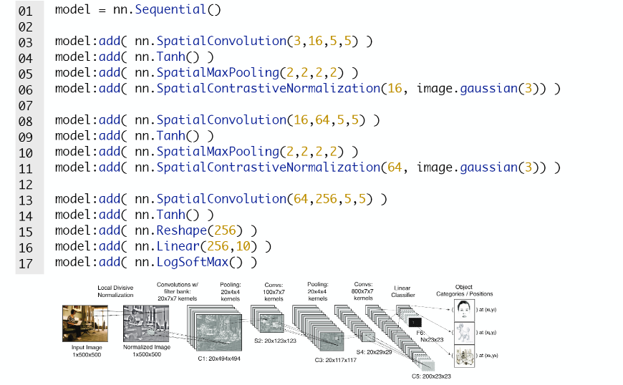
Example: Convolutional model for natural images:
Define a model with pre-normalization to work on raw RGB images:

Slide 30
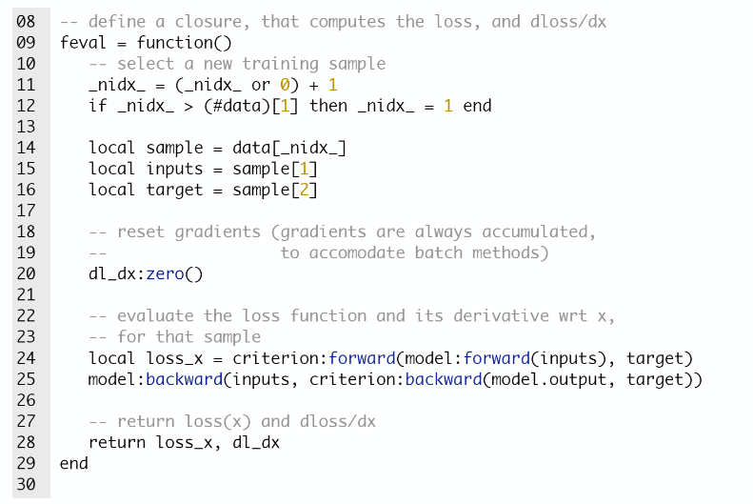
Example : Logistic Regression
Step 4/5: Define a closure that estimates f(x0 and df/dx stochastically.

Slide 31
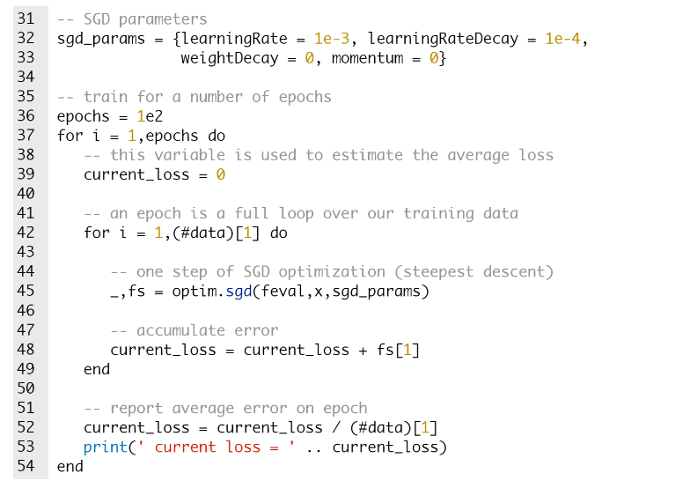
Step5/5
Estimate the parameters to train the model stochastically.

Slide 32
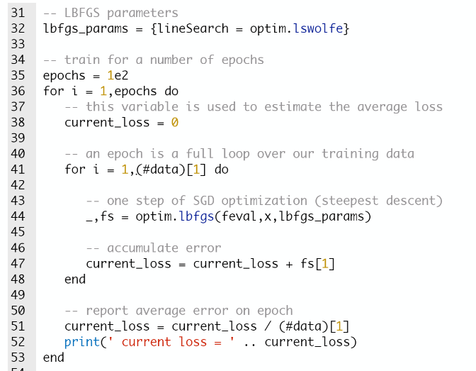
Example: Optimize differently
Estimate parameters to train the model using LBFGS

Slide 33
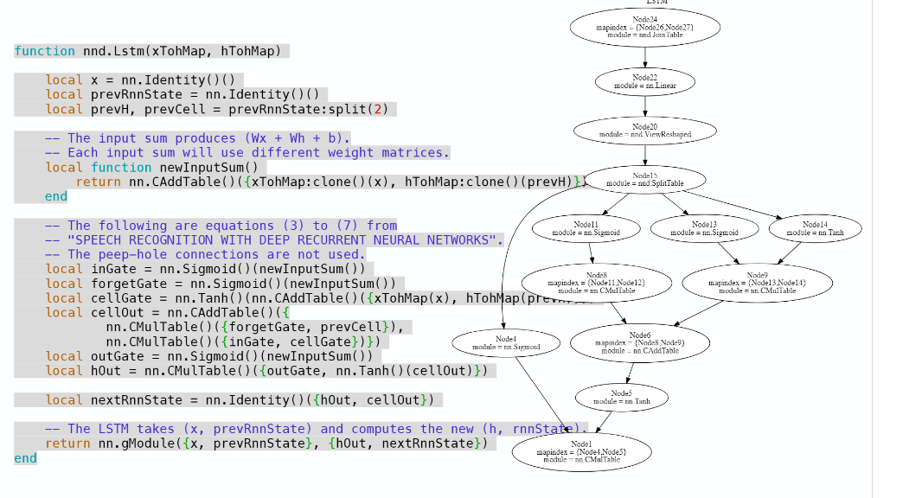
Graph Container

Slide 34
Advantages and Disadvantages compares to other Deep Learning Packages
(+) Lots of modular pieces that are easy to combine
(+) Easy to write your own layer types and run on GPU i.e. Speed
(+) Lots of pretrained models, convenient for research
(-) You usually write your own training code (Less plug and play)
(-) No commercial support
(-) Spotty documentation
Decent proportion of projects in Torch, but less than Caffe.
LuaJIT is not mainstream and does cause integration issues

Slide 35
Applications
Torch7 @ Google Deepmind
Used exclusively for research and prototyping
Supervised and Unsupervised Learning
Reinforcement Learning and Sequence Prediction.
Torch7 @Facebook
Improves parallelism for multi GPU models
Improving host-device communications.
Computation Kernel speeds (e.g.: convolution in time/frequency domain)

Slide 36
Questions?

