Slide 1
Artificial Neural Networks
Deep Learning Overview
Samuel Cheng
With many slides borrowed from
Stanford CS 231n
Hinton’s coursera course

Slide 2
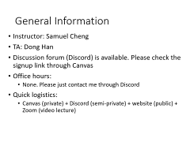
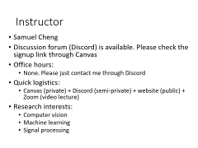
General Information
Instructor: Samuel Cheng
TA: Dong Han
Discussion forum (Discord) is available. Please check the signup link through Canvas
Office hours:
  None. Please just contact me through Discord
Quick logistics:
  Canvas (private) + Discord (semi-private) + website (public) + Zoom (video lecture)

Slide 3
Backgrounds
ECE
CS
AME
Others?

Slide 4
Your Research Directions?
Image Processing/Computer Vision/Imaging?
Medical stuff?
Natural language processing (NLP)?
Others?
HW 0: signup Discord and say a few words about projects you are working on

Slide 5
Deep learning courses online
Hinton’s coursera course
Stanford CS 231n
Oxford’s course
U Toronto’s course
Larochelle’s course
Lecun’s NYU course
Fastai course
Others?

Slide 6
What is this course about?
Look into some history, techniques, applications of neural networks
Will explore quite a bit on so-called ``deep learning”. A hyped-word of artificial neural networks
Course renamed from deep learning to artificial neural networks and applications couple years ago
  Things advance extremely fast. We will explore the topics together ☺
Many students applied what was learned to their research directly last several years
Hope this will help your research!

Slide 7
Goal of this course: expected outcomes
Able to use open source packages (in particular PyTorch) to construct neural network models to solve your research problems
Build a sufficiently strong theoretical foundation to understand current ANN research

Slide 8
Quick Logistics
“Homework” ~ 30%
Presentation ~ 20%
Final Project ~ 30%
Midterm ~ 20%
Extra credit (in-class/Discord participation) ~ 10%
Textbook: Ian Goodfellow, Yoshua Bengio and Aaron Courville, Deep Learning, MIT Press
  I won’t follow it closely but it is a good reference in general
Course website: http://www.samuelcheng.info/deeplearning_2021/index.html

Slide 9
Exposure to deep learning packages?
PyTorch/Torch:
Tensorflow:
Caffe/Caffe2:
Mxnet:
Theano (obsolete):
Keras:
Lasagne (obsolete):
Matconvnet:
Others:

Slide 10
Programming Languages?
Python/Numpy (required but quite easy)
C/C++
Lua
Matlab
Java
Others
None at all

Slide 11
Platforms?
Linux
Windows
Mac
GPUs?

Slide 12
Grading
“Homework” and presentations ~ 30%
Programming assignment: (Important) ~ 30%
  mostly based on Stanford CS231n, maybe more
  require screenshot submission, preferably screencast
  “sample-ly” graded
Final Project: Any target problem, can be group project ~ 40%
  Proposal required near mid semester
  Partially peer graded, precise scoring mechanism TBD

Slide 13
Coverage (tentative)
Overview of machine learning
Overview of supervised learning
Neural network basics
Backpropagation algorithm
Regularization
Optimization methods
CNN
Weight visualization
Recurrent neural networks
Deep learning/neural networks packages? (presented by you all)
Applications: computer vision, natural language processing
Restricted Boltzmann machine, autoencoder, deep belief networks
Introduction to deep reinforcement learning
Capsule networks
Attention networks
Graph networks?

Slide 14
Prerequisite
Python proficiency
  Homework are all based on Python. Actually all common packages (Tensorflow, PyTorch, etc) have Python interfaces
  If you have programmed before and are familiar with one of those high-level languages, you should be fine
  Check out this for a quick tutorial: http://cs231n.github.io/python-numpy-tutorial/
College calculus and linear algebra
  Won’t explore proof much but better math foundation definitely eases understanding of many topics

Slide 15
Deep learning in 1 slide
Wide sense
  (machine) learning goes deep (with layers of representation)
Narrow sense
  (Artificial) neural networks with more than one hidden layers
Why so popular?
  Probably the most powerful machine learning technique at this moment
  Won machine learning competition across wide categories with large margins

Slide 16
AI Taxonomy
Artificial Intelligence
Machine Learning
Representation learning
Deep Learning

Slide 17
AI
Strong-AI (Artificial general intelligence): fully human-like
  Consciousness?
  Common sense?
  Reasoning?
  Check out this video podcast by Lex Fridman
  … not what we try to study here
Weak-AI
  Trying to tackle some (very) specific tasks

Slide 18
AI Tasks
Playing chess :
Playing strategy games (e.g., Starcraft) :
Playing GO :
Solve Sudoku :
Find a cat in a picture :
Describe a picture :
Solve a calculus problem :
Understand a story:

Slide 19
AI Tasks
Playing chess : medium->easy
Playing strategy games (e.g., Starcraft) : hard->medium
Playing GO : hard->easy
Solve Sudoku : easy
Find a cat in a picture : hard to achieve human performance
Describe a picture : ditto
Solve a calculus problem : easy
Understand a story: very hard

Slide 20
AI Tasks
Machine better
Solve Sudoku : easy
Solve a calculus problem : easy
Playing chess : medium->easy
Playing GO : hard->easy
Find a cat in a picture (?) : hard to achieve human performance
Describe a picture : ditto
Playing strategy games (e.g., Starcraft) : hard
Understand a story: very hard
Human better

Slide 21
Hans Moravec’s landscape of Human competence
Slide credit to Max Tegmark

Slide 22
Winograd Schema Test
Winograd Schema questions simply require the resolution of anaphora: the machine must identify the antecedent of an ambiguous pronoun in a statement
Example
  Given
    The city councilmen refused the demonstrators a permit because they feared violence
    The city councilmen refused the demonstrators a permit because they advocated violence
  Question
    Does the pronoun “they” refer to councilmen or demonstrators?

Slide 23
Winograd Schema Challenge
Proposed by Hector Levesque [Le-vek/La-veck], a computer scientist at University of Toronto
Named after Terry Winograd, CS professor at Stanford
Tried to address weaknesses of Turing test (from wiki)
  Deception: The machine is forced to construct a false identity, which is not part of intelligence
  Conversation: A lot of interaction may qualify as "legitimate conversation"—jokes, clever asides, points of order—without requiring intelligent reasoning
  Evaluation: Humans make mistakes and judges often would disagree on the results

Slide 24
A bad Winograd question
"The women stopped taking pills because they were [pregnant/carcinogenic]. Which individuals were [pregnant/carcinogenic]?"
The question does not need reasoning
  Only women but not pills can get pregnant
  Only pills but not women can be carcinogenic
Winograd questions need to be carefully constructed to ensure that common sense reasoning is required

Slide 25
Machine learning overview

Slide 26
Machine learning overview
As the name suggests, have machine learned (from data)
Machine learning is only a part of AI
  Other such as planning and search
  But machine learning is one key component (tool)

Slide 27
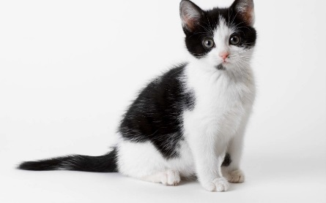

Why and when do we need machine learning?
Program a machine to recognize a cat
  We don’t know how we manage to do it
  So there is no clue how to program such machine
  Even if we know how to do it, the program is probably extremely complicated
Compute the probability of a credit card fraud
  No one simple rule. Need to combine many weak rules
  It is a moving target
No obvious way to implement this function!

Slide 28
_{deeplearning.mit.edu}

Slide 29
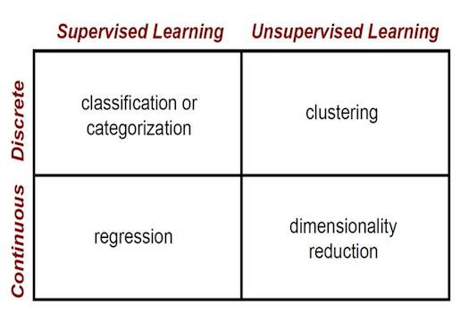
Supervised vs unsupervised learning
https://towardsdatascience.com/supervised-vs-unsupervised-learning-14f68e32ea8d

Slide 30
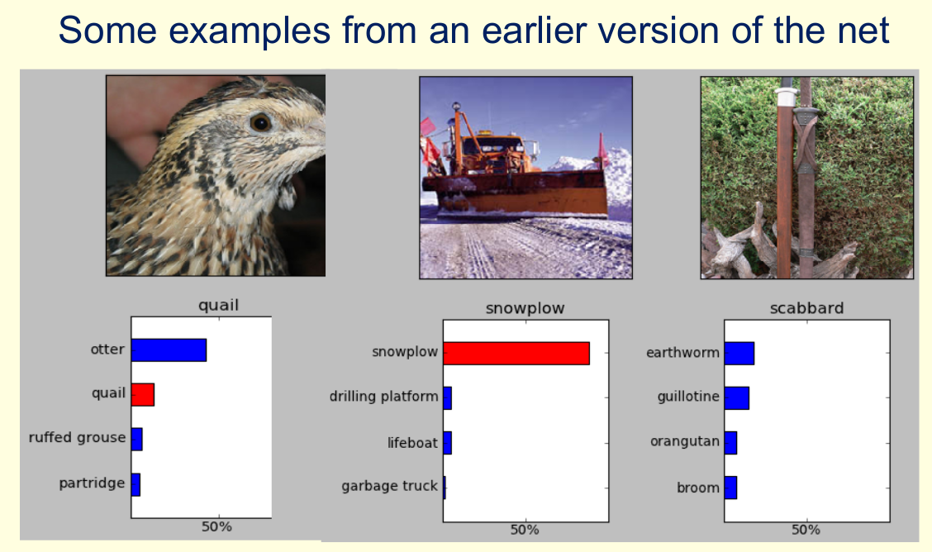
A classic problem: object recognition
From Hinton’s coursera course

Slide 31
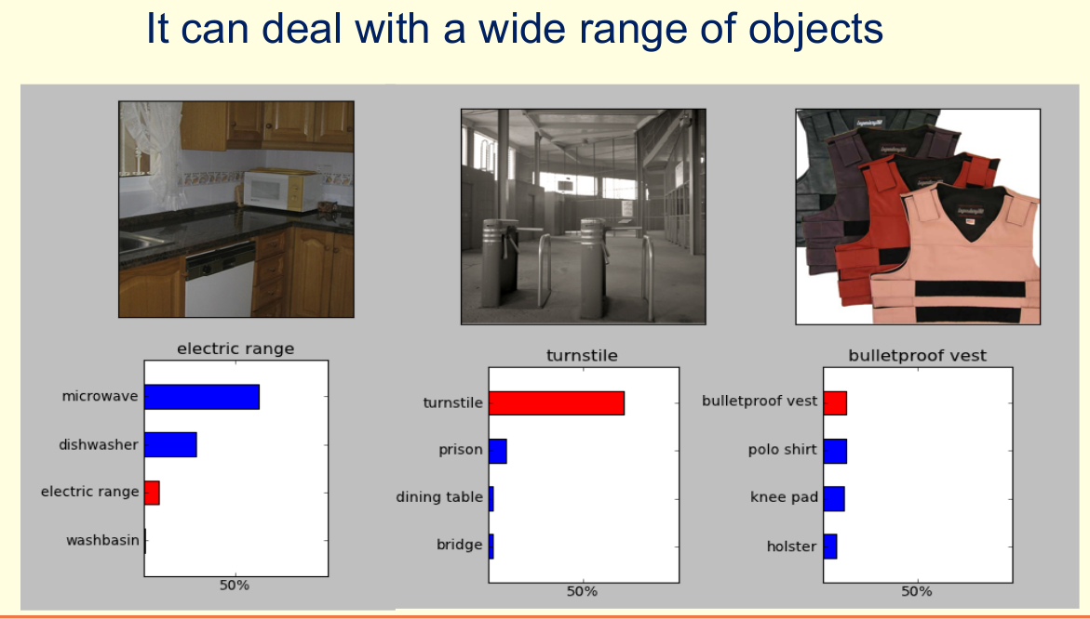
From Hinton’s coursera course

Slide 32
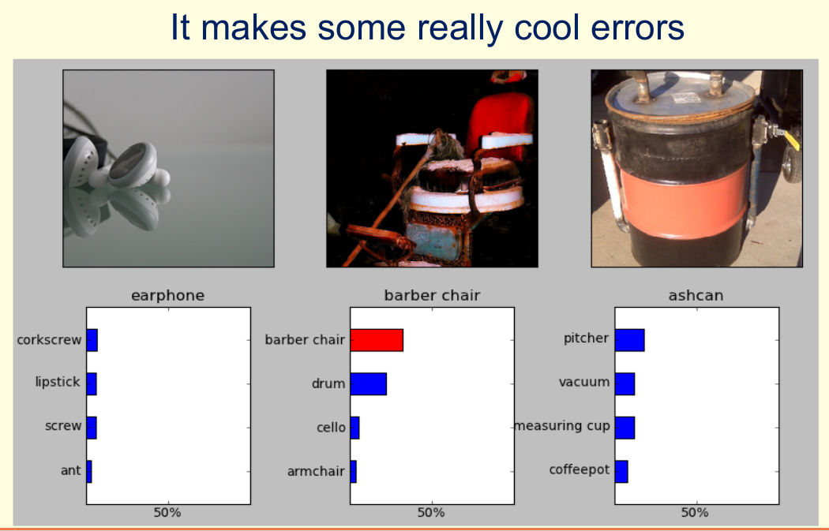
From Hinton’s coursera course

Slide 33
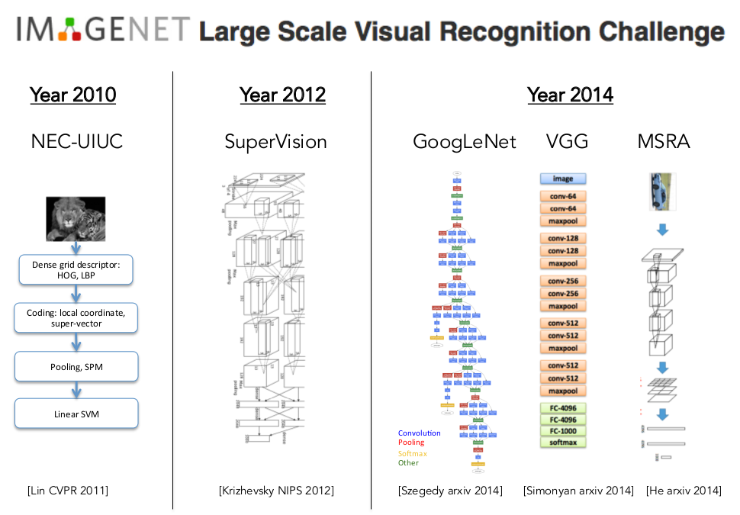
From Stanford CS231n

Slide 34
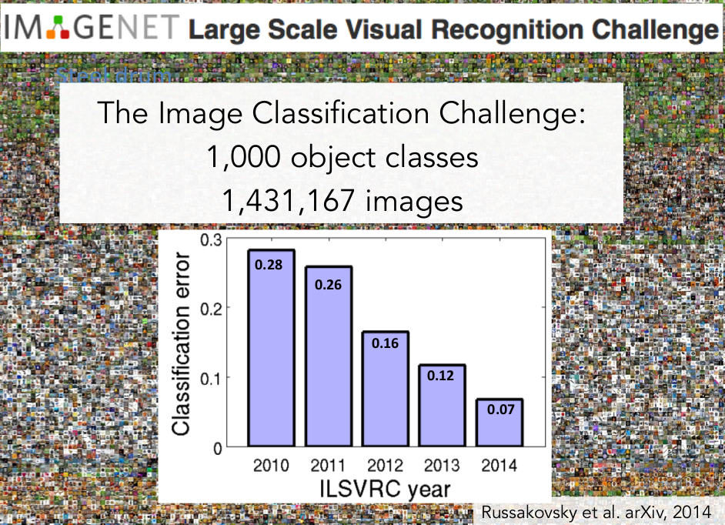
From Stanford CS231n

Slide 35
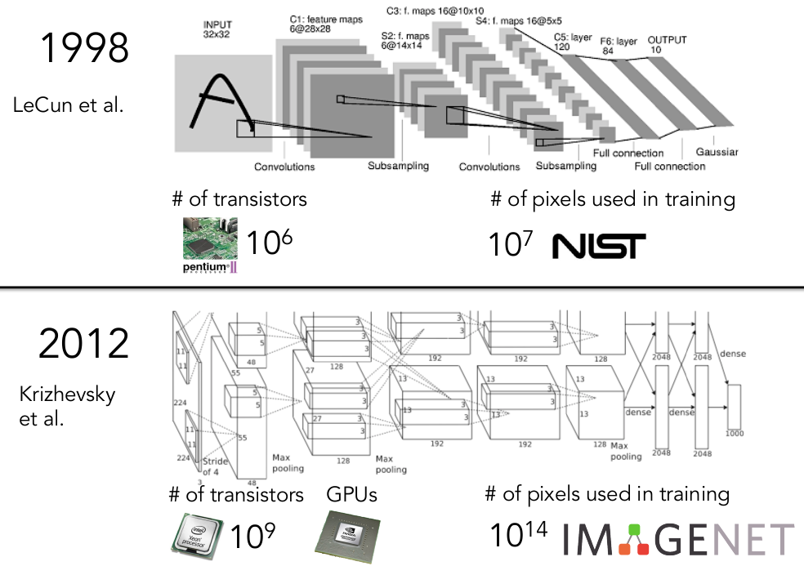
From Stanford CS231n

Slide 36
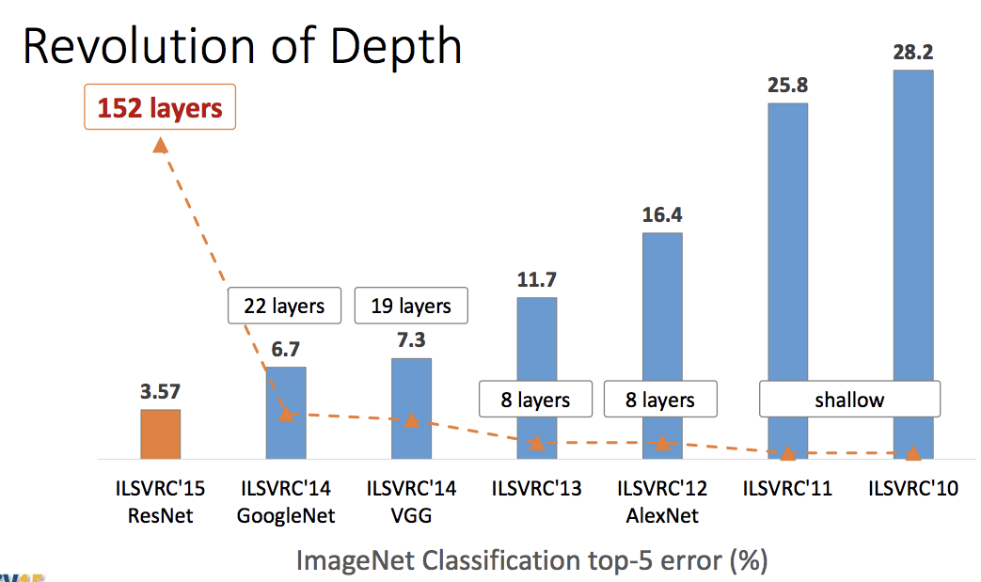
Slide credit: Kaiming He, ICCV 2015

Slide 37
≈5.1
Human
Human benchmark from Russakovsky et al, “ImageNet Large Scale Visual Recognition Challenge”, IJCV 2015
Slide credit: Kaiming He, ICCV 2015

Slide 38
How it becomes so good… Representation learning
Aka feature learning
Deep learning is all about representation (feature) learning rather than feature engineering in the last generation of machine learning

Slide 39
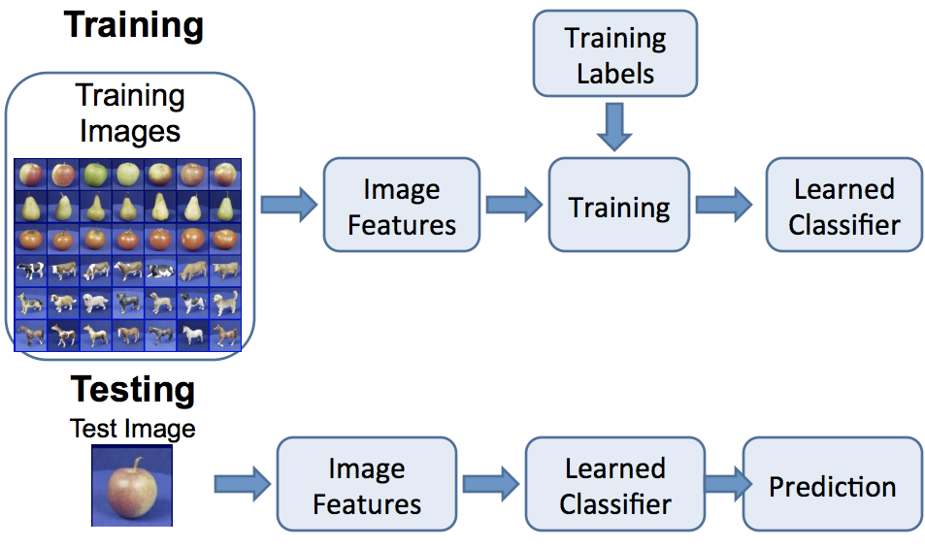
Image Classification
Features remain fixed
Classifier is learned from data
Problem:
How do we know which features to use? We may need different features for each problem!
Solution:
Learn the features jointly with the classifier!
Figure credit: D. Hoiem, L. Lazebnik
Notes:
Hand-engineer feature

Slide 40
Image Classification: Feature Learning
Training labels
Training
Learned Model
Learned features
Image features
Classifier
Learned Classifier
Learned Model
Learned features
Prediction
Learned Classifier

Slide 41
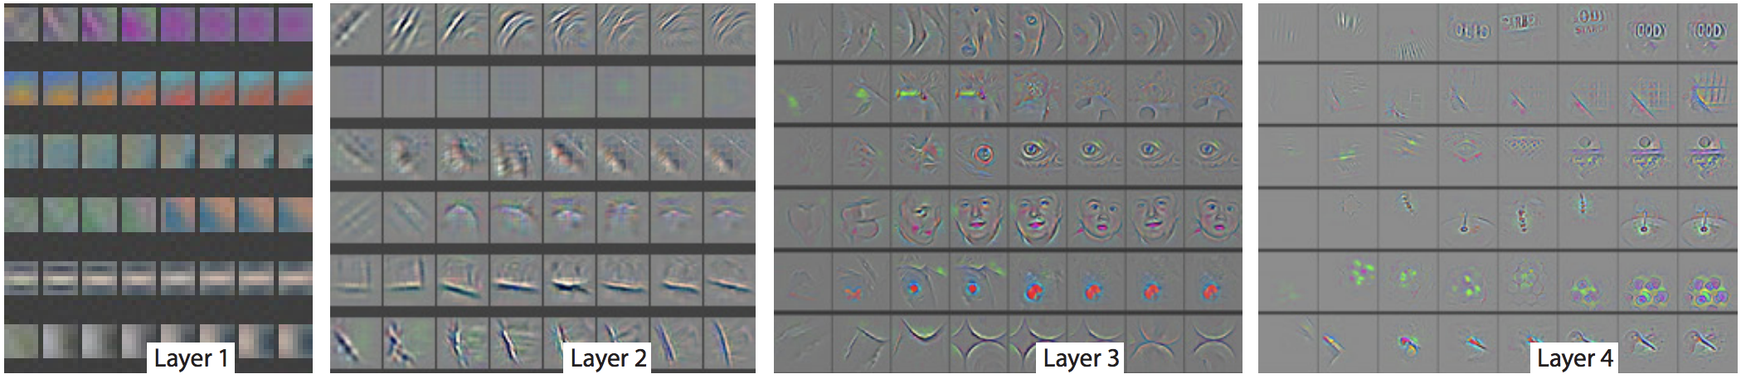
Image Classification: Deep Learning
Training labels
Learned Model
Training
Low-level features
Low-level features
Classifier
Mid-level features
Model is deep: it has many layers
Mid-level features
High-level features
High-level features
Classifier
Models can learn hierarchical features
Figure credit: Zeiler and Fergus, “Visualizing and Understanding Convolutional Networks”, ECCV 2014
Notes:
Simple features with edges and corners at the first layer. First couple layers just aim to generate (extract) features

Slide 42
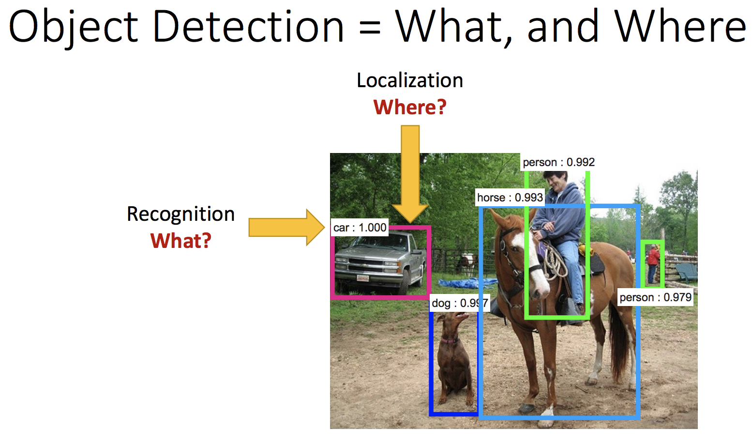
Slide credit: Kaiming He, ICCV 2015

Slide 43
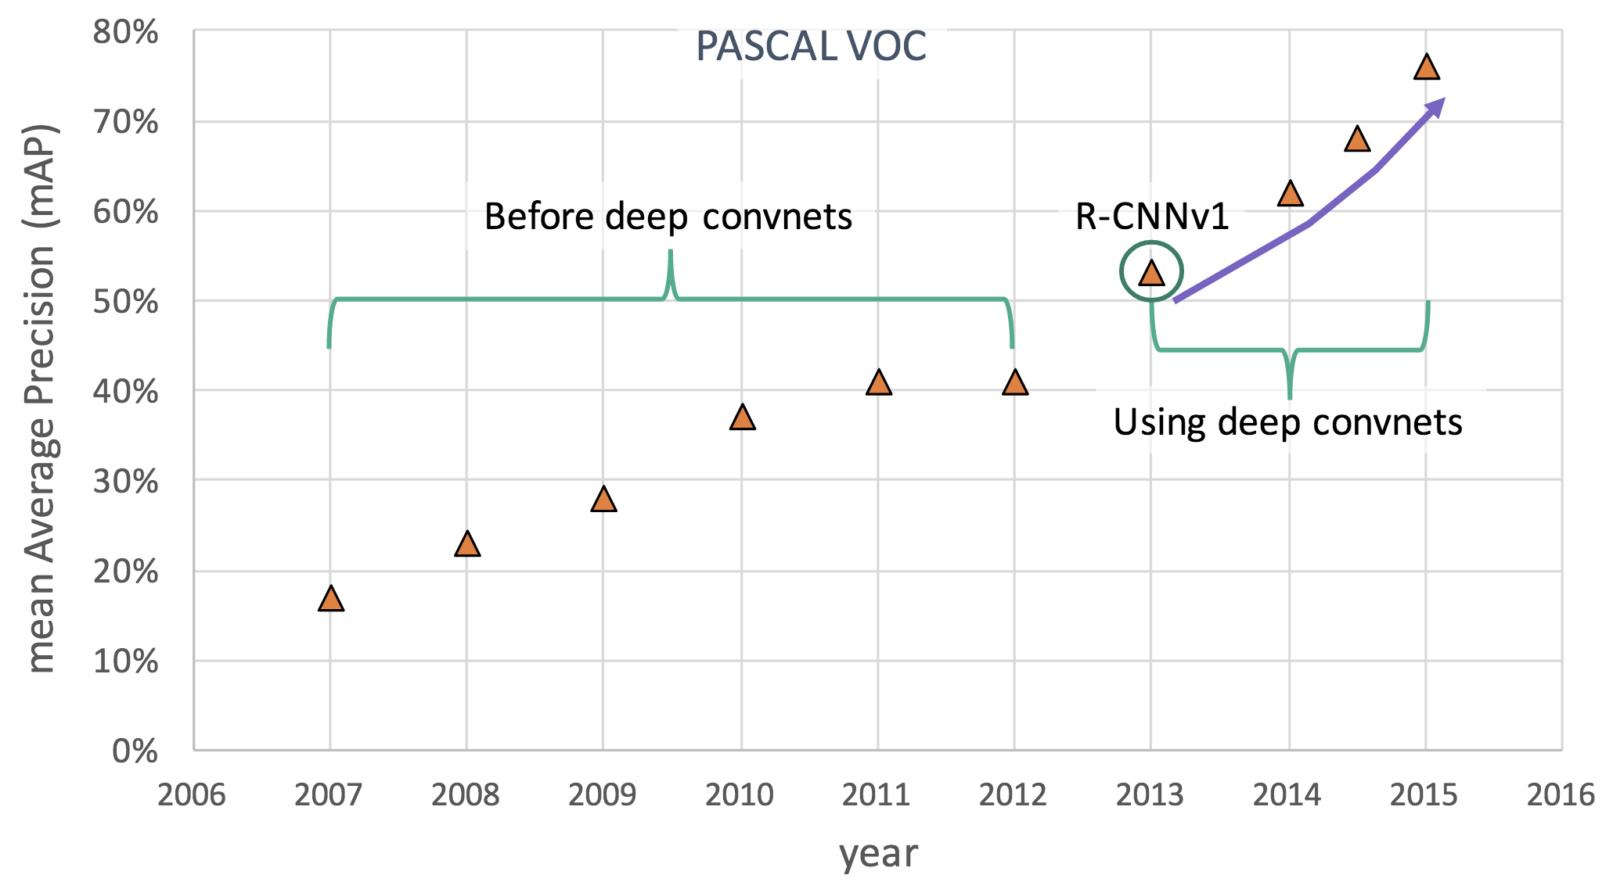
Deep Learning for Object Detection
Slide credit: Ross Girshick, ICCV 2015

Slide 44
Deep Learning for Object Detection
Current SOTA: 85.6
He et al, “Deep Residual Learning for Image Recognition”, CVPR 2016
Slide credit: Ross Girshick, ICCV 2015

Slide 45
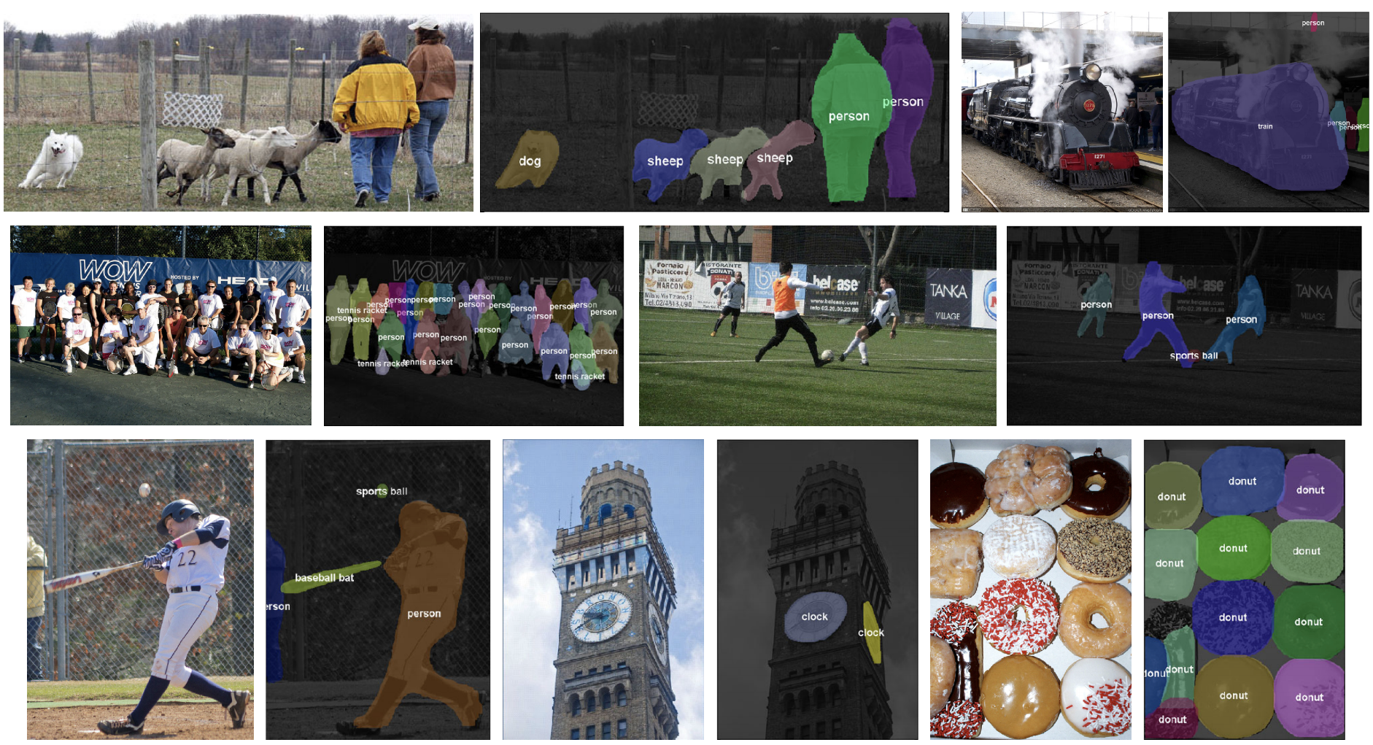
Object segmentation
Figure credit: Dai, He, and Sun, “Instance-aware Semantic Segmentation via Multi-task Network Cascades”, CVPR 2016

Slide 46
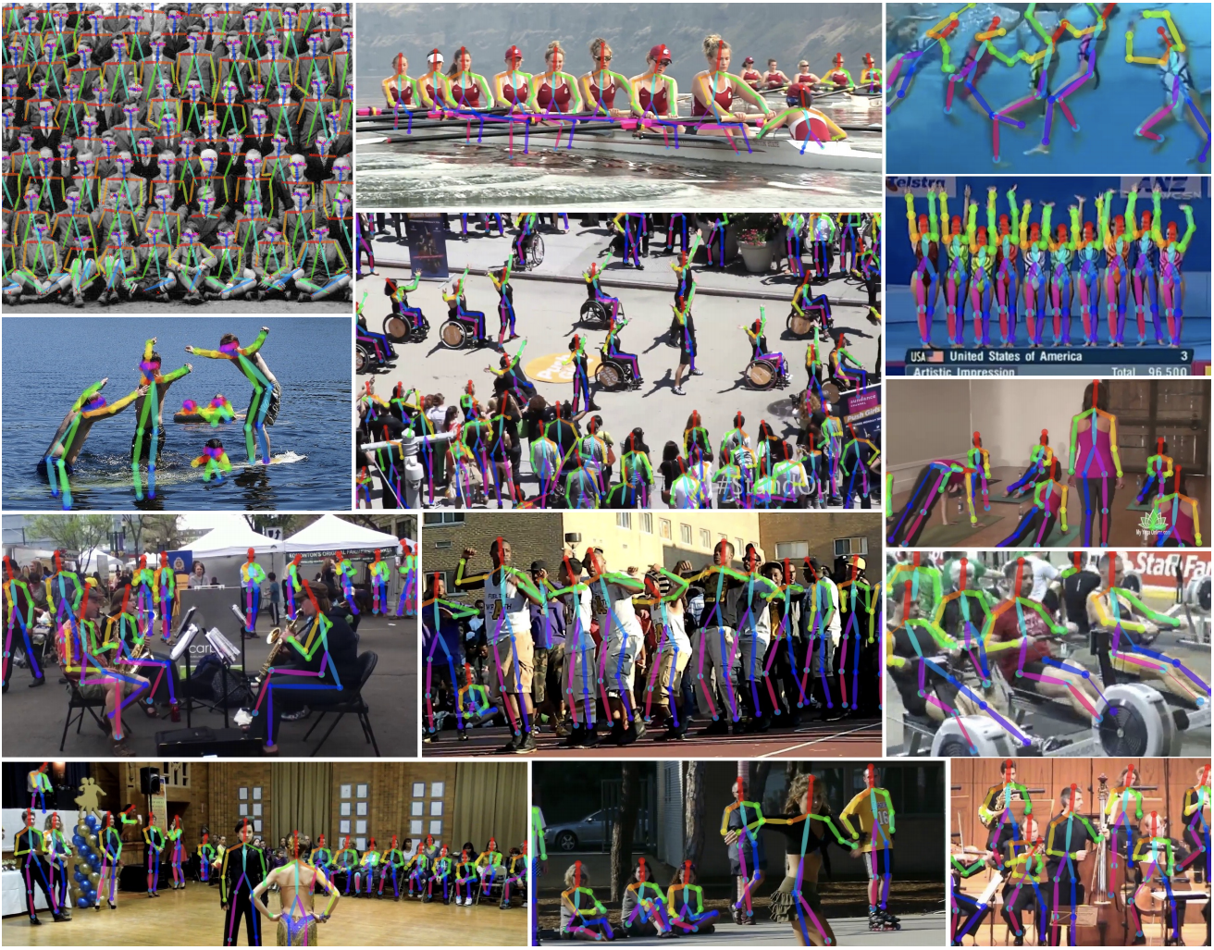
Pose Estimation
Figure credit: Cao et al, “Realtime Multi-Person 2D Pose Estimation using Part Affinity Fields”, arXiv 2016

Slide 47
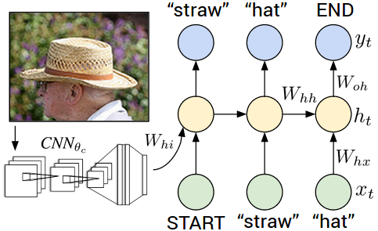
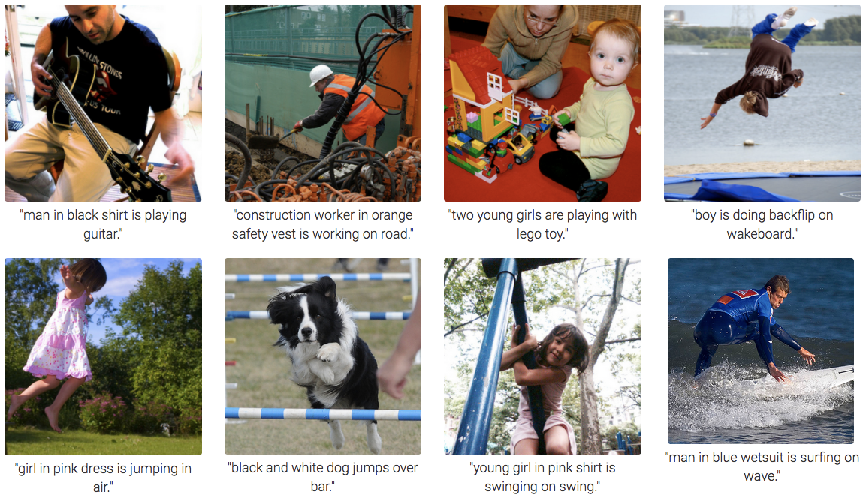
Deep Learning for Image Captioning
Figure credit: Karpathy and Fei-Fei, “Deep Visual-Semantic Alignments for Generating Image Descriptions”, CVPR 2015

Slide 48
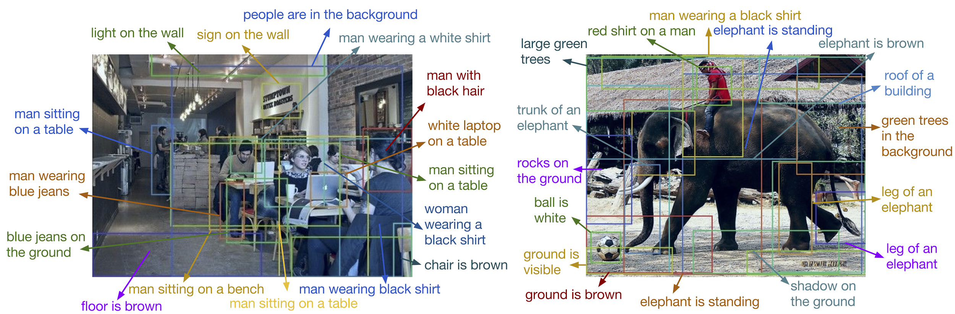
Dense Image Captioning
Figure credit: Johnson*, Karpathy*, and Fei-Fei, “DenseCap: Fully Convolutional Localization Networks for Dense Captioning”, CVPR 2016

Slide 49
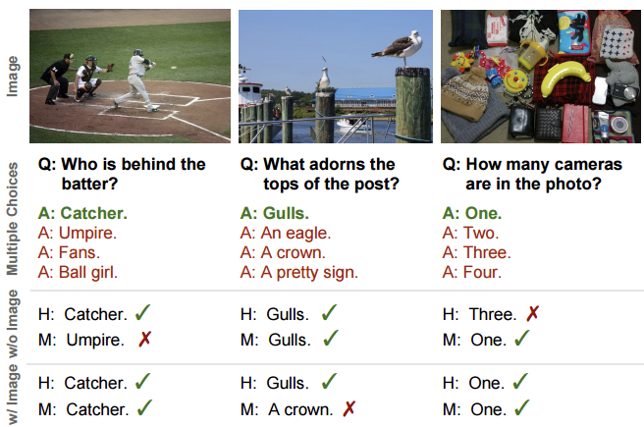
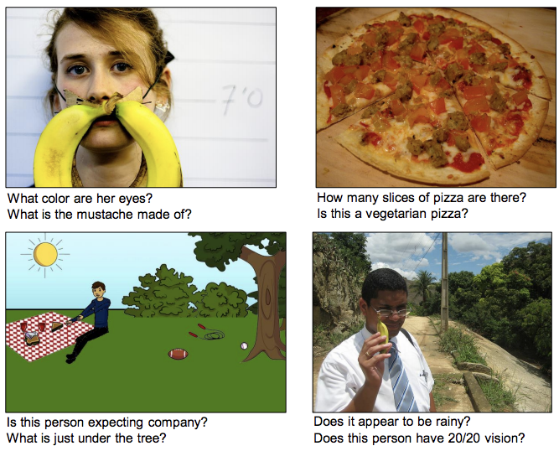
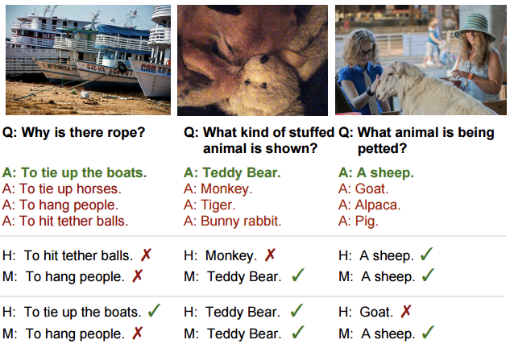
Visual Question Answering
Figure credit: Agrawal et al, “VQA: Visual Question Answering”, ICCV 2015
Figure credit: Zhu et al, “Visual7W: Grounded Question Answering in Images”, CVPR 2016

Slide 50
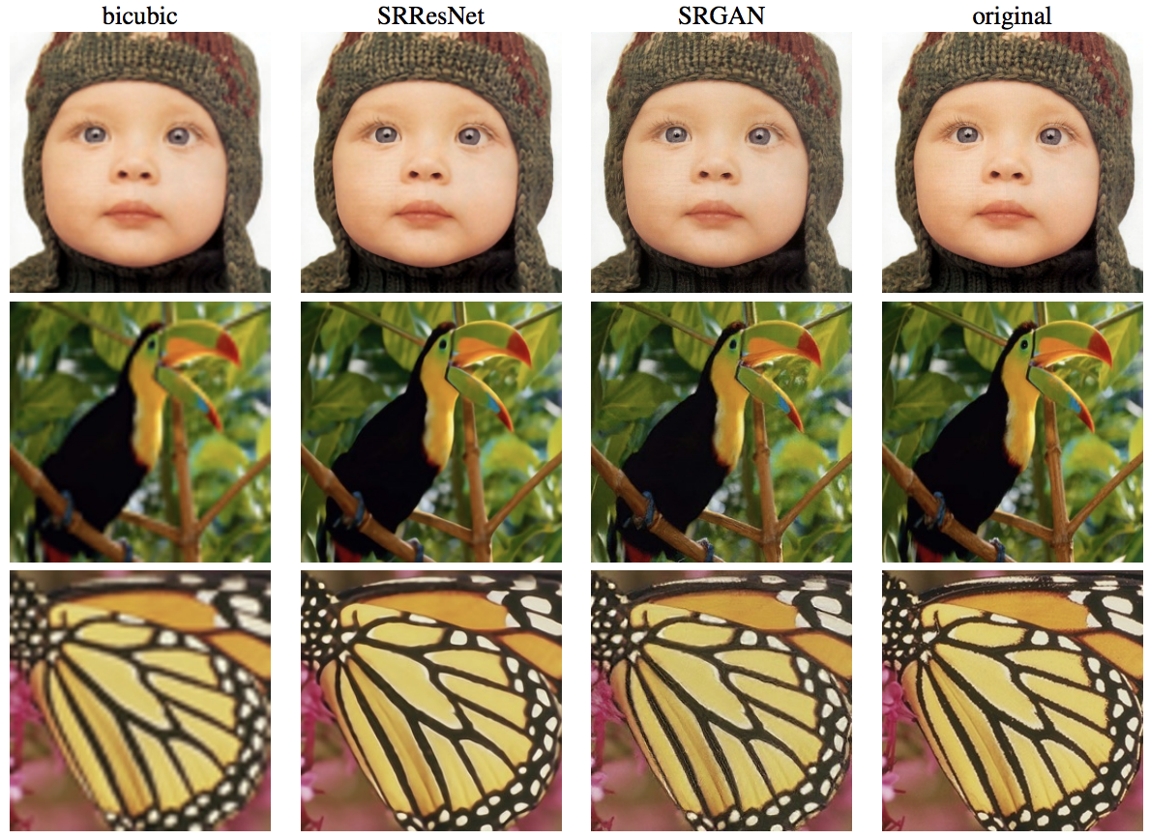
Image Super-Resolution
Figure credit: Ledig et al, “Photo-Realistic Single Image Super-Resolution Using a Generative Adversarial Network”, arXiv 2016

Slide 51
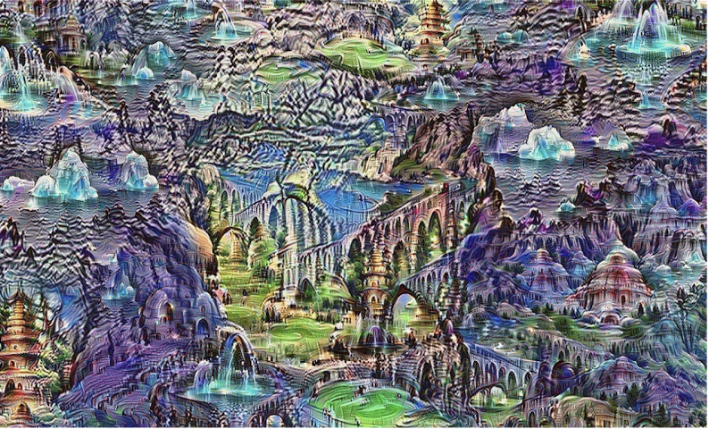
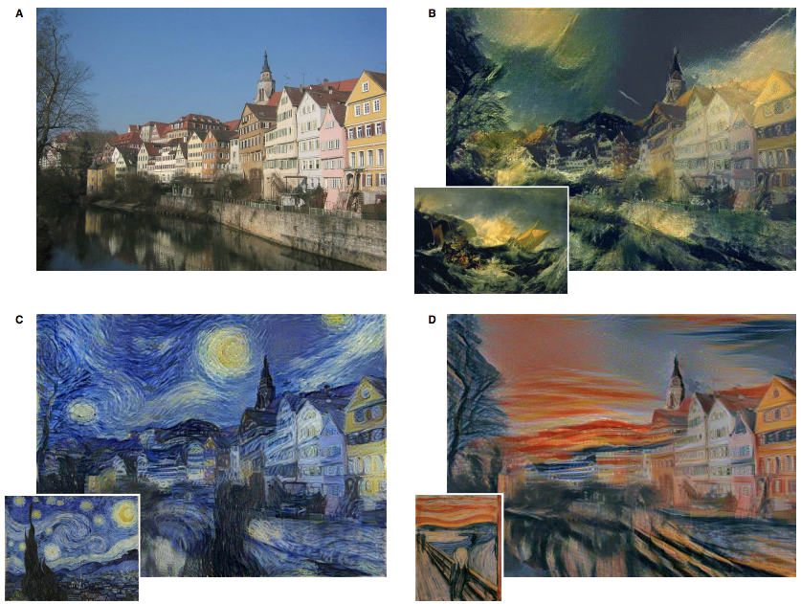
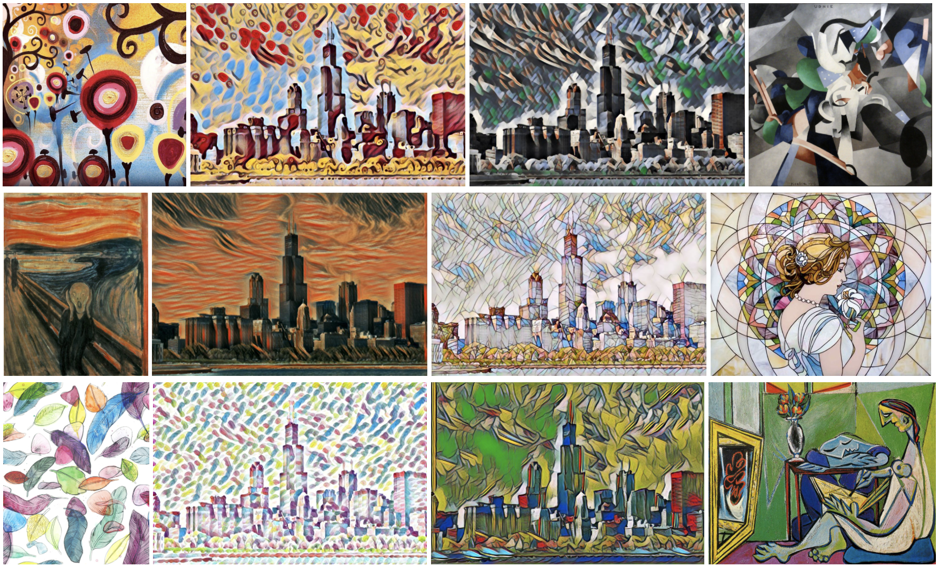
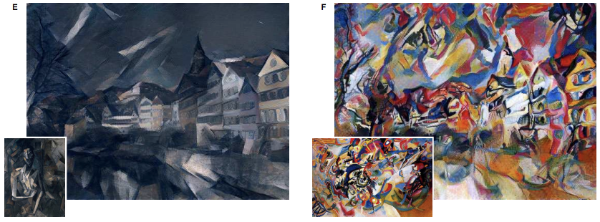
Generating Art
Figure credit: Mordvintsev, Olah, and Tyka, “Inceptionism: Going Deeper into Neural Networks”, https://research.googleblog.com/2015/06/inceptionism-going-deeper-into-neural.html
Figure credit: Gatys, Ecker, and Bethge, “Image Style Transfer using Convolutional Neural Networks”, CVPR 2016
Figure credit: Johnson, Alahi, and Fei-Fei: “Perceptual Losses for Real-Time Style Transfer and Super-Resolution”, ECCV 2016, https://github.com/jcjohnson/fast-neural-style

Slide 52
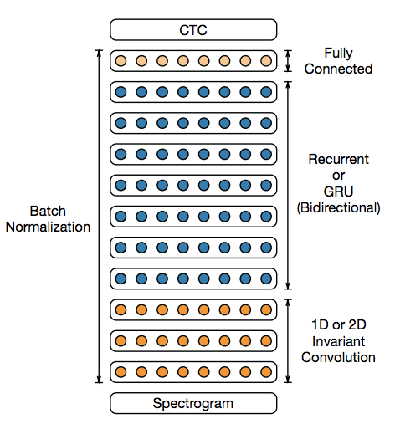
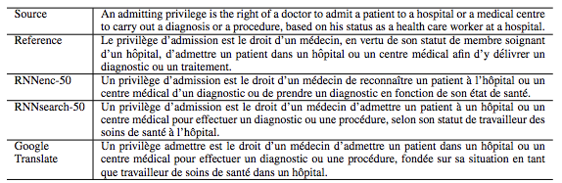
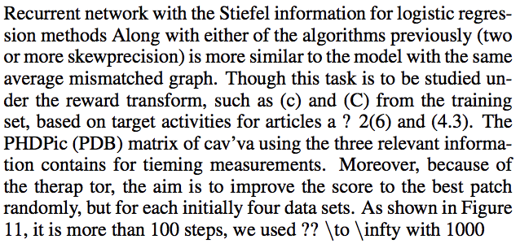

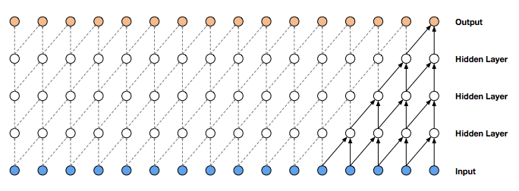
Outside Computer Vision
Speech Recognition
Machine Translation
Figure credit: Bahdanau, Cho, and Bengio, “Neural Machine Translation by jointly learning to align and translate”, ICLR 2015
Text Synthesis
Figure credit: Amodei et al, “Deep Speech 2: End-to-End Speech Recognition in English and Mandarin”, arXiv 2015
Speech Synthesis
Figure credit: Sutskever, Martens, and Hinton, “Generating Text with Recurrent Neural Networks”, ICML 2011
Figure credit: var der Oord et al, “WaveNet: A Generative Model for Raw Audio”, arXiv 2016, https://deepmind.com/blog/wavenet-generative-model-raw-audio/

Slide 53
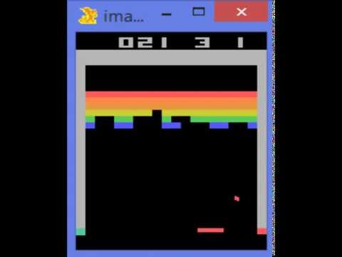
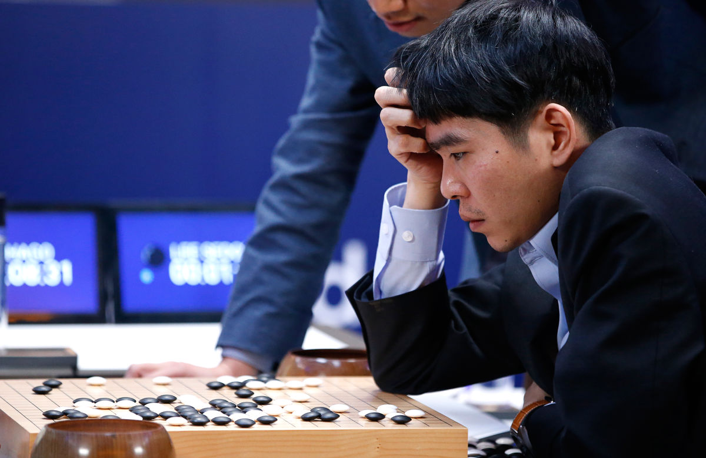
Deep Reinforcement Learning
Playing Atari games
AlphaGo beats Lee Sedol
Silver et al, “Mastering the game of Go with deep
neural networks and tree search”, Nature 2016
Image credit: http://www.newyorker.com/tech/elements/alphago-lee-sedol-and-the-reassuring-future-of-humans-and-machines
Mnih et al, “Human-level control through deep reinforcement learning”, Nature 2015

Slide 54
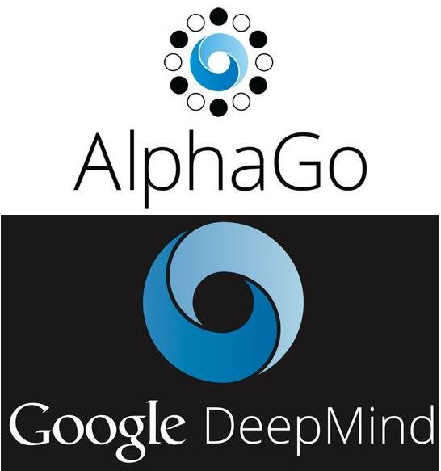
Case study
Go was considered one of most difficult broad games
It was thought that machine wouldn’t be able to beat professional human players for at least another decade
AlphaGo defeated Fan Hui in October 2015, the then European champion
It then defeated Sedol Lee in April 2016, ranked second in terms of international titles
Beat Ke Jie in 2017. The world no.1 rank player at the moment. AlphaGo retired
DeepMind published AlphaGo Zero in October 2017, which does not use human data
Monte-Carlo tree search + Deep neural networks

Slide 55
Artificial neural networks

Slide 56
(Artificial) neural networks
A computing model inspired by the biological brain
Flexible and very powerful
Can be adjusted for different learning tasks (supervised, unsupervised, etc.)

Slide 57
Reasons to study neural networks
We usually cannot directly study brain
  We can with fMRI and EEG but not everyone can afford it
  There are limitations (yet)
To understand what we are likely good (bad) at
  Supposed to be good at things that we are good at: e.g., vision
  And bad at things that we are bad at: e.g., arithmetic
A powerful paradigm to solve real-world problem (this course)

Slide 58
Our brain
Average weight 1.4 kg, about 2% of total body weight
Responsible ~20% of our energy consumption!
  ~12.6 Watts
  It sounds a like but is extremely efficient. A typical GPU server requires ~1000 Watts
Composed of neurons interconnected to each other

Slide 59
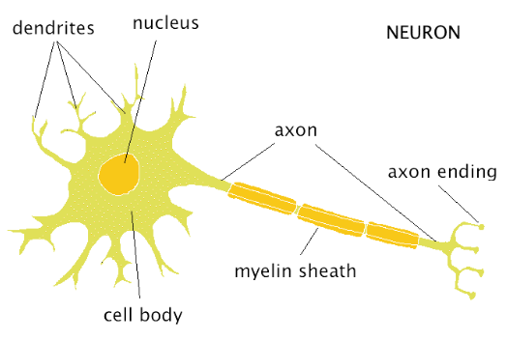
Biological neurons
Dendrites collect chemicals
Neuron may “fire” based on the chemical input
Axon ending will generate chemicals those will in turn be consumed by other neurons

Slide 60
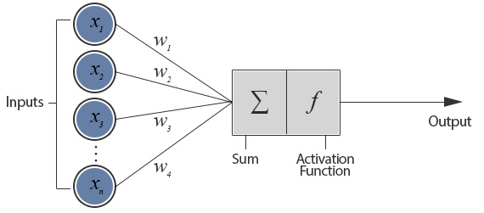
Biological neurons

Slide 61
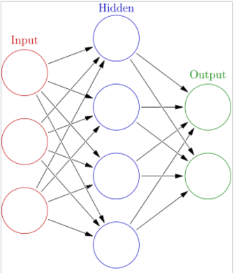
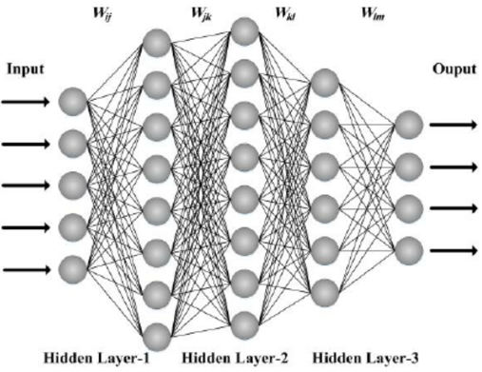
Neural networks
Single layer network
Multiple layer (deep) network

Slide 62
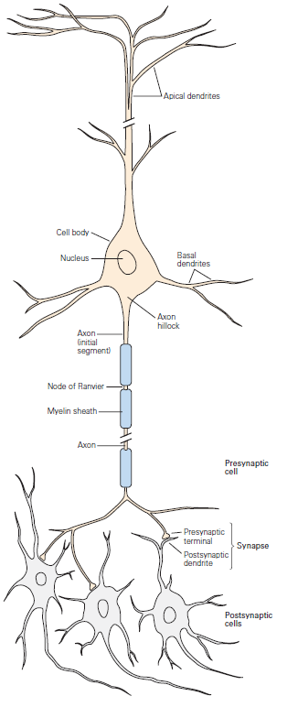

Slide 63
A very brief history of ANN
Warren McCulloch and Walter Pitts introduced Threshold Logic Unit as a computational model of neuron in 1943
Donald Hebb created a hypothesis of learning (Hebbian theory) based on neural plasticity (increase synaptic efficacy by repeated and persistent stimulation) in late 1940’s
Frank Rosenblatt created perceptron in 1958 but no concrete learning method appeared to be described
Bernard Widrow and Marcian Hoff of Stanford developed “ADALINE” and “MADALINE” (Mulitple ADAptive LiINear Elements) in 1959. First neural networks to tackle real world problem. It is still used in air traffic control systems (really?)

Slide 64
A very brief history of ANN (con’t)
Perceptron got high expectation in early year but neural science does not catch up. And the traditional von Neumann and Turing architecture took over the computing scene. Ironically, von Neumann himself suggested to imitate neuron function with telegraph relays or vacuum tubes
Neural network research was hit hard by the introduction of the book Perceptrons by Marvin Minsky and Seymour Papert. It proved the limitation of perceptrons but combined with the initial hype, people lost trust of the potential of neural networks and we entered the “first dark age” of neural networks
Notes:
Papert [pet-p(cut)]

Slide 65
A very brief history of ANN (con’t)
The interest to neural network slowly revived with the invention of the backpropagation algorithm by Paul Webos in 1974. The algorithm was reinvented by many other such as Parker (1985) and LeCun (1985)
Hopfield popularizes a form of bi-directional networks (Hopfield networks) in the 1980’s and neural network research was blooming in that decade
But as the support vector machine (SVM) by Vladmir Vapnik was popularized in late 1980’s and early 1990’s. Neural network slowly lost favors. SVM took hold instead of neural networks because it has more elegant math and worked better at that time
  Less parameters to tune
  Computers were too slow then and labeled datasets were too small

Slide 66
A very brief history of ANN (con’t)
Neural networks got a come-back for the last decade as recurrent neural networks and deep feedforward neural networks won numerous competitions in both pattern recognition and machine learning domains
Fast GPUs were a key for the come-back. Relatively cheap and powerful computing resources are now widely available. And the wide spread of large public labeled datasets helped a whole lot too

Slide 67
Conclusions
Machine learning allows us to automatically generate programs to solve various tasks by learning from data
Different machine learning types:
  Supervised learning (e.g., object recognition)
  Unsupervised learning (e.g., clustering)
  Reinforcement learning (e.g., autonomous driving)
Deep learning is just neural networks with many layers (hence deep)

Slide 68
Next time…
More on supervised learning
  Loss functions
  Regularizations
  Examples
Optimization methods (?)

Slide 69
Questions?

Slide 70
Instructor
Samuel Cheng (samuel.cheng@ou.edu)
Office hours:
  Catch me after class or just email me
  I’ll be teaching from both Norman and Tulsa
    Connection does not always work out of the box. Need your tolerance and help
Piazza: sign up now!
https://piazza.com/ou/spring2020/ece5973

