Slide 1
Introduction to Deep Learning
Samuel Cheng

Slide 2
Deep learning in 1 slide
Wide sense
(machine) learning goes deep (with layers of representation)
Narrow sense
(Artificial) neural networks with more than one hidden layers
Why so popular?
Probably the most powerful machine learning technique at this moment
Won machine learning competition across wide categories with large margins

Slide 3
AI/Machine Learning/Deep Learning
Artificial Intelligence
Machine Learning
Deep Learning

Slide 4
From Hinton’s coursera course

Slide 5
From Hinton’s coursera course

Slide 6
From Hinton’s coursera course

Slide 7
From Stanford CS231n

Slide 8
From Stanford CS231n

Slide 9
From Stanford CS231n

Slide 10
From Stanford CS231n

Slide 11
From Stanford CS231n

Slide 12
From Stanford CS231n

Slide 13
Natural language processing too…
From Hinton’s coursera course

Slide 14
(Artificial) neural networks
A computing model inspired by the biological brain
Flexible and very powerful
Can be adjusted for different learning tasks (supervised, unsupervised, etc.)

Slide 15
Our brain
Average weight 1.4 kg, about 2% of total body weight
Responsible ~20% of our energy consumption!
~12.6 Watts
It sounds a lot but is extremely efficient. A typical GPU server requires ~1000 Watts
Composed of neurons interconnected to each other

Slide 16
Biological neurons
Dendrites collect chemicals
Neuron may “fire” based on the chemical input
Axon ending will generate chemicals those will in turn be consumed by other neurons

Slide 17
Biological neurons

Slide 18
Neural networks
Single layer network
Multiple layer (deep) network

Slide 19
A very brief history of neural networks
Warren McCulloch and Walter Pitts introduced Threshold Logic Unit as a computational model of neuron in 1943
Donald Hebb created a hypothesis of learning (Hebbian theory) based on neural plasticity (increase synaptic efficacy by repeated and persistent stimulation) in late 1940’s
Frank Rosenblatt created perceptron in 1958 but no concrete learning method appeared to be described
Bernard Widrow and Marcian Hoff of Stanford developed “ADALINE” and “MADALINE” (Mulitple ADAptive LiINear Elements) in 1959. First neural network to tackle real world problem. It is still used in air traffic control systems (really?)

Slide 20
First dark age of neural networks
Perceptron got high expectation in early year but neural science does not catch up. And the traditional von Neumann and Turing architecture took over the computing scene. Ironically, von Neumann himself suggested to imitate neuron function with telegraph relays or vacuum tubes
Neural network research was hit hard by the introduction of the book Perceptrons by Marvin Minsky and Seymour Papert. It proved the limitation of perceptrons and combined with the initial hype, people lost trust of the potential of neural networks and we entered the “first dark age” of neural networks

Slide 21
Backprop and second dark age of NNs
The interest to neural network slowly revived with the invention of the backpropagation algorithm by Paul Webos in 1974. The algorithm was reinvented by many other such as Parker (1985) and LeCun (1985)
Hopfield popularizes a form of bi-directional networks (Hopfield networks) in the 1980’s and neural network research was blooming in that decade
But as the support vector machine (SVM) by Vladmir Vapnik was popularized in late 1980’s and early 1990’s. Neural network slowly lost favors. SVM took hold instead of neural networks because it has more elegant math and worked better at that time
Less parameters to tune
Computers were too slow then and labeled datasets were too small

Slide 22
Resurgence of neural networks
Hinton’s 2006 paper described the first way to train really “deep” networks using “unsupervised pretraining”
Krizhevsky’s 2012 (also in Hinton’s group) paper brings deep neural networks to mainstream
Since then, deep neural network models won numerous competitions in both pattern recognition and machine learning domains
Fast GPUs were a key for the come-back. Relatively cheap and powerful computing resources are now widely available. And the wide spread of large public labeled datasets helped a whole lot too

Slide 23
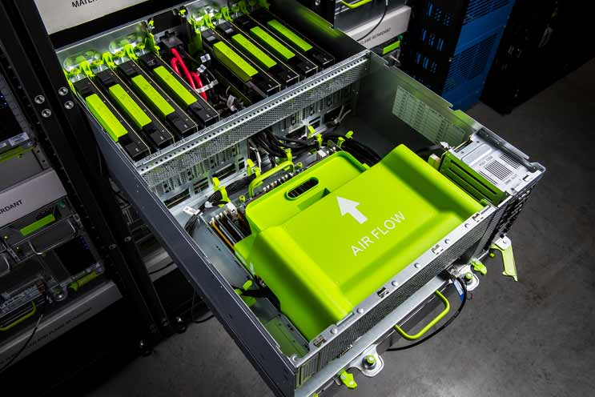
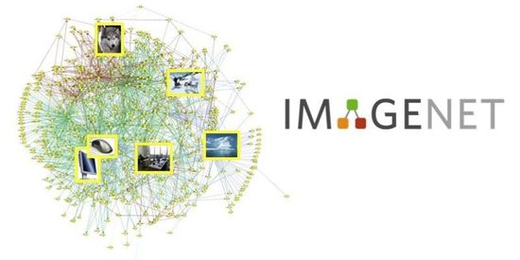
Why took so long? Many ideas were not new…
Mainly two things happened
Inexpensive computational power
GPUs
Large dataset available
ImageNet
MS COCO
Kaggle …
Persistent efforts of many researchers
Hinton (Toronto, Google)
Yann Lecun (NYU, Facebook)
Bengio (Montreal)
Andrew Ng (Stanford, Google, Baidu)
…

Slide 24
How neural networks train?
Consider a simple supervised learning problem:
Define loss function
Train to minimize loss by steep descent
Challenges:
Millions rather than hundreds of parameters -> extremely high dimension
Layer structure is thus preferred to reduce computation -> backprop
Gradient vanishing/exploding problems
Some solutions:
Better activation functions
Better weight (parameter) initializations

Slide 25
From here onwards
Backpropagation
Some common tricks that enable “deep” learning
Choice of activation function to mitigate gradient vanishing problems
Appropriate weight initialization to avoid output “explosion” or vanishing
Batch normalization to improve stability
Ensemble trick and dropout
Convolutional neural networks (CNNs)
Recurrent neural networks (RNNs)
Very quick skim of other models

Slide 26
Backpropagation algorithm

Slide 27
Backpropagation
The backpropagation algorithm has been reinvented many times
At the most fundamental level, it is simply chain rule in calculus
Most easily understood using computational graph

Slide 38
Activation function and gradient vanishing

Slide 60
Weight initialization

Slide 80
Batch normalization

Slide 87
Ensemble trick and dropout

Slide 103
Quick summary
BP is just chain rule in calculus
Use ReLU. Never use Sigmoid as activation
Weight initialization is extremely important
Use batch normalization if you can
Use dropout

Slide 104
Some remark on optimizers
Most optimizers are just refinement of gradient descent
To avoid oscillation, it is common to introduce momentum (inertia) to optimzer
Another trick is to use only direction (ignoring gradient magnitude) for iteration
Many variations: AdaGrad, RMSProp, Adam, etc.
Most recommend Adam and it is available in most deep learning packages
If you problem is small (or just don’t have much data), you may also try second order method such as LBFGS

Slide 105
CNNs
Convolutional neural networks

Slide 156
Some CNN tricks
Data augmentation
Transfer learning
Power of small filters

Slide 200
RNNs
Recurrent neural networks

Slide 232
More results from the Hinton’s group
Use better optimizer
Trained on the entire wikipedia

Slide 262
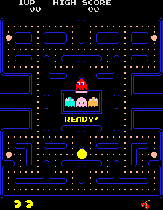
We have went through a lot …
Backprop
Issues: gradient vanishing/explosion
Some solutions:
Different activation functions
Weight initialization
Batch normalization
Dropout
CNNs
RNNs

Slide 263
Some recent research trends
More memory models
Memory nets
Neural Turing machines
Fast weights
…
Generative models
Variational autoencoders
Generative adversarial networks
Deep reinforcement learning

Slide 264
Playing Breakout

Slide 265
Playing Invaders

Slide 266
A remark of deep learning vs graphical models
Compared to graphical models, deep learning models usually have way more parameters
Moreover, some inherent structures are usually assumed in graphical models. In such a way, the model usually can be made sparse
“Loopy” belief propagation can be used for inference
Deep learning models make very little assumption with relationship between parameters
Connections are dense
Belief propagation does not work well

Slide 267
Epilogue
‘When I was doing my Ph.D., my advisor would tell me that (I was wasting my time) every week. And I would say, “give me six months and I will prove you that it works.” And every six months, I’d say that again’ - Geoffrey Hinton
Don’t easily believe something wouldn’t work just because someone told you so
Try it yourself!
If you really believe in it, be persistent and enjoy your last laugh

Slide 268
Shameless advertisement
University of Oklahoma
Locision Ltd (Foshan)
Fully support Ph.D. candidate
Will work in computer vision, deep learning and AI in general
Passionate and self-motivated
Eager to get things done
Good at programming
Full-time/intern research engineers
With undergrad/master degree in any science/engineering disciplines
Passionate and self-motivated

Slide 269
Wish you all good luck with your finals! And have a fruitful sem-break!

